Slide 1
Using Calibrated Peer Review in Statistics and Biology: A Coordinated Statistical Literacy Project
CAUSE Webinar, October 13, 2009
Ellen Gundlach | Nancy Pelaez
gundlach@purdue.edu | npelaez@purdue.edu
Department of Statistics | Biological Sciences
Purdue University, West Lafayette, IN
Notes:
Ellen

Slide 2
Who are we?
Ellen Gundlach STAT 301 Elementary Statistical Methods 900 students from majors all over campus (no math or statistics students) each semester 8 lecturers, 15 graduate t.a.s (mostly international). | Nancy Pelaez BIOL 131 Development, Structure, and Function of Organisms, 250 biology and pre-med majors each semester 5 undergraduate t.a.s.
Notes:
Ellen

Slide 3
Statistics and Biology working together
Statistics teaches science students about experimental design, ethics, and analysis of data, but students seem to have difficulty transferring that knowledge across disciplines.
Experimental design is implied but not explicitly taught in biology. Both life scientists and statisticians currently see a need to emphasize experimental and quantitative aspects of biology.^{1, 2, 9}
Similarities in pedagogical recommendations for biology and statistics instruction convince us that we can solve these problems by working together in ways that neither discipline can accomplish alone.⁸
Notes:
Nancy

Slide 4
Problem-Based Writing with
Peer Review
NSF DUE/CCLI Grant Award #083722 (2008-10)
http://www.nsf.gov/awardsearch/showAward.do?AwardNumber=0837229
Any opinions, findings, and conclusions or recommendations expressed in this material are those of the authors and do not necessarily reflect the views of the National Science Foundation.
Notes:
Nancy

Slide 5
If this is a biology class, why are you making me do “math”?
Modern biologists must have the following quantitative competencies
generate and analyze complex data sets statistically and with other quantitative methods,
build and test complex models, and
interpret data with insight
To invigorate undergraduate life sciences education by better integrating statistical and mathematical reasoning.
NRC BIO 2010 ⁹
Undergrad Vision and Change¹
HHMI Standards for Pre-med Students²
Notes:
Nancy

Slide 6
If this is a statistics class, why are you making me write?
GAISE College Report goals for producing statistically literate students⁷
Emphasize statistical literacy and develop statistical thinking;
Use real data;
Stress conceptual understanding rather than mere knowledge of procedures;
Foster active learning in the classroom;
Use technology for developing conceptual understanding and analyzing data;
Use assessments to improve and evaluate student learning
Notes:
Ellen

Slide 7
Specific GAISE recommendations practiced with CPR assignments
Students should recognize:
Common sources of bias in surveys and experiments.
How to determine the population to which the results of statistical inference can be extended, if any, based on how the data were collected.
How to determine when a cause and effect inference can be drawn from an association, based on how the data were collected (e.g., the design of the study)
That words such as “normal”, “random” and “correlation” have specific meanings in statistics that may differ from common usage.
How to interpret statistical results in context.
How to critique news stories and journal articles that include statistical information, including identifying what's missing in the presentation and the flaws in the studies or methods used to generate the information.
Notes:
Ellen

Slide 8
Calibrated Peer Review (CPR)
Online writing and peer review program.
 rating by MERLOT in 2003.
One of the 21st Century Pedagogies selected by PKAL (Project Kaleidoscope). http://serc.carleton.edu/sp/pkal/index.html
Funding from NSF and the Howard Hughes Medical Institute.
Over 5000 courses from hundreds of high schools, colleges, universities in a variety of subjects but originally intended for science classes.
Notes:
Nancy

Slide 9
Outline of a CPR assignment
Writing stage
Calibrations
Peer review
Self review
Reflection on reviews of writing
CPR allows students to study the same problem from different perspectives (writer and reviewer) over a period of several days so that they have time to think, grow, and change in their understanding.
Notes:
Nancy

Slide 10
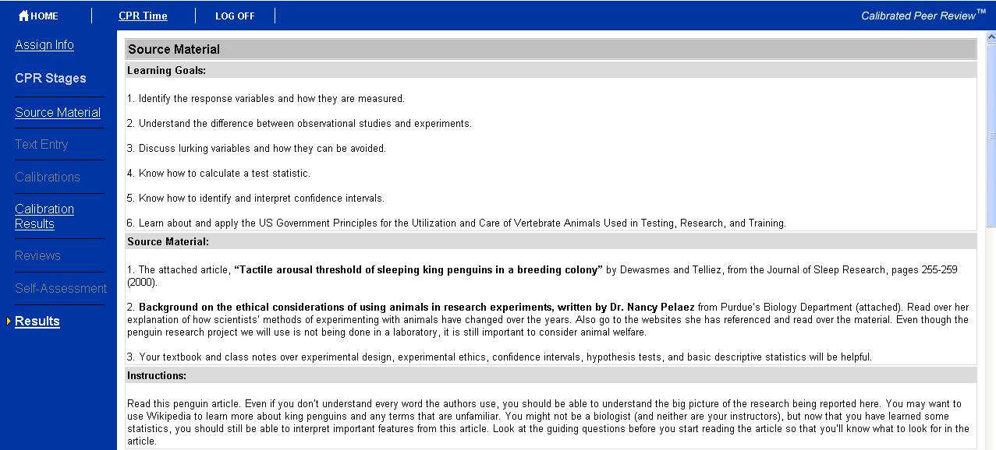
Notes:
Ellen

Slide 11
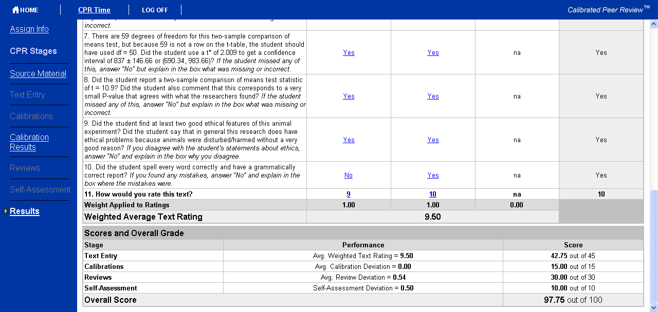
Notes:
Ellen talks about grading scheme from students’ point of view.

Slide 12
How students grade a peer
For STAT 301:
10 yes/no questions all written so that “yes” is a positive aspect to the paper.
Have students count up the number of “yes” answers at the end, and that is the numerical score.
For BIOL 131:
Yes/no questions, but not necessarily 10.
More holistic grading for the score out of 10.
Notes:
Ellen

Slide 13
How the students are graded
For STAT 301: BIOL131:
Writing 45 30
Calibrations 15 (5 points each) 25
Reviews 30 (10 points each) 25
Self-review 10 20
Total 100 100
Notes:
Ellen then Nancy

Slide 14
 |  | BIOL 131 | STAT 301
CPR #1 | Title | “Variables in biological research publications” | “Experimental Design with Plants, Yogurt, and Military Kids”
 | Source material | Original research publication (e.g., Science or Nature) on any biology topic you find interesting Statistics tutorial | Choose 1 of 3 articles, including an excerpt from Darwin’s “Power of Movement in Plants”
 | Discussion topics | Observational study vs. experiment Independent vs. dependent variables Categorical vs. quantitative variables Choosing and describing appropriate graphs for the data | Observational study vs. experiment Unit/subject, sample, population, response variable, treatment Categorical vs. quantitative variables Causation vs. association Principles of experimental design (randomization, replication, control) Ethical or bias concerns Research extensions
Notes:
Ellen then Nancy (students finding their own interesting articles)

Slide 15
 |  | BIOL 131 | STAT 301
CPR #2 | Title | “Darwin (1897) Experiments on Movement in Plants” | “Penguin Poking”
 | Source material | Student-selected experiment from “The Power of Movement in Plants” (online) Statistics tutorial | “Tactile arousal threshold of sleeping king penguins in a breeding colony” from a student response to BIOL 131 CPR #1 Animal research ethics tutorial
 | Calibration resources for instructor | STAT 301 student essays from their CPR #1 | BIOL 131 student essay from their CPR #1
 | Discussion topics | Same as STAT 301 CPR #1, but also discussed: Choosing and describing most appropriate graphs for the data Random variability | Observational study vs. experiment Unit/subject, sample, population, response variable, treatment, control Equivalent treatments for a 150-lb human instead of an 11-kg penguin. Calculate a test statistic and confidence interval from summary statistics Animal research ethics concerns
Notes:
Nancy, then Ellen

Slide 16
STAT 301 CPR assignments using research journal/media articles
Experimental design for yogurt, plants, and military kids
Bad habit or good habit?
Do fish feel pain?
Penguin Poking
Swearing as a response to pain
Bad popcorn in big buckets
Mockingbirds are out to get you!
Predicting Freshman Drinking
Rate My Professors: Does “Hotness” Matter?
Notes:
Ellen

Slide 17
Are journal/media articles the only way to write CPR assignments?
No. In STAT 301, we tried having students analyze data sets and presenting their results in a report for CPR.
Problems:
CPR cannot yet handle graphs or output (but CPR 5 is coming soon).
Wasn’t very different from a homework or lab assignment.
Very boring to read in the calibration/review stage.
Just because we weren’t successful with this type of assignment, doesn’t meant that you couldn’t succeed. Be creative about how you use CPR!
Notes:
Ellen

Slide 18
How do you get CPR assignments?
Write your own
Be sure to find at least one writing partner who can critique your work before giving it to the students!
Use the CPR library (old)
Few statistics assignments available to use.
Stats faculty may have chosen not to share.
May go away soon.
Use the CPR library (new)
ALL assignments will be shared.
All STAT 301 and BIO 131 assignments available soon.
Access is restricted to registered faculty with authorization from Dr. Arlene Russell, Director, Calibrated Peer Review™ project, russell@chem.ucla.edu.
Notes:
Nancy

Slide 19
New CPR Authoring system features
The assignment library will be searchable and indexed at UCLA to make a growing library of assignments accessible to authors and instructors from all institutions.
All assignments are now credited to the original author with credit also given to faculty who modify and make improvements.
Authors will see who uses their assignments.
Notes:
Nancy

Slide 21
New CPR Local system features
The file structure for CPR 4 is more efficient.
CPR 4 solves the current disk space problem with your own student records (and the assignment) on a server on your campus, rather than on a UCLA server supporting the student records for thousands of institutions.
Student data on your own campus can meet FERPA regulations.
Notes:
Nancy

Slide 22
Questionnaire to assess students’ knowledge, experience and confidence
A five-point scaled questionnaire, 33 items address students’ knowledge, experience, and confidence.^{3, 4}
Some questions are related to CPR-taught/assessed topics, some related to topics taught through lectures and assessed with exam questions.
Modified online version of survey (using just statistical concepts) will be used in STAT 301 during Fall 2009.
Surveys available to anyone at any undergraduate institution.http://purdue.qualtrics.com/SE?SID=SV_9ACejVYAgEAT3gM&SVID=Prod
May not tell us what the students actually learned, but items targeting a specific competency the students perform (such as in these CPR assignments) do a better job of predicting student performance on that competency than items with more general attitude questions.⁵
Notes:
Nancy

Slide 23
Notes:
Ellen

Slide 24
Notes:
Ellen

Slide 25
Results from BIOL 131, Spring 2009
250 bioscience majors (mostly freshmen).
Pre- and post-test results from the average of the confidence, knowledge, and experience are shown for selected questions.
All items on graph showed significant change (P-value = 0.000) from pre- to post-test using a matched pairs t test.
Skills A-E were taught and assessed with CPR.
Skills F-H were not taught or assessed with CPR, but rather with a different instructional method such as lectures and exams.
Looking at the side-by-side boxplots, the competencies taught through CPR show a very high frequency of students reporting “a great deal” of knowledge, experience, and confidence on their post-test questionnaire (A-E).
Notes:
Nancy

Slide 26
BIOL CPR- vs. non-CPR-related topics
CPR-related
A. Identifying whether data is quantitative or categorical.
B. Choosing the best way to graphically represent data with a histogram, scatterplot, time course graph, bar chart, dot plot, or side-by-side graph.
C. Distinguishing cause-and-effect conclusions from simple evidence that suggests an association between variables.
D. Describing a carefully controlled experiment from a biological research paper.
E. Understanding how a scientist can deal with variability to establish new knowledge when faced with variation in the natural world.
F. Using the levels of biological organization to sort new information.
G. Understanding signals involved in the shaping of animal body plans in development and evolution.
H. Explaining why biological signal transduction pathways exist.
Notes:
Nancy

Slide 27
CPR-related questions
Notes:
Nancy

Slide 28
Do you have to use CPR to benefit from these assignments?
No, but CPR is a good way to do multiple writing assignments with a large group of students.
Meike Niederhausen at University of Portland is using “Bad habit or good habit?” as a traditional writing assignment with her students.
Michelle Gaddy Everson at University of Minnesota is using a modified version of the “Swearing as a response to pain” and “Bad Popcorn in Big Buckets” CPR assignments as graded online discussion assignments for her online students.
Notes:
Ellen

Slide 29
Collaboration
Notes:
Ellen

Slide 30
Future Directions
Online surveys (pre- and post-test) being given to STAT 301 students this fall.
New CPR assignments written for statistics and biology.
The students clearly feel more confident, knowledgeable, and experienced in these skills after the CPR assignments, but how can we authentically assess whether they have truly mastered these skills?
“Calibrated Peer Review for Computer-Assisted Learning of Biological Research Competencies” with Kari Clase, submitted to Biochemistry and Molecular Biology Education (BAMBEd) (submitted for review).
http://wiki.bio.purdue.edu/stats4bio
Notes:
Ellen (doctoral student interested in Stats Ed will analyze results), then Nancy

Slide 31
Please join us!
We would love to have more people writing and using these CPR assignments.
The better the library is, the more useful it will be to all of us.
We learn something every time we do a CPR assignment, and we have learned a lot from each other. We’re sure that we would learn from your ideas, too.
Notes:
Ellen

Slide 32
Acknowledgements
BIOL 131 T.A.s and the STAT 301 lecturers and T.A.s for providing suggestions on the assignments, especially Christa Sorola and Allison Cummins.
Steven Hunter, Rodney McPhail, Sherry Foley, Stacy Fleming, Alex Kubacki, Cameron Smith, Arlene Russell, Stephen Schimpf, Ed Evans, Nancy Wilson Head, Steven Hare, and Judith Rantz for technical support with CPR.
NSF for funding DUE/CCLI award #0837229. Any opinions, findings, and conclusions or recommendations expressed in this material are those of the authors and do not necessarily reflect the views of the National Science Foundation.
Notes:
Ellen, then Nancy

Slide 33
References
AAAS Vision and Change in Undergraduate Biology Education: A View for the 21st Century, 2009. http://www.visionandchange.org/
AAMC-HHMI Scientific Foundations for Future Physicians Report, 2009.
Berger, C. and E. Carlson. Measuring computer literacy of teacher trainers. Educational Computing Research 4: 287-303, 1988.
Berger, C., N. Kerner, and Y. Lee Y. Understanding student perceptions of collaboration, laboratory and inquiry use in introductory chemistry, 1999. http://www-personal.umich.edu/~cberger/narst99folder/narst99.html
Castro Sotos, A.E.; Van den Noortgate, and Onghena. “How confident are students in their misconceptions about hypothesis tests?”, J of Statistics Education, 17(2):1-19, 2009.
Curran-Everett & Benos. Advan Physiol Educ 28:85-87, 2004.
Guidelines for Assessment and Instruction in Statistics Education (GAISE) College Report, 2005. http://www.amstat.org/Education/gaise/GAISECollege.htm
Metz, A Teaching Statistics in Biology: Using Inquiry-based Learning to Strengthen Understanding of Statistical Analysis in Biology Laboratory Courses CBE Life Sci Educ 7(3): 317-326 , 2008.
National Research Council BIO2010: Transforming Undergraduate Education for Future Research, 2003.

