Slide 1
Teaching for Understanding:
What Will It Take?
Jim Stigler
UCLA
May 29, 2015
Notes:
I learned so much last night; but also was a little deflated by the disparaging remarks about amateurs!
My focus has been on K-12 math teaching around the world, and recently community college developmental math.
Today I’m going to bring what I’ve learned to bear on the problem of how we can teach students to understand statistics.
I’ve never published an article on statistics teaching/learning – so bear that in mind!

Slide 2
Plan for Today
What’s at stake
Why it’s hard
What it will take
Understanding statistics

Slide 3
What’s at stake
Community college developmental mathematics students
Notes:
60% of students entering community college get placed in developmental math.

Slide 4
Developmental Math Students: Views of Math
View math as rules/procedures to be memorized;
can’t “figure it out”
When students were asked, “What does it mean to be good at math?” 77% gave answers like these:
  “Math is just all these steps.”
  “In math, sometimes you have to just accept that that’s the way it is and there’s no reason behind it.”
  “I don't think [being good at math] has anything to do with reasoning. It's all memorization.”
Notes:
These are products of our K-12 mathematics education.

Slide 5
Developmental Math Students
a
5
a
8
Which is greater: or ?
  53% correct, but very few could explain why
  Compulsion to calculate…
5a = a8
5 = 8
✔

Slide 6

Developmental Math Students
462
+ 253
715
Interviewer: “How could you check that your answer is correct?”
715 – 253 = 462
Interviewer: “Why did you subtract 253? Could you have subtracted 462 to check the answer?”
Notes:
What disturbs me is not that these students can’t pass the test, but it’s the lack of understanding.
Today: teaching for understanding; report on TIMSS video and findings from the cognitive sciences.

Slide 7
What Do We Want Our Students to Learn?
Flexible vs. routine expertise (Hatano & Inagaki)
What is flexible expertise?
  Procedural fluency
  Conceptual understanding
  Disposition to think/make sense of mathematics
  Ability to nimbly bring knowledge to bear across a wide array of new situations

Slide 8
Why it’s hard
Teaching is a cultural activity

Slide 9

TIMSS Video Studies: How We Teach Mathematics
Notes:
Add: why study classrooms in other countries? Because it lets us see ourselves more clearly… E.g., confusion in Japan.
The study:
National probability samples
Three countries initially (more later)
Goals:
Understand average teaching; compare teaching; find out what’s common among high achieving countries

Slide 10


TIMSS Video: Teaching is Cultural
Teaching is a cultural activity; varies more across than within cultures (TIMSS 1995 video study; goals/scripts)

Slide 11
US: “Quick and snappy”
Japan: “Slow and sticky”
SOURCE: Hess & Azuma (1991)
Notes:
Hess & Azuma:
Quick & Snappy vs. Slow and Sticky
They also argue: Every society solves the problem of motivation in a different way.
Also: US teachers think teaching math is easy; Japanese teachers think it’s hard!

Slide 12
TIMSS Video: Teaching is a Cultural Activity
Cultural activities are:
  Learned implicitly (ritual learning)
  Multiply determined
  Hard to see (e.g., confusion)
  Hard to change: culture wins
Notes:
Competent implementation of limited methods.

Slide 13
What it will take
A focus on learning opportunities

Slide 14
What do high-achieving countries have in common?*
*Do they all teach like Japan?
Notes:
So, US and Japan very different; but do we have to teach like Japan to get deep learning?

Slide 15
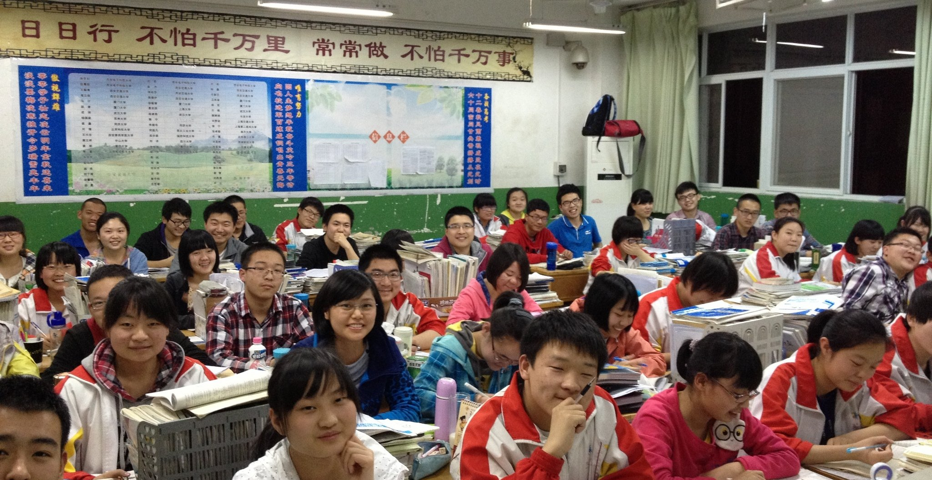
Hong Kong
Notes:
In the second TIMSS video study we studied a variety of other high-achieving countries

Slide 16
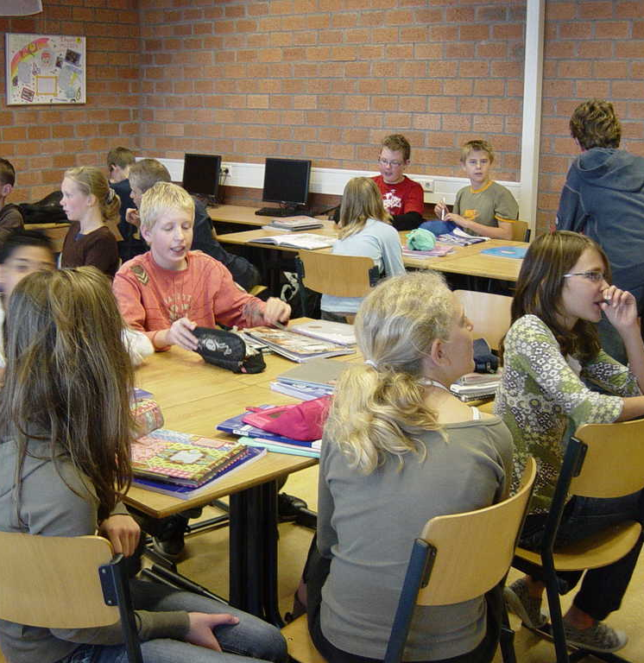
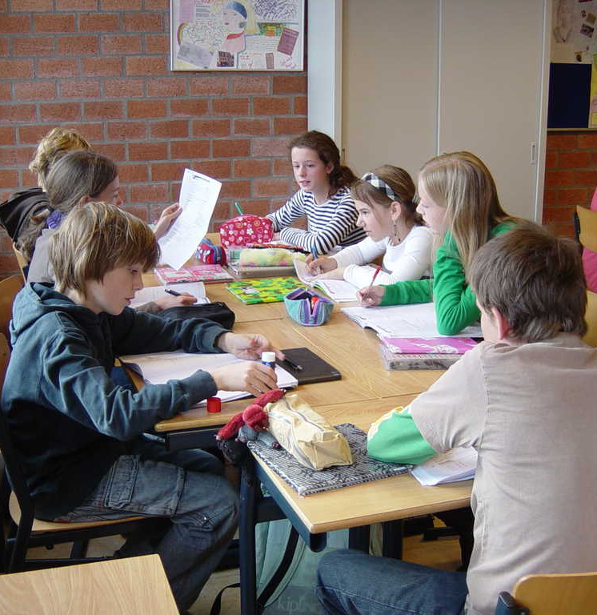
Netherlands
Notes:
Mostly look different from Japan
And though they all differ in most respects
Lecture vs. groups
Real world vs. symbolic
Digging deeper we found that the high-achievers offered something in common
… which we call learning opportunities

Slide 17
Teaching looks different in every country – no one way to teach.
Notes:
This is good news, because it would be hard to teach like Japan.

Slide 18
But: despite using different strategies…
…high-achieving countries create similar learning opportunities for students.
Notes:
Teaching is highly contextual. Different strategies are required in different cultures, and in different classrooms. But to produce high levels of understanding, we need to create these kinds of learning opportunities.

Slide 19
Research Indicates Three Types of Learning Opportunities Required for Deep Understanding
For deep learning, with understanding, students need recurring and sustained opportunities for:
Productive struggle – with important mathematics
Explicit connections – among concepts, procedures, problems, situations
Deliberate practice – increasing variation and complexity over time

Slide 20
1. Productive Struggle
Notes:
Like the confusion in a Japanese classroom.
Problem: goes against our culture – learning is not necessarily “fun.”
Many studies in psychology have supported the idea of “desirable difficulties.”

Slide 21
Productive Struggle and Desirable Difficulties
Students randomly assigned to two conditions to study science text:
Four study periods
  Read passage 14.2 times
  Predicted good recall
One study / 3 recall periods
  Read passage 3.4 times
  Predicted poor recall
Source: Roediger & Karpicke (2006)
Notes:
A number of new studies show that things we do to make learning harder lead to deeper, longer-lasting learning, even though students don’t perceive it this way.
Here’s an example: Roediger & Karpicke
Another example: Mannes & Kintsch – poor outline better than good outline

Slide 22
Productive Struggle and Desirable Difficulties
Students randomly assigned to two conditions to study science text:
Four study periods
  Read passage 14.2 times
  Predicted good recall
One study / 3 recall periods
  Read passage 3.4 times
  Predicted poor recall
Source: Roediger & Karpicke (2006)
Notes:
A number of new studies show that things we do to make learning harder lead to deeper, longer-lasting learning, even though students don’t perceive it this way.
Here’s an example: Roediger & Karpicke
Another example: Mannes & Kintsch – poor outline better than good outline

Slide 23
Confucius
“I never enlighten anyone who has not been driven to distraction by trying to understand a difficulty or who has not got into a frenzy trying to put his ideas into words. When I have pointed out one corner of a square to anyone and he does not come back with the other three, I will not point it out to him a second time” (不愤不启, 不悱不发. 举一隅不以三隅反, 则不复也.) (Lau, 7:8)

Slide 24
2. Explicit Connections

Slide 25
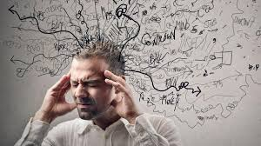
Thinking Hard
Notes:
Struggle is good. But what do we need our students to struggle with? It’s the core concepts that underlie the domain they are learning about, and that will make their knowledge flexible and usable.

Slide 26
The Power of Connections
Few Connections
Many Connections
B
B
C
C
A
A
D
D
F
F
E
E
G
H
G
H

Slide 27
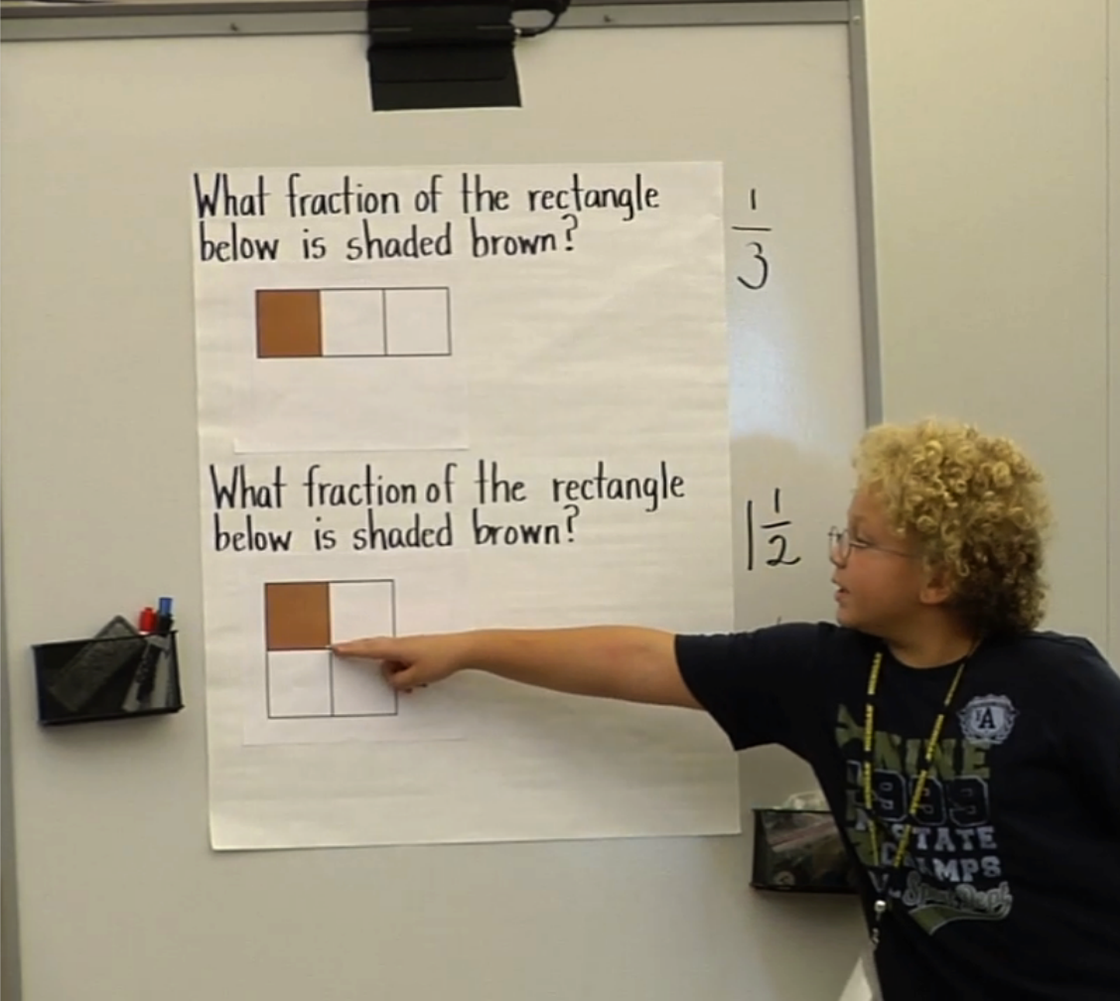
Example: Struggle to Make Connections
What fraction of the rectangle is shaded brown?
(a)
(b)
⅓
¼
⅓
½
SOURCE: Deborah Ball (2013)
Notes:
This illustrates all three learning opportunities: the increasing variation/complexity (deliberate practice); the struggle (hard for students); the connection to explicit concepts (equal size pieces, keeping track of what the “whole” is)
Example of equivalent equations: need to keep students connected to the core idea.

Slide 28
3. Deliberate Practice
Notes:
Adding the dimension of time, because, despite our cultural beliefs, learning/understanding is gradual not sudden.
Our model is the Eureka! moment (for understanding). But even understanding happens gradually with practice.

Slide 29

Deliberate Practice
Different from repetitive practice
Constantly increasing variation, complexity, challenge
With feedback
Staving off premature automaticity
Understanding takes practice, too!
Notes:
We think of understanding as sudden, but this isn’t really the case. It also requires practice, of a certain kind, over time.

Slide 30
Learning Opportunities
Explicit Connections
− +
Step-By-Step Procedures | Well-Formed Lecture
Discovery Learning | ✪
−
+
Productive
Struggle

Slide 31
Learning Opportunities
Deliberate Practice
✪
Explicit Connections
✪
− +
✪
Step-By-Step Procedures | Well-Formed Lecture
Discovery Learning | ✪
−
+
✪
Productive
Struggle
✪
Maintaining
struggle and connections
through time

Slide 32
Understanding statistics
Making connections to core concepts

Slide 33
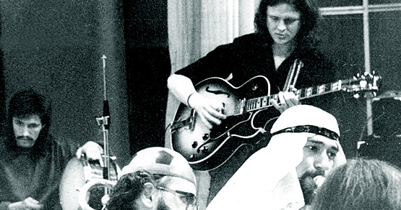
Igor Gregoriev: “Only 5 Chords”
Notes:
What are the core concepts in a domain? It’s an art to figure that out. And, they may be different for novices than for experts.

Slide 34
Connections Map
Related Concept
Core Concept 1
Core Concept 2
Core Concept 3
L1
L2
L3
L4
L5
L6
L7
L3A
L3B
L3C
Example: Connect concept of mean to that of best fitting regression line.
Notes:
Different kinds of conceptual connections: lesson, core, and related.
Hard to figure out what these are, especially the core ones (the five chords).
These are what the teacher needs to have in mind if they want to teach for understanding: constantly asking questions to generate connections.

Slide 35
Working Hypothesis
Statistics is the study of distributions.
The “five chords”: the Distribution Triad.
Hypothesis: practicing these connections over time will result in more coherent and flexible understanding.
Distributions
Sample
Population
Sampling

Slide 36
Developmental Progression
Distributions
Sample
The whole is more than the sum of the parts
Describing/comparing distributions
Notes:
This seems simple, but it’s hard!
Key for algebra: being able to see x+3 as both a procedure and a quantity.
In statistics, a big problem: mean and SD seen as things you do, not as representations of characteristics of distributions.

Slide 37
Developmental Progression
Working from sample to population, and vice versa
Random sampling, and bias
Problem of inference; informal approaches
Sampling variation
Distributions
Sample
Population
Notes:
How can we infer characteristics of population from sample? And, how can we interpret meaning of sample based on what we know about population?
Population and model: e.g., last digit of SSN (uniform); height (normal)
How does model of population (e.g., shape of distributions) affect your predictions?
Questions: If you randomly selected one more, where do you predict it would be? (if you selected 2 and averaged them, how would that change your prediction? For both n=1 and 2, if you re-did the sample many times, what would you predict the mean and SDs to be?

Slide 38
Developmental Progression
A very abstract idea, hard to understand with or without simulation
Confidence intervals, hypothesis tests
Wait: I thought there were only three distributions?
Distributions
Sample
Population
Sampling
Notes:
Ji didn’t understand that SE was SD of the sampling distribution.

Slide 39
Final Question:
How do you make this happen?
Notes:
Will be hard, because teaching is a cultural activity.
And no concrete method to employ: Beware the common recipes and “best practices.”
You will need to figure out what works for your students, in your discipline.
And you will need the patience and perseverance to make it happen.

Slide 40
stigler@ucla.edu

Slide 41
Teacher’s Goal for the Lesson
“What was the main thing you wanted students to learn from today’s lesson?”
Back

Slide 42
“Every system is perfectly designed to achieve the results it gets.”
-Paul Bataldan

