Slide 1
Statistics Education Research: It Takes a Village!
US Conference on Teaching Statistics
Penn State University
May 30, 2015
Michael A. Posner, PhD, PStat®
Villanova University
Notes:
Asked to talk about Stat Ed Research, the role in my career, why it takes a village, the role it could play in your teaching as well
Connection with other talks!

Slide 2
What I learned at uscots 2015
I am teaching intro stat all wrong
..but so is everyone using the textbooks of many of the presenters themselves
More programming skills and better data
I love making connections with my colleagues and am inspired by their work and energy
We stand on the shoulders of giants
Allan is great at many things
….Jim, Roger, Shonda, Michael ???
Reinforce the messages
Consistency

Slide 3
Overview
What makes a great teacher?
Disconnecting at USCOTS
Scholarship of teaching and learning (SoTL)
Growing up in my village
Building your own village

Slide 4
Overview
What makes a great teacher?
Disconnecting at USCOTS
Scholarship of teaching and learning (SoTL)
Growing up in my village
Building your own village

Slide 5
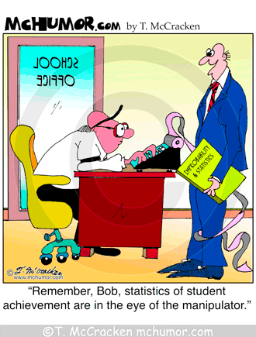
You Are a Great Teacher!
What is it about your teaching that makes you great?
What evidence do you have
that this leads to increased
student learning?
How do you even measure
student learning?

Slide 6
Variation in Styles/Skills
Impeccable recall
Performers deserving of off-Broadway show
Comfortable behind the podium or dynamic, agile facilitator

Slide 7
You are all individuals!

Slide 8
Overview
What makes a great teacher?
Disconnecting at USCOTS
Scholarship of teaching and learning (SoTL)
Growing up in my village
Building your own village

Slide 9
Variations in teaching
Not all teaching methods work for your style
Background
Statistics, computing, etc.
Institutions
Importance of Teaching, Communities, Resources
Courses
Statisticians, service courses, developmental students, future teachers
Large lecture vs. small seminar
Students
Expectations, Aptitude, Motivation, Grit
Familiarity with how to succeed
Context is culture- and experience-specific
Notes:
Everyone else wants you to do more

Slide 10
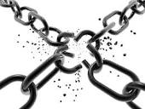
Disconnect!
Not all ideas / suggestions apply to you!
They want you to do more, I want you to do less
…but measure it!
Image from http://ocpatentlawyer.com/broken-chain-of-priority-invalidates-patent/
Notes:
Can’t teach intro stats in R
$5 mil

Slide 11
missed opportunities for Evidence-based Education
“Any questions?”

Slide 12
Ineffective pedagogy

Slide 13
missed opportunities for Evidence-based Education
“Any questions?”
The nod…from the student in the front row.
I gave students a video to watch
…and two of them told me they loved it!
I tried a new active learning technique
…and scores on a content test given after the course were higher than their pre-course test scores.
If we have data, let’s look at data. If all we have are opinions, let’s go with mine.
--- James Love Barksdale

Slide 14
The need for evidence-based education
No one would think of getting to the Moon or of wiping out a disease without research. Likewise, one cannot expect reform efforts in education to have significant effects without research-based knowledge to guide them.
--- National Research Council, 2002
Did you apply a rigorous scientific processes to collect, analyze and present data to make evidence-based decisions about effective teaching?
The most misleading assumptions are the ones you don’t even know you’re making.
--- Douglas Adams

Slide 15
Overview
What makes a great teacher?
Disconnecting at USCOTS
Scholarship of teaching and learning (SoTL)
Growing up in my village
Building your own village

Slide 16
What is the scholarship of teaching & learning (SoTL)?
SoTL is an evidence-based way….[of] creating a “sustained culture of inquiry about teaching and learning” (Maki)…Teaching can always become more effective and learning more significant and enduring. Growth in students and their learning is the life-juice of being a teacher. SoTL can stimulate those juices to flow in innovative, effective, and reflective ways.
SoTL is not only the engagement by individuals in vigorous research on teaching and making that research public in building a body of knowledge, but also an attitude and a way of thinking about teaching. SoTL emphasizes that teaching is serious intellectual activity that can be both deeply personal and highly collegial. SoTL, as understood in an expansive sense, is perhaps the best way to improve teaching for student understanding. That is a lofty claim, yet one not only possible, but when done well, probable.
SoTL Commons - http://academics.georgiasouthern.edu/ijsotl/conference/2013/

Slide 17
Value and benefit of sotl
Doing the Scholarship of Teaching and Learning in Mathematics. Dewar & Bennett. 2015.
Provide guidance for scholarly study of teaching
Promote understanding of value to community
Shulman’s (1999) “taxonomy of pedago-pathology,” when learning doesn’t go so well (for students)
Amnesia – forget what they learned
Fantasia – persistent misconceptions
Inertia – inability to use what they learned

Slide 18
Pedago-pathology of teaching
Amnesia
Forget from one semester to the next
Need data to document and share changes
Fantasia
Misperceptions of what students bring, think, learn, find challenging, or don’t understand
SoTL researchers often shift from “What worked?” to “What if…?” questions as they discover the unexpected
Inertia
What is the best way to teach? Lecture!
That is the way we have been taught
It’s the easiest way to still get your paycheck
Notes:
Pathology can be helpful

Slide 19
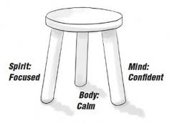
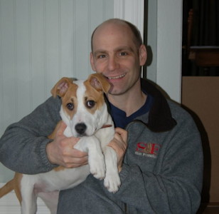
Professional benefits of sotl
Counts as merit…for some
Recognition
One author credited it in
winning the ASA Waller
Award and appointment
to stat ed leadership
Grants
Professional connections
New interests & ideas
Continual improvement
Research
Teaching
$$$
Service
http://yomamaldn.blogspot.com/2008/11/round-of-applause.html
http://newamericamedia.org/network/
Published…
Still
Perished

Slide 20
Sotl at the communal level
Curriculum
Simulation-based vs. Traditional?
Pedagogical methods
Active learning
The flipped/hybrid classrooms
MOOCs
Teacher training
Statistics PhD
No or little statistics background
What are the challenges and opportunities?
Opportunities – broad impact
Challenges – large-scale (time, logistics, etc.)

Slide 21
SOTL at the individual level
What works best
…for me
….and my students
….for this given learning environment?
What are the challenges and opportunities
Challenges
Define the desired outcome
Designing the study
Finding good assessment instruments
Recognize (and remove?) personal bias
Opportunities
Understand what the students know
Better enable student learning

Slide 22
Overview
What makes a great teacher?
Disconnecting at USCOTS
Scholarship of teaching and learning (SoTL)
Growing up in my village
Building your own village

Slide 23
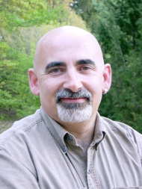
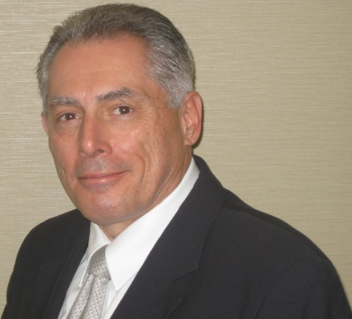
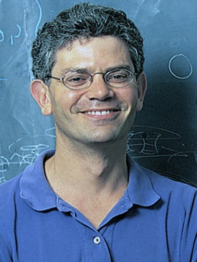
SER infancy (2006)
Workshop on Formative Assessment
Mastery-learning
Educational research
Study formative assessment in classroom
Two classes
Control – traditional numeric grading
Exper – proficiency-based grading with resubmissions
Outcomes
Common Final Exam
Self-designed instrument for student attitudes

Slide 24
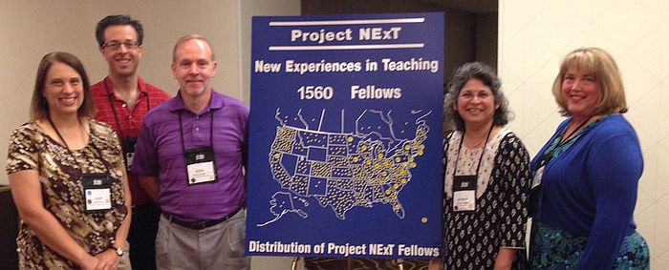
SER infancy, cont’d
Introduction to Stat Ed Community at JSM
Participation in Project NExT

Slide 25
SER Toddler (2007)
Formative assessment study…take 2
Ummm, what is a learning outcome?
Why are 1:30 and 3pm classes different?
How you introduce a study matters!
Lost the pairing of the data
Using validated instruments
Exam -> CAOS
Attitudes -> SATS

Slide 26
lessons/results from parlo
A failure
No differences between PARLO/Control on common final exam
Resubmission associated with course performance
…but not when controlling for Math SAT
But also a success
PARLO increased attitudes more
Students are not second-class learners
Connected with MSPGP on NSF grant application for RCT in high schools
Proficiency-based Assessment and Reassessment of Learning Outcomes (PARLO)

Slide 27
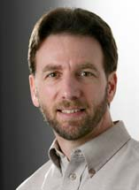
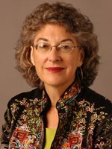
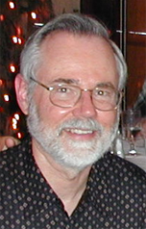
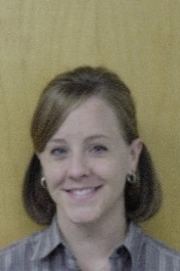
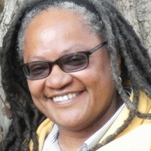
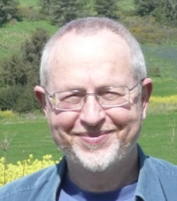
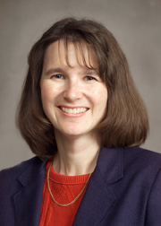
SER Toddler, cont’d
USCOTS 2007
Student poster competition
CAUSEmos research cluster
Led to IASE Satellite Conference (Portugal)
Service to the community
Elected Chair-elect of SIGMAA Stat Ed

Slide 28
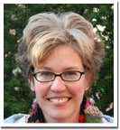
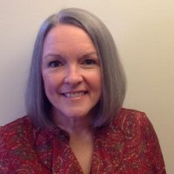
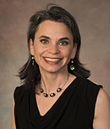
SER – the wonder years (2008-9)
PARLO
NSF PARLO grant submitted…and rejected
IES PARLO grant submitted at 5:03pm
NSF PARLO grant submitted…and awarded
The importance of qualitative research
The Power of Choice
Asked to participate with colleagues teaching MBAs
Giving students choice of semester grade allocations leads to
increased satisfaction
increased desire to take another such course

Slide 29
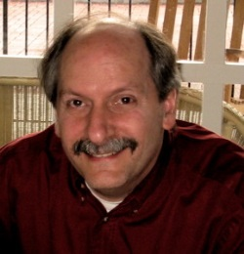
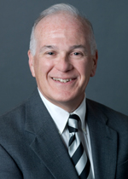
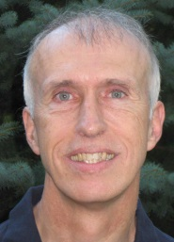
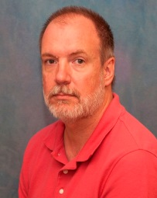
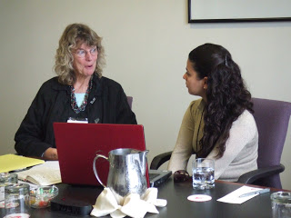
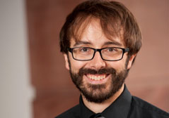
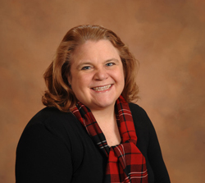
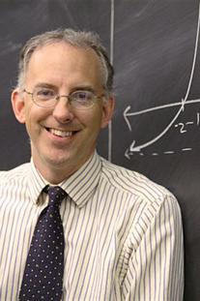
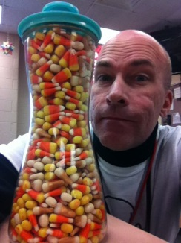
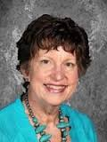
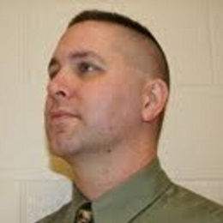
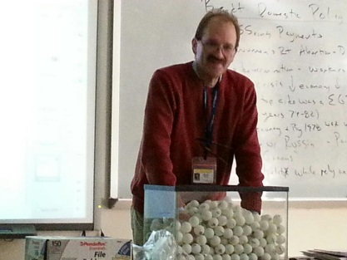
SER – the wonder years, cont’d
USCOTS 2009
Research cluster on fun
Research cluster on attitudes
Philadelphia Area Statistics
Teachers Alliance (PASTA)
Making connections
…with other fields of study

Slide 30
Cognitive learning theory & educational psychology
Bloom’s Taxonomy/Webb’s Depth of Knowledge
Common themes in successful international mathematics education (Stigler & Hiebert)
Deliberate practice
Making explicit connections
Productive Struggle
“Applying Cognitive Theory to Statistics Instruction” (Lovett & Greenhouse)
Time on task
Knowledge is context-specific and learning must integrate new knowledge with existing beliefs
Real-time feedback promotes efficient learning
Learning decreases as mental load increases
Understanding by Design (Wiggins & McTighe)
Goals -> Assessments -> Learning Experiences
Notes:
Practice
Explicit Connections – Roberto???
Productive Struggle – Slanty line

Slide 31
Ser – growing up (2010-today)
PARLO NSF study – Preliminary results
Teachers loved the system, but not the workload
Content tests – no increase
Attitudes – decrease
State tests – causal?
Fun in the classroom
Fun video before exams to reduce anxiety
No impact!
High anxiety related to low exam scores
Attitudes
Instructor characteristics, Pre-post analysis
Villanova attitudes study

Slide 32
Villanova attitudes study
First day impact
Affect and Difficulty higher after the first day
There is large variability across professors
If these results were applied to eight published studies on student attitudes, conclusions would change for seven of them!
Future research – what contributes to changing student impact on the first day?
Relationship with course grade
Affect and Cognitive Competence had a moderate positive relationship
Value and Difficulty had a weak positive relationship
Interest and Effort had minimal relationship

Slide 33
Long-term retention (prelim)
Three-year follow-up in business students
Impact career path? Business analytics courses
Not related to post-course attitudes and grades
Long-term attitudes were related to…
Long-term content test score
Related to HS stat class, Math SAT, and Post Affect
Long-term Attitude | Post- Attitude | Additional Variables
Affect | Yes | Course grade, HS stat class
Cognitive Competence | No | Course grade, HS stat class
Difficulty | No | HS stat class
Value | Yes | Instructor
Interest | Yes | None

Slide 34
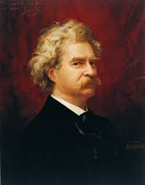
Reflections on the decade
Seek evidence of your teaching effectiveness
Getting started can be hard
Ask the questions
“does it work”?
“how do I know”?
Make connections with friends / colleagues
…with diverse interests
The secret of getting ahead is getting started. The secret of getting started is breaking your complex overwhelming tasks into small manageable tasks, and starting on the first one. --- Mark Twain

Slide 35
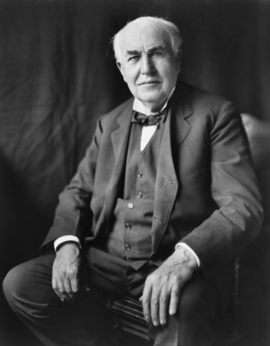
Reflections on the decade
Try new things and be willing to fail
Be generous in how you define success
Your first study design won’t be your last
Embrace in the generous stat ed community
“I have not failed. I’ve just found 10,000 ways that won’t work.” -
--- Thomas A. Edison
“Failure is so important. We speak about success all the time. It is the ability to resist failure or use failure that often leads to greater success. I’ve met people who don’t want to try for fear of failing.”
--- J.K. Rowling

Slide 36
Overview
What makes a great teacher?
Disconnecting at USCOTS
Scholarship of teaching and learning (SoTL)
Growing up in my village
Building your own village

Slide 37
Building your own village
SoTL in your classroom
What just didn’t seem to work well or
what innovation do you want to try?
Design a small study, focus on one thing
How will you measure student learning?
Look for validated assessments
Connect with colleagues with similar interests
If there are insights to share, present at USCOTS

Slide 38
Useful resources
Statistics Education Journals
Journal of Statistics Education
Statistics Education Research Journal
Teaching Statistics
Technology in Statistics Education
Other discipline-based education research
Using Statistics Effectively in Mathematics Education Research (SMER Report)
Statistics Education Research Report (CAUSEweb)

Slide 39
Smer report
Generate -> Frame -> Examine -> Generalize -> Extend cycle
What is the outcome of interest?
Design
What are you comparing it to (control group)
Experimental vs. Observational
Measurement
Use an existing instrument (ATMI, SATS)
Unit of Randomization = Unit of Analysis
Gain scores are sometimes inappropriate
Recognize your own biases
Quantitative and qualitative results
Get IRB approval

Slide 40
Stat ed research report
Connecting Research to Practice in a Culture of Assessment for Introductory College-level Statistics (2012)
Result of many Stat Ed Research initiatives
Goals
Foster productivity and coherence
Provide impetus for instrument development

Slide 41
Stat Ed research report
Seven areas discussed
Cognitive outcomes – content knowledge
Affective constructs - attitudes
Curriculum – simulation-based, data science, etc.
Teaching practice – modality (active, flipped, etc.)
Teacher development – do we have the right skills?

Slide 42
AN opportunity
TANGO Stat Ed
“Training A New Generation Of Statistics Educators”
Pair stat ed mentors with community college instructors
NSF-grant – four regional hubs, training
ASA Member Initiative – national
www.tinyurl.com/TANGOStatEd
Back to our regularly scheduled plenary…

Slide 43
Stat Ed research report
Seven areas discussed
Cognitive outcomes – content knowledge
Affective constructs - attitudes
Curriculum – simulation-based, data science, etc.
Teaching practice – modality (active, flipped, etc.)
Teacher development – do we have the right skills?
Technology – software, computing, etc.
Assessment – valid and reliable evidence
Structure (~5 pages each)
Introduction
Brief literature review
Research questions and priorities
Implications to knowing the answer to the questions
Measurement/assessment needs

Slide 44
Breakout session
Welcome to the Village: Developing a Personal Statistics Education Research Agenda
with Bob delMas, University of Minnesota
Session 4A, 3:00 - 4:15pm today, Room 208
Identify topics of interest
What always irks you after you teach it?
What pedagogical innovation are you interested in exploring?
Meeting your village neighbors

Slide 45
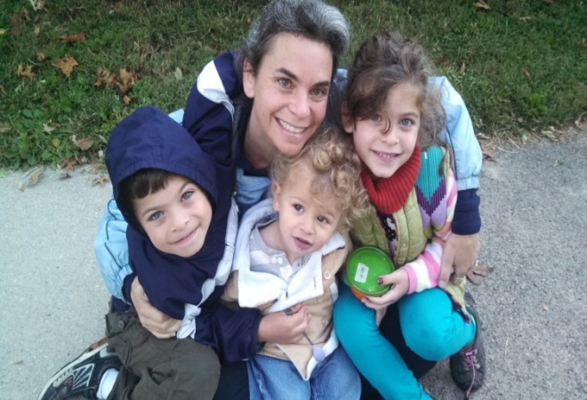
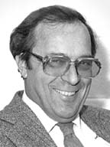
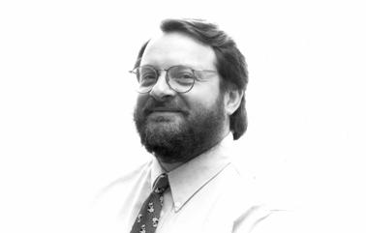
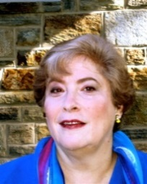
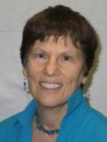
Thank you
I am honored to be here.
Thanks to those who offered wisdom, guidance, support, friendship, etc.
Allan Rossman for the invitation
Dennis Pearl’s CRUCIAL EYES
CReating Unequaled Catalysts for
Inspiring Amazing Leaders Everywhere
You find Educators of Statistics
Carol
Bouma

Slide 46
Change is Hard!
If you would attain to what you are not yet, you must always be displeased by what you are. For where you are pleased with yourself there you have remained. Keep adding, keep walking, keep advancing. ~Saint Augustine
Q: What is it that makes you a great teacher?
A: The desire to improve your teaching
…and your students’ learning
…using evidence-based methods.
Passion for
Statistics
Passion for
Teaching

Slide 47
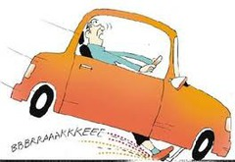
A decade of the evolution of my stat ed research program
Classroom
Experiment
SERJ
Article
Educational
Researchers
NSF
Grant
Refined
PARLO
Formative
Assessment
Workshop
Classroom
Experiment
Take 2
No Main
Effect
No Effect
NSF & IES
Grants
Learning
Outcomes
Content
Attitudes
PSSA
Reject
Negative
Attribute?
Choice
Classroom
Experiment
AMLE
Article
Improved
Experience
No
Effect
Fun
CAUSE
Cluster
Videos
Before Exam
USCOTS
Presentations
JSE
Article
CAUSE
Cluster
Instructor
Characteristics
Villanova Studies
(1st, A<->C, LT)
Attitudes
PARLO
Dear
Dean
PRIMUS
Article
Flipped
Classroom
Year 1
Refine
Year 2
Stat Ed
Community
Research
Retreats
Committee
Leadership
Plenary
Talk
Textbook
Notes:
Car stop - https://quizlet.com/16859495/newtons-laws-of-motion-flash-cards/

