Slide 1
Making Statistics Relevant in a Data-Rich Society
Shonda Kuiper
Grinnell College
United States Conference On Teaching Statistics 2015

Slide 2
Challenges in adapting to a data rich society
  Growing interest in data analysis
  Technology has changed the discipline of statistics
  Making decisions with data in an essential life skill

Slide 3
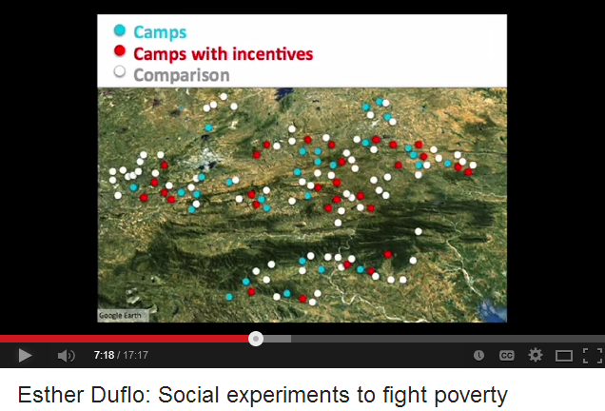
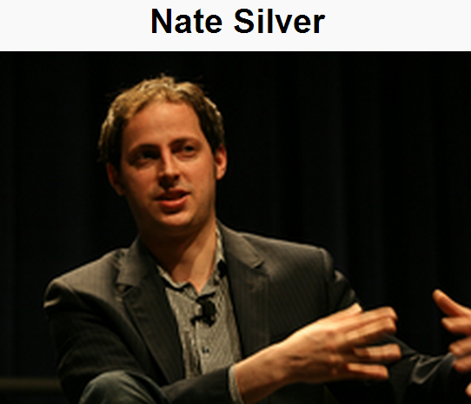
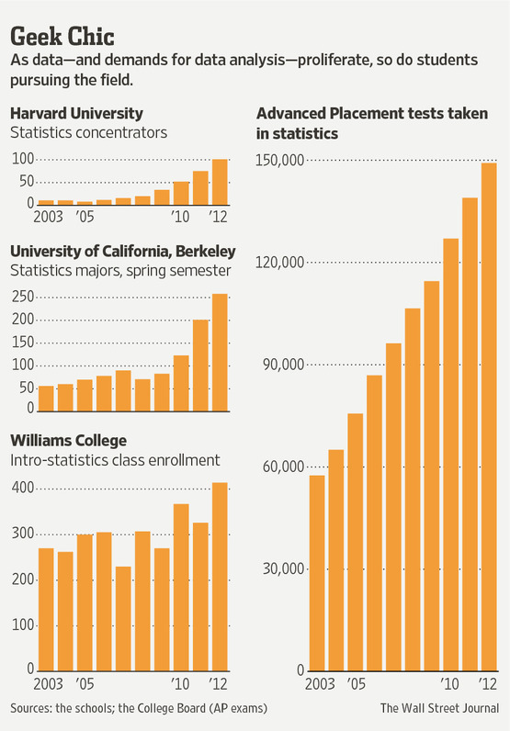
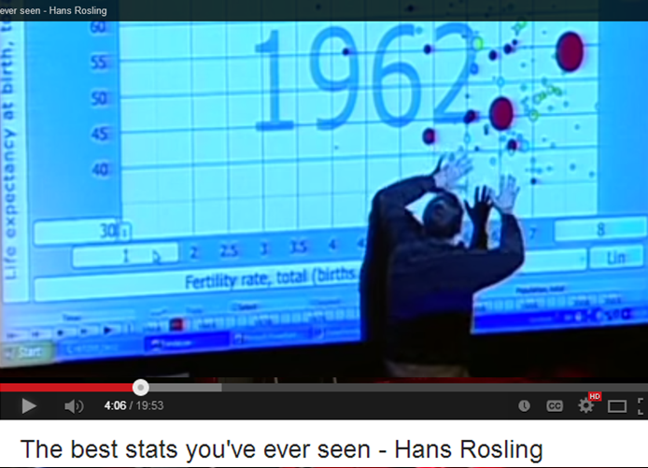
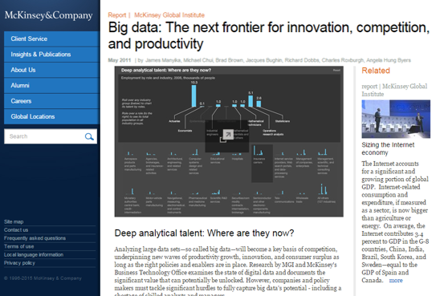



Challenges in adapting to a data rich society
  Growing interest in data analysis
  Technology has changed the discipline of statistics
  Making decisions with data in an essential life skill
Graphic from an article appearing on March 2, 2013, on page A2 in the U.S. edition of The Wall Street Journal, with the headline: Data Crunchers Now the Cool Kids on Campus. http://online.wsj.com/article/SB10001424127887323478304578332850293360468.html?mod=WSJ_hps_RightRailColumns
http://www.mckinsey.com/insights/business_technology/big_data_the_next_frontier_for_innovation

Slide 4
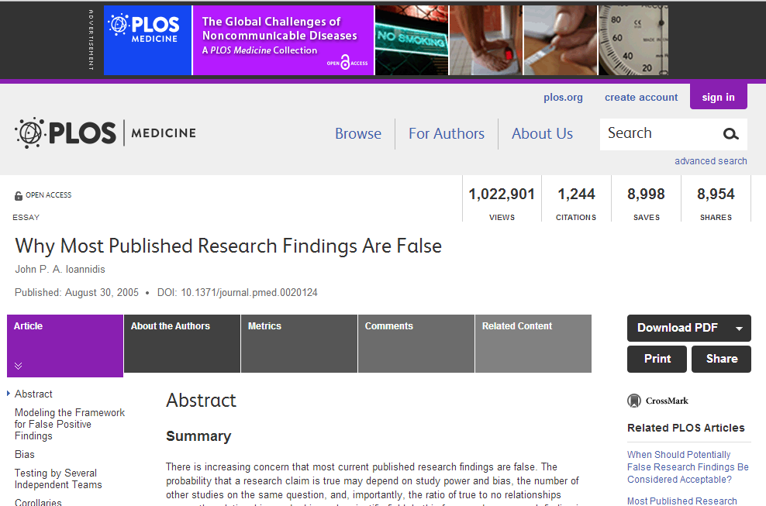
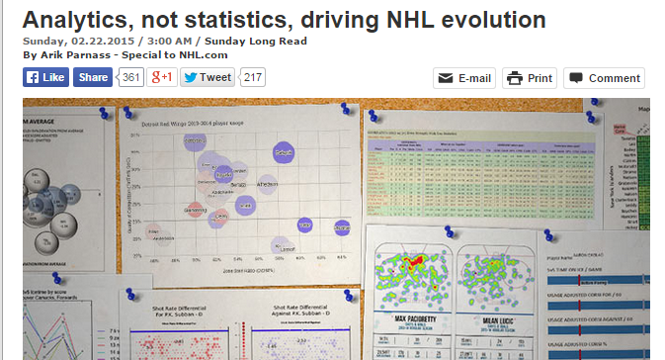
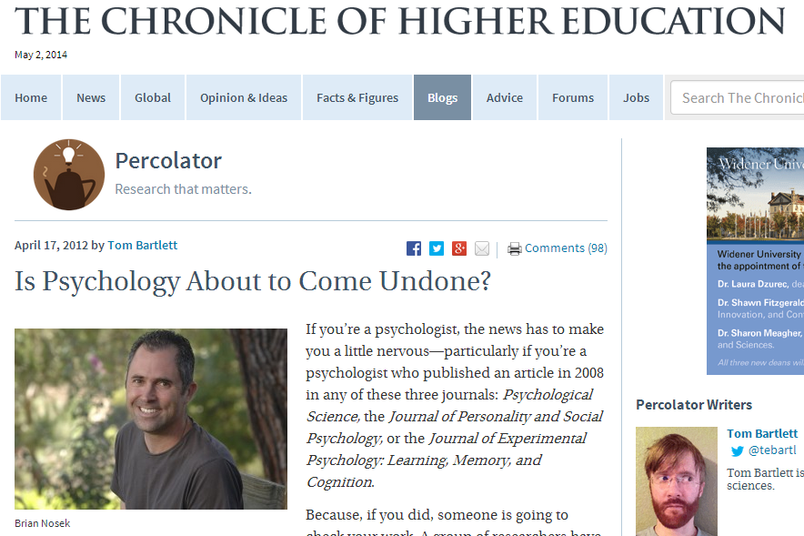
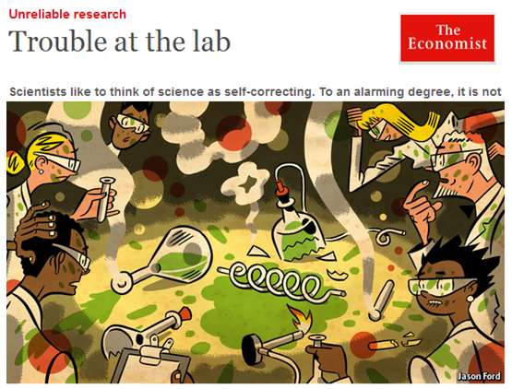
Challenges in adapting to the age of big data
Students who take only an intro course are no longer equipped to apply the more relevant statistical methods in their own work¹
  “We may be living in the early twenty-first century, but our curriculum is still preparing students for applied work typical of the first half of the twentieth century²”
Are our courses really teaching students how to extract meaning from data?
  “Curricula in statistics have been based on a now outdated notion …at every level of study, gaining statistical expertise has required extensive coursework, much of which appears to be extraneous to the compelling scientific problems students are interested in solving.³”
? ? ?
¹Suzanne Switzer and Nick Horton. (2007) “What Your Doctor Should Know about Statistics (but Perhaps Doesn't).” Chance. 20(1): 17-21.
²Cobb, G. (2007) “The Introductory Statistics Course: A Ptolemaic Curriculum?”,Technology Innovations in Statistics Education: Vol. 1: No. 1,
³Brown, E., and Kass. R., (2009), “What is Statistics”, The American Statistician. May 1, 2009, 63(2): 105-110.

Slide 5
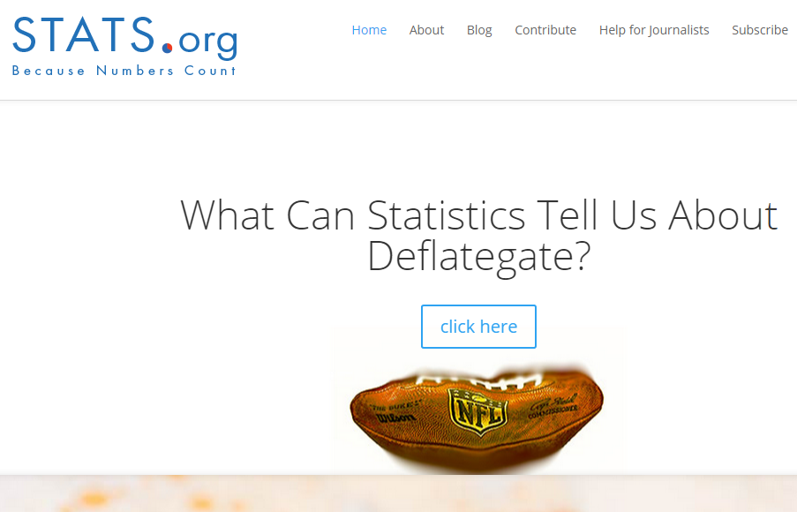
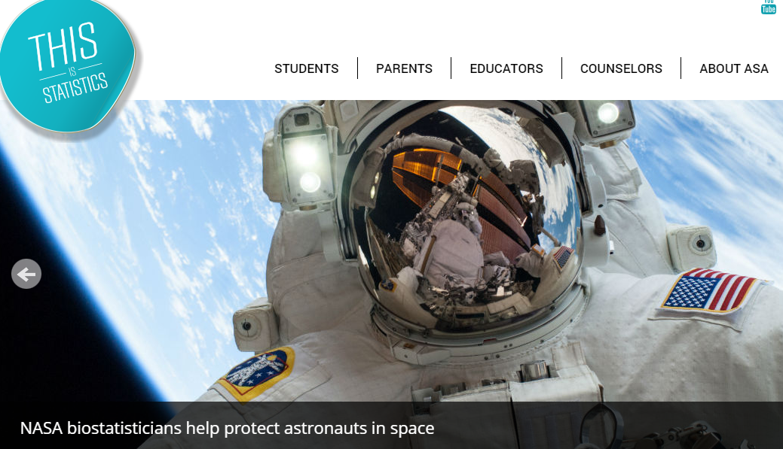
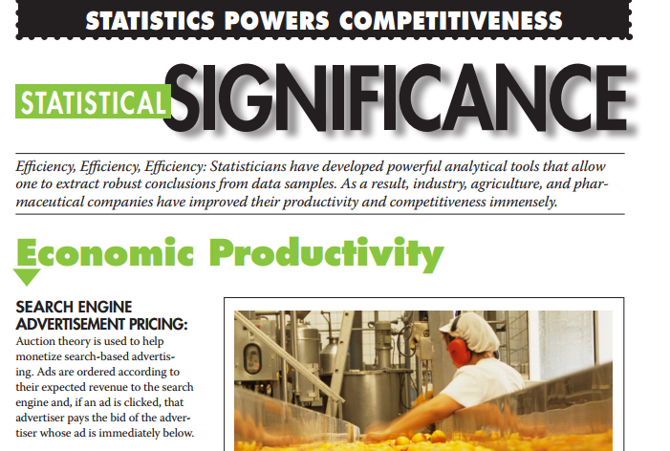
Increase the Visibility of our Profession
Communicating the Power and Impact of Our Profession (Wasserstein, 2015)
Stats.org
This is Statistics http://thisisstatistics.org/
Statistical Significance Series http://www.amstat.org/policy/statsig.cfm
Wasserstein, R. (2015), ``Communicating the Power and Impact of Our Profession: A Heads Up for the Next Executive Directors of the ASA,'' {\it The American Statistician}, 69(2), DOI: 10.1080/00031305.2015.1031283.

Slide 6
2014 Curriculum Guidelines for Undergraduate Programs in Statistical Science
Teach how to “think with data” by having students work with real-world, unstructured datasets and train them to better communicate nuanced statistical ideas.
Practice using all steps of the scientific method to tackle real research questions. All too often, undergraduate statistics majors are handed a “canned” data set and told to analyze it using the methods currently being studied. This approach may leave them unable to solve more complex problems out of context.
Formulate good questions, consider whether available data are appropriate for addressing the problem, choose from a set of different tools, undertake the analyses in a reproducible manner, assess the analytic methods, draw appropriate conclusions, and communicate results.
http://www.amstat.org/education/curriculumguidelines.cfm

Slide 7
SMALL changes can make a BIG difference
Integrate examples that are “real to the students” (Gould, 2010)
Find patterns that matter (tell a story with your data)
Deeper meaning and insights so that better decisions can be made.
Technology: videos, apps, R Markdown, data collection tools
Emphasize how to address bias, confounding and common misunderstandings
Transition from small/carefully vetted data to large/messy data
R. Gould, “R. Statistics and the Modern Student,”. International Statistical Review, vol. 78, n. 2, pp. 297–315, August 2010.

Slide 8
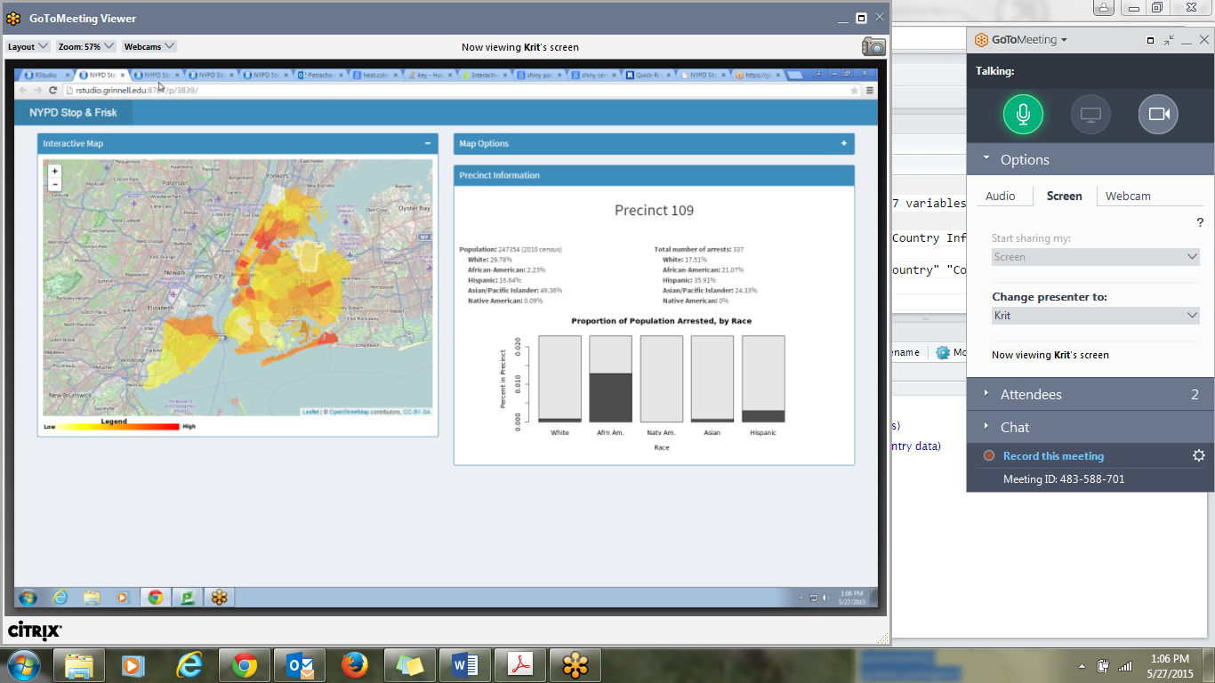
NYPD Stops and Arrests
Are their different arrest patterns for people of a different race, sex, or type of suspected crime?
New York Police Department (NYPD) Stop, Question, and Frisk Database, 2006 (ICPSR 21660)
In 2006, the NYPD stopped a half-million pedestrians because of suspected criminal involvement.
Information for each stop was recorded by the officers on stop, question, and frisk reports kept by the department.¹
We summarized and graphed this data by precinct and posted interactive graphs on-line.
¹Ridgeway, Greg. 2007. Analysis of Racial Disparities in the New York Police Department’s Stop, Question, and Frisk Practices. A technical report by the RAND Corporation, Santa Monica, CA. http://www.rand.org/content/dam/rand/pubs/technical_reports/200/RAND_TR534.pdf

Slide 9
NYPD Stops and Arrests
THANKS to Krit Petrachaianan, Zachary Segall, Ying Long, Ruby Barnard-Mayers, Karin Yndestad, and Dr. Pamela Fellers,

Slide 10
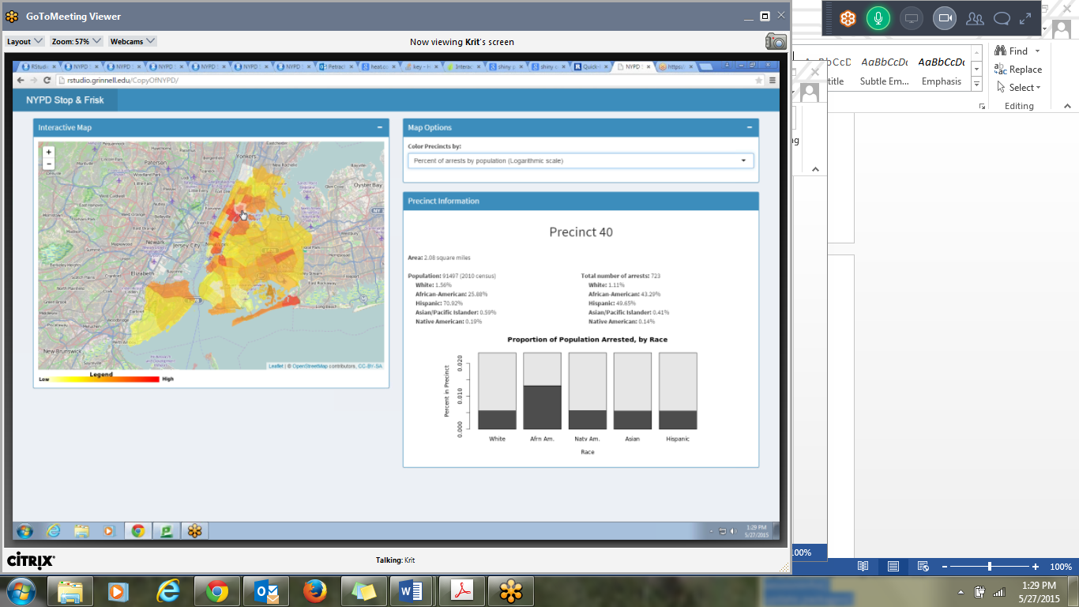
NYPD Stops and Arrests
THANKS to Krit Petrachaianan, Zachary Segall, Ying Long, Ruby Barnard-Mayers, Karin Yndestad, and Dr. Pamela Fellers,

Slide 11
NYPD Stops and Arrests
What were the total number of police stops in NYC?

Slide 12
NYPD Stops and Arrests
What were the total number of police stops in NYC?
What percentage of the stops resulted in an arrest?

Slide 13
NYPD Stops and Arrests
What were the total number of police stops in NYC?
What percentage of the stops resulted in an arrest?
What percentage of arrests involved cases where the police drew a weapon (Handgun, Taser, Pepper Spray or Baton)?

Slide 14
NYPD Stops and Arrests
What were the total number of police stops in NYC?
What percentage of the stops resulted in an arrest?
What percentage of arrests involved cases where the police drew a weapon (Handgun, Taser, Pepper Spray or Baton)?
What precinct had the largest number of arrests?

Slide 15
NYPD Stops and Arrests
What were the total number of police stops in NYC?
What percentage of the stops resulted in an arrest?
What percentage of arrests involved cases where the police drew a weapon (Handgun, Taser, Pepper Spray or Baton)?
What precinct had the largest number of arrests?
What precinct had the largest percentage of arrests based upon each precinct population?

Slide 16
NYPD Stops and Arrests
What were the total number of police stops in NYC?
What percentage of the stops resulted in an arrest?
What percentage of arrests involved cases where the police drew a weapon (Handgun, Taser, Pepper Spray or Baton)?
What precinct had the largest number of arrests?
What precinct had the largest percentage of arrests based upon each precinct population? (one clear outlier)

Slide 17
NYPD Stops and Arrests
What were the total number of police stops in NYC?
What percentage of the stops resulted in an arrest?
What percentage of arrests involved cases where the police drew a weapon (Handgun, Taser, Pepper Spray or Baton)?
What precinct had the largest number of arrests?
What precinct had the largest percentage of arrests based upon each precinct population?
Develop your own question with this dataset (you may restrict your question to just one precinct). In small groups, create a one page report with an appropriate graphic that you can share with the rest of the class.

Slide 18
NYPD Stops and Arrests
Start with a modern and engaging question.
  Have students find and collect data that interests them.
Allow students to experiment with the data, find their own patterns, and ask their own questions.
  Students learn to handle larger/messier datasets.
  Students have input on what questions are asked.
  Common dataset improves communication and greatly reduces the teaching load.
Technology allows for students of all abilities to get involved, but is easily adaptable for more advanced students.
  Simple reports on one precinct can be very professional, but the activity also allows for more advanced statistical analysis.
  Rmd and Shiny App code is also available for more advanced courses (Thanks to the MOSAIC group! http://www.mosaic-web.org)
.

Slide 19
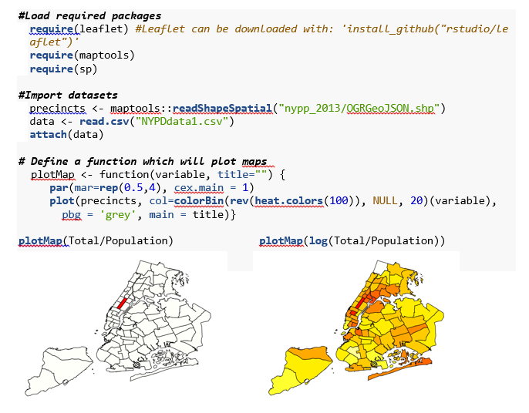
NYPD Stops and Arrests: R Markdown

Slide 20
Faculty Discrimination Project
  In 2009, Adelphi University paid $309,889 to 37 claimants in order to settle a pay discrimination lawsuit.
  Your dean saw this report and has asked you to serve as a statistical consultant. You will evaluate salaries on your campus and submit a three page report to your dean (including appropriate graphics).
“According to the EEOC's lawsuit, a class of female full-time professors was paid less than male professors of the same or lesser rank teaching within the same school…

Slide 21
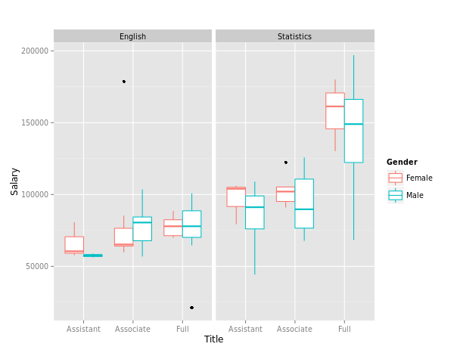
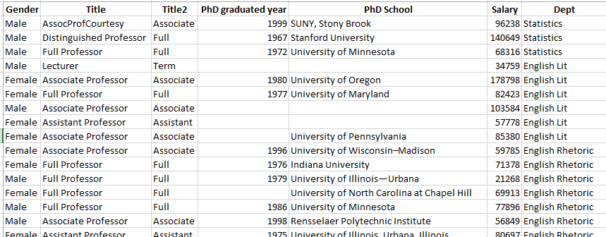
Faculty Discrimination Study
“How can such a simple dataset be so confusing?”

Slide 22
Faculty Discrimination Study
Practicing statisticians often complain that clients bring them pre-collected data and ask the statistician to analyze it without any input on how the data was collected.
To call in the statistician after the experiment is done may be no more than asking him to perform a post-mortem examination: he may be able to say what the experiment died of.
-Ronald Fisher
When we provide only clean, textbook type problems to students, we are inadvertently training our students that statisticians only work with clean data that regularly meet model assumptions and (for introductory classes) involve no more than two to three variables.

Slide 23
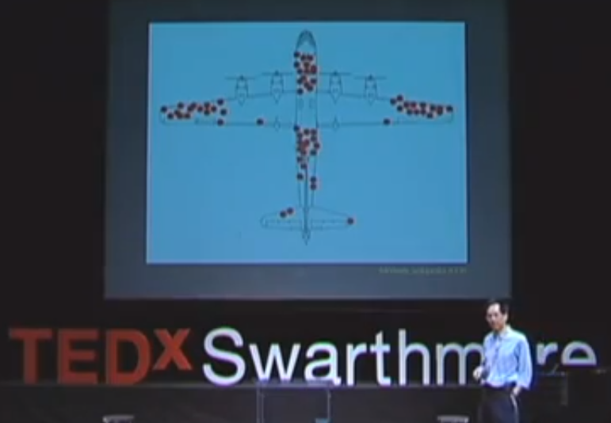
Faculty Discrimination Study
Steve Wang - 180 Degrees

Slide 24
Faculty Discrimination Study
After watching the video (or reading a paper), answer the following questions on blackboard.
What were the main points of the presentation/paper?
How does the presentation relate to our class?
Why is this an important topic in today’s society?

Slide 25
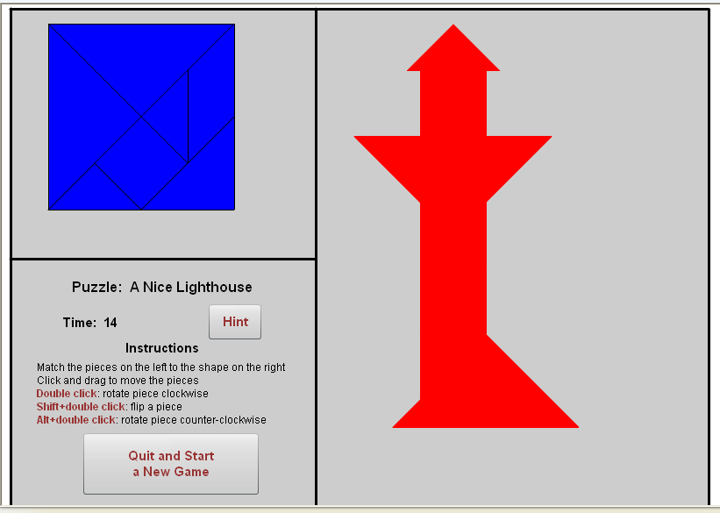
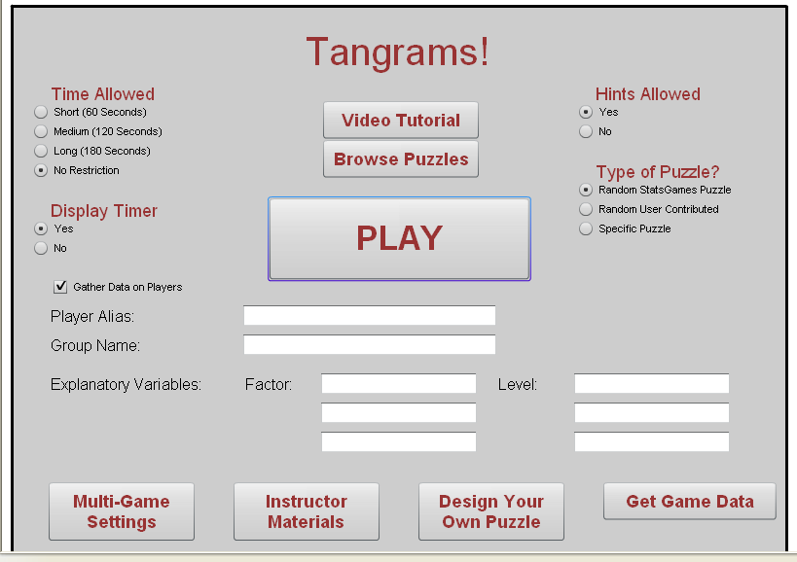
Tangrams
A typical on-line game, but collects data and allows for various experimental designs.

Slide 26
Tangrams
Students can choose from over 20 puzzle designs and can select their own explanatory variables, such as gender, major, or age.
Students may ask variety of questions:
What influences completion time in spatial reasoning tasks?
Does completion time depend on distractors (e.g. type of music played in the background)
Are males or females more likely to “ask for help”

Slide 27
Tangrams:
The class decides upon research questions they want to investigate as a group
Is the average completion time less than 100 seconds?
They design the experiment by determining appropriate game settings and conditions for collecting the data.
After the student researchers design the experiment, they become subjects in the study by playing the game.
The website automatically collects a large number of player variables (e.g. did they use hints, number of clicks, etc…)
After class, small groups analyze the group data and present their results the next day.

Slide 28
Tangrams: Simulating a Case Study or Research Project
Students results vary dramatically – even though they are all using the same dataset!
LOOK at the data
Data is “local” so students can relate to the numerous errors in the data.
Some students play the game more than once, play the wrong puzzle, or choose to use hints to complete the game more quickly.
Data tends to be highly skewed
Is there one “right” dataset to use?

Slide 29

Tangrams
KEY Lesson: How to handle data that is missing, questionable or which leads to issues with assumptions within the statistical model?
http://www.cbsnews.com/news/deception-at-duke-fraud-in-cancer-care/

Slide 30
Tangrams
After watching the video, answer the following questions on blackboard.
What were the main points of the presentation/paper?
How does the presentation relate to our class?
Why is this an important topic in today’s society?
How dependable is a p-value if there are problems with the data collection or cleaning?
Should researchers be required to carefully document how they manage and manipulate their data?

Slide 31
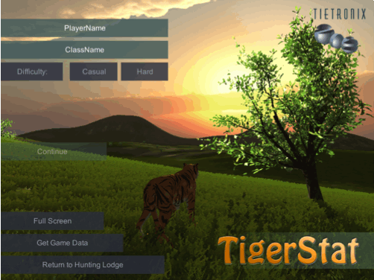
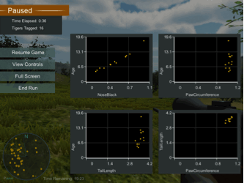
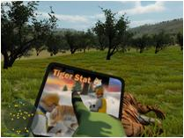
TigerSTAT
Provides an engaging way to practice simple linear regression (or multivariate modeling with transformations) applied to a real problem. Students can read and discuss the research article (Whitman et al. 2004).
In the TigerSTAT game, students collect data on tigers within a reserve that will help them develop a model to predict a tiger’s age.
Whitman, K., Starfield, A. M., Quadling, H. S., and Packer, C. (2004), “Sustainable Trophy Hunting of African Lions,” Nature, 428, 175-178.

Slide 32
TigerSTAT
Each student (or possibly student teams) collects their own sample of tigers.
Each obtains a different slope in their linear regression model
Hypothesis test results also vary
Are p-values a reliable measure of significance?
  If we repeat the study, shouldn’t we expect the p-values to be consistent?
  How much should we expect a p-value to change?
  What does a p-value really tell us?

Slide 33
Student Feedback
Simple activities can dramatically change how students perceive the role of statistics in their world.
“It is so nice to actually work with real datasets for a change.”
“This isn’t a statistics problem, it’s a business question.”
“What does this activity have to do with statistics?”
“You gave us questions to answer before you taught us how to solve them”
“She didn’t teach me anything, I had to figure everything out by myself!”
TELL STUDENTS YOUR GOALS!!!
Determine the appropriate next steps to solve the problem.
Bridge the gap from smaller, focused textbook problems to larger real-world questions and projects.

Slide 34
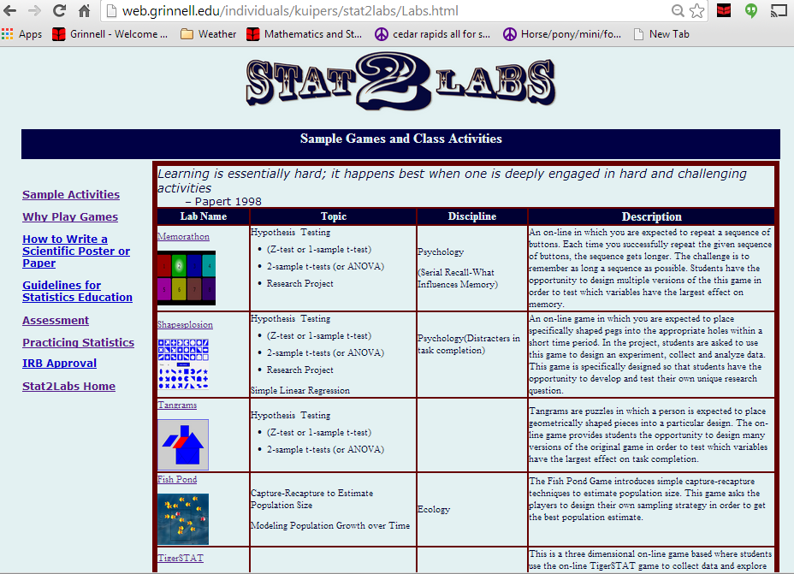

Slide 35
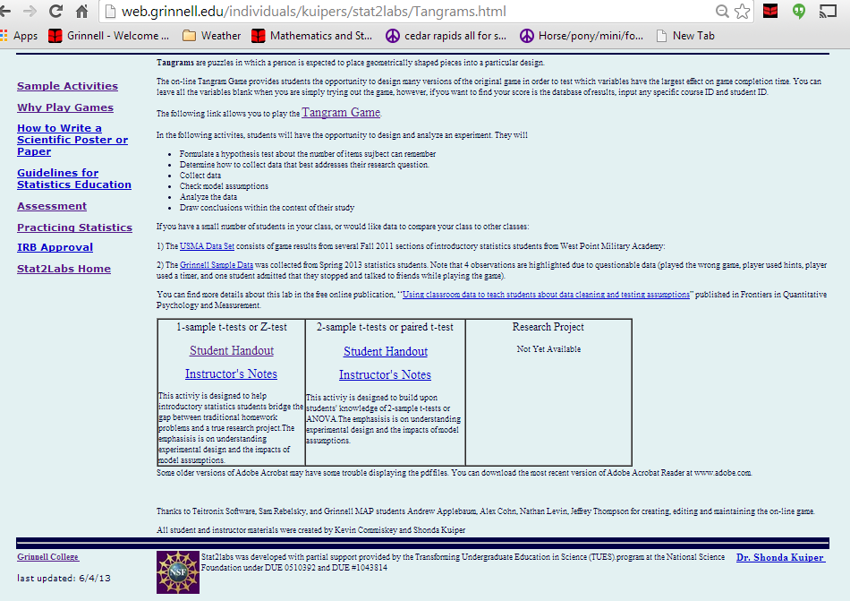
On-line game
Sample datasets
Additional
resources
Multiple Labs for
intro or advanced
courses

Slide 36
Goals of Stat2Labs
Individualized questions (research-like experiences)
When students have input into the research process and the outcome is not known a priori to either the students or the instructors, the study becomes real to the students in very new ways¹
They take action based upon those decisions, and defend their decisions against their peers
These elements likely contribute to a student's sense of responsibility and the importance of his or her contribution to a broader picture²
  Learning gains similar in kind and degree to gains reported by students in dedicated summer research programs¹”
1) Lopatto, D., Undergraduate Research as a High-Impact Student Experience, Association of American Colleges and Universities, Spring 2010, Vol. 12, No. 2, http://www.aacu.org/peerreview/pr-sp10/pr-sp10_Lopatto.cfm
2) Cynthia A. Wei and Terry Woodin Undergraduate Research Experiences in Biology: Alternatives to the Apprenticeship Model, CBE Life Sci Educ, Vol. 10, 123–131, Summer 2011

Slide 37
Goals of Stat2Labs
Create labs and activities that address modern data analysis, without dramatically increasing faculty workload
Students play the role of a consultant or researcher. They are involved in the entire process of statistical analysis (collecting data, cleaning data, appropriate model building, assessment, and effectively communicating their results).
Challenge students to think carefully about data and the models they choose to build.
Active learning in a real context fosters a sense of engagement and encourages students to go deeper than the assignment requires
Learning is essentially hard; it happens best when one is deeply engaged in hard and challenging activities -Papert
Papert, Seymour (1998, June). Does easy do it? Children, games, and learning. Game Developer Magazine, p. 88.

Slide 38
Final Thoughts
  Consider what students find meaningful, interesting or relevant and connect it to a passion for statistics.
  Create situations that challenge students to investigate in order to answer their own questions
  Create space to imagine, practice, and struggle so they become invested in the solutions.

Slide 39
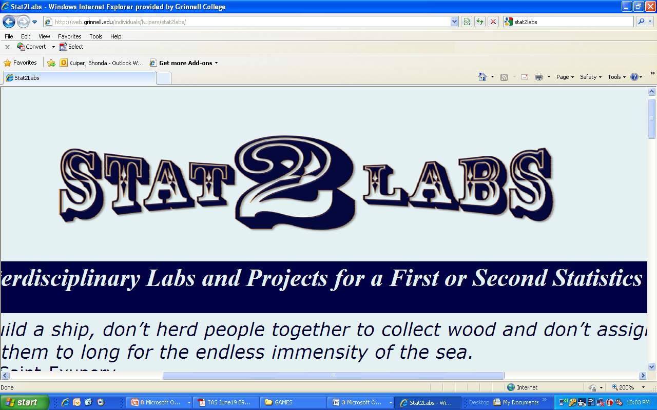
Making Statistics Relevant in a Data-Rich Society
Shonda Kuiper
Grinnell College
Summer Workshop: Making Decisions with Data
July 29 – July 31, 2105
NSF DUE#0510392 and DUE #1043814

