Slide 1
USCOTS 2015
What’s Right with Undergraduate Statistics?
John Holcomb
Cleveland State University

Slide 2
Active Learning
Performed a Metaanalysis of 225 studies
Active learning increases student performance in science, engineering, and mathematics
Freeman, S., et al., Proceedings of the National Academy of Sciences, 111(23), 8410-8415
Results consistent across disciplines

Slide 3
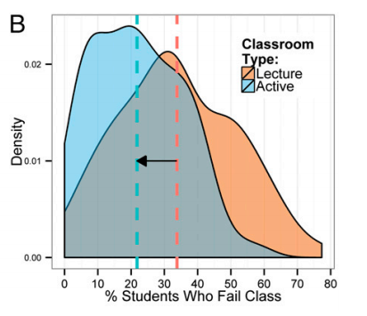

Slide 4
Good News!
The Statistics Education Community has been advocating and promoting active learning ideas for decades
  Journal of Statistics Education
  JSM sessions sponsored by the Section on Statistics Education
  USCOTS
  ICOTS

Slide 5
David Moore’s article The Craft of Teaching
  Remarks on receiving the MAA's 1994 Award for Distinguished College or University Teaching of Mathematics, San Francisco, California, January 1995.
  MAA Focus 15 (1995) Number2, 5-8

Slide 6
“At the present, teachers who keep learning about teaching ought to be thinking about
Active learning (alternatives to lectures)
Technology, especially multimedia
Total Quality Management”

Slide 7
National Conversation
Increasing pressure to raise graduation rates at community colleges and four-year universities;
Funding from the State of Ohio is now tied to student retention and graduation metrics
Mathematics requirements often viewed as the barrier to student success.

Slide 8
Good News!
Statistics is already viewed as the solution – not the problem.
College Algebra as a general education mathematics requirement is now vilified.
Even at the K-12 level, the idea that mathematics preparation should not be building exclusively toward calculus has gained a great deal of ground.

