Slide 1
What’s Right with Statistics Education?
Connections to Other Disciplines
John Gabrosek
Grand Valley State University

Slide 2
My Only Undergraduate Statistics Course in 1984
Without using your calculator find the standard deviation of these 6 numbers. Show all steps.
1,3,6,7,9,10

Slide 3
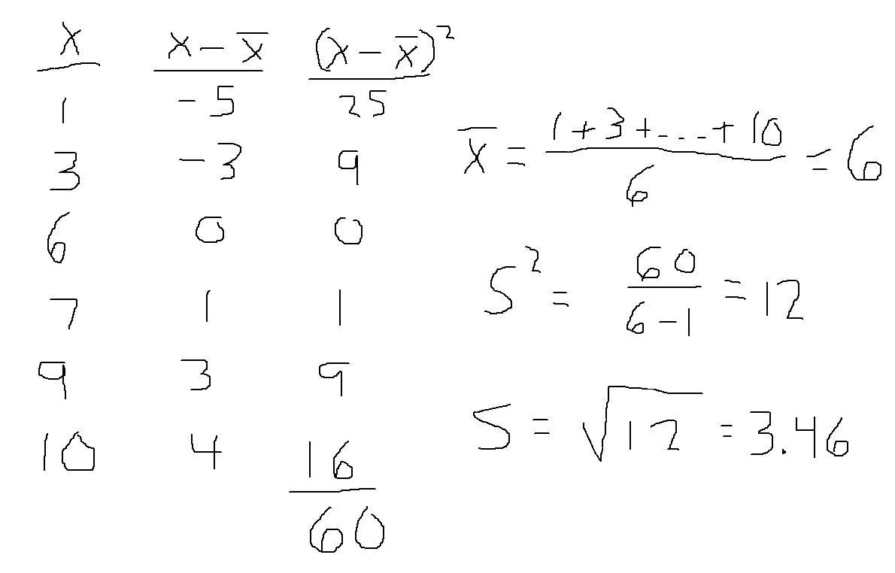
My Solution!

Slide 4
We don’t do this anymore!
Or, do we?

Slide 5
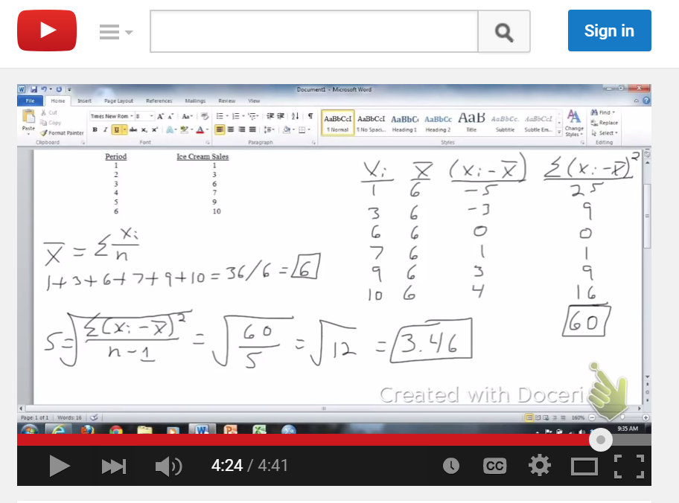

Slide 6
Calls are being made to Connect to Real Data from a Variety of Disciplines
GAISE Report Recommendation 2: Use real data.
It is important to use real data in teaching statistics, for reasons of authenticity, for considering issues related to how and why the data were produced or collected, and to relate the analysis to the problem context.

Slide 7
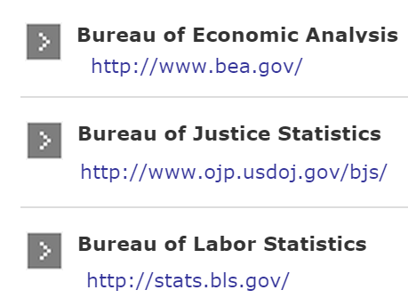
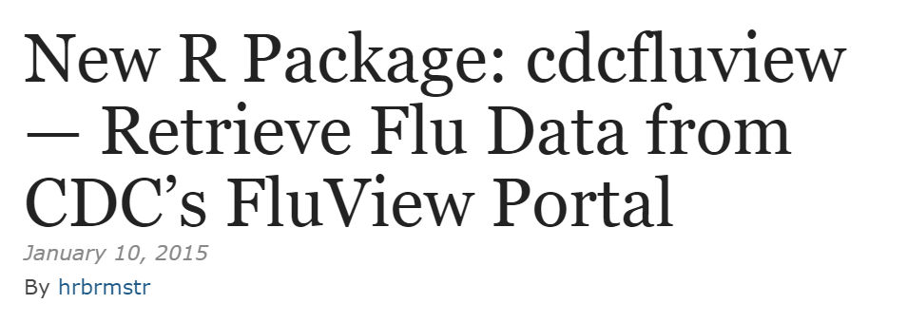
And It’s Working!
Journals
Modelling Raindrop Size, Roger W. Johnson Donna V. Kliche, Paul L. Smith, Journal of Statistics Education, 2015, Issue 1.
Data Repositories
CAUSEweb
R packages
CDC flu Data
Textbooks

Slide 8
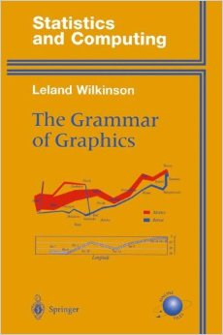
We are Connecting to Ideas from other Disciplines
Physics
Applied Linguistics
Computer Science

Slide 9
