Slide 1
My Vision for Stat 101
Professor Jessica Utts
Department of Statistics
University of California, Irvine

Slide 2
Where I agree
With Dick – we want them to think statistics is:
Relevant
Cool
Powerful for solving problems
Intuitive?? Good luck; see Kahneman’s best-selling book, Thinking, Fast and Slow
With George:
Importance of context
Centrality of teaching the scientific (or other) process

Slide 3
The intro course should connect to…
Daily Life!

Slide 4
Context for my “ideal” course: 3 possible futures for students
Consumers (everyone!)
Professional users such as:
Physicians, who must communicate risk and other health information to patients
Financial planners, who need to understand variability (in markets and income/expenses)
Business/industry people, who need to understand statistical results presented to them
Politicians (if only they cared…)
Producers – research scientists and others

Slide 5
My Ideal, and Why
The intro course should be taught for the consumers, and cover (almost) no methodology
Why?
Most people will take only one statistics course
They need to understand, not do!
Everyone is a consumer
Professional users should get more training in interpretation for their specific discipline
Producers should take lots more courses
No one should “do” statistics after a single course

Slide 6
Example 1: Types of Errors
Thinking about type 1 and 2 errors is useful for decision-making, even without quantitative data
Example:
Came home to find my dog-sitter in a panic because a chocolate bar had disappeared. Did the dog eat it? What to do?

Slide 7
Truth and Decisions
Truth | Evidence not convincing | Evidence convincing
Did not eat chocolate | Don’t go to vet, no problem | Go to vet, pay big bill, stress out the dog needlessly
Did eat chocolate | Probably have a dead dog | Poor Zoe gets her stomach pumped but lives, I get a vet bill
TYPE 1 ERROR
TYPE 2 ERROR

Slide 8
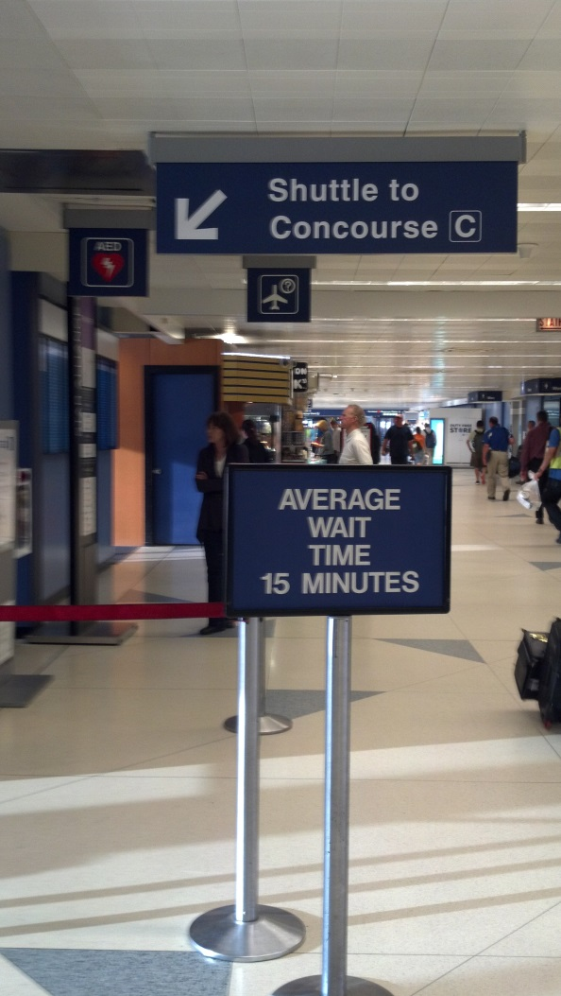
Example 2: Average is not enough!
Fly into Chicago Terminal 2, Concourse E
Need to get to Concourse C, flight leaves in 35 minutes
There is a shuttle! But sign says “Average wait time is 15 minutes.”
What’s missing with this information??
How about maximum wait time?

Slide 9
And finally… a challenge
No matter what else you teach them, make sure everyone leaves your intro course understanding at least 3 scenarios from daily life for which they can use statistical ideas, and ideally lots more!

