Slide 1
Intro Stats in the 21st Century
Dick De Veaux
Williams College
USCOTS 15
May 28, 2015

Slide 2
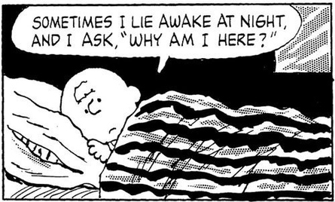
What Keeps me up at Night
Data Scientists teaching our course
Students think that Statistics is irrelevant for their lives and work
Students think that Statistics is essentially univariate
We continue to change the course around the edges
  With Resampling the exception

Slide 3
The Problem
We teach the wrong stuff
We teach it the wrong way
We teach it in the wrong order
I don’t have any answers – but I’ll keep asking the questions
5/28/15

Slide 4
What do I want them to take AWAY?
The Idea that Statistics is
  Relevant
  Intutive
  Cool
  A Powerful Method for Solving Problems in the World
Armed with a Healthy (and Informed) Skepticism for
  Data Quality
  Models
  Inference and Conclusions
5/28/15

Slide 5
How to get to the cool stuff?
Start with it
Introduce models early
  Motivate univariate questions from more complex models
  Socratic method
What to leave out
  Mathematics of Sampling distributions
    We just need the concept
  Getting too under the hood with methods
  They don’t need to “produce” everything – especially in the first course
5/28/15

Slide 6
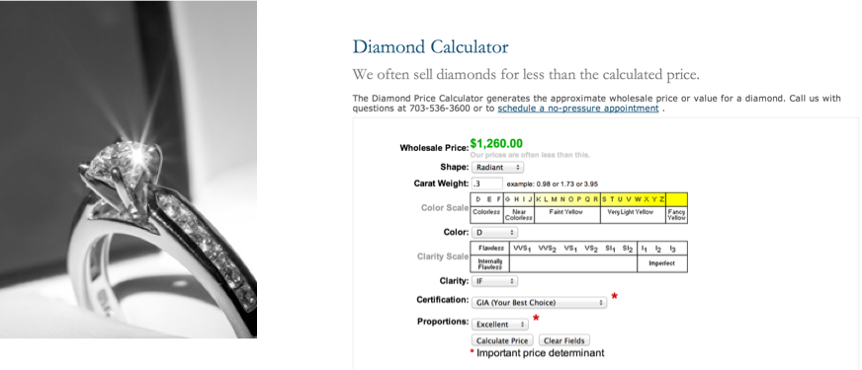
Diamonds
Four C’s:
  Carat, Color, Cut, Clarity
5/28/15

Slide 7
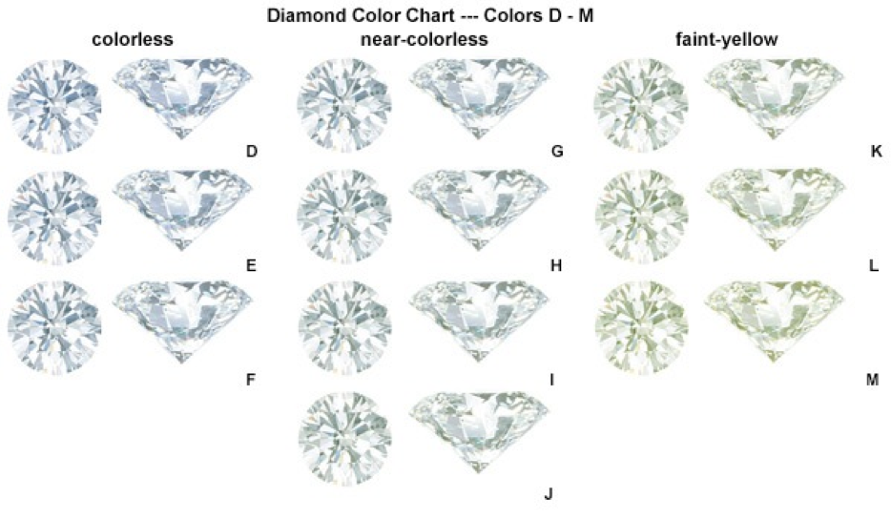
Color

Slide 8
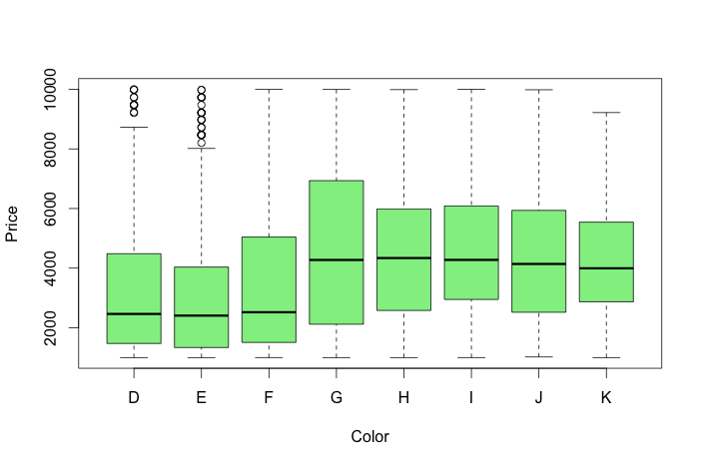
Price by Color

Slide 9
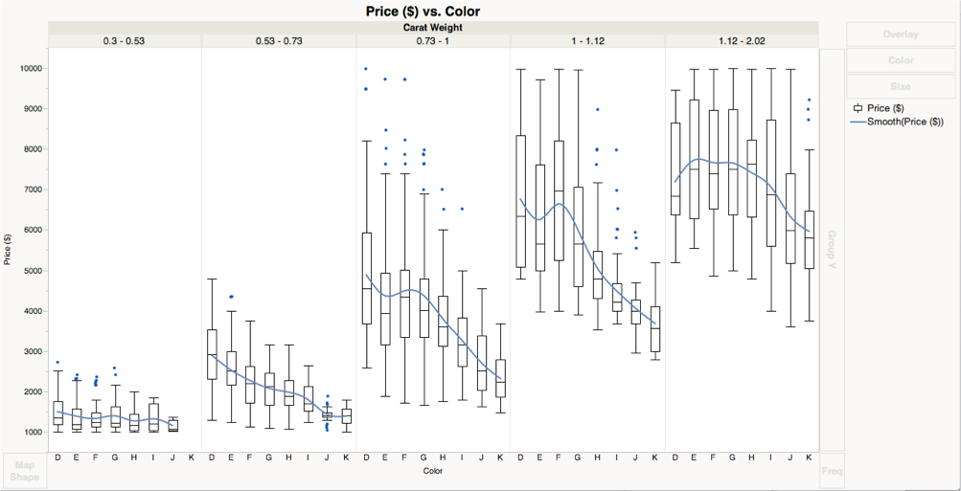
Here’s Why

Slide 10
How much is a fireplace worth?
The Data
  1729 randomly selected homes from the county records of Saratoga New York about 2005.
  Conclusions are only about the Northeast…

Slide 11
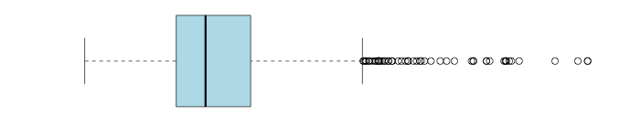
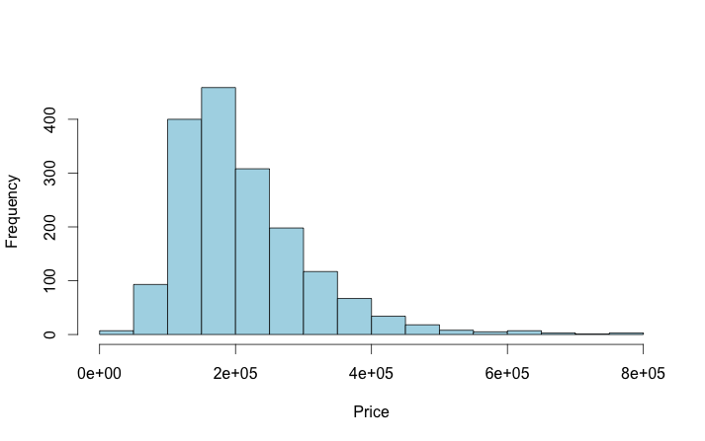
Starting Univariate

Slide 12
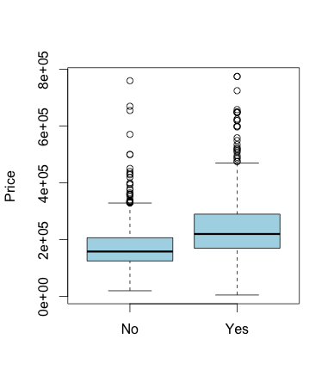
Price by Fireplace?
No 740 $174,653
Yes 988 $239,914
Difference $65,620

Slide 13
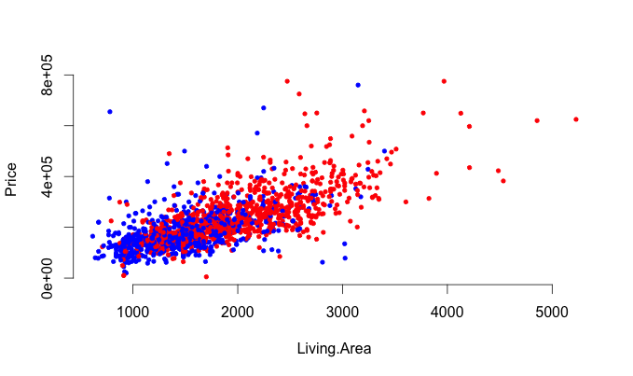
Wait a minute

Slide 14
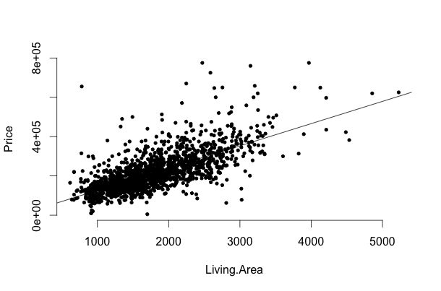
Relationship with size

Slide 15
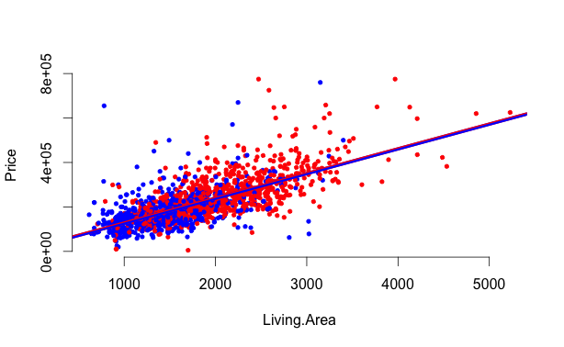
What if we fit two lines?
Difference now is $5567

Slide 16

What if we let them go?

Slide 17
The titanic
Survivors Non-Survivors

Slide 18
Why not?
You’ve cracked the resampling egg,
why not enjoy the omelette?

Slide 19
Where are we?
Introduce models early
  Motivate univariate questions from more complex models
  Not the other way around!
Use complex questions and models to drive topics
Statistics is more than a collection of tools
  Which ones are really important?
How much should we ask them to “produce”?

