Slide 1
What's Right with
Undergraduate Statistics
Christopher Malone
cmalone@winona.edu

Slide 2
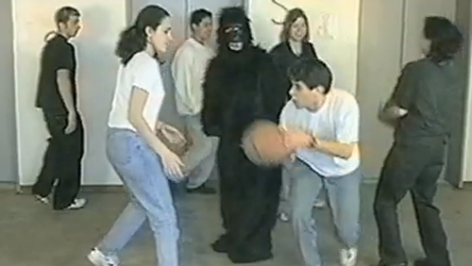
PERCEPTION
2005

Slide 3
PERCEPTION

Slide 4
PERCEPTION

Slide 5
PERCEPTION

Slide 6
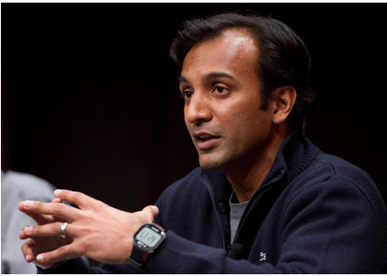
PERCEPTION

Slide 7
PERCEPTION
min_{degree}(Statistician) ≡ Master’s Degree

Slide 8
PERCEPTION
min_{degree}(Statistician) ≡ Master’s Degree
Bachelor’s Degree

Slide 9
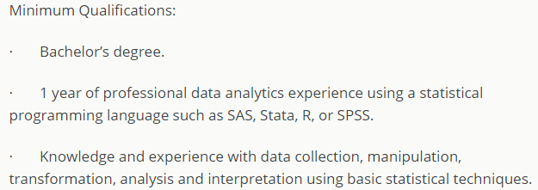
PERCEPTION

Slide 10
PERCEPTION

Slide 11
PERCEPTION

Slide 12
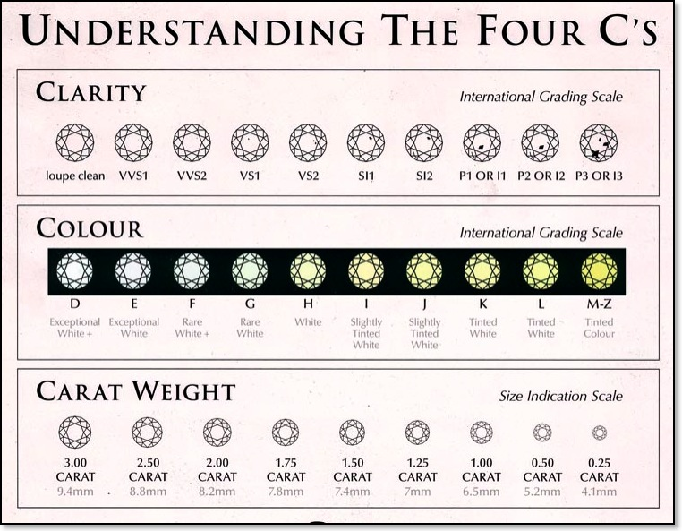
PARTING THOUGHTS

Slide 13
PARTING THOUGHTS
Creative
Confidence
Connections
Computing
Courage
5

Slide 14
PARTING THOUGHTS
Creative
Confidence
Connections
Computing
Courage

