Slide 1
What’s Right with
Undergraduate Statistics?
Amy G. Froelich
Department of Statistics
Iowa State University
USCOTS 2015

Slide 2
What has changed in the last 10 years in undergraduate statistics?

Slide 3
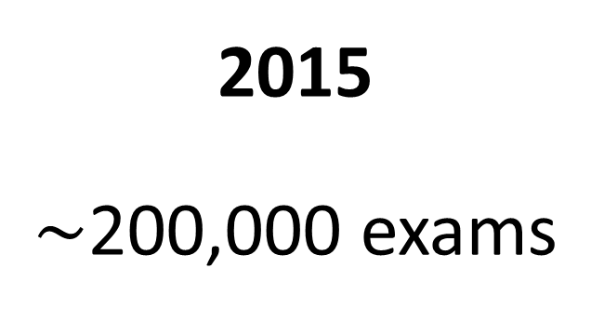
AP Statistics
2005
76,786 exams
2015
$\sim$200,000 exams

Slide 4
Enrollment in Introductory Statistics at Iowa State University
2005
3081 students
2015 - 1
4279 students

Slide 5
Number of B.S. Degrees in Statistics in USA*
2005 - 2
637 degrees
2015 - 2
1,656 degrees
*Source: Curriculum Guidelines for Undergraduate Programs in Statistics Science, American Statistical Association, Undergraduate Guidelines Workshop

Slide 6
Undergraduate Statistics Majors at Iowa State University
2005
34 majors
“Let’s cut the major.”
2015
93 majors
“Work with CS to develop new data science major.”

Slide 7
What’s the connection?

Slide 8

An Explosion of Students

Slide 9
What else has changed
in the last 10 years?

Slide 10




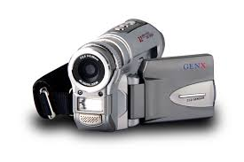
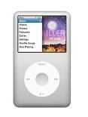
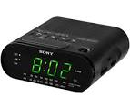
Technology
2005
2015

Slide 11
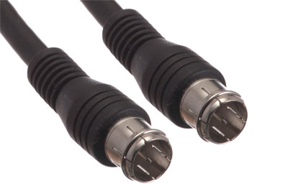


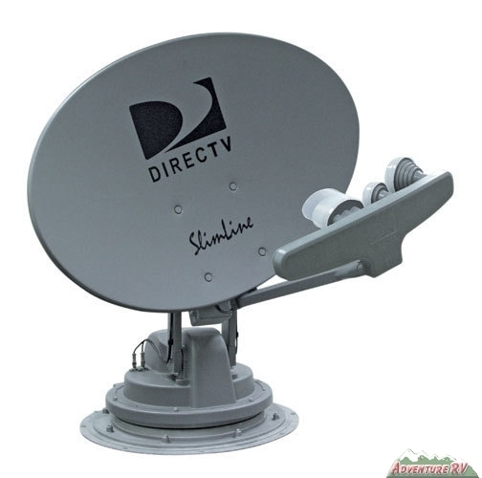


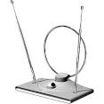

Television
2005
2015

Slide 12










Social media
2005
2015
What’s social media?

Slide 13
What’s the connection?

Slide 14
An Explosion of Data

Slide 15
“The increasing volume and detail of information captured by enterprises, the rise of multimedia, social media, and the Internet of Things will fuel exponential growth in data for the foreseeable future.”*
*Source: McKinsey Global Institute, Big Data: The next frontier for innovation, competition, and productivity, May 2011.

Slide 16
“By 2018, the United States alone could face a shortage of
140,000 to 190,000 people with deep analytical skills.”*
*Source: McKinsey Global Institute, Big Data: The next frontier for innovation, competition, and productivity, May 2011.

Slide 17
What’s Right with
Undergraduate Statistics?
Relevant
In Demand
Visible

