Slide 1
Energizing Higher Education for Statistics and Beyond:
T=(IE)²
Xiao-Li Meng
Department of Statistics
Harvard University

Slide 2
T=T-Shaped Education
Breadth in knowledge and skill sets
Basic General Education and interdisciplinary knowledge
Communication skills, both oral and writing
Personal skills: e.g., time management, dealing with stress and rejection
Social skills: e.g., team work skills, administrative skills
International experiences

Slide 3
T=T-Shaped Education
  Depth in expertise and scholarship
  Comprehensive domain knowledge
  Creative and critical thinking
  Connecting seemingly unrelated dots
  Understanding boundary and limitations
  ……

Slide 4
(IE)²= (Interdisciplinary Education) X (Intergenerational Education)
Interdisciplinary Education
Intergenerational Education

Slide 5
So how many Generations in the higher Education World?
Professor Emeriti
Senior Faculty
Junior Faculty
Ed Administrators, Managers, and Staff
Postdocs
Alumni, Parents, and Friends
Graduate Students
Undergraduates
High Schoolers
K-12 Students
Preschoolers

Slide 6
Intergenerational Education at Harvard
  Graduate Seminar for General Education (GSGE)
    Graduate Courses designed for developing Gen Ed courses
    Taken by both graduate students and undergraduate students
    An ideal way of integrating research and pedagogy
    A great venue for training team work skills
    A unique learning and re-education experience for faculty
  Graduate Seminar for Undergraduate Education (GSUE)
    Extend GSGE for designing any undergraduate courses

Slide 7
STAT305: Statistical Fallacies and
Paradoxes: A Cartoon Guide
Simpson Paradox/Ecological Fallacy
Bayes’ Theorem/False Positive
Paradox;
Prosecutor’s Fallacy
Regression Fallacy
Monty Hall Paradox

Slide 8
Simpson’s Paradox
So what did the students produce?

Slide 9
Kidney Stone Treatment
C. R. Charig, D. R. Webb, S. R. Payne, O. E. Wickham (March 1986)
Br Med J (Clin Res Ed) 292 (6524): 879–882.
Treatment A | Treatment B
78% (273/350) | 83% (289/350)
 | Treatment A | Treatment B
Small Stone | 93% (81/87) | 87% (234/270)
Large Stone | 73% (192/263) | 69% (55/80)
A: Open Surgery; B: Percutaneous Nephrolithotomy
2013/5/18
9
Notes:
9

Slide 10
Trivial Mathematics
It is possible for
BUT
2013/5/18
10
Notes:
10

Slide 11
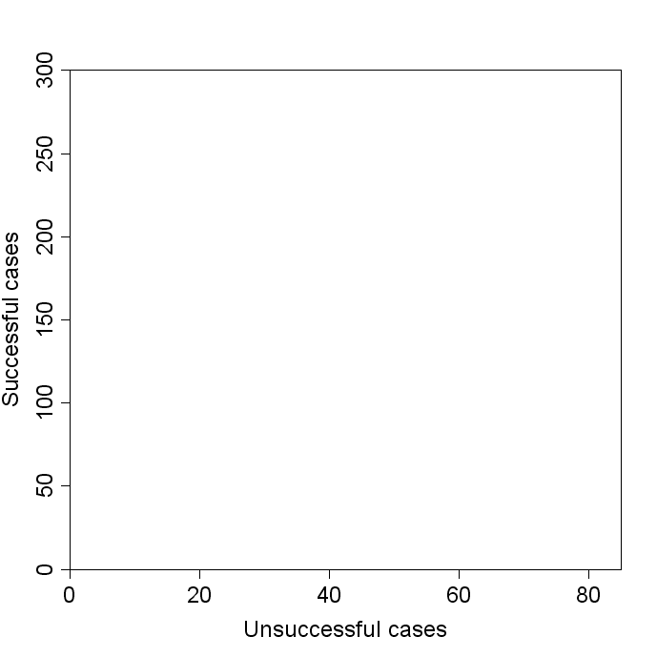
2013/5/18
11

Slide 12
Slope = # successful / # unsuccessful = odds
Small Stones | Treatment A | Treatment B
Successful | 81 (93%) | 234 (87%)
Unsuccessful | 6 | 36
2013/5/18
12

Slide 13
Slope = # successful / # unsuccessful = odds
Large Stones | Treatment A | Treatment B
Successful | 192 (73%) | 55 (69%)
Unsuccessful | 71 | 25
2013/5/18
13

Slide 14
Combined | Treatment A | Treatment B
Successful | 81+192=273 | 289
Unsuccessful | 6+71=77 | 61
2013/5/18
14

Slide 15
Combined | Treatment A | Treatment B
Successful | 273 | 234+55=289
Unsuccessful | 77 | 36+25=61
2013/5/18
15

Slide 16
Combined | Treatment A | Treatment B
Successful | 273 (78%) | 289 (83%)
Unsuccessful | 77 | 61
2013/5/18
16

Slide 17
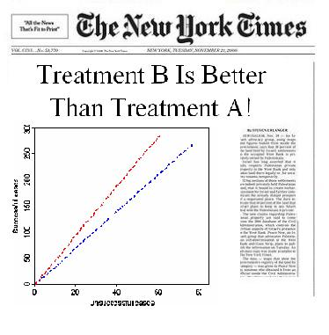
2013/5/18
17

Slide 18
Treatment A
73% successful
93%
78%
Large Stones
Small Stones
Overall
Successful
Unsuccessful
Treatment B
69% successful
87%
83%
Large Stones
Small Stones
Overall
Uneven distribution of stone sizes across treatments makes overall success rate misleading.

Slide 19
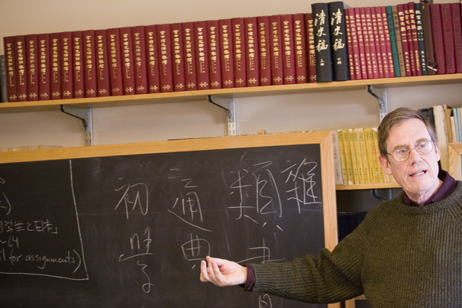
An Example from THE Humanities

Slide 20
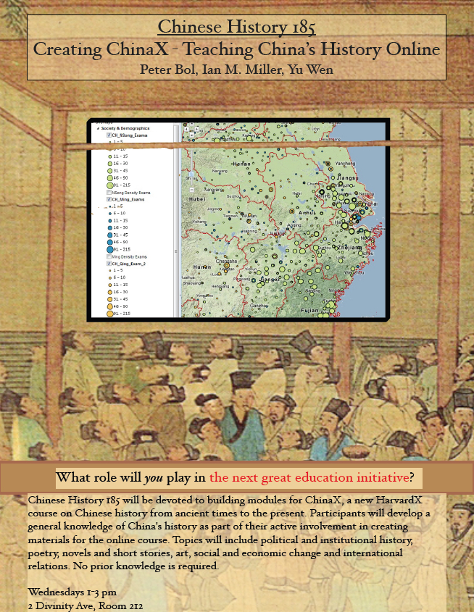
Creating ChinaX- Spring 2013
Peter Bol, YU Wen, Ian Miller, REN Wei

Slide 21
EdX-HarvardX-ChinaX
http://isites.harvard.edu/icb/icb.do?keyword=k91981&pageid=icb.page573633
Click the link above to hear about what a HarvardX course is.

Slide 22
What is a HarvardX Course? http://cm.dce.harvard.edu/2012/01/13785/L04/index_H264SingleHighBandwidth-16x9.shtml
(above link leads to a video that shows how we taught Chinese History in the past.)

Slide 23
What is involved in creating ChinaX?
Graduate students taking the class both to contribute from their areas of expertise and/or to learn how to create such courses
Undergraduates who want to learn about China and/or technology of learning, and provide feedback
Graduate student TFs to help manage instruction in technology (A/V editing, map making, photoshopping), to find content, and to oversee organization

Slide 24
Professional Development Curriculum
STAT 303: The Art and Practice of Teaching Statistics
  Always involve 4 generations (undergraduates, graduates, junior and senior faculty), plus Bok Teaching Center staff
STAT 366: Research Cultivation and Culmination
  Emphasize how to develop an idea into a successful publication
  How to deal with negative feedback and rejection
  Attended by both graduate students and advanced undergraduate students
  Producing world’s first “Polystat” paper by “Students”

Slide 25
StaT366: producing a Polystat paper
The class is given a topic: optimal strategy for enhanced security check at airports
… and a task: finish a research paper by the end of the semester
Key emphasis: How to develop an idea into a successful publication

Slide 26
How WAS the course structured?
Form (time varying) groups for
  Literature Review
  Theoretical concepts and results
  Methodology development
  Simulation studies
  Applications
In-class Discussions and Presentations
Comment and critique each others’ writing

Slide 27
Writing, commenting and editing abstracts
We discussed possible titles, and agreed on a couple of them
Then each student was asked to write, independently, an abstract
All abstracts were then presented to the class, and commented upon and ranked
One abstract was discussed in detail and went through a “live editing”

Slide 28
Examples of the actual Abstracts
Detecting rare events is a common problem in the world. For instance, TSA screens for possible terrorists at the airport, the IRS audits tax filings for possible fraud, and gamblers want to pick upsets in the NCAA tournament. Failing to detect an event will have massive repercussions, but the screening method must also be feasible. We propose several probabilistic screening methods that correspond to minimizing different risk functions. The risk functions are motivated through interpretable quantities such as the number of undetected events or the probability of failing to detect one event. We relate our results to previous work and give examples of applications.
Notes:
Dave Watson’s, a short one.
No title provided.

Slide 29
Affordable screening when you Can’t afford to miss (Application-Focused)
From malfeasor detection, to breast cancer diagnosis, and even prediction of upsets in basketball games, screening techniques are crucial for identification of important events. Screening strategies that minimize the probability of missed detection, under a constraint on the expected number of screenings one can perform, exist for the case of one malfeasor with perfect screening and multiple sequential searches. Little attention, however, has been paid to more realistic scenarios, particularly detection of multiple malfeasors with imperfect screening. We explore these cases using a new risk function, and derive optimal screening procedures under this constraint by a novel and intuitive application of the water filling algorithm. Our investigations into prediction of upsets in the NCAA basketball tournament, and breast cancer screenings, illustrate the potential utility of our approach. Ultimately, new questions are raised for the application of these new screening strategies under complicated dependencies between malfeasance and screening probabilities.
Notes:
Arman Sabbaghi, application-focused.

Slide 30
Affordable screening when you Can’t afford to miss (Optimization-Focused)
Probabilistic screening is extremely powerful and practical in statistical decision theory. In this article we propose a general method with application of KKT conditions to get optimal probabilistic screening procedures. KKT approach provides an effective tool for solving convex optimization problems and is widely used in statistics and many other scientific areas. The real cases we focus in this paper have extremely high cost of Type II error and application of KKT conditions guarantees the finding of the optimal solutions. Real life examples of this kind include terrorist screening in airport setting, tax fraud auditing, decision of death penalty, and etc. We study both finite sample and asymptotic properties of the optimal strategies under various loss functions. We then interpret the optimal strategy with connection to both water filling algorithm and its dual problems. By simulation studies, we demonstrate the effectiveness of our optimal strategy comparing with other few conventional strategies. We further apply the strategy on real datasets, including basketball match upset prediction, terrorist detect, and cancer screening, and obtain promising results.
Notes:
Yang Li, KKT and optimization focus.

Slide 31
Affordable screening when you Can’t afford to miss (Conversational tone)
How do you catch a terrorist when resources are limited? In the presence of perfect knowledge, the answer is simply logistical, but in realistic cases where resources are limited, and the best available information about each potential terrorist is simply a degree of suspicion, the appropriate strategy to employ is not immediately obvious. Indeed, it is not even clear how the goal should be defined.
We treat one special case of the problem – the case of selecting airline passengers for enhanced screening – and consider several reasonable objectives that one may attempt to optimize when designing a selection strategy. Notably, these objectives are not all equivalent and their solutions grant insight into the tradeoffs inherent in each.
While homeland security was our original motivation, our formulation of the problem is more general. The definitions of our objective functions are tied to the statistical literature on multiple testing; the solutions to our optimization problems are related to the classical water-filling problem in convex optimization; and the applications of this framework extend into fields as diverse as medical screening and sports betting.
Notes:
Alex D’Amour, conversational tone

Slide 32
Efficient probabilistic screening when you Can’t afford to miss
Screening for rare phenomena is a central problem in statistical design and decision theory. In the standard statistical setting, false positives are assumed to be far more costly than false negatives, leading to a broad range of multiple testing procedures. However, how should we screen when false negatives are the dominant cost? Inspired by the problem of detecting rare malfeasors, we present a set of optimal strategies for probabilistic screening under expected cost constraints. These strategies are built on a set of realistic loss functions reflecting different threat profiles. We show that some optimal strategies reduce to water-filling designs, establishing a bridge between this problem and the signal processing literature. We demonstrate the effectiveness of these strategies on real and simulated data, focusing on the settings of cancer screening, upset prediction in basketball, and terrorist detection.
Notes:
Alex Blocker’s, just right ☺

Slide 33
integrated postdocs
College Fellows
HarvardX Fellows
HILT (Harvard Initiative on Learning an Teaching) Fellows
Curriculum Fellows
Statisticians are in high demand for such research and pedagogically integrated fellowships

Slide 34
More Examples of T-shaped Education
Stanford’s new 1 year STEP program to help PhDs in humanities teach K-12
Cornell’s Teaching and Learning program
http://phystec.physics.cornell.edu/seminar
Brown’s BEST (Brown Executive Scholar Training) program involves administrators and staff to train graduate students to become university administrators

Slide 35
Harvard Horizons
http://www.gsas.harvard.edu/harvardhorizons
https://www.dropbox.com/s/2z4izeravvbvoyu/Hansun_Rough_001.m4v

Slide 36
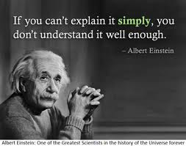
T=(IE)² requires as much energy as E=MC²

