Slide 1
Chris Wild
University of Auckland
New Zealand

Slide 2
“With only 5 mins …
Channelling …
there is no time for balance …
so I will be
unbalanced”
Chris Wild

Slide 3
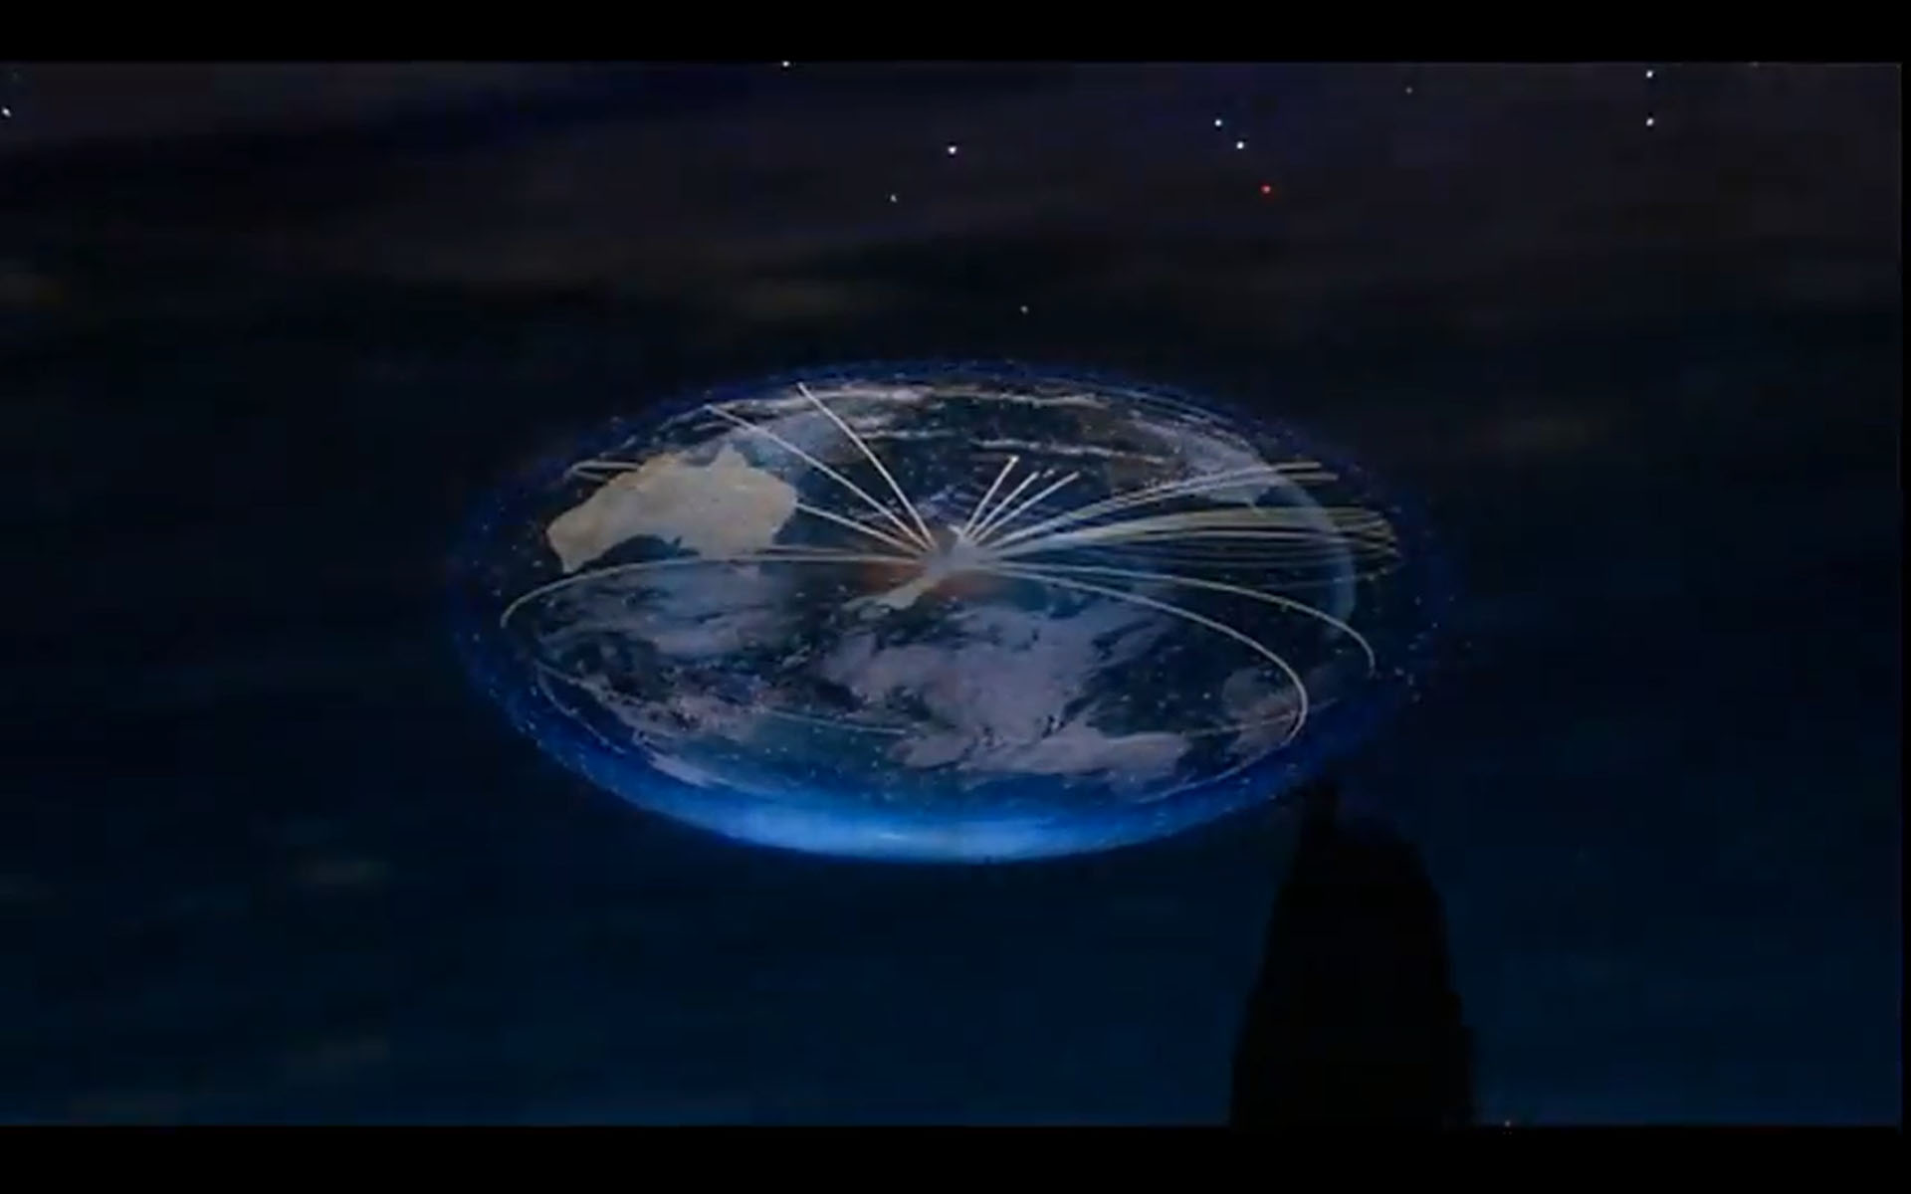
Changing Statistics
in New Zealand
Radically, across all school levels, nationwide

Slide 4
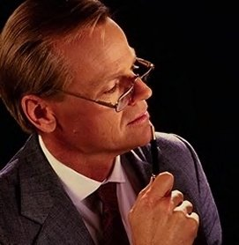
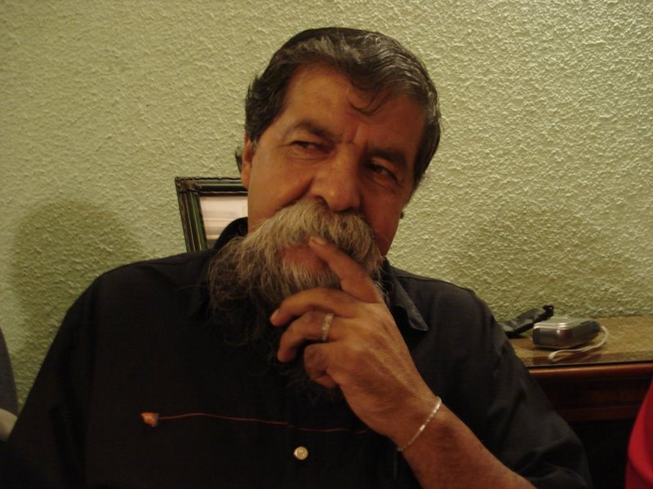
Changed Subject Name
What’s in a name?
“Mathematics & Statistics” !
“Mathematics”
Heaps !!!
18??
1950
2009
20??

Slide 5
Change-Drivers
The data world has changed
The data world has changed
and so should we

Slide 6
Change-Needs
Society’s people-needs
Society’s people-needs
Theory &
Software devel.
Advanced analysis & “design”
Simple forms of analysis & “design”
Literacy, critique and recognition of utility

Slide 7
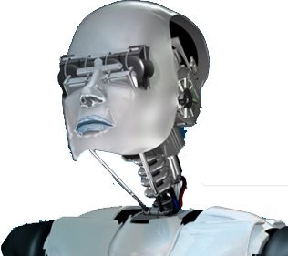
Change-Needs
What can machines do?
and what thinking is essentially human?
Education … should pay particular attention to the latter
What can machines do?
and what thinking is essentially human?
Education … should pay particular attention to the latter

Slide 8
Change-Vision
Real and Relevant
To create excitement about …
“what I can do with data …
and what data can do for me”
Real and Relevant
To create excitement about …
“what I can do with data …
and what data can do for me”

Slide 9
Change-Opportunities : jump on
Arrgghhh, what was that??
Just a passing opportunity ...
Don’t worry ...
there won’t be another for ages

Slide 10
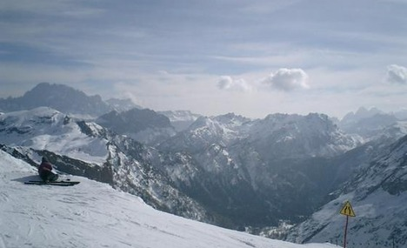
Change-Alternatives
Sliding
down
the slippery slope
into …
Irrelevance
o

Slide 11
Change involves risks
Teachers can learn
Anything is creaky at first
If wait for adequate formal education ...
It’ll be the next millennium
& the new learning will be outdated

Slide 12
Change-Needs
Debating values and priorities
Blank-slate thinking
Enabling technology
Research on students and teachers
Enabling pedagogy (incl new forms of assessment)
Evaluative research

Slide 13
Change-Needs
To have it all …
To have it all …
Debating values and priorities
Blank-slate thinking
Enabling technology
Research on students and teachers
Enabling pedagogy (incl new assessment)
Evaluative research
you have to do it all

Slide 14
Change-Realities
Systems change is political
Systems change is political
More about people than “science”

Slide 15
Change by Consensus
Build …
Build …
Group with all stakeholder sectors
Not all worked out beforehand
Group must own decisions
Not be “sold”
Notes:
professionals, academics, teachers, teacher educators and delevelopers, officials

Slide 16
Change-Alliances
Build …
Build …
Became trusted and relied on
by the major decision-owners
especially officials

Slide 17
Change Hearts and Minds
Then …
Then …
Change Hearts and Minds
… leading from a compelling vision

Slide 18
Change History
Change History
Change History
Have turned teachers’ lives upside down
Despite pressure of high-stakes assessments & league tables
Support & development inadequate
Resources inadequate
But it seems to be working
Most seem excited and stimulated by it

Slide 19
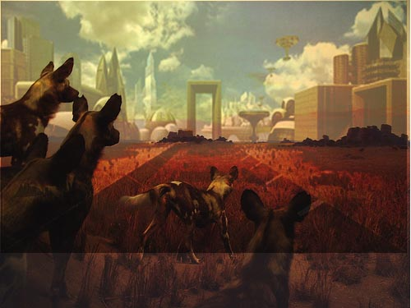
Thank you

Slide 20
Change diapers

Slide 21
Thank you

