Slide 1
Welcome to USCOTS ‘13: Making Change Happen
Allan J. Rossman
Program Chair
Cal Poly – San Luis Obispo

Slide 2
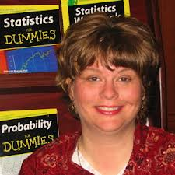
Thanks to Deb Rumsey!
Program Chair for USCOTS ‘05, ‘07, ‘09, ‘11

Slide 3
Conference themes
Notes:
Deb has excelled at coming up with excellent themes, organizing conference around themes

Slide 4
USCOTS vision
Bring together people who are curious and passionate about teaching statistics
Design conference to model good teaching in
Sessions
Social activities
Hallways
Notes:
Deb has also excelled at this; I hope this year’s conference lives up to the standard set

Slide 5
Making change at USCOTS
Igniting a Passion for Change in Teaching Statistics
Five-minute presentations
20 slides of 15 seconds each (auto-advance)

Slide 6
Did you notice?
This welcome presentation is in Ignite format
I’ve never attempted this before
I suspect that other presenters have not either
As I have prepared this presentation, I’ve had second, third, fourth, … thoughts about this whole idea!
But if I’m going to torture other presenters, I should also torture myself

Slide 7
THANKS to star-studded lineup
Bob delMas, Chris Wild
Christine Franklin, Dalene Stangl
Daniel Kaplan, Daren Starnes
Hollylynne Stohl Lee, Mary Parker
Nicholas Horton, Rob Gould
Robin Lock, Shonda Kuiper
Notes:
Preview of coming attractions

Slide 8
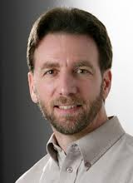
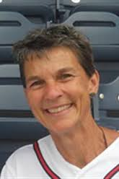
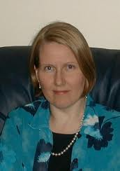
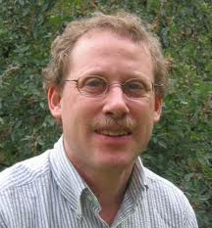
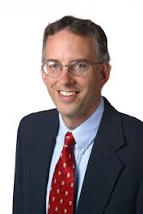
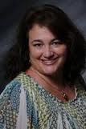
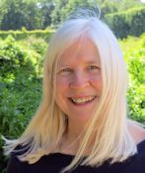
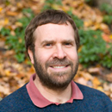
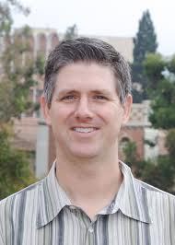
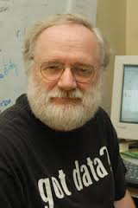
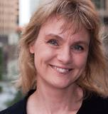
A change for me: use images, not text!

Slide 9
Did you notice?
Alphabetical order by first name
In my (Allan’s) humble opinion, a vastly underused and underappreciated sorting criterion!
These presenters are also presenting later in conference
Tonight a preview of coming attractions

Slide 10
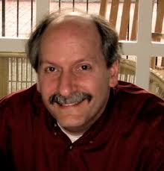
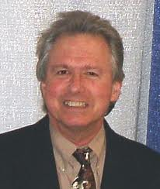
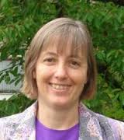
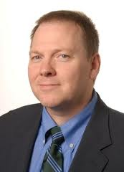
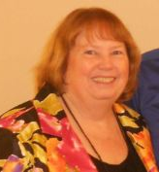
Closing session on Saturday afternoon

Slide 11
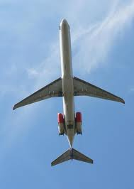
For those planning to leave early
CHANGE your plans!
If necessary, change your Saturday flight to enable you to stay for Closing Session
Call your airline right now
Really, I’ll wait …

Slide 12
Go ahead, really …
I can wait for 15 more seconds …

Slide 13
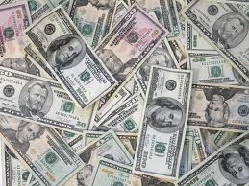
Worried about airline change fee?
If you find that Closing Session does not provide greater value than airline change fee
Then these six presenters will refund the difference out of their own pockets!

Slide 14
How hard is preparing something short?
“I have made this longer than usual because I have not had time to make it shorter.”
Blaise Pascal
“Not that the story need be long, but it will take a long while to make it short.”
Henry David Thoreau

Slide 15
How hard is preparing a short talk?
“If I am to speak ten minutes, I need a week for preparation;
If fifteen minutes, three days;
If half an hour, two days;
If an hour, I am ready now.”
Woodrow Wilson
Notes:
What would he have done with 5 minutes?

Slide 16
What have I asked of presenters?
Include CHANGE in title
How have you effected change?
How has change affected you?
Make your presentation
Personal
Inspiring
Fun
Notes:
Just showing off that I know how to spell these two words

Slide 17
An extremely tall order
Even without the time constraints!
I am really pushing presenters out of their comfort zones
Many have expressed their discomfort to me!

Slide 18
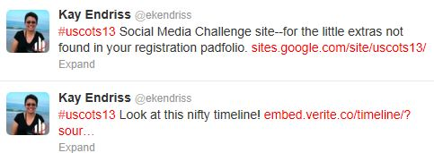
Social media challenge
Organized by Kay Endriss
Use hashtag #uscots13
Prizes!

Slide 19
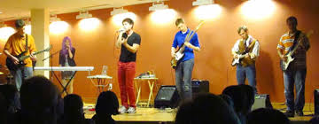
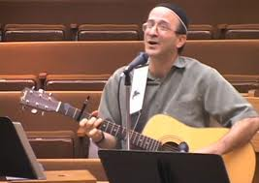
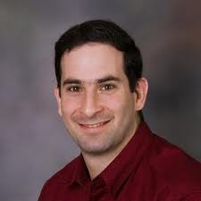
Musical/statistical entertainment
Later this evening: The Fifth Moment
Friday banquet: Larry Lesser, Michael Posner

Slide 20
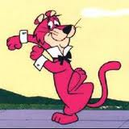
Did you notice?
I have not said a single word of substance about teaching statistics!
Rest assured that others will
I’m just the host for this event
Time for me to exit stage left!

