Slide 1
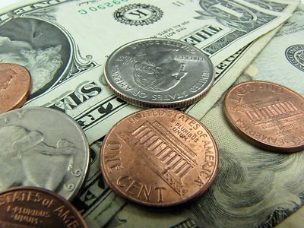
Making Change
Roxy Peck
Cal Poly, San Luis Obispo

Slide 2
Making Change Requires the Right Mindset!
Mindset Adjustments…

Slide 3

The Dishes…

Slide 4


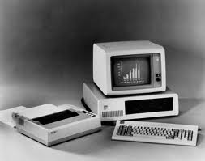

A New Mindset

Slide 5
Sometime Epiphanies Lead to a New Mindset…
A sudden insight into the reality or essential meaning of something.
Mindset changing epiphanies are often a motivation for change.

Slide 6

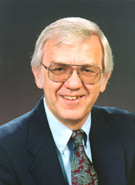

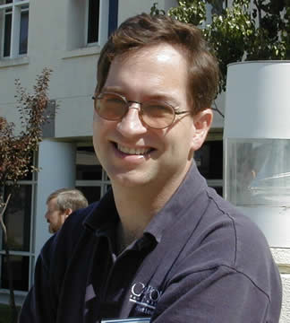
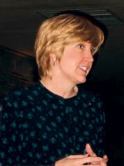
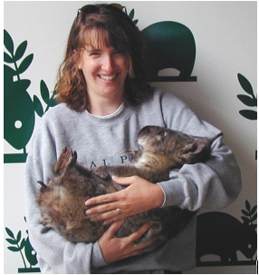
A 90’s Teaching Epiphany

Slide 7
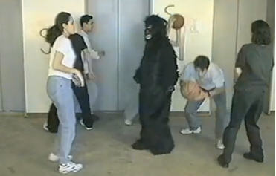
A More Recent Epiphany

Slide 8

A Mindset Adjustment
“Outing” things we keep hidden from students.

Slide 9
Mindsets
Pessimistic
naysayer, worrywart, cynic,
gloomy Gus, wet blanket
Life sucks, and nothing I do will make it better. ☹

Slide 10
Mindsets
Optimistic
romantic, idealist
Life is good, and it might even get better! ☺

Slide 11


Change is Easier if You Are an Optimist!

Slide 12

Speaking of Mindset…

Slide 13
Not a Productive Mindset in an Education Setting…
Definitely the product of
a pessimistic mindset!

Slide 14
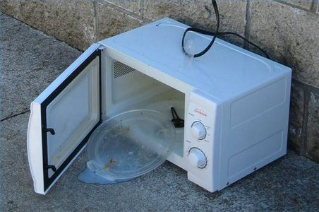
How Do You Know if Something is Broke?

Slide 15

Not So Easy with Education…

Slide 16
A Collective
Mindset Adjustment
In Education, there is no place for the “If it ain’t broke” mindset.
Replace with
If it is Absolutely Perfect, Leave it Alone.

Slide 17
Which got me thinking…
Airlines have a change fee to discourage making changes
(and they keep raising it).
Nobody likes the change fee!

Slide 18
“No Change” Fee
My new campaign:
As educators, I propose we should have a “NO change” fee!

Slide 19
In Summary…
My recommendations for making change happen
Be willing to adjust your mindset.
Be (or become) an optimist.
If you can’t be an optimist, at least replace “If it ain’t broke, don’t fix it” with “If it is absolutely perfect, leave it alone.”
Never risk the “no change” fee!

Slide 20
AND
Take the pledge:
I will never risk the
“NO CHANGE” fee!

