Slide 1
Radical Change in Small Steps
Dennis Pearl
USCOTS Closing Session
May 18, 2013
Notes:
Deb asked me to give a banquet talk on what I see as the Next Big Thing – I see that as Personalized Education – and figured I’d talk about how my thirty years of teaching has led me to that conclusion. But when I thought about it I realized that the decade before as a student shaped my opinions about core themes even more.

Slide 2
Radical Change …
  New ideas may be worth trying
  Think outside the box
Notes:
That’s my short list: Opportunity, success, usefulness, motivation, and interest.

Slide 3
Radical Change …
  It doesn’t all have to be done in a one-hour class period
  Think outside the clocks
Notes:
That’s my short list: Opportunity, success, usefulness, motivation, and interest.

Slide 4
Radical Change …
  Freely shared and collaborative is better
  Think outside the locks
Notes:
That’s my short list: Opportunity, success, usefulness, motivation, and interest.

Slide 5
Radical Change …
  Technology can allow for personalization
  Think outside the flocks
Notes:
That’s my short list: Opportunity, success, usefulness, motivation, and interest.

Slide 6
Radical Change …
  Move beyond the 1954 Polio Vaccine trial
  Think outside the Salk’s
Notes:
That’s my short list: Opportunity, success, usefulness, motivation, and interest.

Slide 7
… Small Steps
Plan each component of change carefully
Gather data to examine each component
Use that data to make good decisions
Use that data to inform others

Slide 8
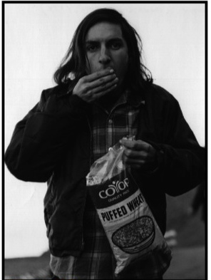
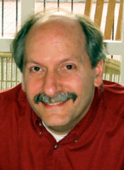
Does trying to make change happen in statistics education make you want to pull your hair out?
Let’s look at the data.

Slide 9
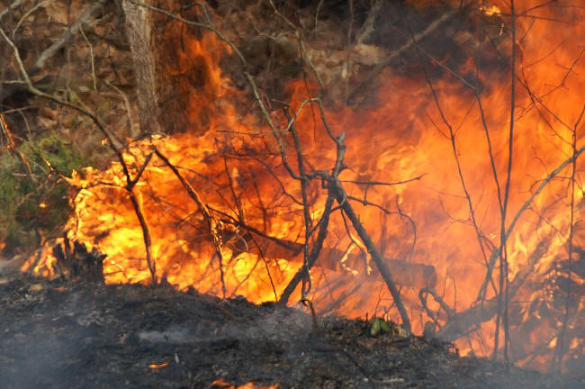
Pivotal Experience
Summer, 1971 Modeling Fire

Slide 10
From Stat Major to Statistician
Summer, 1971 Modeling Fire
NSF funded Interdisciplinary student-centered project
4 students from Mathematical Sciences
4 students from Engineering
2 students from Life Sciences
Notes:
Life changing experience – really wanted to learn about what drives fire and wanted to do a good job in my role as a team member - see the value of interdisciplinary teams. 2 from Math and 2 from Statistics (me and Dan Cherkin). Challenge to predict spatial and temporal dynamics of fire given characteristics of environment. Set up with four controlled burns happening in California early in summer Engineers design instrumentation to measure stuff like moisture content to surface to volume ratio of fuel to temperature at different heights and locations. Math students to develop differential equations to model system. Statistics students to design data collection methods (not easy because trampling stuff to lay out instruments changes character of fuel) and empirical models to be blended with deterministic models and ecology/zoology students examine effects on plants, insects, small animals and soil. Got selected to go to AAAS meeting in Philadelphia December 1971 to give my first talk

Slide 11
Still relevant today…
Opportunity
Success
Usefulness
Motivation
Interest
Notes:
I don’t expect students to have the same ideas of what is useful motivators or the same interests as me or as each other. But what is still relevant is the need .. Opportunity for engagement and teaching that promotes success in learning and is where most work has generally concentrated so far. But the rest is crucial for long term and is the part that most needs to be addressed in an individualized manner.

Slide 12
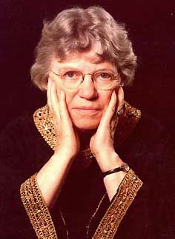
Never doubt that a small group of thoughtful, committed citizens can change the world. Indeed, it's the only thing that ever has.
-- Margaret Mead

Slide 13
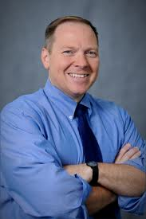
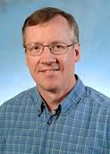
Thoughtful Committed Citizens I’ve been fortunate to work with
CAUSEweb
CAUSEway workshops

Slide 14
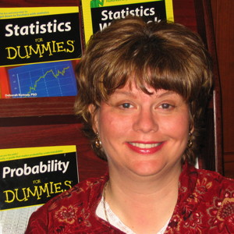
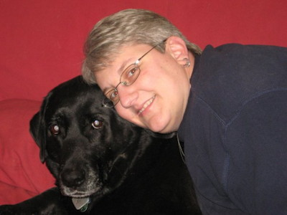
Thoughtful Committed Citizens I’ve been fortunate to work with
USCOTS
Webinars

Slide 15
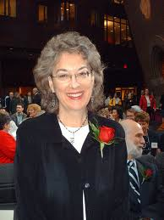
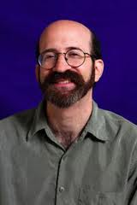
Thoughtful Committed Citizens I’ve been fortunate to work with
CAUSE Research Efforts & More
Study of Fun

Slide 16
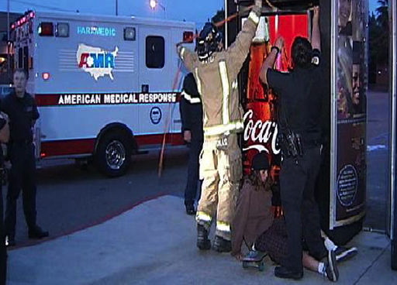
Statistics Teachers should not be broken vending machines that can’t make change happen.
Even when you call in the authorities.
Notes:
I’ll give you forty.

Slide 17
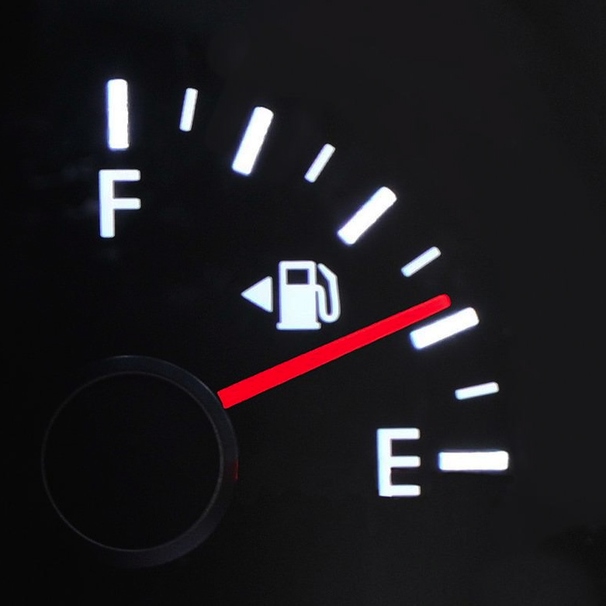
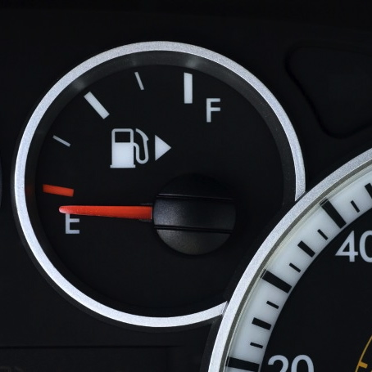
Watch out - I’m going to teach you something that will change your life!
Gas Cap on the driver side
Gas Cap on the passenger side

Slide 18
Whoa. That’s good to know.
The moment I discovered this I knew I would remember it.
Gas Cap on the driver side
Gas Cap on the passenger side

Slide 19
Watch out – I’m going to finish with an IF-THEN proof.

Slide 20
IF statistics really is something that will change the way you think about the world, THEN we need to change the way we teach.
With O-S-U-M-I every statistical concept should be met with a student reaction of
“Whoa – That’s good to know.”

