Slide 1
Bringing Change to Community College Statistics Courses
Dr. Monica Dabos & Dr. Robert Gould
rgould@stat.ucla.edu
monica.dabos@canyons.edu

Slide 2
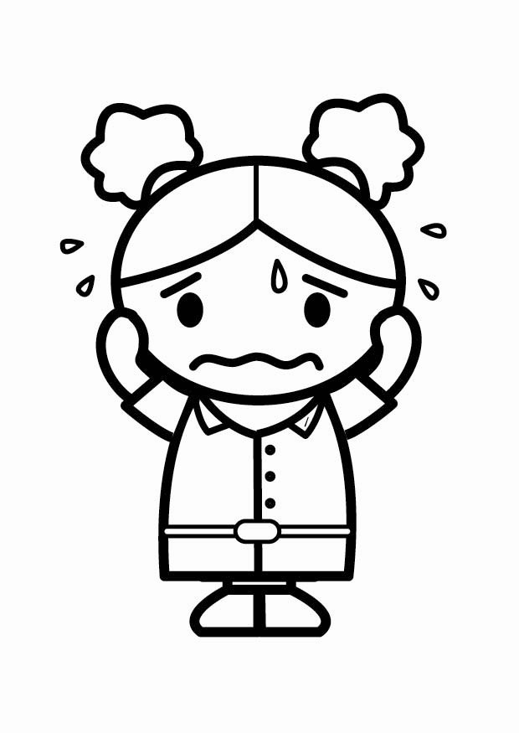
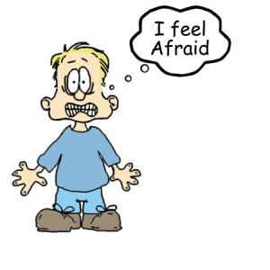
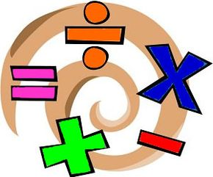
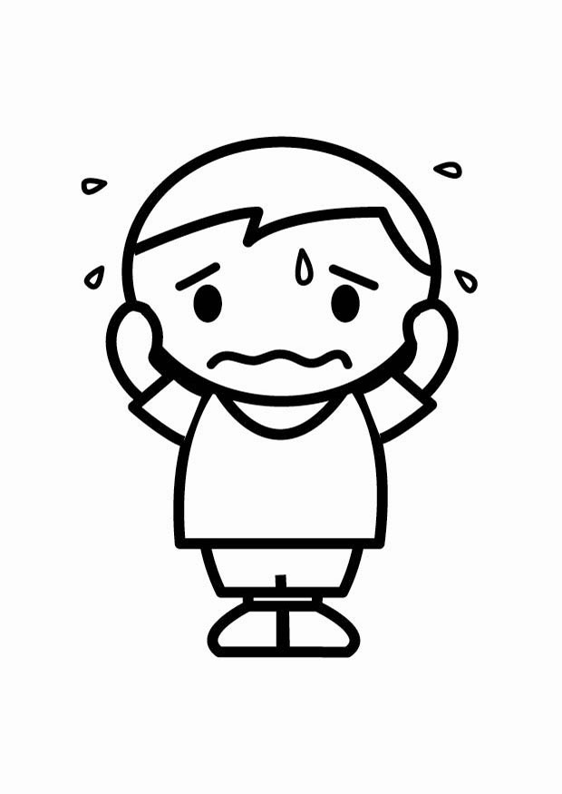
When you look at a math/stats classroom, do you notice students afraid of asking questions and/or afraid of being wrong?
How do we move students from fear to inquiry?

Slide 3
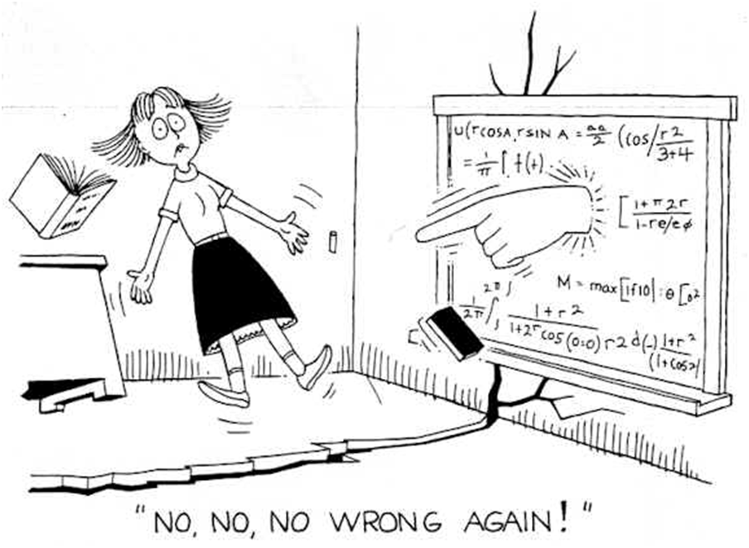
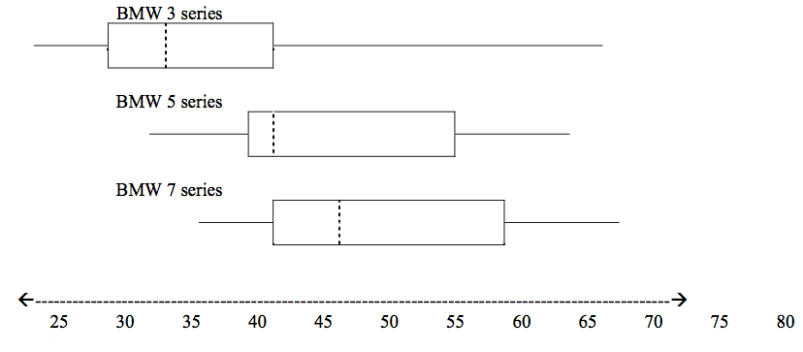
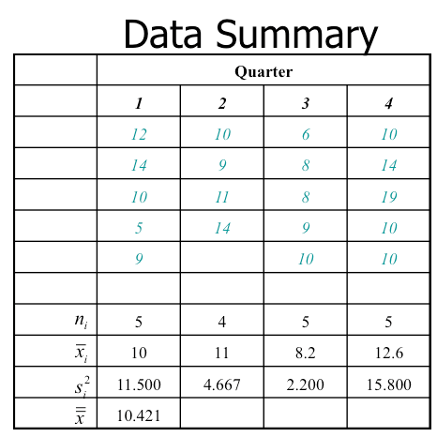
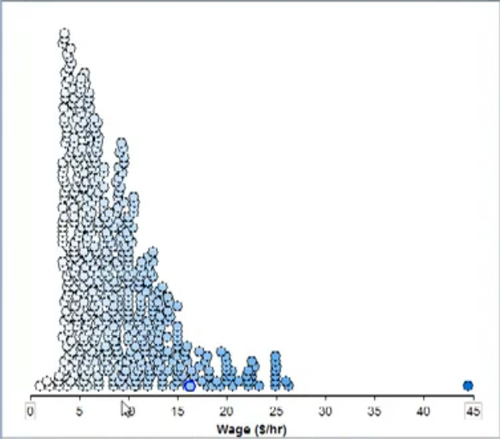
What about instructors? Do they experience similar apprehensions? Especially when it comes to Statistics classes…?
If so, how can we move instructors from fear to inquiry?
Notes:
It is not surprising that some fear may be there as only 2% of full time and 2% of part time instructors have a degree in statistics. Many instructors are encourage to teach statistics as there are more stats courses opening to teach than calculus per say.
Statistics textbooks have also lack the necessary information and they can be in many cases vague.

Slide 4
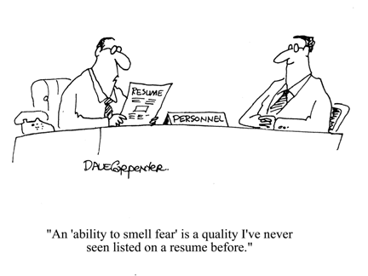

Slide 5
Activity One 5 to 10 minutes
Part A
  Stand up
  Look for somebody you don’t know
  Introduce yourself
  Discuss your experience with statistics classes
  How do you feel, have you taught it before, etc.
Part B
  Introduce to the rest of the group the person you just met
Notes:
Only 2% of full time instructors and 2% of part time instructors have a degree in statistics.
I have some ideas and we are going to practice them today.

Slide 6
Activity Two (15 – 25 minutes)
Part A (15 minutes)
No names please
Answer page Question 1 and turn it in when you are done
Answer page Question 2 and turn it in when you are done
Answer page Question 3 and turn it in when you are done
Answer page Question 4 and turn it in when you are done
Part B (I will redistribute back Question 1 and 3)
Were these answered the same way you answered them?
Talk to your neighbor
Who is right? Who is wrong? Could it be that both are right?
What do you think the rest of the group answered? Check around.

Slide 7
The purpose of these questions
Dare to Disagree
Signal and Noise
Astronomers
Nate Silver
Notes:
Margaret Heffernan
In the oxford 1950 Alice Stuart Unusual Women Doctor
Epidiomiology
Childhood cancer
Most diseases were corellated with Poverty but children with cancer seem to come from afluent families what could explain
One thing champ out with statistical clarity
2 to 1 mothers who had being x-rayed when pregnant
The statistician Job was is to prove Doctor Stuart wrong
----- Meeting Notes (5/18/13 08:19) -----
Most people instinctively avoid conflict, good disagreement is central to progress.
She illustrates (sometimes counterintuitively) how the best partners aren't echo chambers –
and how great research teams, relationships and businesses allow people to deeply disagree.

Slide 8
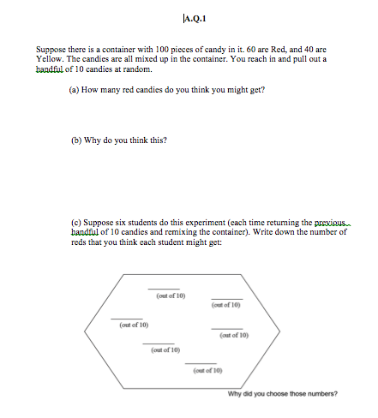
Results
Lets look at Question 1 a
Q.1
Did you read:
What is the expected value of…..?
or
How many candies do you think you might get?

Slide 9
You may Not be alone
Prior results:
Out of 55 instructors’ responses
Only 12% (n=6) predicted variability in A.Q1.a
Number of Instructors Predicting Variability in Repeated Samples A.Q1
6 = 1 + 2 + 3
ST (n=7) MT (n=22) M (n=23)
ST= Had statistics degree and teach statistics
MT= Mathematics degree and teach statistics
M= Mathematics degree and do not teach stats
Notes:
Justification exhibited explicit or implicit attention to either sample variability and/or spread from center.

Slide 10
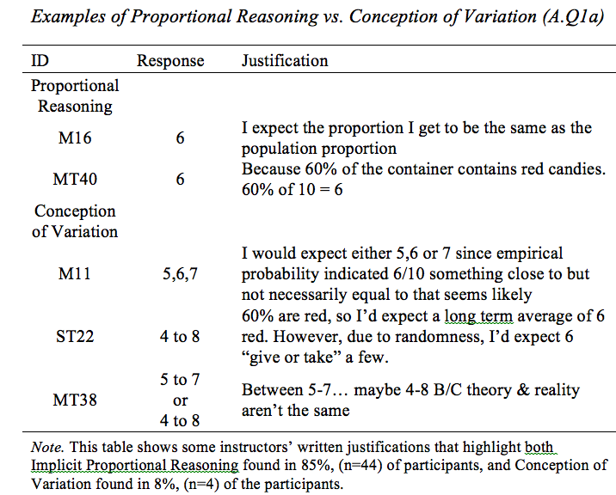
Examples of Proportional Reasoning vs. Conception of Variation (Question 1 a)

Slide 11
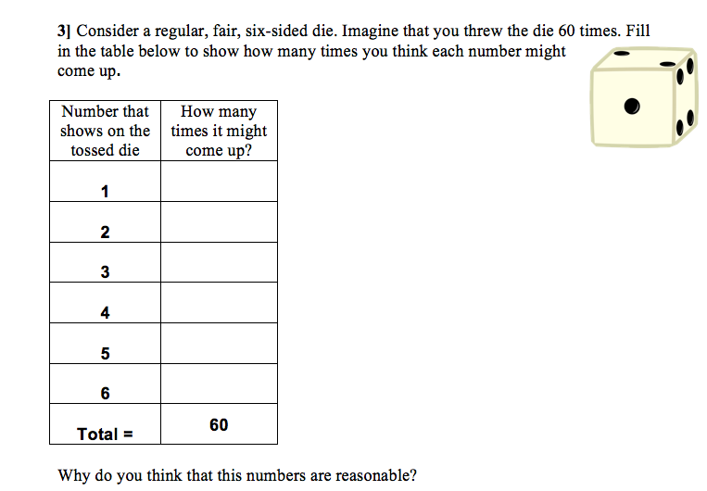
Look at Question 2
For this question, out of 52 instructors in the past,
only 27% (n=14) of the instructors gave responses indicating variability,

Slide 12
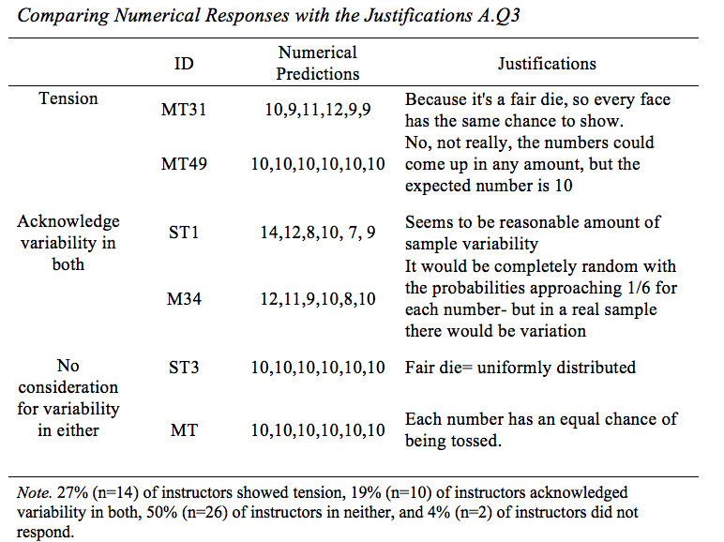
Comparing Numerical Responses with the justifications Question 2

Slide 13
Why?

Slide 14
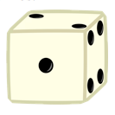
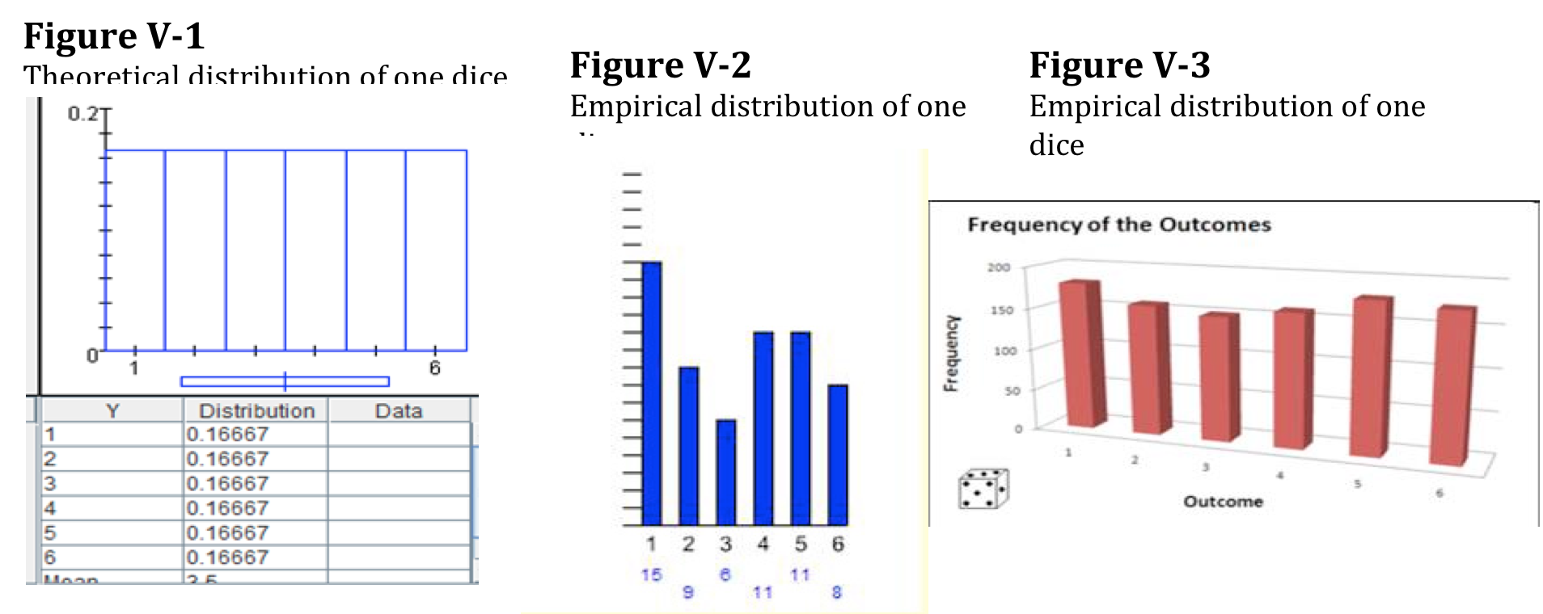
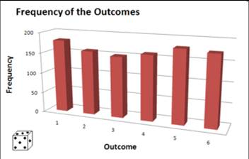
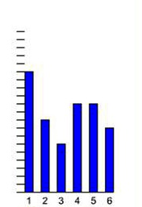
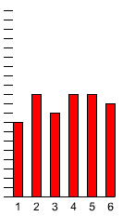
Theoretical vs. Empirical
Distributions
Theoretical Distribution
Empirical l Distribution
1000 trials
Empirical l Distribution 60 trials
1514131211109
8
7
6
5
4
3 2
1
Notes:
http://academic.evergreen.edu/curricular/doingscience/flash/dice.html
Sample Variability
Random Variation
Natural Variability
Bring Dices
Theory vs. practice why matters in Statistical data analysis
Vietnam drafting for example

Slide 15
Understanding Variability and its practical application
The Draft
On January 4, 1970, the New York Times ran a long article,
"Statisticians Charge Draft Lottery Was Not Random."

Slide 16
Re-distribute Question 3
Discuss with your neighbor

Slide 17
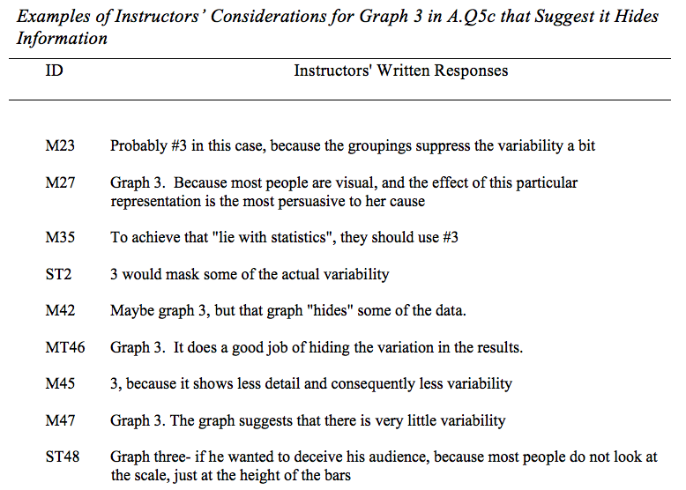
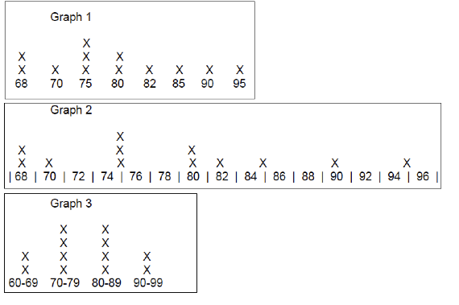
Lets look at Question 3 c.
90% (n=47) of the instructors did not see the benefit of displaying the data as in Graph 3
Examples of Instructors’ considerations for Graph 3 in A.Q 4c
Notes:
90% (n=47) of the instructors did not see the benefit of displaying the data as in Graph 3. On the contrary, statements like it "loses info", or "masks variability", or "best way to cheat" were common. Table 5.5 shows examples of instructors’ exact statements. One can conclude that instead of seeing aggregate data as a way to see the bigger picture and understand what is happening in general, instructors tended to believe that Graph 3 loses information or concealed some information purposefully.

Slide 18

Context
Braking power of a car
only 23% (n=12) gave even a small indication of the context
Every motor vehicle or combination of vehicles, at any time and under all conditions of loading, shall, upon application of the
service brake, be capable of stopping from an initial speed of 20 miles per hour according to the following requirements:
Maximum
Stopping
Distance
(feet)
(1) Any passenger vehicle ....... 25
(2) Any single motor vehicle
with a manufacturer's gross
vehicle weight rating of less
than 10,000 lbs. ................ 30
Notes:
Context. DEPARTMENT OF TRANSPORTATION
National Highway Traffic Safety Administration
Only one of the 52 instructors wrote in response to part 'd', "fair? Consistent? 28 inches for 40 mph seem great. Consistent"
When instructors' justification were analyzed for reference to context, it was found that only 23% (n=12) gave even a small indication of the context and even then they did not use the context to guide their decisions

Slide 19
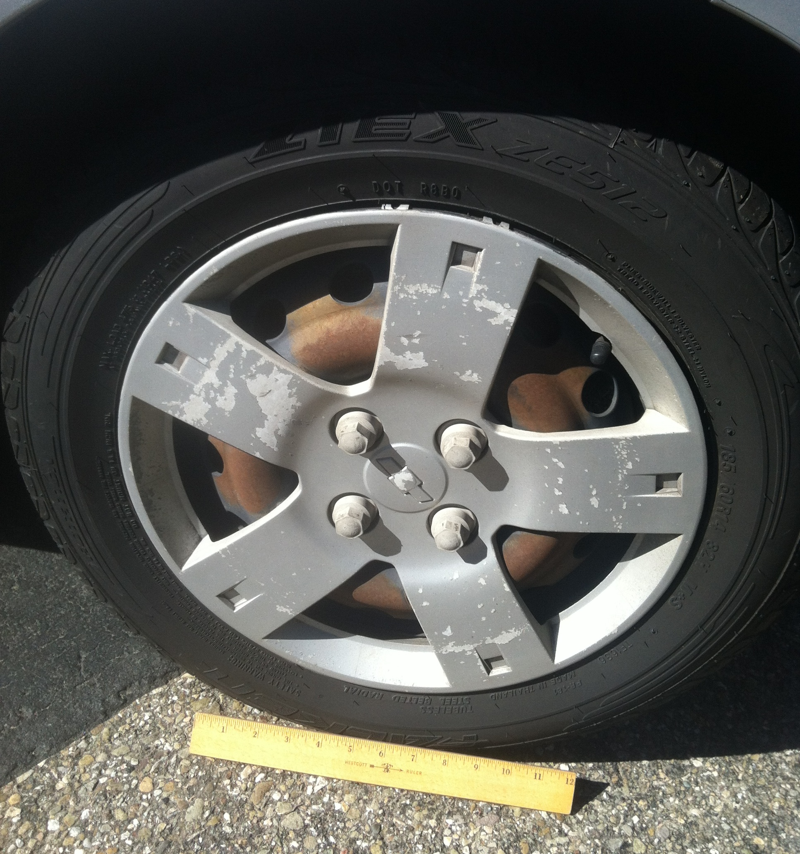
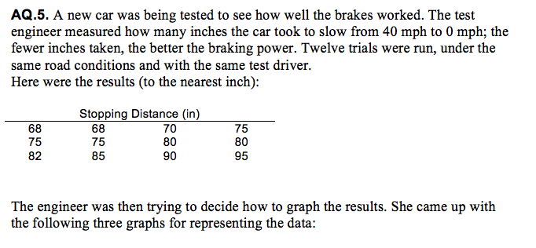
Context
Q. 3

Slide 20
Scale is in inches
Insert picture tire ruler
Range = 95 - 68=27
27 inches ≅ 2 feet
Notes:
that 94% (n=49) of instructors stated that Graph 2 showed more variability. While not everyone gave the same reasoning, the largest percentage (48%, n=25) of instructors wrote that Graph 2 showed more variability due to the spacing of individual data values and because it clearly showed the extreme values.

Slide 21
Let’s look at Question 3
What do you think now that you know the context?!!!
Examples of instructors’ Consideration for Graph 3 in Question 3c that suggest it Hides information
Notes:
90% (n=47) of the instructors did not see the benefit of displaying the data as in Graph 3. On the contrary, statements like it "loses info", or "masks variability", or "best way to cheat" were common. Table 5.5 shows examples of instructors’ exact statements. One can conclude that instead of seeing aggregate data as a way to see the bigger picture and understand what is happening in general, instructors tended to believe that Graph 3 loses information or concealed some information purposefully.

Slide 22
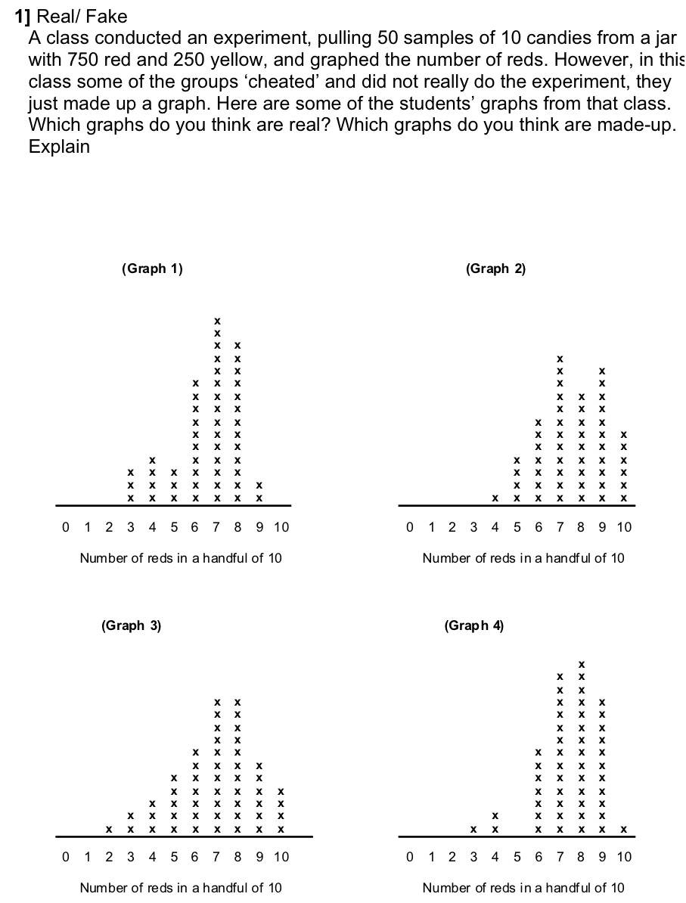
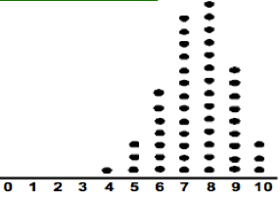
Sampling
Real vs. Fake

Slide 23
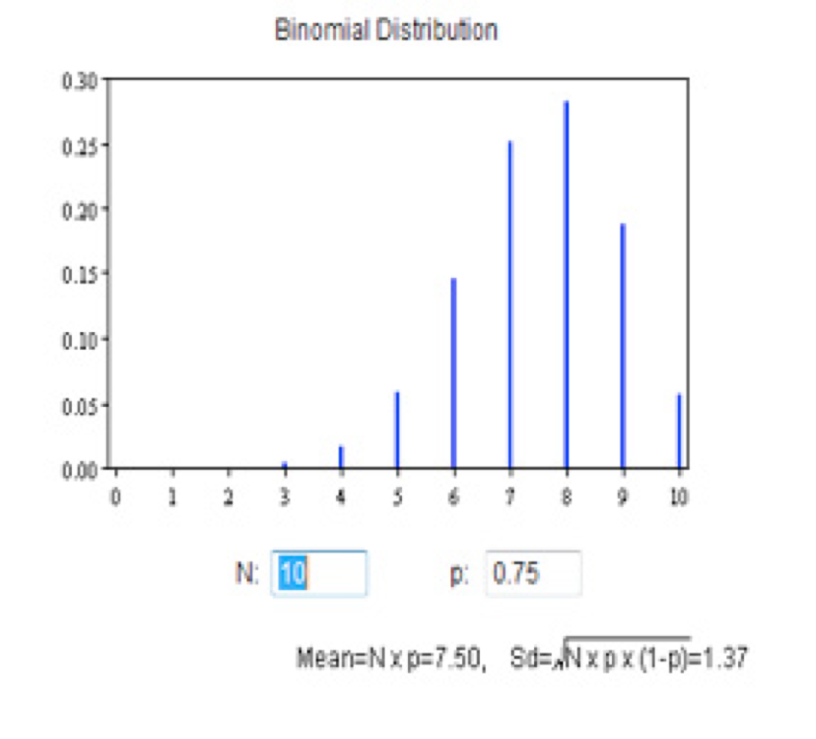
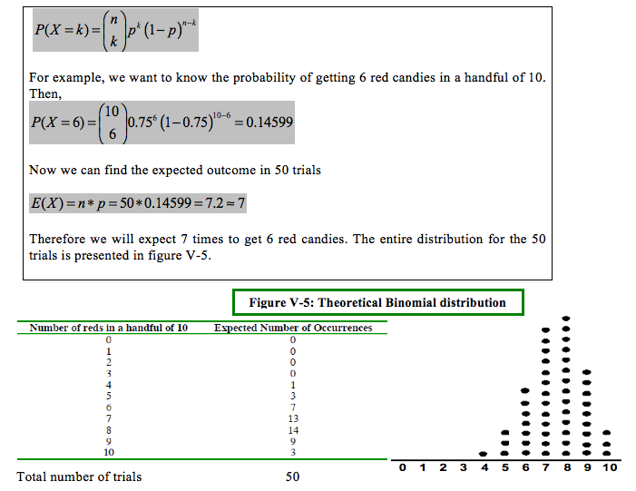
Theoretically

Slide 24
Conclusions
Cognitive Conflict
“Dare to disagree”
  Ask questions
The essence of Statistics is
Variability
    Separating the signal and the noise
Difference between theoretical distributions and empirical distributions (data driven)
Pass it on to your students
Feel free to contact us

