Slide 1
Change From the Ground Up:
A Faculty Perspective of the Carnegie Foundation Statway Networked Improvement Community
James Gray, Seattle Central Community College
Jim Smart, Tallahassee Community College

Slide 2

The Problem
Nationally, two-thirds of incoming community college students must take at least one developmental math course before they can enroll in college-credit courses.
Up to 80 percent of these students never get out.
As a consequence, millions of people each year are not able to progress toward their career and life goals.
We cannot continue using the same approach and expect different results.

Slide 3
A New Way: Coherent, Intensive, Accelerated Learning
Statway
Quantway
College
Math
Credit
Semester1
Semester 2
Semester
3 or more
Elem. Algebra
Int. Algebra
College Math
College
Math
Credit
What Colleges Traditionally Have Done

Slide 4
It starts with…
Professional organizations established learning goals
Critical Thinking
Lessons, Assessments,
Online
Math that Matters
Learning
Goals,
Curriculum, and Pedagogy
Benchmarking performance against college and university courses
4

Slide 5
But It’s More Than a Curriculum
Connecting Research to Practice
Carol Dweck/David Yeager, Mindset
Productive Persistence
Jim Stigler/Karen Givvens, TIMSS Project
Productive Struggle
What does this look like? Let’s see.

Slide 6
What is productive persistence?
Tenacity + Good strategies

Slide 7
Students need skills and habits required for college success
Skills
Students don’t see themselves as math learners
Productive Persistence
Course material not seen as interesting or useful
Mindsets
Attendance
Assignments
Help-seeking
Learning from errors
Effort after failure
Embracing challenge
Students have weak ties to peers, faculty and course of study

Slide 8
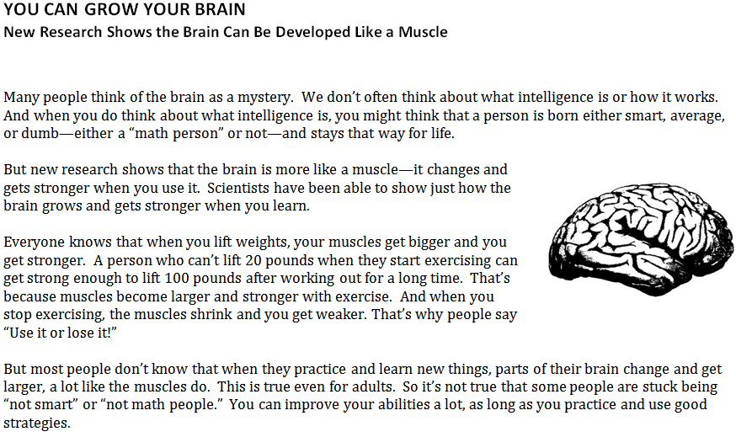
Mindset Activity

Slide 9
Mindset Activity
1 Think about the article that you just read. What are all the reasons why scientists say that people's math ability can grow and get better with effort and practice? Please summarize them briefly below.
In the article, you learned 3 things:
When you work hard and learn new things, your brain grows new connections and you get smarter.
The more you challenge yourself, the smarter you will become.
Smart kids are the kids who have practiced more—they have built up their reading and math "muscles."
2 Think about an example from your own life. What is something you weren’t good at first. Then you practiced it using a good strategy and became really good at it. Write about it and explain how you became good at it.

Slide 10
Carnegie Project: Instructional Model
Assumption: same instruction and content as before will likely lead to the same result
Strategy: Focus on understanding concepts/relationships (these students can’t learn math by remembering procedures)
Create learning opportunities hypothesized to support understanding concepts/relationships
  Struggle
  Connections to explicit concepts
  Deliberate practice
How do we do that? In theory…

Slide 11
Carnegie Instructional Model
Secondary Drivers: How do these teachers use these
Instructional resources to create learning opportunities
for these students
Primary Drivers
Instructional resources that afford creation of learning opportunities:
Relevant to students interests
Focus on understanding/thinking with concepts
Clear learning goals (concepts & skills) aligned with formative and summative assessments
Lesson structure: struggle, then instruction
Conceptual flows to structure instruction
Instruction / Learning Opportunities
Struggle with important mathematics/
statistics
Statistics Proficiency: Flexible and stable knowledge of concepts, procedures, strategies; and productive disposition
Explicit connections to mathematical/
statistical concepts
Students engage productively with learning opportunities:
Believe they are capable of learning math, gradually over time
See math/statistics as something that makes sense, that one can “figure out”
Overcome anxiety from previous failure
Willing to invest persistent effort
Deliberate practice applying concepts/
procedures to solving problems
Teachers effectively implement curriculum with students to create learning opportunities:
Belief that these students are capable of learning math and statistics
See math/statistics as something that makes sense, that one can “figure out”
Skills and knowledge to implement instructional system: engage students in problems; make concepts explicit in ways students can understand; provide emotional support

Slide 12
Lesson Design
Struggle
  Start with rich problem, followed by discussion/instruction
Connections
  Idea of “conceptual flow”
Deliberate practice
  Different from repetitive practice
Let’s look at a lesson to see this in practice.

Slide 13
Online Learning Materials
Out of class learning materials, called MyStatway, are hosted by the Carnegie Mellon University Open Learning Initiative (OLI).
Learning materials and practice are integrated.
Faculty can track student progress through the Learning Dashboard.
A graded Checkpoint follows each topic to assess student learning.

Slide 14
Assessment
End of Module Assessment problems.
Midcourse and End of Course Common Assessments

Slide 15
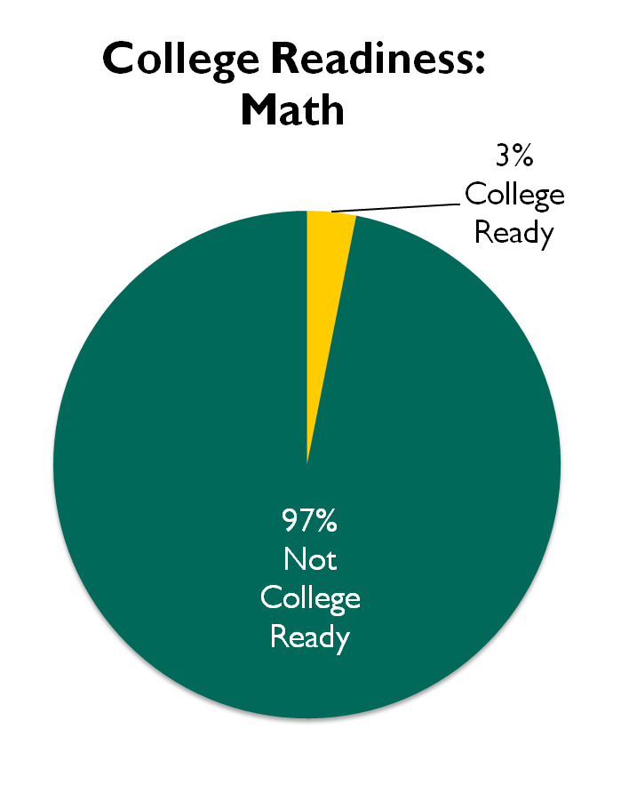
Who Are Our Pathways Students?
75%
2 Levels and Below
Notes:
New chart when roll out the 75%.

Slide 16
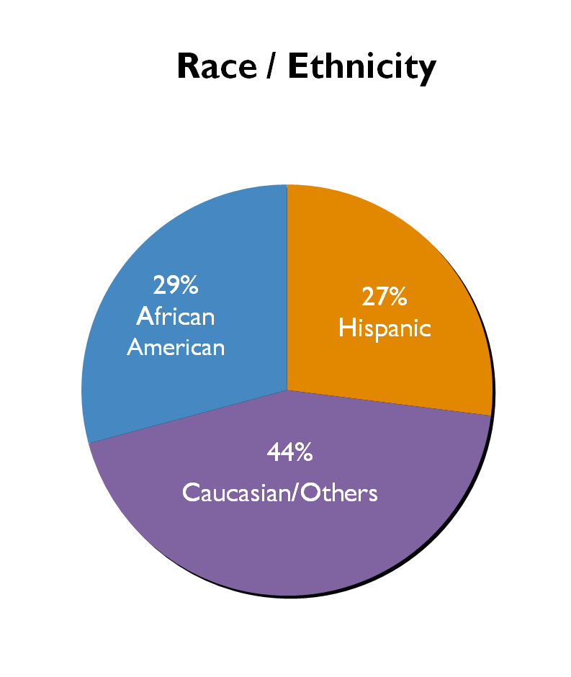

Who Are Our Pathways Students?

Slide 17
Dramatic Success for Students in Developmental Mathematics
First Year Results from Carnegie’s Pathways Programs

Slide 18


Time to Complete College Level Math Course:
Statway vs. Traditional Sequence
1 Year
2 Years
6%
15%
Traditional Sequence
Triple the success rate in half the time.
Statway
51%

Slide 19
Networked Improvement Community
Rapid Analytics
Continuous Improvement
A Focus on Continuous Improvement
Advancing Quality Teaching
Language & Literacy
Learning
Goals,
Curriculum, and Pedagogy
Three Essential Supports
Productive Persistence

Slide 20
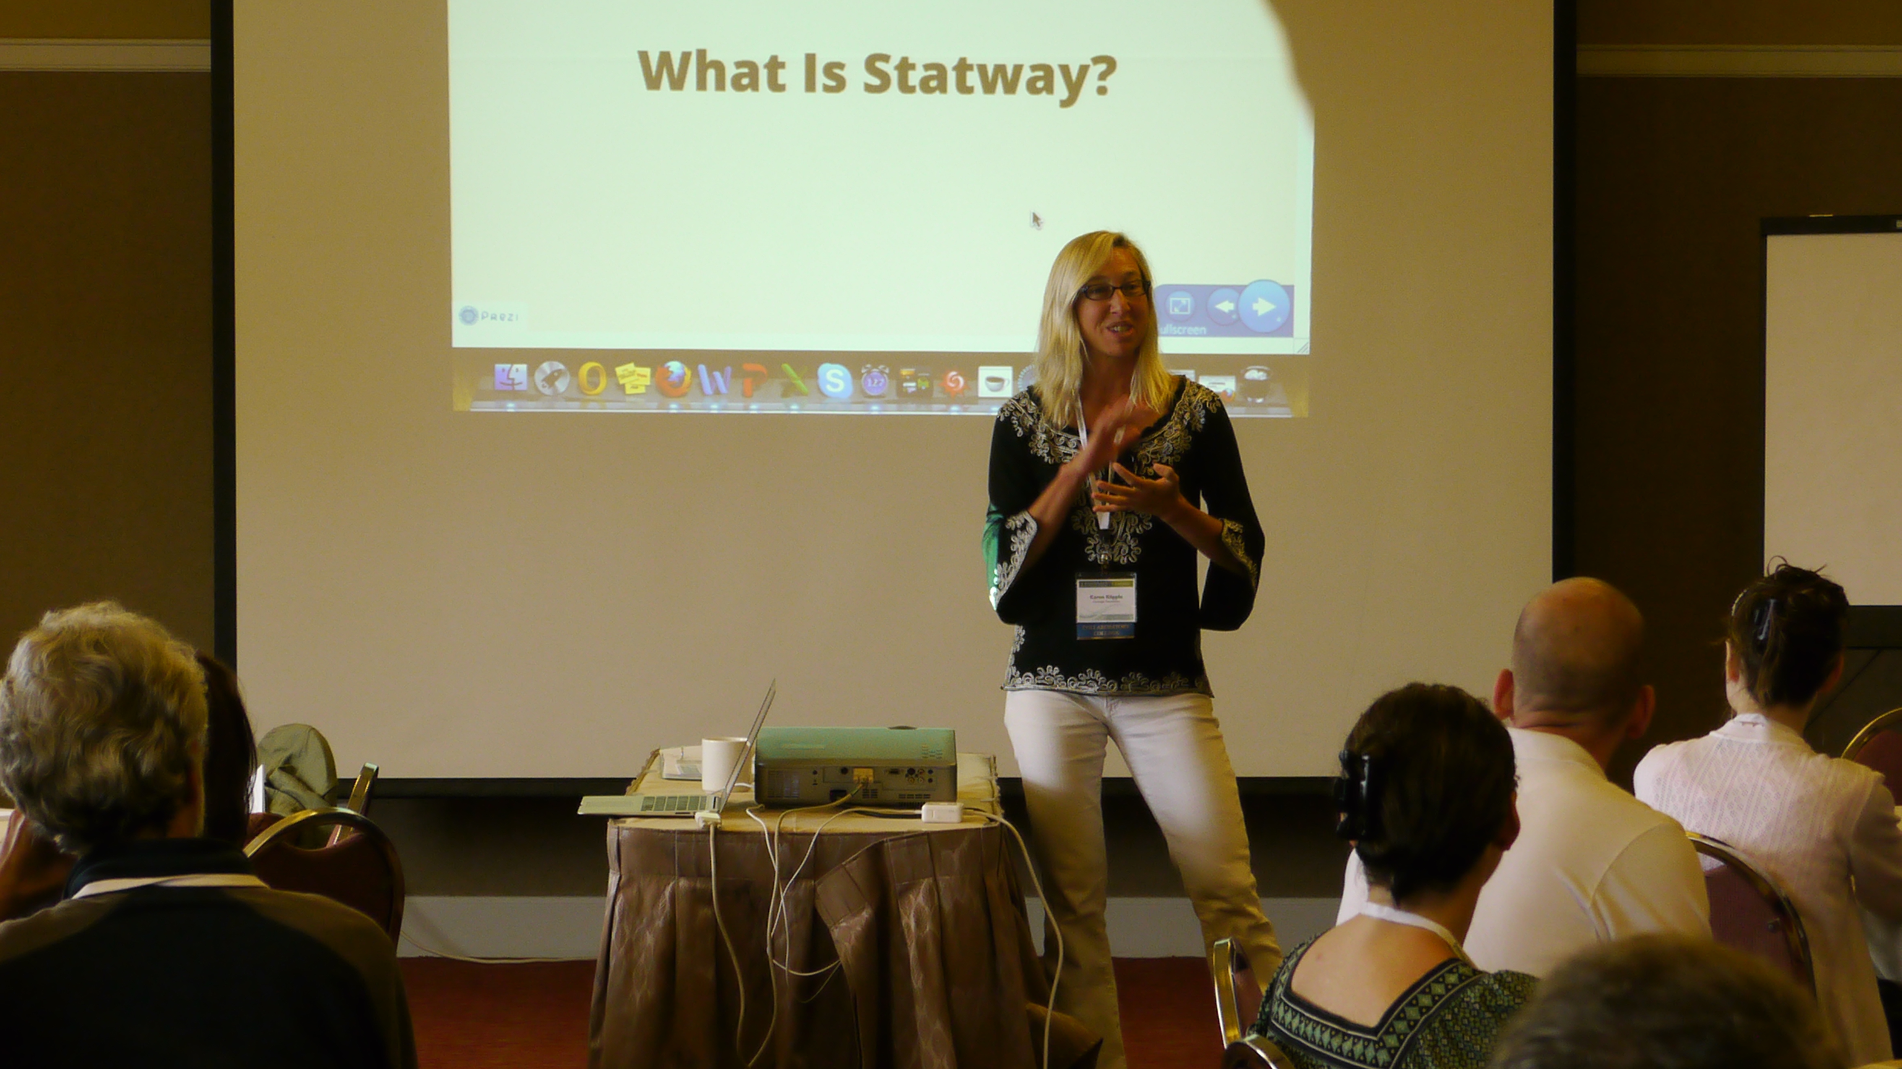
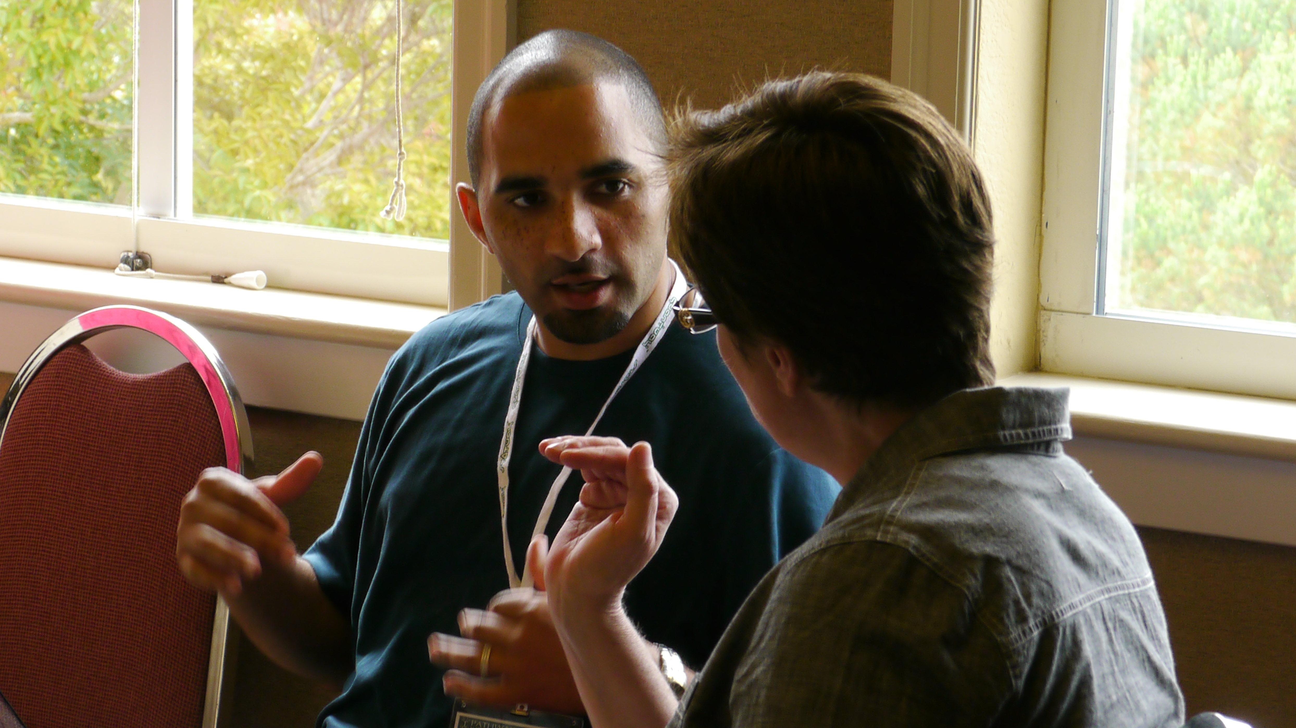

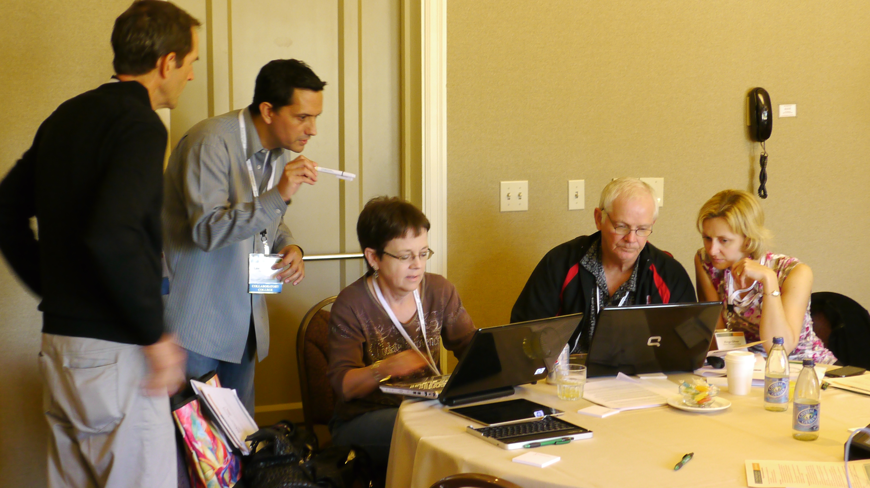
New Roles for Faculty
20

Slide 21
Next Steps: Getting to 3.0
The three parts of the curriculum, in class lessons, online material, and assessments, were developed independently.
Same learning goals, but lack of common language, voice, etc.
We want materials to be integrated, to look like they were written together.
We want supports for students.

Slide 22
Next Steps: Getting to 3.0
Various faculty led committees
Developmental Math Support
Assessment Revisions
Curriculum Redesign!!!

Slide 23
Next Steps Getting to 3.0
Online materials will align with in class materials at lesson level, rather than topic level.
Same definitions and language in online and lessons.
Revamp content arrangement.

Slide 24
Next Steps: Getting to 3.0
Faculty working with CFAT
Rewrote online and in class lessons for Modules 7 and 8
Pilot new material in 3 waves with current Statway students.

Slide 25
Next Steps: Getting to 3.0
Feedback from faculty and students.
Few focused changes to lesson materials.
How can we measure the effect of the change.
New conversation after each wave.

Slide 26
Faculty Voices
“Teaching is a lonely job, and it is really great to have others watch and experience what is going on in my classroom to help inform all of us on how to improve our methods to have better student engagement.”
- Julie Phelps, Valencia Community College

Slide 27
Faculty Voices
“I thought I was a pretty good teacher, but being involved in lesson study forced me to ask the harder questions about how what I did in class impacted student learning.”
- Michelle Brock, American River College

Slide 28
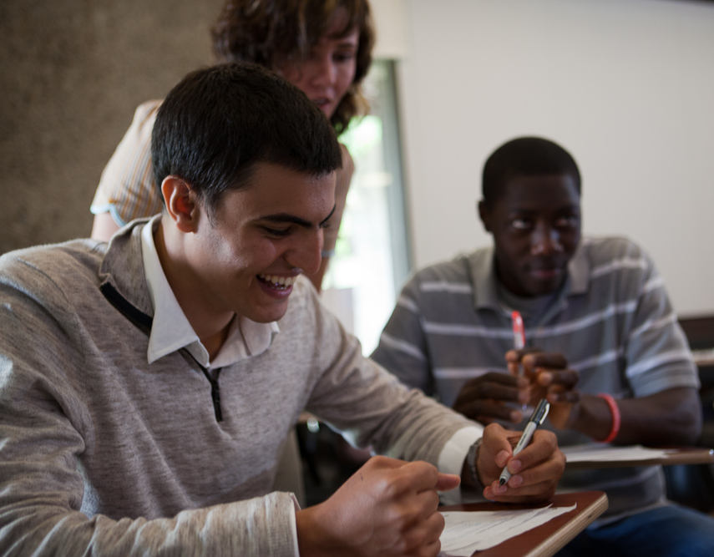
Student Voices
“It’s very refreshing to be not only grasping it, but actually interested in math…. It’s nice to wake up and be excited for my first class of the day.”

Slide 29

Student Voices
“It gave me hope at the beginning of this quarter. And so now it’s kind of like ‘I can [do this]’ but I’m also doing something that I think is very useful. …The stereotypes [that minorities and females can’t do math] aren’t true!”

Slide 30

Student Voices
“This class has helped me in my other classes. This has…exercised my mind enough for me to become a better writer, believe it or not.”

Slide 31

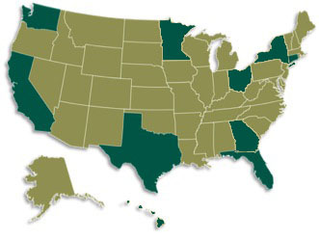
Where We Are Now, 2013
34 Community Colleges
State Universities
10 States

Slide 32
www.carnegiefoundation.org

