Slide 1

Publishing
Juana Sanchez (JSDSE), Sue Peters (SERJ), Rhys Jones (Teaching Statistics)

Slide 2
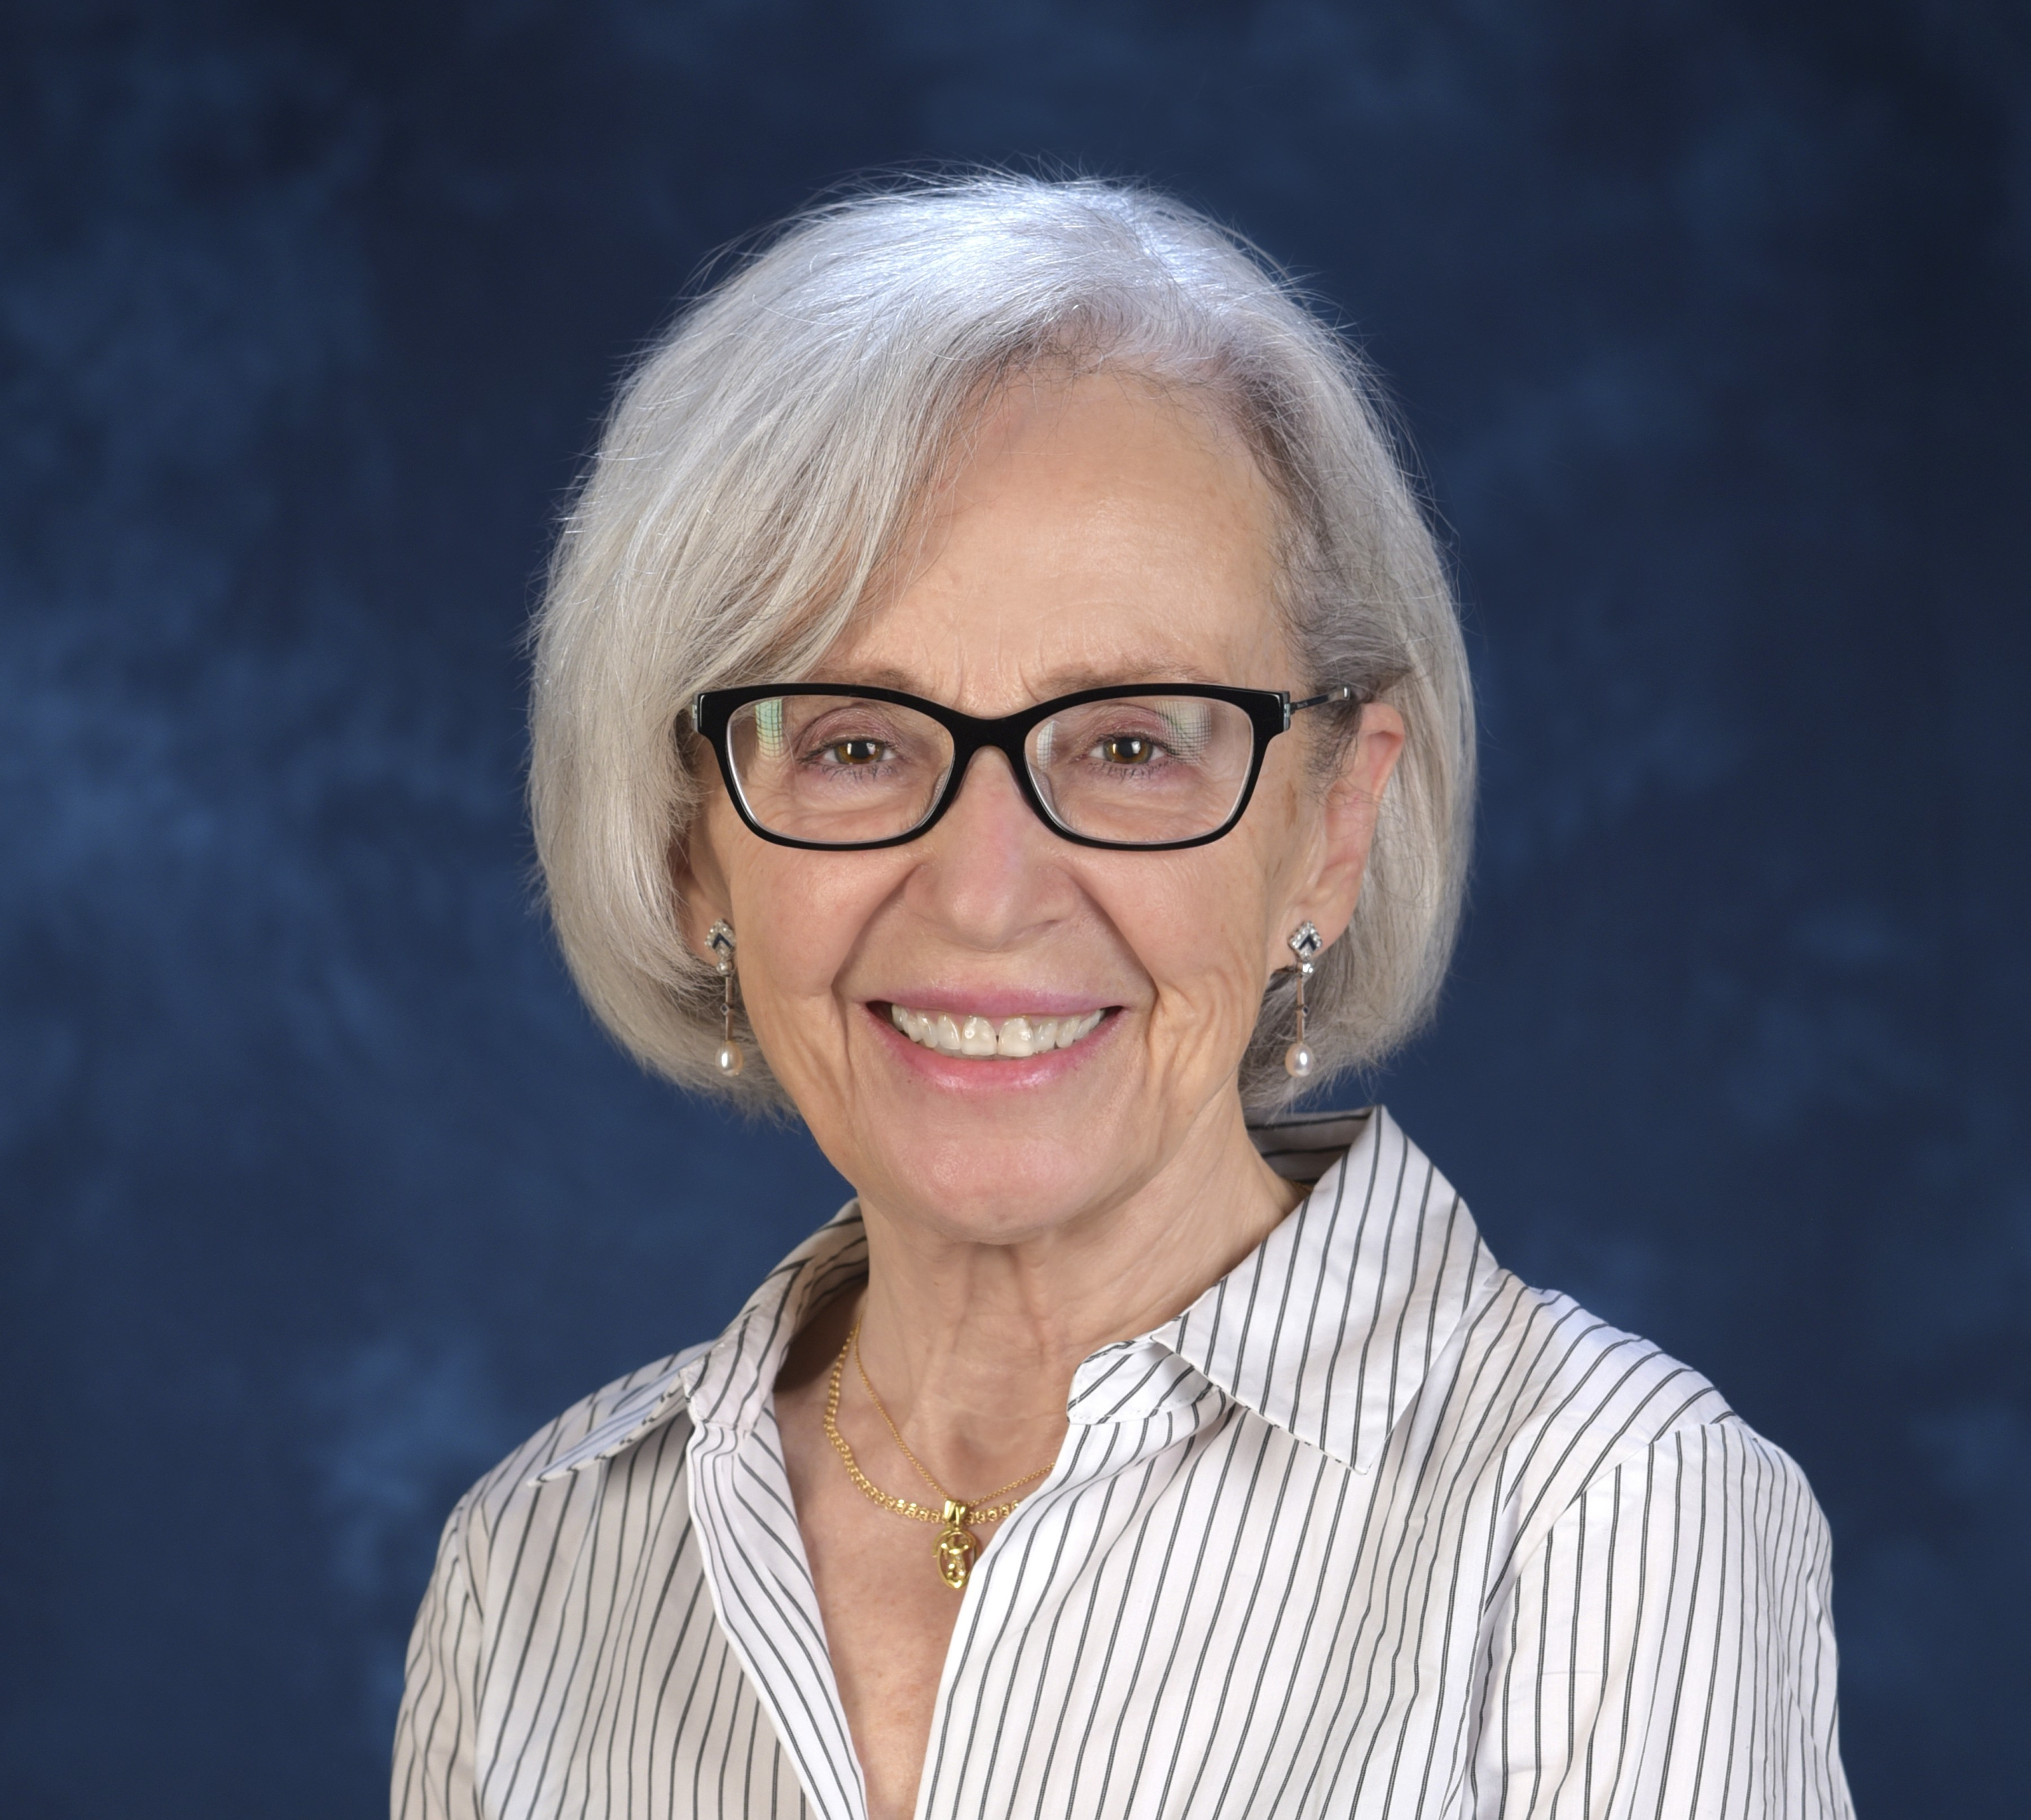
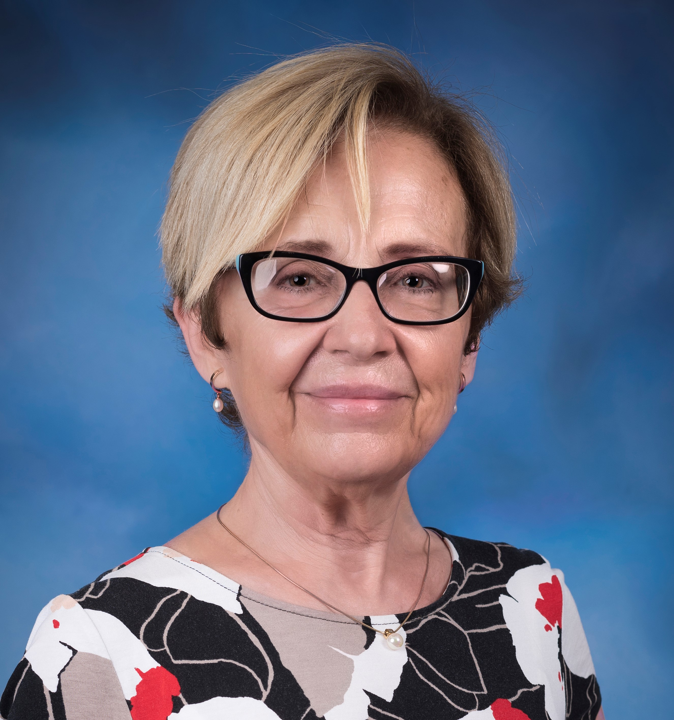
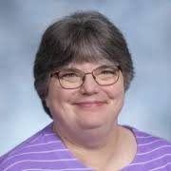
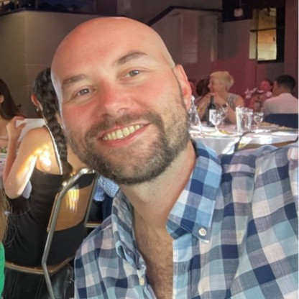
Dr Juana Sanchez – JSDSE
jsanchez@stat.ucla.edu.
Dr Sue Peters – SERJ
s.peters@louisville.edu.
Dr Rhys C Jones
- TS
minkywhales@hotmail.com.

Slide 3
Asking questions about your teaching is at the heart of SoTL
Think back to a single class or session that you think worked well, or a session that did not go so well.
Will it work well next semester? Why didn’t it work? How do I go about sharing this with other teachers? What kind of data would be needed?
SoTL for statistics education can help! With SoTL you create new knowledge!

Slide 4
What is statistics education research (aka Science of Teaching and Learning (SoTL) applied to statistics education)?
Academic research, including statistics education research, involves generating new knowledge through systematic inquiry. This involves identifying a problem or gap, grounding the study in the literature to provide a theoretical framework and motivate research questions prior to data collection, methodologically planning and carrying out the study, and reporting on the results in a way that others can understand
                Cross (1999)

Slide 5
What is SoTL (continued)?
The systematic study of teaching and learning, using established or validated criteria of scholarship, to understand how teaching (praxis: beliefs, behaviours, attitudes, and values) can maximize learning and develop a more accurate understanding of learning, resulting in products that are publicly shared for critique and use by an appropriate community (p.2)
                Potter and Kustra (2011)

Slide 6
Scholarly teaching is not the same as SoTL. Scholarly teaching applies what is known, SoTL creates new knowledge
Teaching grounded in critical reflection using systematically and strategically gathered evidence, related and explained by well-reasoned theory and philosophical understanding, with the goal of maximizing learning through effective teaching (p. 3).
                Potter and Kustra (2011)
Scholarly teaching approach = Read articles about integrating active learning into the classroom and redesign the course based on suggestions from the literature. Make observations and adjust accordingly. (Casey Chapiro, TLC, UCLA, Intro to SoTL)

Slide 7
Why engage with SoTL in statistics ed?
Can help to rejuvenate and create a dynamic and exciting teaching and learning environment, where students learn
Provides an intellectual challenge! Enhancing your own skills development
Helps you to develop the practice of others and can contribute to the development of knowledge across the entire sector
Will have an impact on your career progression (promotion and job applications, UK: National Teaching Fellow & Advance Higher Education fellowship applications)
Will enhance your departments reputation, and potentially your university
Can be a useful stepping stone into more formal research (career pathway)

Slide 8
Top tips to get started
Think about what really interests you in your teaching practice or more broadly in statistics education.
Read! Read! Read! Check out published research in some of the main statistics education journals: Statistics Education Research Journal (SERJ), Journal of Statistics and Data Science Education Research (JSDSE), Technology Innovations in Statistics Education, Teaching Statistics
Also check out conference proceedings: International Association for Statistical Education (IASE): International Conference On Teaching Statistics (ICOTS) and satellite conferences: https://iase-web.org/.
Attend conferences/webinars and network: Royal Statistical Society, IASE, JSDSE/CAUSE American Statistical Association, National Centre for Research Methods, other CAUSE webinars
Think about upskilling or doing a training course, if you need to develop skills in survey design, ethics application, research methods in education etc – UK Data Service, Consortium for the Advancement of Undergraduate Statistics Education - CAUSE (see above organisations)
Scholarship activities can lead to more formal research, if you want to go down that path (career pathway)

Slide 9
To discuss (Who wants to start? With which question? )
Is there something in your teaching that worked really well or really bad, and you would like to know what impact it has on your students’ satisfaction and learning?
Who has published a paper in statistics education and data sciences?
What type of paper did you publish or what paper(s) are you working on?
If you are currently working on a paper tell us about it, what are the challenges?
What were the challenges involved with a paper you have previously published?
What were your successes? Did your published paper lead to any other work? Or any other achievements?
Do you have any other questions?

Slide 10
References
Boyer, E.L. (1990). Scholarship reconsidered: priorities of the professoriate, Carnegie Foundation for the Advancement of Teaching.
Bristol Institute for Teaching and Learning (2025). Scholarship of Teaching and Learning (SoTL). Accessed on 10/02/2025. Available from: https://www.bristol.ac.uk/bilt/our-work-and-who-we-are/scholarship-of-teaching-and-learning/.
Cross, N. (1999). Design Research: A Disciplined Conversation. Design Issues, 15, (2) 5–10. doi: 10.2307/1511837.
Felton, P., & Kustra, E. (2009). A framework for transformative teaching through engaged learning. In Taking Stock: Research on Teaching and Learning in Higher Education (pp. 13-26). Springer.
Hubball, H., & Clarke, A. (2010). Distinguishing between communities of practice and communities of interest. Learning, Culture and Social Interaction, 1(2), 110-121.
Hutchings, P., & Shulman, L. S. (1999). The scholarship of teaching: New elaborations, new developments. Change: The Magazine of Higher Learning, 31(5), 10-15.
Jones, R. C. (2020). Data Analysis and Critical Thinking Skills Training for Teachers – The Welsh Baccalaureate. Statistics Education Research Journal, 19 (1), 92-105.
Jones, R. C. (2019). How do we change statistical and critical thinking attitudes in young people? Numeracy, 12 (2). 10.5038/1936-4660.12.2.9.
Terry, J., Le, L., Jones, R., Sergeant, J.C., Dunham, B. & Jones, E. Education research: Getting started, Teach. Stat.48 (2026), S53–S66, DOI 10.1111/test.70008

Slide 11
References (Webinars, conferences)
Kaplan, J., and Rhys, J. (2025, Feb 13), “Getting Started in SDSE Research Webinar Series: What is
Scholarship and Research in Statistics and Data Science Education?”
https://www.causeweb.org/cause/webinar/rose/2025-02
Le, L., Hayat, M., Green, J., Kaplan, J., Peters, S., and Zieffler, A. (2023, June 2nd), “Demystifying
the Publishing Process for Statistics Education Journals.”
https://www.causeweb.org/cause/uscots/uscots23/2g-demystifying-
publishing-process-statistics-education-journals-room-112
Sanchez, J., Witmer, J., Peters, S., Green, J., and McGillivray, H. (2025, July 19th), “Can the
Usefulness of Publishing Models for Statistics and Data Science Education
Journals be Improved?”
https://www.causeweb.org/cause/uscots/uscots25/program/breakouts/3B

