Slide 1
Teaching about models: A unifying topic?
Beth Chance, with Visruth Srimath Kandali
Cal Poly – San Luis Obispo
bchance@calpoly.edu
Notes:
And calming my nerves

Slide 2
“Pre-Lab”
What does the word model mean to you in an introductory statistics course?
What do you think the term means to your students?

Slide 3
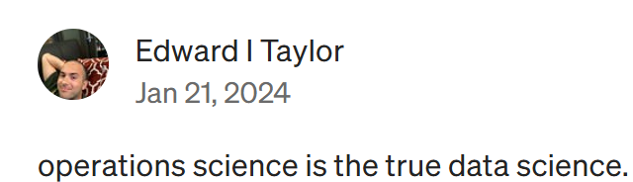
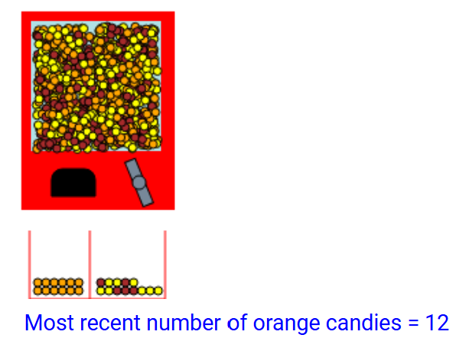
Trivia
PhD in Operations Research
  Applied Math/Engineering
First applet I “developed” was
Sampling Reese’s Pieces ~ 1996
Currently one of my biggest pet peeves -
difference in percentages
Challenge question: Why is any of this relevant?

Slide 4
Outline/Caveats
Overview of current course(s)
  Stat 217 – Algebra-based introductory statistics, primarily social science majors (Introduction to Statistical Investigations, ISI)
  Stat 301 – Primarily math, statistics, economics majors (Calc 1 – Co-req) (Investigating Statistical Concepts, Applications, and Methods, ISCAM)

Slide 5
Outline/Caveats
Overview of current course(s)
Why I think there is something missing
Some things I’m trying in my introductory statistics course
Examples of what others are saying
Summary of key ideas

Slide 6
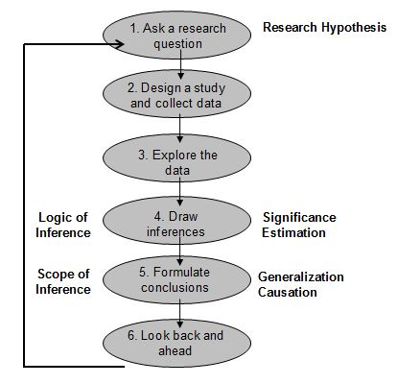
Introduction to Statistical Investigations (Wiley, zyBooks)
Six-step statistical investigation process
Focus on real data, tactile and computer simulations, visuals
Rossman/Chance applets

Slide 7
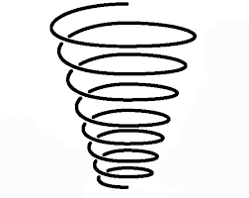
Introduction to Statistical Investigations (Wiley, zyBooks)
Simulation-based inference
  Don’t start with probability, but with genuine research questions (e.g., can dogs detect Covid?)
  3S Method: Statistic, Simulation, Strength of evidence
Spiral curriculum
  Aiming to anticipate student questions
  Introduces topics as needed
Two variables
Two groups
One mean
One prop

Slide 8
Start of the course (Days 1-3)
“Preliminaries” chapter
Distribution/ Variability
Obs unit/ Variable/ Res Q
Probability / Simulation
(as long run
proportion…)

Slide 9
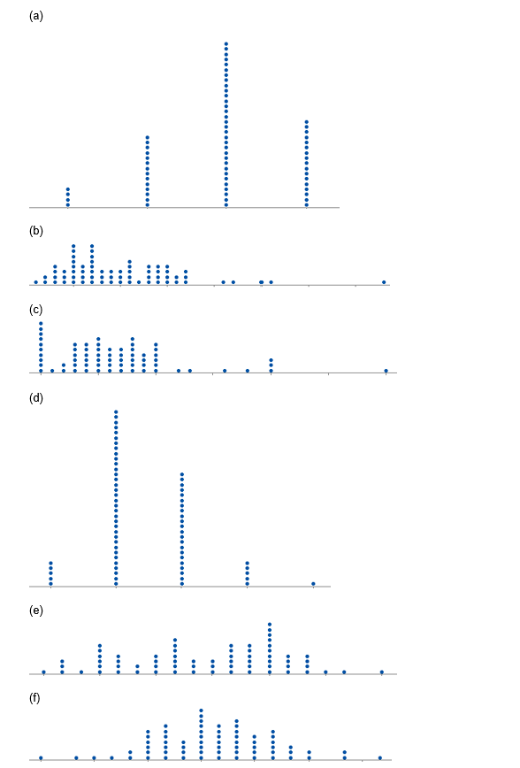
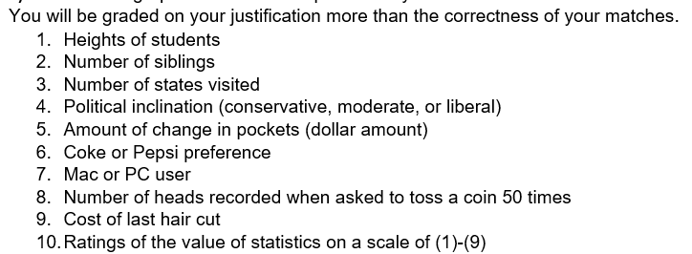
HW 1: Matching variables to graphs
Anticipate variable behavior
Orig: Activity-Based Statistics
Notes:
End of first week

Slide 10
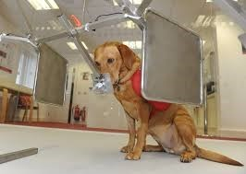
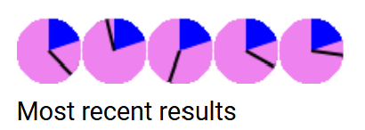
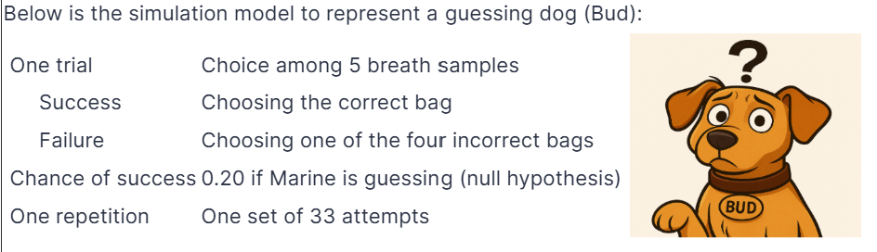
Ch. 1: Chance Models
Can Dogs Smell Covid
Notes:
Day 4

Slide 11
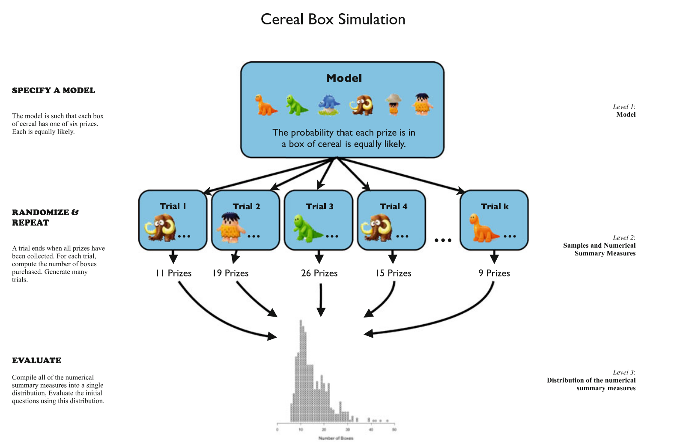
CATALST Curriculum

Slide 12
Evidence of improvements in student understanding
Can listening to music improve typing speed?
Do I want a large or small p-value?
Ability to ask “Step 6” questions
  What I'd do differently next time is include more types of students and try different music styles. Also I'd test people on more than one day to get more accurate results.
  For further research next time, I could look at which kinds of music help people focus the best.
  The familiarity the participants have with the music could also be a factor, along with the type of music (classical vs pop).
  …make sure this group of people is randomly chosen, this would allow me to generalize my results to a larger group.

Slide 13
Evidence of improvements in student understanding
12) A recent research study randomly divided participants into groups who were given different levels of Vitamin E to take daily. One group received only a placebo pill. The research study followed the participants for eight years to see how many developed a particular type of cancer during that time period. Which of the following responses gives the best explanation as to the purpose of randomization in this study?
(a) To increase the accuracy of the research results.
(b) To ensure that all potential cancer patients had an equal chance of being selected for the study.
(c) To reduce the amount of sampling error.
(d) To produce treatment groups with similar characteristics.
(e) To prevent skewness in the results.

Slide 14
Extended to 2nd course for non-majors
Leveraging the simulation-based approach
  Multiple means – Choice of statistic
  Power – “Non null” models
  Randomized block designs - Change the simulation to match the study design

Slide 15
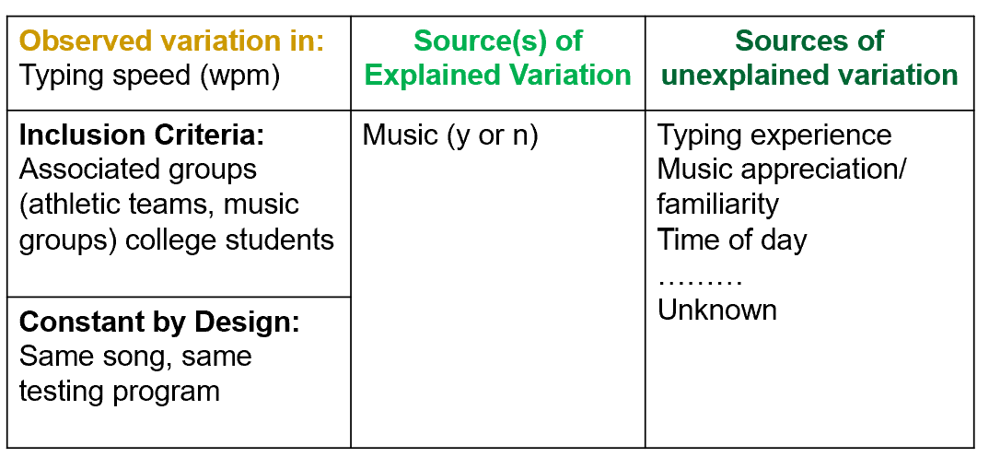
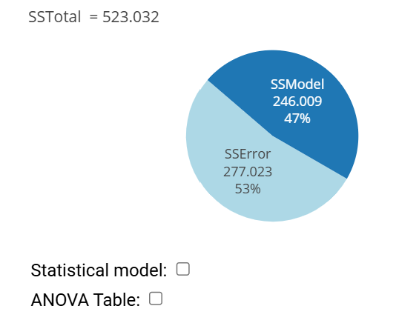
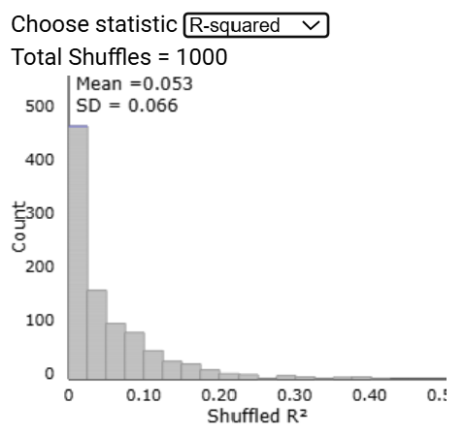

Expansion to 2nd course for non-majors
Sources of Variation Diagram
  Explained and unexplained variation
Statistical model + ANOVA table (applet)
Multivariable thinking
R² = SSModel / SSTotal
  F = $\frac{{(n−2)R}^{2}}{{ (1−R}^{2})}$
Notes:
Natural for students to come up with sources of variation; Finally a good use for pie charts

Slide 16
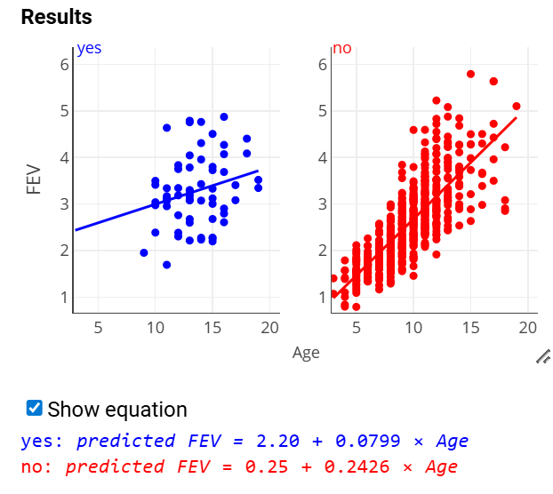
Implications for First Course
Sources of Variation Diagram
Explained and unexplained variation (R²)
Multivariable thinking (coded scatterplots)

Slide 17
Key Ideas
Statistics education has made great strides in
  Focusing on conceptual understanding over recipes
  Using real data and genuine research contexts
  Using technology to help students explore and gain understanding of key ideas
  Assessing what matters
“Shift in emphasis from how to construct graphs by hand using small data sets to a focus on exploring multivariate data sets and learning how to interrogate and reason from data.”
Pfannkuch et al., 2017
Notes:
Authentic assessment

Slide 18
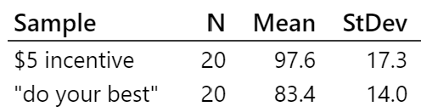
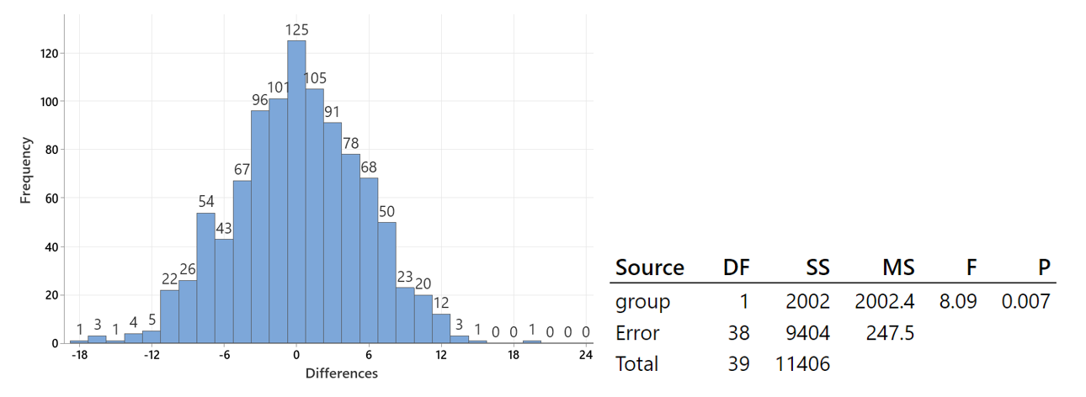
But something still missing?
1000 re-randomizations
97.6-83.4= 14.2
Simulation-based p-value ≈ 2/1000

Slide 19
But something still missing?
1000 re-randomizations
(b) (2 pts) Determine the simulation-based p-value. Clearly explain your approach.

Slide 20
But something still missing?
Suppose that you take a random sample of 100 houses currently for sale in California. Does the Central Limit Theorem suggest that a histogram of the house prices in the sample will display an approximately normal distribution?
To simulate the above randomization distributions, the observed results were “re-randomized.” What was the purpose of these re-randomizations? (Choose one.)
  (a) To create a normal distribution
  (b) To create equivalent treatment groups
  (c) To estimate the chance variation in the statistic
  (d) To increase the sample size for more accurate results

Slide 21
But something still missing?
A student participates in a Coke versus Pepsi taste test. She correctly identifies which soda is which four times out of six tries. She claims that this proves that she can reliably tell the difference between the two soft drinks. You have studied Statistics and you want to determine the probability of anyone getting at least four right out of six tries just by chance alone. Which of the following would provide an accurate estimate of that probability?
(a) Have the student repeat this experiment many times and calculate the percentage time she correctly distinguishes between the brands.
(b) Simulate this on the computer with a 50% chance of guessing the correct soft drink on each try, and calculate the percentage of times there are four or more correct guesses out of six trials.
(c) Repeat this experiment with a very large sample of people and calculate the percentage of people who make four correct guesses out of six tries.
(d) All of the methods listed above would provide an accurate estimate of the probability.

Slide 22
So what am I going to do?
1) “It’s all regression”/“It’s all about the SSError”
2) “Model” and “Simulation”

Slide 23
1) It’s all regression
Data = model + “error”
Maybe this should be the focus on the introductory course?

Slide 24
Joe Ward (1963, 1973 texts)
Practitioners struggling with selecting a method, cookbook procedures
Wanted more general approach, ability to attack new problems
  Every problem a prediction problem
  Reasons for uncertainty in the accuracy of predictions
  Understand tradeoffs in model complexity
Take advantage of advancements in technology
“How do we control for the uncontrollable?”
“If you can't control it, then try to ‘measure’ it”

Slide 25
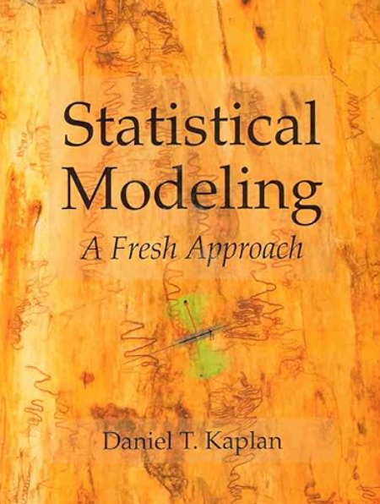

More recent examples
Kaplan, D. (2017). Statistical Modeling: A Fresh Approach (2nd ed.). Project MOSAICbooks.
CourseKata Introductory Statistics with R: A Modelling Approach
Laura Hildreth and Adam Loy
Breakout sessions…

Slide 26
Son, Blake, Fries, & Stigler
(JSDSE, 2021)
“Modeling first… ″
  Students should not spend their time accruing bits of disconnected information. Make appropriate connections that can help organize the domain.
    Modeling, Distributions, Randomness
  Statistics is about making sense of variation. The goal of modeling is to reduce error (unexplained variation), and students learn to fit more complex models as a means of reducing error.

Slide 27
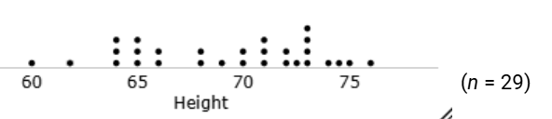
Example (ESTARS)
Collected height data of students in my class
  What is your best prediction of an absent student’s height?
  What makes this the best?
  How accurate is your prediction?

Slide 28

Interactive exploration
Rossman/Chance Descriptive Statistics applet
  HeightFootHand.txt
  Prediction errors
  Minimize sum of prediction errors
    Absolute values
    Squared values
  Measuring accuracy in terms of “typical prediction error”

Slide 29
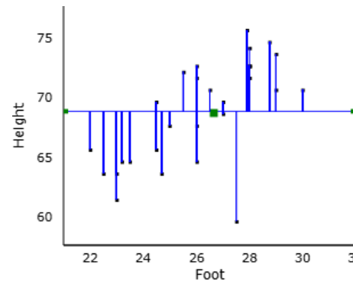
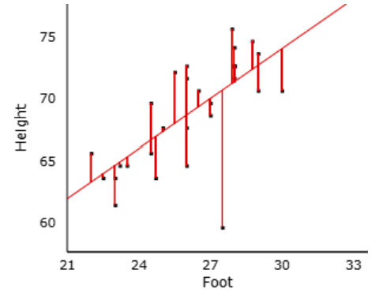
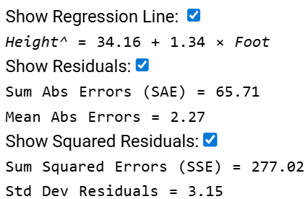
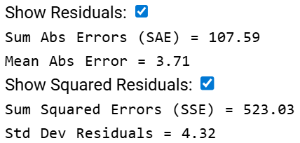
Example: Predicting Heights, cont.
Null model
Empty model
lm(y ~ 1)
Statistical Model
Word equation
Height = 69.20 + “error”
Height = [Foot length] + error
Height^ = 69.20

Slide 30
Comparing the models
I had this much unexplained variation …
Now I have this much unexplained variation
Percentage change
  (4.32 – 3.15)/4.32 x 100% = 27% decrease
  (4.32² – 3.15²)/4.32² x 100% = 47% decrease

Slide 31
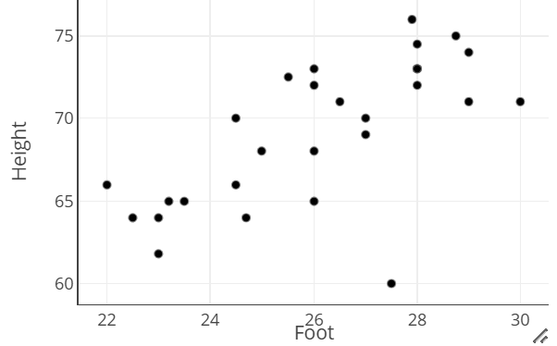
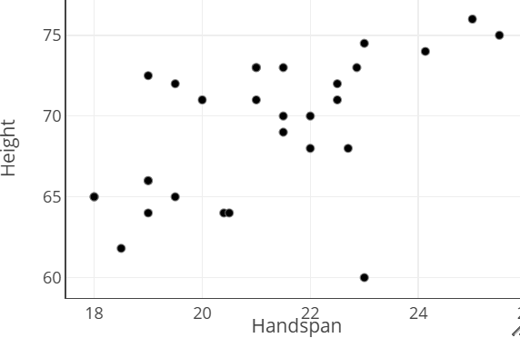
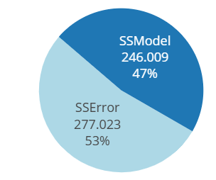
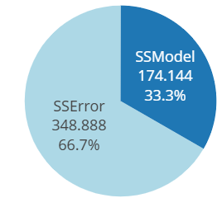
Proportional Reduction in Error
PRE = (SS Total - SS Error) ≈ 1 – Var(res)
SS Total Var(Y)
Predicting criminal’s height based on footprint or gloved handprint left at scene of crime
Notes:
Why can’t compare models when have transformed Y
Closer to statistical practice

Slide 32
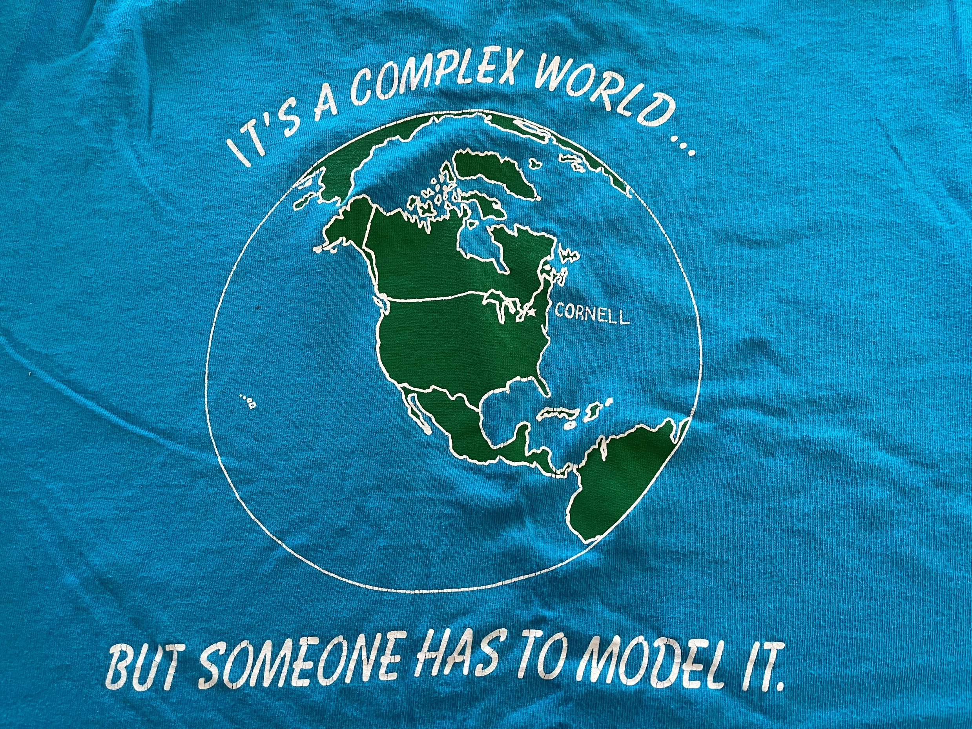
2) What is a model?
Speaking of never throwing things away…

Slide 33
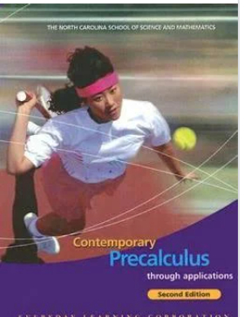
Mathematical models
Contemporary Precalculus through
Applications (2nd ed.,) NCSSM
  Models are representations of phenomena.
  Scientists and mathematicians use models to help them study and understand the physical world.
  To be useful
    Imitate important characteristics of the phenomenon it represents
    Simpler than what it represents
  The ability to predict is the ultimate test for a model.

Slide 34
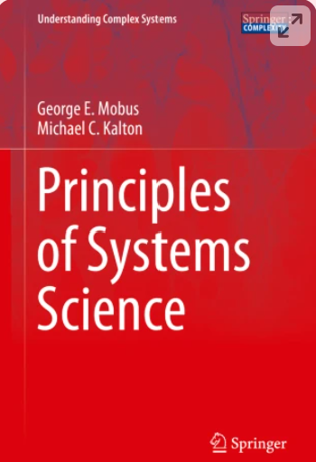
Engineering/Science
Principles of Systems Science,
Mobus & Kalton, Springer
  A representation of a system that is more abstract and reduced in form
  Only [includes] the essential elements that represent the important aspects of the system.
  To explore questions about structure and functions
  Types: physical, conceptual, visual, computer-based, mathematical

Slide 35
Engineering/Science
Principles of Systems Science,
Mobus & Kalton, Springer
  “If we get a model to produce the same behavior as the real-life system, then we have a great deal of confidence that we really understand the system.”
  Tradeoff in complexity and depth of understanding
    Nuclear fusion
  Uses: prediction, testing factors/design, verification of understanding (test hypotheses/ ”post-diction”)
Notes:
nuclear fusion example

Slide 36
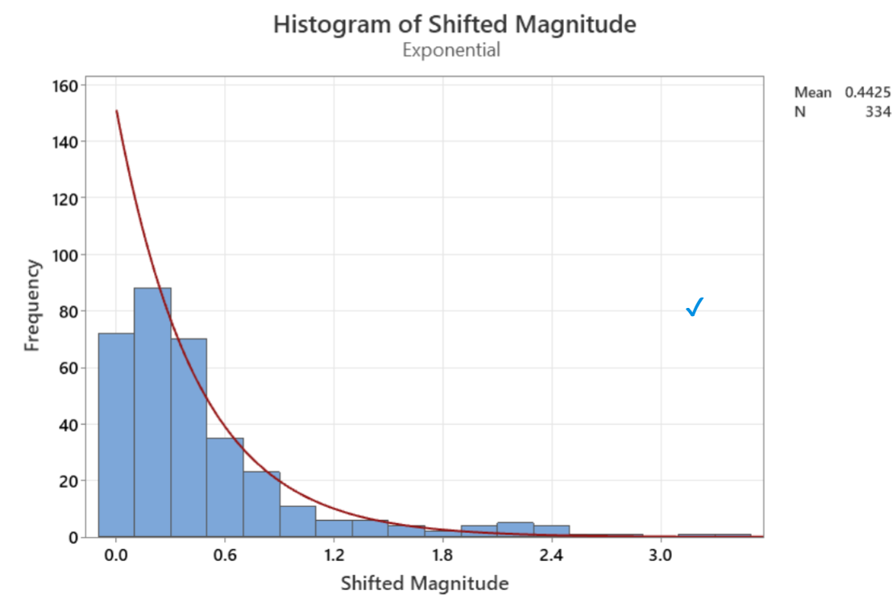
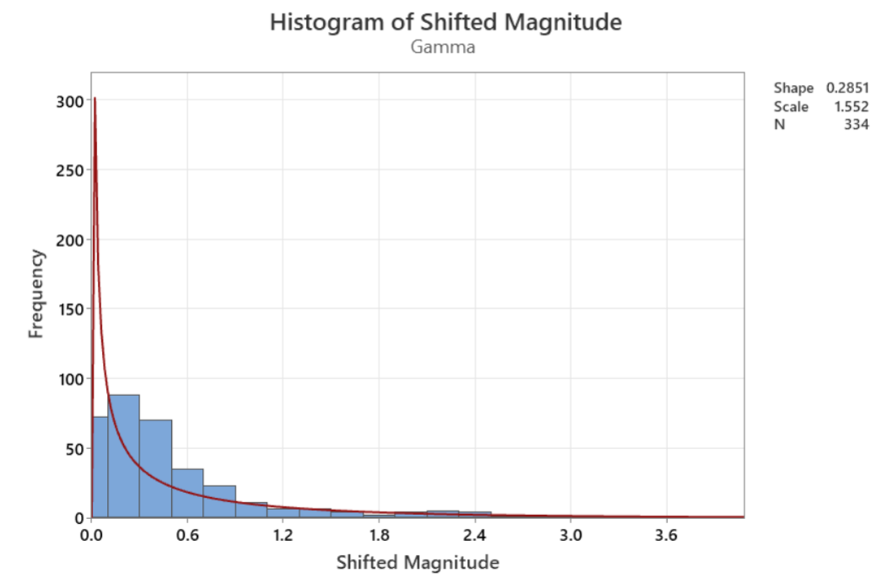
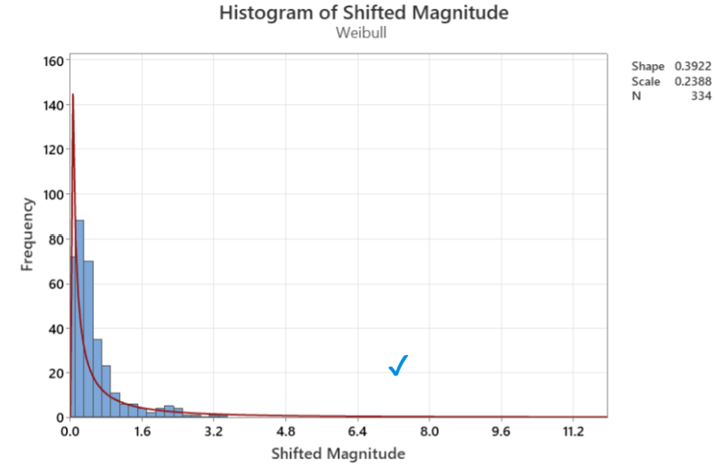
Stat 321 (Probability and Statistics for Engineers)
Lab 6: Modelling earthquake magnitudes
Suppose we want to estimate the probability of an earthquake registers 3.0 or higher.
  Download the most recent earthquake data: https://www.642weather.com/weather/earthquakes-usa.php
  Calculate the proportion of these earthquakes that are above 3.0

Slide 37
How should I teach about models in introductory statistics?
Build on student intuition
  Choice of language
Provide hands-on/tactile experience
Relevant contexts
Multiple representations
  including conceptual, visual

Slide 38
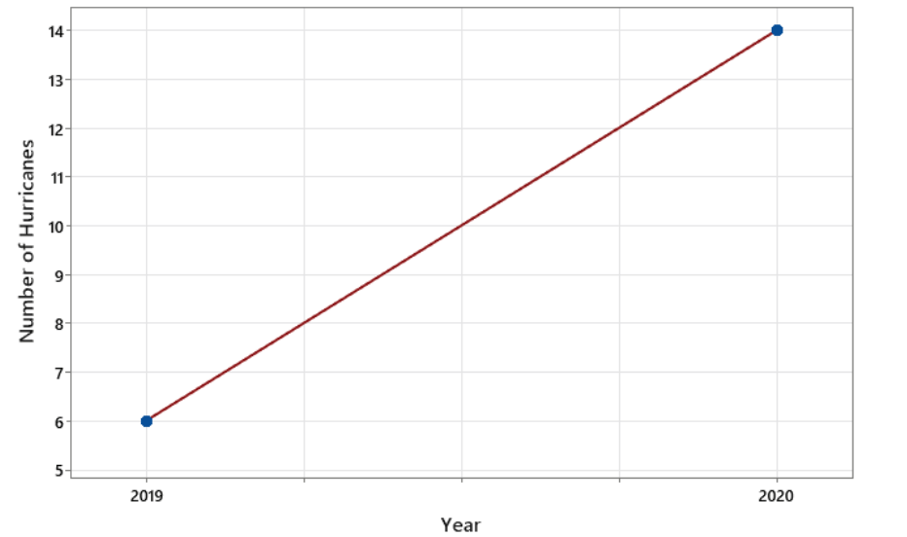
Stat 301 – Day 1
One of the concerns with climate change is an increased number of tropical storms (including hurricanes and major hurricanes).
In 2020, scientists were alarmed because there were 14 recorded hurricanes, compared to 6 in 2019.

Slide 39
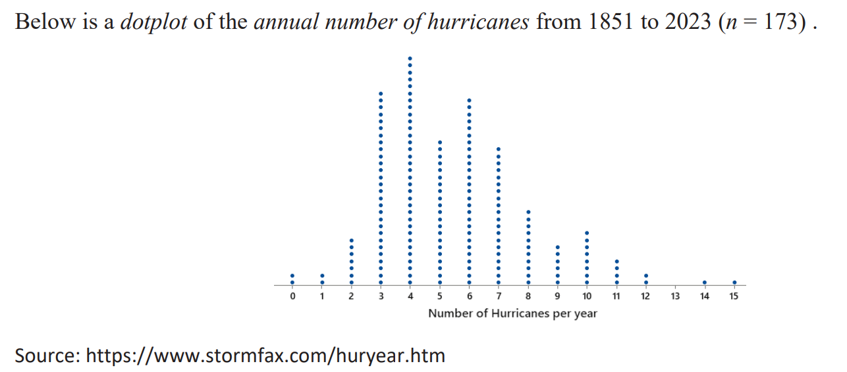
Stat 301 – Day 1
Calculate percentage change
Does this convince you that climate change is leading to an increase in the number of hurricanes (in the Atlantic)? If so, explain why. If not, explain what additional information you would want to know

Slide 40
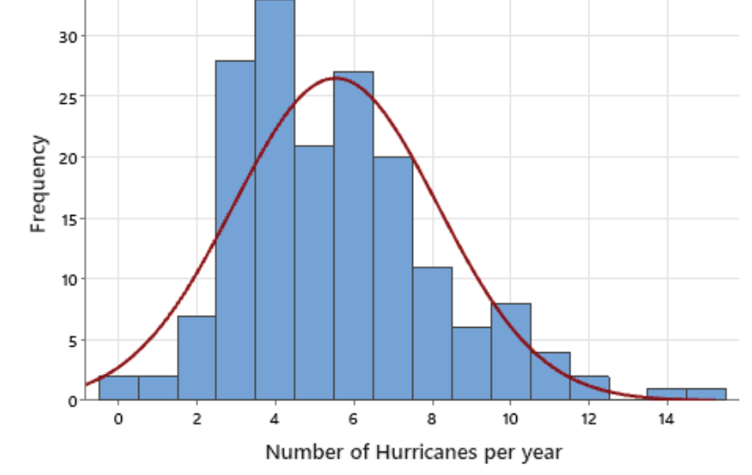
Potential model
Between classes: Read about shape, center, variability, mean, median, SD
Does this model appear to be a good match to the data? Explain why or why not.
According to the model, would we be surprised if next year had 13 hurricanes?
Is 14 in a year an unusual amount?

Slide 41

HW 1
(a) Model a hurricane
  Visit https://scied.ucar.edu/interactive/make-hurricane
  Move the red hurricane symbol to a circle on the map and read what happens.
  Switch between the Sea Surface Temperature, Moisture, and Wind maps to see the data for each circle.
  Which circles create the strongest hurricanes? Why?
  In your own words, explain how sea surface temperature, moisture, and wind interact to create strong hurricanes - or weaken them.
(b) What does the term “model” mean here? What did it mean when we were looking at data? (Your answer to (b) should be your own thinking, you should not look up any definitions. (full credit for submissions))

Slide 42
Stat 301 “I wonder” questions
How accurate are weather prediction models? How do weather analysts give their predictions?

Slide 43
What does the term “model” mean here?
Vs when we were looking at data?
“Here, the term “model” means to simulate or to represent something that will be studied.”
  Representation, Artificial, Simulation, Mimic, Recreation, Theoretical, Hypothetical
  Diagram, Display, Example
Allows us to study the phenomenon
  Analyze variables/factors, Make predictions, Interaction
  Explore possibilities, Demonstration
When looking at data?
  See trend, patterns, make predications/expectations
Notes:
More than just a model airplane

Slide 44
Stat 217 – Day 1
The 2020 Atlantic hurricane season was extremely active and destructive with 30 named storms… Let’s explore National Hurricane Center (www.nhc.noaa.gov). Select Educational Resources > Climatology.
(a) How many different types of storms are there? What is the main differentiation among the types of storms?

Slide 45
Stat 217 – Day 1
(d) Calculate the percentage change in the number of hurricanes from 2019 to 2020.
(e) Does this convince you that climate change is leading to an increase in the number of hurricanes (in the Atlantic)? If so, explain why. If not, explain what additional information you would want to know

Slide 46

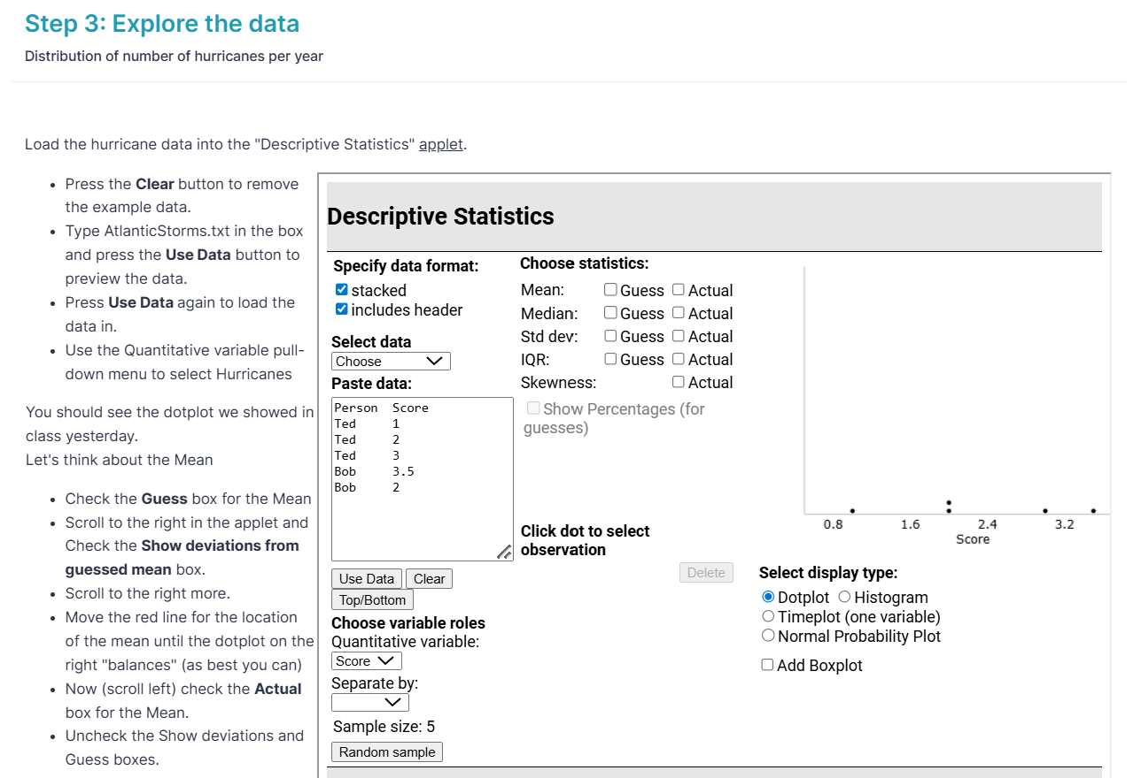
Day 2 – Investigation 0

Slide 47
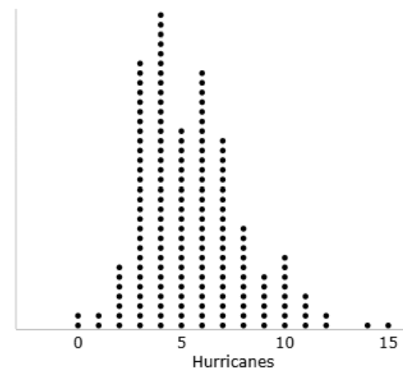
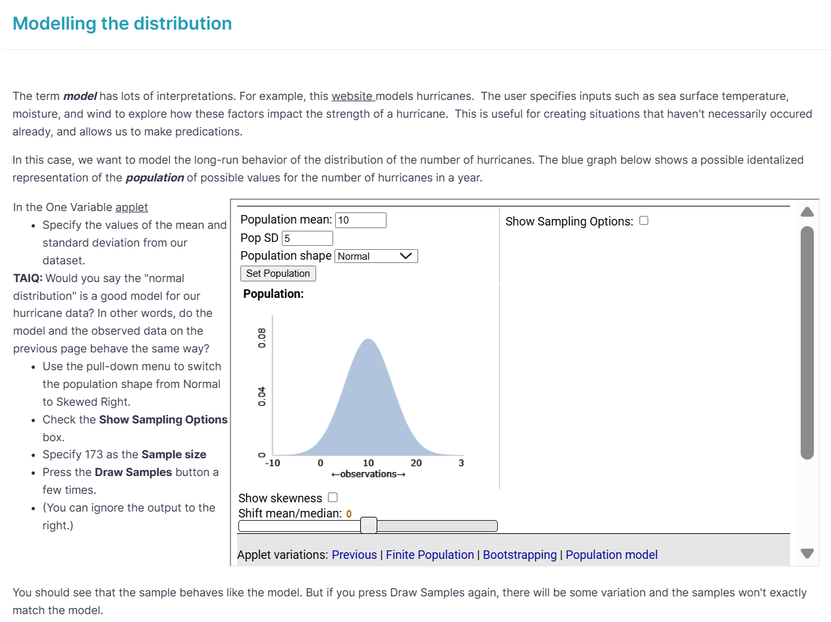
Day 2 – Investigation 0
Mean = 5.54
SD = 2.60
Notes:
MEAN = 5.538, SD = 2.603

Slide 48
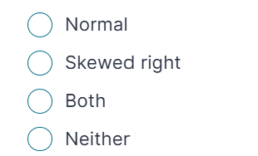
How’d they do?
(c) Which model seems more appropriate for our hurricane data?
16/18 groups chose the skewed right model

Slide 49
(d) Explain your reasoning.
Our observed data set is definitely from the skewed right population as it has a longer tail toward the right of the graph as the number of hurricanes per year gets larger. Through the observation of multiple random variations, our sample and the randomly generated samples are pretty consistent, as most of the generated graphs also have a clear longer tail towards the right, making their data also skewed right.
The original data set's outliers are concentrated on the right side of the graph, creating a definitive skew. When creating data sets with the random generator model, the skewed to the right models much more accurately mirrored the actual data. On the other hand, the normal model was never able to match the shape as accurately.
Yes, because there are many outliers on the right side of the graph and the behavior of the sample is consistent. The actual data matches up with the models that are skewed to the right most accurately.
The observed data set appears to be consistent with a right skewed population, though not entirely. While it follows the general trend of a right- skewed distribution, there are some inconsistencies. This could be due to random variation, sample size limitations, or other factors affecting the data.

Slide 50
End of Day 2: “I wonder” Questions
How the data we found through the hurricane website, while it explains how the 2020 total number of hurricanes was concerning, relates back to climate change as the initial question asks.
How are hurricanes related to climate change?
The number of hurricanes that occur and what is normal and what is not.
How general of data is too general to make specific assumptions based off of it.
I wonder how the graph demonstrating hurricanes per year would differ if the data collected was associated with strength or wind and amount of rain rather than number, which could possibly show a clearer correlation to climate change.

Slide 51
Beginning of Day 3: Please write what the term “model” means to you (Definition? Example? Visual?)
Representation/Exemplification of theory, real life
Representation of data
  Visual, display
  Used to help visualize and determine patterns within that data
    Example: dotplot
  To infer things about the real world
Visual demonstration
  Set of instructions vs. How something works
Notes:
Maybe not as sophisticated, but is that background or activity?

Slide 52
Start of the course (Days 1-3)
Distribution/ Variability/ Models
Obs unit/ Variable/ Res Q
Probability/ Simulation

Slide 53
So which is it?
Statistical model
  Data generating model (Data = Model + Error)
  Start with the mean as a model
  Deterministic vs. Stochastic model
Probabilistic model
    “… it is important for researchers to understand the assumptions embedded in mathematical probability theory before attempting to make statistical claims.”
Aronow & Miller, 2019

Slide 54
Statistics Education Research
Statistical Reasoning, Thinking, and Literacy (International) Forums (SRTL https://srtl.info/)
  SRTL-9 (2015): statistical modeling and informal inference
  SRTL-10 (2017): how students reason about models; connecting data, chance, and context

Slide 55
Pfankuch, Ben-Zvi, & Budgett
(ZDM, 2018)
The field of statistics education research seems to have matured to the point that it is now ready to consider statistics learning and thinking as a modeling enterprise.
EDA approach: goal is to model/learn about the nature of a real-world situation
Probabilistic: probabilistic nature of the model being used and the situation involved (sampling, uncertainty)
Need for a “smooth transition” between them
  And between data and model
Notes:
Innovations in statistical modeling to connect data, chance and context

Slide 56
Introducing students to models
e.g., Konold, Harradine, & Kozlak (2007), Lehrer, Kim, & Schauble (2007)
  Creating models to simulate data, compare to observed data
  Develop a measure of precision (MAD, SD)
    Pros and cons of different measures
    Limitations of different approaches
  Inventing and revising models
  Facilitated by advancing software for teaching

Slide 57

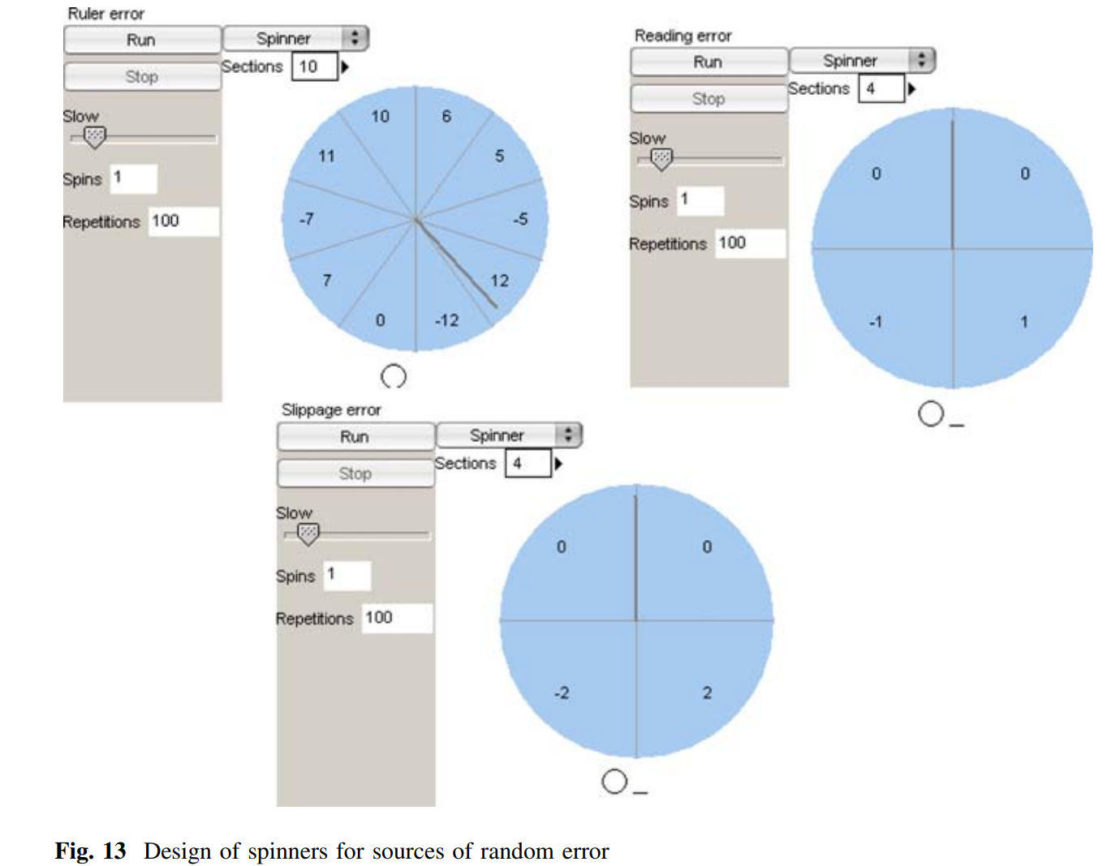
Tinkerplots

Slide 58

Hey ChatGPT, make me an
RShiny app…
https://iambethchance.shinyapps.io/modeling2/
Goals (Phase 1)
  Visualization of Data = Model + Error
  Relatable context
  Student control (“if you can make it…”)
    Flexibility (Sources of variation)
    Number of repetitions
    One element at a time
    Ability to compare to observed data
Notes:
Repeated measurements of my temperature

Slide 59
Benefits
Get students thinking about
  Data = Model + Error
    Prediction + prediction error (deviation)
    Fit + residual
    Tabor& Franklin: performance = ability + random chance
    “truth + error”
    Structure + variability

Slide 60
Algorithmic Models
Use of means of subsets of data for making predictions (Ward & Fountain, 1996)
  “The intuitive nature of classification trees and use of simple performance measures such as classification accuracy may allow the students’ cognitive resources to be spent on understanding the process of statistical modeling.”
Zieffler et al., 2021

Slide 61
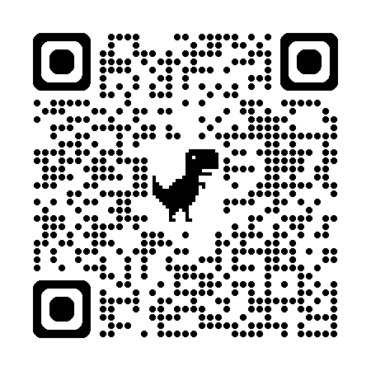
I’ve got an applet for that…
Multiple Variables applet
  Testing new “splitting” feature

Slide 62
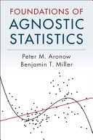
Foundations of Agnostic Statistics (Aronow & Miller, 2019)
  “We attempt to consider what can be learned about the world without assuming that there exists a simple generative model that can be known to be true.”
Key: Data consist of “independent and identically distributed” observations
  Not clustered (new information from each observation)
  Not changing over measurement timeframe
“Random generative process”
  Parameter = estimate + uncertainty
  Metric: Mean squared error
Notes:
Rather than making unrealistic model assumptions
How well the random variable approximates c

Slide 63
I used to have an applet for that…

Slide 64

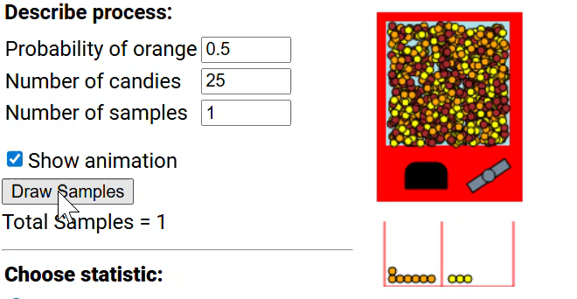
I used to have an applet for that…
Reese’s Pieces applet

Slide 65
What is a Model?
Mean as a model
Normal distribution as a model
  And are alternatives
Regression
Simulation models
  Compare to mathematical model when can

Slide 66
Some Key Takeaways
Data = Model + Error can serve as an overall framework to help students connect tools, methods, and ideas together across courses
  Visuals, Word Equations
Allows focus on explained vs. unexplained variation (“It’s all about the SSError”)
  Statistics is about making sense of variation
Allows more opportunities to contrast data and chance

Slide 67
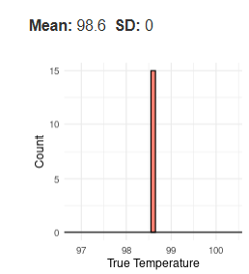
Some Key Takeaways
Start with “repeated measurements”?
  Independent and identically distributed
  Ask students to speculate about the behavior of the data if the precision of measurement were perfect, so that there were ‘‘no mistakes, no errors.’’
Compare model to raw data
  Visually, Proportion in particular region
  Does the data behave like you expect?
  Does the model? (predictive model checking)

Slide 68
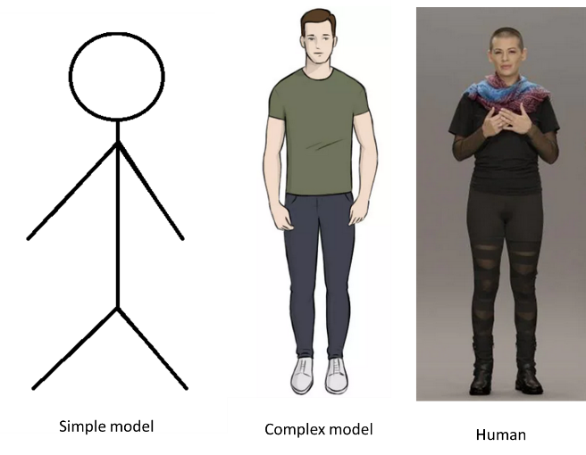
Some Key Takeaways
Consider a formal definition, initial engagement with the principle of models
  “Perhaps an introduction to statistical modeling that does not embed the topic in statistical inference would help set foundations that could better facilitate important ideas of probabilistic modeling later on.”
(Zieffler et al., 2021)
STUB participant Natalia Toporikova, Biology, Washington & Lee University

Slide 69
Some Key Takeaways
Engage students in the model building process
  Choice of “inputs”
  Outline/Describing the process
  Limitations of simple models
Try to leverage students’ natural language
  Fake, Synthetic, Simulated, Fluke
“Agency mediates students’ apprehension of variability by making the process transparent”
(Lehrer et al., 2007)

Slide 70
Some Key Takeaways
Meaningful context
  Including why useful to model
‘Tasks that required students to collect and model their own data increased their need and desire for finding their own solutions and extending their knowledge.’
Notes:
Practice is more about comparing competing models

Slide 71
Some Key Takeaways
Include focus on evaluating models
  Show more than one
    Rejecting the null hypothesis…
  Focus on (mean) sum of squared errors or standard deviation of residuals
    Residual variation
  Zieffler et al, 2021: Not always intuitive for teachers

Slide 72
Teachers need…
More focus on transition from deterministic model to stochastic model
Incorporate specific instructions to compare models
More experience
  “… teachers need to be exposed to a range of modelling activities that provide multiple opportunities for explanations and justifications of the modelling decisions that were made.” (not just regression) (Doerr, 2007)
  SET Report: Recommendation 4. All courses and professional development experiences for statistics teachers should allow them to develop the habits of mind of a statistical thinker and problem-solver, such as reasoning, explaining, modeling, seeing structure, and generalizing

Slide 73
References
Justice, N., Le, L., Sabbag, A., Fry, E., Ziegler, L., & Garfield, J. (2020). The CATALST Curriculum: A Story of Change. Journal of Statistics Education, 28(2), 175–186. https://doi.org/10.1080/10691898.2020.1787115
Son, J.Y., Blake, A.B., Fries, L., & Stigler, J.W. (2021). Modeling first: Applying learning science to the teaching of introductory statistics. Journal of Statistics Education.
Ward, J., Polk, S., Alley, W. (1990). Teaching Researchers to Create Linear Models to Solve Practical Problems, ICOTS-3
Wald, J., & Fountain R. (1996). More Problem Solving Power: Exploiting Prediction Models and Statistical Software in a One-Semester Course, JSE 4(3).

Slide 74
References
Pfannkuch, M., Ben-Zvi, D., & Budgett, S. (2018). Innovations in statistical modeling to connect data, chance and context, ZDM.
Konold, C., Harradine, A., & Kazak, S. (2007). Understanding distributions by modeling them. International Journal of Computers for Mathematical Learning, 12(3), 217–230.
Lehrer, R., Kim, M.-J., & Schauble, L. (2007). Supporting the development of conceptions of statistics by engaging students in measuring and modeling variability. International Journal of Computers for Mathematical Learning, 12(3).
Zieffler, A., Justice, N., delMas, R., & Huberty, M. D. (2021). The Use of Algorithmic Models to Develop Secondary Teachers’ Understanding of the Statistical Modeling Process. Journal of Statistics and Data Science Education, 29(1), 131–147. https://doi.org/10.1080/26939169.2021.1900759
Doerr, H. (2007). What Knowledge Do Teachers Need for Teaching Mathematics Through Applications and Modelling? In Modelling and Applications in Mathematics Education

Slide 75
References
Aronow, P. & Miller, B. (2019). Foundations of Agnostic Statistics, Cambridge University Press.
Tabor, J. & Franklin, C. (2019). Statistical Reasoning in Sports, Bedford, Freeman, & Worth.
Different cultures of modeling vs. prediction vs. causation
Breiman, L. (2001) “Statistical Modeling: The Two Cultures,” Statist. Sci. 16 (3) 199 - 231,
Shmueli, G. (2010) “To Explain or To Predict,” Statistical Science, 25(3), 289-310.
Interpretable machine learning…

Slide 76

Thank you!
Thanks also to Anelise Sabbag, Sinem Dimerci, Frank Chance, Amy Truong, Allan Rossman, Soma Roy, Karen McGaughey
Notes:
For supporting this talk along the way

