Slide 1
Improving the Presentation of Visual Information All Things Gestalt
Chris
Malone
Tisha
Hooks
Todd
Iverson
Winona State University

Slide 2
Block 1
An introduction to the Gestalt principles

Slide 3
Gestalt Principles
e
d
n
o
n
l
@
u
Chris Malone
Email: malone@winona.edu
i
a
c
m
o
w
e
a
.

Slide 4
Concept
e
ways
b
Predictable
w
y
which
or gan ize
s
o
r
Informatl0n
y
s
n
e

Slide 5
Concept
Predictable ways by which we organize sensory information
language has structure & patterns

Slide 6
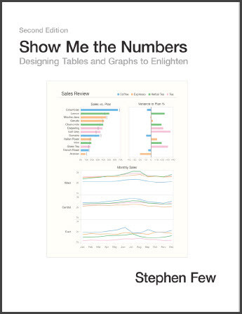
Source: https://www.usertesting.com/blog/gestalt-principles#common
Source: https://www.amazon.com/Show-Me-Numbers-Designing-Enlighten/dp/0970601972

Slide 7
Few
_
Similarity
Proximity
Enclosure
Closure
Continuity
Connection
UserTesting
Figure-Ground_
Similarity
Proximity
Common Region
Closure Continuity
Focal Point
_
1
2
3
4
5
6
7

Slide 8
Principle #1: Figure-Ground Principle
Predictable

Slide 9
Predictable

Slide 10
Principle #1: Figure-Ground Principle
Predictable
We can separate letters from background because of figure/ground principle
Perceive objects as either being in foreground or background

Slide 11
Principle #1: Figure-Ground Principle
Predictable
We can separate letters from background because of figure/ground principle
Perceive objects as either being in foreground or background

Slide 12
Principle #1: Figure-Ground Principle
Predictable
If you want to emphasize this less

Slide 13
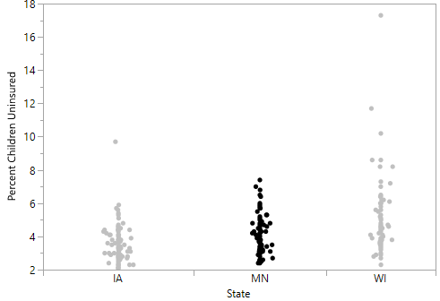
Principle #1: Figure-Ground Principle

Slide 14
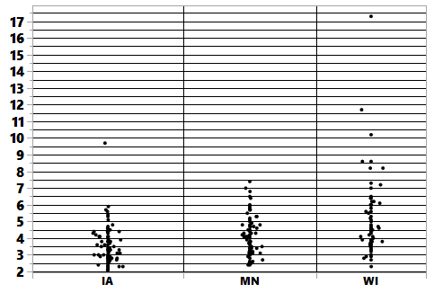
Principle #1: Figure-Ground Principle
Bad

Slide 15
Principle #2: Similarity
Informatl0n

Slide 16
Principle #2: Similarity
Informatl0n
When things appear to be similar to each other, we group them together

Slide 17
Principle #2: Similarity

Slide 18
Principle #2: Similarity
How many groups?

Slide 19
Principle #2: Similarity
How many groups?

Slide 20
Principle #2: Similarity
How many groups?
Similarity + Similarity

Slide 21
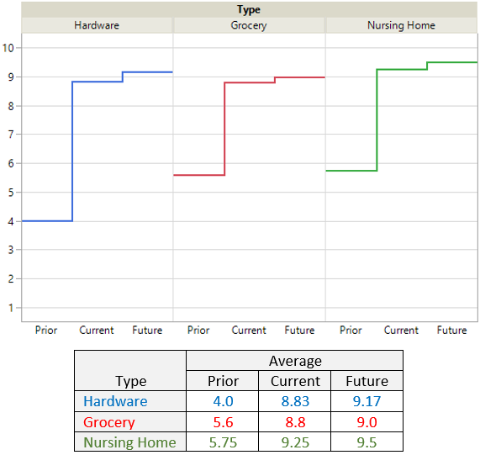
Principle #2: Similarity
Bringing trends and text together via similarity

Slide 22
Principle #3: Proximity
or gan ize
Things that are close together appear to be more related than things that are spaced apart

Slide 23
Principle #3: Proximity

Slide 24
Principle #3: Proximity
How many groups?

Slide 25
Principle #3: Proximity
How many groups?

Slide 26
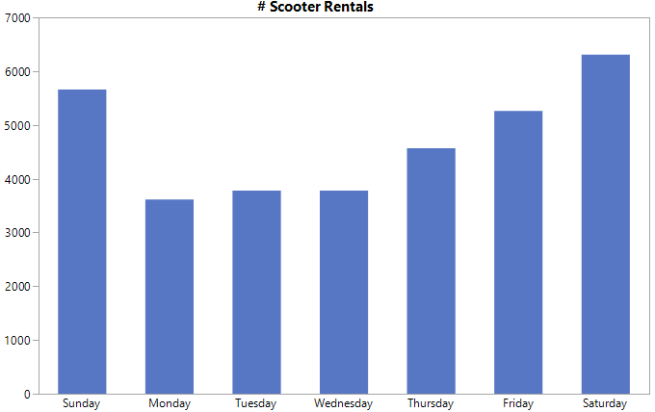
Principle #3: Proximity
Compare weekdays &
Compare weekend days

Slide 27
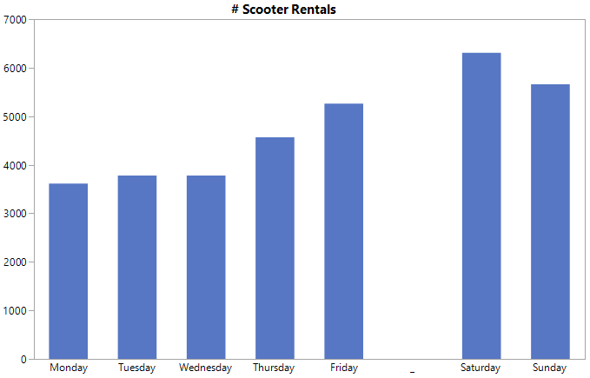
Principle #3: Proximity
Compare weekdays &
Compare weekend days
Create a gap

Slide 28
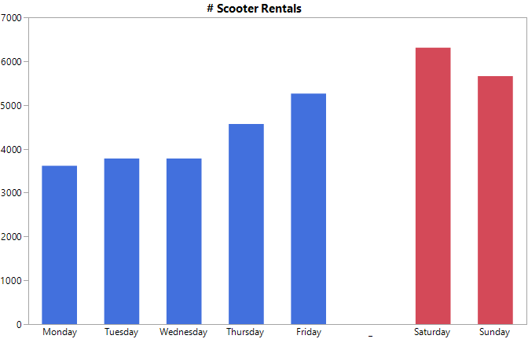
Principle #3: Proximity
Compare weekdays &
Compare weekend days
Proximity + Similarity

Slide 29
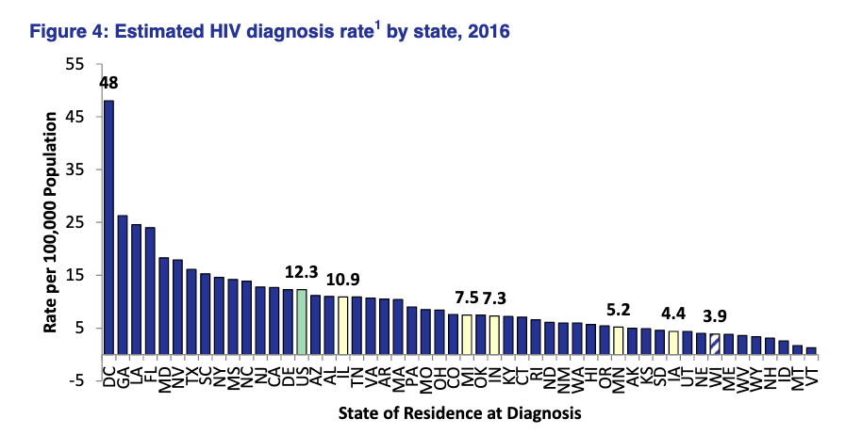
Principle #3: Proximity
Compare HIV Rates in WI to other states

Slide 30
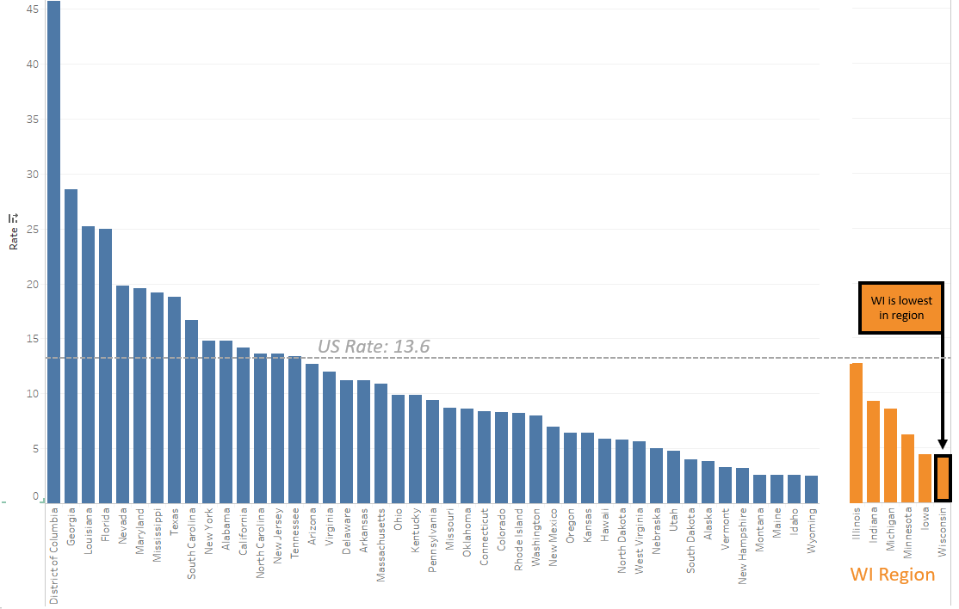
Principle #3: Proximity
Compare HIV Rates in WI to other states

Slide 31
Principle #4: Enclosure / Common Region
e
w
Objects located within the same enclosed region are perceived to be grouped together

Slide 32
Principle #4: Enclosure
e
w

Slide 33
Principle #4: Enclosure

Slide 34
Principle #4: Enclosure
How many groups?

Slide 35
Principle #4: Enclosure
How many groups?

Slide 36
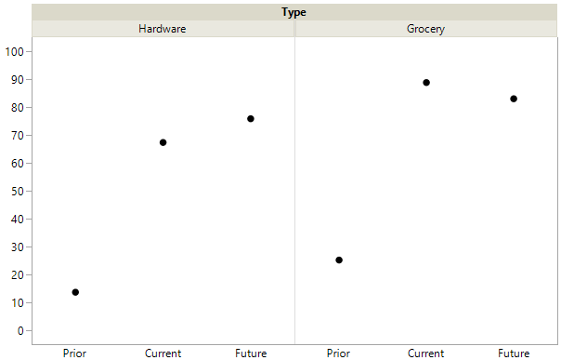
Principle #4: Enclosure
Compare face mask use
across business type
% Customers Wear Face Masks

Slide 37
Principle #4: Enclosure
Circled dot gets compared against which other dots?
% Customers Wear Face Masks

Slide 38
Principle #4: Enclosure
Circled dot gets compared against which other dots?
% Customers Wear Face Masks

Slide 39
Principle #4: Enclosure
Circled dot gets compared against which other dots?
% Customers Wear Face Masks
No

Slide 40
Principle #4: Enclosure
Dots enclosed are to be compared
% Customers Wear Face Masks

Slide 41
Principle #6: Closure
ways
We tend to put objects in
whole regions

Slide 42
Principle #6: Closure
Not a whole
anymore

Slide 43
Principle #5: Closure
Closure allows us
to see the zebra

Slide 44
Principle #5: Closure
Goal: Identify 6 out of 20

Slide 45
Principle #5: Closure
Goal: Identify 6 out of 20

Slide 46
Principle #5: Closure
Goal: Identify 6 out of 20
Closure + Similarity

Slide 47
Principle #5: Closure
Goal: Identify 6 out of 20
Closure + Similarity + Proximity

Slide 48
Principle #5: Closure
Goal: Identify 6 out of 20
Closure + Similarity + Proximity

Slide 49
Principle: Continuity

Slide 50
Principle: Continuity

Slide 51
Principle #6: Connection
s
o
r
y
n
e
Elements that are connected are perceived to be more related than elements not connected

Slide 52
Principle #6: Connection
s
o
r
y
n
e

Slide 53
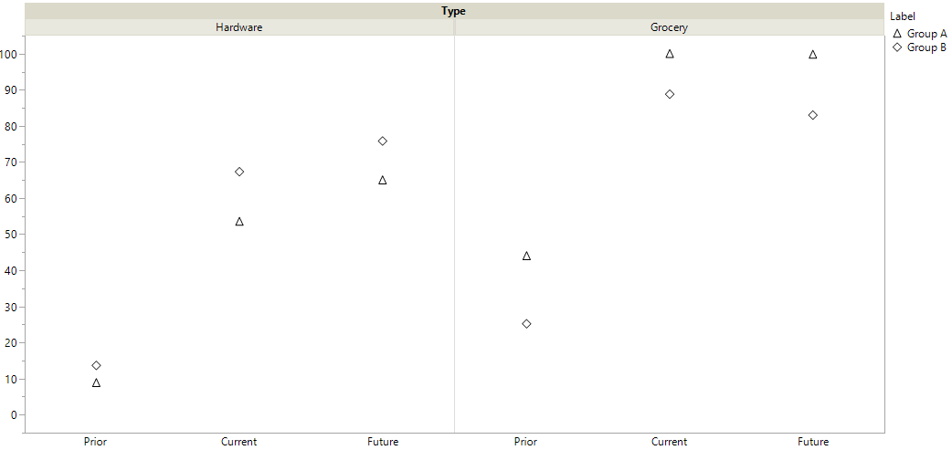
Principle #6: Connection
Goal: Compare across
three time periods

Slide 54
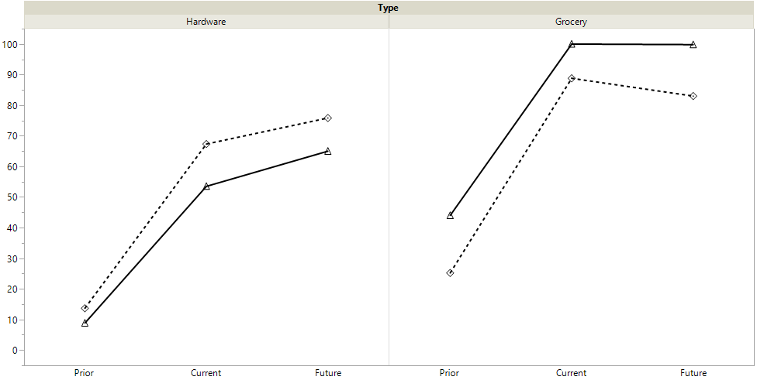
Principle #6: Connection
Connecting the dots
improves our
ability to compare

Slide 55
Principle #7: Focal Point
b
y
Elements that stand out will capture and hold the viewers attention first

Slide 56
Principle #7: Focal Point
Compare HIV Rates in WI to other states

Slide 57
Principle #7: Focal Point

Slide 58
Principle #7: Focal Point
Annotations ↔ Focal Points

Slide 59
Breakout #1
Identify Gestalt Principles

Slide 60
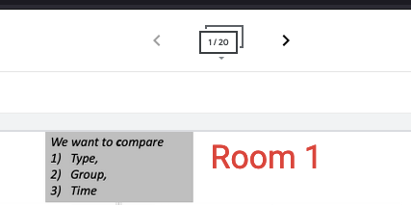
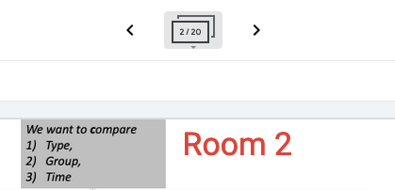

Slide 61
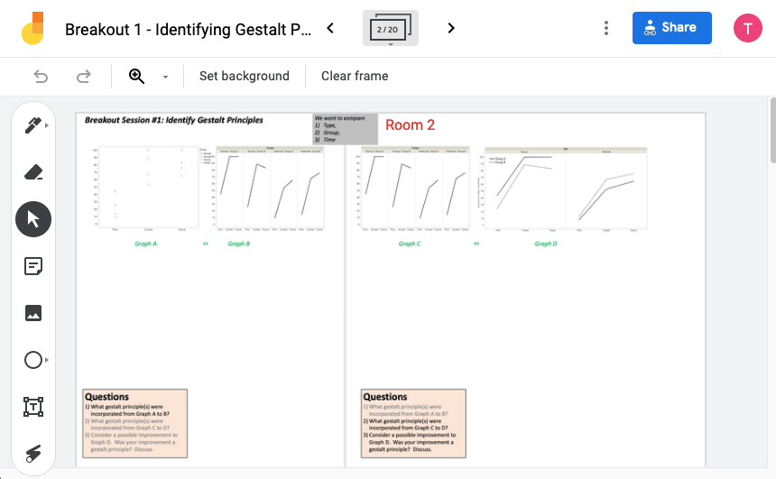
Please record your group’s work!

Slide 62
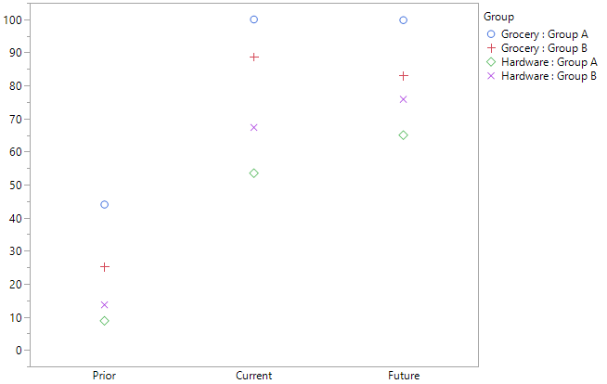
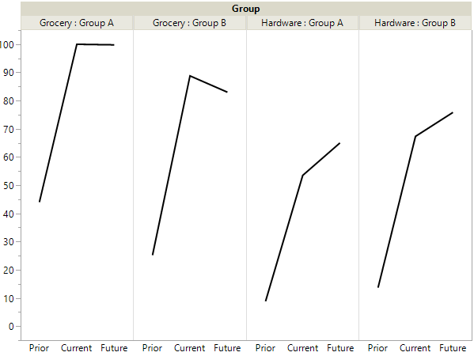
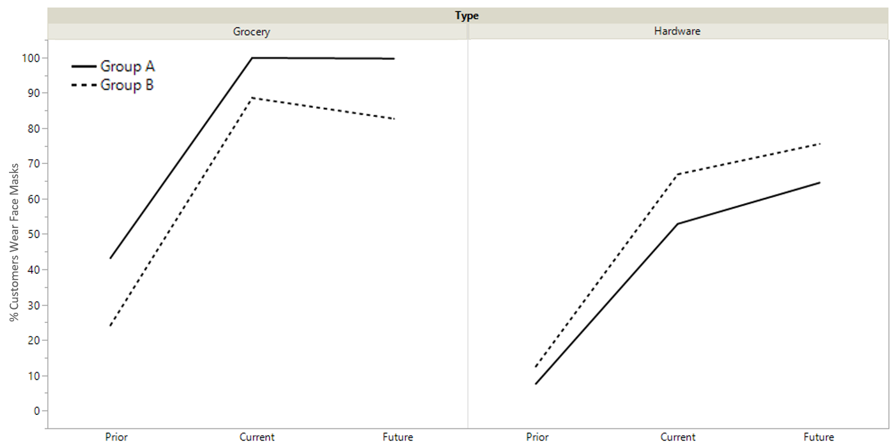
Sticky Note
What gestalt principle(s) were incorporated from Graph A to B?
What gestalt principle(s) were incorporated from Graph C to D?
Consider a possible improvement to Graph D. Was your improvement a gestalt principle? Discuss.
Breakout Session #1: Identify Gestalt Principles
Desire: Compare 1) Type, 2) Group, 3) Time
Graph A
Graph C
vs
vs
Graph B
Graph D

Slide 63
Gestalt hierarchy (Adapted from Bergen 2020)
Tables
Graphs
Enclosure
Closure
Connection
Proximity
Similarity
Grids/cell shading
Rules/Divider
White space
Font properties
Facets / Pane
Divider
Lines
White space
Color/Shape
Strongest
Weakest

Slide 64
Block 2
Elemental Groupings, Tables, and a Case Study

Slide 65
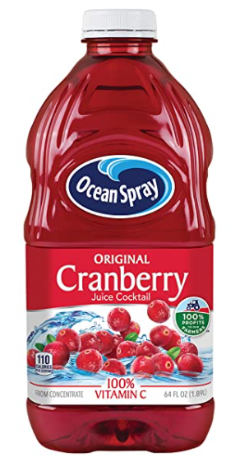
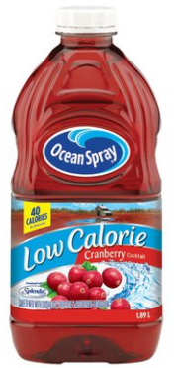
Gastric emptying example
Standard CBJ
Reduced Cal CBJ
0
30
60
90
120
Healthy
Metabolic Syndrome
Plasma AC
Higher Plasma AC faster gastric emptying rate

Slide 66
Gastric emptying example – research questions
Primary: Does the change in plasma AC level depend on juice type?
Secondary: Does the relationship between the change in plasma AC level and juice type differ depending on whether the subject is healthy or has metabolic syndrome?

Slide 67
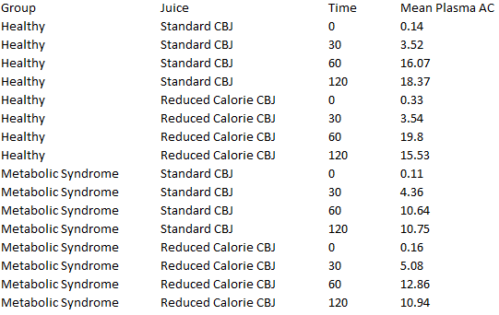
The data
Does the change in plasma AC level depend on juice type?
Need to identify and emphasize the most important comparisons.

Slide 68
Elemental grouping
An elemental grouping is an individual or small collection of data value(s) where interest lies in comparing this individual or collection across levels of one or more grouping variable(s).

Slide 69
The data
Does the change in plasma AC level depend on juice type?

Slide 70
The data
Does the change in plasma AC level depend on juice type?

Slide 71
The data
Does the change in plasma AC level depend on juice type?

Slide 72
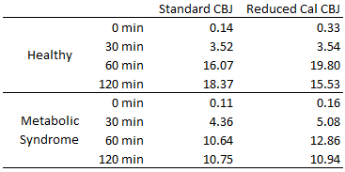
Some table options
proximity
closure

Slide 73
Some table options

Slide 74
Some table options
enclosure
closure

Slide 75
A poor table choice
Proximity violated!

Slide 76
A better table choice
proximity

Slide 77
A better table choice

Slide 78
Even better?

Slide 79
Another poor choice
Enclosure working against us!

Slide 80
Another poor choice
Enclosure still working against us!

Slide 81
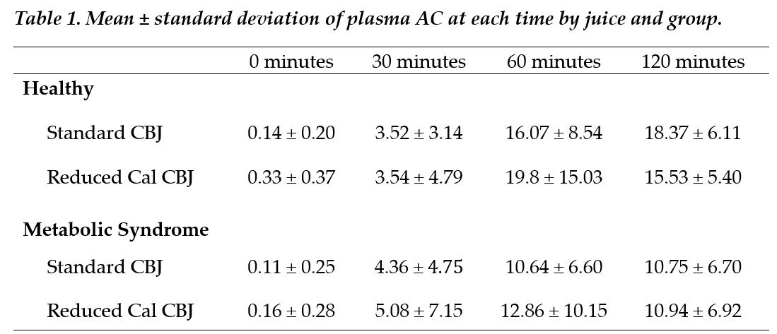
Using white space effectively

Slide 82
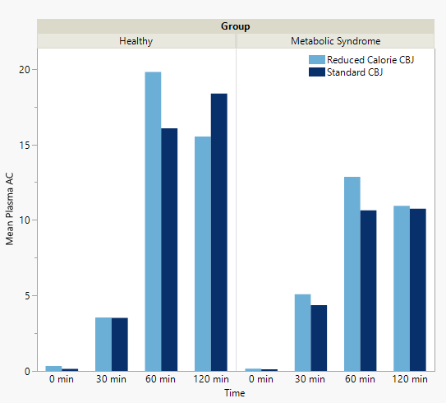
What about graphs?

Slide 83
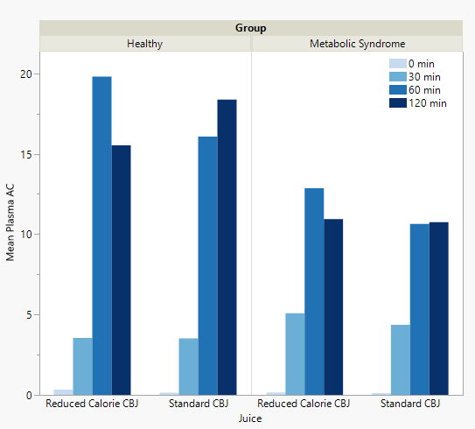
What about graphs?

Slide 84
Gestalt hierarchy (Adapted from Bergen 2020)
Tables
Graphs
Enclosure
Closure
Connection
Proximity
Similarity
Grids/cell shading
Rules/Divider
White space
Font properties
Facets / Pane
Divider
Lines
White space
Color/Shape
Strongest
Weakest

Slide 85
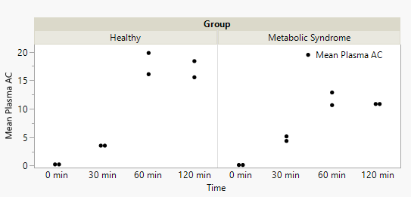
More on graphs…
Elemental grouping not emphasized!

Slide 86
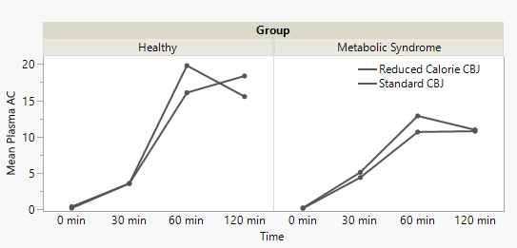
More on graphs…
Elemental grouping emphasized using connection

Slide 87
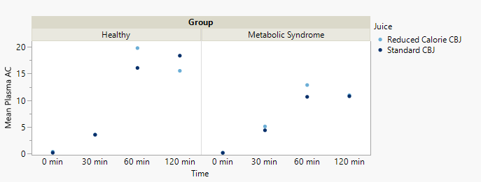
More on graphs…
Elemental grouping emphasized using similarity

Slide 88
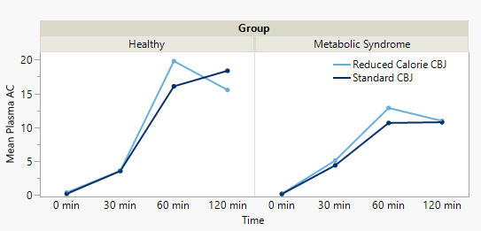
More on graphs…
Reduced Cal. CBJ
Standard CBJ
Elemental grouping emphasized using similarity and connection

Slide 89
The big idea…
1. Identify the most important comparisons.
2. Important comparisons should be close.
3. Emphasize/Group using Gestalt principles.

Slide 90
Breakout Session #2: Redesign the table
Task 1: Create a table to emphasize the most important comparisons.
Task 2: Sketch a rough graph that emphasizes the most important comparisons.
Research question: Does the change in plasma AC level differ between healthy subjects and patients with metabolic syndrome?

Slide 91
Block 3
Gestalt Principles in Presentation Slides

Slide 92
Design Resolution
Bulleted List $≠$ Gestalt Principle
Definition
A design is of resolution $R$ if no $p$-factor effect is aliased with another effect containing less than $R−p$ factors.
Resolution III
no main effect/main effect aliasing
Possible that main effects/two-factor interactions aliasing,
Possible two-factor interactions/two-factor interactions aliasing
Possible two-factor interactions/three-factor interactions aliasing
Resolution IV
No main effect/main effect aliasing
No main effects/two-factor interactions aliasing,
Possible two-factor interactions/two-factor interactions aliasing
Possible two-factor interactions/three-factor interactions aliasing
Resolution V
No main effect/main effect aliasing
No main effects/two-factor interactions aliasing,
No two-factor interactions/two-factor interactions aliasing
Possible two-factor interactions/three-factor interactions aliasing

Slide 93
Design Resolution
Shapes ➔ Leverage Principles
Resolution III
Resolution IV
Resolution V
Main Effect
Main Effect
Main Effect
Main Effect
Main Effect
Main Effect
Main Effect
2-way Interaction
Main Effect
2-way Interaction
Main Effect
2-way Interaction
Possible
2-way Interaction
2-way Interaction
2-way Interaction
2-way Interaction
2-way Interaction
2-way Interaction
Possible
Possible
2-way Interaction
3-way Interaction
2-way Interaction
3-way Interaction
2-way Interaction
3-way Interaction
Possible
Possible
Possible

Slide 94
The $2^{k−p}$ Design
Exercise
Which principles were applied?
Figure/Ground
Similarity
Proximity
Enclosure
Connection
Closure
Focal Point
Original
Design
Total
Runs
$$2^{3}$$
$${2^{3}}/2=2^{3−1}$$
½ Cube
Designs
$$2^{4}$$
$${2^{4}}/2=2^{4−1}$$
$$2^{5}$$
$${2^{5}}/2=2^{5−1}$$
$$2^{3}$$
$${2^{3}}/4=2^{3−2}$$
¼ Cube
Designs
$$2^{4}$$
$${2^{4}}/4=2^{4−2}$$
$$2^{5}$$
$${2^{5}}/4=2^{5−2}$$
$1/{2^{p}}$ Cube
Designs
$$2^{k}$$
$${2^{k}}/{2^{p}}=2^{k−p}$$

Slide 95
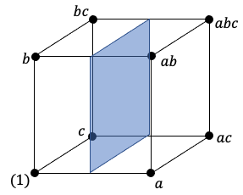
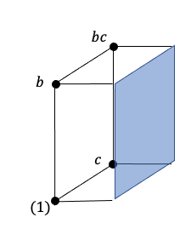
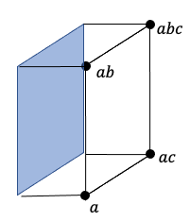
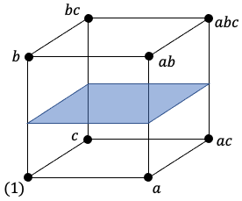
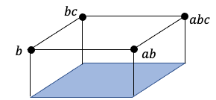
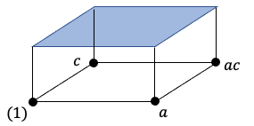
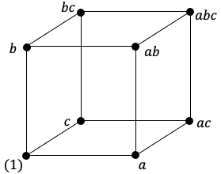
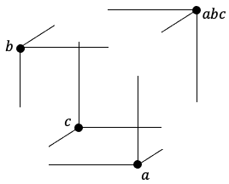
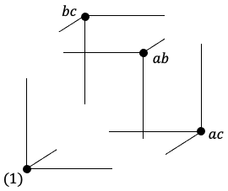
Saving $$ with a fraction of the factorial
Enclosure + Proximity + Connection
OR
1. Split Vertically
OR
2. Split Horizontally
3. Split Diagonally
OR

Slide 96
Saving $$ with a fraction of the factorial
Reveal content using Figure/Ground
OR
1. Split Vertically
OR
2. Split Horizontally
3. Split Diagonally
OR

Slide 97
Saving $$ with a fraction of the factorial
Reveal content using Figure/Ground
OR
1. Split Vertically
OR
2. Split Horizontally
3. Split Diagonally
OR

Slide 98
Saving $$ with a fraction of the factorial
Reveal content using Figure/Ground
OR
1. Split Vertically
OR
2. Split Horizontally
3. Split Diagonally
OR

Slide 99
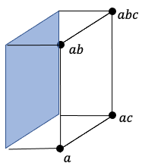
Hard to see the connections
Exploring a Fractional Factorial Splitting Vertically
Treatment | Factorial Effects
Notation | I | A | B | AB | C | AC | BC | ABC
(1) | + | – | – | + | – | + | + | –
c | + | – | – | + | + | – | – | +
b | + | – | + | – | – | + | – | +
bc | + | – | + | – | + | – | + | –
a | + | + | – | – | – | – | + | +
ab | + | + | + | + | – | – | – | –
ac | + | + | – | – | + | + | – | –
abc | + | + | + | + | + | + | + | +

Slide 100
Step 1 – Add a divider
Exploring a Fractional Factorial Splitting Vertically
Treatment | Factorial Effects
Notation | I | A | B | AB | C | AC | BC | ABC
(1) | + | – | – | + | – | + | + | –
c | + | – | – | + | + | – | – | +
b | + | – | + | – | – | + | – | +
bc | + | – | + | – | + | – | + | –
a | + | + | – | – | – | – | + | +
ab | + | + | + | + | – | – | – | –
ac | + | + | – | – | + | + | – | –
abc | + | + | + | + | + | + | + | +

Slide 101
Step 2 - Connection
Exploring a Fractional Factorial Splitting Vertically
Treatment | Factorial Effects
Notation | I | A | B | AB | C | AC | BC | ABC
(1) | + | – | – | + | – | + | + | –
c | + | – | – | + | + | – | – | +
b | + | – | + | – | – | + | – | +
bc | + | – | + | – | + | – | + | –
a | + | + | – | – | – | – | + | +
ab | + | + | + | + | – | – | – | –
ac | + | + | – | – | + | + | – | –
abc | + | + | + | + | + | + | + | +

Slide 102
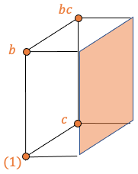
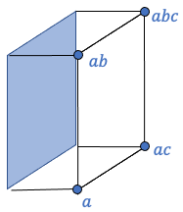
Step 3 - Similarity
Exploring a Fractional Factorial Splitting Vertically
Treatment | Factorial Effects
Notation | I | A | B | AB | C | AC | BC | ABC
(1) | + | – | – | + | – | + | + | –
c | + | – | – | + | + | – | – | +
b | + | – | + | – | – | + | – | +
bc | + | – | + | – | + | – | + | –
a | + | + | – | – | – | – | + | +
ab | + | + | + | + | – | – | – | –
ac | + | + | – | – | + | + | – | –
abc | + | + | + | + | + | + | + | +

Slide 103
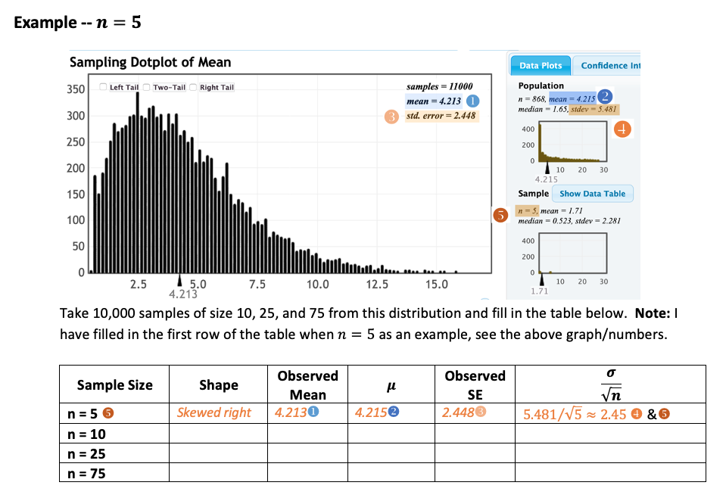
Works with worksheets too!

Slide 104
Population vs. Sample
Example 1.1: Giver vs. Taker
Sample = the 12 five-month-olds
Population = all five-month-olds
Example 1.2: Discrimination
Sample = the 20 employees selected most recently for management in this company
Population = all potential management selections in this company
Example 1.3: Ice Cream Preference
Sample = the 40 subjects in this study
Population = all potential consumers

Slide 105
Population vs. Sample
Sample
Population
Example 1.1
We observed the 12 five-month-olds in the study, but we are making a claim about all five-month-olds.
Example 1.2
We observed the 20 most recent employees selected for management in the study, but we are making a claim about the true long-run behavior of this company towards all of its potential selections for management.
Example 1.3
We observed the 40 subjects in the study, but we are making a claim about what all potential consumers might prefer.

Slide 106
Population vs. Sample
Sample
Population
Example 1.1
We observed the 12 five-month-olds in the study, but we are making a claim about all five-month-olds.
Example 1.2
We observed the 20 most recent employees selected for management in the study, but we are making a claim about the true long-run behavior of this company towards all of its potential selections for management.
Example 1.3
We observed the 40 subjects in the study, but we are making a claim about what all potential consumers might prefer.

Slide 107
Population vs. Sample
Sample
Population
Example 1.1
We observed the 12 five-month-olds in the study, but we are making a claim about all five-month-olds.
Example 1.2
We observed the 20 most recent employees selected for management in the study, but we are making a claim about the true long-run behavior of this company towards all of its potential selections for management.
Example 1.3
We observed the 40 subjects in the study, but we are making a claim about what all potential consumers might prefer.

Slide 108
The Null and Alternative Hypotheses
Breakout Session #3: Suggest 3 improvements that leverage the principles
Consider Example 1.2:
H_{o}: The company is not discriminating against females when selecting employees for the managerial training program.
H_{a}: The company is discriminating against females when selecting employees for the managerial training program.
Consider Example 1.3:
H_{o}: There is no preference for either the original or modified recipe in the population of all consumers.
H_{a}: Consumers prefer one recipe (either the modified or the original) over the other.

Slide 109
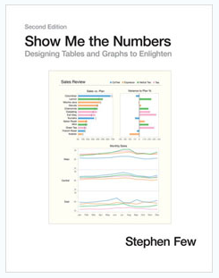
References
7 Gestalt principles of visual perception: cognitive psychology for UX (April 9, 2019); Link: https://www.usertesting.com/blog/gestalt-principles.
Bergen, Silas (2020). Using Gestalt principles to help students design effective tables and graphs; Link: https://github.com/WSU-DataScience/SDSS20_teaching_gestalt/raw/master/Bergen_Gestalt_presentation_SDSS2020.pptx.
Few, Stephen (2012). Show me the numbers: designing tables and graphs to enlighten, second edition, Analytics Press, El Dorado Hills, CA.

Slide 110
Design Resolution
Lab 1 – Redesign this slide
Definition
A design is of resolution $R$ if no $p$-factor effect is aliased with another effect containing less than $R−p$ factors.
Resolution III
no main effect/main effect aliasing
Possible that main effects/two-factor interactions aliasing,
Possible two-factor interactions/two-factor interactions aliasing
Possible two-factor interactions/three-factor interactions aliasing
Resolution IV
No main effect/main effect aliasing
No main effects/two-factor interactions aliasing,
Possible two-factor interactions/two-factor interactions aliasing
Possible two-factor interactions/three-factor interactions aliasing
Resolution V
No main effect/main effect aliasing
No main effects/two-factor interactions aliasing,
No two-factor interactions/two-factor interactions aliasing
Possible two-factor interactions/three-factor interactions aliasing

Slide 111
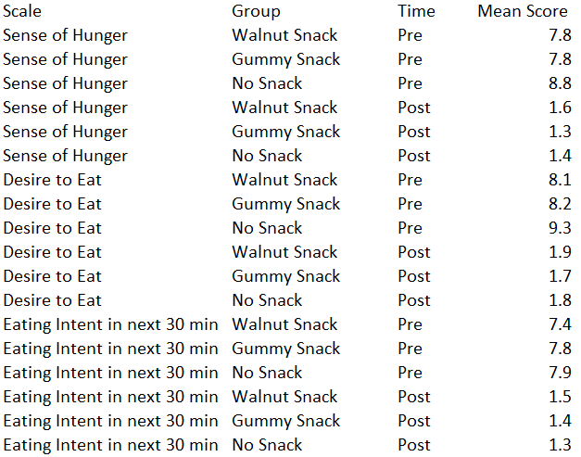
Lab 2 – Design a table + graph
Complete the following tasks for each research question (see following slides).
Task 1: Identify the elemental groupings.
Task 2: Create a table to emphasize the most important comparisons. Remember to think about how to use white space, grids/rules, font styles, etc., to communicate effectively!
Task 2: Sketch a rough graph (or graphs) that emphasize(s) the most important comparisons.

Slide 112
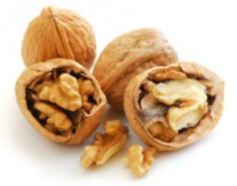
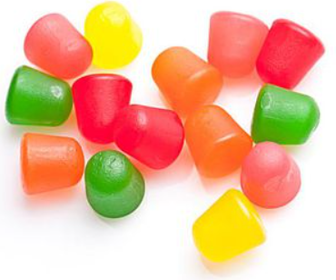
Lab 2 – data description
1 oz. walnuts
190 cal. gummy candy
no snack
Subjects were randomly assigned to one of three pre-meal snack interventions. Treatments were administered 90 minutes before subjects received a standard meal on a tray.
Hunger, Desire to eat, and Food consumption plans were measured at two time periods (pre- and post-meal).
5 min. pre-meal
5 min. post-meal

Slide 113
Lab 2 – the data and research questions
Research Questions:
Does each scale as measured pre-meal differ across treatment group?
Does the change in each scale from pre- to post-meal differ across treatment group?

