Slide 1
Why Johnny Can’t See The Big Picture of Statistics
and what we can do about it
Matthew T. Brenneman, M.S. Statistics
Embry-Riddle Aeronautical University
Rebecca L. Pierce, PhD Statistics
Ball State University

Slide 2
Maybe it’s us…
Dick DeVeaux
“We teach
the wrong stuff
in the wrong way
in the wrong order”
(2015 USCOTS)
Vice President ASA
(2019-2020)

Slide 3
We teach the wrong stuFF
Teach steps not the process
DATA (SURVEY QUESTIONS, n=93)
TESTS (H₀: π = π₀)
SURVEY QUESTION ABOUT STEPS OF THE PROCESS (4 choices) | SURVEY QUESTION ABOUT STEPS OF THE PROCESS
Response | Correct | Incorrect
# students | 60 | 33
$$π_{0}=1/4$$
$p−value<0.01\%$
Students are learning steps
SURVEY QUESTION ABOUT PURPOSE OF THE PROCESS (3 choices) | SURVEY QUESTION ABOUT PURPOSE OF THE PROCESS
Response | Correct | Incorrect
# students | 35 | 58
$$π_{0}=1/3$$
$$p−value=19\%$$
but not the process

Slide 4
In the wrong way
EVERYTHING SHOULD BE centered
around the logic of inference
QUESTION
EXPLAIN
DO
“QED”
Why are we doing this?
How does this work?
What do we do?
PURPOSE
Motivation
Principles
Notation, terms, formulas, etc.
OUTCOME
Statistical
Reasoning
Statistical
Thinking
Statistical
Literacy

Slide 5
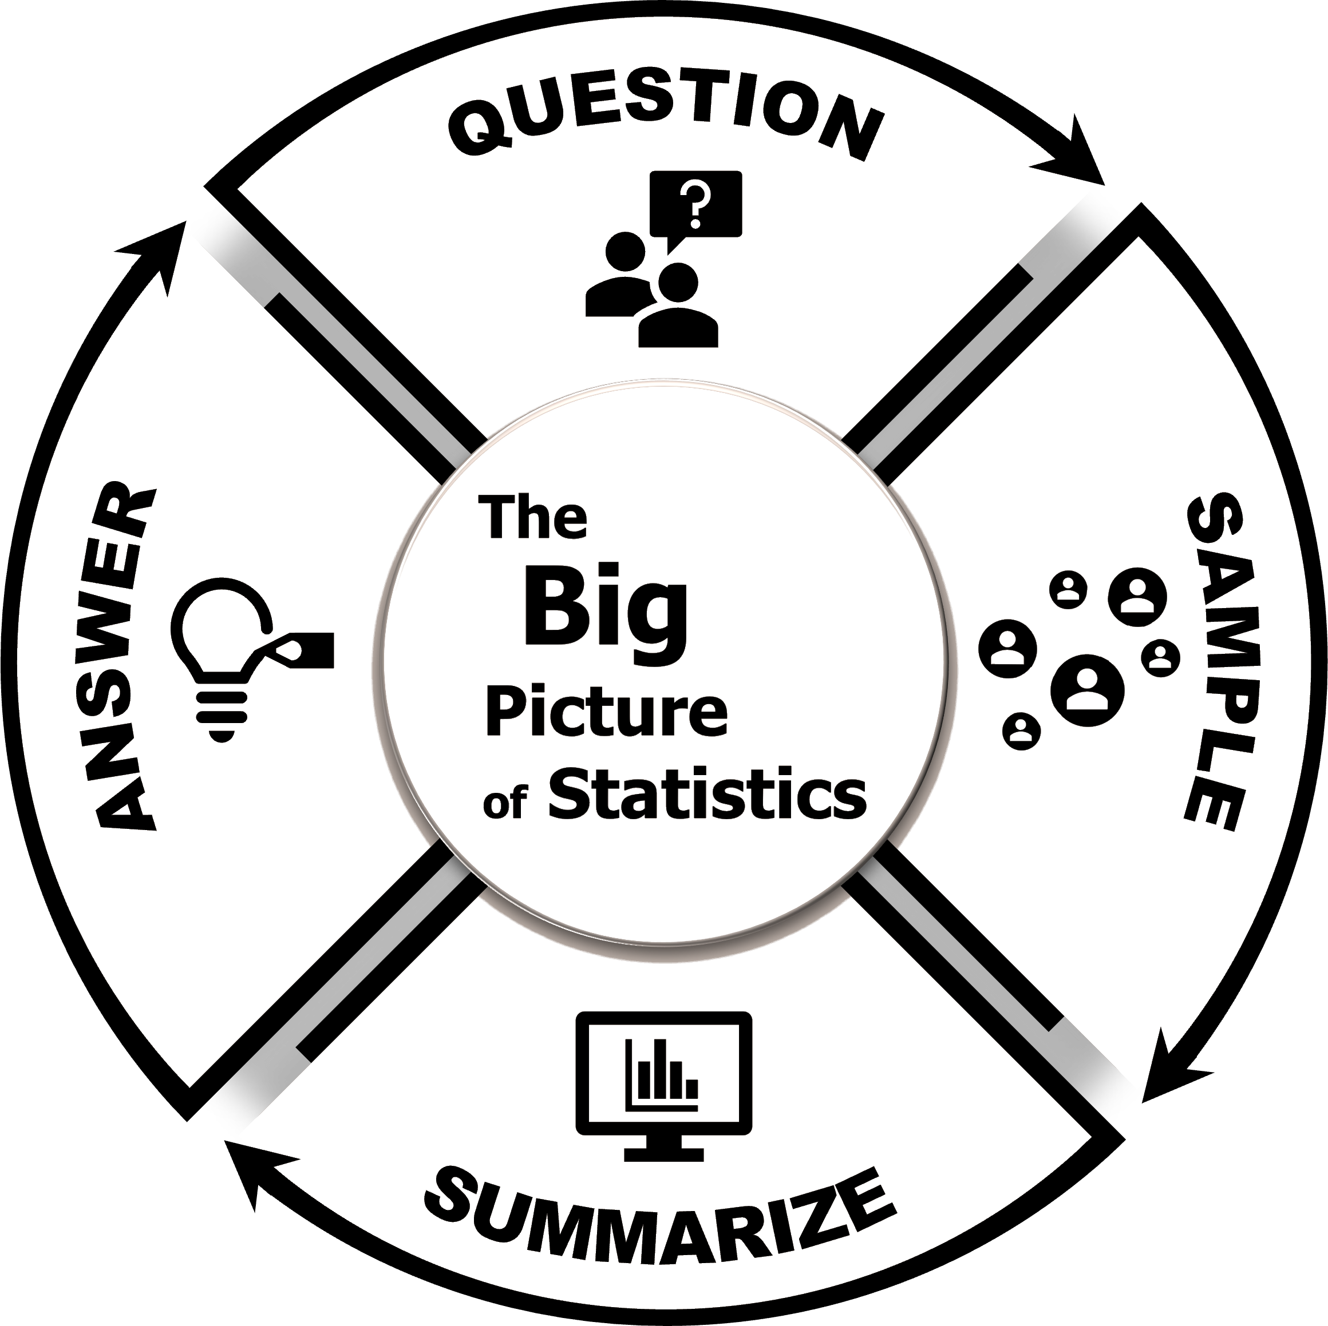
In the wrong order
key elements are introduced at end
With QED We Can Tell Statistics as a Story
Characters:
Parameter & the Estimator
Plot:
Estimator approximates Parameter
Setting:
Context of our problem

Slide 6
CHAPTER 1
The Persnickety Population Parameter Problem

Slide 7
STEP 1 – ASK A QUESTION
QUESTION
Why do we need a statistical question?
Vague, imprecise
questions cause problems
EXPLAIN
DO
nom
nom
Notes:
(D 5/10) I further bubble-ized the bubbles (made them look a little more 3D using the Shape Effects preset #3). I also simplified the animations, changing them from motion paths to fade-ins.

Slide 8
STEP 1 – ASK A QUESTION
Principles behind forming
a statistical question
QUESTION
Need to specify four things
EXPLAIN
DO
Purpose
Population
Variable
Parameter

Slide 9
STEP 1 – ASK A QUESTION
What do we need to know to form a statistical question?
QUESTION
EXPLAIN
Data types
Parameters
DO

Slide 10
STEP 1 – ASK A QUESTION
Statistical questions
are questions about
a parameter’s value
QUESTION
EXPLAIN
What types of statistical questions can we ask?
DO
Hypothesis Tests
Confidence Intervals

Slide 11
CHAPTER 2
The Elucidating Estimator Explanation

Slide 12
STEP 2 – SAMPLE
Can’t get a parameter
Need to get an estimate
QUESTION
EXPLAIN
Why do we need a sample?
DO

Slide 13
STEP 2 – SAMPLE
How do we get a good sample?
Two things affect how good our estimator is
QUESTION
EXPLAIN
DO
Randomly chosen
Large enough

Slide 14
STEP 2 – SAMPLE
QUESTION
What do we need to know to get a good sample?
EXPLAIN
Different types of studies
Sampling methods
DO

Slide 15
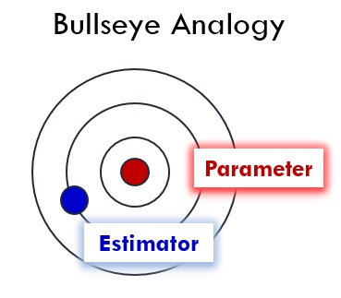
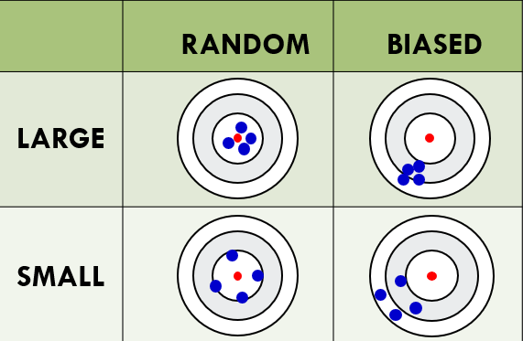
STEP 2 – SAMPLE
Samples estimate population
QUESTION
EXPLAIN
DO

Slide 16
Acknowledgements:
Professor Bada Dehili (Survey administration)
Denise Perry (PowerPoint Design)
More Information
Full length talk about QED from recent Data Science conference
https://sites.google.com/view/goldenjubileestat/home?authuser=0
QED-based Textbook (“Intro Stats Done Right”) to be published soon

