Slide 1
What Might We Do Differently in STAT 101?
Jeff Witmer
Oberlin College

Slide 2
I have a list of 8 items (pared down from a list of 19 items) but I want to hear from others.

Slide 3
1. We don’t talk about effect size.
We tell students to find a p-value and then reject or retain H0, but sometimes the effect is rather small and we only rejected H0 because we had a large sample size.

Slide 4
test stat = (effect size)*(sample size inflation):
E.g., for a t-test,
$t=\frac{\overline{y}−μ}{s}∗\sqrt{n}$
E.g., for a two-sample t-test,
$t=\frac{{\overline{y}}_{1}− {\overline{y}}_{2}}{s}∗\sqrt{\frac{n_{1}n_{2}}{n_{1}+n_{2}}}$
E.g., for a correlation t-test (equivalent to a slope t-test),
$t=\frac{r}{\sqrt{1−r^{2}}}\sqrt{n−2}$
E.g., for an F-test,
$F=\frac{R^{2}}{1−R^{2}}$ $\frac{\left(n−\left(k+1\right)\right)}{k}$ or $F=\frac{{SS}_{m}}{SSE}\frac{\left(n−\left(k+1\right)\right)}{k}$

Slide 5
2. We greatly oversell hypothesis testing.
For one thing, p-values aren’t good, consistent measures of strength of evidence. (See The Dance of the P-Values.)
For another thing, Pr(H0 true | P) ≈ 8*P.
Let’s use more modeling and less formal inference.
(There are only 6 answers a witness should give during a trial…)

Slide 6
3. We warn students about the multiple testing problem (see https://xkcd.com/882/ on jelly beans) but not about the garden of forking paths (see https://xkcd.com/1478/ ).
See the reproducibility project.
Let’s say more about publication bias.

Slide 7
Ben Goldacre TED MED talk
Notes:
Gigernenzer and Marewski, Surrogate Science

Slide 8
4. We use the words “statistically significant.”
To call an effect “statistically significant” confuses students…and us.
I prefer to call an effect “statistically discernible,” meaning that the precision of measurement, aided by a large enough sample size, let us discern that an effect exists (and that the sample difference was not likely to arise by chance – which is what a small p-value announces). (“How embarrassed should the null hypothesis be?”)

Slide 9
A quote from a PhD statistician: “Since this p-value is less than 0.05, that means that H0 is rejected and there is a significant difference in degree completion status between men and women.”
No; there is evidence of a difference between men and women. (And that difference might be so small that no one should care about it.)
In practice, we might only care that the means are close or are not close. It is rarely the case that µ1 – µ2 = 0.0000. A better H0 might be that |µ1 – µ2| < threshold. Let’s promote estimation and model fitting.

Slide 10
(NYT 7/15/21) Recent data from the Pew Research Center revealed that married men went from voting 62 percent for Donald Trump and 32 percent for Hillary Clinton in 2016, to 54 percent for Trump and 44 percent for Joe Biden last year. That sizable shift — a 30-percentage-point margin sliced to 10 points, and a 12-point jump for the Democratic candidate — was underscored by the much lower movement Pew found among unmarried men, married women and unmarried women.
“That’s definitely statistically significant,” said Brian Schaffner, a professor of political science at Tufts University. “Married men are a pretty big group,” he added, “so that’s pretty meaningful in terms of the ultimate margin.”

Slide 11
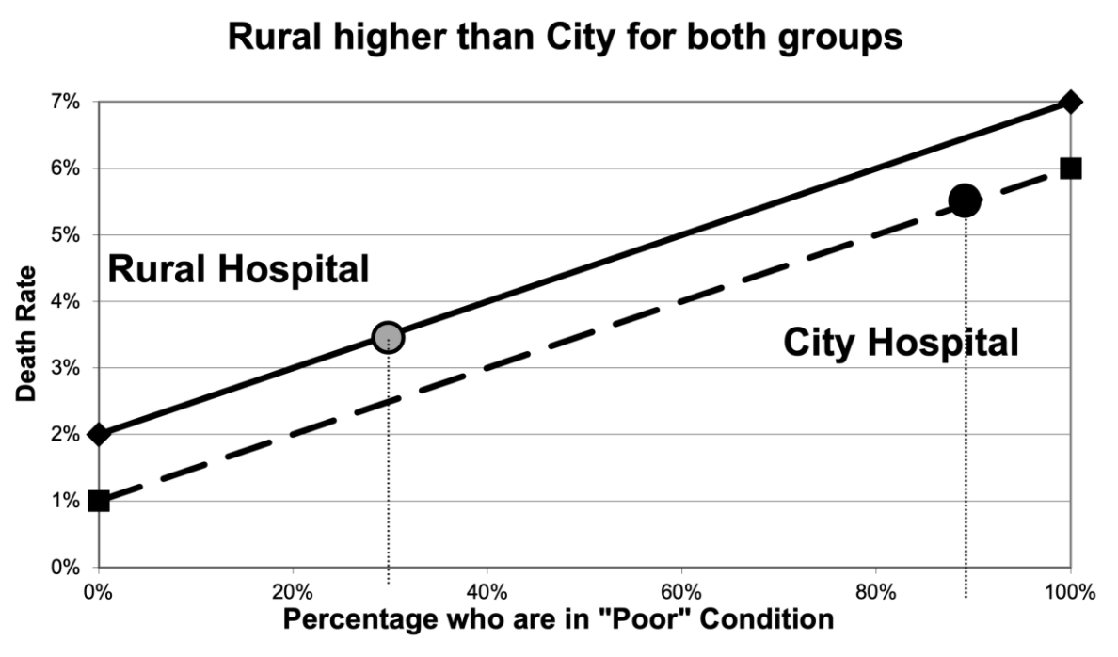
5. We teach Simpson’s paradox, but not how to adjust for a confounder.
City hosp. has 90% poor cond. vs 30% for rural hosp.

Slide 13
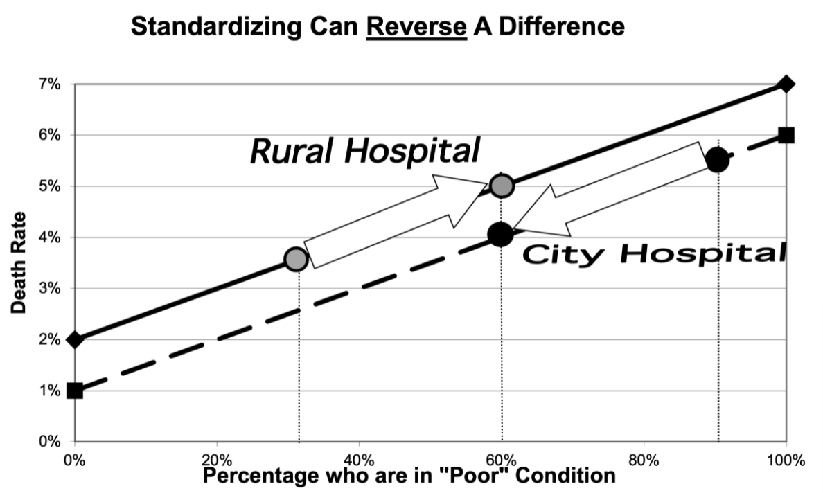
Suppose each hospital had 60% in poor condition.

Slide 14
Cornfield Conditions (Jerry Cornfield, 1959)
In the presence of a confounder, an association is nullified or reversed only if two conditions are satisfied:
• the confounder (patient condition) has a stronger association with the outcome (death) than does the predictor (hospital).
• the predictor (hospital) has a stronger association with the confounder (patient condition) than with the outcome (death).
In the causal diagram, the Z → X and Z → Y arrows are thicker than the X → Y arrow.

Slide 15
Let’s teach Berkson’s paradox also.
Sometimes when we condition on a variable, we create a negative association that isn’t present in the full population.
Suppose you can end up in the hospital if you have disease 1 or disease 2 (or both). Then among hospital patients there will be a negative association between incidence of the two diseases.

Slide 16
Smoking
COVID-19
X
Y
Z
Hospitalization
If you aren’t a smoker, then you are more likely to have COVID-19 – because you were admitted to the hospital for some reason.

Slide 17
Good hitter
Good pitcher
X
Y
Z
In major league baseball
If you can’t hit, then you must be a good pitcher, because you are in MLB (and if you were bad at both hitting and pitching then you wouldn’t be a profession player).

Slide 18
6. We teach prediction intervals only in the regression chapter.
Why not teach about prediction in the 2-sample chapter (Or the 1-sample chapter)?
If we decide that the drug is better than the placebo, let’s go beyond saying by how much, with a CI for µ, but let’s also make a prediction for one person’s response, with a PI.

Slide 19
7. We don’t mention logistic regression until the second course.

Slide 20
8. We teach about p1 – p2 but not about p1/p2 when often relative risk is what matters.

