Slide 1

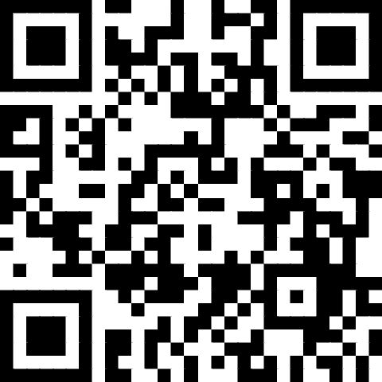
Exploring Alternative Grading Models for Teaching Statistics
Nicholas Bussberg, Ryne VanKrevelen, Heather Barker
Saturday, July 19, 2025
Use the QR code below to complete our check-in poll
https://tinyurl.com/AltGradingCheckIn

Slide 2

Presentation Outline
Introduction and Context
Case Study Presentations of Alternative Grading Models
Small Group Discussions
Group Share Out
Q&A
Notes:
Intro and Context – 15 minutes (Note to Ryne: Nic went through the beginning, and it's going to take ~6 minutes with the poll to get through the alt grading themes slide. Let me know if you need this to be closer to 5 min)
- (In my practice run, I went through the definitions and graph in 4-5 minutes)
Case studies – 30 minutes (10 min each)
Case study takeaways – 5 minutes (Nic added this in the timing)
Small groups – 10 minutes
Share out / Q&A – 10 minutes

Slide 3
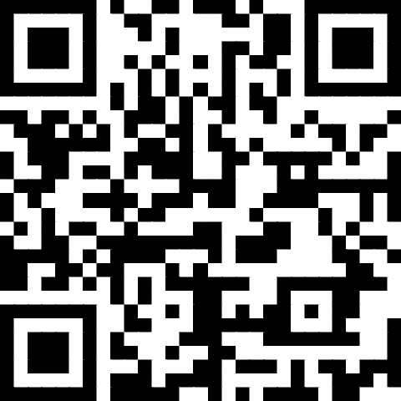
Presentation Materials
tinyurl.com/ElonStatsGrading

Slide 4
Introduction
Complete our short check-in poll, if not already done
Introduce yourself to someone around you. You can provide:
  Name
  Pronouns
  Where you're from
  What brings you here
Use the QR code below to complete our check-in poll
https://tinyurl.com/AltGradingCheckIn

Slide 5
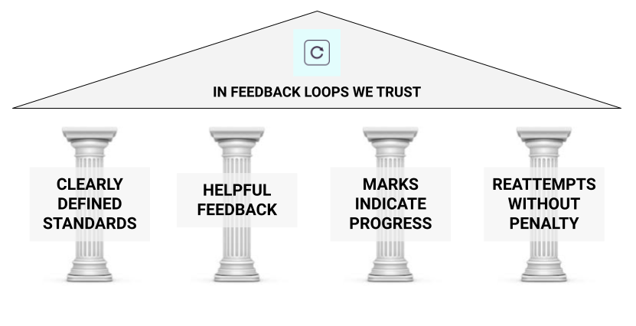
Common Alt Grading Themes
From Grading for Growth by David Clark and Robert Talbert
Image url: https://gradingforgrowth.com/p/finding-common-ground-with-grading
Notes:
NB Mention this can shift student incentives from a focus on the product (could be ChatGPT's work, not theirs) to a focus on the process (i.e. learning)
Clearly defined standards – Students should know what is expected of them. They shouldn't have to guess what the professor is looking for.
Helpful feedback – If we want students to learn, they need feedback that helps them do that.
Marks indicate progress – These are based on course/learning progress, not irrelevant aspects like background knowledge or willingness to raise hand in class
Reattempts without penalty – Not everyone gets everything right away. This doesn't mean unlimited reattempts.

Slide 6
Overview of Terms
Brief Overview of Alternative Grading Terms
Traditional Grading
  Typically, each assignment receives points. Those points go into a weighted average that determines an overall course grade.
Alternative Grading
  Standards-Based Grading
  Specifications Grading
  Ungrading
  Combinations of these
Further reading: https://gradingforgrowth.com/p/an-alternative-grading-glossary
Notes:
RV Possibly mention things like dropping lowest scores, retake attempts, choice of assignments, and others as gateways to alternative grading

Slide 7
Overview of Terms
Brief Overview of Alternative Grading Terms
Traditional Grading
Alternative Grading
  Standards-Based Grading
    Course standards (based on learning objectives) are given to students. Various assignments are used to assess if students are meeting those standards.
  Specifications Grading
  Ungrading
  Combinations of these
Further reading: https://gradingforgrowth.com/p/an-alternative-grading-glossary
Notes:
RV Possibly mention things like dropping lowest scores, retake attempts, choice of assignments, and others as gateways to alternative grading

Slide 8
Overview of Terms
Brief Overview of Alternative Grading Terms
Traditional Grading
Alternative Grading
  Standards-Based Grading
  Specifications Grading
    Individual assignments have specifications that should be met when completing them. Grades often determined by meeting specs on multiple assignments.
  Ungrading
  Combinations of these
Further reading: https://gradingforgrowth.com/p/an-alternative-grading-glossary
Notes:
RV Possibly mention things like dropping lowest scores, retake attempts, choice of assignments, and others as gateways to alternative grading

Slide 9
Overview of Terms
Brief Overview of Alternative Grading Terms
Traditional Grading
Alternative Grading
  Standards-Based Grading
  Specifications Grading
  Ungrading
    Assignments are largely not graded. Focus is on feedback. Overall expectations for course grades may be given. Frequently involves student progress meetings.
  Combinations of these
Further reading: https://gradingforgrowth.com/p/an-alternative-grading-glossary
Notes:
RV Possibly mention things like dropping lowest scores, retake attempts, choice of assignments, and others as gateways to alternative grading

Slide 10
Overview of Terms
Brief Overview of Alternative Grading Terms
Traditional Grading
Alternative Grading
  Standards-Based Grading
  Specifications Grading
  Ungrading
  Combinations of these
    Ideas and pieces from each of these can be combined with one another to make a grading system that works for you / your course / your institution.
Further reading: https://gradingforgrowth.com/p/an-alternative-grading-glossary
Notes:
RV Possibly mention things like dropping lowest scores, retake attempts, choice of assignments, and others as gateways to alternative grading

Slide 11
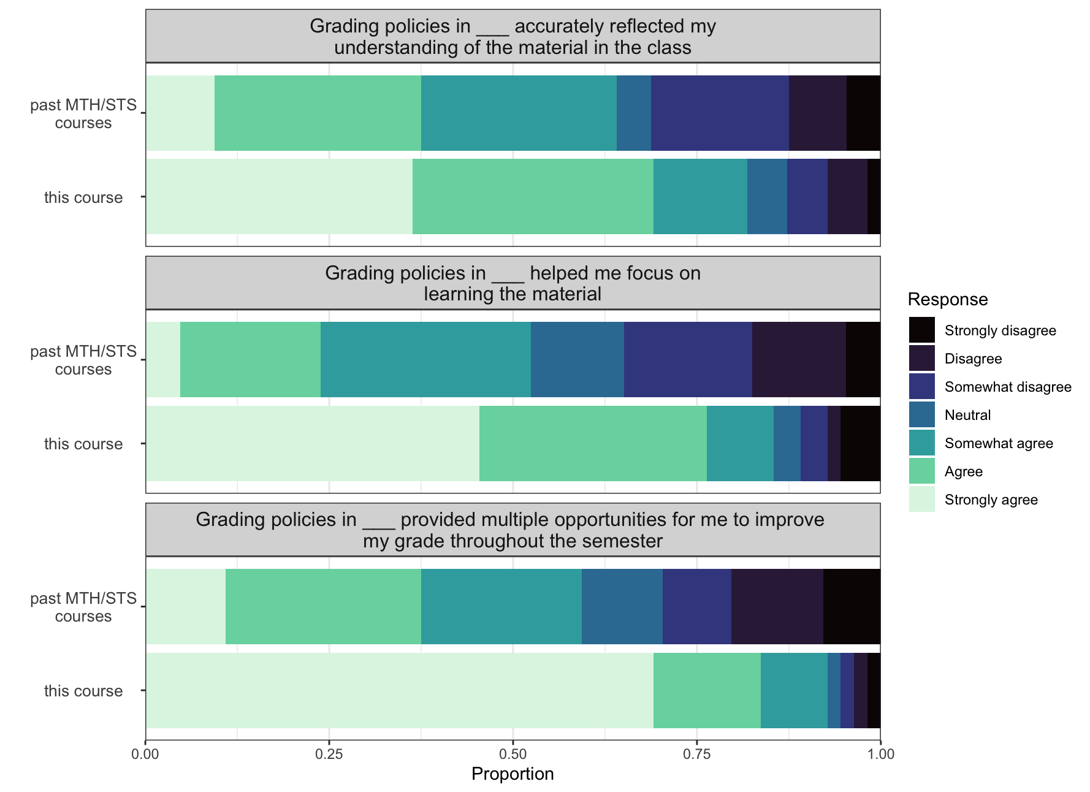
Initial Student Data
Students largely found that grading policies in our alt graded courses
  better reflected their understanding of material
  helped them focus on learning material
  and provided more chance for improvement
compared to previous math or stats courses they had taken.
Notes:
RV

Slide 12

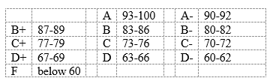
Case Study #1
My “why”
I also teach math education courses, and two of my methods students were taking an assessment class and reading the book Grading for Equity by Joe Feldman. I read it too.
Joined a Community of Practice about Alt Grading
A big thing that stuck out to me was how our traditional grading scale mostly sets you up to fail.
30% of grades Pass
70% of grades Fail

Slide 13
Case Study #1
The Course(s) – I’ve used alternative grading for ~3 years
Statistics Courses
STS1100 – Introduction to Statistical Reasoning
STS2120 – Statistics in Application
STS2320 – Statistical Modeling
Math Education Courses
MTH 2090 – Geometry and Data for K-8 Teachers
MTH 3080 – Mathematics and Statistics for Secondary Teachers
MTH 3090 – Teaching with Technology in Math and Statistics

Slide 14
Case Study #1
The Course(s)
Statistics Courses
STS1100 – Introduction to Statistical Reasoning
  Introductory course that focuses on conceptual understanding
  Mostly 1st year students, ~30 students per class
  My section satisfies Advancing Equity Requirement, work towards a large end of semester project for this requirement
Math Education Courses
MTH 2090 – Geometry and Data for K-8 Teachers
  Preservice elementary and middle grade teachers, all years represented. ~33 students per class.
  Also very conceptual, project-based course.

Slide 15
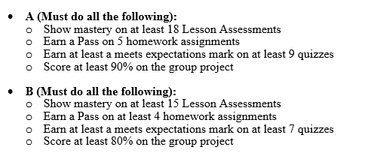
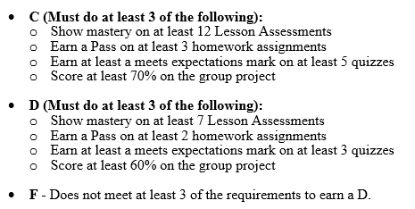
Case Study #1
Grading Scheme
Lesson Assessments – online quizzes (2 attempts), at least 80% to pass, 20 a semester
Homework (pass/fail) – longer partner assignments, 6 a semester
Quizzes (needs improvement/meets expectations/exceeds expectations) – 10 of these, in class
Group Project – traditional rubric, scaffolded during the semester

Slide 16
Case Study #1
Reattempts – Token System
Each student gets 5 “tokens” they can use at any time, no questions asked for the following assignments
Lesson Assessments – have 2 attempts but sometimes need more to get the 80%
Quizzes – if they don’t get a meets expectations take a similar quiz at another time
Opportunities to earn more tokens throughout the semester (i.e. attend seminars, go to tutoring, take a selfie with me at a game, etc.)

Slide 17
Case Study #1
Final Exam: The final exam is used to determine the difference between -/+ in your grade. The final exam is graded like a traditional test.
If a student does not take the final exam or score less than 40%, you will drop a letter grade.
Score between 40% - 60%, your letter grade will be given a minus (i.e. B-)
Score between 60% - 80%, your letter grade will remain the same
Score greater than 80%, your letter grade will receive a plus (i.e. B+)

Slide 18
Case Study #1
Student Reflections
Dr. Barker sincerely looks out for every student of hers, making sure a "bad" grade doesn't discourage them from giving up. Her unique grading system allows for students to pay more attention to the material, rather than having to cram for a test and then forget the information.
She prioritized learning over success in the classroom, and it was reflected in her unique grading style. It definitely helped me enjoy the learning process even more than I already do.
It really helped with my anxiety and pressure to do well in the class. I was able to make mistakes along the way and still do well in the course.
I think that the way grading is set up in this course really puts learning over memorization, which I appreciate.
I think not having exams throughout the semester is very helpful because it allowed me to learn along the way without the stress of memorizing things for an exam.

Slide 19
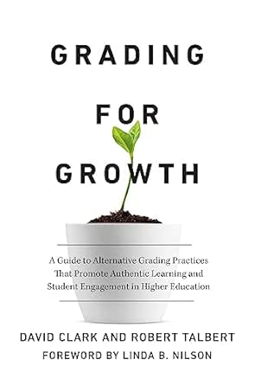
Case Study #2
My "why" for using alternative grading...
  Getting an A shouldn't require coming into the course with the most experience/knowledge
  Grades should promote and reflect student growth
The year before my first alternatively graded course, I joined a reading group for Grading for Growth and took part in a day-long course planning workshop around the book.
Notes:
Motivation / Journey
Course
Pros / Cons
Pull some quotes

Slide 20
Case Study #2
The Course
STS 1100: Introduction to Statistical Reasoning
  Taken by around 80% of all students
  Quite likely the only statistics / data course many of these students take
  Focus is on interpretation and application over coding and calculation
Notes:
Motivation / Journey
Course
Pros / Cons
Pull some quotes

Slide 21
Case Study #2
Grading Scheme (my first time trying this)
Standards-Based Quizzes + Specifications Grading
  The course was broken into six modules with 4 – 5 standards for each (26 total).
  Each standard showed up on four quizzes over the semester.
  Students received N (needs revision), R (revisable), or S (successful) as the "grade" on each standard.
  They need to achieve an S twice to pass a standard (and only the first pass can come from a revision).
Notes:
Motivation / Journey
Course
Pros / Cons
Pull some quotes

Slide 22
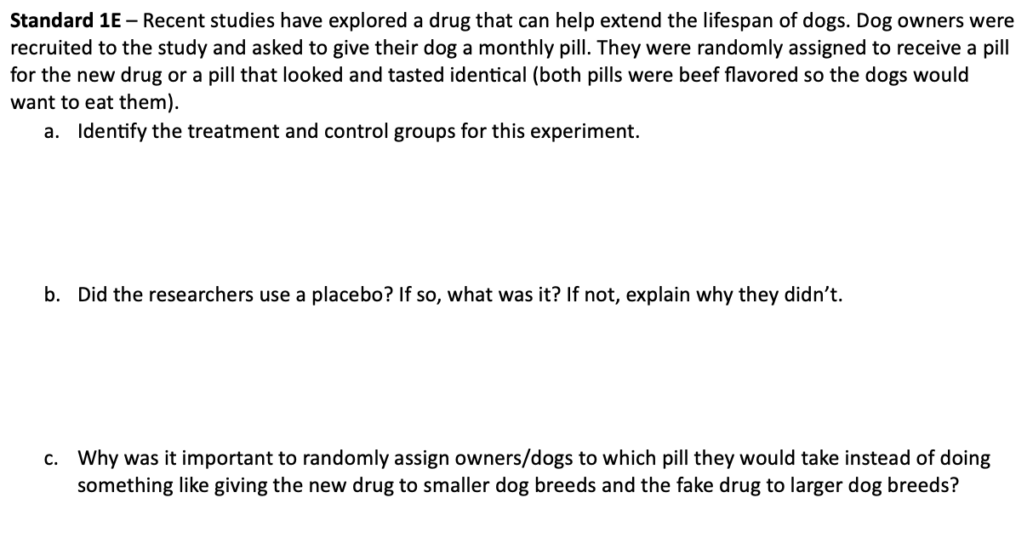
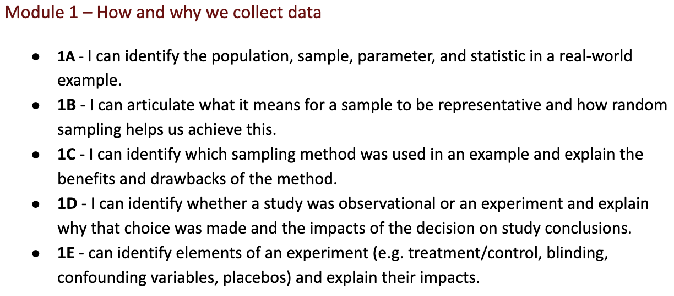
Case Study #2
Grading Scheme
Standards-Based Quizzes + Specifications Grading
Example Standards
Example Quiz Question
Notes:
Motivation / Journey
Course
Pros / Cons
Pull some quotes

Slide 23
Case Study #2
Grading Scheme
Standards-Based Quizzes + Specifications Grading
  They completed a project that had five parts.
  Each part received a grade of N (needs revision), S (successful), or E (excellent). Explanations were given for what constituted grades of S or N.
  Each section could be revised and resubmitted (with encouragement to come discuss it in office hours)
A | B | C | D | F
2+ Es / Rest are S | 1E / 4 Ss | All Ss | At most 1 N | More than one N
Notes:
Motivation / Journey
Course
Pros / Cons
Pull some quotes

Slide 24
Case Study #2
Grading Scheme
Standards-Based Quizzes + Specifications Grading
  Overall course grade starts with Base Grade from quizzes and is adjusted based on project, homework, activities.
Grade | Standards | Project | HW | Activities
A | 24 – 26 passed | 2+ E / Rest S | 5 or 6 passed | 10+ complete
B | 21 - 23 | 1 E / S | 4 passed | 9
C | 18 - 20 | All S | 3 passed | 7 - 8
D | 15 - 17 | 1 N | 2 passed | 6
F | 14 or fewer | 2+ N | 0 or 1 passed | 5 or fewer
Notes:
Still need to update this to make it clearer

Slide 25
Case Study #2
"the grading policy in this course definitely gave me some anxiety, not knowing where I stand until the end or not being able to check my grade during quizzes or after projects or activities"
Student feedback was mixed...
"at first made me anxious, but after taking the course for the semester it made me less anxious about my grade and ensure that my attention was focused on learning the material rather than stressing about my grade."
"made me feel less anxious about doing the work/taking the quizzes."
"made me very stressed... Having a quiz each week and barley having time to prepare has been very difficult and is the main reason behind me not being able to pass a lot of modules."
"Confuse/stress me out a little bit because of passing the standards twice."
"The grading system was awesome, really took the stress out of taking big quiz’s and the option to revise encouraged my learning"
"Make me less stressed compared to my other courses."

Slide 26
Case Study #2
Other feedback
What's my grade? -- Students are used to seeing a grade in the gradebook. Many didn't like that they didn't have a "current grade"
Falling behind -- Some felt they couldn't learn new material if they were going back to try to pass older standards
I get it now! -- Revision opportunities were appreciated
Clarity for system – Knowing exactly how many activities they'd have and spacing out project sections more would help for planning
Effort -- Some suggested classmates who struggled thought they could get by putting in less effort than normal and would do fine if they were told otherwise from the start
Notes:
Mention things I've learned and will change like communication of activties, better project spacing, grade tracking and mid semester meetings, etc.
Mention issues with attendance that likely impacted some students who thought they fell behind

Slide 27

Case Study #3
My "why" for using alternative grading...
  Being a “good test taker” should not be the only way you can demonstrate learning
  Each student regardless of experience should be challenged to continue learning
  Students with less (or no) prior experience should not be at an immediate disadvantage in the class
  I joined a Community of Practice on Alt Grading and read Ungrading

Slide 28
Case Study #3
Courses I've used alternative grading (in all my courses since 2022)
  STS 2120 Statistics in Application
  STS 2300 Introduction to Data Analytics
  STS 3300 Statistical Methods for Data Analytics
  Research and internship mentoring

Slide 29
Case Study #3
The Course
STS 2120: Statistics in Application
  An introduction to statistics typically for quantitative majors
  More focus on standard statistical hypothesis tests relative to STS 1100
  Code-based (SAS) for calculations, visualizations, models, and tests

Slide 30
Case Study #3
Grading Scheme
Specifications Grading + Ungrading
  The syllabus breaks assessments into five groups.
  Students must pass/complete a certain number of assignments within a category to receive a grade.
  Each assessment is marked as Pass/Complete or Not Pass/Incomplete (i.e., no points or grades on any individual assignment)

Slide 31
Case Study #3
Specifications Grading + Ungrading
Grade | Criteria
B | Show mastery on 9 Objective Assessments and attempt the other four. Receive a Pass on 6 Homework Assignments and attempt the other two. Pass both projects (group portions). Pass one project individual assessment and attempted the other. Completes the final grade reflection and one other reflection.
A | Show mastery on all 13 Objective Assessments. Receive a Pass on 7 Homework Assignments and attempt the other one. Pass both projects (group portions). Pass both project individual assessments. Completes all three reflections.

Slide 32
Case Study #3
Grading Scheme
Specifications Grading + Ungrading
  Students receive feedback-only on all assignments (and the Pass/Complete mark).
  On most assignments, there are opportunities to revise and resubmit work to demonstrate growth.
  The specifications-based table forms the initial grade range for the student.
  Students complete reflections (mid- and end-of-semester) and propose a grade for themselves based on evidence

Slide 33
Case Study #3
Grading Scheme
Specifications Grading + Ungrading
  For finalizing the grade in the class, the instructor meets with each student one-on-one (at mid- and end-of-semester).
  Prior to each meeting, the instructor reads the student’s reflection.
  In the meeting, the instructor and student discuss the class and decide on what the grade for the student should be.

Slide 34
Case Study #3
Student feedback was generally positive:
“made me feel less anxious and allowed me to be ok making mistakes and learning from them."
“[Grading policies] help me focus more on learning the concept and less on my grade"
“Definitely helped me learn better because I wasn't stressed to get everything right and take my time and think about the problem"
“Definitely made me happier about the course however some times made it difficult to stay on track."
“At first I was worried about what this format would look like, but I have really come to like the style. It has eliminated a lot of grade stress as I know I can resubmit for more points and go over things I didn’t do as well."
“[Grading policies] make this class more about learning what we want to learn and less about the stress of learning every concept perfectly."

Slide 35
Instructor Take-Aways
Heather's Take-Aways (Specs)
Students feel less stressed, less “grade haggling”
More student engagement
Creating / grading multiple assessments is a lot of work, but informative
Ryne's Take-Aways (Specs + Standards)
Plan ahead as much as possible
It was more work, but the work was more meaningful
The first implementation will have some kinks to work out
Nic's Take-Aways (Specs + Ungrading)
"Grading" is more enjoyable
More work overall (esp. with grade meetings)
Love talking with each student
Specs portion helps intro students

Slide 36
Small Group Discussion
Describe your current grading structure in 3 words.
What are the biggest barriers you face when thinking about alternative grading? Institutional? Student resistance?
What are some things you already do in your grading practice that are seeds of alternative grading? Allowing revisions? Specification based rubrics?
If you could rebuild your grading system, what values would guide you, what must you have? What does success look like for your students? What new grading approaches/ideas do you want to try?
Notes:
HB In padlet we could have a column for barriers, try one thing
~10 minutes then reveal padlet

Slide 37
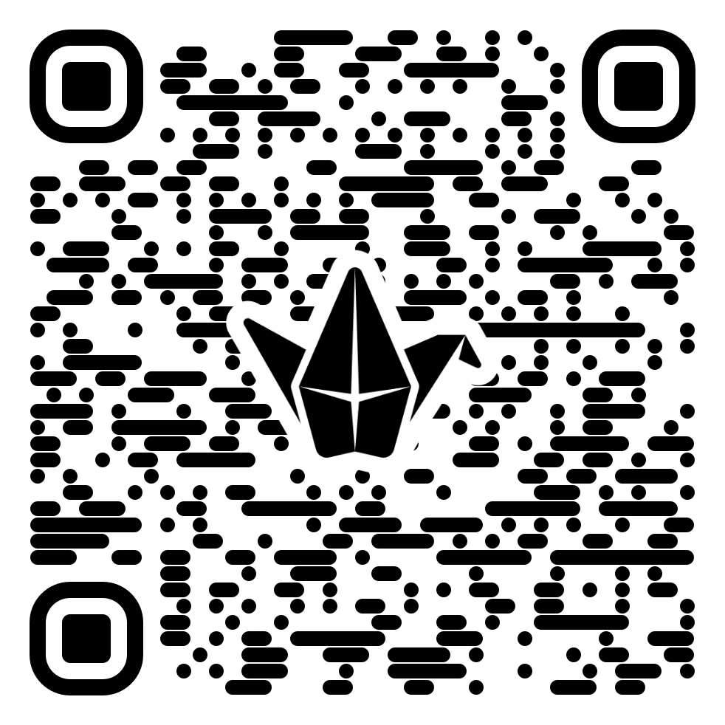
Small Group Discussion
tinyurl.com/StatsAltGrading
Notes:
https://padlet.com/hbarker216/alternative-grading-in-statistics-513bp3mlwd7a49hq

Slide 38
Questions/Comments
Presentation Materials
Questions
Comments
Discussion
tinyurl.com/ElonStatsGrading

Slide 39
Further Reading

Slide 40
Questions
Nicholas Bussberg, Elon University
nbussberg@elon.edu
Heather Barker, Elon University
hbarker2@elon.edu
Ryne VanKrevelen, Elon University
rvankrevelen@elon.edu
Materials: https://tinyurl.com/ElonStatsGrading

