Slide 1
A Regression-Forward Framework for Intro Stats: An Example Lesson
QTM 110
Zachary Binney
Oxford college of emory university

Slide 2
Roadmap
1. Introductions
2. Current vs. Regression-Forward Framework for Intro Statistics
3. How to Introduce Regression First?
4. Example Lesson Linking Regression and ANOVA
5. A Step Further: Skip the Tests, Focus on Tasks

Slide 3
Introductions

Slide 4
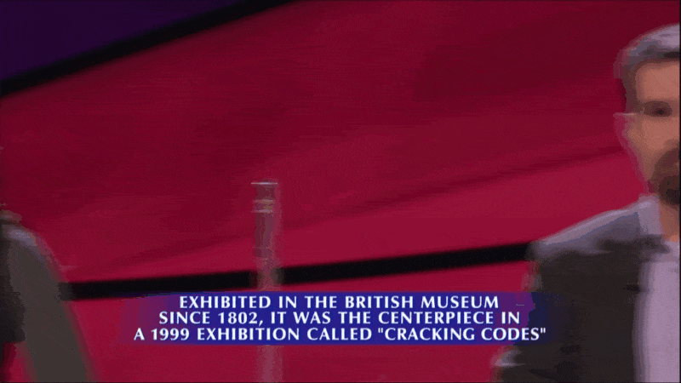
Who am I?
PhD, Epidemiology, Emory, 2018
Assistant Professor of Quantitative Theory and Methods, Oxford College
  Teach: “Intro to Scientific Methods” (research design, causal inference, critical thinking); R programming; Statistics in Sports; Probability Theory
Statistical consultant for sports teams, pharmaceutical companies, media outlets; expert witness
  Past: NFL, NBA, and MLB teams; healthcare consultant; end-of-life care
Been on Jeopardy!
...lost on Jeopardy!

Slide 5
Who Are You?
Pollev.com/zbinney

Slide 6
Disclosures
Not the first to suggest this (SEE Ward, Gelman, Zhang and Son Wednesday, Beth Chance like an hour ago, etc.)
Not doing literature/research/evidence overview
Focus on: practically…how might I do this?

Slide 7
Current vs. Regression-Forward Framework for Intro Statistics

Slide 8
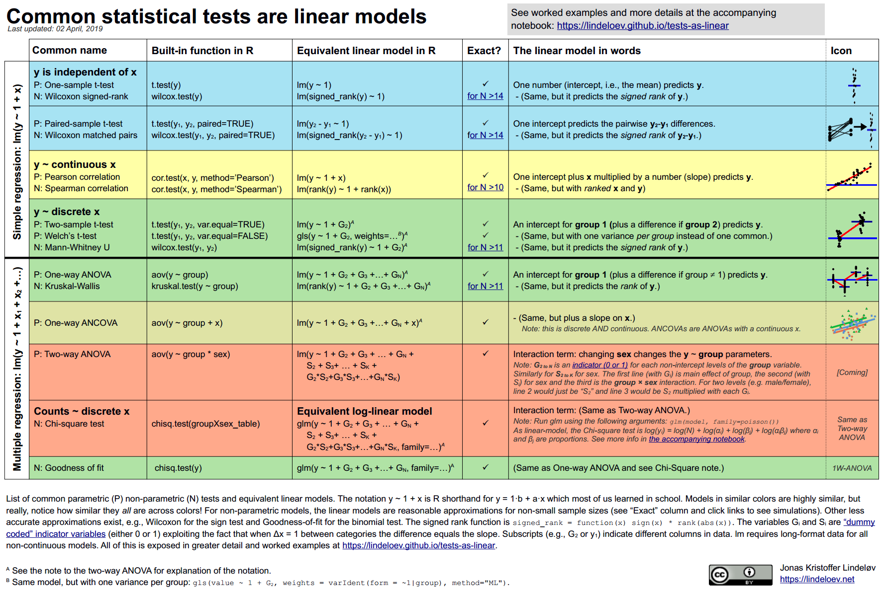
Regression to Accomplish Common Tests

Slide 9
Current Structure of our Intro Course
1. Intro to Data (data basics, sampling, experiments)
2. Summarizing Data (numerical, categorical)
3. Probability (conditional prob, RVs, continuous dist’ns)
4. Distributions (normal, binomial)
5. Inference Foundations (sampling variance, CIs, hypothesis tests)
…
Uses OpenIntro Statistics (4th ed.)
No notes so far…
  …(except that these authors have another book, Intro to Modern Statistics, that introduces regression first!)

Slide 10

Current Structure of our Intro Course
…
6. Categorical Data Inference (single prop., diff of two props., Chi Square for GoF and independence)
7. Numerical/Continuous Data Inference (one-sample t-test, paired t-test, two-sample t-test, ANOVA)
8. (Simple) Linear Regression (fitting, inference, outliers)
9. Multiple Linear Regression
This is where I [pause for strained polite laughter]

Slide 11
Why Don’t I Like This Structure?
Leaves students thinking statistics is not a unified framework, but simply a matter of plugging your data into the correct test or model
Instills other bad habits such as categorizing continuous data to fit one of these tests

Slide 12
Regression-Forward Framework
…
6. Categorical Data Inference (single prop., diff of two props., Chi Square for GoF and independence)
7. Numerical/Continuous Data Inference (one-sample t-test, paired t-test, two-sample t-test, ANOVA)
8. (Simple) Linear Regression (fitting, inference, outliers)
9. Multiple Linear Regression
What I like better:

Slide 13
Regression-Forward Framework
…
9. Multiple Linear Regression
6. Categorical Data Inference (single prop., diff of two props., Chi Square for GoF and independence)
7. Numerical/Continuous Data Inference (one-sample t-test, paired t-test, two-sample t-test, ANOVA)
8. (Simple) Linear Regression (fitting, inference, outliers)
What I like better:
Teach how to accomplish all of these tasks using regression

Slide 14
Need a Textbook?
You don’t need to modify existing books like the last slide!
Several good options of books already using this approach, just from USCOTS attendees:
  Intro to Modern Statistics, Cetinkaya-Rundel and Hardin, https://www.openintro.org/book/ims/
  Statistics and Data Science: A Modeling Approach, Son and Stigler, https://coursekata.org/preview/book/8f5a440a-e704-42a9-a6b5-3ac01b563d9d/lesson/1/0

Slide 15
How to Introduce Regression First?
How I do it in my non-intro but no pre-req, 100-level undergrad course

Slide 16
Example – Brief Walkthrough
Use the textbooks I mentioned for intro stats!
How I do it in a different context - a statistical critical thinking course:
  QTM 110, Lecture 11
  QTM 110, Pset #6 Qs 1-3

Slide 17
Example Lesson Linking Regression and ANOVA
And where does it fit?

Slide 18
Example from SCORE Network
Ace rates on different tennis surfaces
https://modules.scorenetwork.org

Slide 19
Example from SCORE Network
Written as a full lesson in data analysis – we’ll focus on most relevant parts for regression-forward design
Learning Objectives: Students will be able to 1) explore data with a mix of categorical and continuous variables and calculate a new variable from two existing continuous variables, 2) create a stratified boxplot to compare the distribution of a continuous variable across levels of a categorical variable, 3) conduct a linear regression using dummy variables for a categorical predictor, 4) find and interpret the coefficients and p-values to explain how a categorical predictor and continuous outcome are associated, 5) recognize and demonstrate that this linear regression is equivalent to a typical ANOVA.

Slide 20
Example from SCORE Network
Do the following sections:
  1. Background
  2. Data Exploration and Descriptive Analysis (stop at “Calculate Ace Rate”)
  3. Ace Rate vs. Surface Analysis

Slide 21
Where Does This Lesson Fit?
Flexible, but easiest with these prereqs:
  Basic understanding of simple linear regression +/- dummy variables
  (?) ANOVA, if you want to teach that separately
…
9. Multiple Linear Regression
6. Categorical Data Inference (single prop., diff of two props., Chi Square for GoF and independence)
7. Numerical/Continuous Data Inference (one-sample t-test, paired t-test, two-sample t-test, ANOVA)
8. (Simple) Linear Regression (fitting, inference, outliers)
Lesson goes here

Slide 22
A Step Further: Skip the Tests, Focus on Tasks

Slide 23
Should We Teach [to] The Tests At All?
Within the regression-forward framework you could teach linear regression, then:
  1. Teach the tests and show how they are equivalent to regression, OR
…
9. Multiple Linear Regression
6. Categorical Data Inference (single prop., diff of two props., Chi Square for GoF and independence)
7. Numerical/Continuous Data Inference (one-sample t-test, paired t-test, two-sample t-test, ANOVA)
8. (Simple) Linear Regression (fitting, inference, outliers)

Slide 24
Should We Teach [to] The Tests At All?
Within the regression-forward framework you could teach linear regression, then:
  1. Teach the tests and show how they are equivalent to regression, OR
  2. Barely mention tests; focus on tasks and how to do them with linear regression
…
9. Multiple Linear Regression
6. Categorical Data Inference (single prop., diff of two props., Chi Square for GoF and independence)
7. Numerical/Continuous Data Inference (does mean != 0, do two independent or paired means differ, do means differ across 3+ groups, etc.)
8. (Simple) Linear Regression (fitting, inference, outliers)

Slide 25
Where Does This Lesson Fit – Using “Traditional” Intro Stats Topics
1. If you are still teaching ANOVA (and other tests) separately:
  Put this lesson after you have taught ANOVA (and of course linear regression) to emphasize the links and show ANOVA is a special case of linear regression, as well as giving students practice with a broader, practical data analysis pipeline exercise
    Depending on what you covered with linear regression already (e.g. dummy variables) may be able to skip/shorten parts of that section

Slide 26
Where Does This Lesson Fit – Using A Task-Focused Approach
2. Task-Focused Approach: teach the task + how to accomplish using linear regression
  Would use this module to teach how to use linear regression to check for differences in continuous variable across 3+ groups
  When was the last time you did ANOVA (with the ANOVA table, F-test, etc.) outside of a class?
  Could just leave it at “Hey, there’s this other thing called ANOVA, it’s just what we’ve taught you already, here’s proof it’s equivalent.” – this module works for this approach
Same argument for t-tests, Wilcoxon, Mann-Whitney, etc.
Exception: Chi Square test for independence (requires interaction terms)?

Slide 27
Reactions? Thoughts?
Pollev.com/zbinney

Slide 28

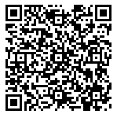
📌 What: A 3-day, virtual Summer Institute
📌 Who: Professors and graduate students planning to teach intro stats
📌 Cost: We have secured funding which will fully cover the cost of participation!
📌 When: July 22-24, 2025 from 8:00 - 10:00am PT daily
📌 Deadline has technically passed but note that you met Ji at USCOTS and we'll make it work!
Scan the QR code to apply!
Or go to this link: https://bit.ly/CourseKataInstituteApplication
Notes:
https://forms.zoho.com/coursekata1/form/CoruseKataSummer2025InstituteforTeachingIntroducto https://bit.ly/CourseKataInstituteApplication

Slide 29

Thanks!
Questions? zbinney@emory.edu, @binney_z on Bluesky

