Slide 1

Teaching Statistical Significance
UNDER a True and A False Null Hypothesis
Eugene Komaroff, Ph.D.
Professor of Education
Keiser University
1900 W. Commercial Blvd.
Fort Lauderdale, Fl 33309
ekomaroff@keiseruniversity.edu
Cell: 973-900-2963
United States Conference on Teaching Statistics
Penn State University
June 3, 2023

Slide 2
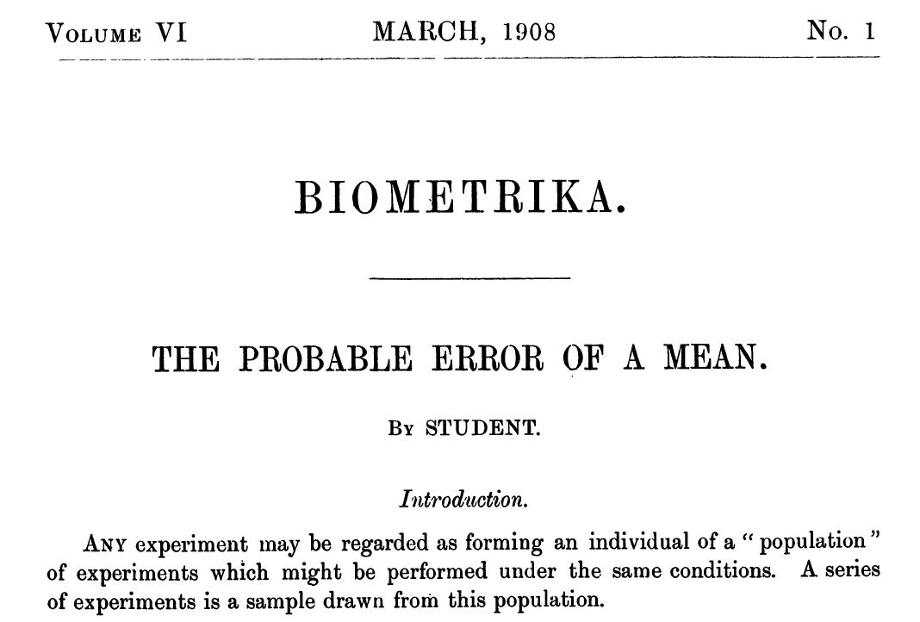
Sampling Distribution Concept According to Student (William Sealy Gosset )

Slide 3
Sampling Distribution Concept According to Ronald Aylmer Fisher
The entire result of an extensive experiment may be regarded as but one of a possible population of such experiments….the object of our study is not the individual result, but the population of possibilities of which we do our best to make our experiments representative (pp. 2-3).
R.A. Fisher (1970). Statistical Methods For Research Workers (14th ed.). Edinburgh: Oliver and Boyd. Reprinted in a collection of Fisher’s three books: Statistical Methods, Experimental Design and Scientific Inference by Oxford University Press (1995).

Slide 4
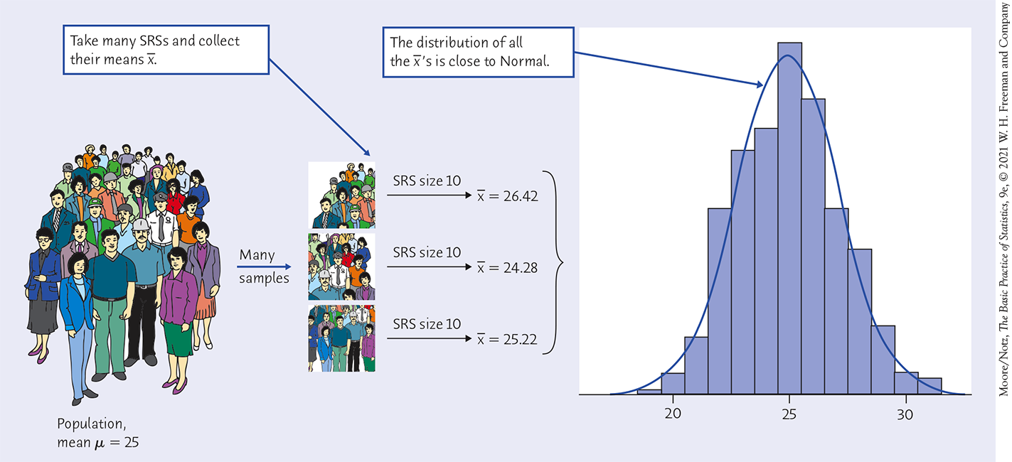
Theoretical and Empirical Sampling Distribution of $\overline{x}$
Width of histogram bars narrow as more samples are added
Theoretical
Normal Curve
Empirical Histogram
Population Mean = Grand Mean of Sampling Distribution
Source: Moore, D.S, Notz, W.I., & Fligner, M. (2021) Basic practice of statistics (9th ed.). Macmillan Learning/William H. Freeman and Co.

Slide 5
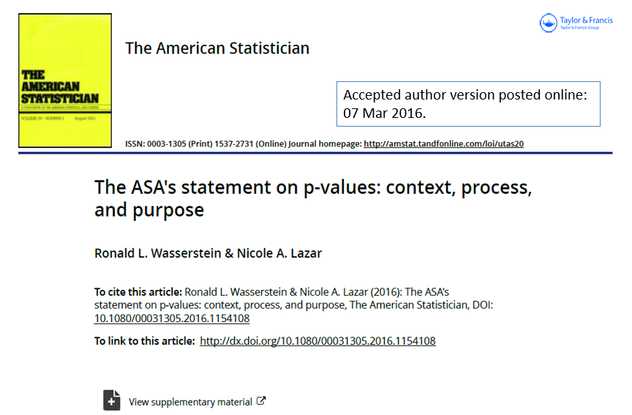
ASA aware of widespread abuse and misunderstanding of p-values and statistical significance
2016
The American Statistical Association (ASA) published six principles to explain “p-values in non-technical terms to researchers, practitioners and science writers who are not primarily statisticians” (p. 3)

Slide 6
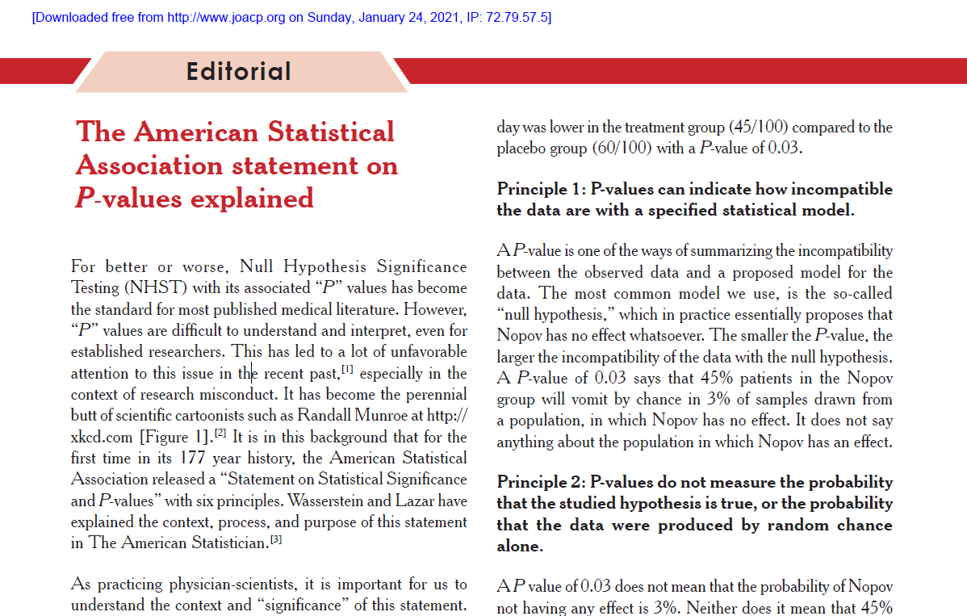
Journal of Anaesthesiology Clinical Pharmacology
2021
Apparently,
practitioners did not understand the ASA statement

Slide 7
Motivation for this Presentation about Effect Sizes, P-values and Statistical Significance
Problem: Written/oral explanation in non-technical terms is inadequate/insufficient for the proper understanding and use of p-values and statistical significance.
Plan: Created a simulation tool with SAS OnDemand for Academics that enables students to generate their own data and run two-independent groups t-tests under a true null hypothesis and a false null hypothesis.
Solve: Produced calculations and graphs that can supplement non-technical explanation.
Conclusion: Empirical sampling distributions provide foundational insight into the proper interpretation and use of p-values and statistical significance.

Slide 8
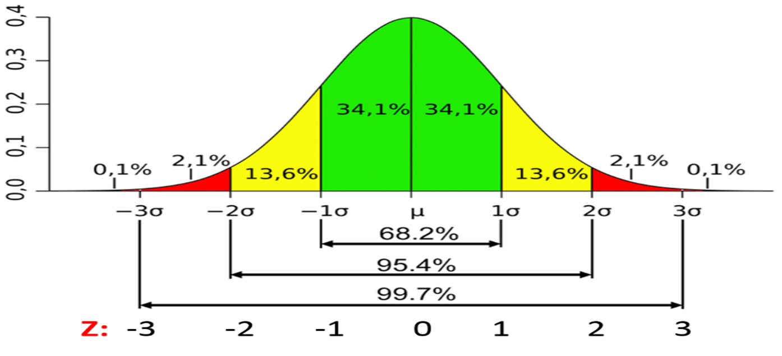
Data Sampled from the Standard Normal Distribution [~N(0,1)]
Simulate Independent, Identically Distributed, Normal Random Variables

Slide 9
True Null Hypothesis
Snippet from SAS macro that simulates independent, identically, distributed, standard, normal random variables
%MACRO M2Ttest(runs= , N= );
ODS EXCLUDE ALL;
data n;
call streaminit (0); /* seed set to computer clock time */
do i = 1 to &N;
y1 = rand("Normal",0,1);
y2 = rand("Normal",0,1);
output;
end;
drop i;
run;
“0” seed permits each student to create their own variables populated by unique random values
Two variables from the same standard normal distribution [~N (0,1)]

Slide 10
True Null Hypothesis
Snippet from SAS macro that simulates independent, identically, distributed, standard, normal random variables
This sets number of simulated data sets and t-tests generating that number of means, effect sizes and p-values.
%MACRO RUNDS(N= );
%do i=1 %to 1000;
%M2Ttest(runs= &i , N=&N );
data twogp_n&N;
set %if &i gt 1 %then %do; twogp_n&N %end;
twogp&i;
run;
This number sets same sample size for each group (e.g., here n = 15 per group, total sample size = 30).
%RUNDSALL(ns=%str(15));
To avoid long computer processing time for teaching purposes, 100 simulated t-test for two independent groups with relatively small sample sizes (e.g., 2, 15) is sufficient for teaching concepts involving sampling distributions, effect sizes, p-values and statistical significance

Slide 11
Null Hypothesis is False
Snippet from SAS Macro for Simulating iid Normal Random Variables
%LET E = .5;
%Let P = P5;
%MACRO M2Ttest(runs= , N= );
ODS EXCLUDE ALL;
data n;
call streaminit (0); /* seed set to computer clock time */
do i = 1 to &N;
y1 = rand('Normal',0,1) + &e;
y2 = rand('Normal',0,1);
output;
end;
drop i;
run;
Here E denotes effect size (Cohen’s d) = .5, but can be any positive or negative value, except “0”
Cohen’s d (effect size) = .5 was added to the continuous outcome variable in the first group, only.
Otherwise, same SAS code as for True Null Hypothesis

Slide 12
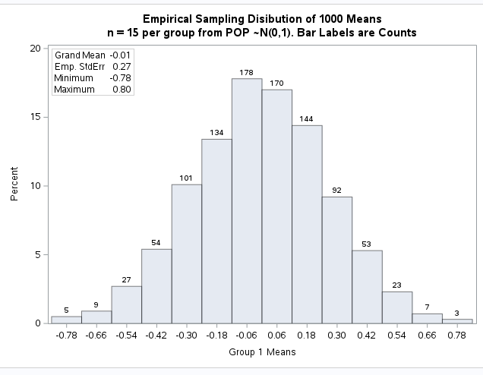
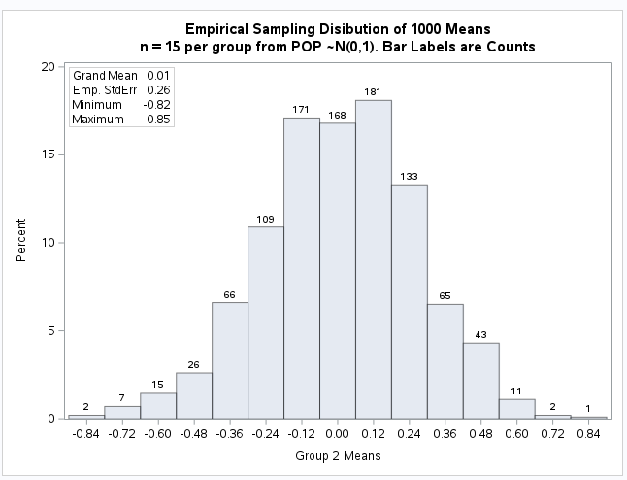
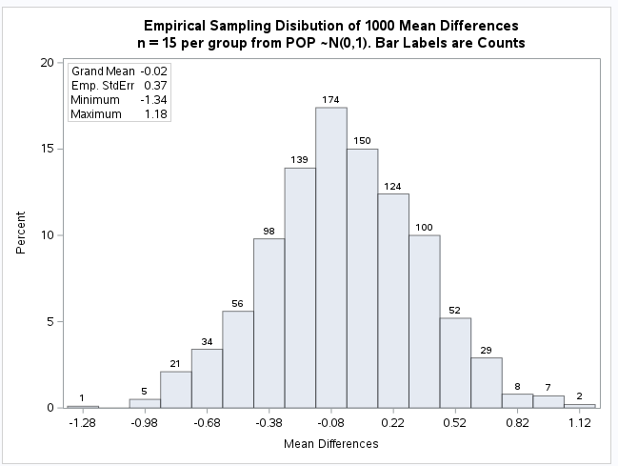
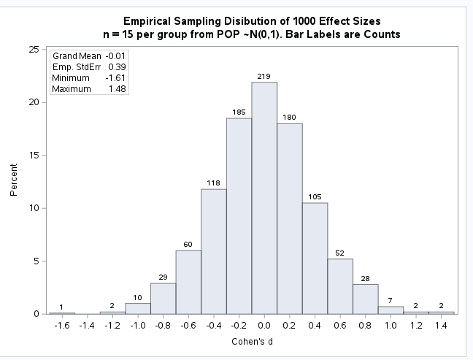
Null Hypothesis is True
H₀: μ₁ = μ₂ ( μ₁ - μ₂ = 0)
Group 1
Means
Group 2
Means
EMPIRICAL
SAMPLING
DISTRIBUTIONS
Each Centered at ≈ 0
Mean
Differences
Effect Sizes

Slide 13
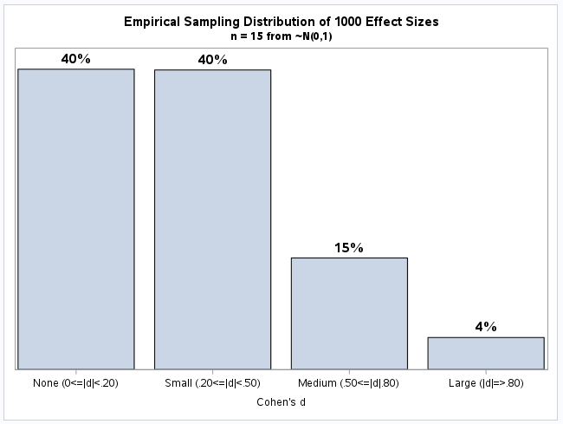
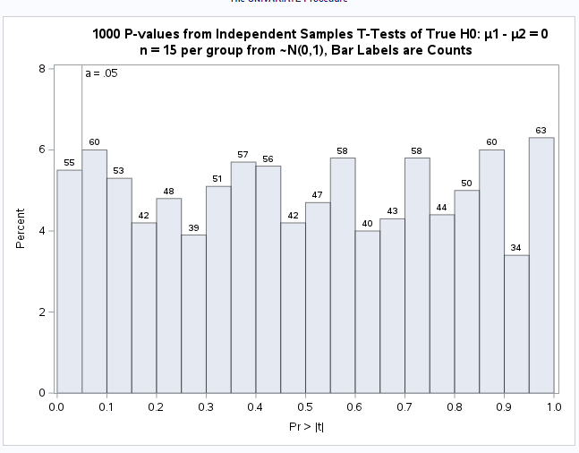
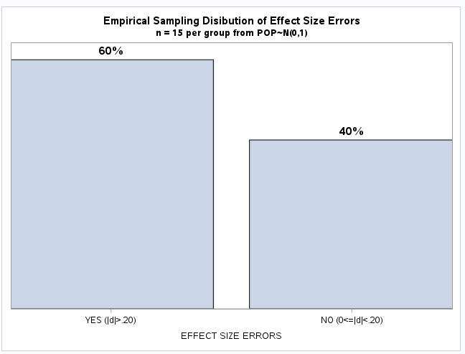
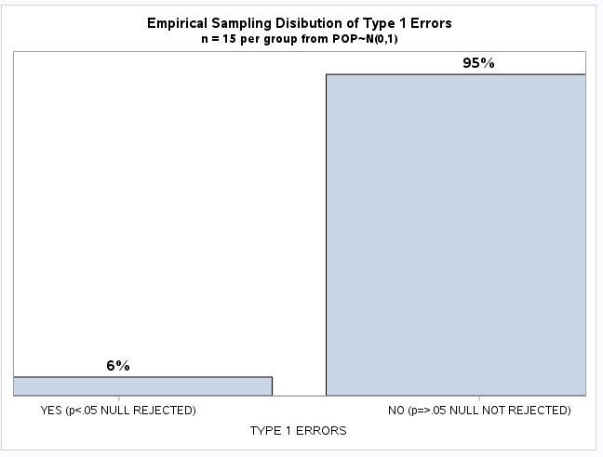
Null Hypothesis is True
H₀: μ₁ = μ₂ ( μ₁ - μ₂ = 0)
Cohen’s d categories
P-values
EMPIRICAL
SAMPLING
DISTRIBUTIONS
Effect Size
Errors
Type 1 Errors

Slide 14
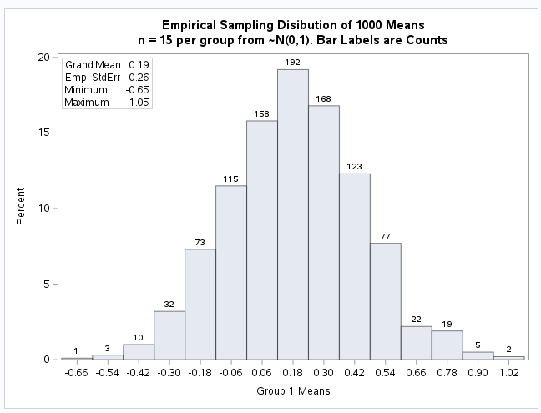
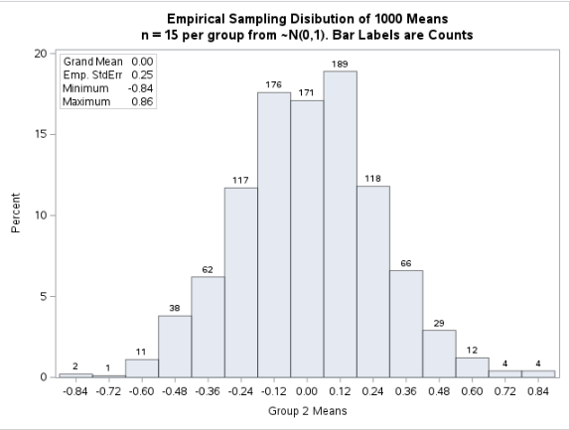
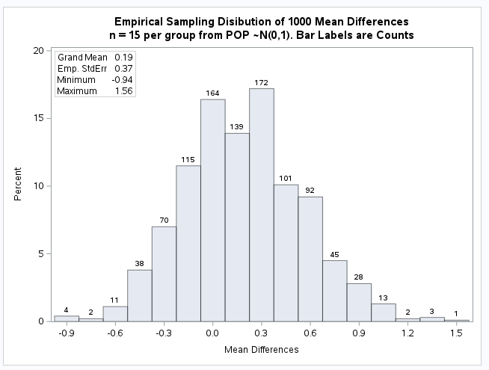
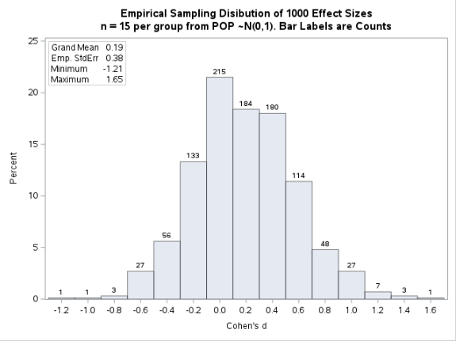
Alternative Hypothesis is True, Null Hypothesis is False
H_{a}: μ₁ ≠ μ₂ ( μ₁ - μ₂ ≠ 0)
Centered at 0.19
Centered at 0.00
Group 1
Means
Group 2
Means
EMPIRICAL
SAMPLING
DISTRIBUTIONS
Centered at 0.19
Mean
Differences
Centered at 0.19
Effect
Sizes

Slide 15
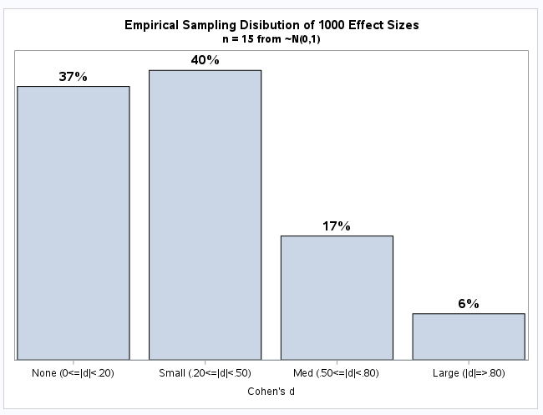
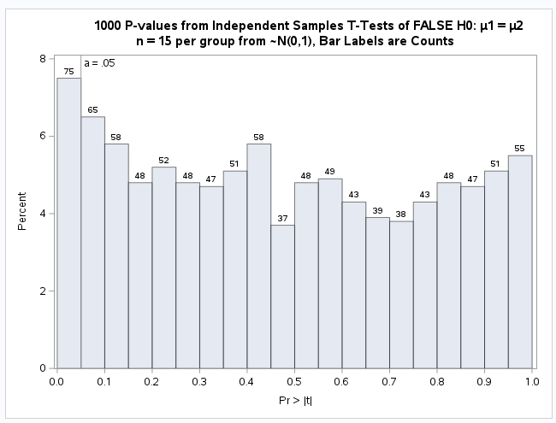
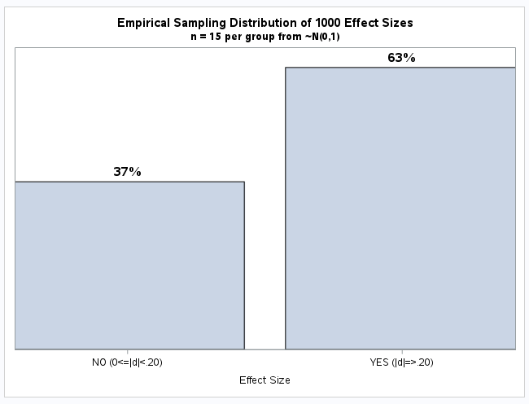
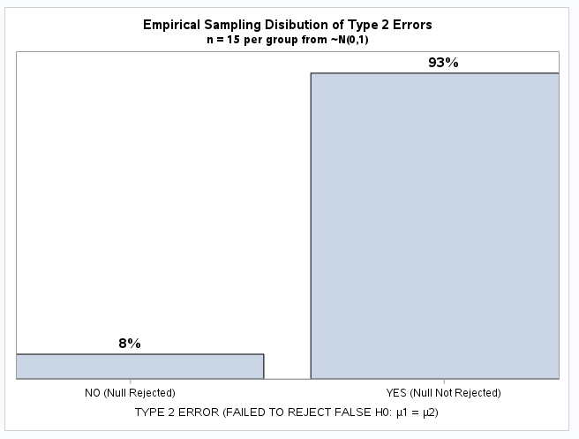
Alternative Hypothesis is True, Null Hypothesis is False
H_{a}: μ₁ ≠ μ₂ ( μ₁ - μ₂ ≠ 0)
Cohen’s d categories
P-values
EMPIRICAL
SAMPLING
DISTRIBUTIONS
True
Effect Sizes
Type 2 Errors
Power

Slide 16
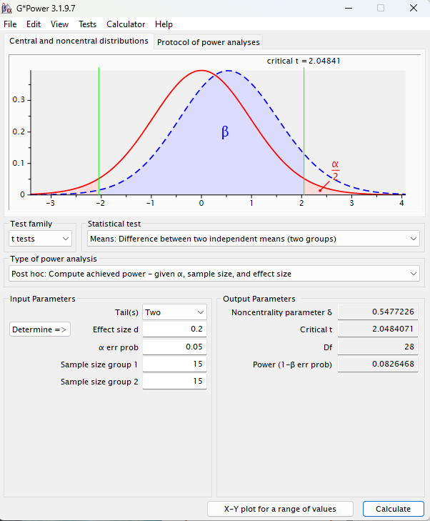
G*Power 3.1: Post Hoc Power Analysis
Two-sided T-test
Alpha = .05
Cohen’s d = .20
n = 15 per group
Power = 8%
Ask for a live demonstration
Simulate a True Null Hypothesis
Simulate a False Null Hypothesis
Effect Size Errors under a True Null Hypothesis
Effect Sizes under a False Null Hypothesis
Type 1 Errors under a True Null Hypothesis
Type 2 Errors under a False Null Hypothesis

