Slide 1
"Wait, What Do You Mean?": Helping Students Become "Full Stack" Communicators
Sara Stoudt (@sastoudt)

Slide 2
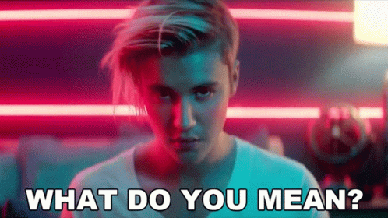
I have to learn/teach statistics, data science, computational tools, AND communication?!?
Notes:
Full course resources:
https://www.amelia.mn/STAT336/ (Amelia McNamara)
https://docs.google.com/document/d/19HnV9PRFGb4djHFBuL_dhYraV4fL9zRoGwPhQoE9BAs/edit (Sara Stoudt)

Slide 3
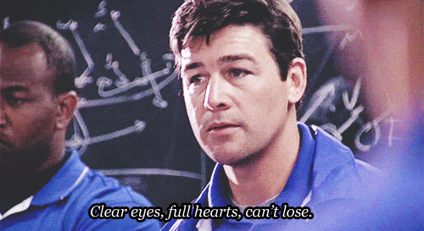
Yes, but…

Slide 4
Communication encompasses many actions and requires relationships with many audiences, but it can often be invisible or undervalued labor.

Slide 5
“Full Stack”
connotes a breadth of *technical* skills that are performed in a role that *spans* a data-intensive workflow.

Slide 6
Spanning

Slide 7
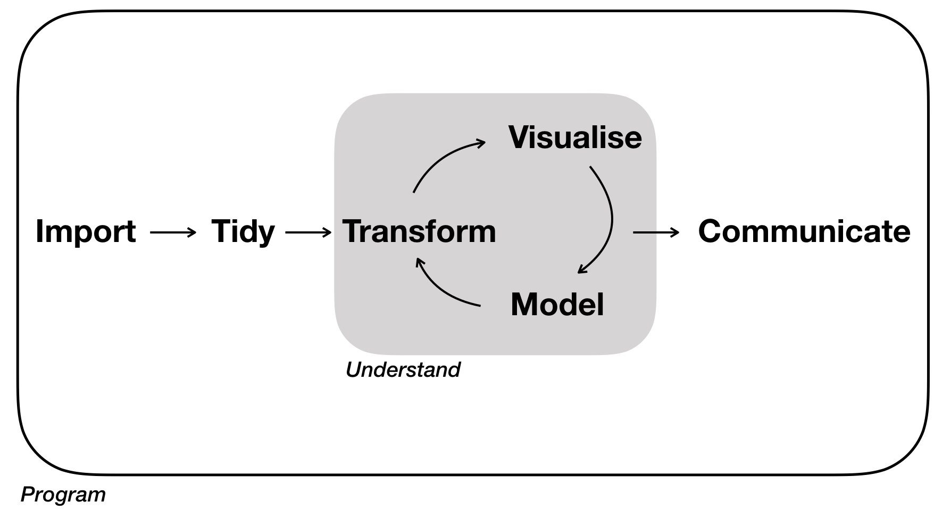
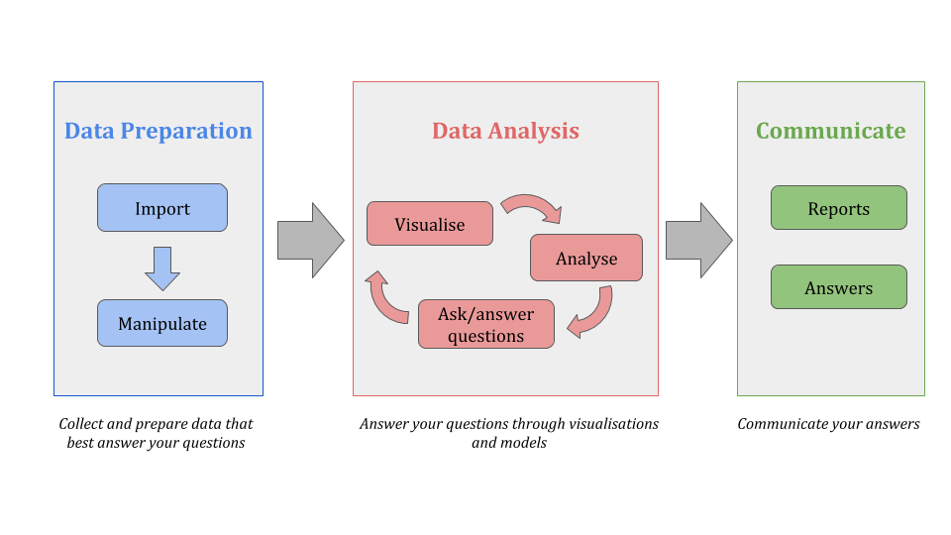
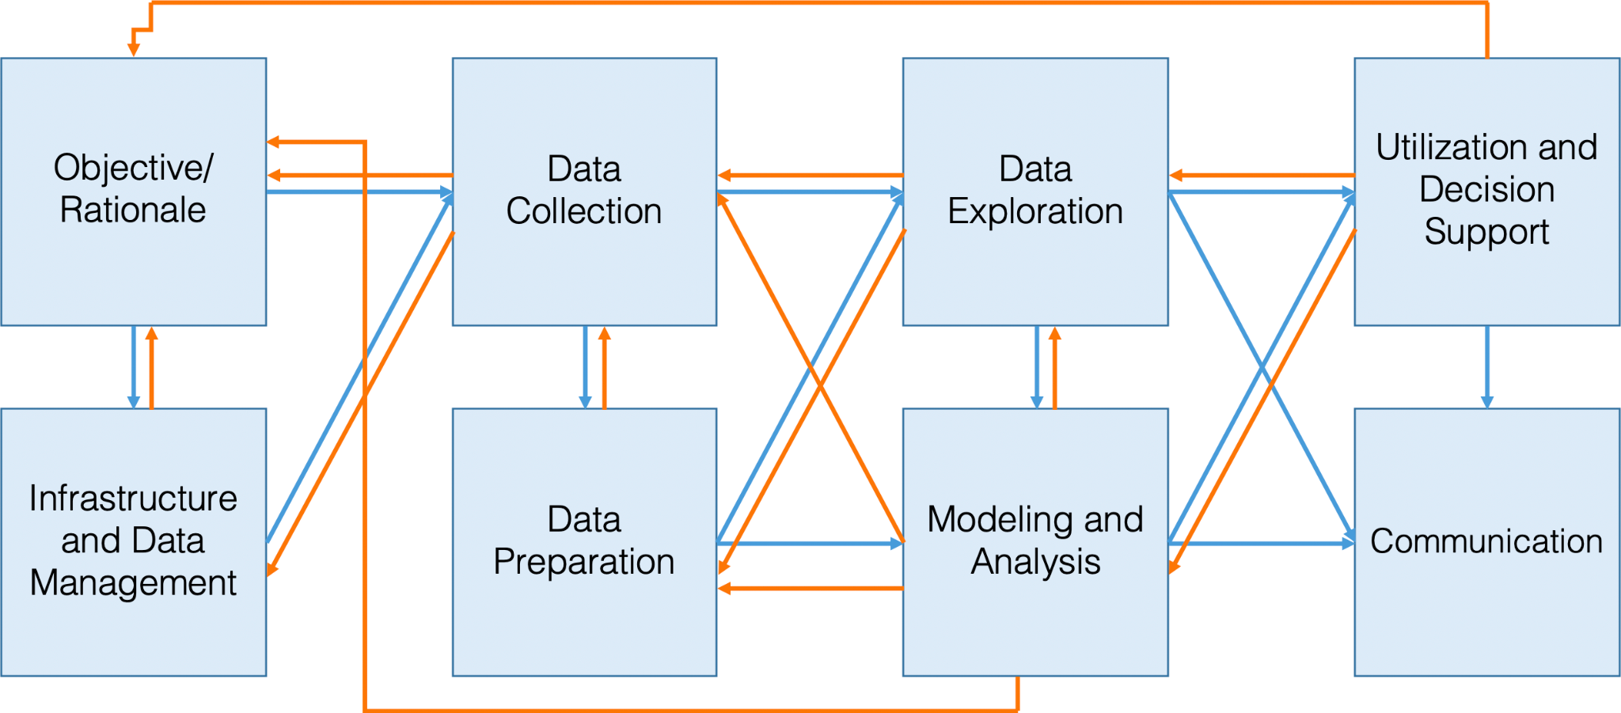
Clockwise starting at top left:
R for Data Science - Wickham and Grolemund
Data Understanding, Data Analysis, and Data Science - Patrick Boily
Answering questions through data: The Workflow - Emanuela Furfaro

Slide 8
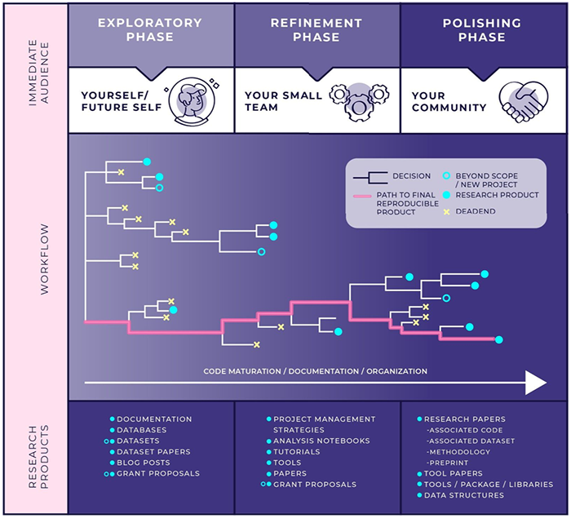
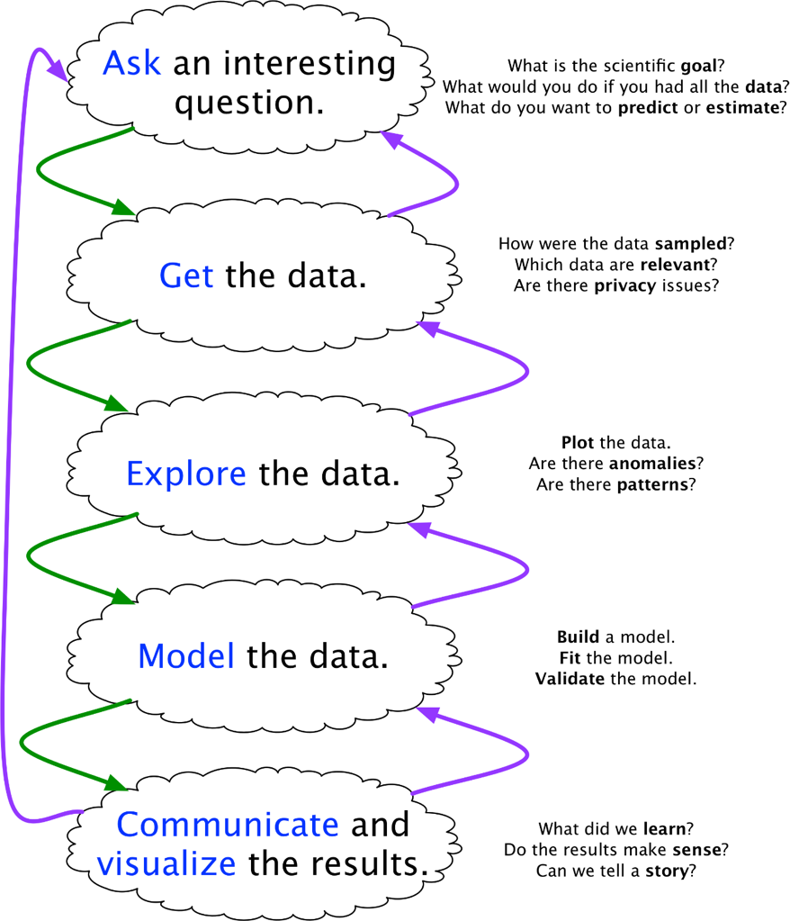
Blitzstein and Pfister
Stoudt, Vasquez, and Martinez

Slide 9
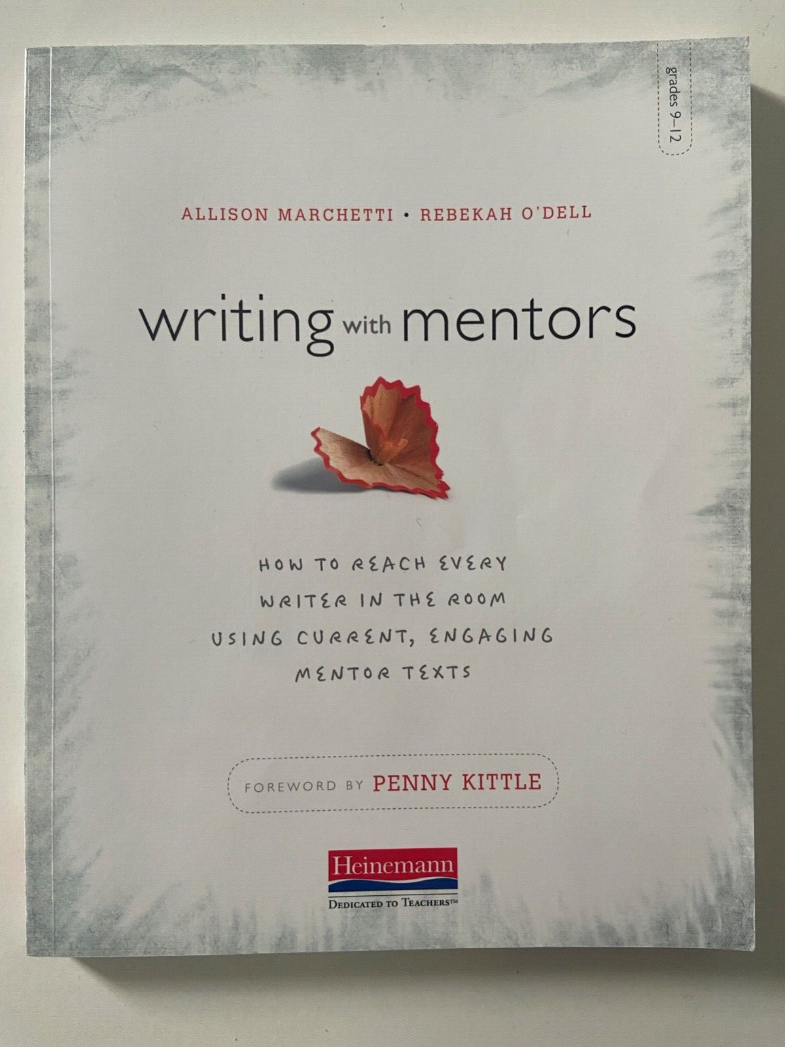
Reading
Notes:
https://ciaran-evans.github.io/files/bryozoan_paper_activity.html (Reading a Research Paper - Cieran Evans)
https://rss.onlinelibrary.wiley.com/doi/10.1111/1740-9713.01469 (Reading to Write - Nolan and Stoudt)

Slide 10
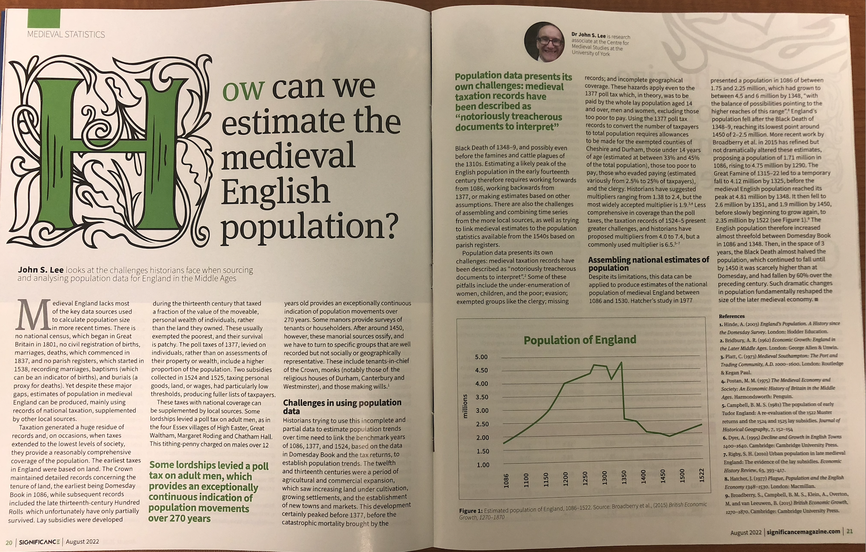
https://doi.org/10.1111/1740-9713.01669
Notes:
Break down a Significance article - accessible, talk about audience - does it succeed

Slide 11
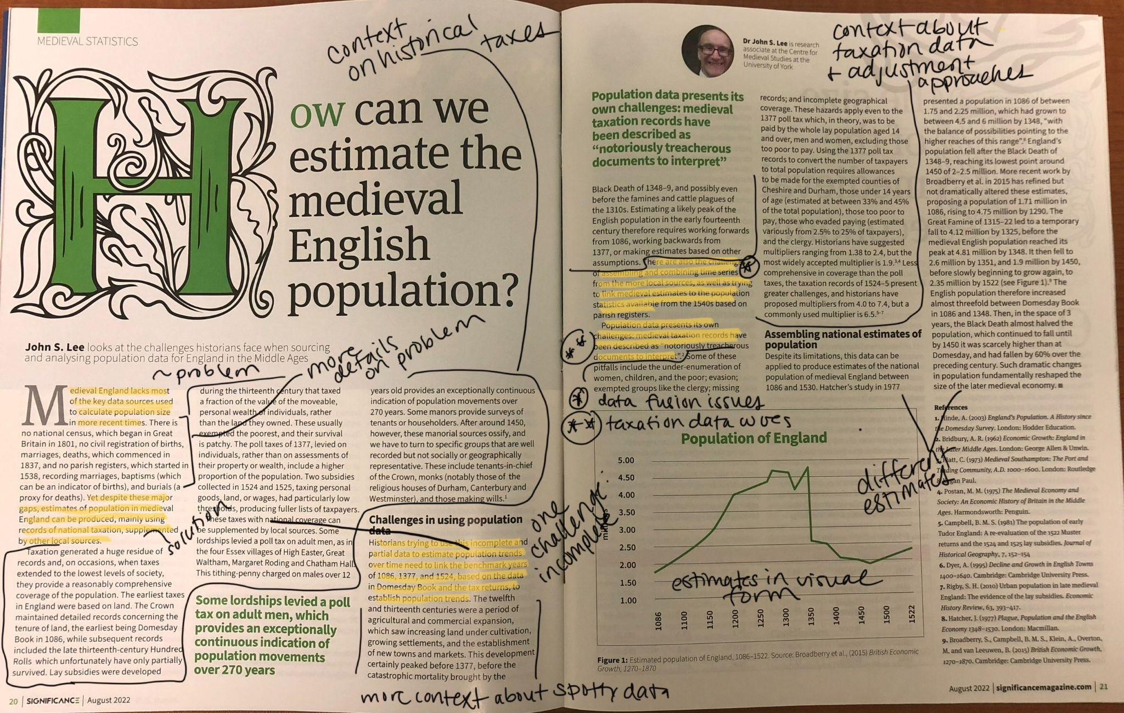

Slide 12
Breaking down a word problem
I was listening to my running playlist, and it made me wonder if it had the same pump-up energy as a workout mix curated by Spotify. It turns out that Spotify has a bunch of data on each song including a measure of “energy”. I decided to compare a random sample of 50 songs from my playlist to Spotify’s gold standard. They report that the songs on their workout playlists have an average energy score of 0.75 (larger means more energy) with a standard deviation of 0.15. The songs in my sample have a mean energy score of 0.71.

Slide 13
Breaking down a word problem
I was listening to my running playlist, and it made me wonder if it had the same pump-up energy as a workout mix curated by Spotify. It turns out that Spotify has a bunch of data on each song including a measure of “energy”. I decided to compare a random sample of 50 songs from my playlist to Spotify’s gold standard. They report that the songs on their workout playlists have an average energy score of 0.75 (larger means more energy) with a standard deviation of 0.15. The songs in my sample have a mean energy score of 0.71.

Slide 14
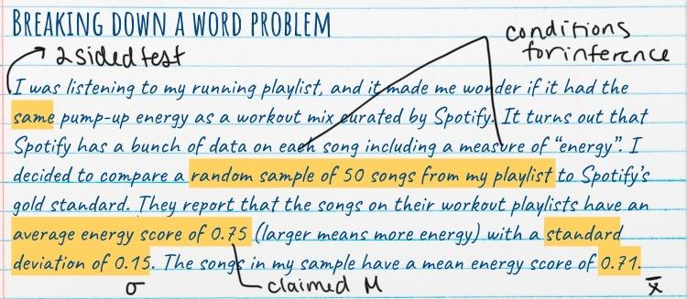
Notes:
Same goes for once you know many tests what words signal using a particular type of test over another one?

Slide 15
Organizing
Notes:
https://causeweb.org/cause/uscots/uscots21/th-21-storyboarding-part-process-statistical-investigation (storyboarding - video)
https://www.causeweb.org/cause/ecots/ecots22/program/breakout/4 (storyboarding slides)
https://academic.oup.com/book/40034/chapter/340414696 (storyboarding book chapter - freely available)

Slide 16
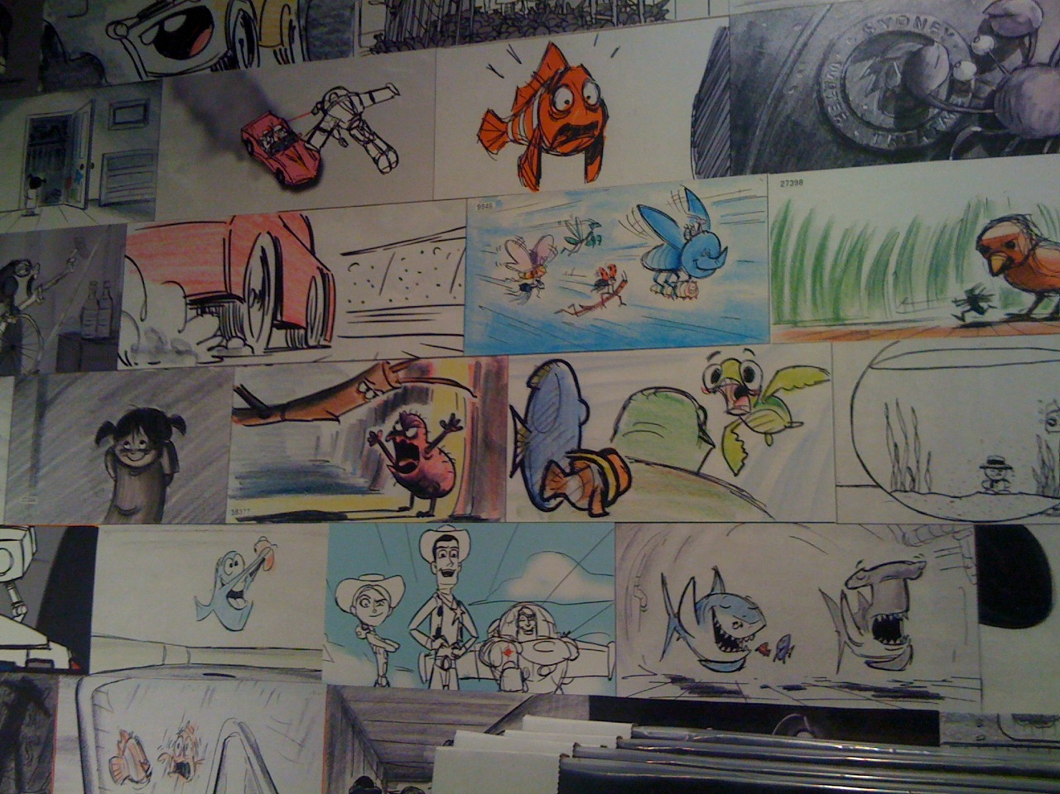
What is a storyboard?
visual outline used in movie making → set of figures and tables with connecting text from an exploratory phase of analysis
tactile way to group, filter, and order intermediate products of an analysis to find the bigger picture
https://oaklandliving.wordpress.com/2010/12/29/last-chance-to-see-pixar-at-oakland-museum-of-california/

Slide 17
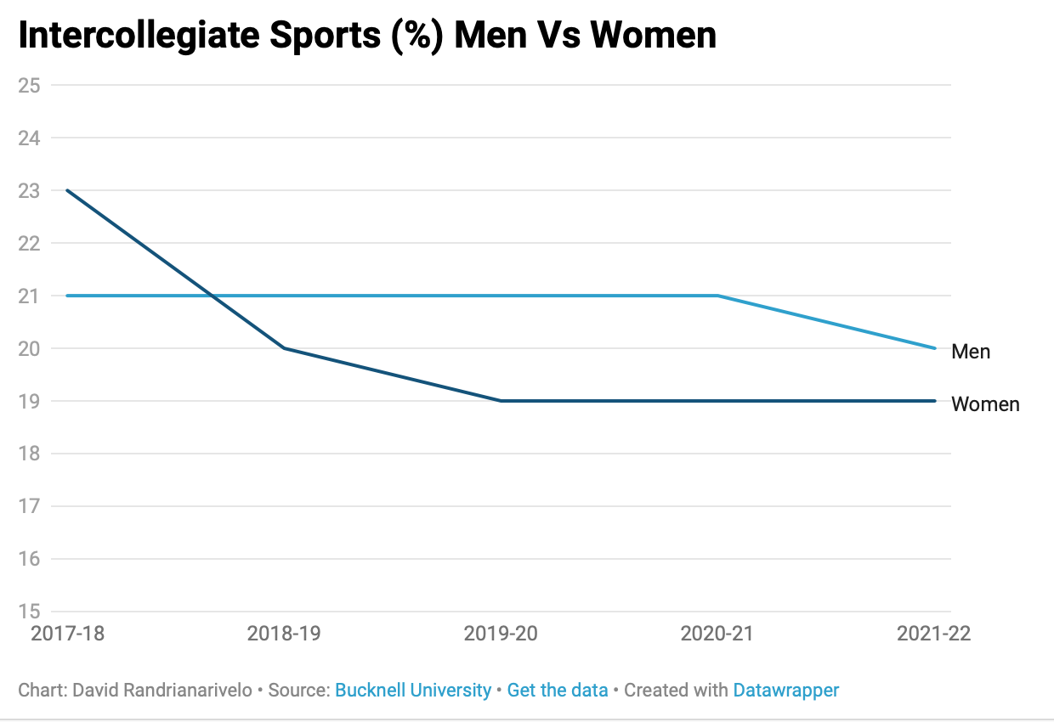
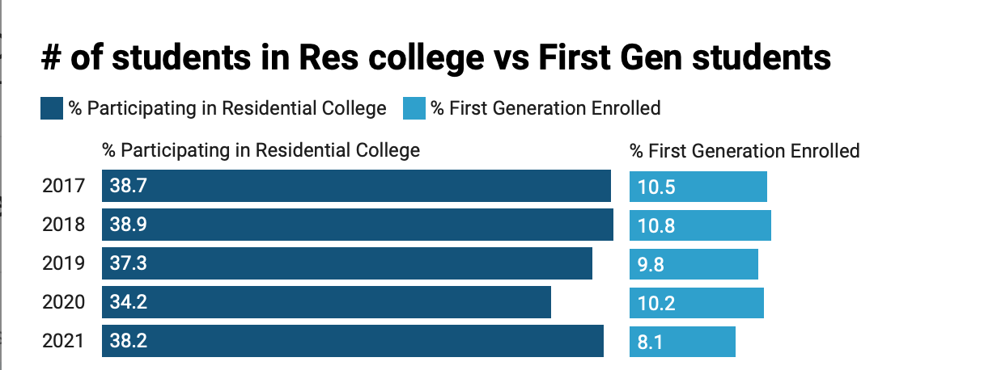
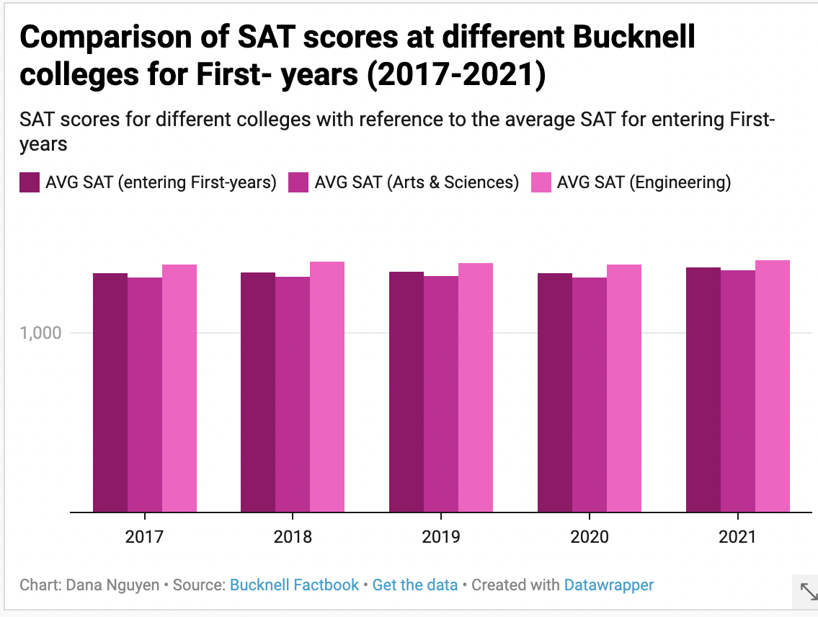
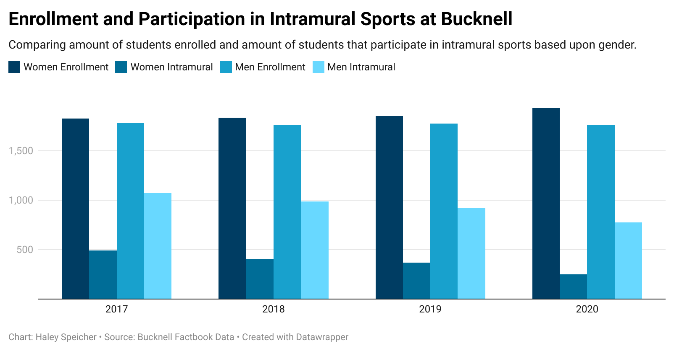
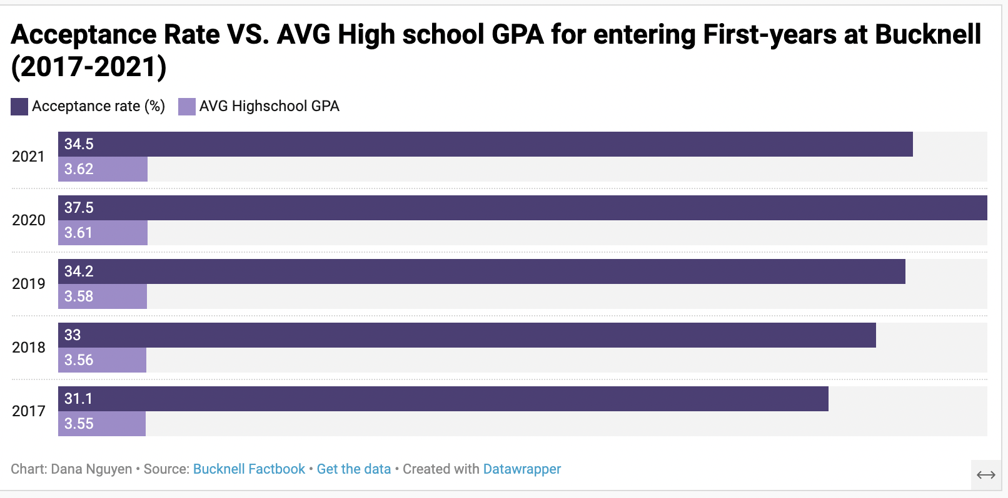
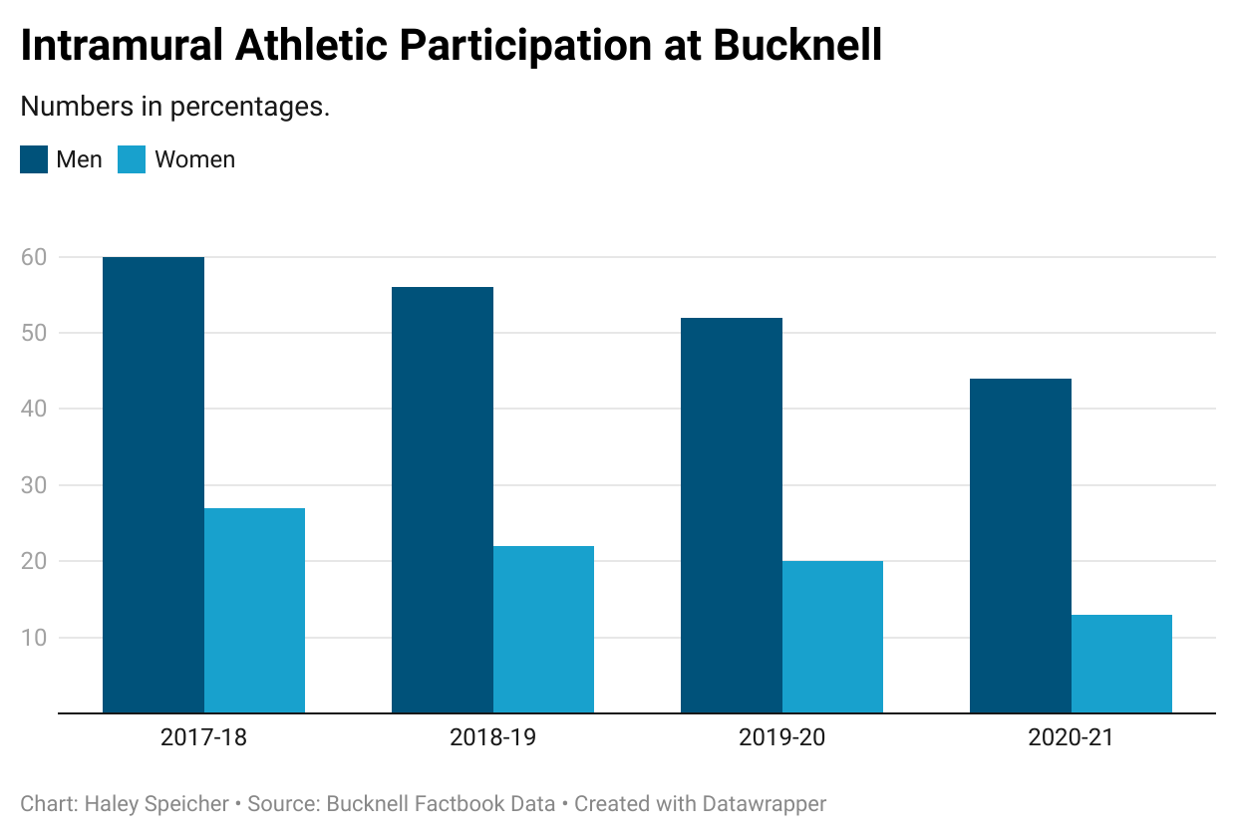
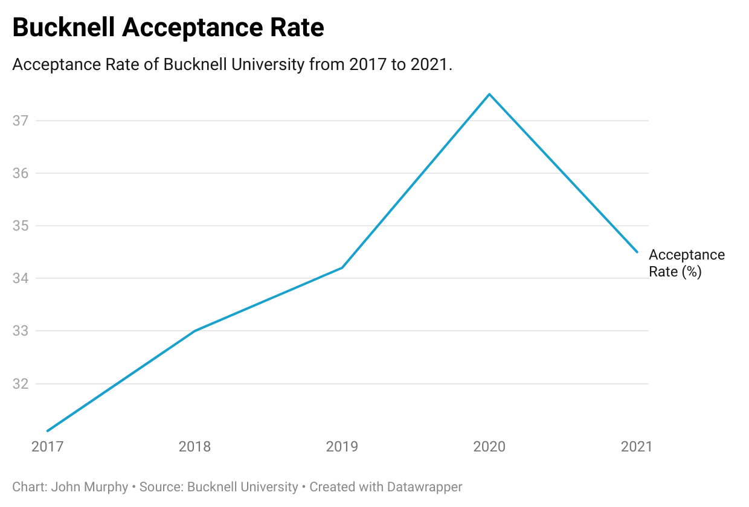
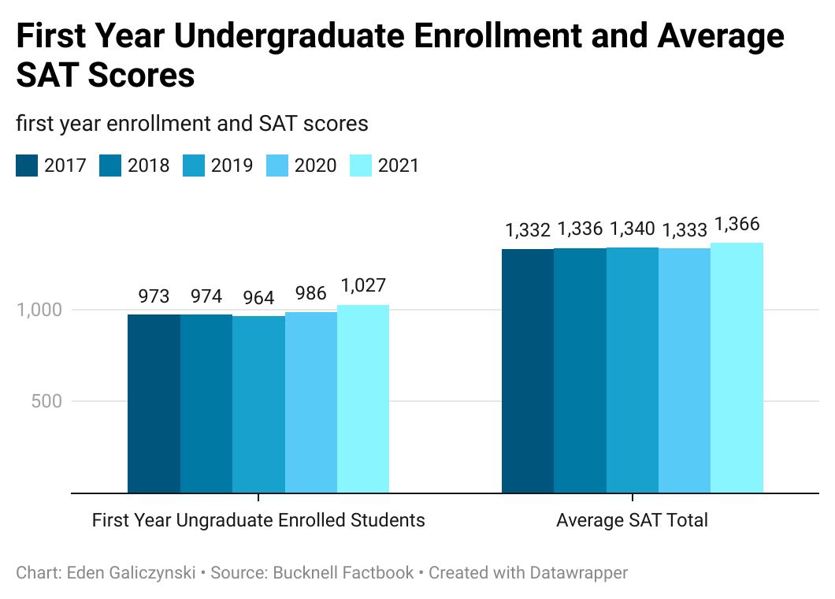
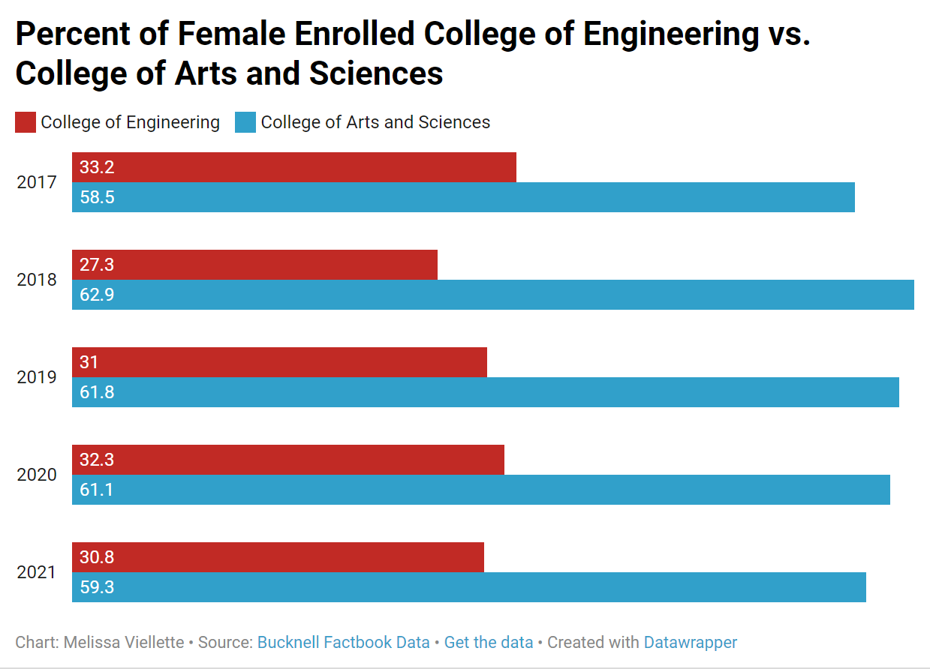
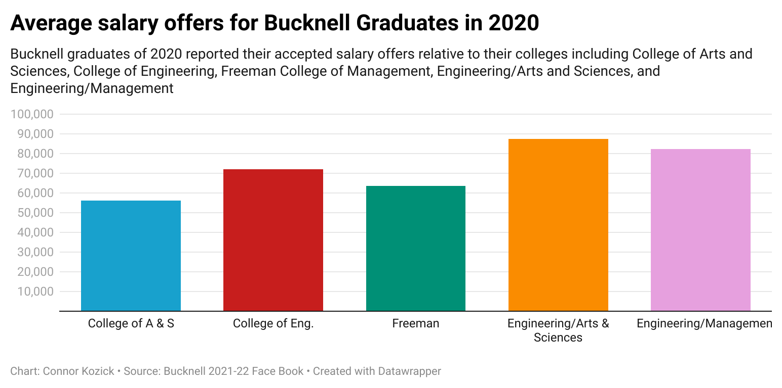
Notes:
Admissions (applicants, accepted, enrolled), sports, demographics, salaries after graduation, etc.
First year seminar - learn about Bucknell + skills - data on the school itself
Every person makes # of plots, then come together in a group to find the story in their collective plots
Then put everyone’s plots together and the groups need to revise their story adding some new plots
Can do this when learning about different visualization types

Slide 18
My students’ story:
SAT scores going into each part of University
Overall acceptance rate
Translation of applied/accepted as # rather than %
Accepted v. Enrolled (Who decides to come?)
Experiences once here: e.g. research experience
Post-graduation outcomes: e.g. salary

Slide 19
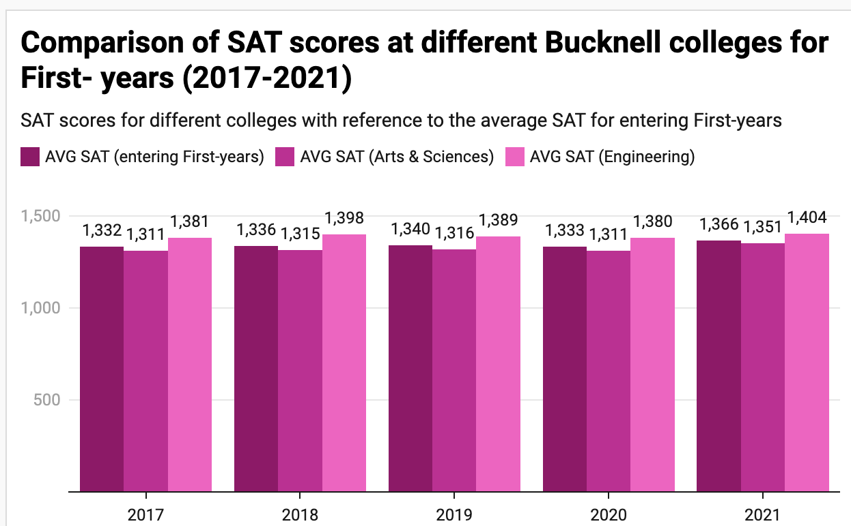
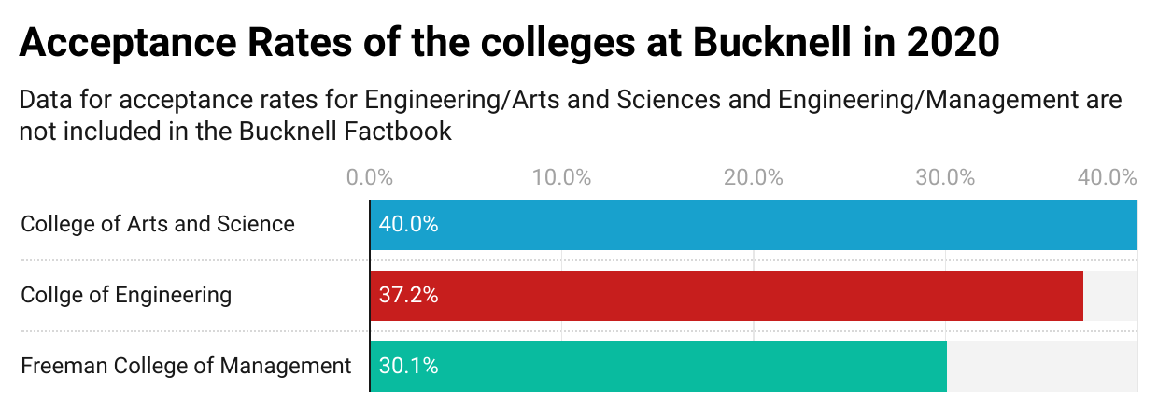
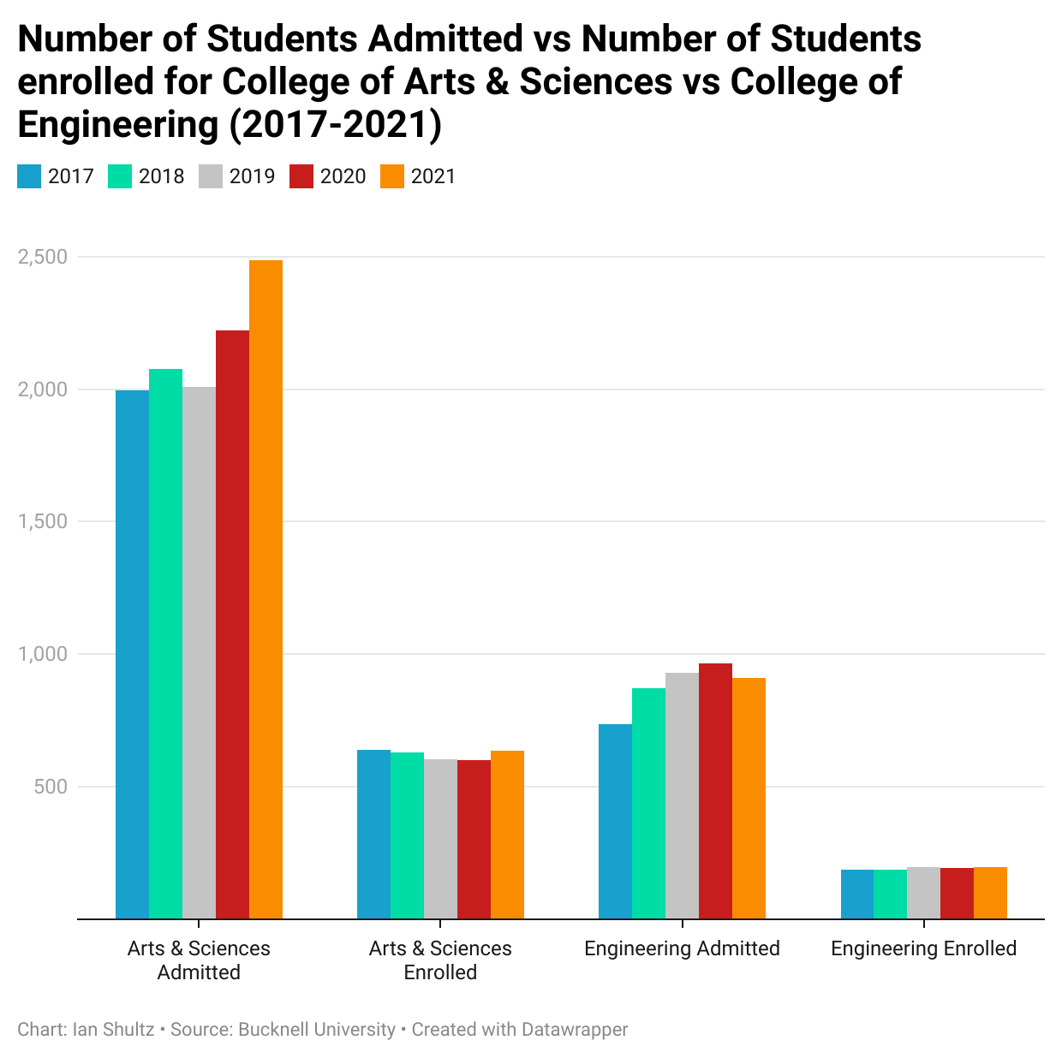
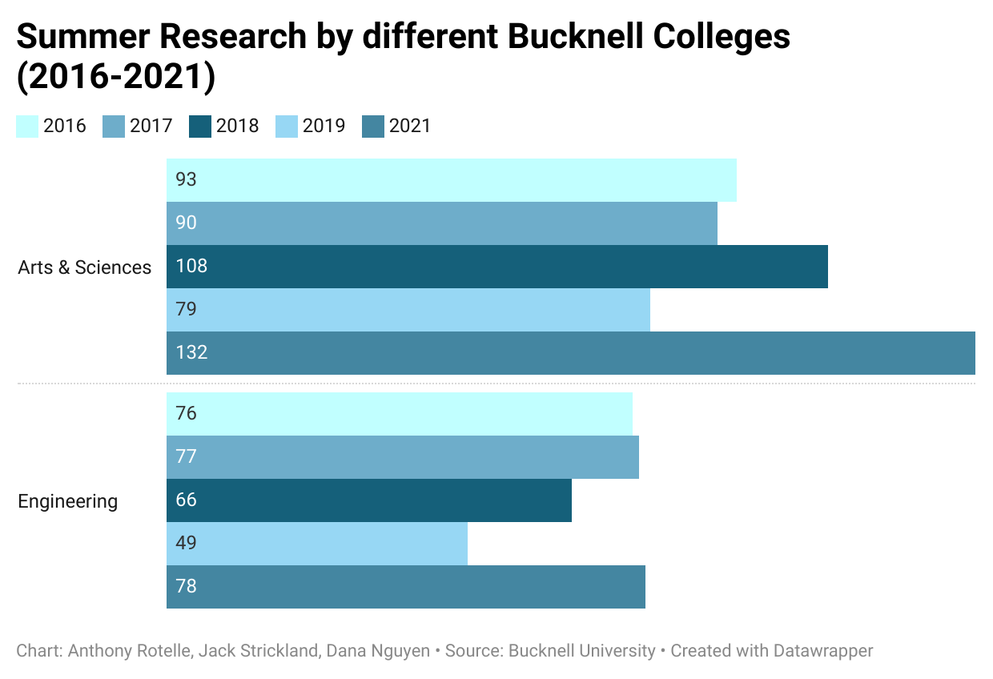
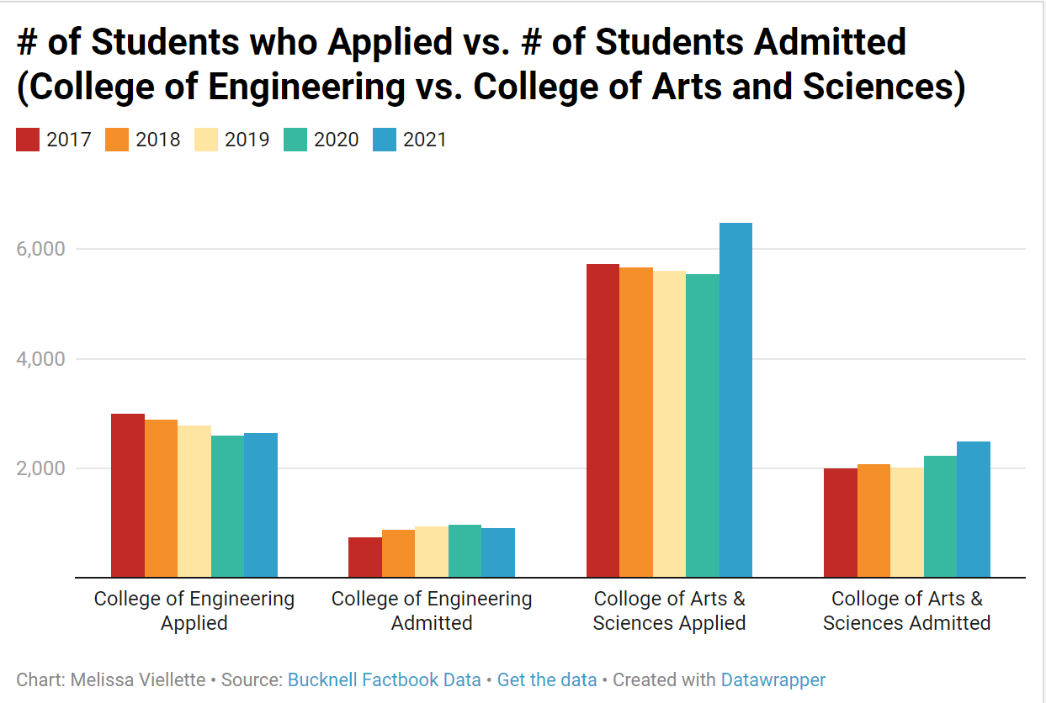
<- #2
^#1
<- #4 #5 →
#6 →
^#3
Notes:
Audience - Bucknellian

Slide 20
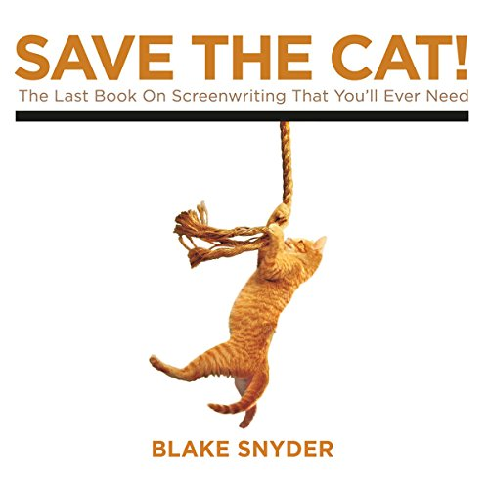
Speaking
Notes:
Coming soon - Significance article

Slide 21
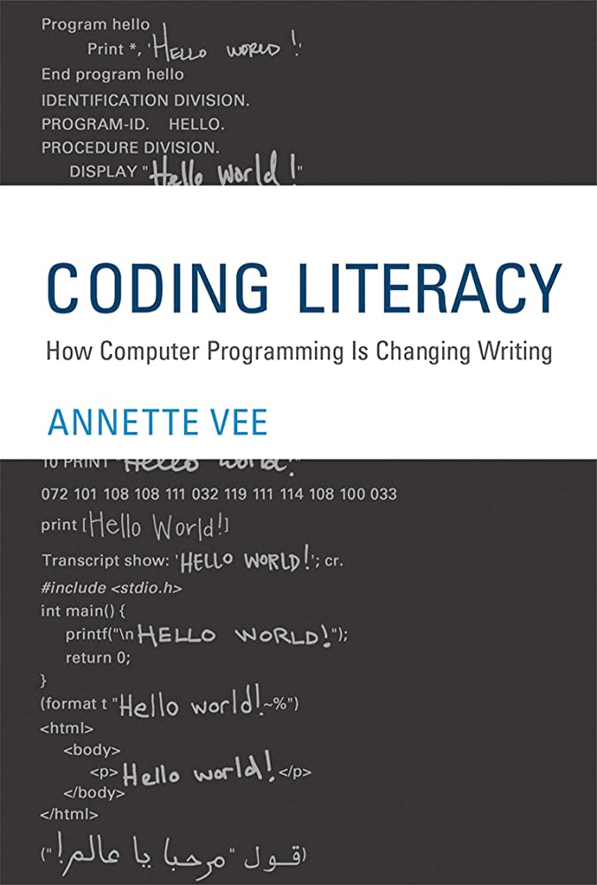
Coding
Notes:
Code comments
Pseudocode

Slide 22
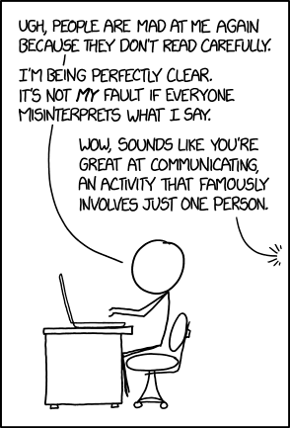
Drafting
https://xkcd.com/1984/

Slide 23
Time to get a little crafty…

Slide 24
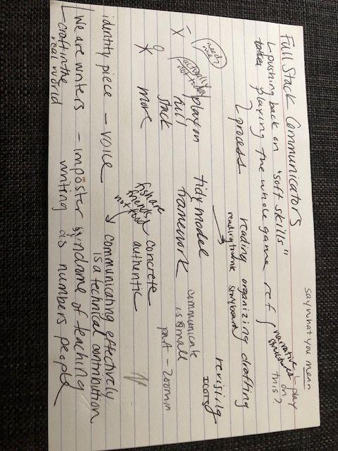
Notes:
Show note card of initial sketches of this talk

Slide 25
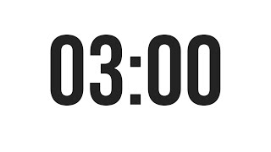
Noticing, Amplifying, and Supporting
What are you already doing?
How can you emphasize the communication’s role/value?
Who will you reach out to when you need help or feel doubt?
Notes:
Tell a better story about the role/value
Try to think beyond the last part of the course

Slide 26
Potential Pain Point Alert!

Slide 27
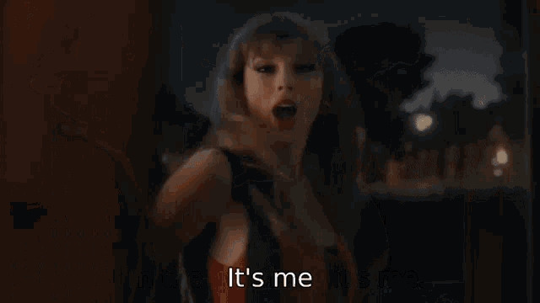
“Handing students a template should not be our default response to struggle.” - Jennifer Fletcher
Notes:
https://docs.google.com/presentation/d/1KjwExuvSyUcohcqFvR6bOhBPLpXSPjEB0qcn4JEtSOM/edit?usp=sharing
JSM 2022 proceedings
Conditional knowledge - when to do what
Transfer learning - other rhetorical situations of the same kind

Slide 28
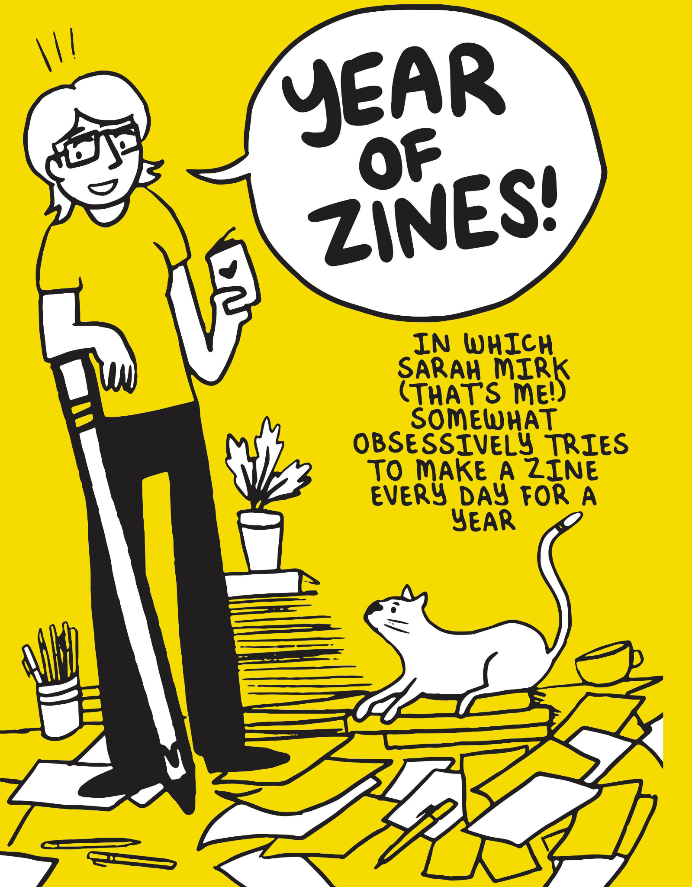
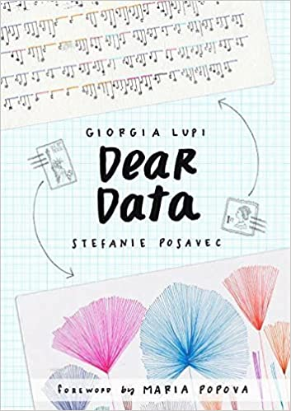
Visualizing
Notes:
https://iase-web.org/documents/papers/sat2021/IASE2021%20Satellite%20174_STOUDT.pdf?1649974218 (captions)

Slide 29
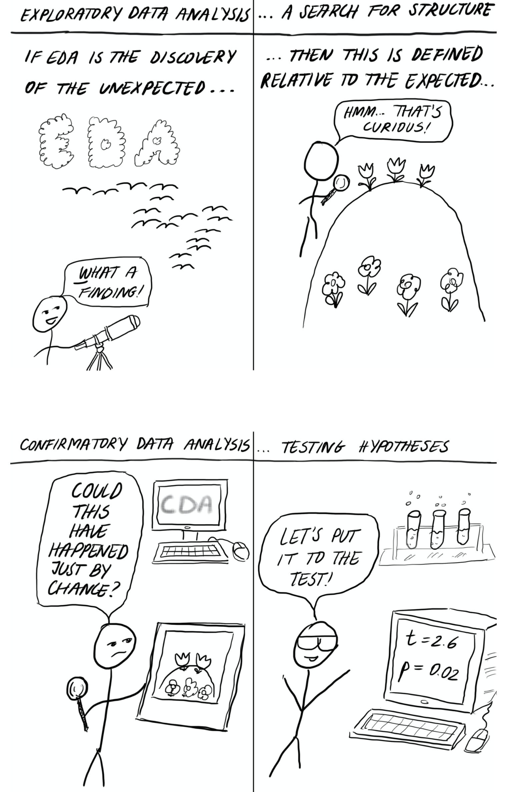
With Kelly Blumenthal, Aleksandrina Goeva, Ana Trisovic, and Pavle Trisovic
https://hdsr.mitpress.mit.edu/pub/49opxv6v/release/1

Slide 30
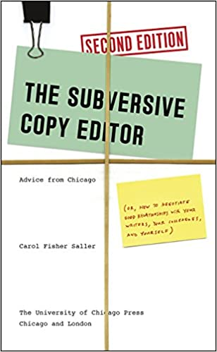
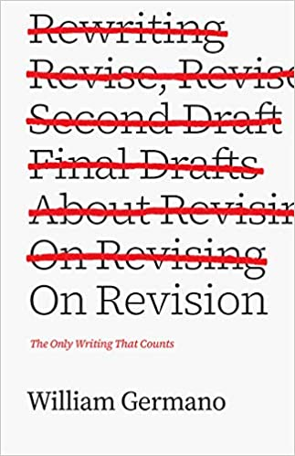
Revising
Notes:
http://iase-web.org/icots/11/proceedings/pdfs/ICOTS11_344_STOUDT.pdf?1669865558 (revision beyond the copy edit)

Slide 31
Modeling the process & embracing vulnerability
Using examples from your own formal writing…
Instructions: Improve each sentence. When you are finished, scroll to the next page to see the changes I made and compare them to your own.
Using examples from your own writing for broader audiences…
Instructions: Read my first and second drafts (made after editor feedback). What makes the revisions stronger?
Notes:
Examples from Laura Malafarina: https://twitter.com/lauramalafarina/status/1532848207222521860
Instructions: Analyze the techniques you notice in each sentence and imitate those techniques in your own original sentence (about anything).

Slide 32
Revision schedule - Writing intensive Intro stat
Exploratory Data Analysis Lab - common data set
Get feedback from instructor and revise #1
Exploratory Data Analysis for Final Project Data Set
Get feedback from instructor and peers and revise #3
3 Inference labs on final project data set
Get feedback from instructor on 4 and 5
Revise 4 and 5 - combine into one final project report.
Additional Revision Tasks (Optional): additional peer review, targeted revision guides for certain labs, use a writing resource during revision and reflect on how it impacted the revision
Notes:
Change to use your own work - role of copy editor v. rewriting - minimal change to make it better

Slide 33
Potential Pain Point Alert!

Slide 34
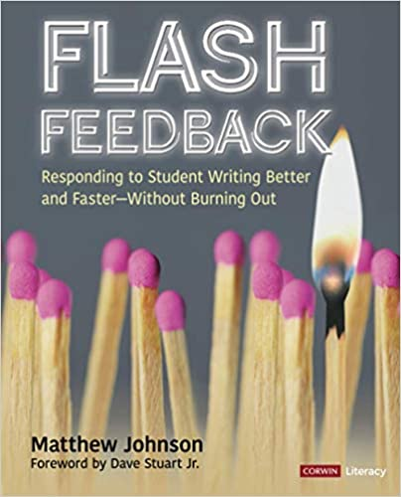
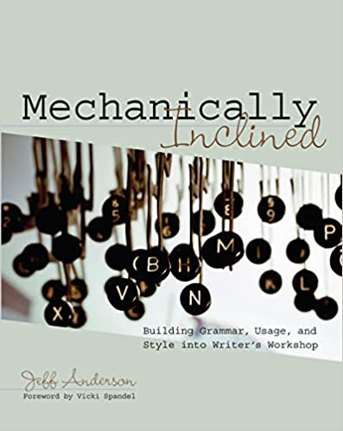
Feedback
Notes:
Stay tuned… IMSI workshop

Slide 35
Technicality (and Identity)

Slide 36
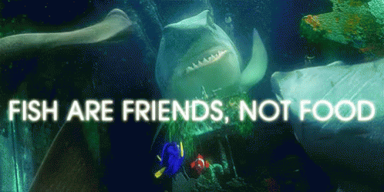
Communication is a technical skill… not a “soft” one!
Notes:
Goes hand in hand with not just being something cleaned up and pretty-ified at the end - full stack

Slide 37
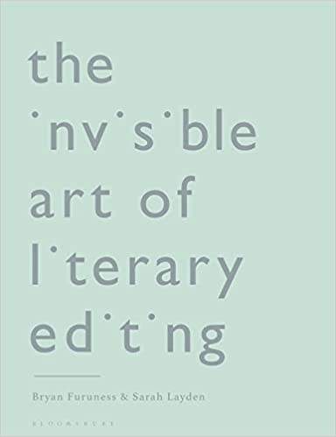
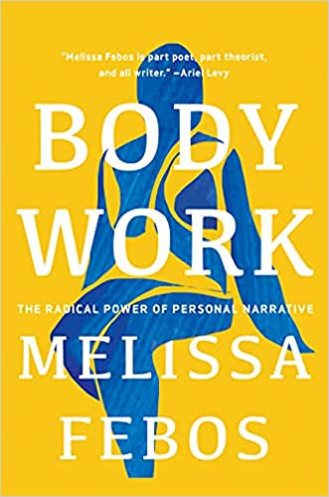
Cultivating and Valuing Voice
Notes:
Back to the feedback - not only is the quantity and efficiency- Not over smoothing
Editor not copyeditor - give students agency in addressing feedback
Questions only feedback
Workshop the idea not necessarily the product
Goes back to not over-scaffolding - allow for flexibility in communication approach

Slide 38
This is a gratitude slide for those who told me I could claim the title “writer” … Thank you!
writer
Notes:
Conference organizers for inviting me to give this keynote
Deb Nolan - asking me to help develop and teach the course and then write the book
Folks at the LA Times Data Desk
All of the people who have published my work in non-academic settings
We need to be that person for one another and for our students.

Slide 39
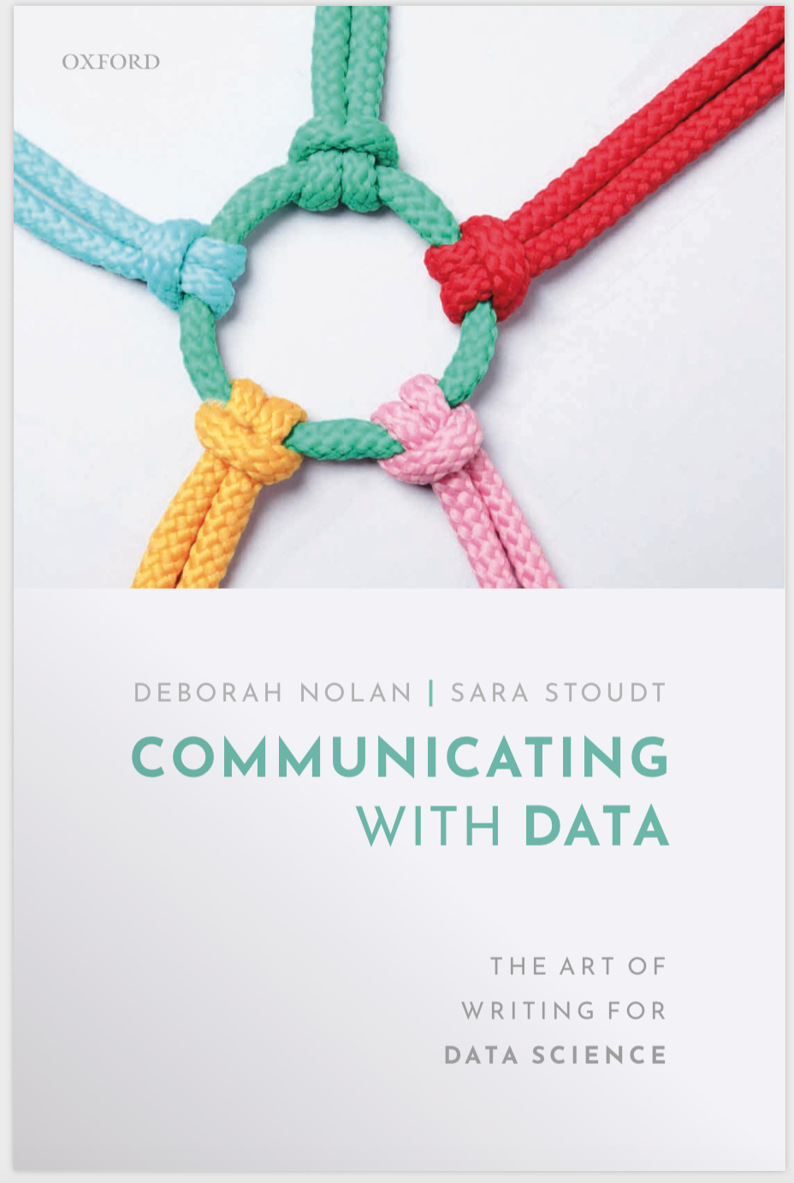
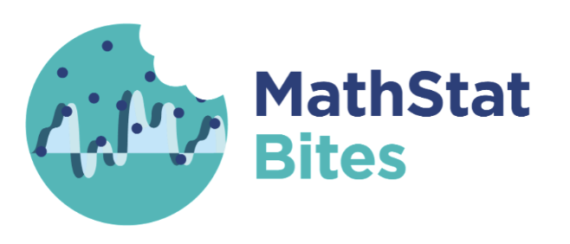
Thank you! Any questions?
sas072@bucknell.edu
@sastoudt
https://datasciencebydesign.org/book-2 https://global.oup.com/academic/product/communicating-with-data-9780198862758
https://mathstatbites.org/

