Slide 1
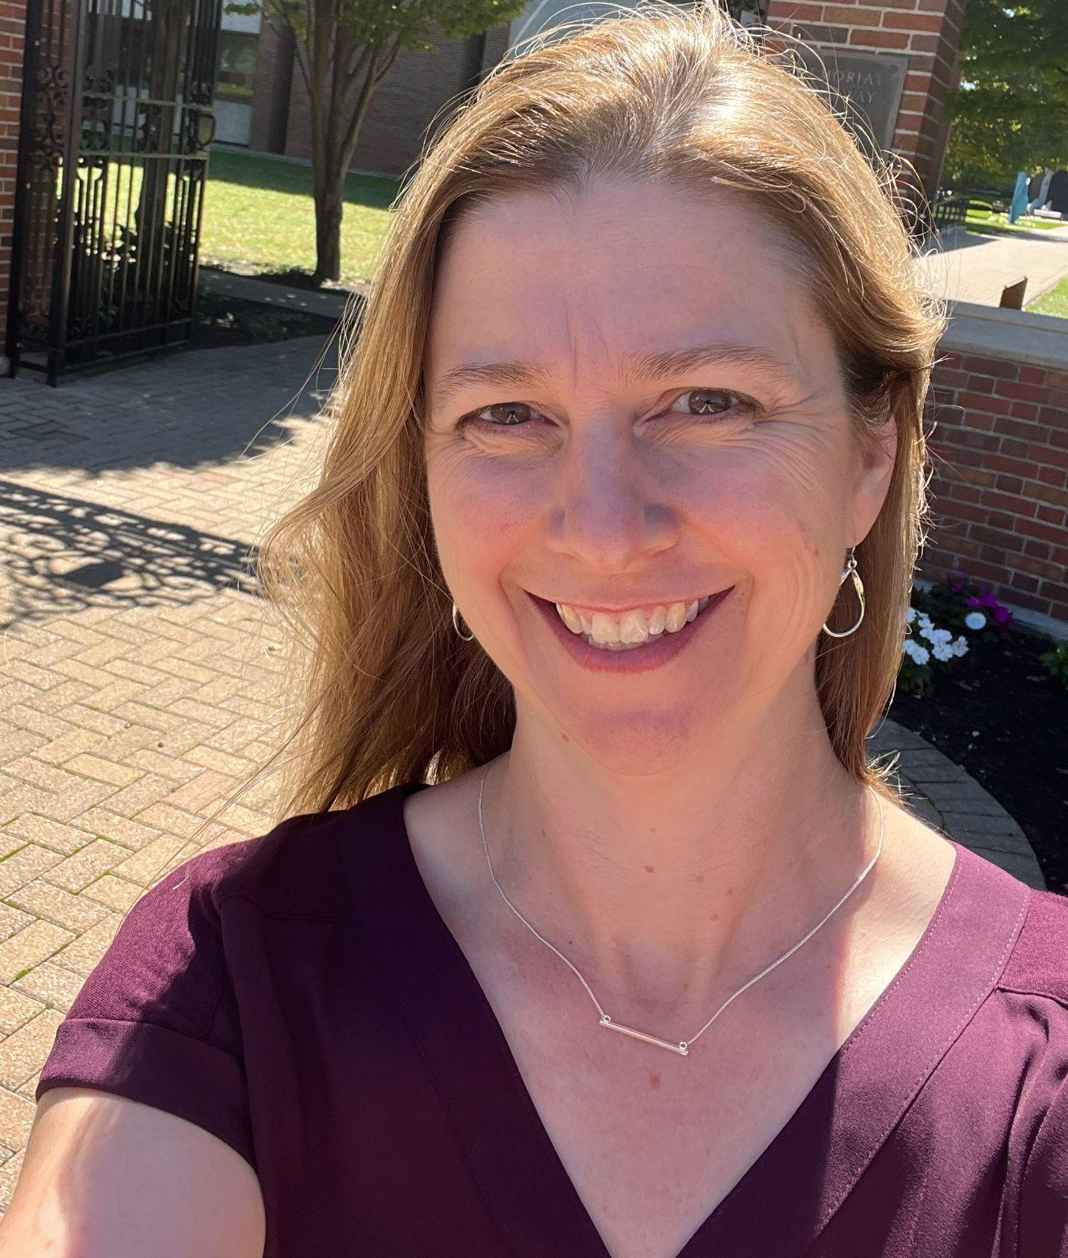
Effective teamwork and communication: Process Oriented Guided Inquiry Learning (POGIL) in the statistics classroom
Leigh Johnson, Ph.D.
Capital University
ljohnson2@capital.edu
Tracey Arnold Murray, Ph.D.
Capital University
tmurray2@capital.edu
Notes:
Explain “Attention Signal”: When the facilitator raises his/her hand, everyone in the room should also raise their hands. It is a signal to stop your discussion and pay your attention to the facilitator. Everyone will keep their hands up until all groups stopped their discussion. It is a quick and non-intrusive way to gather groups’ attention in your class/session.

Slide 2
Welcome!
Please sit in teams of 3-4
(Turn around if needed)
Introduce yourselves
Notes:
Explain “Attention Signal”: When the facilitator raises his/her hand, everyone in the room should also raise their hands. It is a signal to stop your discussion and pay your attention to the facilitator. Everyone will keep their hands up until all groups stopped their discussion. It is a quick and non-intrusive way to gather groups’ attention in your class/session.

Slide 3
Questions (about POGIL) during the activity
Write them down on a post-it/notepad
Hold till the end

Slide 4
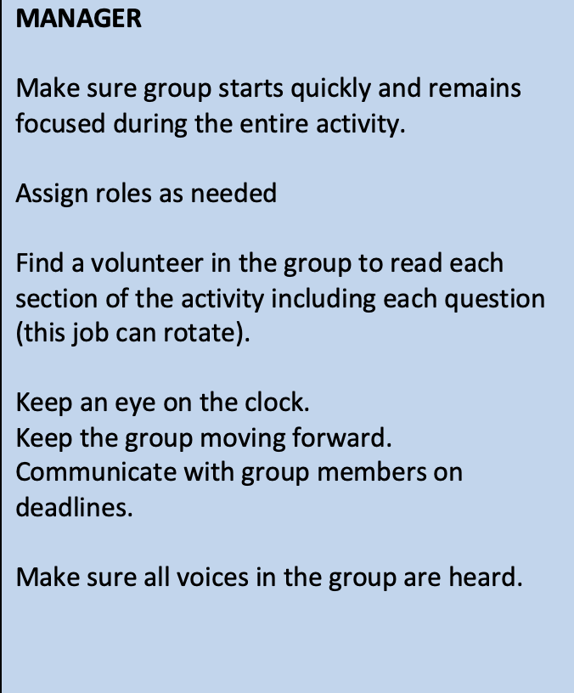
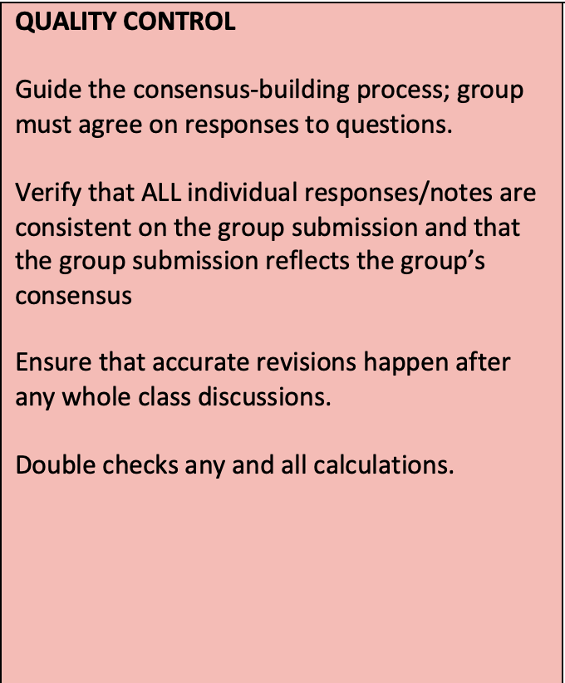
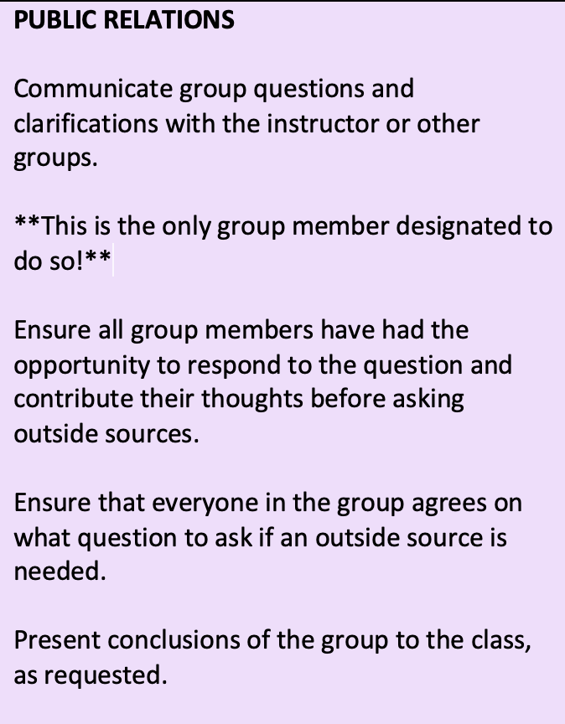
Getting Started
From the envelope provided to your team, choose one of the following roles:
MANAGER
QUALITY CONTROL
DATA ENTRY
PUBLIC RELATIONS
Spend 30 seconds reviewing your responsibilities.
Spend 2 minutes (30 seconds each) summarizing your role for the other members of your team
Notes:
Instructor each group to use the set of role cards placed on their table to assign roles.
After the groups have had a chance to choose their roles, you can check that they are ready by practicing the “hand raised”/quiet signal, and/or by asking people to raise their hands if they are the “manager/spokesperson/etc.”

Slide 5
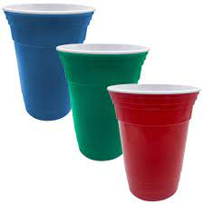
A POGIL Classroom Experience
SOLO CUPS
Blue = We’re done
Green = Group is OK
Red = We have a question
Notes:
You will use the Atoms and Molecules activity as the classroom experience.

Slide 6
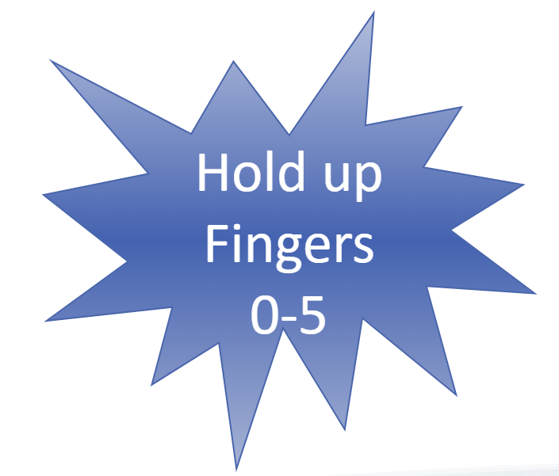
A POGIL Classroom Experience
How well do you understand atoms, molecules and particles?
Notes:
At the end of this activity ask if anyone has questions about their role or how to fulfill the responsibilities of their role. (Note: This is not a good time to answer questions like: How often do you switch roles? How do you assign roles? Are there other roles you use? If these questions come up, ask the participant to make a note of that question and there will be a Q&A time at the end.

Slide 7
A POGIL Classroom Experience
MANAGER: Distribute copies of “Atoms, Molecules, and Particles, Oh My!” to all members of your team.
Work as a team to complete the activity.
Be sure to follow your role(s).
10 minutes
Notes:
At the end of this activity ask if anyone has questions about their role or how to fulfill the responsibilities of their role. (Note: This is not a good time to answer questions like: How often do you switch roles? How do you assign roles? Are there other roles you use? If these questions come up, ask the participant to make a note of that question and there will be a Q&A time at the end.

Slide 8
A POGIL Classroom Experience
Notes:
You will use the Atoms and Molecules activity as the classroom experience.

Slide 9
Report Out
Options:
Each team answers one question - all questions included
Teams put certain questions on boards (visible to all)
Clickers are used to gather info on key questions (or similar questions)
Each team answers one question - only key questions included
Notes:
Have participants write down their responses individually for about a minute, then have the groups discuss for 3 minutes to generate a list for the Presenter/Spokesperson to report from. When Presenter/spokesperson reports out, emphasize that the response should describe something that students gain, and perhaps rephrase or ask for rephrasing if unclear. For example, “working in a group” is not something that students gain, but “experience working in a group” or “teamwork skills” would be better. Also, steer participants away from any discussion of barriers to implementation or implementation questions. Keep the focus on student outcomes and gains. If time remains, ask for any general insights about teaching an learning that participants have gained so far.

Slide 10
A POGIL Classroom Experience
How well do you understand atoms, molecules and particles?
Notes:
At the end of this activity ask if anyone has questions about their role or how to fulfill the responsibilities of their role. (Note: This is not a good time to answer questions like: How often do you switch roles? How do you assign roles? Are there other roles you use? If these questions come up, ask the participant to make a note of that question and there will be a Q&A time at the end.

Slide 11
Student Outcomes
Other than content knowledge, what might students gain from this type of learning environment?
Write individually: 1 minute
Share within team: 3 minutes
Report out (Presenter)
Notes:
Have participants write down their responses individually for about a minute, then have the groups discuss for 3 minutes to generate a list for the Presenter/Spokesperson to report from. When Presenter/spokesperson reports out, emphasize that the response should describe something that students gain, and perhaps rephrase or ask for rephrasing if unclear. For example, “working in a group” is not something that students gain, but “experience working in a group” or “teamwork skills” would be better. Also, steer participants away from any discussion of barriers to implementation or implementation questions. Keep the focus on student outcomes and gains. If time remains, ask for any general insights about teaching an learning that participants have gained so far.

Slide 12
Questions about POGIL?
We will talk about definitions and data later.
Notes:
Have participants write down their responses individually for about a minute, then have the groups discuss for 3 minutes to generate a list for the Presenter/Spokesperson to report from. When Presenter/spokesperson reports out, emphasize that the response should describe something that students gain, and perhaps rephrase or ask for rephrasing if unclear. For example, “working in a group” is not something that students gain, but “experience working in a group” or “teamwork skills” would be better. Also, steer participants away from any discussion of barriers to implementation or implementation questions. Keep the focus on student outcomes and gains. If time remains, ask for any general insights about teaching an learning that participants have gained so far.

Slide 13
What is POGIL?
Guided Inquiry (Constructivism):
Learning Cycle Activities
Process Oriented Guided Inquiry Learning
Notes:
Summary to show both pieces…

Slide 14
The Learning Cycle
Invent
Explore
Apply
Notes:
Guided Inquiry component is based on a constructivist view of learning. The Learning Cycle developed by Karplus, based on Piaget’s work, forms the basis for the structure of many of the activities. There will be more specifics on Guided Inquiry and the Learning Cycle later…

Slide 15
GAISE Report (2016)
1. Teach statistical thinking.
Teach statistics as an investigative process of problem-solving and decision making.
Give students experience with multivariable thinking.
2. Focus on conceptual understanding.
3. Integrate real data with a context and purpose.
4. Foster active learning.
5. Use technology to explore concepts and analyze data.
6. Use assessments to improve and evaluate student learning.

Slide 16
Foster Active Learning
“Using active learning methods in class allows students to discover, construct, and understand important statistical ideas as well as to engage in statistical thinking. Other benefits include the practice students get communicating in statistical language and learning to work in teams to solve problems…A recent meta-analysis (Freeman et al. 2014) concludes that there are distinct advantages in terms of course outcomes when active learning is employed in STEM courses.”
“Instructors should not underestimate the learning gains that can be achieved with activities or overestimate the value of lectures to convey information”
-GAISE Report (2016)

Slide 17
What is POGIL?
Process Oriented (Cooperative Learning):
Develop Key Process Skills
Process Oriented Guided Inquiry Learning
Notes:
The POGIL Pedagogy is an intentional synthesis of two approaches – a focus on the development of key process skills, and the use of guided inquiry frameworks to build content knowledge. In the next part of the workshop, we will examine each of the components separately before considering how they fit together to make a POGIL classroom.

Slide 18
POGIL Process Skills
Information Processing
Critical Thinking
Problem Solving
Communication
Teamwork
Management
Assessment
Essential Data Scientist/Statistician Skills (towardsdatascience.com)
Communication Skills
Domain Knowledge
Business Acumen
Teamwork
Problem Solving
Notes:
Emphasize that the “Process Oriented” piece means thinking explicitly about what process skills you want your students to gain, and how you are going to create an environment for them to further develop those skills. Can be done for each class meeting, each course, the entire major, etc. The listed process skills are the ones that the POGIL Project initially targeted, and they are the ones that are most generally developed through POGIL. But what is important is that each instructor think about the process skills goals that he/she has for his/her students in his/her unique context and work to create a learning environment that promotes growth of those goals.
If time is available beyond the intended 60 minutes we suggest using the NGSS/Common Core alignment with POGIL activity where participants would look at the Science and Engineering Practices of NGSS, the Common Core Standards for Mathematical Practice and the seven POGIL Process Skill areas. This additional activity will take about 20 minutes total.

Slide 19
What is POGIL?
Process Oriented (Cooperative Learning):
Develop Key Process Skills
Guided Inquiry (Constructivism):
Learning Cycle Activities
Process Oriented Guided Inquiry Learning
Notes:
Summary to show both pieces…

Slide 20
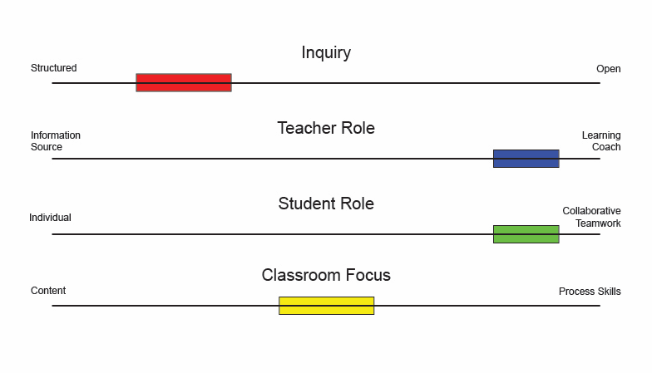
Role of Teacher and Student

Slide 21
The POGIL Project
Mission Statement:
The mission of The POGIL Project is to improve teaching and learning by fostering an inclusive, transformative community of reflective educators who design, implement, assess, and study learner-centered environments.
Notes:
Emphasize that the “Process Oriented” piece means thinking explicitly about what process skills you want your students to gain, and how you are going to create an environment for them to further develop those skills. Can be done for each class meeting, each course, the entire major, etc. The listed process skills are the ones that the POGIL Project initially targeted, and they are the ones that are most generally developed through POGIL. But what is important is that each instructor think about the process skills goals that he/she has for his/her students in his/her unique context and work to create a learning environment that promotes growth of those goals.
If time is available beyond the intended 60 minutes we suggest using the NGSS/Common Core alignment with POGIL activity where participants would look at the Science and Engineering Practices of NGSS, the Common Core Standards for Mathematical Practice and the seven POGIL Process Skill areas. This additional activity will take about 20 minutes total.

Slide 22
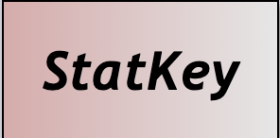
POGIL in a Statistics Classroom
Capital is a small, liberal-arts institution located in Columbus, Ohio
Math 215 (Elementary Statistics) is an algebra prerequisite course required of a variety of majors (business, nursing, computer science, biology, etc)
Currently use Statistics: Unlocking the Power of Data, 3rd Edition, by Lock⁵
Book emphasizes a randomization curriculum and comes with many activities.

Slide 23
POGIL in a Statistics Classroom
Was already using many of the Lock activities and others from various sources in the classroom: tried to do something hands - on in every class period
Still had many issues with groups not forming effective teams
one dominant personality
a student working on their own despite encouragement to “talk to their neighbor”
groups simply getting chatty and not focusing
getting multiple lab submissions with different responses from the same group

Slide 24
POGIL in a Statistics Classroom
Was convinced by my co-presenter (and funded by our college) to attend a summer three day workshop that introduced POGIL in 2017.
Recognized several of the same educational theory in statistics education (guided inquiry, constructivism) in the POGIL materials but with the added equal emphasis on process skills.
Unlike Tracey, I wasn’t ready to go “all - in” and completely turn my statistics classroom into a POGIL classroom (there was also the issue of not having a POGIL-ready statistics textbook.)
The workshop presenters emphasized that the “volume” of POGIL activities can range from occasional to “all -in” in a real classroom & adaptation of already existing materials was encouraged.

Slide 25
POGIL in a Statistics Classroom
“This book leads students to learn about the process of conducting statistical investigations from data collection, to exploring data, to statistical inference, to drawing appropriate conclusions. We focus on genuine research studies, active learning, and effective use of technology. In particular, we use simulation and randomization tests to introduce students to statistical inference, yielding a strong conceptual foundation that bridges students to theory-based inference approaches, which are presented throughout the book…Our implementation follows the GAISE recommendations endorsed by the American Statistical Association.”

Slide 26
POGIL in a Statistics Classroom
Look over the the Murderous Nurse handout (at least through the first few questions on page 264.)
In groups, discuss:
What is similar about the structure of the activity to the molecules, atoms, and particles activity?
What is different about the structure of the activity to the molecules, atoms, and particles activity?

Slide 27
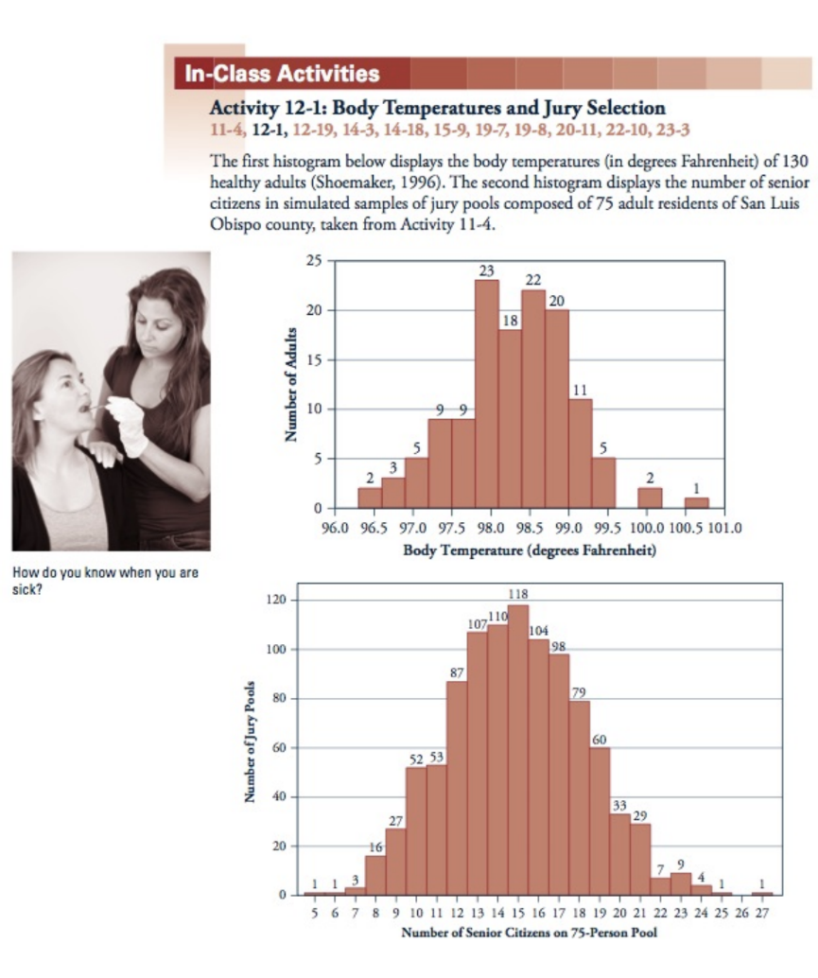
POGIL in a Statistics Classroom

Slide 28
Introducing POGIL to students
Leigh
Syllabus “scavenger hunt” activity first class - done with role cards
Statement in the syllabus explaining the purpose of POGIL and the activities
One of the questions on the activity is about that statement.
Murderous Nurse is usually the 4th or 5th meeting, so I come back to it fairly quickly.
Tracey
Syllabus activity - not POGIL, introduces teamwork idea
Second day: Roles and data on POGIL and why I do this
Later in semester: questions about how this is helping prepare for “real life”
Last day of semester: Things employers are looking for

Slide 29
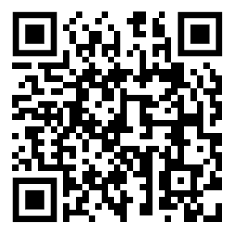
Is POGIL effective?
https://pogil.org/about-pogil/effectiveness-of-pogil

Slide 30
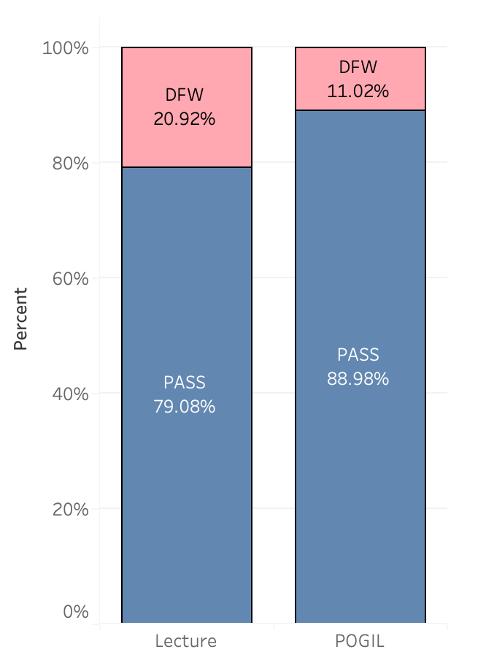
General Chemistry
Capital University
Fall 2015 - Fall 2022
Lecure: n =196
POGIL: n = 236
(All sections were taught by same instructor)
p-value = .0046

Slide 31
Other DFW Summaries - General Chemistry
Capital University Fall 2015 - Fall 2022
 | White | Non-White
Lecture | 21% (n = 154) | 24% (n = 42)
POGIL | 8% (n = 168) | 19% (n = 68)
 | Non-First Generation | First Generation
Lecture | 17% (n = 139) | 30% ( n = 57)
POGIL | 11% (n = 192) | 14% (n = 44)

Slide 32
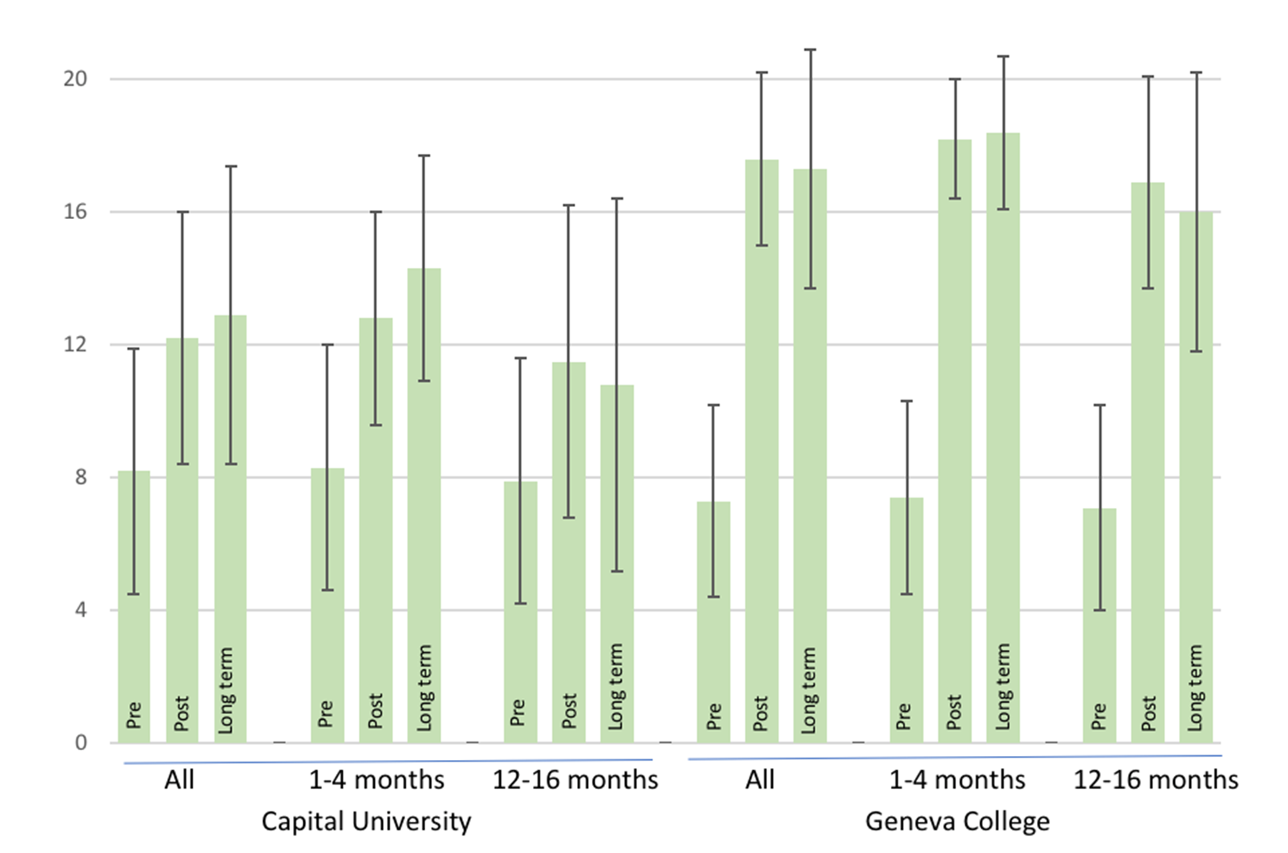
Biochemistry Pre/Post test data
Capital University & Geneva College

Slide 33
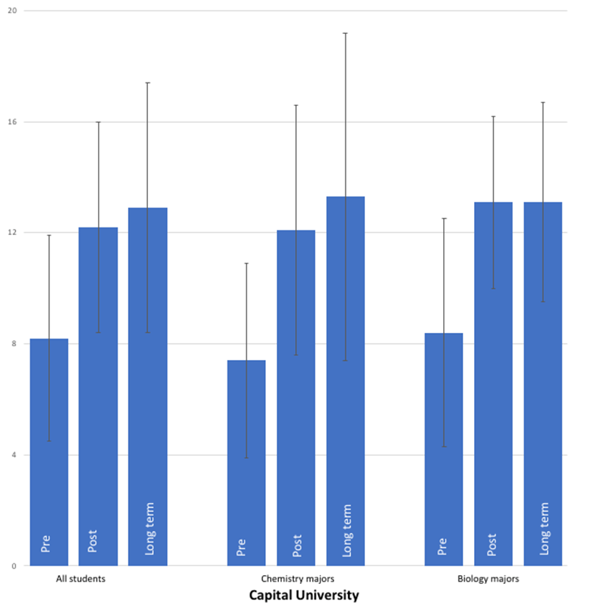
Biochemistry Pre/Post test data (separated by major)
Capital University

Slide 34
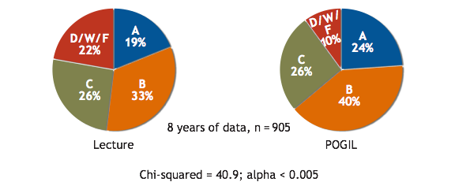
General Chemistry - Franklin & Marshall College
Lecture (Fall 1990 – Spring 1994): n = 420
POGIL (Fall 1994 – Spring 1998): n = 485
Sections of approximately 24 students each
Same instructors
Students randomly placed fall semester and designated their preference spring semester (but not guaranteed their choice)
ꭓ²=40.9, p-value < 0.005
Farrell, J.J., Moog, R.S., Spencer, J.N. (1999) A Guided Inquiry Chemistry Course. J. Chem. Educ., 76, 570 – 574.

Slide 35
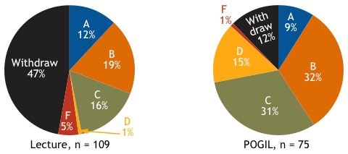
Organic Chemistry I - Virginia Commonwealth University
Two sections, one lecture, one POGIL, taught at the same time
Students randomly placed in sections
Compared common exam scores (created by lecture professor) and “W” rate
ꭓ²=19.1, p-value < 0.005
Ruder, S. M., & Hunnicutt, S. S. (2008). POGIL in Chemistry Courses at a Large Urban University: A Case Study. In ACS Symposium Series (pp. 133–147). American Chemical Society. https://doi.org/10.1021/bk-2008-0994.ch012

Slide 36
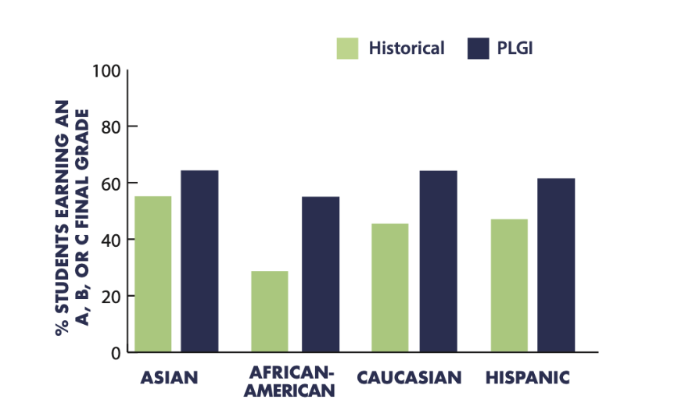
“The use of POGIL pedagogy supports the achievement of underrepresented groups in STEM fields.”
Pass rates (A, B, and C grades) for The University of Southern Florida calculus students before and after the implementation of Peer-Led Guided Inquiry (PGLI) using POGIL activities. (Bénéteau, 2016)

Slide 37
More About POGIL: www.pogil.org
Notes:
Direct participants to the POGIL website. Show them the Upcoming events section, the news and the Blogs. Show them the high-school tab where there is a wealth of information about implementing POGIL in your classroom. Show them the resources section where they can find the materials that are currently available that have been endorsed by The POGIL Project.

Slide 38
More About POGIL:
Attend a Workshop
Virtual “Fundamentals of POGIL”
July 6-7
August 2-3
In-Person 3-Day Workshop
July 24-26 (St. Paul, MN)
Classroom Facilitation or Activity Writing
Both virtual in July
See website for details
Notes:
Fill in with your local network or contact, summer workshops

Slide 39
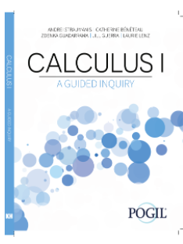
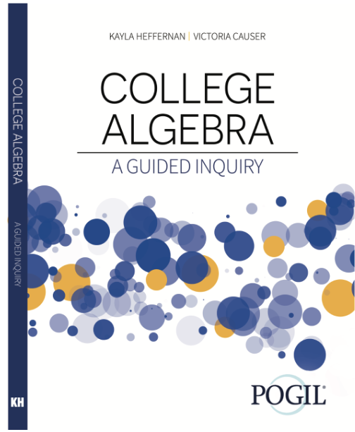
More About POGIL:
Existing Materials
Request from Kendall Hunt
Sample Calculus 1 Activity
Computer Science POGIL
Notes:
Fill in with your local network or contact, summer workshops

Slide 40
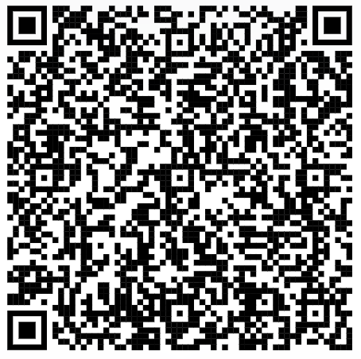
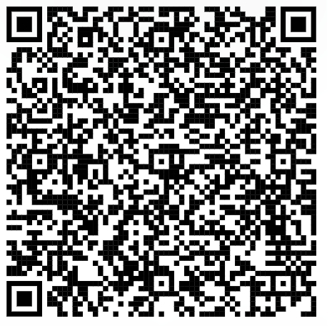
More About POGIL:
Email us
Leigh Johnson Tracey Murray
ljohnson2@capital.edu tmurray2@capital.edu
Slides
Role Cards
Notes:
Fill in with your local network or contact, summer workshops

