Slide 1
Connecting to Communicate with ALL Students
Kelly Spoon
Associate Professor, Mathematics
San Diego Mesa College
Notes:
Notes are for the prepared

Slide 2
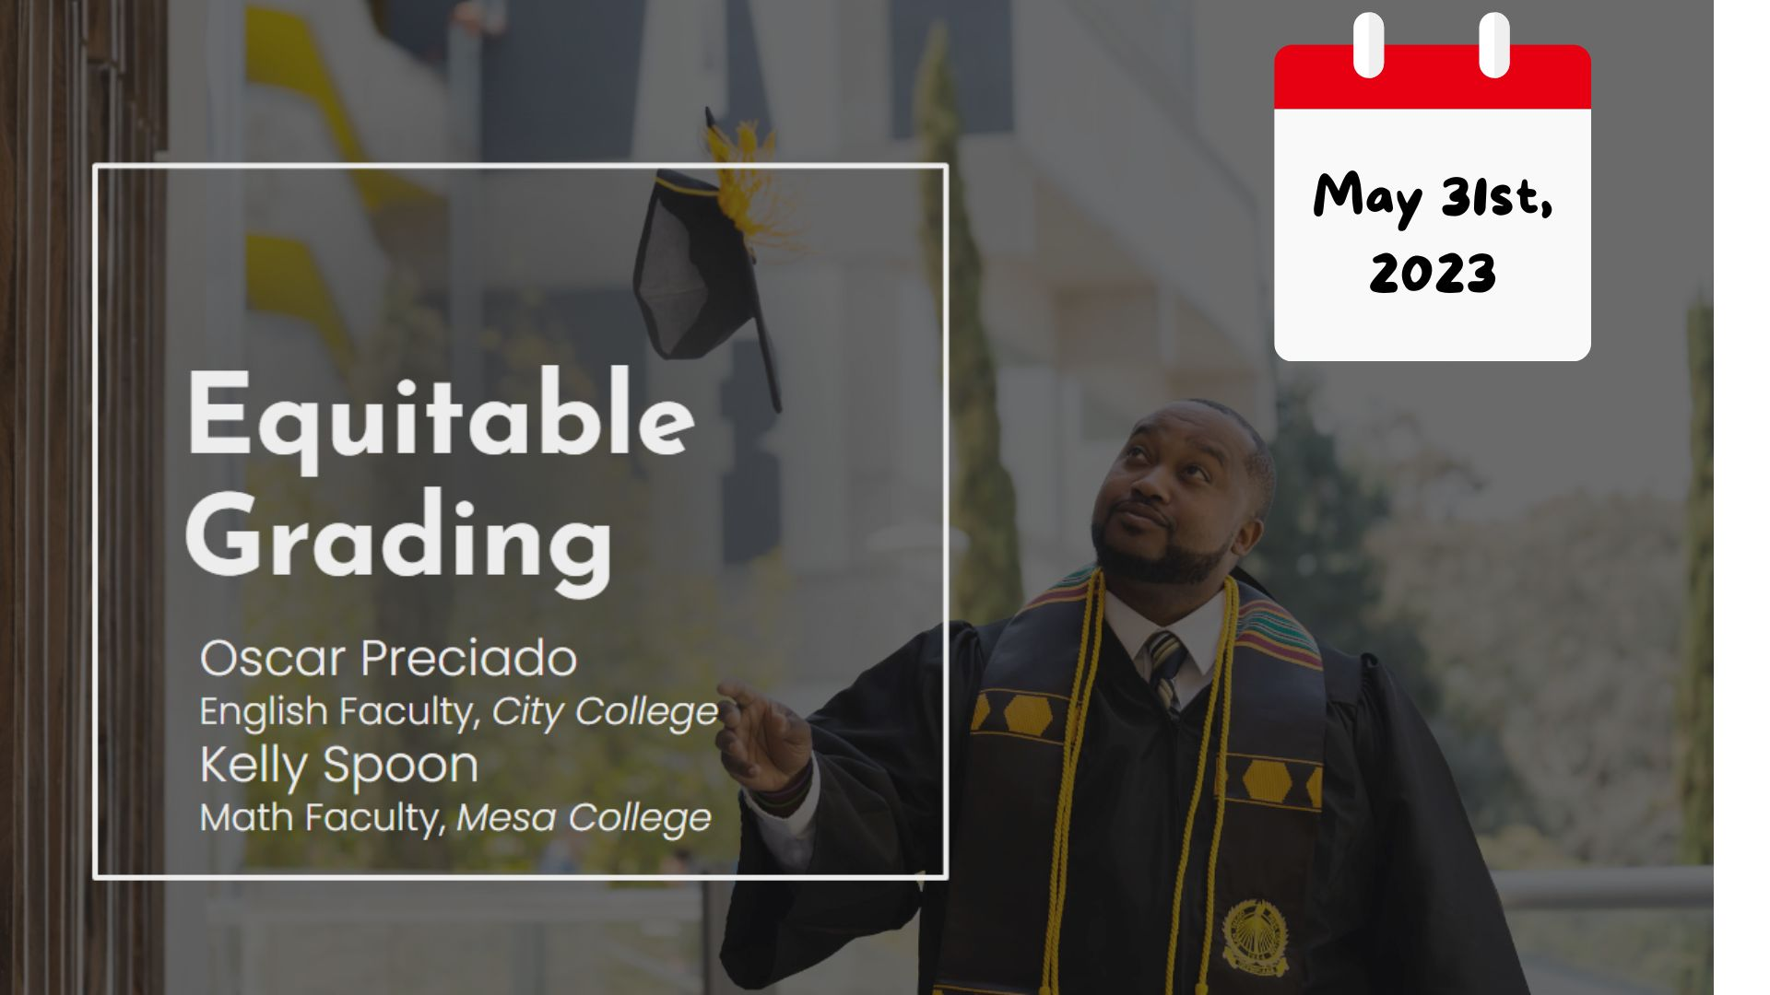
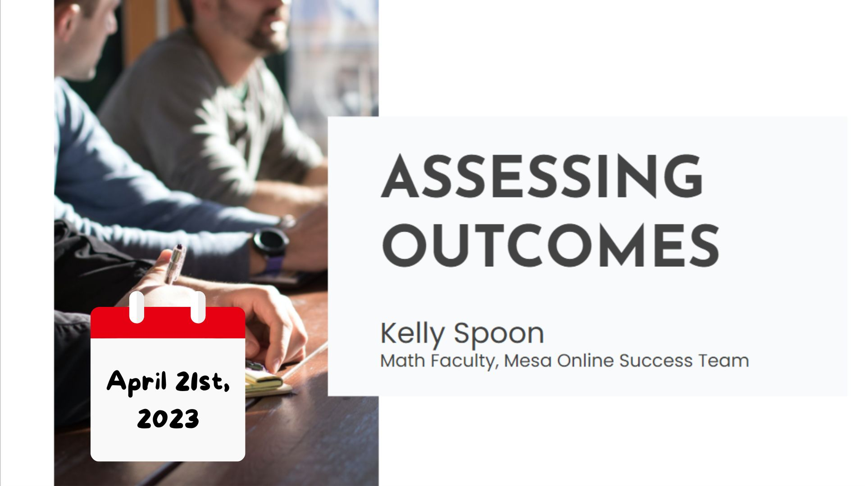
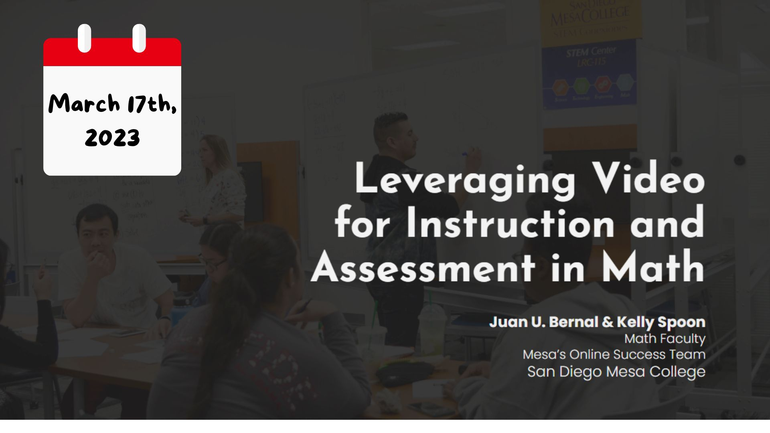
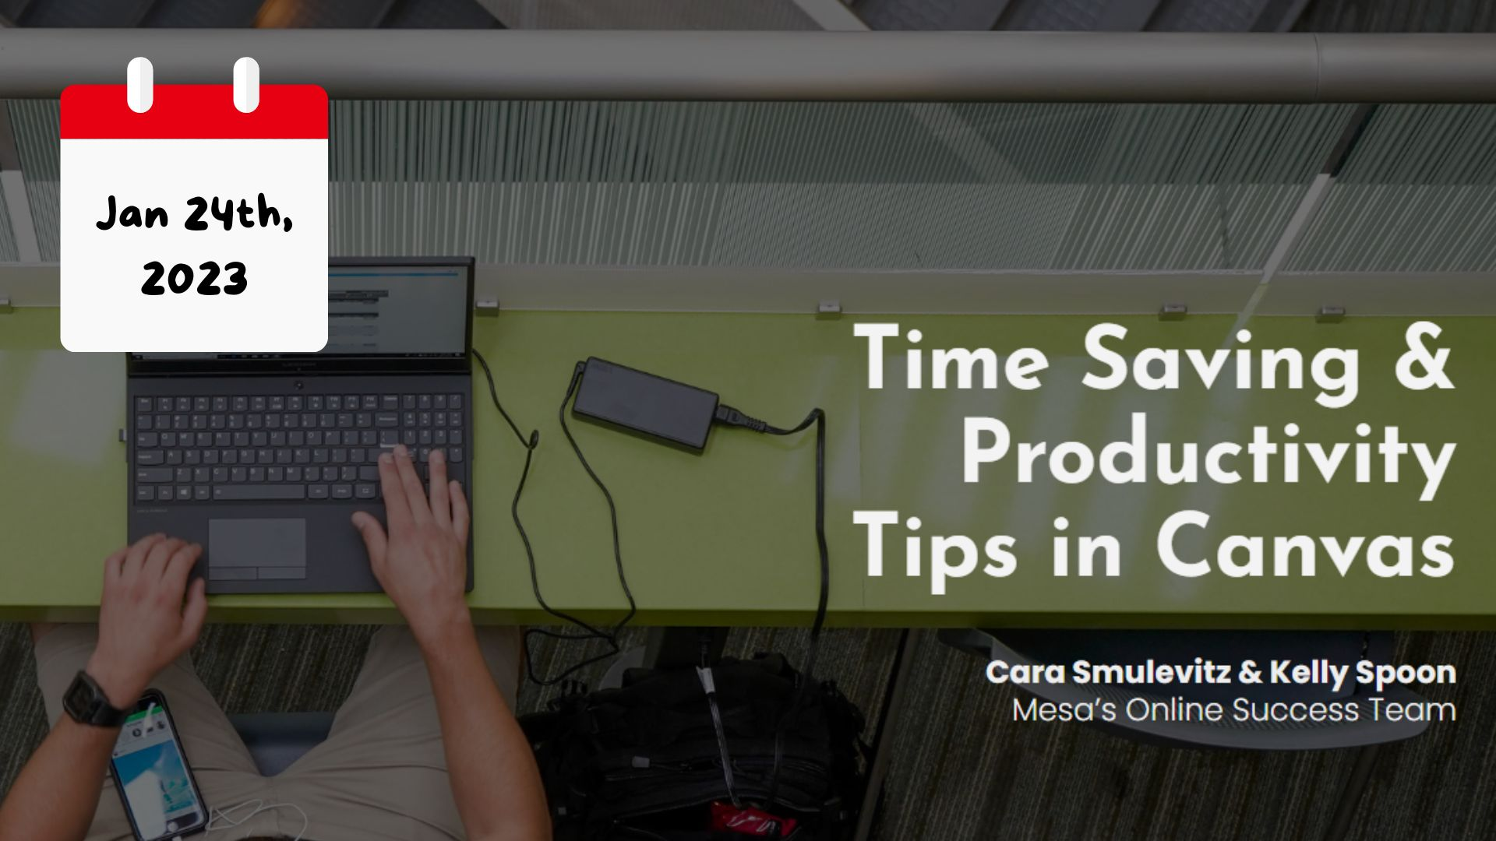
Notes:
In fact, the day before I felt out to USCOTS, I was running a 3 hour workshop with an English faculty I had never met before from another campus… And before that, another talk about outcomes… I have also done webinars and presentations on online teaching topics like video, accessibility, Canvas tips. I’m telling you all this for two reasons (1) it’s my attempt to deal with a bit of imposter syndrome … but mostly to point out that I was so flattered when Allan and Kelly asked me to be a *keynote* speaker for USCOTS, but also completely and utterly terrified because none of the 27 presentations, webinars, workshops, courses, you-name-it whether they were paid or unpaid were *keynotes*... So I did what I do - and I decided to research it.

Slide 3
Notes:
And I attended a webinar by Robert Kaplinsky on Steps to create a captivating keynote presentation - they were good steps, but I didn’t really follow them - mostly because June snuck up on me. And if you don’t know Robert Kaplinsky, you probably don’t teach K-12 math but he wrote a book called Open Middle Math and runs a website of teh same name with these lovely questions like this:

Slide 4
OPEN MIDDLE QUESTIONS
Use the numbers 1 - 9 each one time to create a data set with the smallest possible standard deviation.
⬜⬜, ⬜⬜, ⬜⬜, ⬜⬜⬜
Notes:
Almost all the questions ask you to use the digits 1-9 once each to fit some criteria - admittedly their math questions are *beautiful*

Slide 5
Robert Kaplinsky’s Five Steps to Create Captivating Keynote Presentations
Notes:
And I attended a webinar by Robert Kaplinsky on Steps to create a captivating keynote presentation - they were good steps, but I didn’t really follow them - mostly because June snuck up on me.

Slide 6
Robert Kaplinsky’s Five Steps to Create Captivating Keynote Presentations

Slide 8
Credit: StatsMedic
Notes:
Reading a research paper, communication + teamwork,

Slide 9
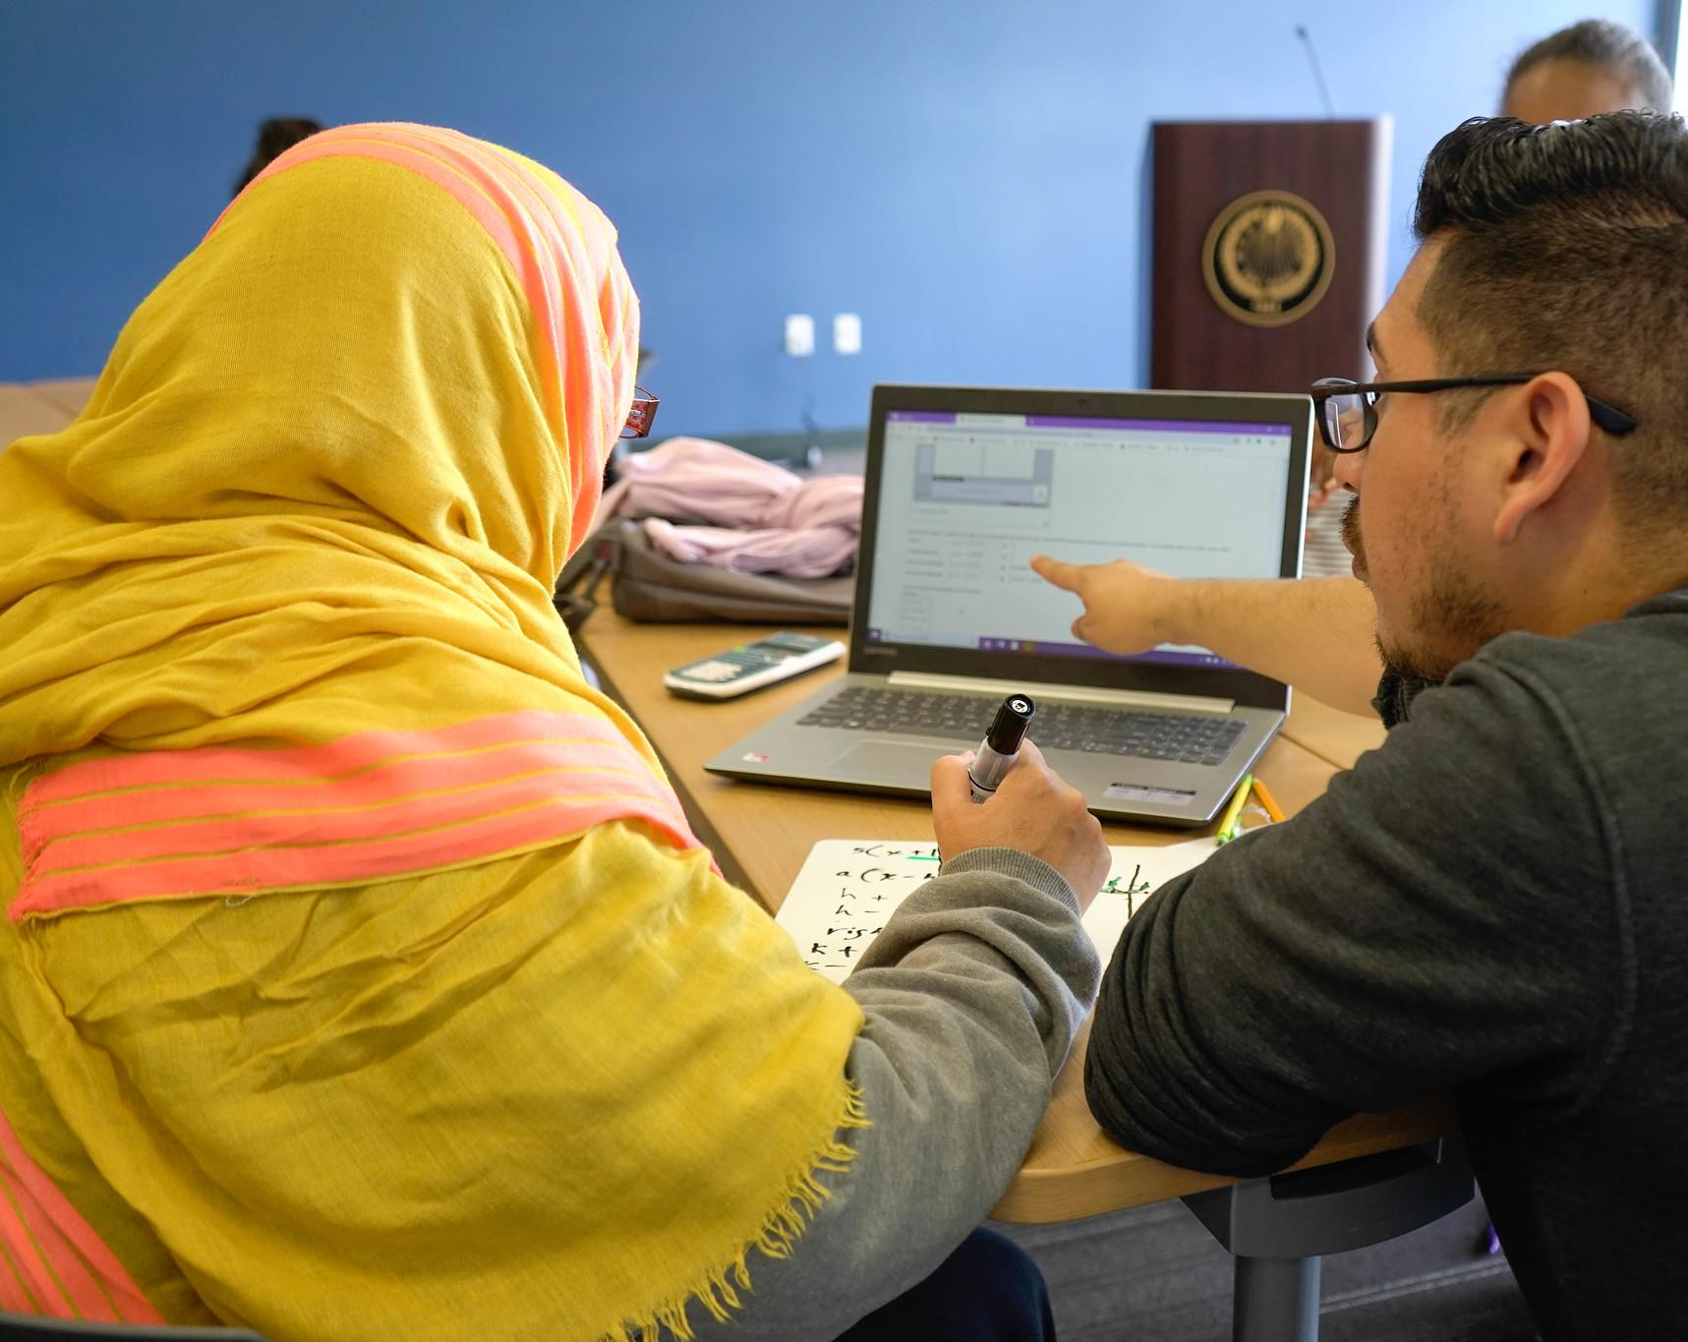
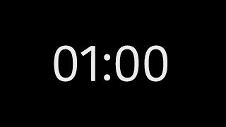
What should students know or be able to do at the end of your course?
Notes:
Was this a challenge for you?

Slide 10
What do you want students remember about your course in five years?

Slide 11
BACKWARDS DESIGN
01
OUTCOMES
Start with your learning goals.
02
ASSESSMENTS
Design assessments to measure those goals
03
CONTENT
Design content and activities to support learning.

Slide 14
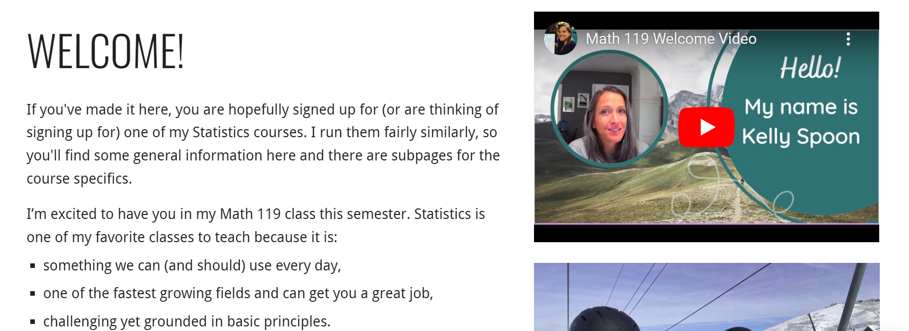

Slide 15
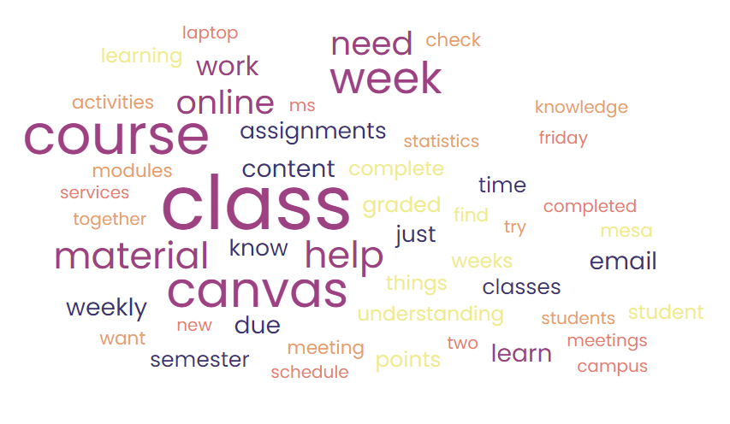

Slide 16
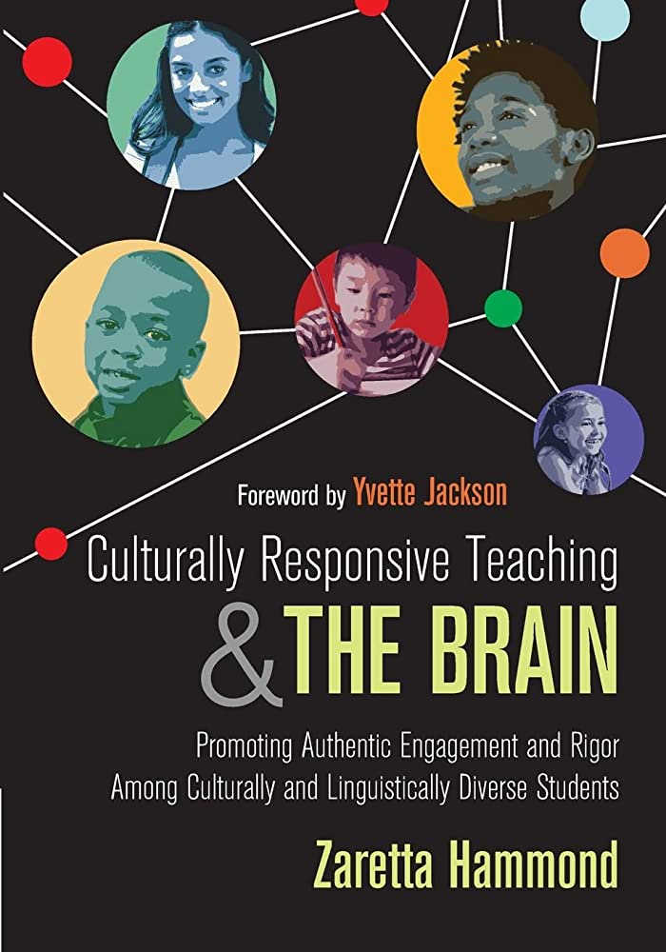
INFORMATION PROCESSING
01
IGNITE
How are we getting students attention?
02
CHUNK
How are we making content approachable?
03
CHEW
How will students actively process content?
04
REVIEW
How will students revisit or apply new info?

Slide 17
TODAY’S ROADMAP
SPARKING CURIOSITY
ASSESSING UNDERSTANDING
EXPLORING CONTENT
How are we getting students attention?
How will students actively process?
How will students apply new info?
Notes:
Juan

Slide 18
Sparking
Curiosity

Slide 19
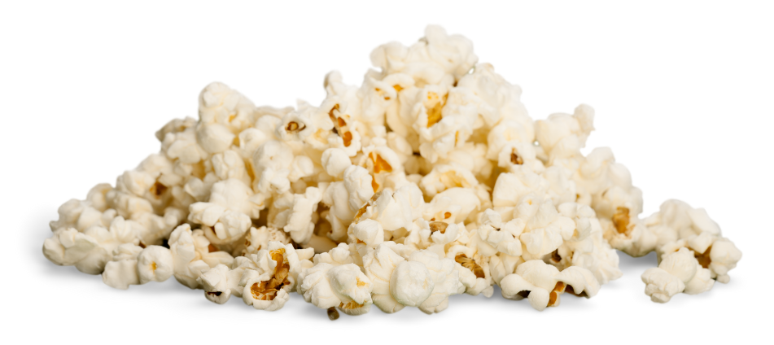
PREDICTION
Notes:
Predictive activities are effective for learning as they allow students to:
Reveal their gaps and problems with their existing knowledge of the subject matter
Have a clearer understanding of what and how they need to study and learn
Connect new ideas with existing knowledge
Spark curiosity for the content
Be comfortable with making mistakes and not knowing

Slide 20
PREDICTION
Source: Julie Anker’s Earth’s Surface Desmos Activity
Notes:
Predictive activities are effective for learning as they allow students to:
Reveal their gaps and problems with their existing knowledge of the subject matter
Have a clearer understanding of what and how they need to study and learn
Connect new ideas with existing knowledge
Spark curiosity for the content
Be comfortable with making mistakes and not knowing

Slide 21
PREDICTION
Source: Julie Anker’s Earth’s Surface Desmos Activity
Notes:
Predictive activities are effective for learning as they allow students to:
Reveal their gaps and problems with their existing knowledge of the subject matter
Have a clearer understanding of what and how they need to study and learn
Connect new ideas with existing knowledge
Spark curiosity for the content
Be comfortable with making mistakes and not knowing

Slide 22
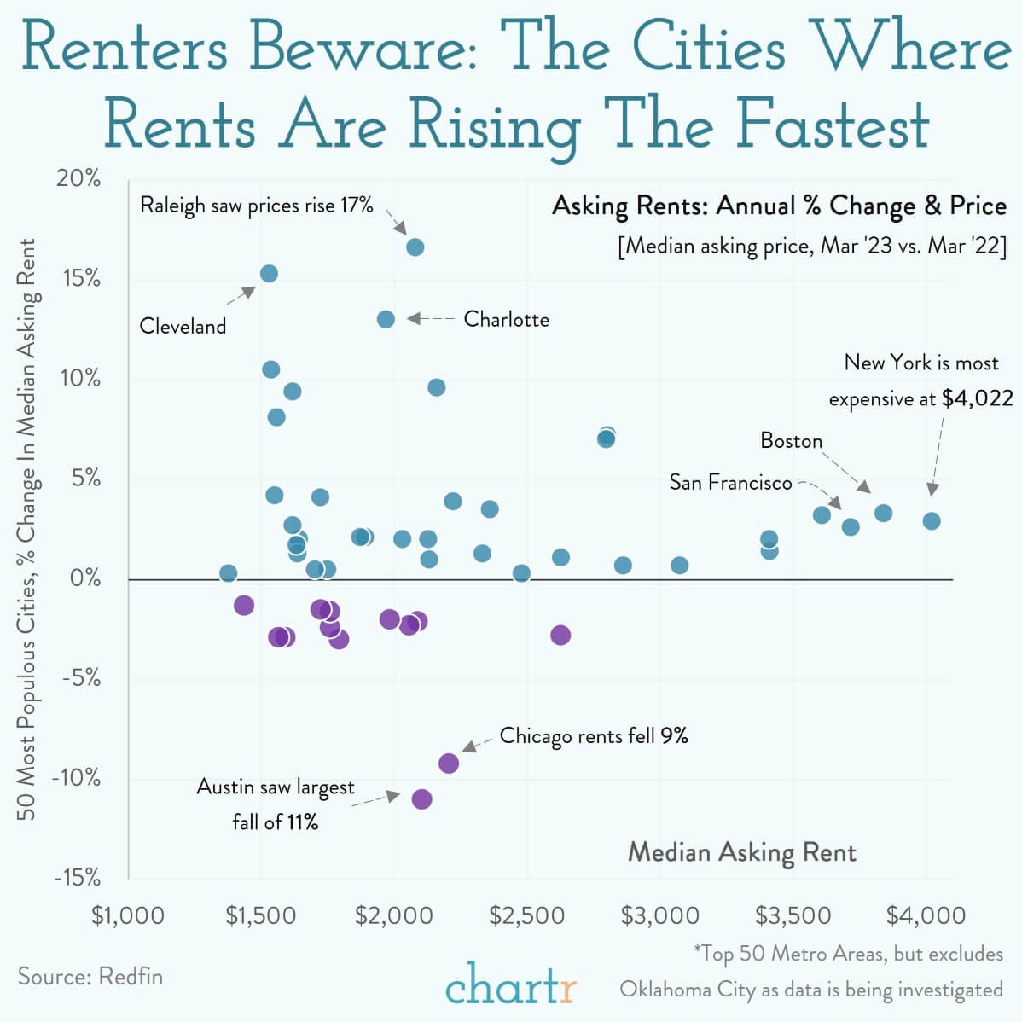
Source: slow reveal by Jenna Laib
Notes:
What do you notice? What do you wonder? Why do you think two colors are used?
[source] [slow reveal by Jenna Laib] [more slow reveal graphs at slowrevealgraphs.com]

Slide 23
Source: slow reveal by Jenna Laib
Notes:
What new information did we just learn? How does it change your thinking? What do you think this graph might be about?
[source] [slow reveal by Jenna Laib] [more slow reveal graphs at slowrevealgraphs.com]

Slide 24
Source: slow reveal by Jenna Laib
Notes:
What new information did we just learn? How does it change your thinking? What do you think this graph might be about?
[source] [slow reveal by Jenna Laib] [more slow reveal graphs at slowrevealgraphs.com]

Slide 25
Source: slow reveal by Jenna Laib
Notes:
What new information did we just learn? How does it change your thinking? What do you think this graph might be about?
[source] [slow reveal by Jenna Laib] [more slow reveal graphs at slowrevealgraphs.com]

Slide 26
Source: slow reveal by Jenna Laib
Notes:
What should we label the percentages along the y-axis? (e.g. % change in…)
[source] [slow reveal by Jenna Laib] [more slow reveal graphs at slowrevealgraphs.com]

Slide 27
Source: slow reveal by Jenna Laib
Notes:
What cities do you think are the most expensive to rent in? Where would you find those data points?
[source] [slow reveal by Jenna Laib] [more slow reveal graphs at slowrevealgraphs.com]

Slide 28
Source: slow reveal by Jenna Laib
Notes:
Where is the price of rent increasing the fastest? Where is it the most expensive? With percentage change, we can get a sense for relative increase. Which cities have the greatest dollar value increases each month?
Who might want this information? Why?
[source] [slow reveal by Jenna Laib] [more slow reveal graphs at slowrevealgraphs.com]

Slide 29
Notes:
What is included in this data? What is not included? How was the data collected? What might you have done differently, if anything?
[source] [slow reveal by Jenna Laib] [more slow reveal graphs at slowrevealgraphs.com]

Slide 30
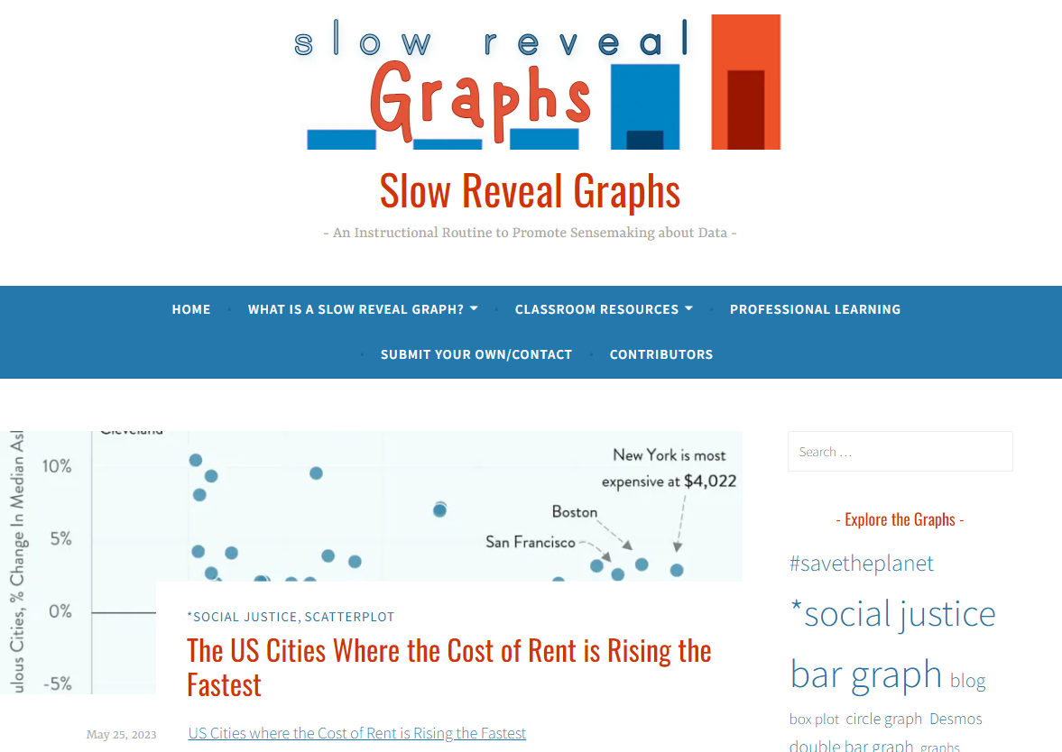

Slide 31
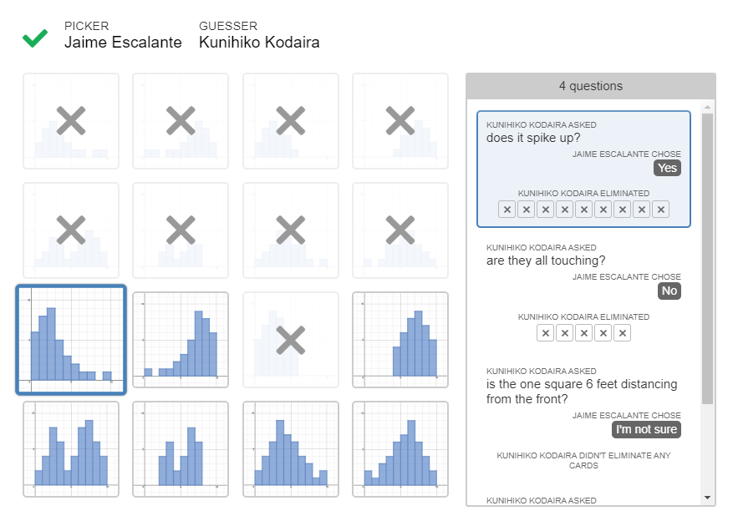
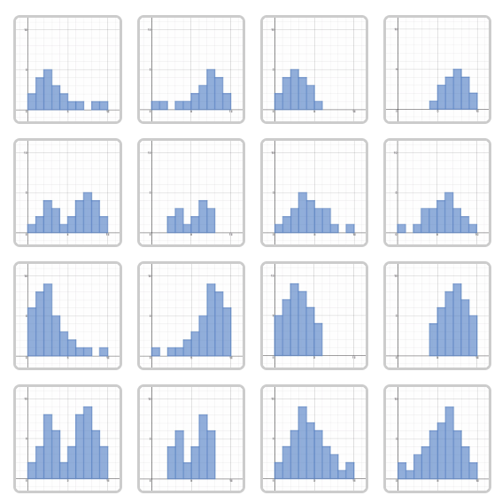
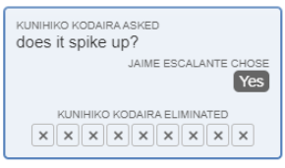
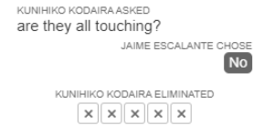

Slide 33
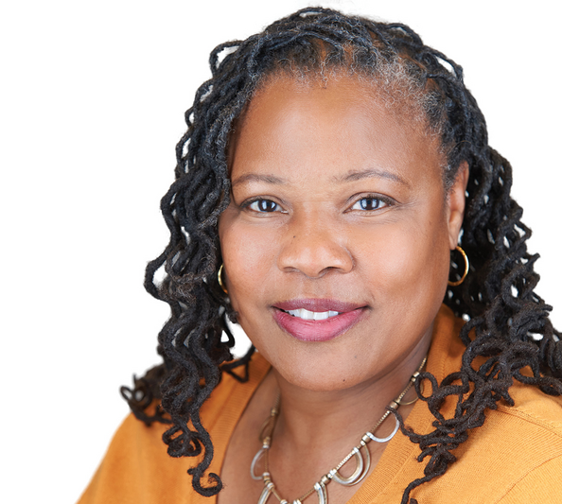
“Do we do enough to create classroom environments for students to be intellectually curious?“
Zaretta Hammond
“Culturally Responsive Teaching & The Brain”

Slide 34
Assessing Understanding
Notes:
Kelly

Slide 35
GRADING SYSTEMS
Notes:
UDL - not ONLY video! KELLY

Slide 36
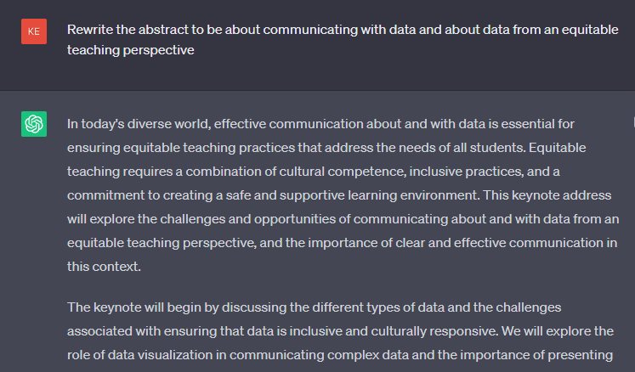
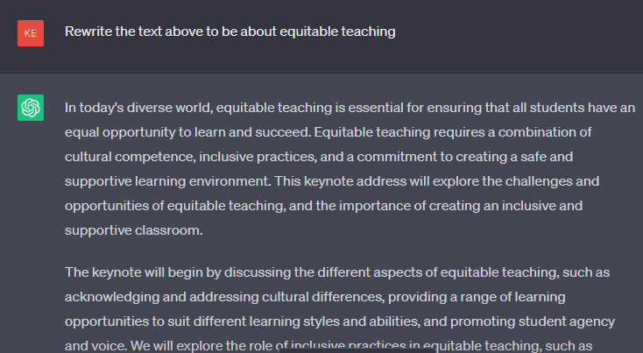
ABSTRACT
To effectively teach our students how to communicate with and about data, we must design our courses to illustrate the impact of data on their lives and interests, highlight their unique talents and experiences, and find ways to show they belong in our courses, the college, and the statistics field generally.
This presentation will focus on course design choices to ensure all students are ready to communicate about data. Focusing on findings from learning science and culturally responsive teaching…

Slide 37
ABSTRACT
To effectively teach our students how to communicate with and about data, we must design our courses to illustrate the impact of data on their lives and interests, highlight their unique talents and experiences, and find ways to show they belong in our courses, the college, and the statistics field generally.
This presentation will focus on course design choices to ensure all students are ready to communicate about data. Focusing on findings from learning science and culturally responsive teaching…

Slide 38
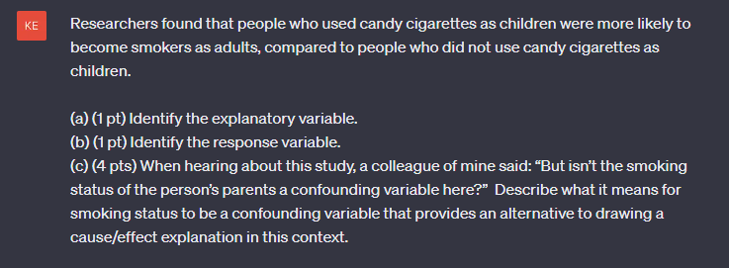
ASSESSMENT WITH CHAT GPT
Notes:
UDL - not ONLY video! KELLY

Slide 39
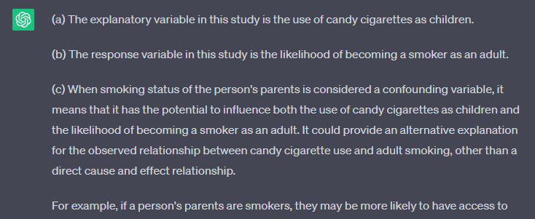
ASSESSMENT WITH CHAT GPT
Notes:
UDL - not ONLY video! KELLY

Slide 40
UNIVERSAL DESIGN FOR LEARNING

Slide 41
AUTHENTIC ASSESSMENTS
01
ACTION
Do something to demonstrate understanding.
02
PURPOSE
Contextualize and apply learning.
03
GOAL
Make connections and be remembered.
Notes:
Adapted from @one - portfolios, case studies, journals, open-ended, concept maps…

Slide 42
Typical assignments “add no value to the world— after a student spends three hours creating it, a teacher spends 30 minutes grading it, and then the student throws it away.”
David Wiley
Photo by Scott Graham on Unsplash
Notes:
Kelly

Slide 43
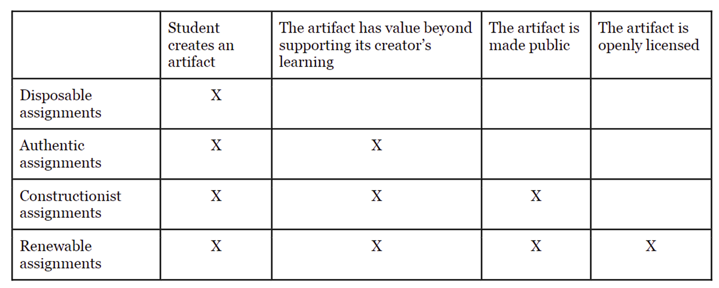
RENEWABLE ASSIGNMENTS
The work is of value beyond the students’ own learning.
Notes:
Kelly

Slide 44
Exploring Content
Notes:
Waiting on permission from Chase to use his video

Slide 45
OPEN MIDDLE QUESTIONS
Use the numbers 1 - 9 each one time to create a data set with the smallest possible standard deviation.
⬜⬜, ⬜⬜, ⬜⬜, ⬜⬜⬜

Slide 46
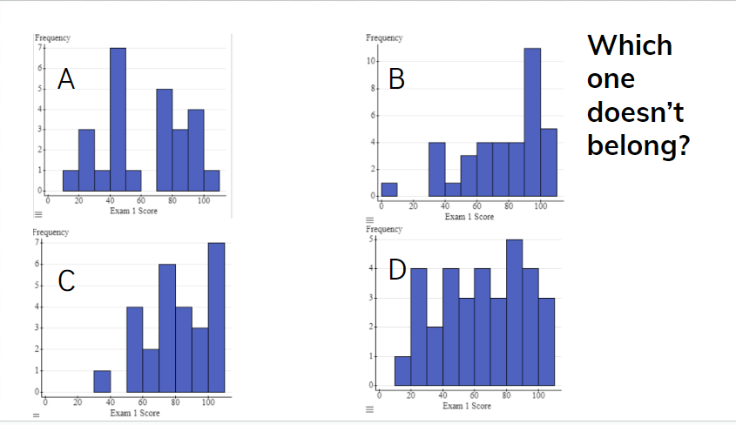

Slide 47
FLIPPED CLASSROOM
Notes:
Roxy… CHUNK - accessible.

Slide 48
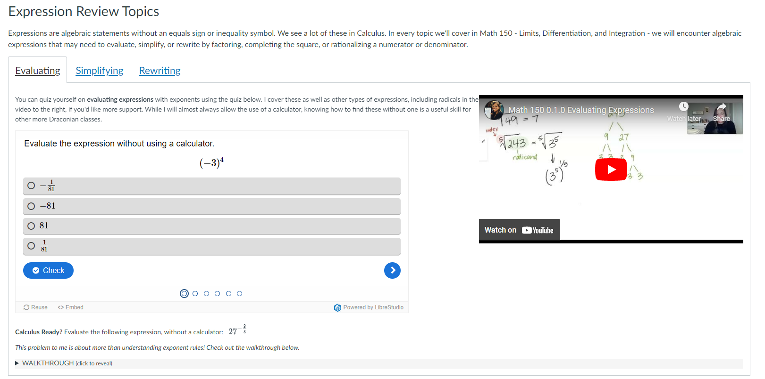
UNIVERSAL DESIGN FOR LEARNING
Notes:
UDL - not ONLY video! KELLY

Slide 49
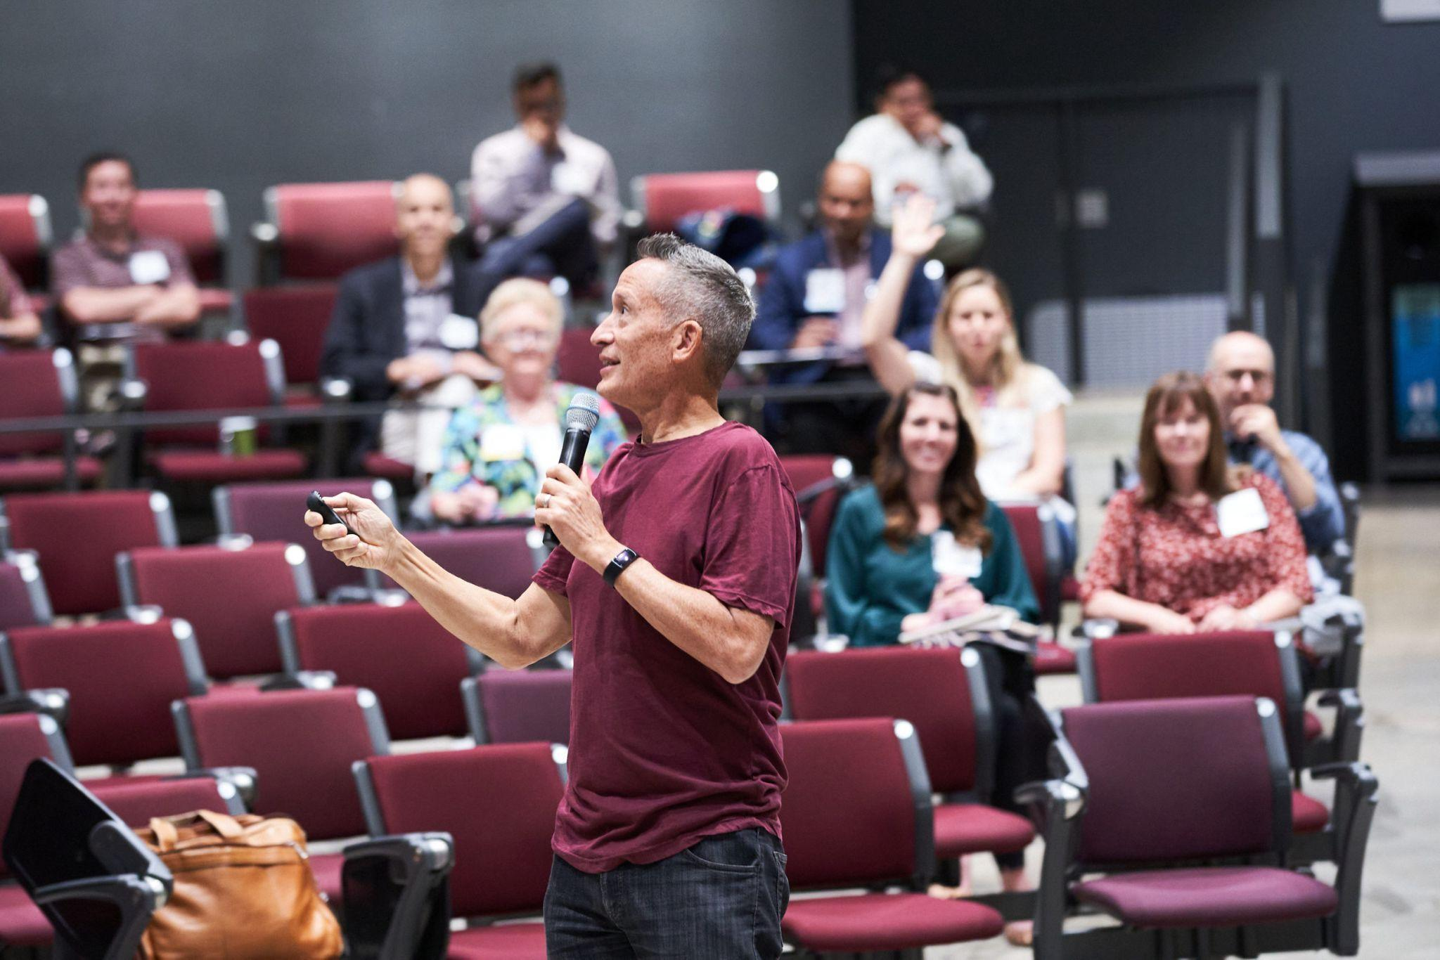
"I actually think that what we do as teachers is we motivate, we design, we're really cognitive coaches. That's a much better title for what we do. We design situations where you do cognitive work."
Jose Antonio Bowen

Slide 50
Kelly Spoon
@kellymspoon
kspoon@sdccd.edu
THANK YOU

Slide 51
RESOURCES
INTRO
PREDICTION
CONTENT
Keynote Webinar
Open Middle
Backwards Design
CRT & The Brain
Small Teaching Overview
Sampling Distribution Desmos
Slow Reveal Graphs
Histogram Polygraph
Flipped Classroom + Slack Channel
Accessibility
UDL
ASSESSMENT
OTHER CREDITS
Alternative Grading
Authentic Assessment
UDL for Assessment
Renewable Assessments
Slides: Slidesgo.com
Icons: Flaticon
Images: Unsplash
Graphics: Canva

Slide 52
INTERESTED IN… EQUITABLE TEACHING?
Culturally Responsive Teaching & The Brain by Zaretta Hammond - a great starting point… written for K-12 with great teaching moves and the Ready4 Rigor framework
Choosing to See: A Framework for Equity… by Pamela Seda & Kendall Brown - a book for math classrooms, also K-12, that is an excellent read with an ICUCARE framework
Learning that Matters: A Field Guide for Course Design… by Zehnder, Metzker, Kleine, & Alby - written for higher ed and full of great ideas
Equity by Design: Delivering on the Power and Promise of UDL by Mirko Chardin & Katie Novak

Slide 53
INTERESTED IN… EQUITABLE ASSESSMENT?
Grading for Equity: What It Is, Why It Matters and How It Can Transform Schools and Classrooms by Joe Feldman
Ungrading: Why Rating Students Undermines Learning by Susan Blum
Grading for Growth: A Guide to Alternative Grading Practices that Promote Authentic Learning and Student Engagement in Higher Education by David Clark and Robert Talbert
Alt Grading Google Doc with extensive grading podcast, articles, and more.

Slide 54
INTERESTED IN… CLASSROOM ACTIVITIES?
Skew the Script (Desmos) - social justice themed content written for AP Stats
StatsMedic (Desmos) - discovery-based content written for AP Stats
Other Desmos Collections: Sports Analytics by Joel Bezaire, Miscellaneous Activities, My Collection
AP Stats Best Practices Night 2017 - present, AP Stats Best Practices Night 2011-2016

Slide 55
INTERESTED IN… MY OTHER FAVE READS?
Small Teaching: Everyday Lessons from the Science of Learning by James Lang
Flipped Learning: A Guide for Higher Education Faculty by Robert Talbert
Rough Draft Math: Revising to Learn by Amanda Jansen
Building Thinking Classrooms in Mathematics by Peter Liljedahl

