Slide 1


Slide 2


Slide 3
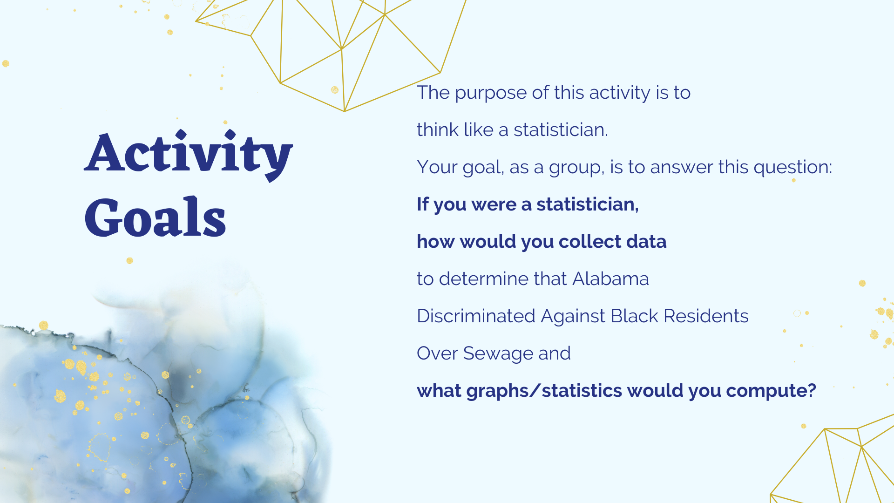

Slide 4
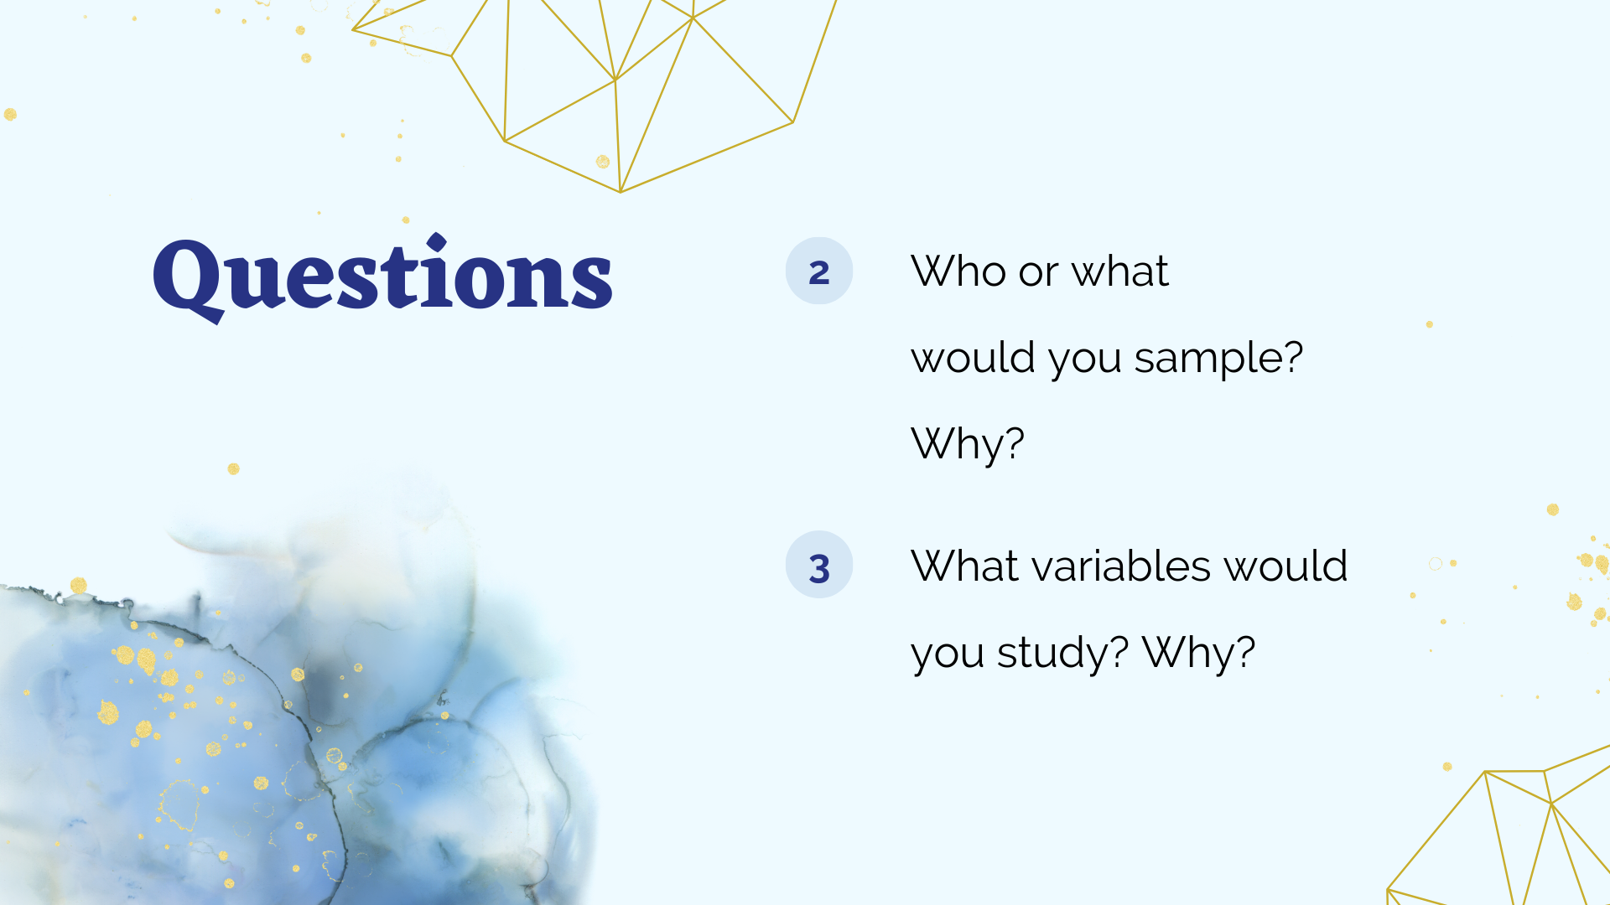

Slide 5
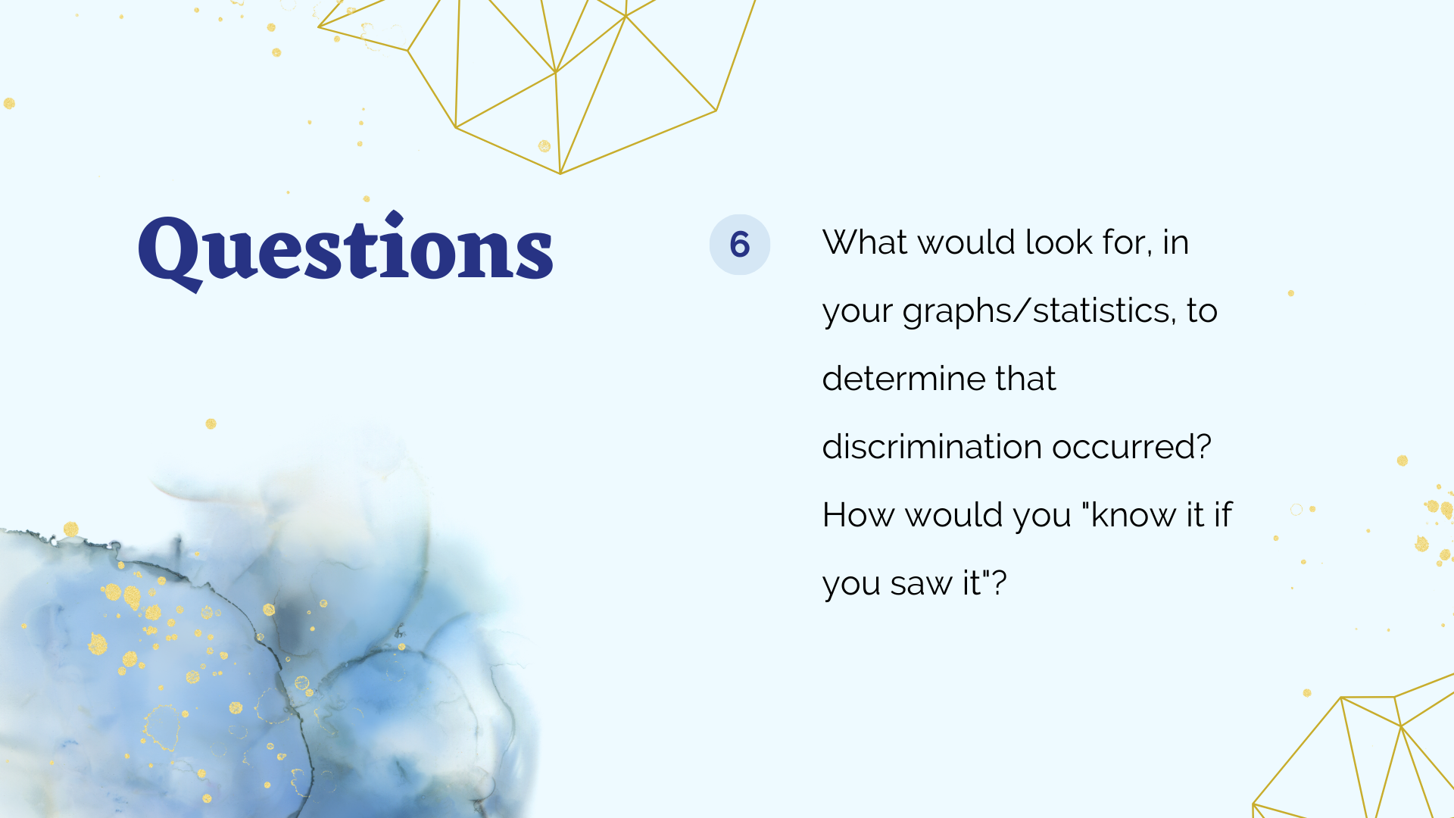

Slide 6


Slide 7


Slide 8
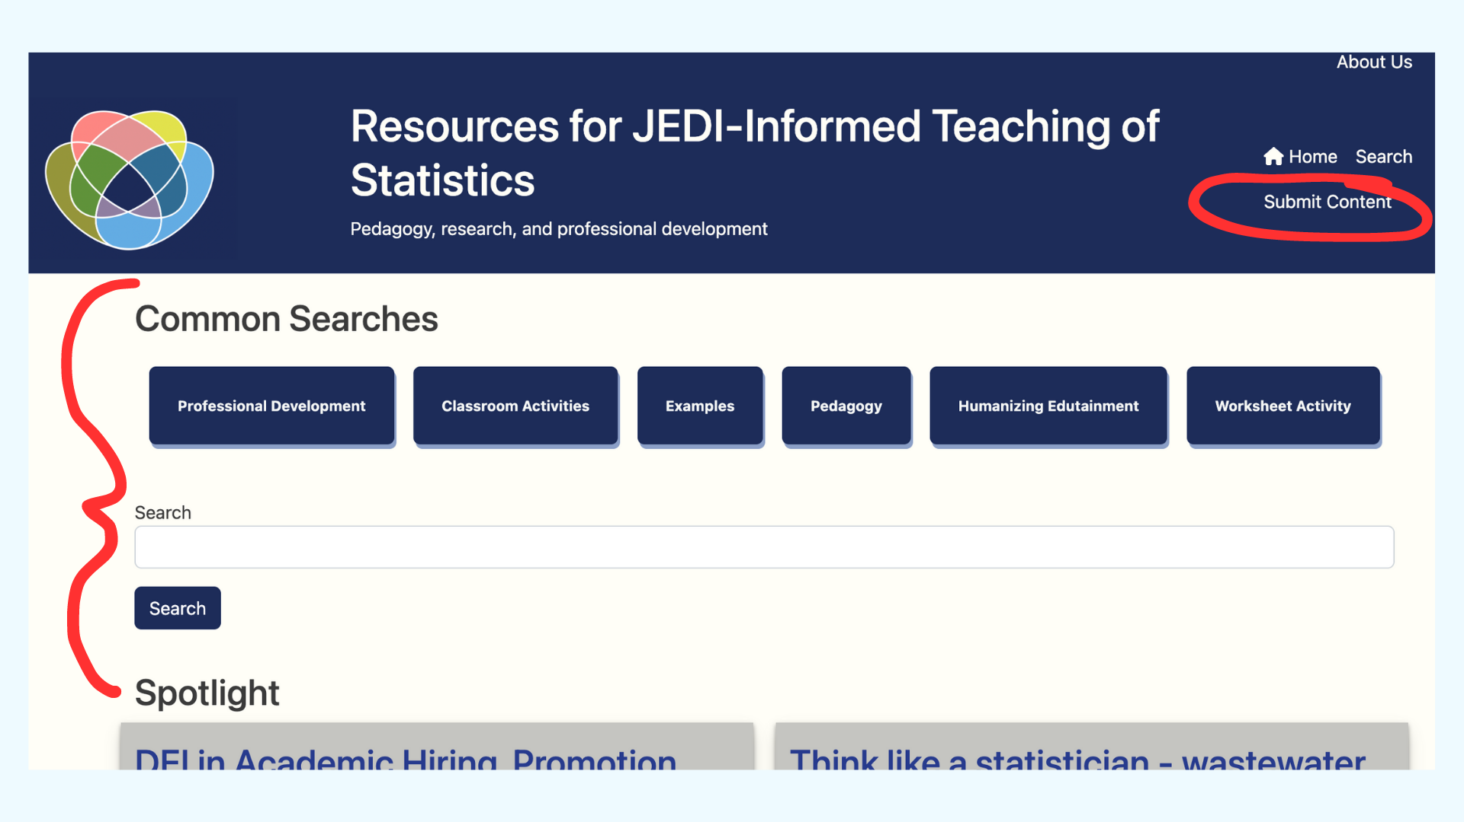
causeweb.org/jedi

Slide 9


Slide 10


