Slide 1
Be effective;
don’t be significant.
(What are the log odds of that?)
Jeff Witmer
Oberlin College
USCOTS 2025

Slide 2
Three themes (three complaints)
We don’t talk enough about effect size.
We use the words “statistically significant.”
We don’t teach logistic regression.

Slide 3
When conducting a hypothesis test
Knowing the p-value is the main thing
So don't tell me that
We should focus on the size of the effect
Students need to understand that
Significant means important
Don't make the mistake of thinking that
A small p-value can be meaningless
Notes:
https://brianbilston.com/2016/03/23/refugees/

Slide 4
When conducting a hypothesis test
Knowing the p-value is the main thing
So don't tell me that
We should focus on the size of the effect
Students need to understand that
Significant means important
Don't make the mistake of thinking that
A small p-value can be meaningless
(Read from the bottom to the top)
Hat tip to Brian Bilston/refugees poem
Notes:
https://brianbilston.com/2016/03/23/refugees/

Slide 5
We don’t talk enough about effect size.
We tell students to find a p-value and then reject or retain H0, but sometimes the effect is rather small and we only rejected H0 because we had a large sample size.

Slide 6
Recall the Physicians Health Study: P < 0.0001 said that aspirin works to prevent myocardial infarction.
But n = 22,071 and r² = 0.001, with reduced probability of MI of only 185 per 100,000 per year.
Taking aspirin has side effects…
Notes:
https://www.nejm.org/doi/full/10.1056/NEJM198907203210301
https://pmc.ncbi.nlm.nih.gov/articles/PMC3444174/#i1949-8357-4-3-279-Bartolucci1

Slide 7
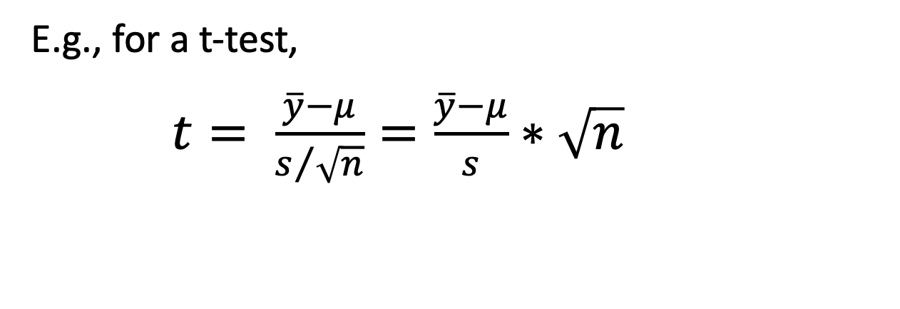
test stat = (effect size)*(sample size inflation):
    E.g., for a t-test,
    $t= \frac{\overline{y}−μ}{s/{\sqrt{n}}}=\frac{\overline{y}−μ}{s}∗\sqrt{n}$
Cohen’s d

Slide 8
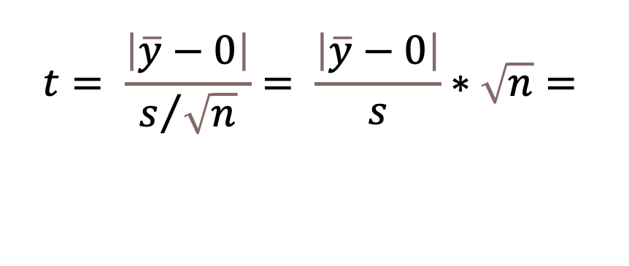
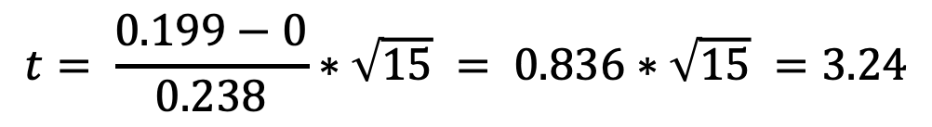
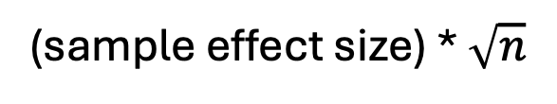
One mean (via pairs of monozygotic twins/NEJM) –
Is hippocampus volume small in schizophrenics?
$$t= \frac{\left|\overline{y}−0\right|}{s/{\sqrt{n}}}= \frac{\left|\overline{y}−0\right|}{s}∗\sqrt{n}=$$
(sample effect size) * $\sqrt{n}$
So t can be large because of the effect size, or because of n.
$$t= \frac{0.199−0}{0.238}∗\sqrt{15} = 0.836∗\sqrt{15} =3.24$$
Notes:
Sleuth page 30; NEJM 322(12) (1990): 789 – 93.

Slide 9
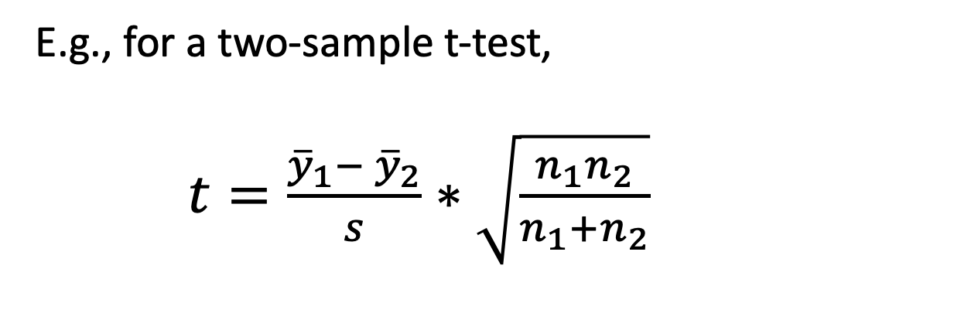
test stat = (effect size)*(sample size inflation):
    E.g., for a two-sample t-test,
    $t=\frac{{\overline{y}}_{1}− {\overline{y}}_{2}}{s}∗\sqrt{\frac{n_{1}n_{2}}{n_{1}+n_{2}}}$

Slide 10
Comparing two populations
Cohen’s d:
We could use a pooled SD; I just use the larger sample SD.
Guidelines(?):
Small 0.2
Medium 0.5
Large 1
Notes:
Prob of superiority = Pr(Y1 > Y2); vs Pr(Z > |mu1 – mu2|/sigma)) = Pr(Z > d).

Slide 11
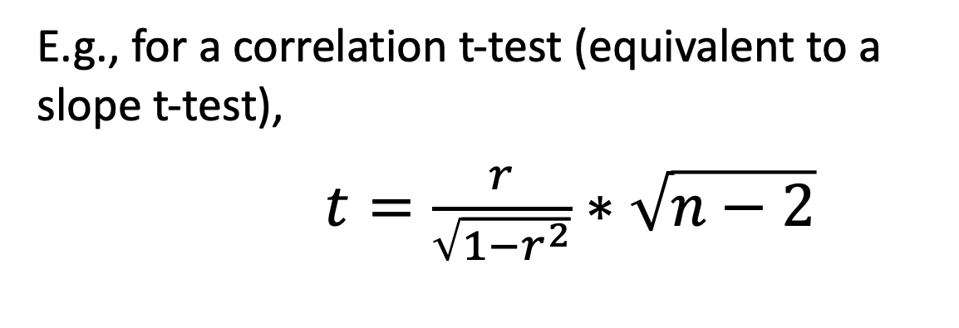
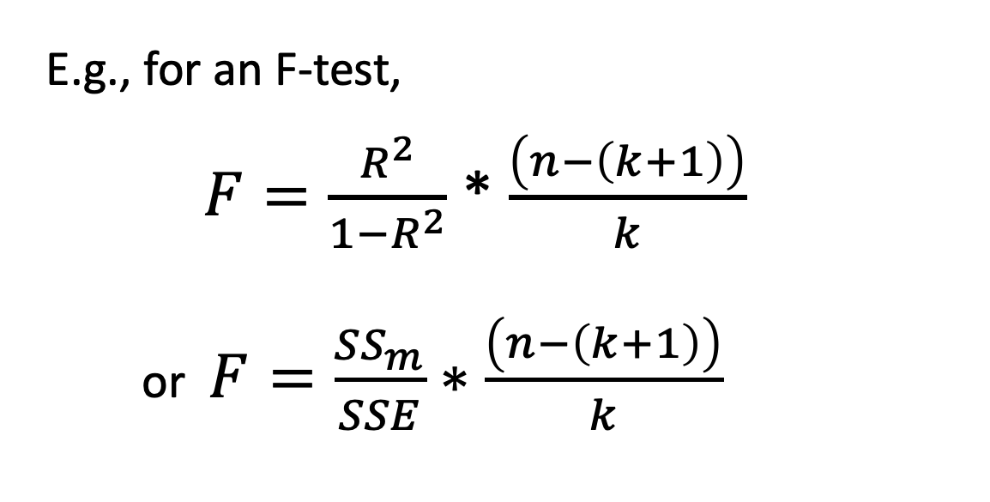
test stat = (effect size)*(sample size inflation):
    E.g., for a correlation t-test (equivalent to a slope t-test),
    $t=\frac{r}{\sqrt{1−r^{2}}}∗\sqrt{n−2}$
    E.g., for an F-test,
    $F=\frac{R^{2}}{1−R^{2}}$ * $\frac{\left(n−\left(k+1\right)\right)}{k}$
    or $F=\frac{{SS}_{m}}{SSE}∗\frac{\left(n−\left(k+1\right)\right)}{k}$
Beth yesterday

Slide 12
Other situations
Regression: report r or R², i.e., % variation explained
ANOVA: η² = SS(Trt)/SS(Total), so % variation explained
(or use Cohen’s d extended)
Chi-square test setting: report Cramer’s V:
where n = sample size and
m = min{r, c} = smaller dimension of the table

Slide 13
Ways to think about effect size
In standard units (e.g., Cohen’s d)
In natural units ($ or minutes or whatever)
As the % of variation explained
With a confidence interval
A CI is the flip side of a test, so as n changes, so does the CI.

Slide 14
Also, we greatly oversell hypothesis testing.
For one thing, p-values aren’t good, consistent measures of strength of evidence. (See The Dance of the P-Values.)
Reporting a p-value to many decimals is silly.
For another thing, Pr(H0 true | P) ≈ 8*P.

Slide 15
Data collection – from you
Consider two drugs, A and B. Each is compared to a placebo in a trial.
A: n₁=n₂=50, A better than placebo, P-value = 0.03
B: n₁=n₂=12, B better than placebo, P-value = 0.07
Each looks better than a placebo, but we can’t be sure. Which is more promising?
Which would you ask your doctor to prescribe for you?

Slide 16
Data collection – from others
I asked this question of 26 statisticians over a few years.
13 chose A
13 chose B
If n₁=n₂=50 and the (population) effect size is 0.44, then the median P-value is 0.03.
If n₁=n₂=12 and the (population) effect size is 0.77, then the median P-value is 0.07.
That’s why I like B: To get a P-value of 0.07 with only n₁=n₂=12 , the effect size is likely to large.

Slide 17
What should we teach?
Effect size is related to power but is more important.
We often try to teach power, but it is a really hard concept for students.
Effect size is easier – and more important.
What does an effect size of 0.5 (e.g.) look like?

Slide 18
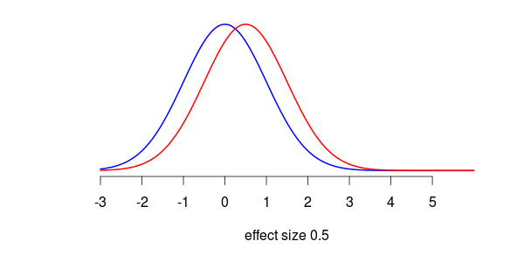
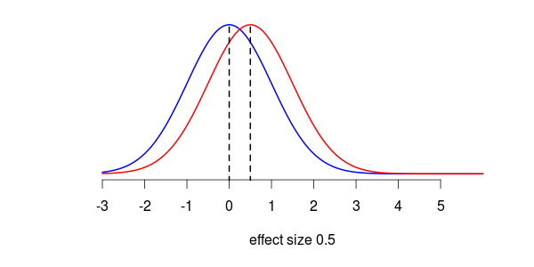
Effect size
Normal curves for an effect size of 0.5.

Slide 19
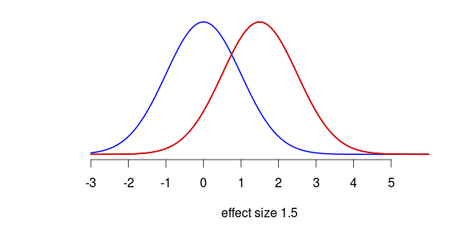
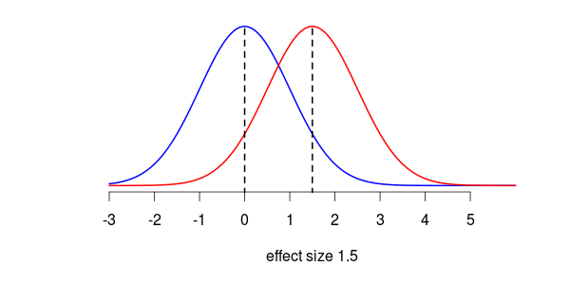
Effect size
Normal curves for an effect size of 1.5.

Slide 20
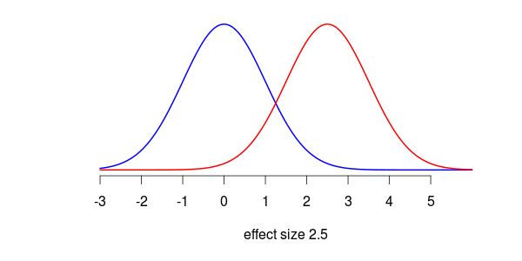
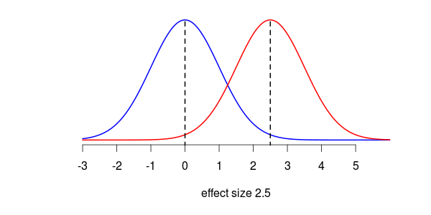
Effect size
Normal curves for an effect size of 2.5.

Slide 21
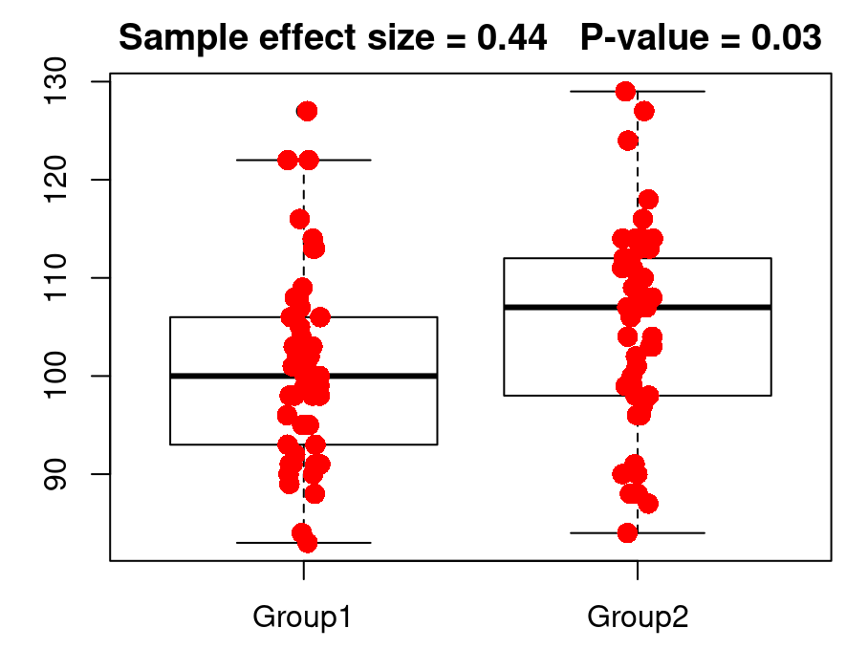
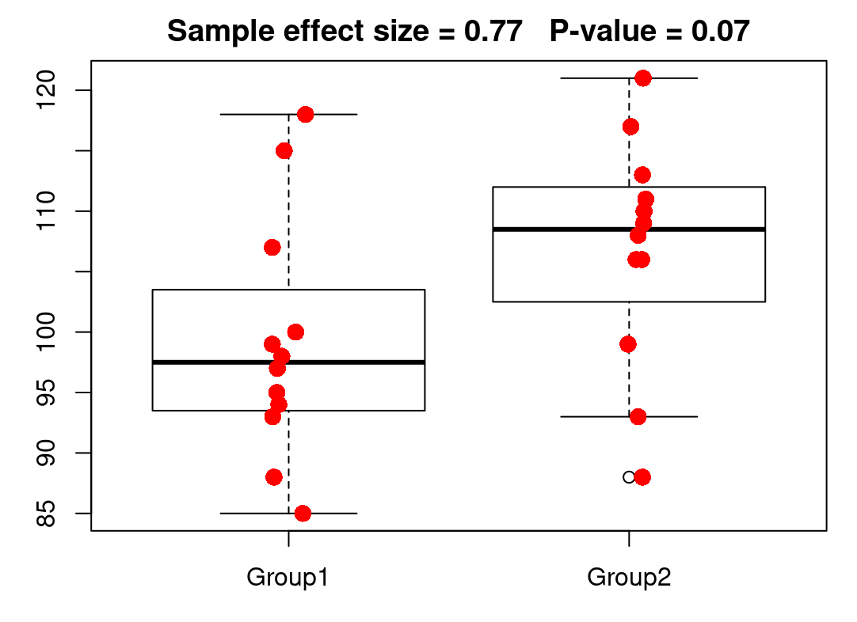
Sample effect size = 0.44 P-value = 0.03
Drug A
Sample effect size = 0.77 P-value = 0.07
Drug B

Slide 22
TAKING A BREAK…
Strongly Disagree
Disagree
Neutral
Agree
Strongly
Agree
1
2
3
4
5
Likert scale
Likert is pronounced "lick-ert" not "like-ert”
Notes:
Rensis Likert’s daughter, Betsy David, was married to ‘Tin David, an ASA Fellow.

Slide 23
We use the words “statistically significant.”
To call an effect “statistically significant” confuses students…and us.

Slide 24
?
small P-value
“significant”
?
important
“statistically significant”
≠
practically important

Slide 25
The word "significant" gets in the way of student learning. People think "significant" means "important."
I prefer to call an effect “statistically discernible,” meaning that the precision of measurement, aided by a large enough sample size, let us discern that an effect exists (and that the sample difference was not likely to arise by chance – which is what a small p-value announces).

Slide 26
"In this randomized clinical trial of dementia care programs, there were no significant differences between a health system-based vs a community-based care intervention … with respect to patient behavioral symptoms and caregiver strain."
Does this mean "No p-values less than 0.05" or "No medically meaningful differences"?
It might mean both – but we can’t tell.
Notes:
Jamanetwork.com, 01-30-2025, Health System, Community-Based, or Usual Dementia Care for Persons With Dementia and CaregiversThe D-CARE Randomized Clinical Trial

Slide 27
Gas permeable vs soft contact lens for children…
“GP wearers had statistically significantly better visual acuity though the difference was not clinically meaningful (p < 0.001).”
Notes:
Optom Vis Sci. 2010 June ; 87(6): 414–420. doi:10.1097/OPX.0b013e3181dc9a04

Slide 28
Senator Ron Wyden, Democrat of Oregon, represents a state where groundwater depletion is particularly severe.
Almost two-thirds of monitoring wells in Oregon show a statistically significant decline in water levels since 1980.*
But this is not a statement about p-values. The issue isn't that a sample size was large enough to rule out chance variation in sampling; it is that the decline is meaningful/alarming/unsustainable.
*NYT 2023/08/28 article
Notes:
https://www.nytimes.com/interactive/2023/08/28/climate/groundwater-drying-climate-change.html?campaign_
id=190&emc=edit_ufn_20230902&instance_id=101696&nl=from-the-times&regi_id=3100222&
segment_id=143567&te=1&user_id=a86a0596690d944c5cab3377cc35edbb

Slide 29
Data from the Pew Research Center revealed that married men went from voting 62 percent for Donald Trump and 32 percent for Hillary Clinton in 2016, to 54 percent for Trump and 44 percent for Joe Biden in 2020. That sizable shift — a 30-percentage-point margin sliced to 10 points…
“That’s definitely statistically significant,” said Brian Schaffner, a professor of political science at Tufts University. “Married men are a pretty big group,” he added, “so that’s pretty meaningful in terms of the ultimate margin.”
Note: Schaffner’s comment has nothing to do with a hypothesis test or a p-value.
Notes:
https://www.nytimes.com/2021/07/15/us/politics/married-men-voters.html
NYT 7/15/21; 2024: married men, favored Trump by 22 points, 60% to 38%, see https://www.unmarried.org/featured/what-we-missed-by-ignoring-marital-status-in-the-2024-presidential-election/

Slide 30
“But we can’t change the language everyone uses!”
Yes, we can.
“Conditions” is replacing (has replaced??) “assumptions.”
Hesterberg and Chihara 3rd ed. uses “discernible.”
Lock5 4th ed. will use “discernible.”

Slide 31
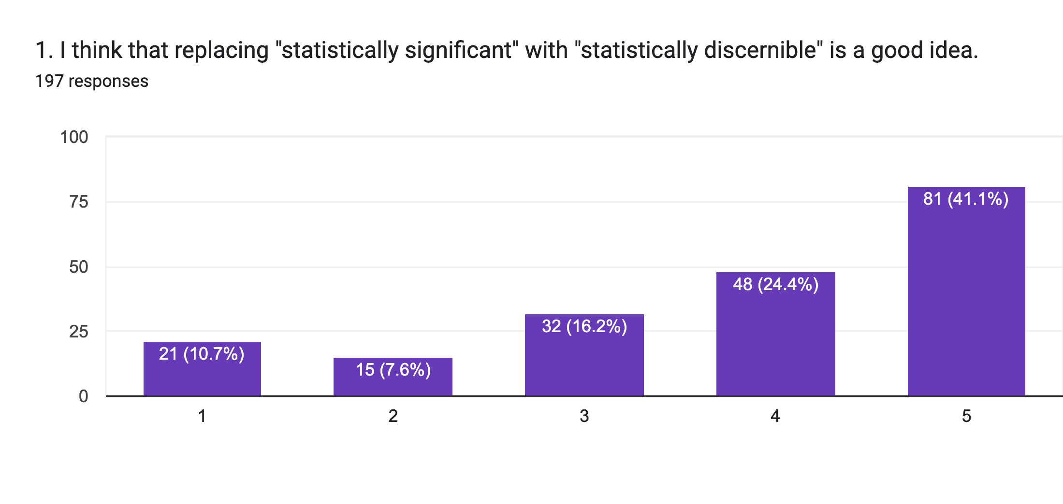
Isostat poll (fall 2023, J. Witmer and E. Daza)
Notes:
https://docs.google.com/forms/d/1J5H3Zdr1Be-wdyWG6ZCQ-yw6CVsxZYV2hCl49i2wmUU/viewform?pli=1&edit_requested=true#responses

Slide 32
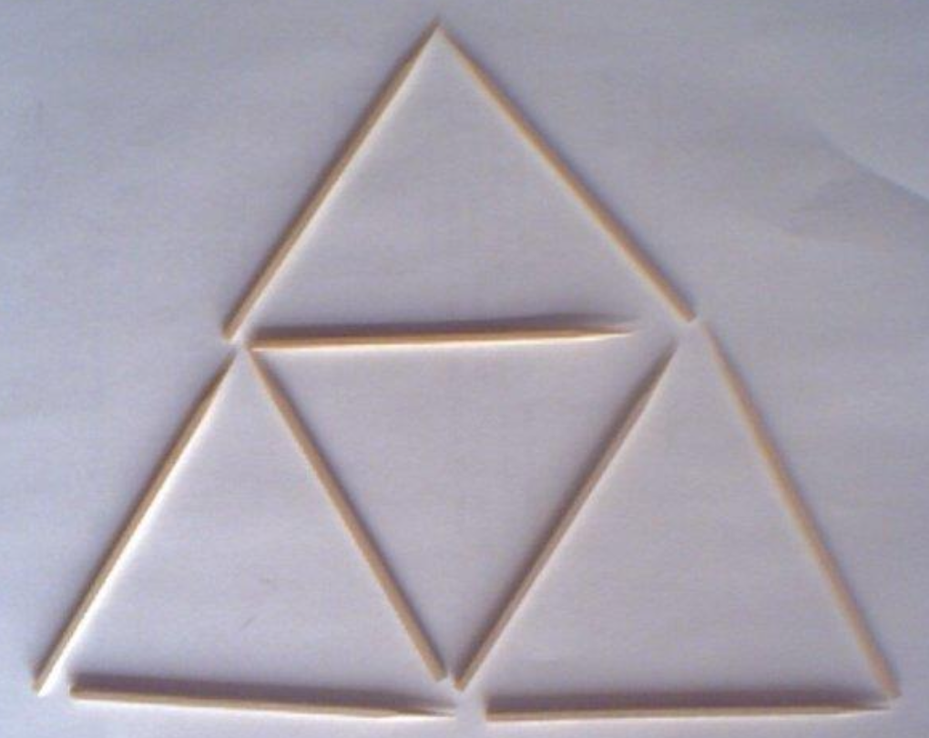
TAKING A BREAK…
How many triangles do you see?

Slide 33
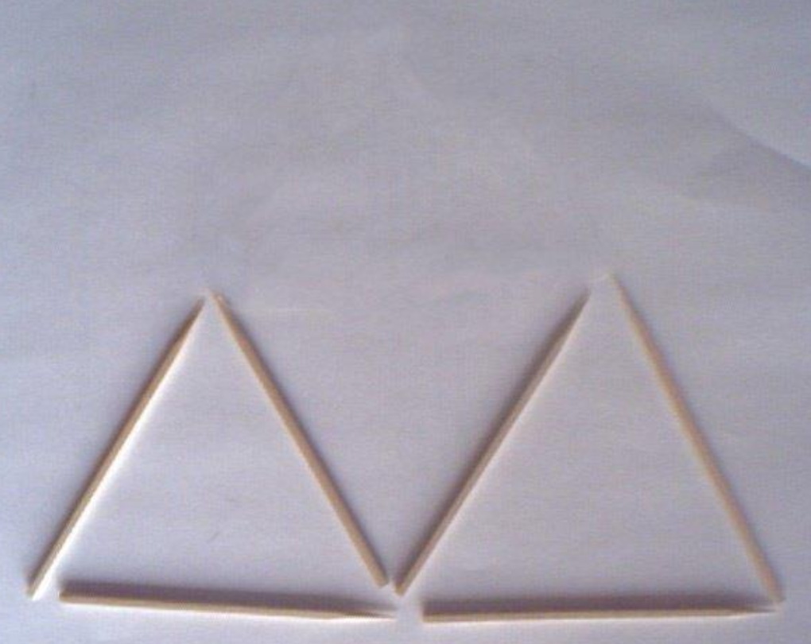
Remove the top one. Now many triangles do you see?

Slide 34
What happened to the one in the middle? Did it ever exist?
Context matters…
Hat tip: Hannah Yang, Quora, 1/3/24
Notes:
Hannah Yang (via Quora 1/3/24): One answer is that none of these triangles “exist.” They’re only the result of context. When the circumstances around them change, we realize that they never had any inherent
“triangle-ness” - that was just a temporary label we ascribed to them.

Slide 35
STAT 205: Day 11
9/18/24
Context
Effect size
Power
CI vs test
Inference for a proportion
Read: Chpt 17
HW #2 is on Blackboard and due today
Bootstrapping a proportion.Rmd

Slide 36
We don’t mention logistic regression until the second course, but it is an important topic.
Logistic regression is better than a chi-square test.

Slide 37
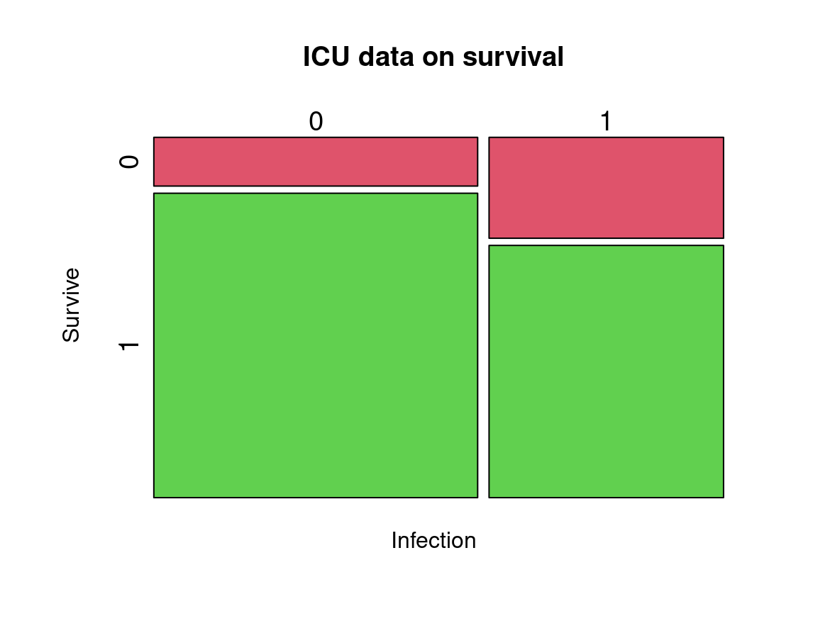
Infection
Survive 0 1
0 16 24
1 100 60
P-value = 0.01
prop 0 prop 1
0.14 0.29
prop 0 prop 1
0.86 0.71

Slide 38
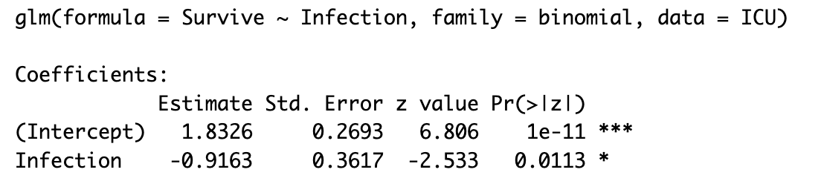
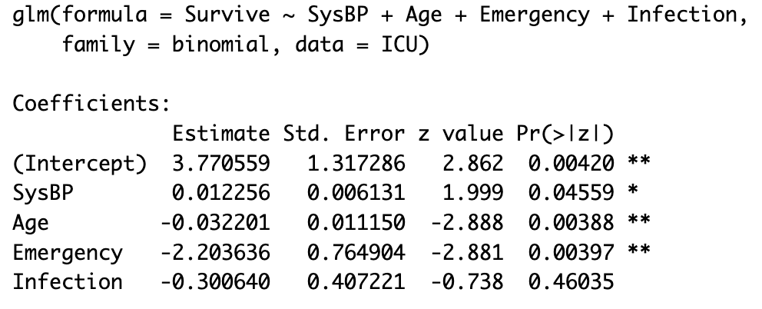
Infection is a strong predictor of survival:
The effect goes away when covariates are considered. We can see this via (multiple) logistic regression; a Chi-square test isn't sufficient.

Slide 39
Logistic regression is widely used.
I looked at recent research articles in JAMA or JAMA Internal Medicine and found two dozen that went beyond comparing two means or two proportions.
The most commonly used statistics methods were (ordinary) regression and hazard ratios, 8 times each.
Right behind these methods was logistic regression, in 6 articles.
(Cox proportional hazard regression and Kaplan-Meier were among the other, less frequent, methods.)

Slide 40
Milo Schield surveyed alumni from Augsburg Univ. (business majors) and the #1 topic they wish had been added to the course that they took was logistic regression.

Slide 41
It is true that fitting a logistic model is difficult, and we don’t want to teach MLE in a STAT 101 course, but we also don’t teach the mathematics behind OLS, we just lean on technology.
With modern technology it is as easy to fit a logistic model as a linear regression model
Students need to learn what, why; how to interpret -- but not how to code/how to get a calculated answer.
Notes:
Milo: log(odds) as a 2-step process: (1) probability lives on (0,1) odds maps that to (0, infinity); (2) log(odds) maps that to (-infinity, infinity).

Slide 42
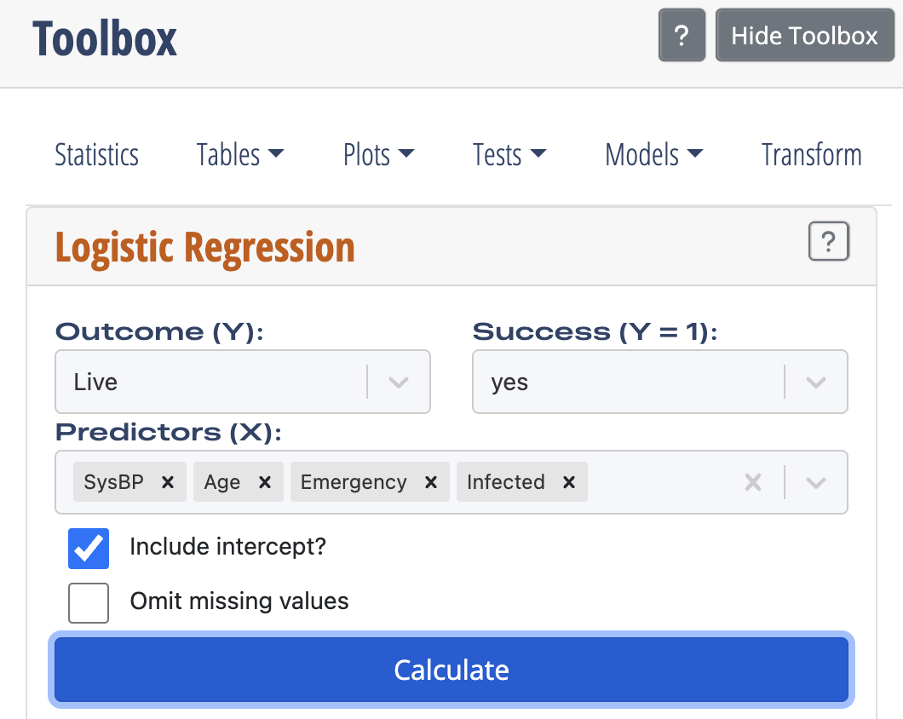
In the ISLE Toolbox we choose Models > Logistic Regression, then the Outcome variable (and what level of the variable is “Success”), then we choose two Predictors.

Slide 43
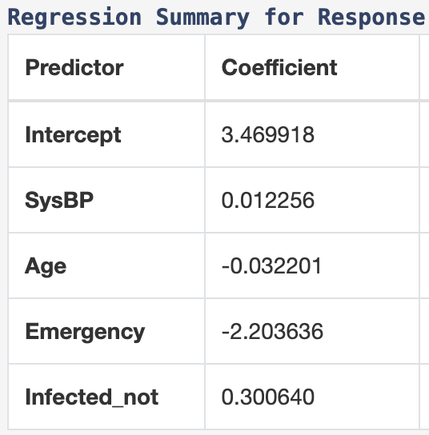
Here is the ISLE output:
So the logs odds of living are given by
3.47 + 0.012*SysBP – 0.032*Age – 2.2*Emergency + 0.3*Infected_not

Slide 44
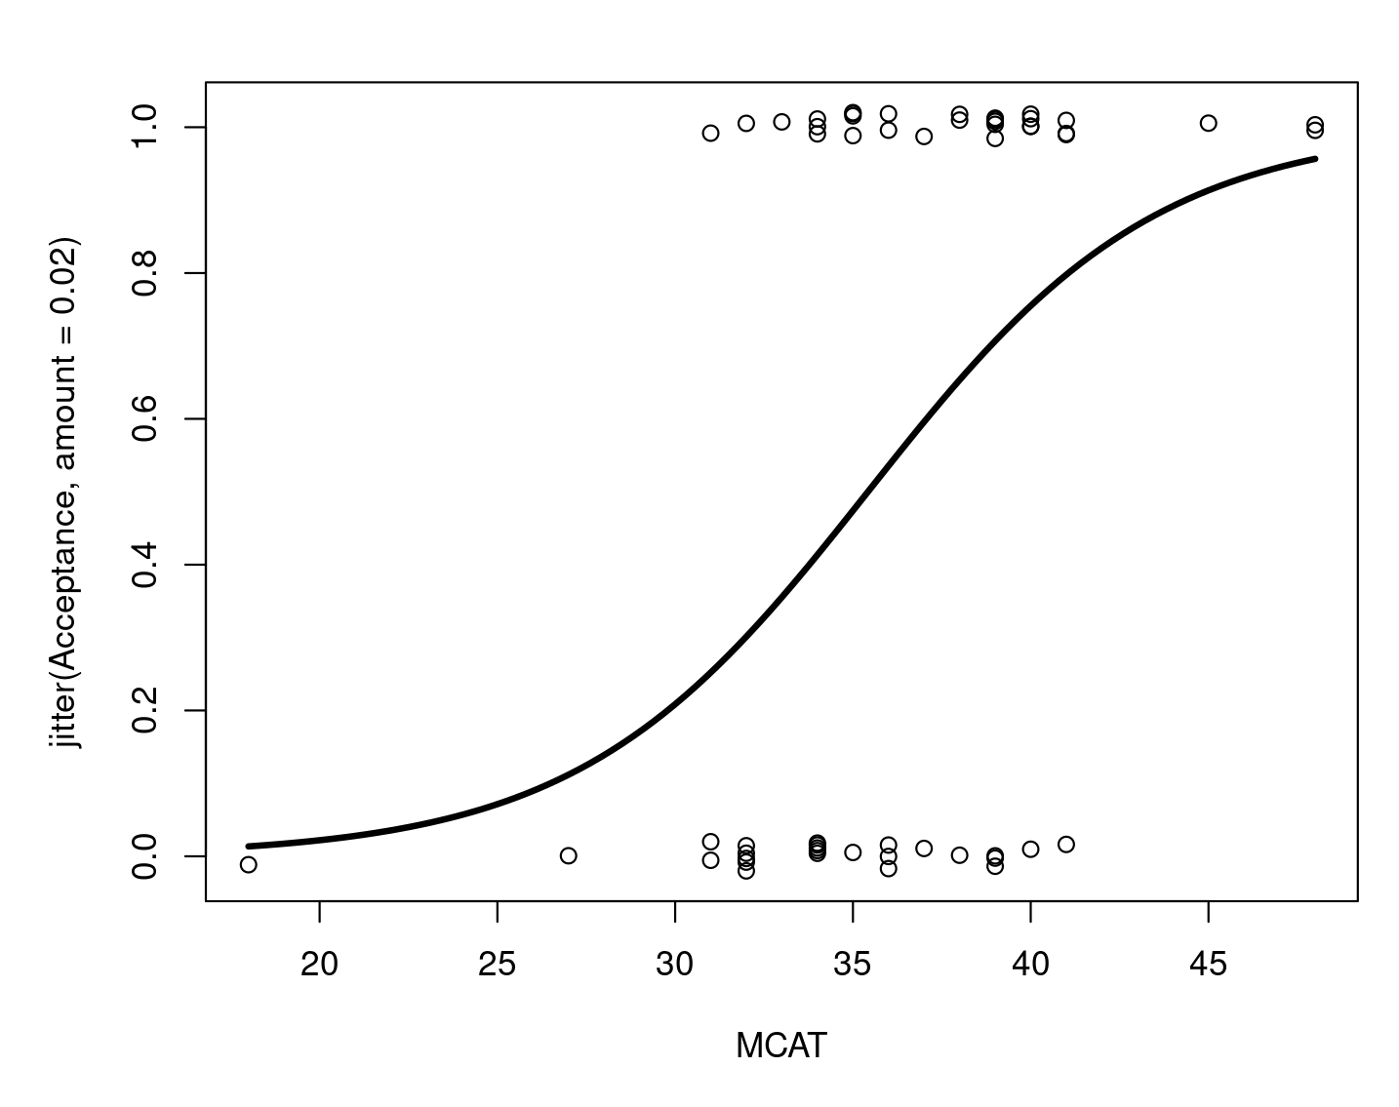
Predict med school admission based on MCAT score.
Notes:
m2=glm(Acceptance~MCAT,family=binomial,data=MedGPA)
with(MedGPA,plot(jitter(Acceptance,0.02)~MCAT))
Predict.Plot(m2,pred.var="MCAT",add=TRUE)

Slide 45
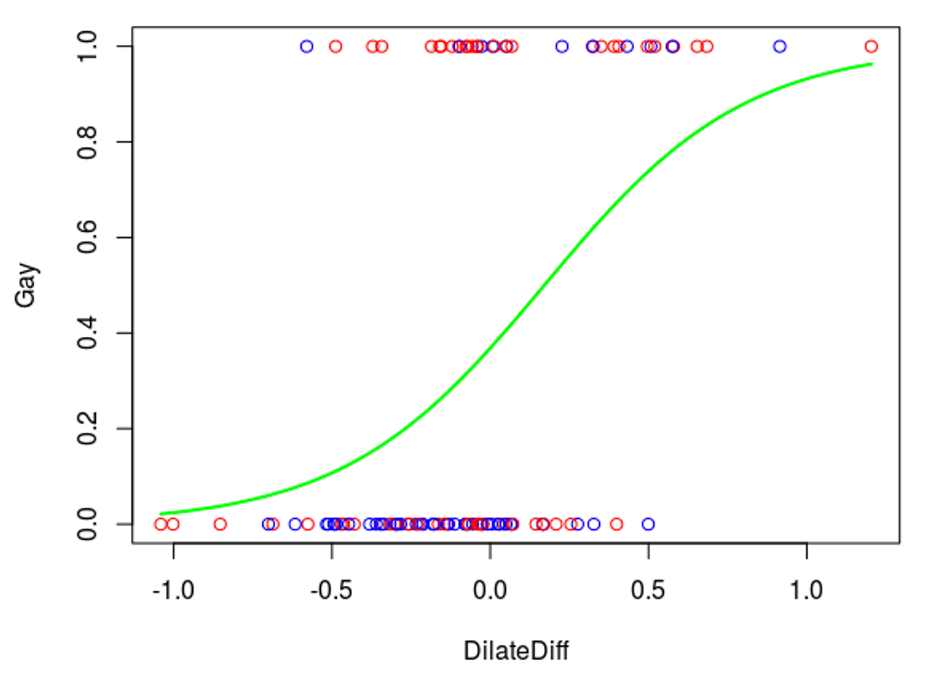
Predict sexual orientation based on pupil dilation*. Here DilateDiff is a difference in pupil dilation:
dilation looking at same-sex nudes –
dilation looking at opposite-sex nudes
Thus, DilateDiff > 0 means “more response to same-sex nudes.”
*”The Eyes Have It: Sex and Sexual Orientation Differences in Pupil Dilation Patterns,” PLoS ONE, (2012) Vo7, Issue 8
Notes:
with(eyes, plot(Gay~DilateDiff,col=28-2*(SexMale))) #male blue female red
m3 <- glm(Gay~DilateDiff,family=binomial, data=eyes)
Predict.Plot(m3,pred.var="DilateDiff",add=TRUE,plot.args=list(col="green",lwd=2))

Slide 46
In this graph blue is for male subjects and red is for females.
Notes:
Code using the software R:
with(eyes, plot(Gay~DilateDiff,col=28-2*(SexMale))) #male blue female red
m4 <- glm(Gay~DilateDiff+SexMale,family=binomial, data=eyes)
Predict.Plot(m4,pred.var="DilateDiff",SexMale=1,add=TRUE,plot.args=list(col="blue",lwd=2))
Predict.Plot(m4,pred.var="DilateDiff",SexMale=0,add=TRUE,plot.args=list(col="red",lwd=2))

Slide 47
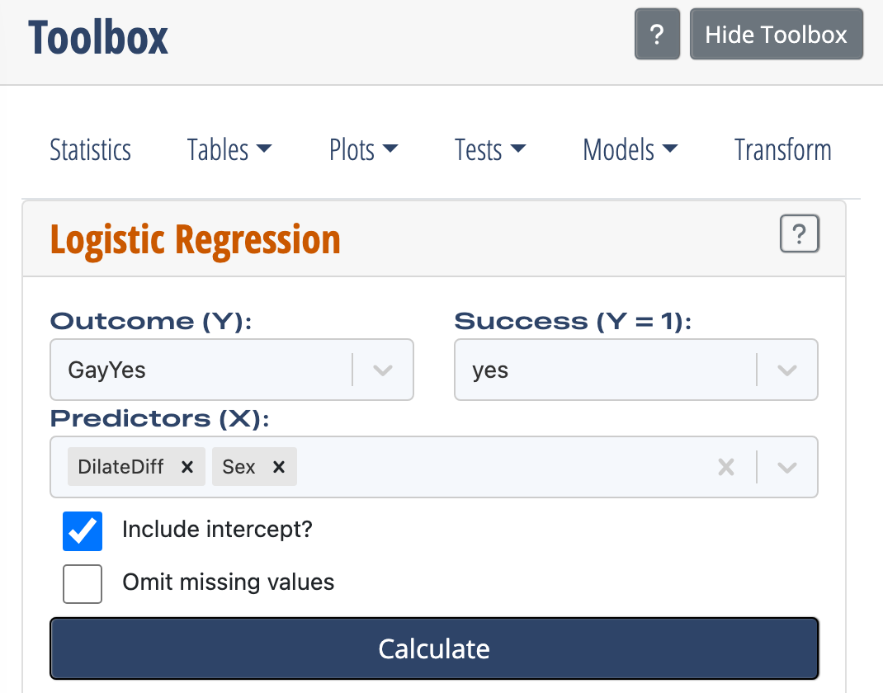
In the ISLE Toolbox we choose Models > Logistic Regression, then the Outcome variable (and what level of the variable is “Success”), then we choose two Predictors.

Slide 48
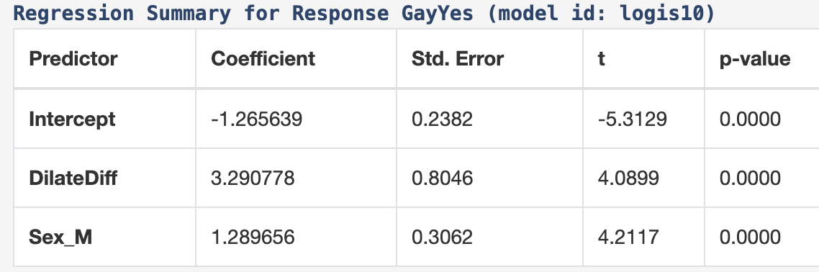
Here is the ISLE output:
So the logs odds of being gay are given by
-1.266 + 3.29*DilateDiff + 1.29*Sex_M
where Sex_M is 1 for males and 0 for females.

Slide 49
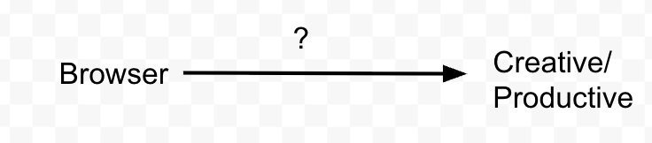
FINAL BREAK
TED talk by Adam Grant – “The surprising habits of original thinkers.” Employees who use Firefox or Chrome have a 15% higher retention rate and report more satisfaction at work and are more productive than employees who use Internet Explorer or Safari.
Notes:
What your web browser says about you

Slide 50
FINAL BREAK
TED talk by Adam Grant – “The surprising habits of original thinkers.” Employees who use Firefox or Chrome have a 15% higher retention rate and report more satisfaction at work and are more productive than employees who use Internet Explorer or Safari.
This is because they’re less likely to accept the default way of doing things. PCs come with Internet Explorer, macs come with Safari; 2/3 of people just use the default browser.
So "browser -> satisfaction" is wrong. The confounding variable is personality.
Notes:
What your web browser says about you

Slide 51
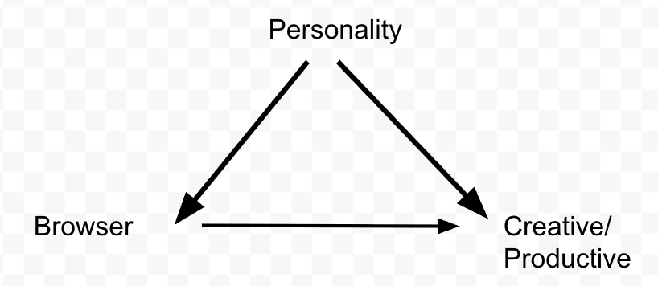
Notes:
https://docs.google.com/drawings/d/12u0ULSknjrWi7QGg52iXjNC191gnzeXnf0kgOM7CWCo/edit

Slide 52
Don’t just accept the default browser.
Don’t accept the status quo.
Our biggest regrets are not the things we do that don’t turn out like we had hoped, but the things that we didn’t do, the chances not taken.

Slide 53

Don’t take for granted what we have in the stat ed community.
Almost everything I said today I stole copied from someone else.
Impostor syndrome
Notes:
To talk about my accomplishments and contributions to statistics education in comparison with what George did and what he meant to our profession is like using the moonlight to describe the sun.
Macrina Wiederkehr: I will believe the truth about myself, no matter how beautiful it is.

Slide 54
It is easier to act yourself into a new way of thinking than to think yourself into a new way of acting.
Be effective (talk about effect size).
Say “statistically discernible,” not “statistically significant.”
Show your students logistic regression.
Don’t worry if people think that you are out of step by doing this; do it anyway. It is easier to live with other people’s judgments than to live with regrets.

Slide 55
Thank you

