Slide 1
2F: Teaching Statistics From Primary Source Documents
Beverly Wood
Embry-Riddle Aeronautical University
Dominic Klyve
Central Washington University

Slide 2
Background: Teaching with Primary Sources
TRansforming Instruction in Undergraduate Mathematics via Primary Historical Sources (TRIUMPHS) – PIs Janet Barnett, Kathy Clark, Dominic Klyve, Jerry Lodder, Danny Otero, Nick Scoville, Diana White
NSF-funded project (Collaborative Award #1524098)
Primary Source Projects (PSPs) use historical sources to teach standard topics in university mathematics.
Notes:
I met this team at a workshop during JMM 2018 that I chose to attend because the first project related statistics had just been published. Dominic said, “this will be the only one because statistics is relatively new topic in mathematics.” I objected to that statement on several accounts, and he encouraged me to write my own. I found a doctoral student also interested in the history of statistics and we were published by the end of the year!

Slide 3
Design Principles
All PSPs are designed to:
Move between original sources and student “Tasks”
Include a range of Tasks (computational, conceptional, experimental)
Provide a detailed “Notes to Instructors” with historical and mathematical background, sample implementation schedules, and more
Open source, LaTeX available (by request) for you to edit to fit your use

Slide 4
The TRIUMPHS Collection
At least 90 Primary Source Projects
All peer-reviewed & expert reviewed
Field tested and revised
Used in over 240 classrooms at more than 100 different institutions across the US and Canada
Want more? Enter “TRIUMPHS Primary Sources” into your favorite search engine

Slide 5
Why teach with primary sources?
Using Primary sources can:
Promote reflection on present-day standards and paradigm of subject;
Hone students’ verbal and deductive skills through reading;
Provide practice moving from verbal descriptions of problems to precise mathematical formulations;
Engender cognitive dissonance when comparing a historical source with a modern textbook approach.

Slide 6
How people use PSPs
Replace lectures
Supplemental project
Full classes
Emergency math talks!
And more…

Slide 7
But why tell you about them when…?
Work Session 1
Notes:
https://blogs.ursinus.edu/triumphs/
https://digitalcommons.ursinus.edu/triumphs_statistics/
We’ll work the shortest and newest one first to be sure I can keep my promise that you will have completed at least one of the three PSPs I’m sharing today.

Slide 8

Regression to the Mean
Dominic Klyve, Central Washington University
Notes:
Five paragraph introduction on the first page of this PSP begins with recognition of the multiple levels of the word “regression” in a first-year statistics course then distinguishes those from the word “regress” as in “to go back, usually to a previous state.” The rest of that first page is about Galton’s work on heredity; the Notes for Instructors section includes further information about the controversial nature of his work, his own coining of the word “eugenics”, and a reference document for further reading about Galton’s brand of eugenics.

Slide 9
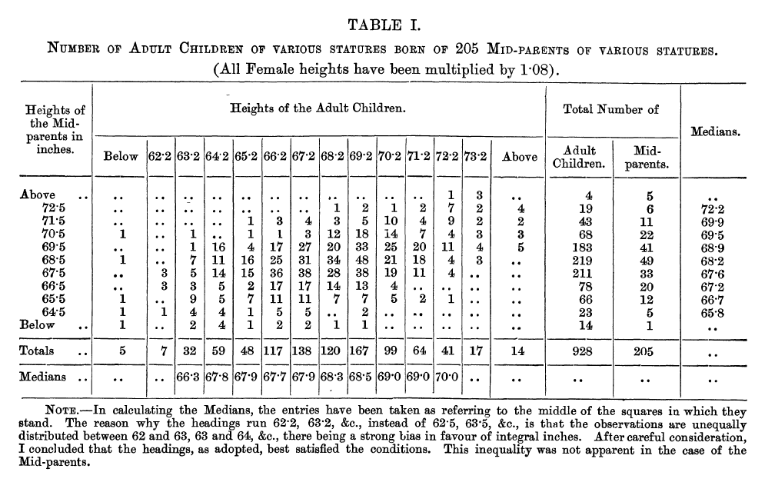
Regression Toward Mediocrity in Hereditary Stature
By Francis Galton
The Journal of the
Anthropological Institute
of Great Britain and Ireland
Vol. 15, 1886, pp. 246-263
Notes:
This 1886 article by Sir Francis Galton serves as the primary historical document and the table of data that comes from it for students to use. You won’t be able to read it from the slide, so I have some print outs to use when we get to the calculation tasks.

Slide 10
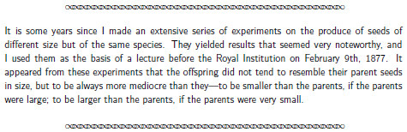

Explain in your own words what Galton had discovered.
Give a possible explanation for why the offspring of tall plants are usually shorter than their parents.
Cognitive Task
Notes:
Not surprisingly, cognitive tasks ask student to think about what they read from the primary historical source.
[CLICK] This is the first quote that comes from Galton’s paper. All quotes have the upper and lower dividers to distinguish them from other text in the PSP. (I’ll read it to you).
[CLICK] This style label is the indication for student activities among the explanatory text and quotes.
[CLICK] And these are the first two cognitive tasks. For my asynchronous online courses, these are the kinds of tasks to do in a discussion prompt or in a small group discussion.

Slide 11
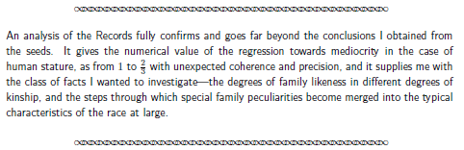
Let’s first try to understand Galton's claim. Assume that the height of the average adult in his study was 69 inches. If a parent were 75 inches tall, how tall would Galton predict the child to be? What if the parent were 66 inches tall?
Children seem to be, on average, more "mediocre" (in terms of their height) than their parents; what if we turn the question around? If an adult child is 72 inches tall, how tall would you expect
the parent to be? Why?
Calculation Task
Notes:
The next quote from Galton is key to the calculation tasks! [CLICK] (read the excerpts)
[CLICK] These two tasks are calculations based on that ratio “towards mediocrity”. Task 4 that I didn’t copy here was to write an equation that would describe the relationship between parent and child using the 2/3 value.
Give these two a try and consult your neighbors.

Slide 12
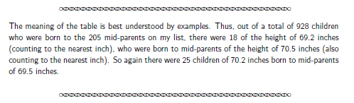
Write down three things you notice about the data or the values in this table.
Write down at least one question that you have about the table.
In Task 5 you tried to predict the height of a parent, given that the child’s height is 72 inches. Use Table 1 to find the actual value. Is that what you predicted? Why do you think this is?
Notes:
Between Tasks 5 and 8 there is a lengthier quote that contains Galton’s background on the data collection and the table about to be presented:
He recorded the heights of 930 adult children and the corresponding heights of their parents, “205 in number”
The “transmuting” of female parent heights by 1/12th – multiplying by 1.05 – before averaging with the male parent height. He called this the “mid-parental height”.
(hand out the data sheets)
[CLICK] Again, quoting Galton, (read aloud)
[CLICK] Notice that Tasks 9 & 10 are cognitive and might preface a discussion (in class or online) or be homework if you dole this out in small chunks. Talk to a neighbor about your own observations or questions then use the table to answer the two direct questions in Task 11.

Slide 13
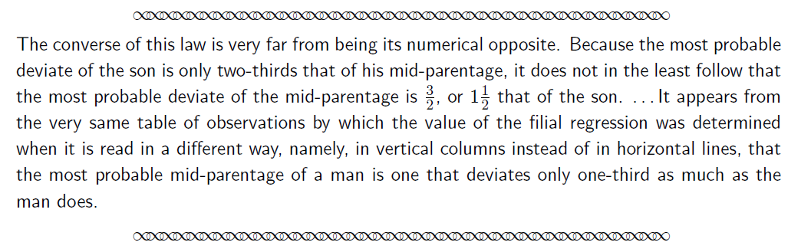


Look again at the table. Is it true that the average mid-parent height of children of a given height is more “mediocre” than that of the children?
Give a possible explanation for why this seemingly-contradictory result might hold.
Notes:
Unless you were thinking beyond what most of my students would have thought on Task 5, you probably ran into a seeming contradiction in looking at the data table in Task 11. That brings us to the next Galton quote [CLICK], which poses the greatest challenge for 21st-century readers of Galton. (read aloud)
This is the kind of thing that not all students will appreciate the effort to make sense of unfamiliar vocabulary! Scaffolding the reading or a Socratic discussion might merge the reading with the tasks.

Slide 14
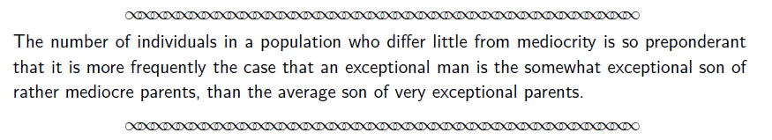
Last Quote from Galton
Notes:
(read aloud)
Tasks 14-16 are the last for students to engage with the Primary Historical Source (hand out slips)
TIME CHECK!!!
1:40 or earlier, give them time to work on Task 14
Later than that, hand out the last page at the same time and move on

Slide 15
Work Session 2
Notes:
Copy the graphs covered, maybe a few Tasks and talk about the separation between discussions and assignments.

Slide 16
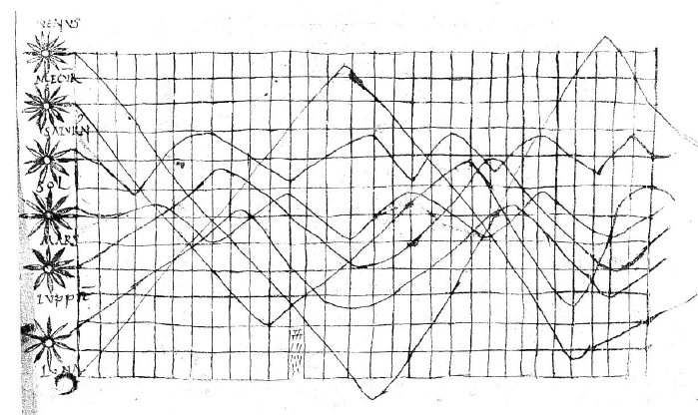
Seeing and Understanding Data
Beverly Wood, Embry-Riddle Aeronautical University
Charlotte Bolch, Midwestern University
Notes:
Like the previous PSP, this one starts with an introduction. In this case, a paragraph setting up the expectation of seeing types of data visualizations that won’t match – or only appear to match – the sorts that we see in everyday life today.
This is the first “quotation” from a primary source dated in the 10th or 11th century. So much for Dominic’s naïveté about the history of statistics! ☺ Accompanying explanation describes this as coming from an appendix to a commentary on the first century work of Cicero. The appendix reviews the physics and astronomy as known to Cicero.
Task 1a is to think about what the missing axis labels should be. Task 1b is to contemplate the reason for the grid system of this drawing. Share your initial ideas with a neighbor.
For another layer of history, a 20th-century mathematician is quoted that dispels the idea of a time series graph and Task 2 asks if they want to reconsider their answer to Task 1a.
Quick thanks to the Astrostatistics group at ASA and an astronomer colleague for helping me get the terms right, adding some footnotes for interested readers.

Slide 17
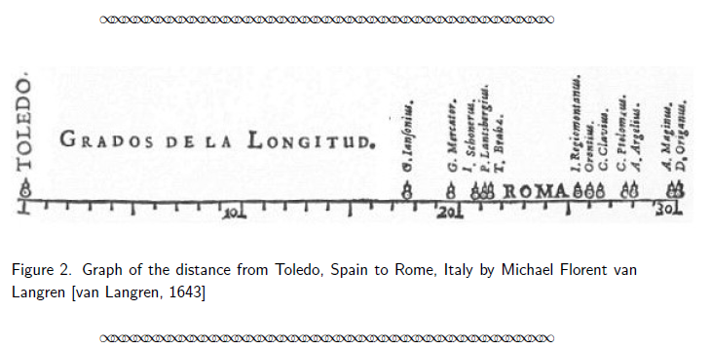
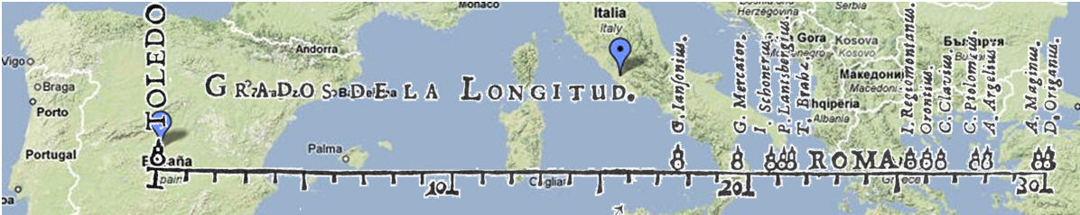
Experimentation Task
Notes:
The next section has some technical details regarding the laborious printing process prior to moveable type, giving credit to China and Korea for their moveable type prior to any in Europe. Gutenberg’s use of a metal alloy made it commercially profitable, giving rise to opportunity to include some printed graphics when absolutely necessary.
Most of my students have a terrible time with this graph from the mid-1600s. They really want it to be a simple dot plot but are confused by the labels. Task 3 asks about the spread of the data points and their relation to each other. Any ideas? (variation among the four astronomer’s estimates) Task 4 is a group/class guessing game about the distance from their classroom to some other place – no Google Maps! – and creation of their own graph of the estimated distances.
I have not checked all 90-some PSPs, but I suspect that this one has the longest Notes to Instructors section! There is a table that is a type up of every word that is readable on any web source we found or described by a science historian we knew about for the 8 figures of this PSP. The references take more than a page, links to online images that could be projected in a classroom, and multiple alternative tasks or activities for many of those figures, including this one. In all cases, even with GPS, there should be some variability, though perhaps not as much as this one! [CLICK]

Slide 18
William Playfair
(1759-1823)
Notes:
The field testing on this PSP repeatedly mentioned the difficulty in reading the images scaled down to fit standard paper width. Our 2019 revision added the Table of Figures I’ve mentioned to help with readability. The two with beige backgrounds have tasks on interpretation of the intended message and comparison to the modern usage of bar and pie charts. The third is much more complicated so the task has six direct questions about the left and right axes, vertical and slanted lines, and the circles’ radii to draw attention to the detail being represented here. There is also a question about the context of any modern one like it – so far, no one has – or if we could find one to use in this style.
One of the TRIUMPHS team members worked with math education graduate student to expand the library of statistics PSP with four others focused on Playfair with additional graphs and different tasks. The placement and presentation order will fit a variety of statistical contexts.

Slide 19
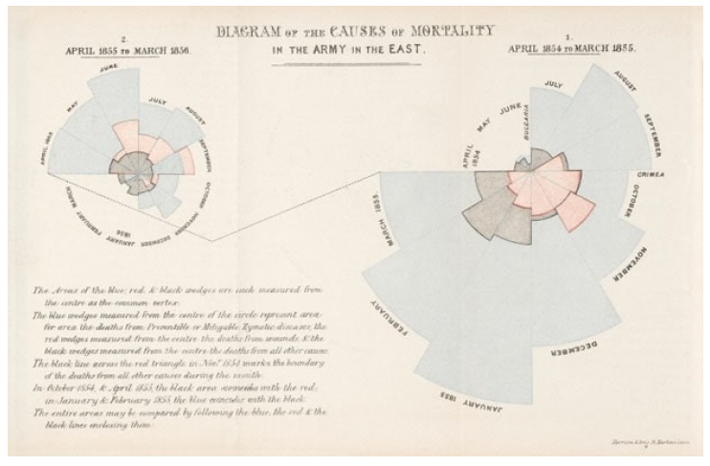
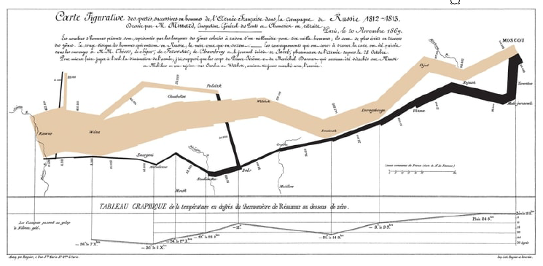
Florence Nightingale
(1823 - 1910)
Charles Minard
(1823 - 1910)
Notes:
I’m sure most of you have seen these two before! A few of my students recognize one or the other from history classes. Task 9 asks them to speculate on the physical tools that Nightingale would have needed, compare wedges of the same month in the two years, again to consider contemporary information that might be displayed like this. Task 10 is a think-pair (and could be share) activity to uncover all of the variables in Minard’s chart and why each was important for telling the story of Napoleon’s disastrous march on Russia. Once I carefully read the text on this image, I was struck by the fact that never once is Napoleon’s name used! A significant point that Minard was making with this chart.

Slide 20
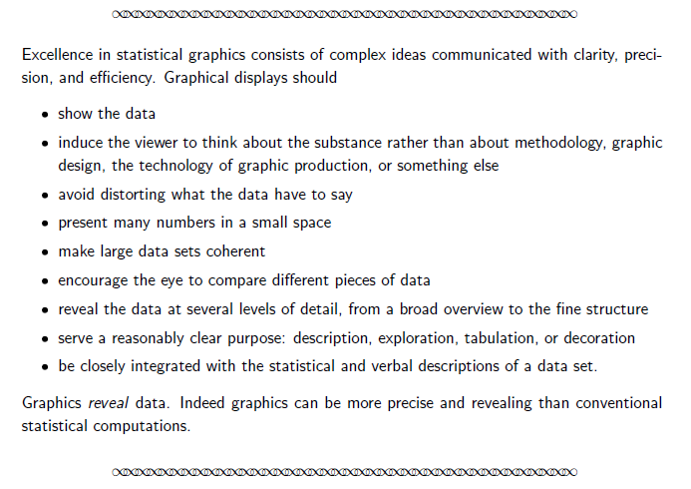

200 Countries, 200 Years, 4 Minutes
Notes:
The last set of tasks does not come with an image but with Edward Tufte’s Principles of Graphical Excellence and data-ink ratio as well as links to Hans Rosling’s video and the Gapminder tool used to create it. The tasks ask students to evaluate the previous graphs on Tufte’s standards and choose a single non-US country to tell the story using Gapminder’s visualization (and some reading about that country’s history).
TIME CHECK!!!
Must be before 2:15 to even continue!

Slide 21
Work Session 3:
Quantifying Certainty: the p-value
Dominic Klyve, Central Washington University

Slide 22

Quantifying Certainty: the p-value
Dominic Klyve, Central Washington University
Notes:
This is the first – and purportedly only – PSP in the statistics category.

Slide 23
Quantifying Certainty: the p-value
Source 1: John Arbuthnot’s An Argument for Divine Providence, taken from the Constant Regularity observed in the Births of both Sexes
Arbuthnot implicitly uses a sign test – students tease out the null hypothesis, the alternate, and the p-value.

Slide 24
Notes:
This is the table for Arbuthnot’s work.

Slide 25
Alternative Hypotheses
If we reject H₀, we need to accept something else. But what?
Arbuthnot’s attempt reminds us that this can be tricky….

Slide 26
Certainty Thresholds
First significance level?

Slide 27
P-values were confusing even before they existed…
Source 2: Georges-Louis Leclerc, Compte de Buffon’s
Essais d'Arithmétique Morale (Essays on Moral Arithmetic)
Contains the “needle experiment”
Discusses the St. Petersburg Paradox
Works with utility theory
And an early significance threshold.

Slide 28
Certainty thresholds
Georges-Louis Leclerc, Compte de Buffon, wrote on “moral certainty” and “physical certainty”.

Slide 29
Certainty Thresholds
First significance level?

Slide 30
Ron Fisher and p=0.05
The Project continues with Ron Fisher, and a discussion of p=0.05.

Slide 31
Thank you
Beverly Wood
Beverly.Wood@erau.edu
Dominic Klyve
Dominic.Klyve@cwu.edu
Notes:
I am working on a proposal for sabbatical to create some more PSPs in the Probability and Statistics category. I’m thinking about linear regression, Bayes’ rule, and gaming probabilities. I’m open to more ideas or collaborators!

