Slide 1
Homage for Stu Hunter
Today is Stu’s 100th birthday.

Slide 2
On ASQ website
J. STUART HUNTER
Statistician, educator, author, and editor
Hunter co-authored Statistics for Experimenters with George E.P. Box (another ASQ Honorary member) and W.G. Hunter. He is the author of the textbooks Design of Experiments and Statistics for Problem Solving and Decision Making designed for use in conjunction with his television series.
Hunter is the founding editor of Technometrics, the quarterly journal co-published by ASQ and the American Statistical Association. Hunter served as president of the American Statistical Association in 1993.
Hunter taught courses on evolutionary operation, factorial and fractional factorial design, and response surface methodology for ASQ's Chemical and Process Industries Division, as well as the American Statistical Association’s Section on Physical and Engineering Services.
A fellow of ASQ, the American Statistical Association, the Royal Statistical Society, and the American Association for the Advancement of Science, Hunter is a member of the American Society for Testing Materials, the American Institute of Chemical Engineers, the Institute of Industrial Engineers, the Institute of Mathematical Science, the Biometrics Society, and the Environometrics Society, of which he was a founding member.
Hunter received ASQ’s Brumbaugh Award in 1959 and 1985 and Shewhart Medal in 1970. He also received the Ellis Ott Award in 1978 and the Metropolitan Section’s Deming Medal in 1986
Hunter’s Shewhart Medal citation recognizes his "outstanding contributions in the development and application of statistical techniques for engineering and industrial needs and his inspiring leadership in applying these technologies to quality control." In his Shewhart Medal speech, Hunter said, "The rational man who solves problems has to be an articulate man. He has to be able to use the English language well, but he also has to be a quantitative beast if he is going to solve his problem." Surely the rational and articulate Hunter is just such a quantitative beast.

Slide 3
Lynne Hare interviews
Stu Hunter: Views the Future of Statistics – YouTube
https://www.youtube.com/watch?v=MWfzJzSsGsY

Slide 4
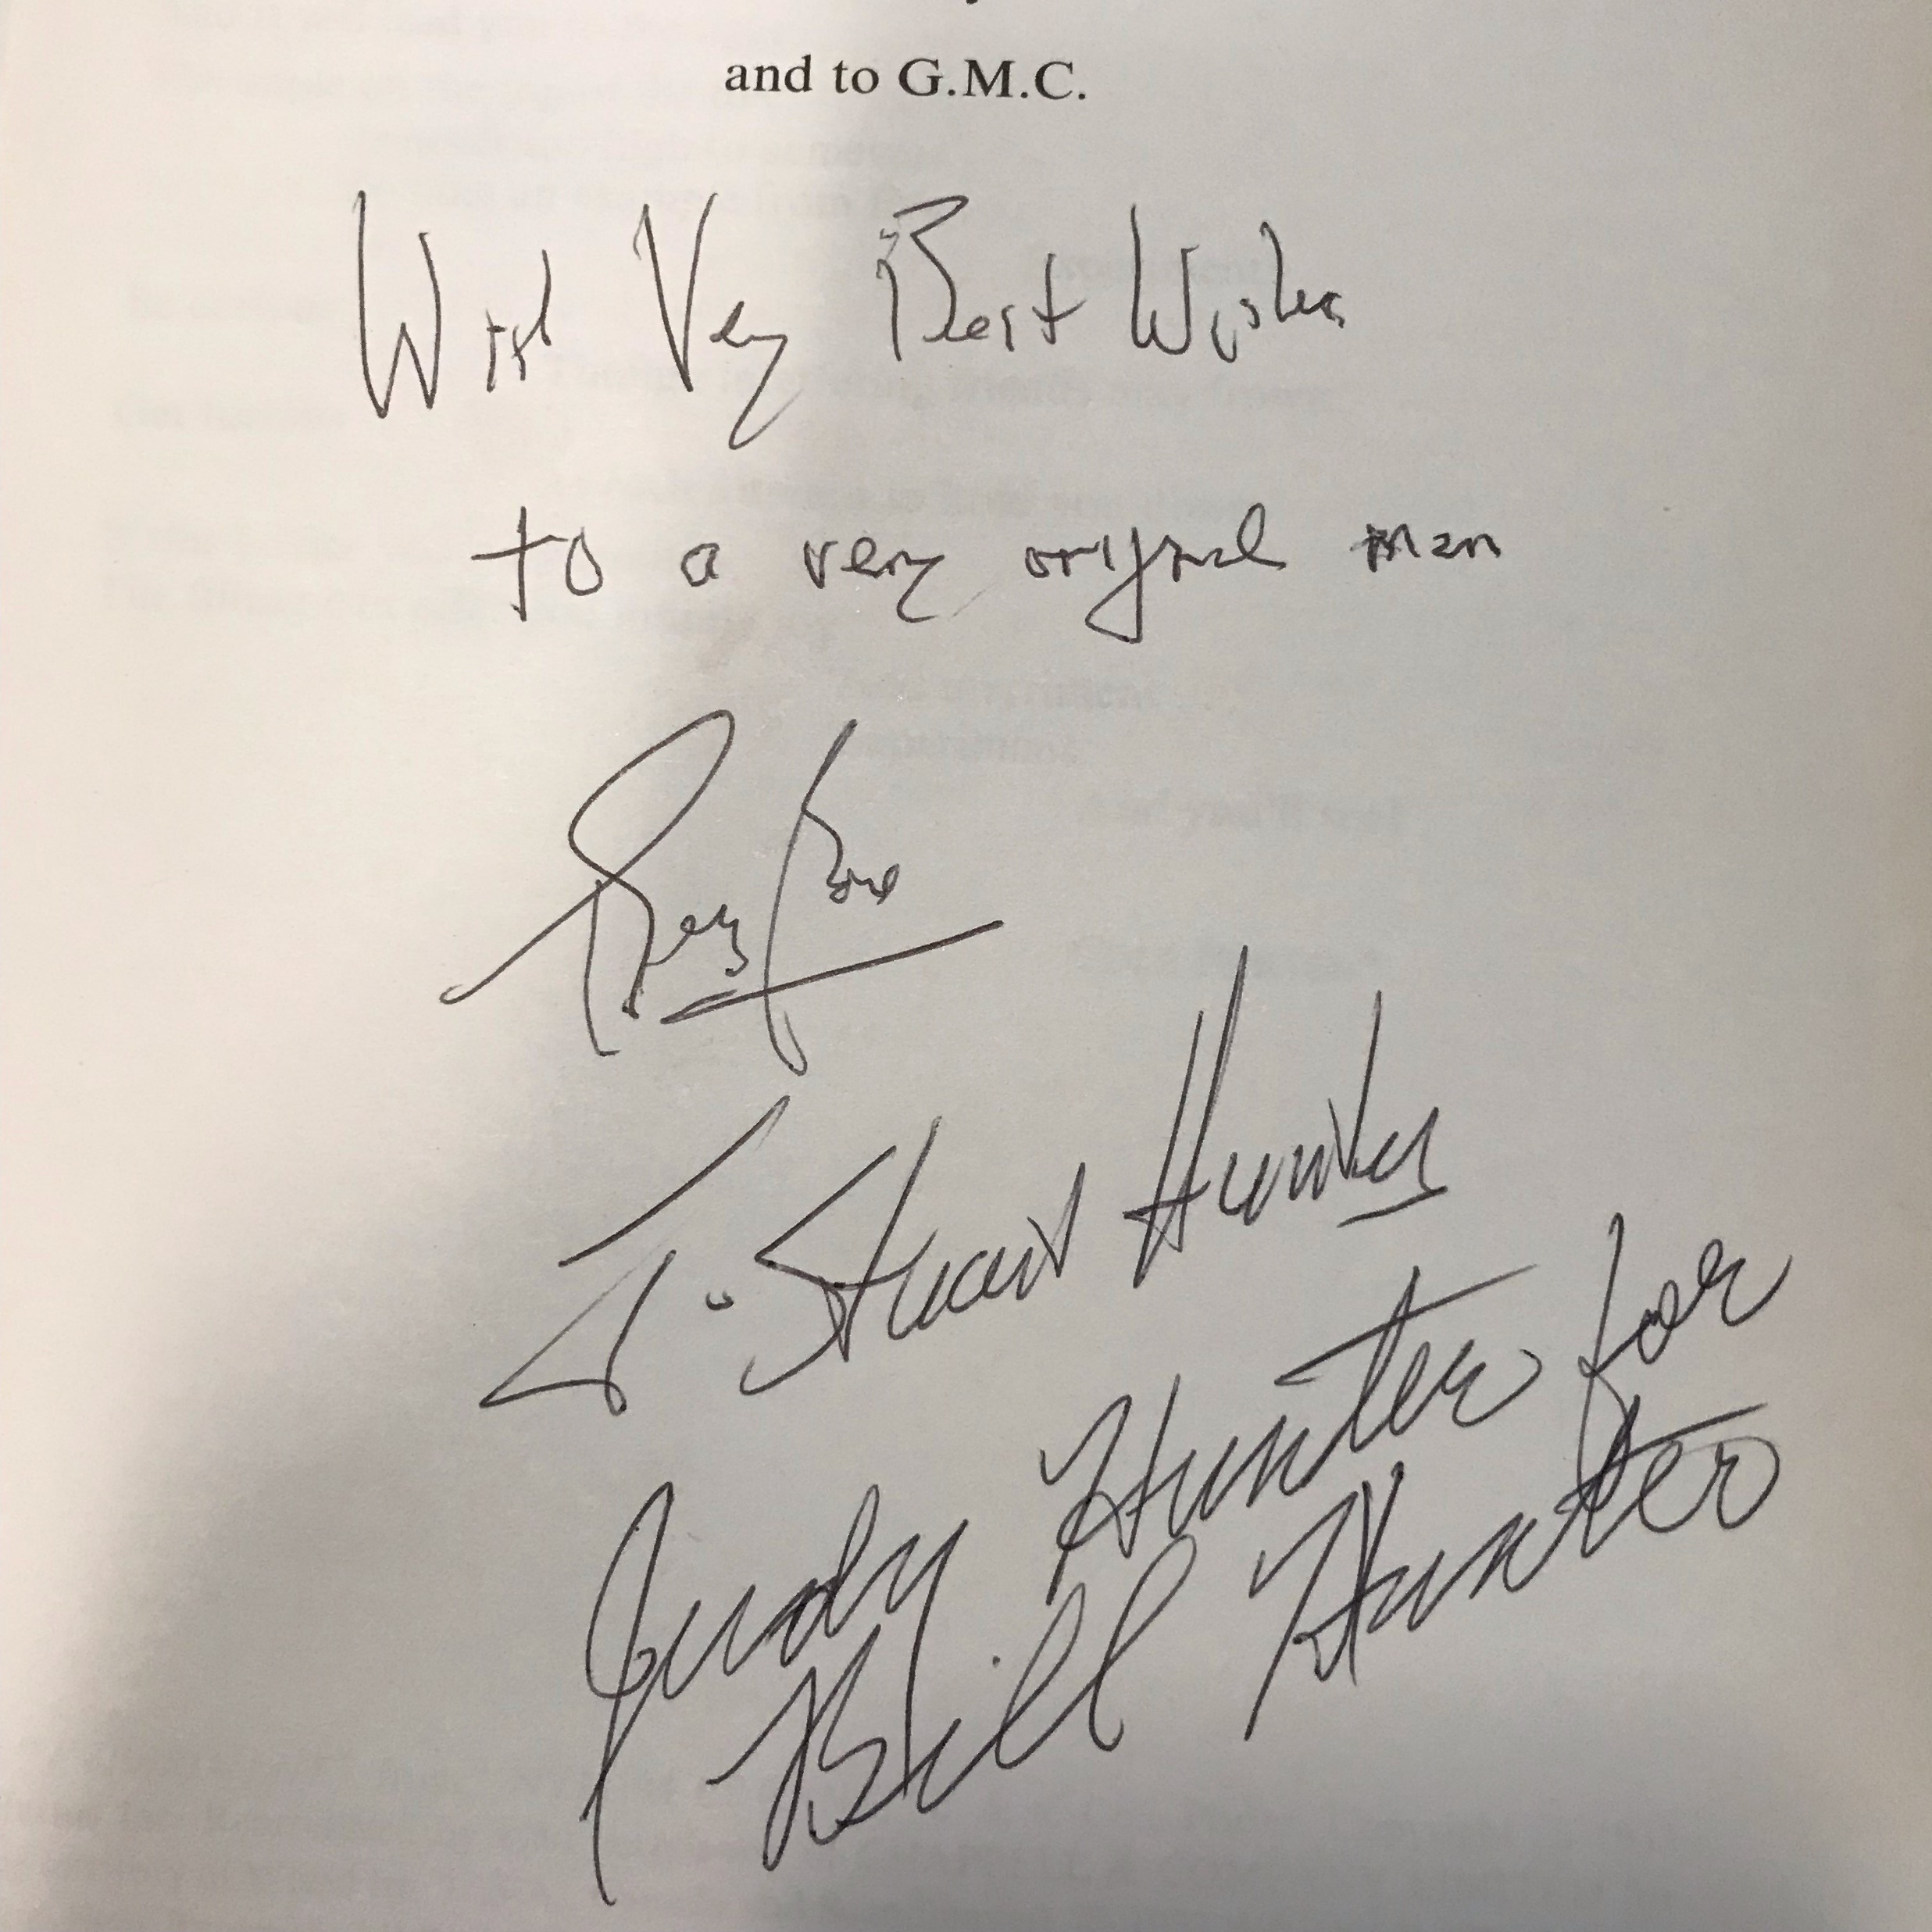
Box, Hunter, & Hunter

Slide 5
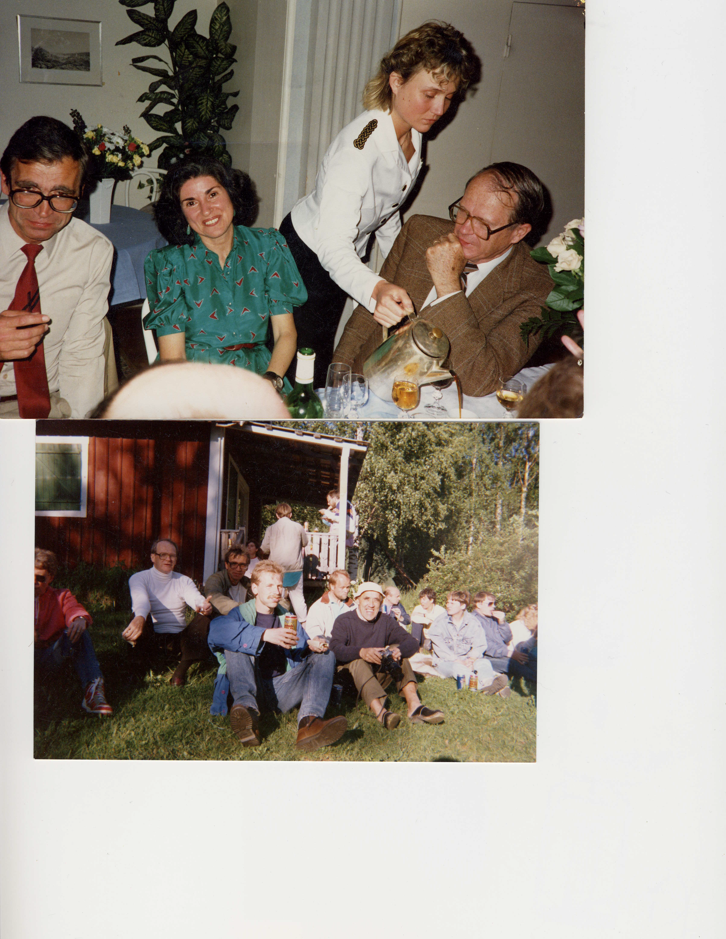
At the Gordon Conference

Slide 6
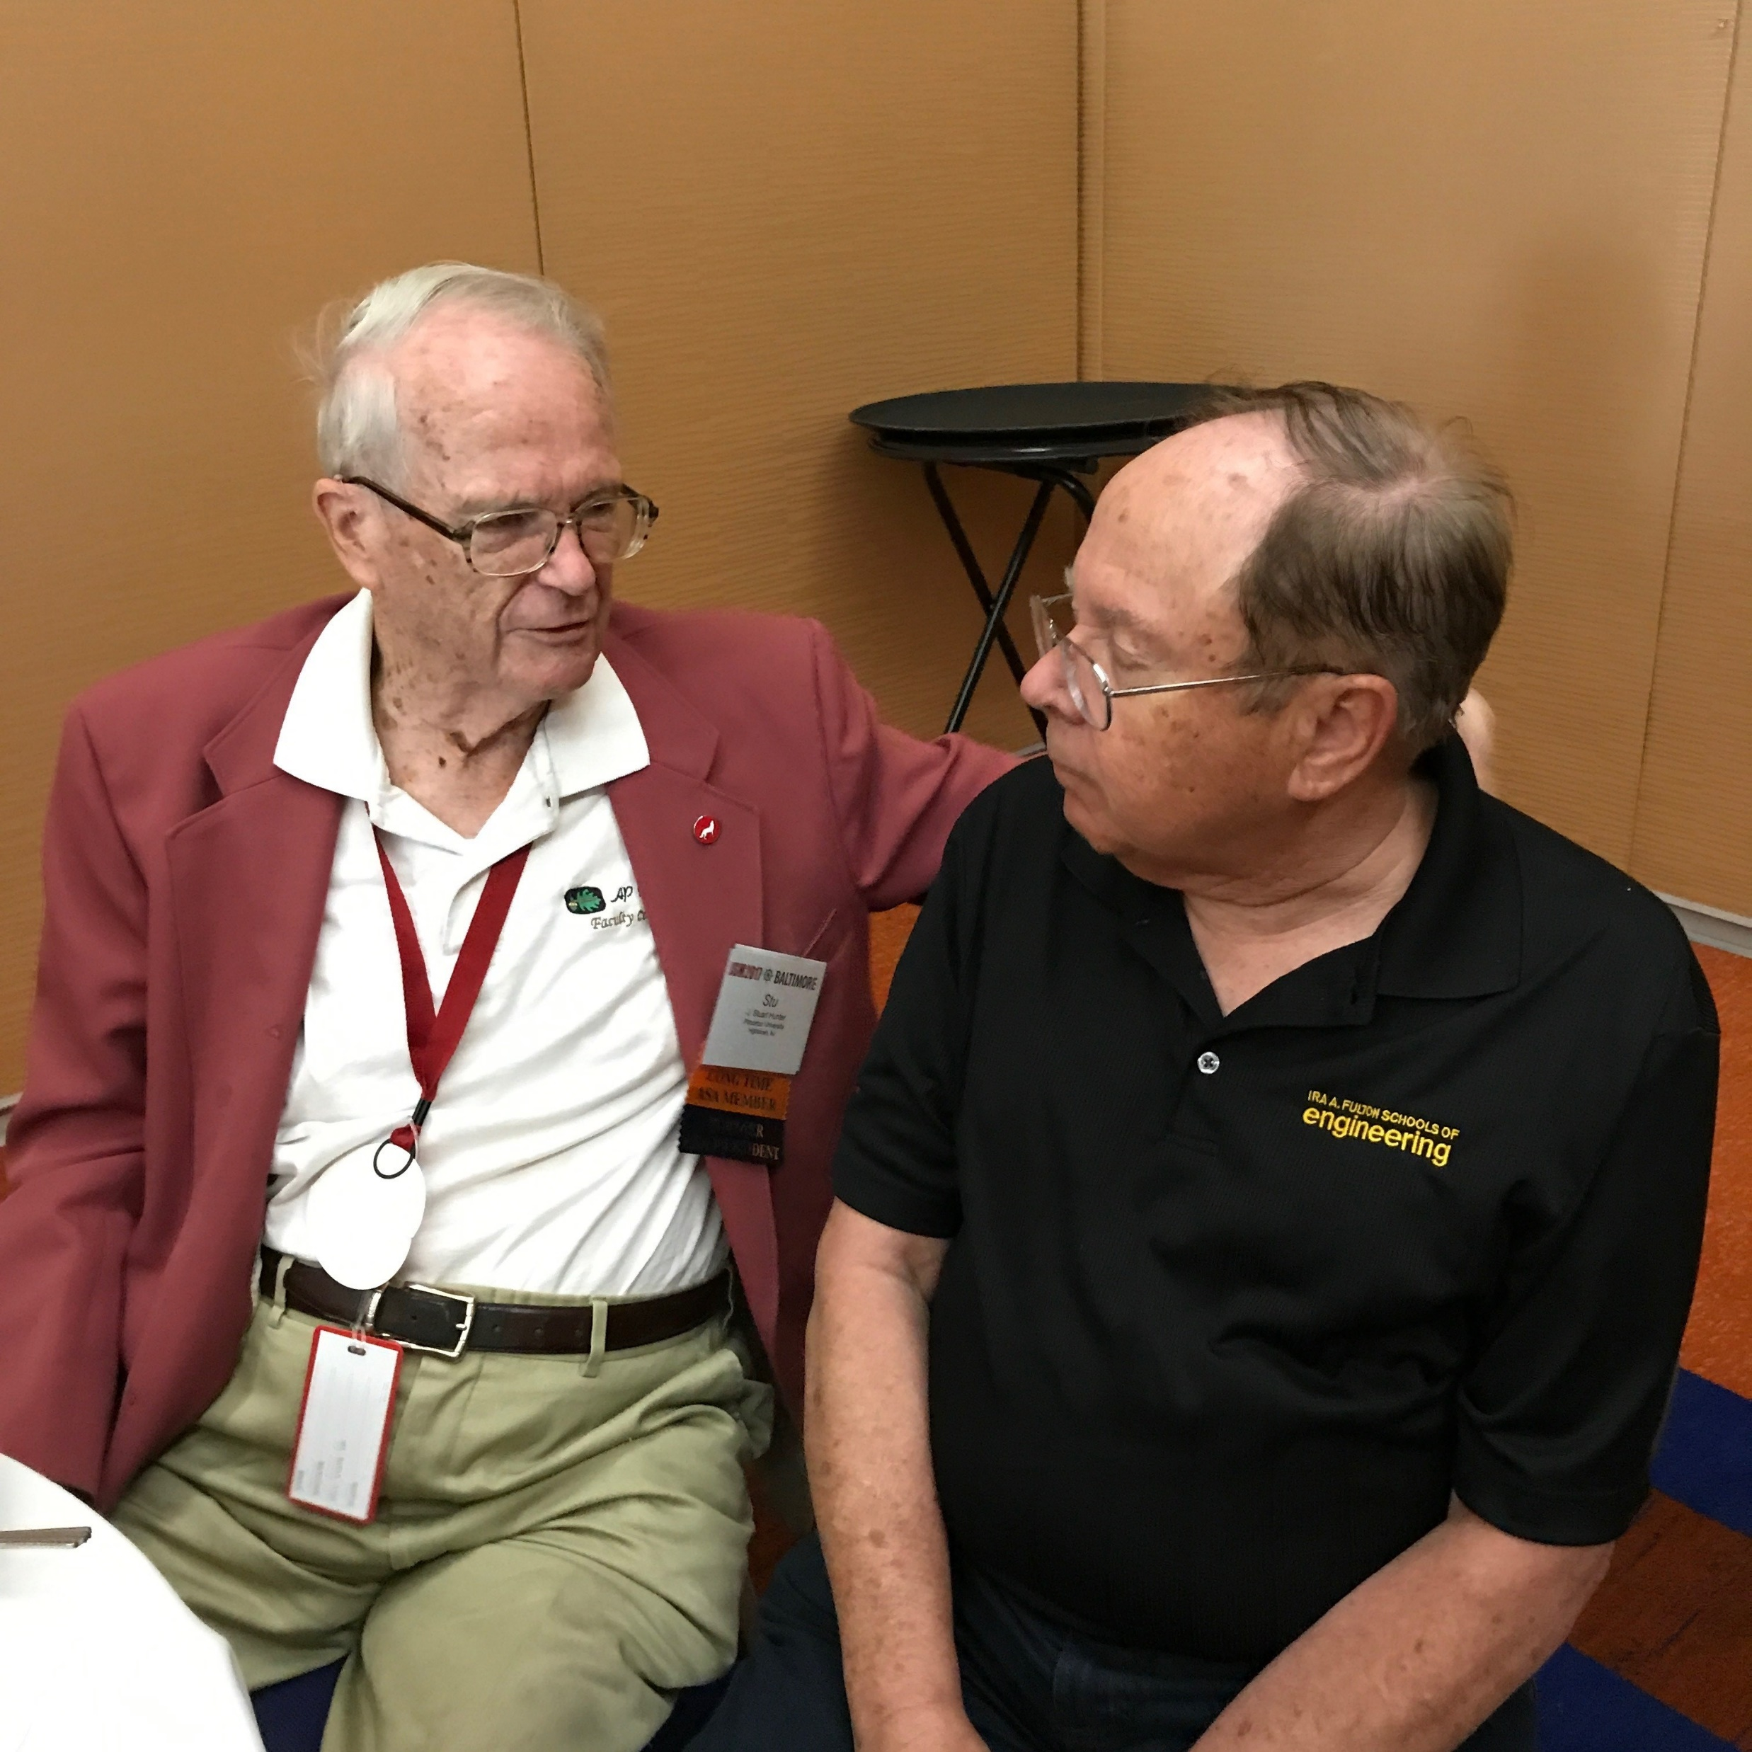
Stu and Doug

Slide 7
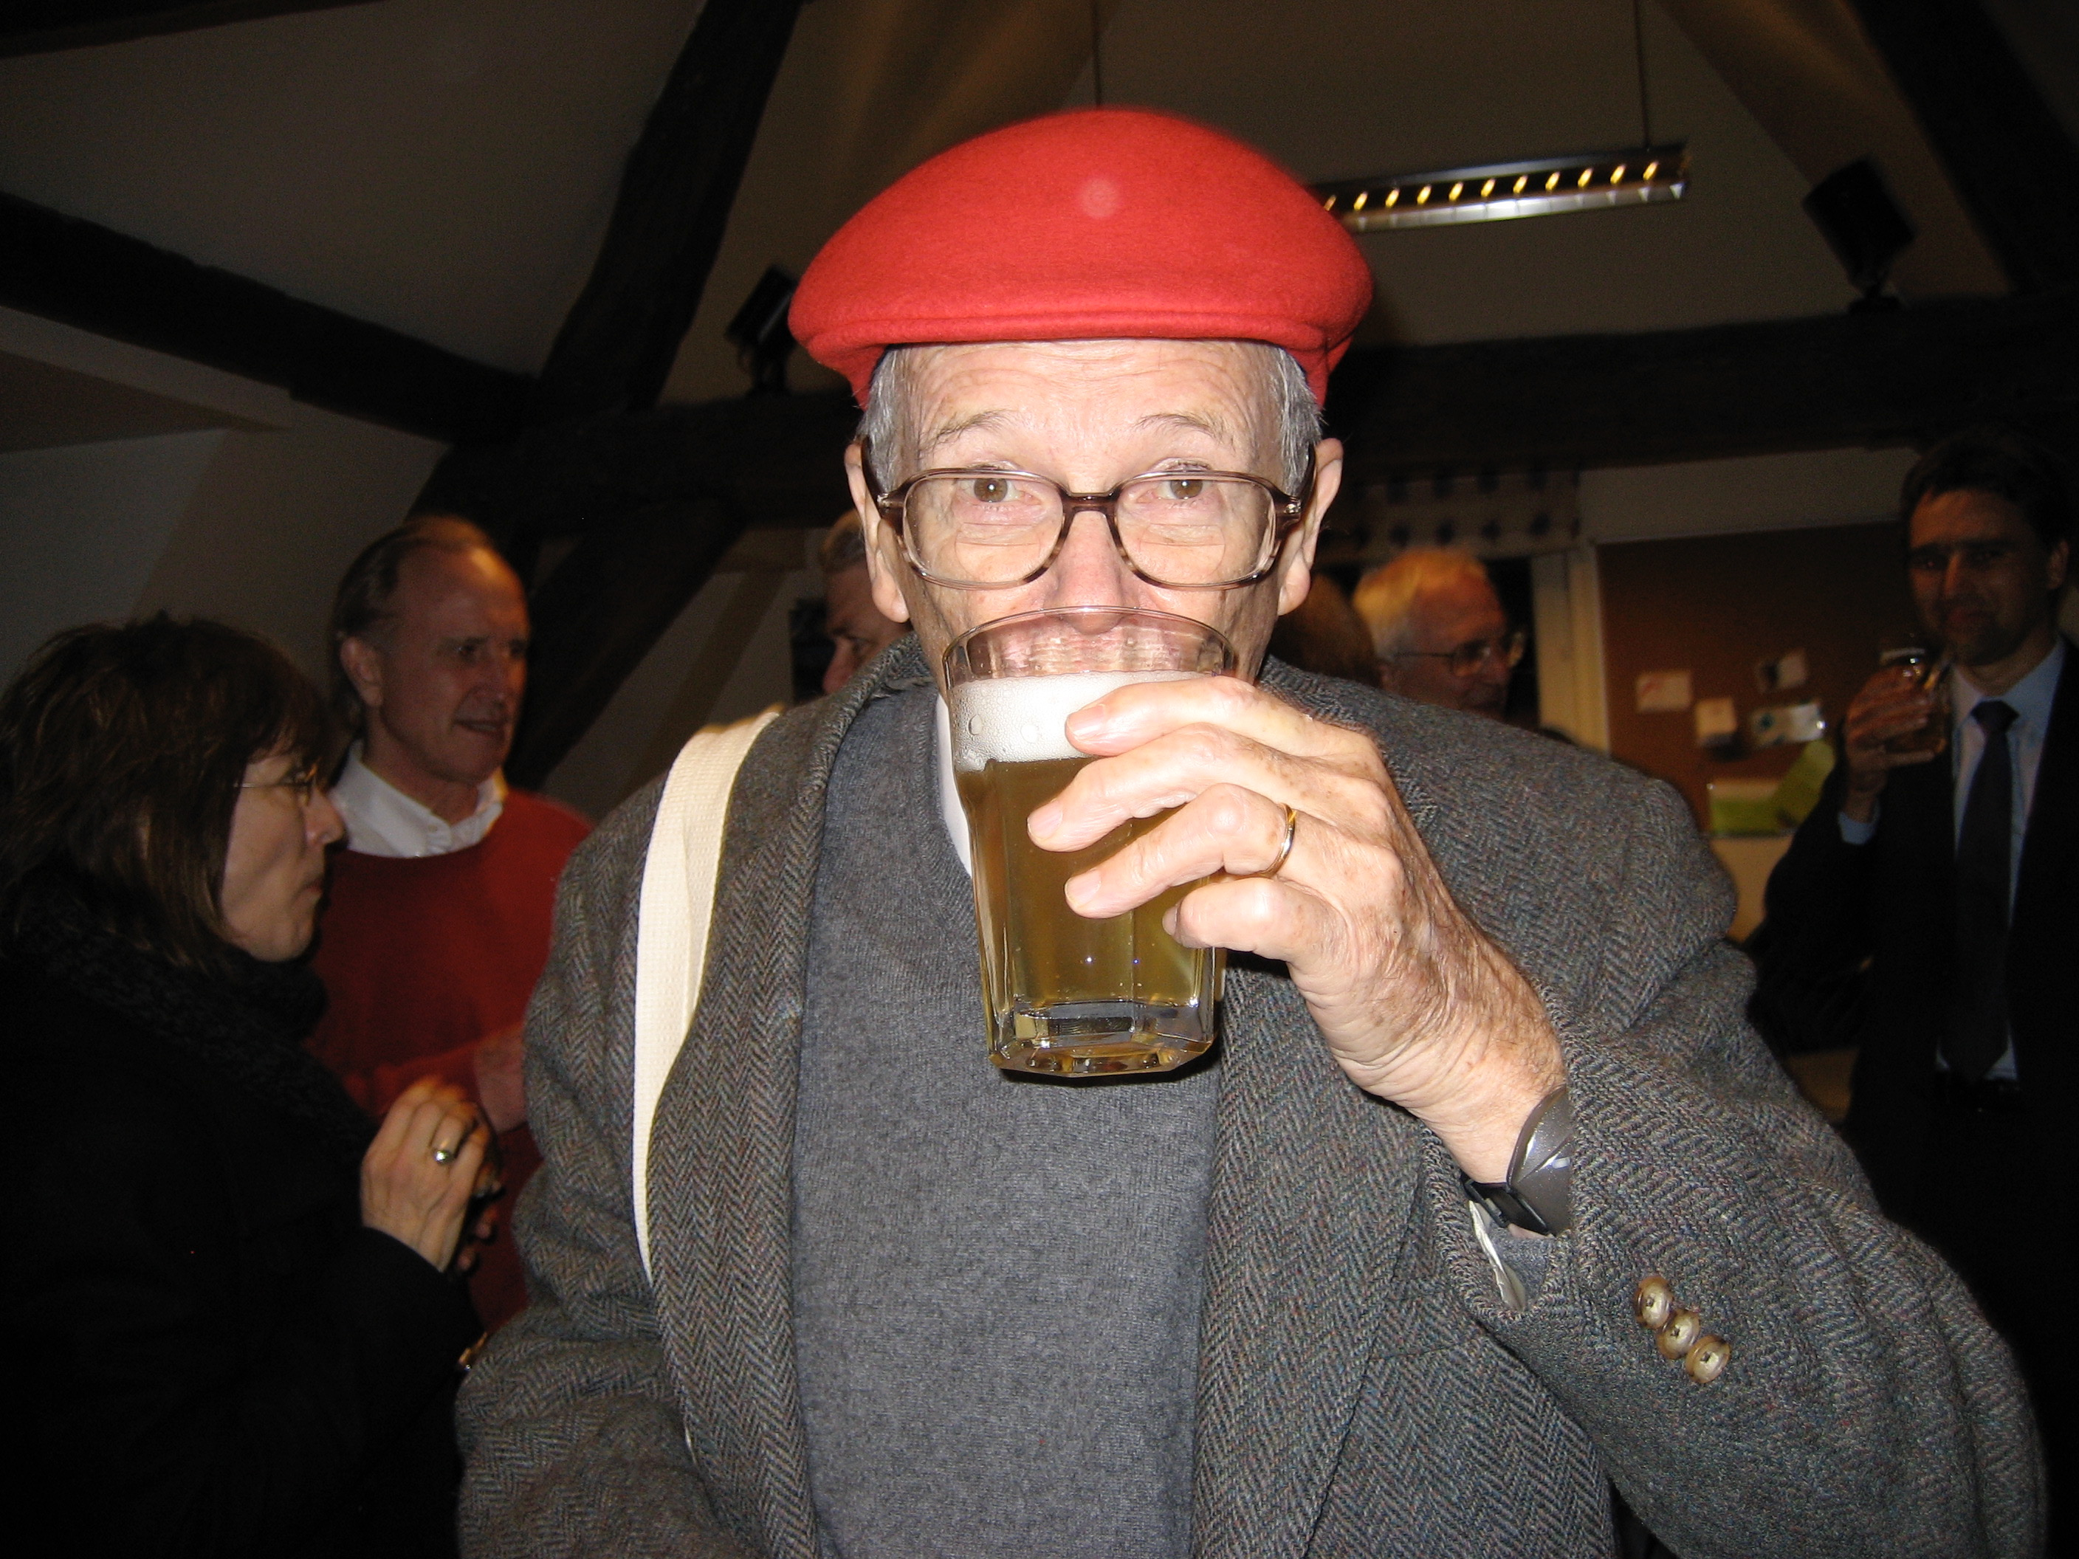
Stu in Belgium

