Slide 1
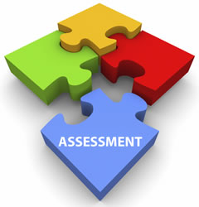
Direct vs. Indirect assessment in a Business Analytics course at a minority-serving institution
Dr. Sinjini Mitra
Professor, ISDS Department
California State University, Fullerton
eCOTS Conference, June 10 – 13, 2024

Slide 2
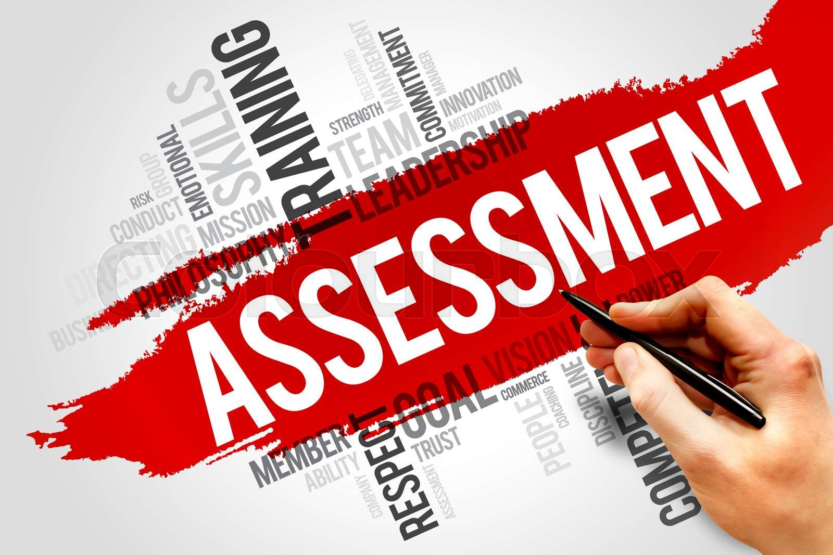
Outline
Introduction & background
Data
Research goals
Summary of results
Conclusions & future work
Practical implications

Slide 3
Introduction & Background
Assessment is an integral part of instruction
Determines whether student learning goals of a course/program are met while driving decisions regarding pedagogical changes and curriculum advancement
Assessments include different approaches to capturing student outcomes from different perspectives (Menhart, 2011)
Direct assessment
Indirect assessment
Direct assessment methods provide evidence of student learning by direct examination of students’ skills via tests, assignments, etc.
Indirect assessment methods measure student attitudes and perceptions about their own learning - exit surveys or focus group interviews
Provide rich data to complement or corroborate direct assessment outcomes (Rogers, 2020)

Slide 4
Data
Undergraduate Business analytics course at a 4-year public university (n = 81 from 2 sections)
Data collected from multiple sources
Final exam consisting of 10 multiple-choice problem-based questions from key topics in Statistics: descriptive statistics, normal distribution, interval estimation, hypothesis testing, and regression – direct assessment data
Online survey administered to the same students to understand student perceptions of their own learning and course satisfaction – indirect assessment data
Students’ demographic and academic background information were collected in the survey for research purposes
Data collected with campus IRB approval and student participation was voluntary with no incentives provided

Slide 5
Research goals
Overall goal: To form an in-depth understanding of how students are learning different statistical concepts in a Business Statistics course. Specific research questions included:
Do direct and indirect assessment outcomes match and lead to the same conclusions about student learning and performance in the Business Statistics course? What are the similarities and dissimilarities between the two sets of outcomes?
How do the two sets of outcomes differ across different student sub-populations as defined by academic and demographic background?
Can indirect assessment outcomes predict direct assessment outcomes?
How do the above findings help inform and improve the formal assessment outcomes for the course in future via pedagogical changes?

Slide 6
Summary of results
Both similarities and dissimilarities exist in the findings from the two assessment methods
The topics of hypothesis tests and regression models were generally perceived by students as difficult to master; however, they performed reasonably well on those topics in the direct assessment test
On the other hand, normal distribution is a topic that is usually well-understood by students as indirect assessment results showed although student scores were the lowest on that topic
Discrepancies occur between different assessment outcomes because students often overestimate or underestimate their knowledge and abilities in some areas
Prediction
Student perception about their own learning and understanding of the statistical concepts and satisfaction are strongly associated with direct assessment scores

Slide 7
Conclusions and future work
The key take-away from this research is thus that multiple methods of assessment are crucial to obtaining a comprehensive picture of student learning
Both similarities and dissimilarities exist in the findings from the two methods of assessment
Indirect assessment results can predict direct assessment outcomes
External factors impact assessment outcomes
Jobs, family responsibilities adversely impact student performance
Underrepresented students find it more difficult to find work-school-life balance and are less academically and emotionally prepared for college
Future work: Collect additional data to increase sample size for more in-depth studies and extend to other traditionally difficult courses

Slide 8
Practical implications
Pedagogical improvements
Understanding of topics that are challenging to students for faculty
Development of additional support materials by the instructors, supplementary resources like external videos (YouTube, Khan Academy), tutorials/applets, more in-class practice opportunities, especially for difficult topics, and in-depth exam reviews
Expansion of support services
Academic support services like SI and tutoring
Programs that target underserved and non-traditional students specifically to help them find an anchor in the institution and feel comfortable seeking help
More financial aid for low-income students

