Slide 1
Exploration!
Open “Exploration – Assessment Examples” within Google Drive Folder
In groups, select at least one assessment example to explore:
  Class Activity (Sufficiency)
  HW Question (MLEs)
  Exam Question (Probability Distributions)
  Group Project (Sampling Distributions)
Notes:
https://drive.google.com/drive/folders/17djJHdhcQH12OqZffSflnB6Q-bU-cPeK?usp=sharing

Slide 2
Exploration!
Guiding Questions:
  How does the assessment example compare to traditional assessments?
  What features and characteristics do you notice about the assessment?
  How does the assessments create opportunities for students to think in different and potentially novel ways?
Group Share-Out:
  In 15 minutes, each group will share one highlight or observation they noticed about the assessment(s)
Notes:
https://drive.google.com/drive/folders/17djJHdhcQH12OqZffSflnB6Q-bU-cPeK?usp=sharing

Slide 3
Group Share-Out
What is one highlight or observation your group noticed about the assessment(s)?

Slide 4
Developing Assessments
Identify Goal(s) and Purpose(s) of Assessment
  What is the purpose of this assessment?
  What do I hope to learn about students’ thinking and/or current understandings?
  How will I use this information, and how will it help inform instruction?

Slide 5
Developing Assessments
Identify Goal(s) and Purpose(s) of Assessment
  What is the purpose of this assessment?
  What do I hope to learn about students’ thinking and/or current understandings?
  How will I use this information, and how will it help inform instruction?
Sufficiency Example:
Low-stakes, develop student understanding, productive struggle
Low- to Mid-Stakes, check current student thinking and understandings to inform instruction

Slide 6
Developing Assessments
Identify Goal(s) and Purpose(s) of Assessment
  What is the purpose of this assessment?
  What do I hope to learn about students’ thinking and/or current understandings?
  How will I use this information, and how will it help inform instruction?
Sufficiency Example:
Low-stakes, develop student understanding, productive struggle
Low- to Mid-Stakes, check current student thinking and understandings to inform instruction
Use sufficiency class activity so students can experience the concept of sufficiency and what it means.
Use a homework question so students can practice explaining why one stat that is sufficient would be preferred over another stat that is not sufficient for estimating a parameter.

Slide 7
Developing Assessments
Identify Concepts
  What concepts are important for tackling and understanding this problem? (i.e., Dissect a problem into a list of concepts.)
  What aspects are important for understanding this concept?
  What aspects/concepts would I like an assessment to dig into deeper?

Slide 8
Developing Assessments
Identify Concepts
  What concepts are important for tackling and understanding this problem? (i.e., Dissect a problem into a list of concepts.)
  What aspects are important for understanding this concept?
  What aspects/concepts would I like an assessment to dig into deeper?
CDF Example:

Slide 9

Developing Assessments
Identify Concepts
  What concepts are important for tackling and understanding this problem? (i.e., Dissect a problem into a list of concepts.)
  What aspects are important for understanding this concept?
  What aspects/concepts would I like an assessment to dig into deeper?
CDF Example:

Slide 10




Developing Assessments
Identify Concepts
  What concepts are important for tackling and understanding this problem? (i.e., Dissect a problem into a list of concepts.)
  What aspects are important for understanding this concept?
  What aspects/concepts would I like an assessment to dig into deeper?
CDF Example:

Slide 11





Developing Assessments
Identify Concepts
  What concepts are important for tackling and understanding this problem? (i.e., Dissect a problem into a list of concepts.)
  What aspects are important for understanding this concept?
  What aspects/concepts would I like an assessment to dig into deeper?
CDF Example:

Slide 12
Developing Assessments
Identify Concepts
  What concepts are important for tackling and understanding this problem? (i.e., Dissect a problem into a list of concepts.)
  What aspects are important for understanding this concept?
  What aspects/concepts would I like an assessment to dig into deeper?
CDF Example:

Slide 13
Developing Assessments
Identify Ways of Knowing / Representation
  What types of thinking are involved?
  In what ways can students represent their understandings of this concept?
  What information will their responses provide?

Slide 14
Developing Assessments
Identify Ways of Knowing / Representation
  What types of thinking are involved?
  In what ways can students represent their understandings of this concept?
  What information will their responses provide?
Sampling Distribution Example:
Group project: Create two questions (and their solutions) about sampling distributions
  Population dists: 1 discrete, 1 continuous
  Theoretical derivations
  Technology / Simulation
  Originality

Slide 15
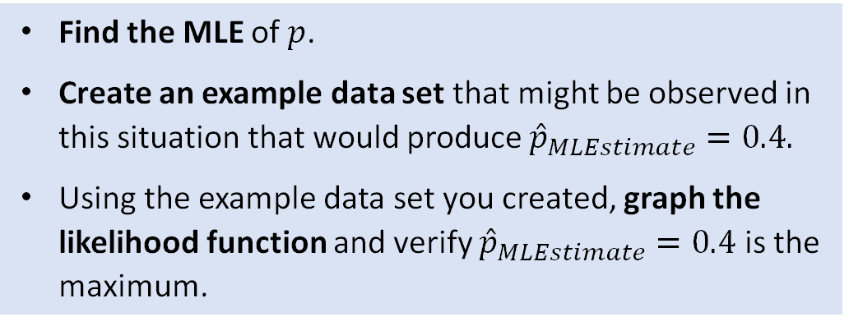
Developing Assessments
Identify Ways of Knowing / Representation
  What types of thinking are involved?
  In what ways can students represent their understandings of this concept?
  What information will their responses provide?
Sampling Distribution Example:
MLE Example:
Group project: Create two questions (and their solutions) about sampling distributions
  Population dists: 1 discrete, 1 continuous
  Theoretical derivations
  Technology / Simulation
  Originality
Find the MLE of $p$.
Create an example data set that might be observed in this situation that would produce ${\hat{p}}_{MLEstimate}=0.4.$
Using the example data set you created, graph the likelihood function and verify ${\hat{p}}_{MLEstimate}=0.4$ is the maximum.

Slide 16
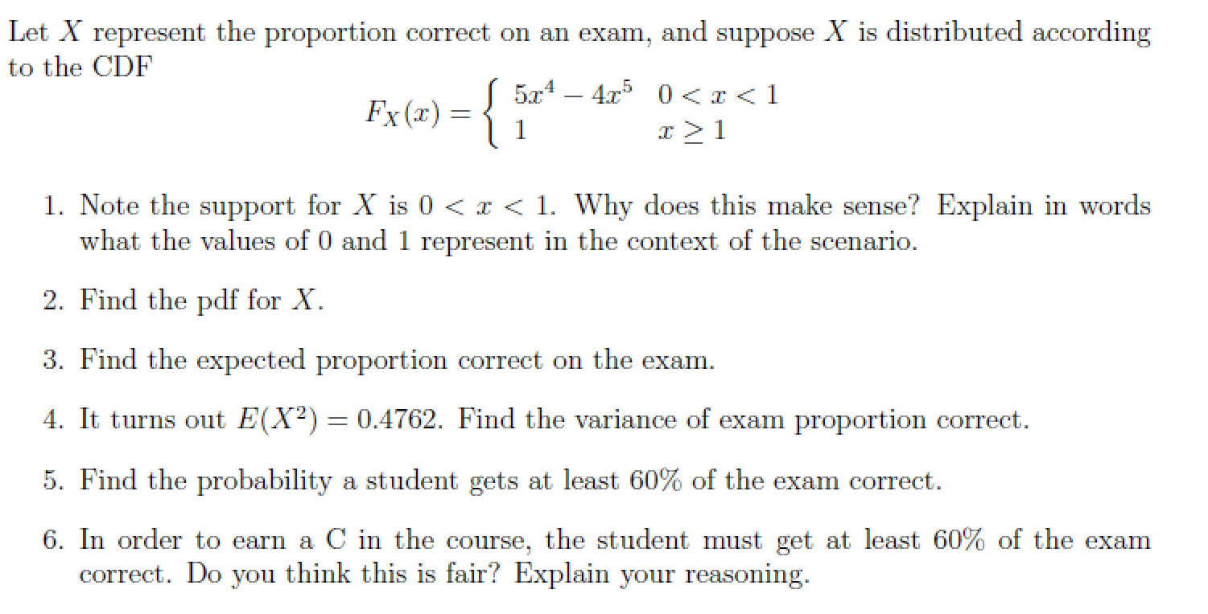
Guiding Principles/Strategies - Example

Slide 17

Guiding Principles/Strategies
The assessment should be at least partially do-able for a student with only a cursory understanding.

Slide 18

Guiding Principles/Strategies
Focus on the concept I really care about, often the process as opposed to an answer.
  Ex: Find the maximum likelihood estimator of p and show that it is
  Ex:

Slide 19
Guiding Principles/Strategies
Focus on the underlying statistics concept, as opposed to math
  Ex:
  If the problem requires integration by parts more than once, change the problem!

Slide 20
Guiding Principles/Strategies
Backwards thinking: the application of a concept to a new scenario or looking at a concept from a different perspective
  Ex: Sufficiency activity. Rather than starting with a list of random variables, we ask the students to start with a summary statistic.
  Ex:

Slide 21
Guiding Principles/Strategies
Context

Slide 22
Practice!
In groups, select a traditional assessment to transform to focus on conceptual understanding.
  If you brought an assessment, please use that one!
  Additional example questions are in the Google drive.
Each group: cut-and-paste the question you've chosen to work with into the page labeled with your group number. Then use that page to modify that assessment.
We'll be popping into the breakout rooms to answer questions or discuss.
In 15 minutes, we'll be coming back together. Please be prepared to share something about the transformed assessment you're particularly proud of or have questions about.
Notes:
https://drive.google.com/drive/folders/17djJHdhcQH12OqZffSflnB6Q-bU-cPeK?usp=sharing

Slide 23
Shareout
Elements of the modification your group is particularly proud of?
Elements of the modification you are unsure about?
Other discussion topics?
The transformed questions are all in the Google drive, so all attendees will have access to each group's work.
Notes:
https://drive.google.com/drive/folders/17djJHdhcQH12OqZffSflnB6Q-bU-cPeK?usp=sharing

Slide 24
Thank you!
Peter Freeman, pfreeman@cmu.edu
Erin Blankenship, erin.blankenship@unl.edu
Jennifer Green, jg@msu.edu

