Slide 1
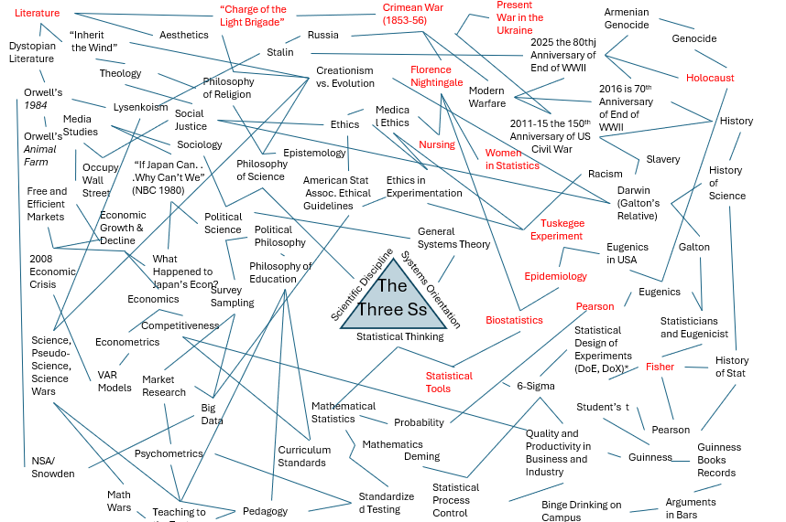
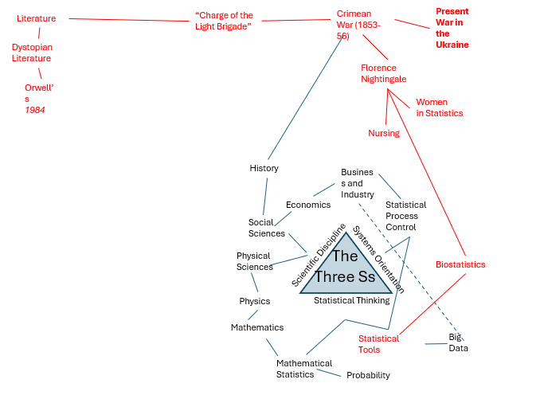
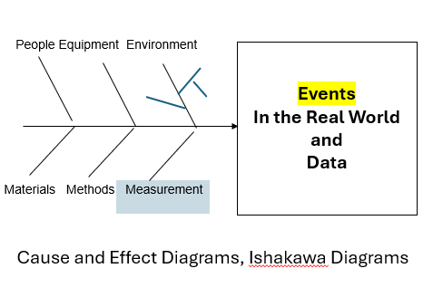
Non-Cognitive Predictors of Student Success:
A Predictive Validity Comparison Between Domestic and International Students
Non-Cognitive Predictors of Student Success:
A Predictive Validity Comparison Between Domestic and International Students
Connecting Statistical Thinking to the Wider World of Ideas and Events: A Liberal Arts Perspective
Non-Cognitive Predictors of Student Success:
A Predictive Validity Comparison Between Domestic and International Students
David A. Fluharty MBA, PhD School of Public Health—Bloomington, Department of Epidemiology & Biostatistics dfluhart@iu.edu USCOTS 2025
INTRO
Students will produce “concept maps” connecting statistical thinking to the wider world of ideas and events in an introductory Biostatistics Course.
The first step is an in-class presentation of what might be called “The 3 Ss:”
• Statistical Thinking: Variation is a fundamental aspect of every physical, biological, psychological, and social system and statistical tools are necessary to understand this variation.
• Process Orientation: Most important phenomena are the result of multiple causes.
• Scientific Discipline: Every theory is subject to challenge.
STEP #1: Define and Discuss THE 3Ss
Statistical Thinking: Realizing the omnipresence of variation in every physical, biological, psychological, and social system and knowing that statistical tools (data-informed intellectual technologies) are essential to understand that variation and thus the phenomena themselves.
Process Orientation: Realizing that the most interesting and important events in the world are multicausal, a blending of People, Equipment, Environment, Materials, and Methods
STEP #2: Begin to Build a “Concept Map” So Students Understand Assignment
STEP #3 “Concept Map” Assignment
Assign building a concept map
  Possibly in small teams
  Possibly ask each person to contribute two or three concepts.
  Possibly online homework assignment
  STEP #4: Discuss Student “Concept Map(s) in Class
Student think of very interesting connections and see about the variety of possible connections!
Article of Interest
Moore, D. S. (1998). Statistics among the Liberal Arts. Journal of the American Statistical Association, 93(444), 1253–1259. https://doi.org/10.1080/01621459.1998.10473786
NOTE: Until Spring 2025 David Fluharty started presented the above “concept map "to his classes, In Spring of 2025 he shifted from a passive presentation to active learning in which students build the “concept maps.”
  Scientific Discipline:
  Realize that the business of science is building testable models to describe systems that produce phenomena (THE Scientific Method).
  Recognizing that any models we build in an effort to understand the phenomena produced by systems are tentative and susceptible to challenge (as George Box said, “All models are wrong, some models are useful”).
  As Carl Sagan said, “At the heart of science is an essential balance between two seemingly contradictory attitudes--an openness to new ideas, no matter how bizarre or counterintuitive they may be, and the most ruthless skeptical scrutiny of all ideas, old and new. This is how deep truths are winnowed from deep nonsense.”
Notes:
Notes:
In Powerpoint, click View > Guides
Keep text within gutter guides.
Author list: Don’t split names onto two lines (e.g., “Jimmy [break] Smith”). If that happens, use a new line, unless you need the space. Bold the first names of anybody who’s presenting in person.
Intro/methods/result: Do not drop below font size 28, but if you have extra space, jack up the font size until the space is full.
Do not use color in the sidebars except in graphs/figures. It’ll pull attention from the center and slow interpretation for passersby.

