Slide 1
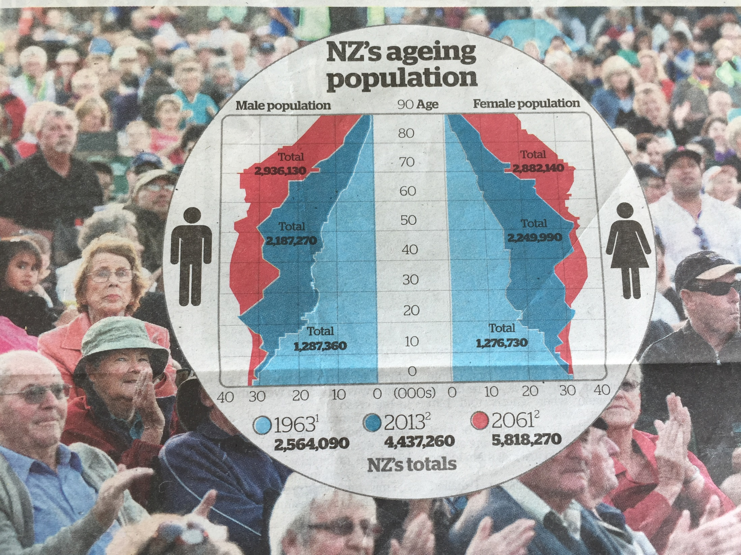
Making sense of data-based information
NZ Herald, 15/8/13
Maxine Pfannkuch
Auckland University | Waipapa Taumata Rau
Aotearoa New Zealand

Slide 2
My challenge
Are students leaving school with the ability to understand and to critically evaluate data information and misinformation that will affect their lives in areas such as health, environment, social justice and politics?

Slide 3
What do statisticians think?
Citizens need “the ability to understand and critically evaluate statistical results that permeate our daily lives” (Wallman, 1993, ASA president)
“Many students who take introductory statistics come away from the course able to compute a standard deviation, yet unable to spot an egregious example of poor statistical reporting …. We are doing an inadequate job of educating the next generation…. Every student who takes one statistics course should first and foremost be learning the statistical ideas they need to make informed decisions in daily life” (Utts, 2010, p. 1).

Slide 4
What do educators think?
“Critical thinking using data is an increasingly important core life skill” (Nicholson et al., 2010) and is essential for a vision of society as a “participatory democracy” (Gigerenzer, 2014, p. 261).
Students need to develop a habit of mind to interrogate data-based information, to know what questions to ask, to communicate a reasoned opinion about whether the evidence is convincing, and to advocate for social action.
(Brown et al., 2021; Engel & Wilhelm, 2021; Gal & Geiger, 2021; ProCivicStat, 2018; Ridgway, 2022; Souza & Araújo, 2022; Souza et al., 2020; Weiland, 2017)

Slide 5
My claim
Statistics educators have not, in general, addressed these challenges
School and tertiary students should be explicitly taught how to critique and evaluate data-based information and misinformation

Slide 6
Some questions
What statistical thinking skills do students need to participate in society?
In particular
What “worry questions” would help students question data-based arguments?
i.e., worry questions that are habituated and internalised

Slide 7
Nurturing the disposition to interrogate a data-saturated world
Activate a set of critical or
“worry” questions
For example:
Where do the data come from?
How is the measure defined?
Do the numbers make sense?
(Gal, 2002; STATS 150, 2004; Utts, 2004)

Slide 8
Where do the data come from?
What is the source of the data?
Who commissioned the research?
What is the hidden agenda?
Why are these questions being addressed?
Who funded the research?
Has the study and its conclusions been scrutinized by experts in the field?
Has the study been published in a reputable journal?
Who is publishing or giving this message?

Slide 9
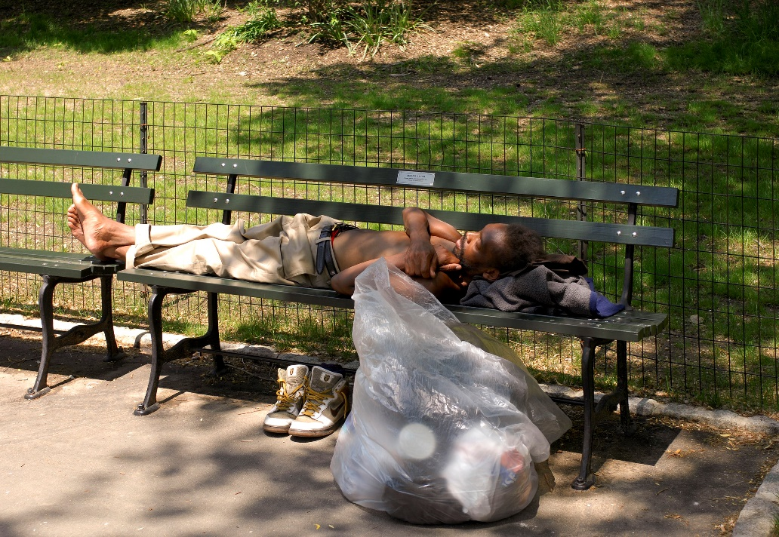
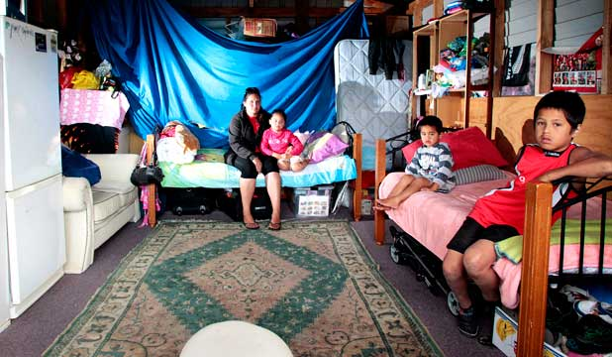
Example: How is the measure defined?
Political controversy in NZ in 2016
People believed homelessness was increasing
Politicians estimated about 480 people homeless
How was homelessness defined?
Living rough on the street?
Living in a garage?

Slide 10
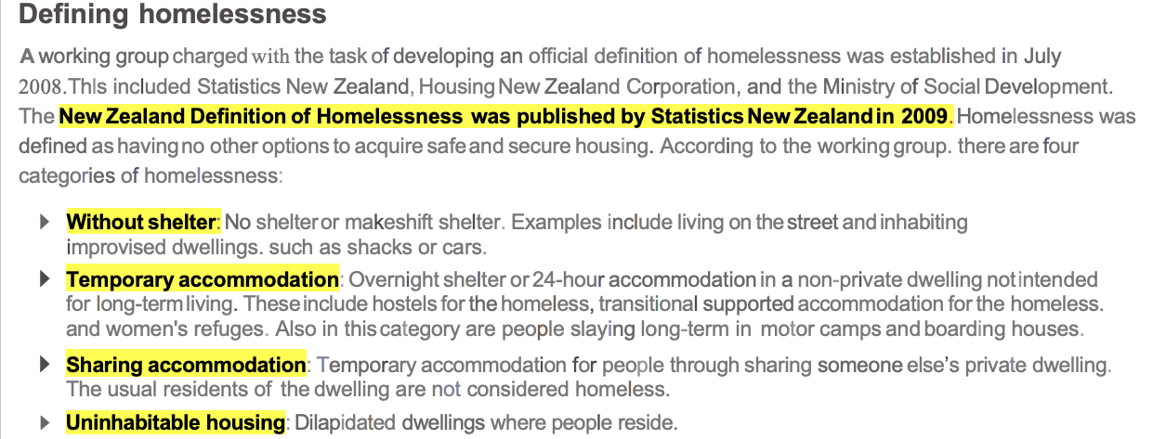
Example: How is the measure defined?
Government Report:
42,000 (about 1 in 100)
Politicians: 480
2014 Source: http://www.parliament.nz/en-nz/parl-support/research-papers/00PLEcoRP14021/homelessness-in-new-zealand
3 June 2016 http://www.healthyhousing.org.nz/wp-content/uploads/2016/06/Homelessness-accelerates-in-New-Zealand.pdf

Slide 11
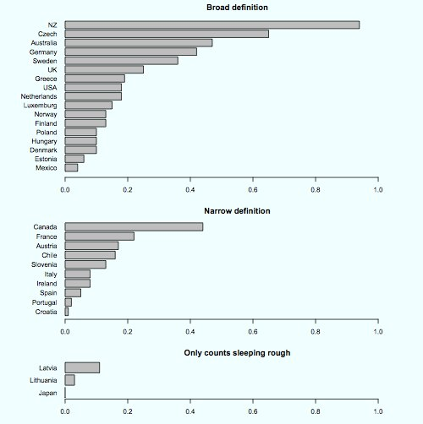
Example: How is the measure defined?
Lumley, Stats Chat
Newshub, 12/2/18
Data reflect social and
political values
Beware of inter-country comparisons
Q: How do OECD countries define homelessness?

Slide 12
Example : Do the numbers make sense?
Beware of relative risk / increased risk statements

Slide 13
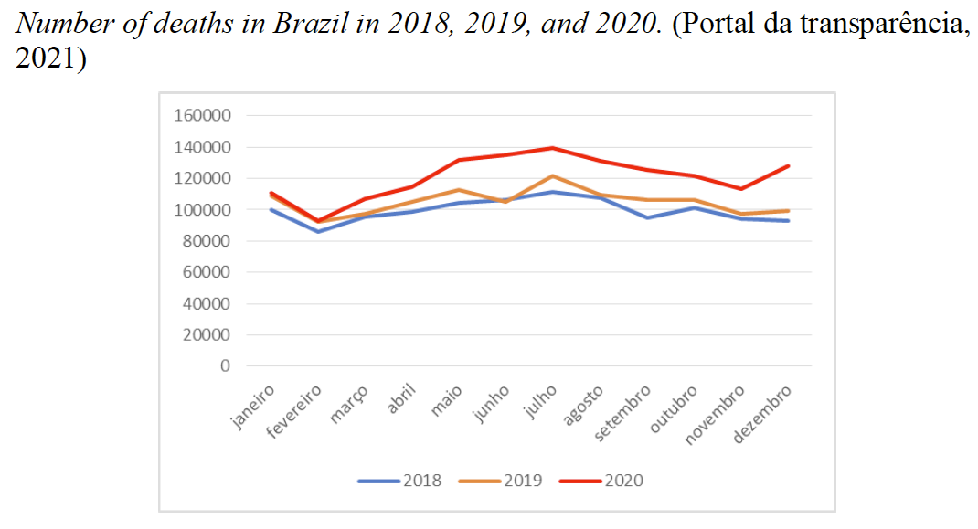
The pandemic and misinformation
First Covid-19 case recorded March 12, 2020
Souza & Araújo, 2022

Slide 14
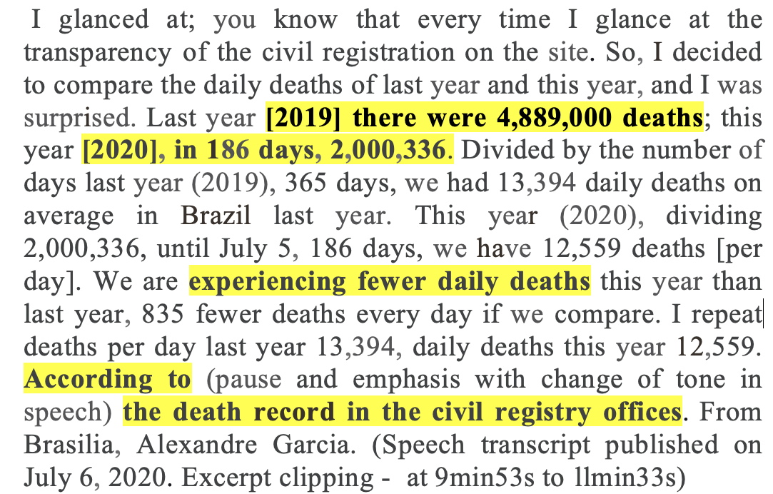
Misinformation: Do the numbers make sense?
First Covid-19 case recorded March 12, 2020
Souza & Araújo, 2022

Slide 15
How are we going to explicitly teach students
to deconstruct and evaluate misinformation?

Slide 16
Citizens need “the ability to understand and critically evaluate statistical results that permeate our daily lives”
(Wallman, 1993, ASA president)
AMSTATNEWS, 2016
When will we seriously address this challenge?

