Slide 1
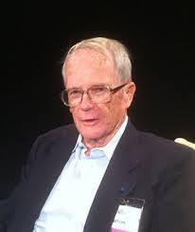
Honoring
Stu Hunter
Bradley Jones
(JMP Statistical Discovery Software)

Slide 2

Stu Hunter Research Conference has been held in/at:
Arizona State
Denmark
Duke
Milano
Netherlands
Virginia
Waterloo

Slide 3
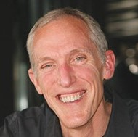
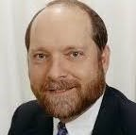
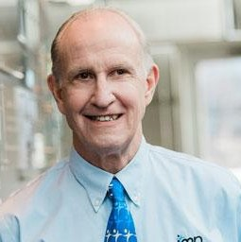

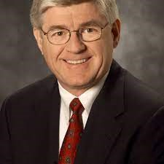
Sat 9:30am Breakout Session: An Homage to Educator Par Excellence, J. Stuart Hunter, on the Occasion of His One Hundredth Birthday (Room 112)

