Slide 1
Making Statistics Relevant for Students
Asal Aslemand
Assistant Professor, Teaching Stream (CLTA)
Department of Mathematical and Computational Sciences
University of Toronto, Mississauga Campus
Ontario, Canada

Slide 2
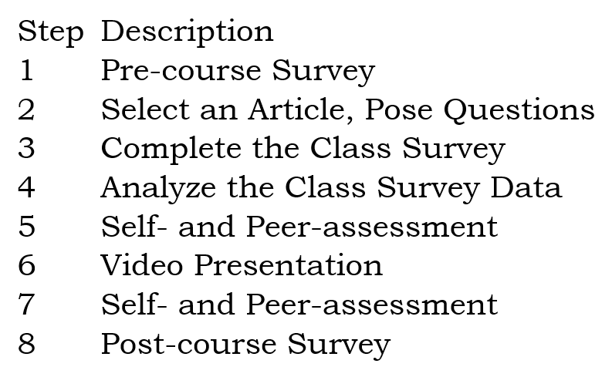
Semester-long Collaborative Student-generated Data
A scaffolded assignment in an undergraduate statistics service course with relevant topic to explore (impacts of COVID-19 pandemic on students’ experience) and with several steps to complete throughout the term.
Students were randomly assigned in Quercus to work in small groups (4 to 5 students) within their tutorial section.

Slide 3
Most students in non-statistics programs, feel this way (“afraid”) when they learn that they need to take a course that requires them to make sense of numbers.

Slide 4
Motivation
Research in Education
Activities that enable students use a familiar context (e.g., impacts of COVID-19 pandemic on students’ academic life and social life experiences) to investigate will allow learners experience the value and relevance of grappling with data to explain certain outcomes and patterns that emerge from data.

Slide 5
Motivation
Research in Education
Activities that involve students generate their own data to facilitate the learning of statistics will positively contribute to students’ interest in, understanding of, and appreciations of the relevance of using statistics in their academic and professional lives.

Slide 6
Group’s Home Page in Quercus
Collaborative learning environments enable students to operate as practitioners who may need to interpret, understand, and communicate quantitative results to various audiences.

Slide 7
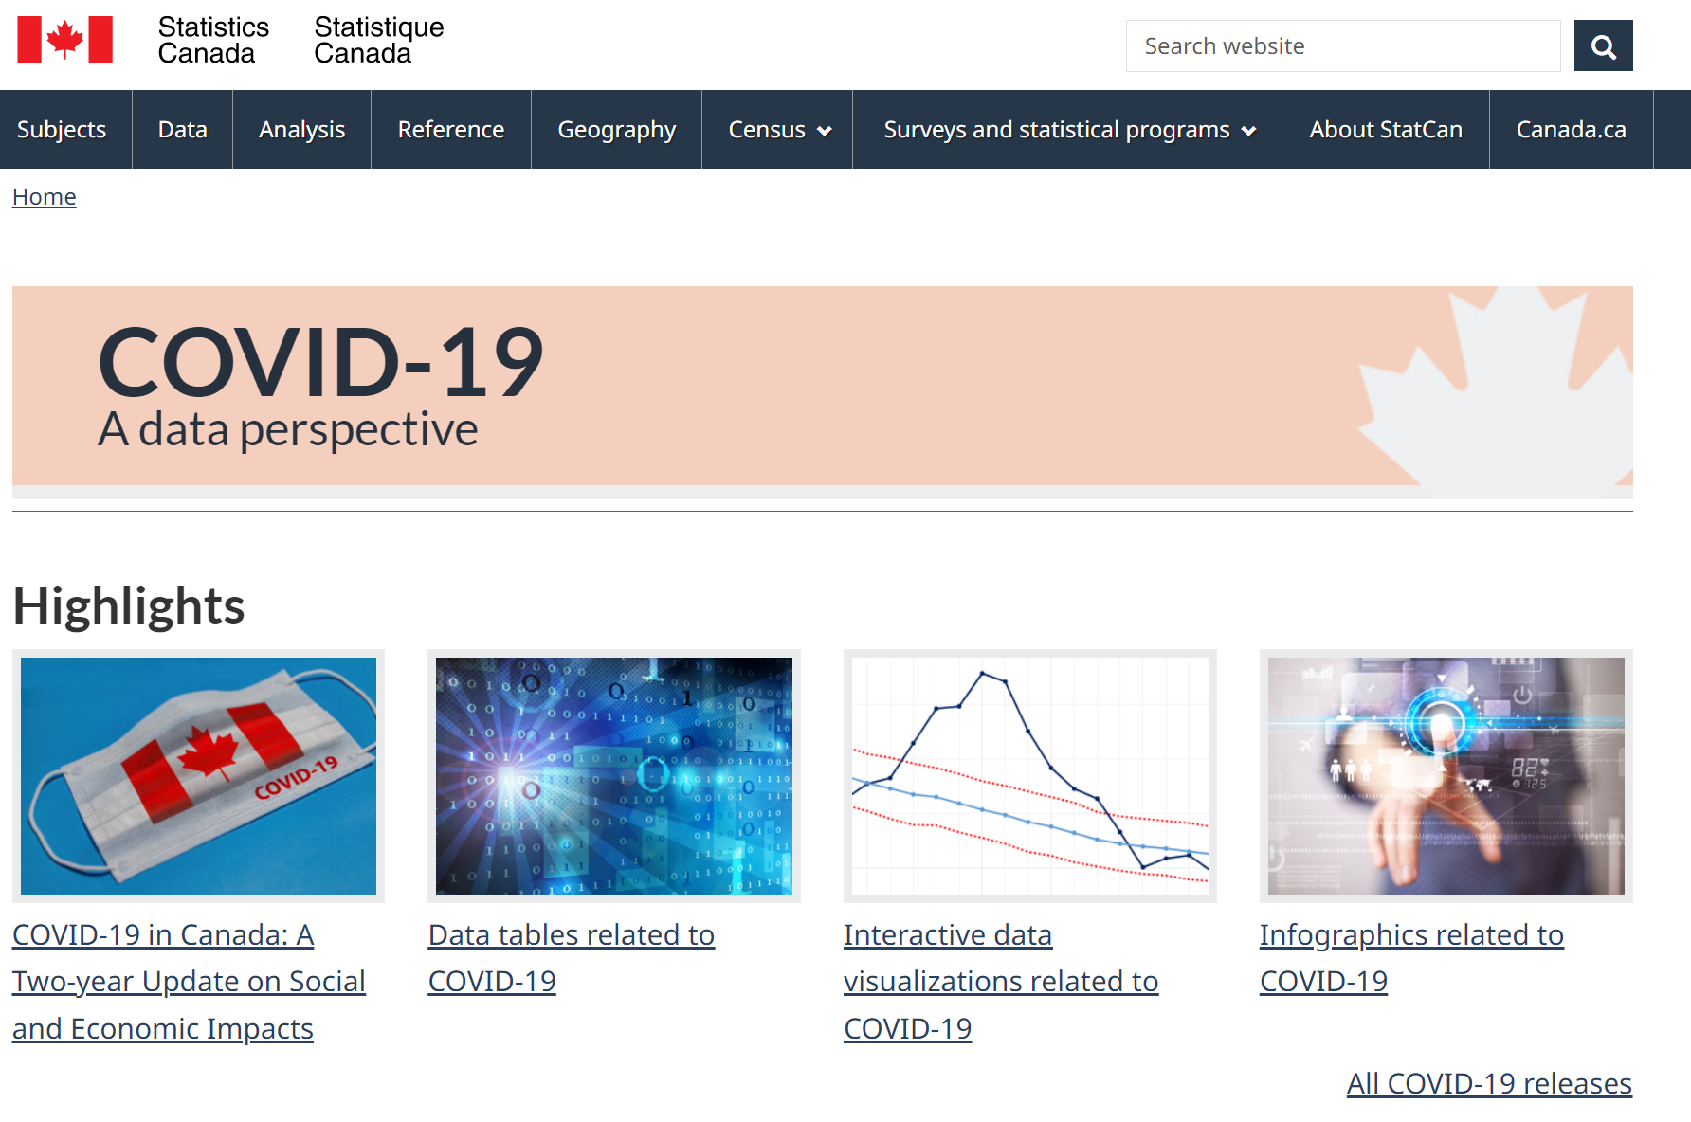
In small-groups, students were asked to choose and read an article from Statistics Canada that is concerned with the impact of COVID-19 on Canadian’s perspective.
COVID-19, A Data Perspective
Statistics Canada

Slide 8
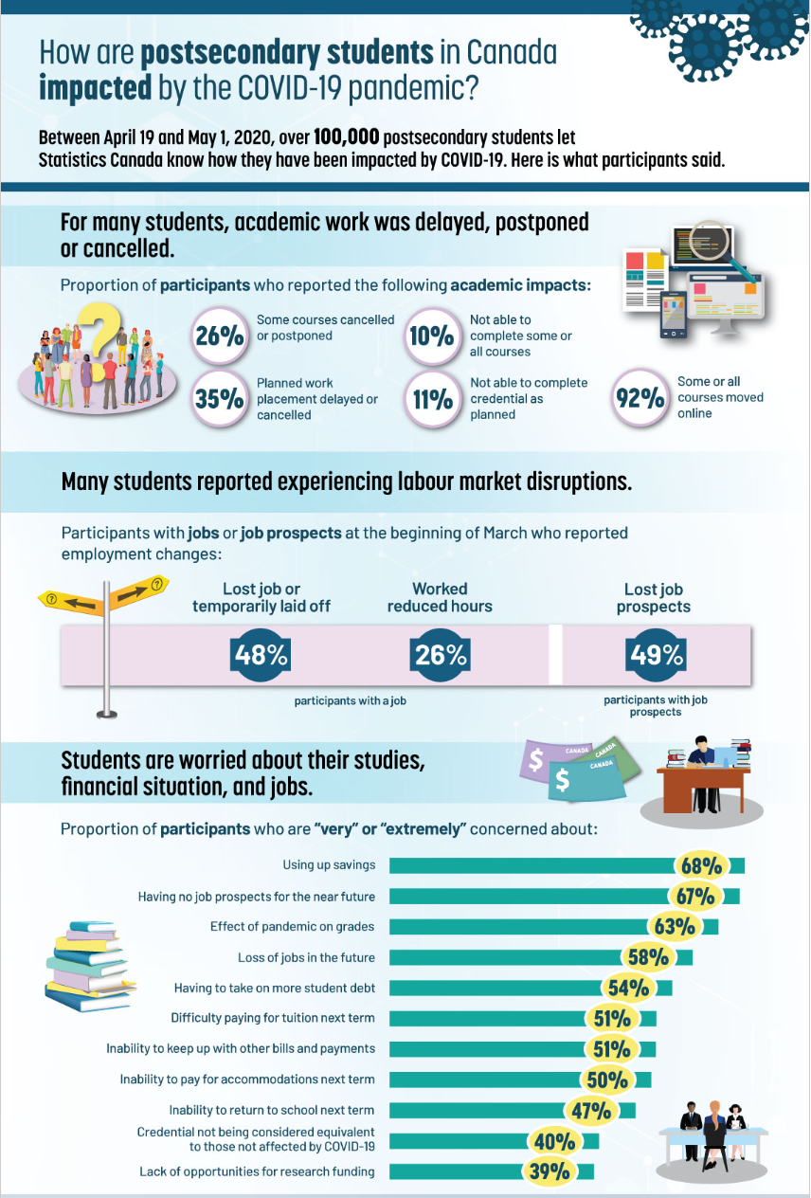
Reflect on the Selected Article
A brief description about the purpose of the study.
Identify the population in the study.
Identify the cases in the study.
Identify three variables in the study, their type, and their scale of measurement. Note that there may be more than three variables included in your article. Select (decide on) the variables that appear important to you.
Identify the type of the study (e.g., sample survey).
What procedure(s) and instrument(s) were used for conducting the study? (e.g., give the name of survey and its method of data collection).
Link to the Article

Slide 9
Design Survey Questions
Students in their small groups were asked to:
propose two survey questions (statistical in nature) that they wanted to anonymously ask their peers in class in order to generate their class survey data (later in the course for conducting data analysis).
to clearly identify the variable(s) in their question, their type, and their scale of measurement.

Slide 10
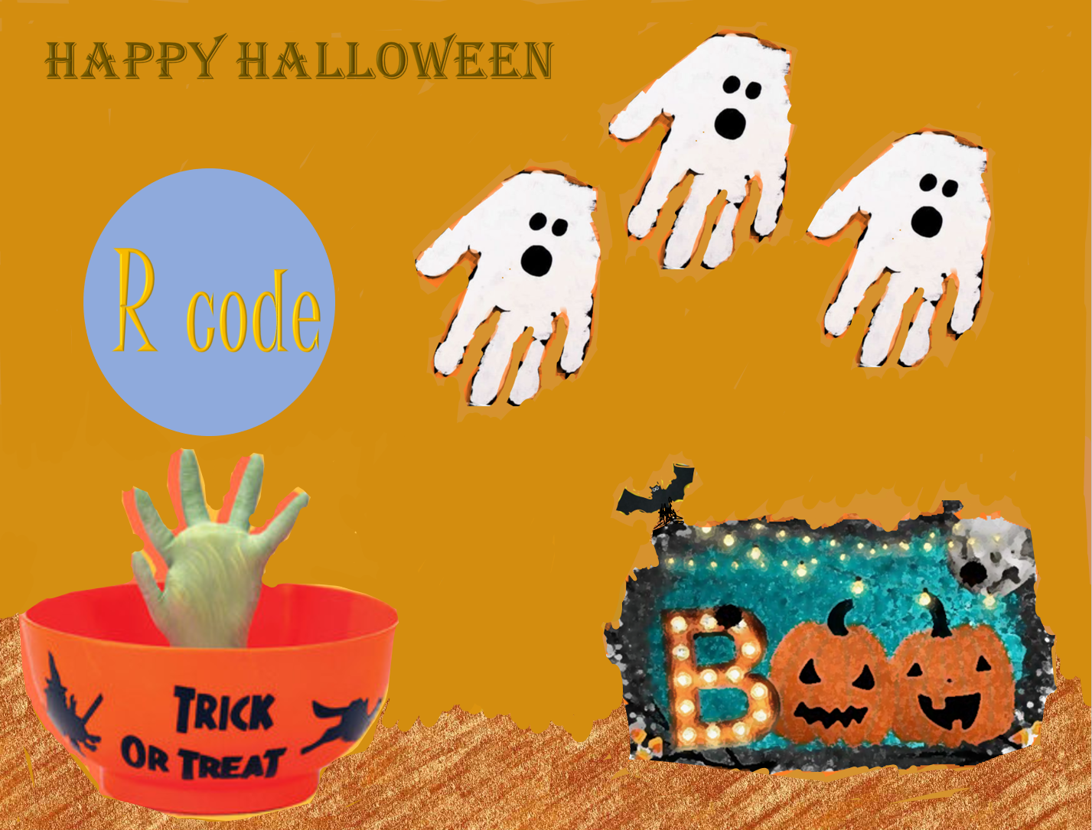
Pose three statistical questions to investigate.
Refer to the posted R script to model from.
Make a 20-minutes appointment using Quercus calendar with Prof. Asal to discuss your in-progress work.

Slide 11
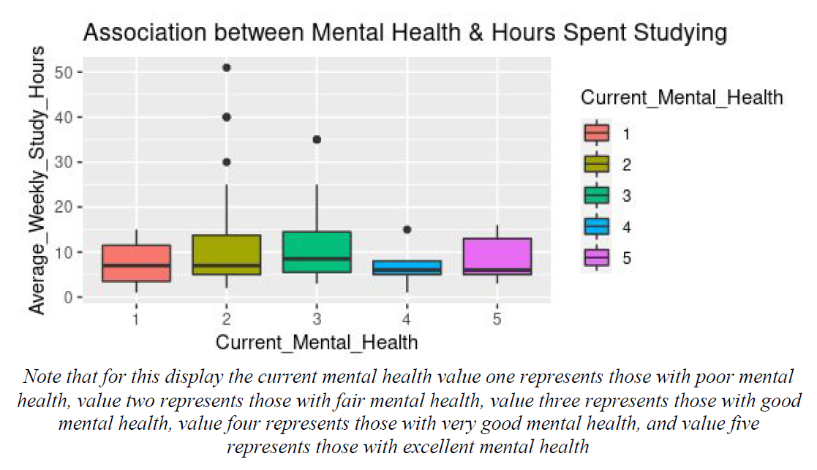
A Group’s Example
In the current semester, which of the following best describes your mental health?
Poor
Fair
Good
Very Good
Excellent
In the current semester, on average, during the week, how many hours do you spend time studying for each of your courses? Please give a numeric answer (e.g., 10)
Hours of Study: Quantitative Variable
Self-perception of Current Mental Health: Categorical Variable

Slide 12
Video Presentation
Tips for Making A Video Presentation
10-minute voice-over video-presentation (e.g., PowerPoint, Prezi, Infographic, Padlet, mind map, concept map) of analysis of the data, utilizing group’s report and provided feedback from teaching team.
Create up to 10 slides (including an introduction and a conclusion slide).
At the beginning of your video presentation, one member will introduce your team members and will give an overview of what section (what statistical question) each member will present.
Aim for telling the story of your findings. Your audience is students in this course.
Use key words as prompts to motivate telling the story of your statistical findings.

Slide 13
Video Presentation Example

Slide 14
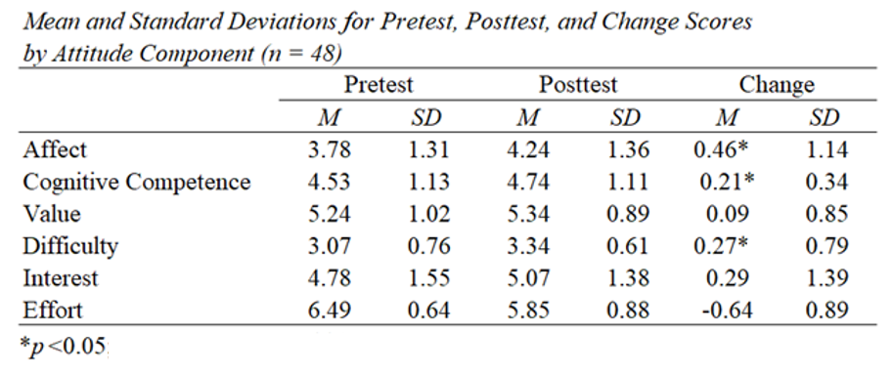
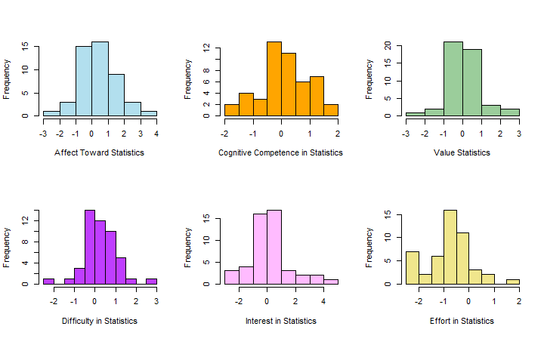
Survey of Attitudes Toward Statistics (SATS-36©) Six Attitudes-Components, Higher scores are indicative of positive attitudes component
By the end of the course, on average, students had more attitudes towards statistics regarding their:
Feeling about statistics
Competence in doing statistics
Perception of difficulty of statistics

Slide 15
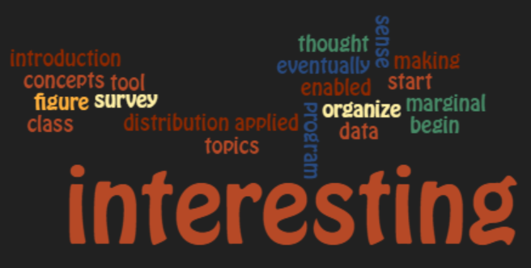
Anonymous Students Feedback
How did the course project enable you use and apply statistical concepts and techniques covered in this course?
This course project was fantastic, it puts many of the concepts learned in this course into a real-world application setting. The fact that we used our class as a survey was very interesting. This way its not just made-up data, we use real data to find real associations.
It was interesting to use data from our class survey, because we were the real-life sample that we were examining.
The course project allowed to put all the statistical concepts learned in class together. It touched on every aspect of the course material, showing its application in real world data sets.

Slide 16
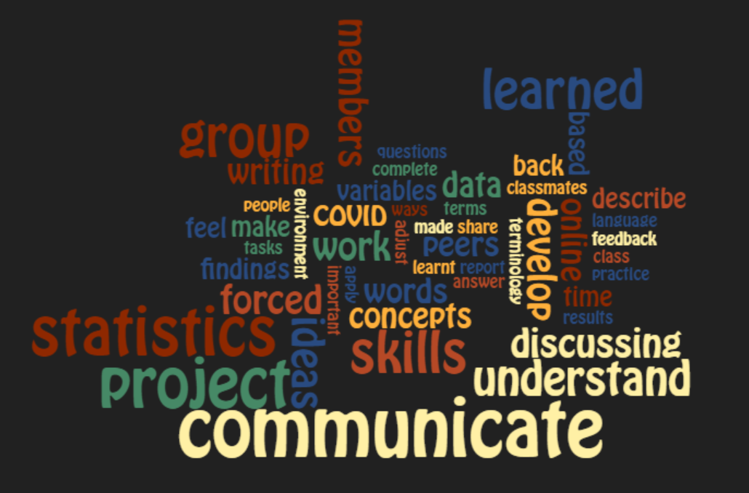
Anonymous Students Feedback
How did the course project develop your communication skills in statistics?
It helped me be able to articulate my words regarding statistics.
Ensuring that I used the rights words like correlating instead of causing.
Going back over the content, often discussing the course project with other group members gave a new perspective to one another. It was often times that if someone wrote an answer, then the others would look over it, check the explanation to make sure it covered all the necessary cases, making sure that the explanation is readable and concise when someone else would read it

Slide 17
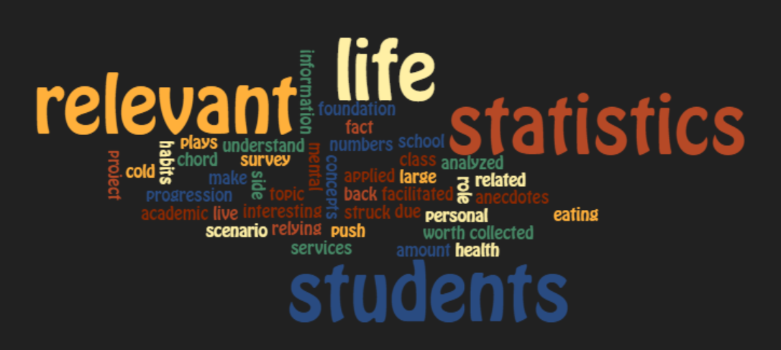
Anonymous Students Feedback
How did the course project facilitate the usefulness, relevance, and worth of statistics in your personal and academic life?
“Since my major is not relevant to the statistics, but I will focus on the articles which contains statistic knowledge in the future, since I think it's useful.”
“The course project is beneficial for my academic life since it gave me an in-depth understanding of conveying statistical results more effectively. Since I am in a psychology program, which usually requires a lot of lab reports, I hope to use what I learned here for any lab reports I would write in the future.

Slide 18
Thank You ☺

