Slide 1
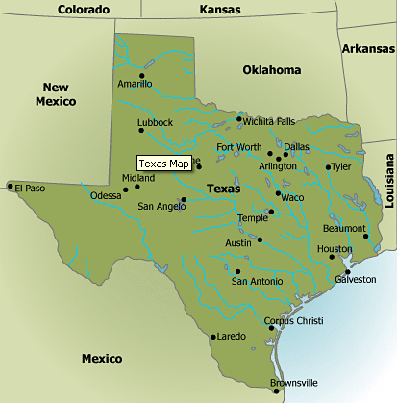


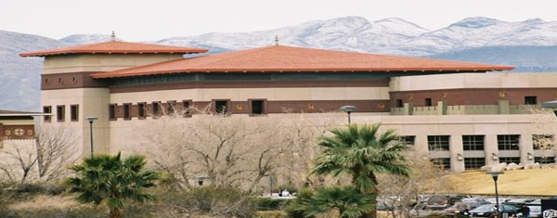
Communication Rumination:
Engaging with Sci-comm & Edutainment
Larry Lesser
UTEP Distinguished Teaching Professor
The University of Texas at El Paso

Slide 2
in early March 2020…..
Anticipating our son’s visit from college for spring break week
My statistical literacy & social sciences precalculus students
would soon have even more motivation
to understand data and exponential growth

Slide 3
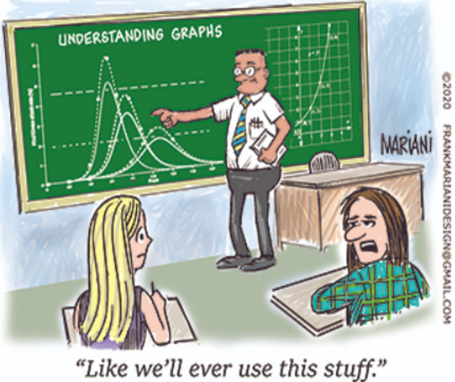
Frank Mariani
March 2020 cartoon https://www.ams.org/education/teaching-resources

Slide 4
from article on doubling growth (Lesser, 2021)
“[Americans] might have heard on the news
that the number of cases roughly doubled every 3* days…
but didn’t seem to realize that meant, for example,
that the number of cases was less than 1%
of what it would be in just 3 more weeks (since 2⁷ > 100).”
*actually, 2.68 before widespread mitigation efforts

Slide 5
3/23/20 email to a TX colleague’s campus
"There are over 200 counties [of 254] in Texas
that have no cases of COVID-19....
Every community and University is different
and the state is supporting local decision making…."

Slide 6
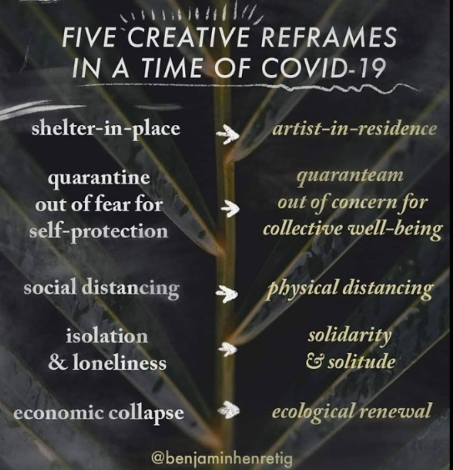

Slide 7

FRAMING
MATTERS

Slide 8
Schonger & Sele (2020) study in PLOS ONE
online survey March 25-26, 2020
explored whether the way exponential spread is communicated affects how much people underestimate benefits of mitigation
n = 459 Swiss college students in non-STEM majors,
each randomly assigned to 1 of 4 frames

Slide 9
 | Mitigation given as reduction in daily growth rate | Mitigation given as increase in days for # of cases to double

Slide 10
 | Mitigation given as reduction in daily growth rate | Mitigation given as increase in days for # of cases to double
Estimate # of cases avoided in 30 days
Estimate time gained until 1 M cases reached

Slide 11
POLL: which frame best avoids underestimating benefits of mitigation?
 | Mitigation given as reduction in daily growth rate | Mitigation given as increase in days for # of cases to double
Estimate # of cases avoided in 30 days | A | B
Estimate time gained until 1 M cases reached | C | D

Slide 12
“The frame that combines doubling times [instead of growth rates] with the logarithmic perspective fully eliminates mitigation bias…” (Schonger & Sele, 2020)
 | Mitigation given as reduction in daily growth rate | Mitigation given as increase in days for # of cases to double
Estimate # of cases avoided in 30 days (exponential perspective) | Worst frame A | B
Estimate time gained until 1M cases reached (logarithmic perspective) | C | Best frame D

Slide 13
FRAMING
MATTERS

Slide 14
Insight from van der Bles et al. (2019) framework
Graphical/numerical summaries chosen
may influence whether uncertainty communication
is received as a marker of transparency/honesty
or is politicized to “undermine the perceived competence of the communicator”

Slide 15
speaking of doubling growth:
my newest contribution to CAUSEweb.org/fun
takes real data and a bad graph
and asks students….

Slide 16
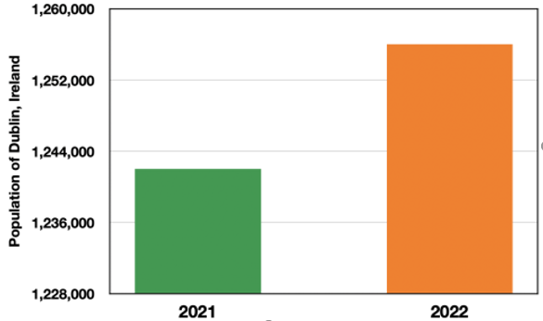
Is Dublin Doublin’ ? CAUSEweb.org/fun

Slide 17
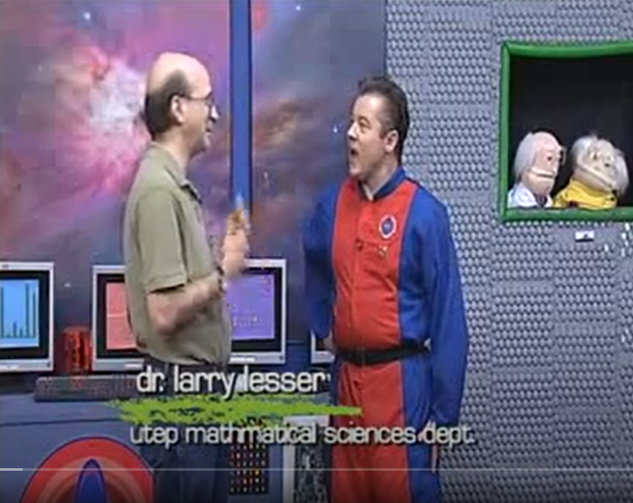
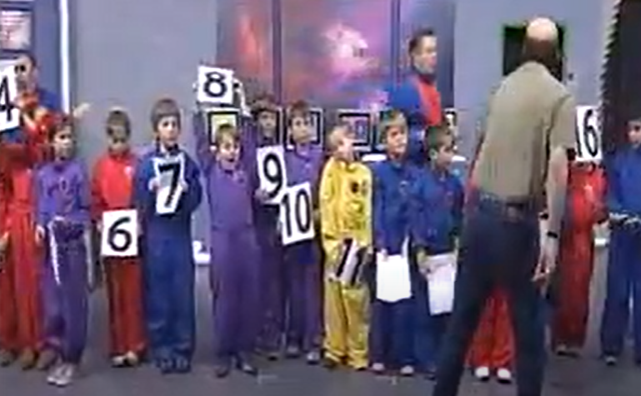
KCOS-TV, Blast Beyond
Seas. 2 Ep. 6; 1/30/12

Slide 18
Can outreach comm. inform “regular teaching”? Lesser (2021)

Slide 19
Can outreach comm. inform “regular teaching”? Lesser (2021)
sharpen focus on main point
make interactive (e.g., build in questions, demos/props),
have lesson ‘plan’ that can adjust to unexpected questions,
have compelling opening ‘hook’ to generate engagement

Slide 20
ideas for opening HOOK
JSE papers on “Setting the Tone”/“Counterintuitive Examples”,
“Striking Demonstrations”
also, ideas adapted from Barkley (2019):
Quote from someone famous
Tell a story
Show a statistic
Contrarian statement
Pose intriguing what-if question
Quick class poll

Slide 21
3 decades ago
(my 1st sci-comm experience)
not much literature or degree programs
I was a grad student in TX,
which had just launched its state lottery

Slide 22
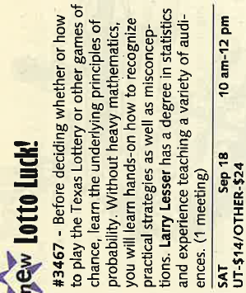
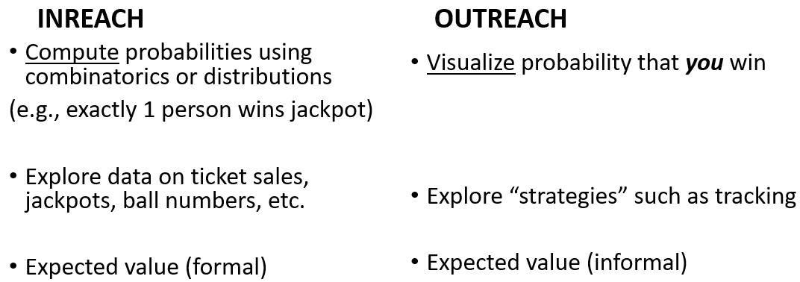
I created & taught
adult ed for UT-Austin Informal Classes

Slide 23
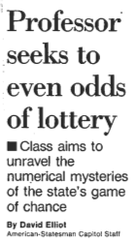
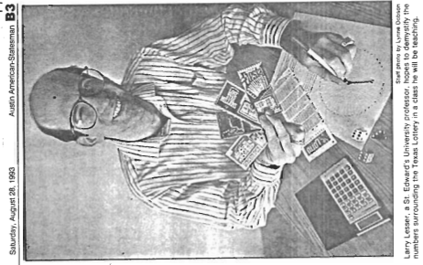
a ‘lotto’ media experience for a grad student!
Periodicals: Austin American-Statesman (37 column inches) & other city papers, Real Simple, BottomLine Retirement, USA Today, Associated Press, etc.
Radio: Atlanta, Austin, Denver, El Paso, Houston, San Antonio
TV: CNN and various local stations

Slide 24
this crash course in media relations taught me:
Start with main point; have analogies (Lesser, 2016) and ‘sound bites’
Reframe questions when necessary
Ask to accuracy check the write-up (usually won’t happen)
“Every great news story has 6 qualities: timeliness, proximity, prominence, novelty, human interest and conflict” (Deschamp, 2006)
Know (and don’t judge) your audience

Slide 25
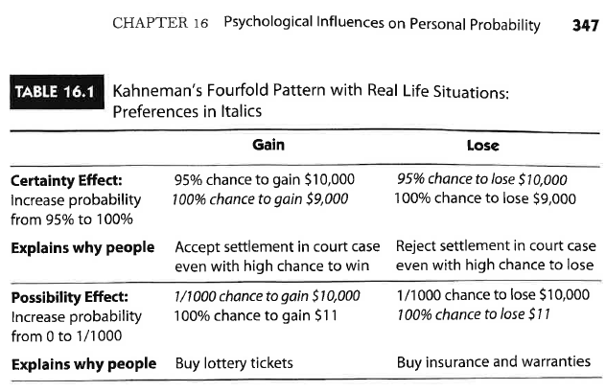
Utts (2015)
FRAMING
MATTERS

Slide 26
visualizing (1 in 26 M) Lotto Texas jackpot chance
1 sheet of typing paper from 1.6-mile stack
1 inch on road from El Paso to Phoenix
1 person from 500 full Sun Bowl stadiums
1 minute in a half-century
1 pixel from 13 high-definition TVs [student-contributed!]
1 win (on average) if you buy 100 tickets/week for 5,000 years

Slide 27
When jackpots get big, some questions I get:
(How to grasp) jackpot chances?
Are there strategies to increase chances?
Do YOU ever play (or win)?
Is Quick Pick better than self-picks?
Chance adjacent numbers [etc.] are drawn?
How rare is a jackpot this big?

Slide 28
“LOTTERY STRATEGY” my limerick in June 2021 Amstat News
The lottery numbers you choose
Won’t change your chance to lose.
But if all 6 match,
You’ll get way more cash
If you picked what’s picked by few!

Slide 29
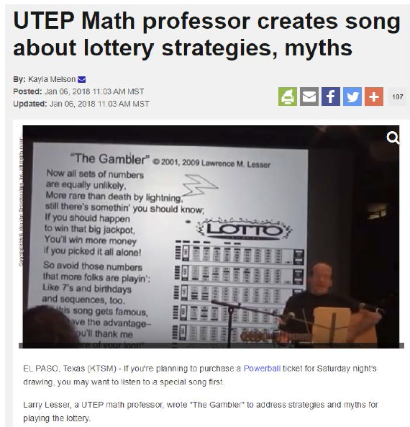
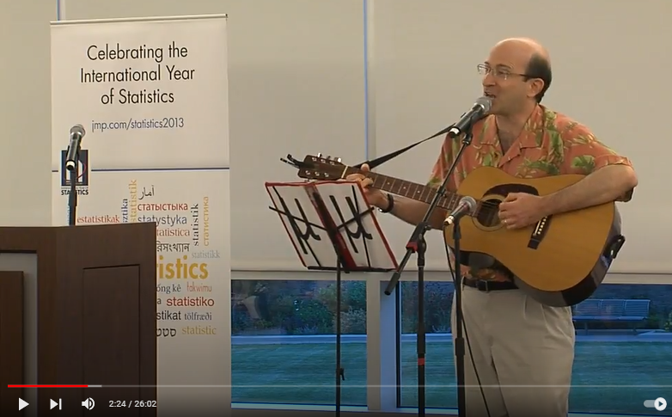
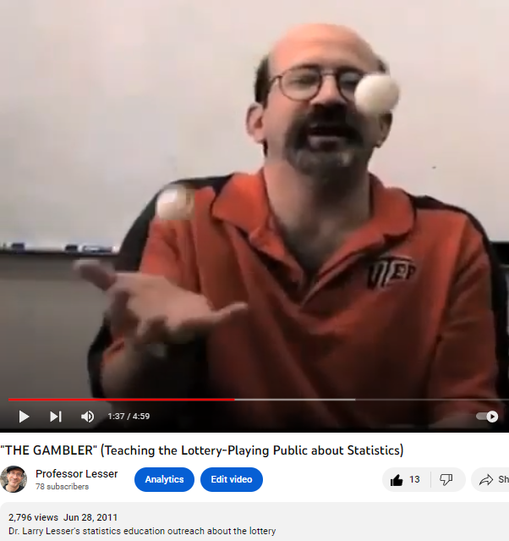
“THE GAMBLER”
to tune of Kenny Rogers’ hit
song/video in CAUSEweb.org/fun

Slide 30
NSF has helped turn science into songs!
recent examples:
NIMBioS BioSongs Project (Louis Gross) turned biology research into songs via songwriter-in-residence program
CAUSEweb.org/smiles/ (Pearl/Lesser/Weber) 6 writers wrote interactive statistics songs (spinoff CAUSEweb.org/voices works across STEM)

Slide 31
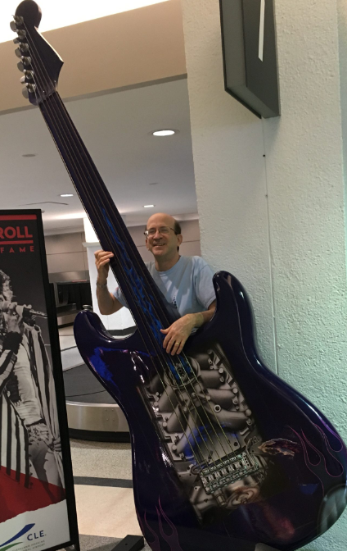
Communicate like a songwriter for big new views?

Slide 32
Songwriters and educators must:
grab attention with memorable “hook”/story
plan trajectory (e.g., start gently)
think when to “set up” material vs.
dive in and debrief later
think when/how to incorporate humor
use concrete specifics and simple words

Slide 33
Songwriters and educators must:
grab attention with memorable “hook”/story
plan trajectory (e.g., start gently)
think when to “set up” material vs.
dive in and debrief later
think when/how to incorporate humor
use concrete specifics and simple words

Slide 34
simple ain’t always simple….
Everyday words (e.g., “spread”) may reinforce misconceptions (Kaplan et al. 2012: use “variability” instead)
Phrases with simple words like “in the long run” can be idiomatic (Lesser et al. 2016: use “in the long term” instead)
Assignments like “Explain Concept X as if talking to your grandma” communicate things you don’t intend!

Slide 35
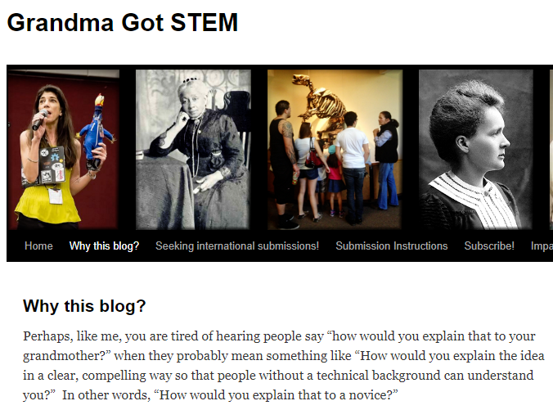
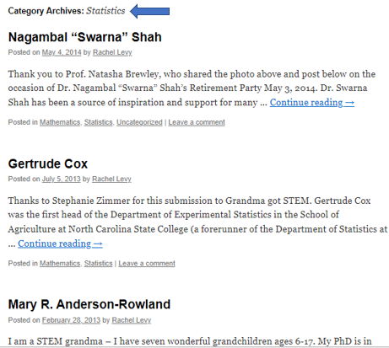
blog of NCSU’s Rachel Levy

Slide 36
Song is just 1 of many edutainment forms (red ones are in CAUSEweb.org/fun )
[adapted from Lesser & Pearl (2008)]
Art Gallery
Cartoon/Comic Strip
Celebration Days
Clothing
Food
Games
Game Shows
Humor/Jokes
Kinesthetic Activity (e.g., dance)
Literature
Magic
Media Bloopers
Poem
Puzzle/Wordplay
Quotation
Skits
Song/Rap
Statistics (fun) book
Short Story
Strange News
Striking Examples
Video/movie

Slide 37
some edutainment resources in stat ed
CAUSEweb.org/fun (since 2005):
usage guidance,
literature,
& some 1000-odd items!
Study of Fun research cluster (since 2009)
column in Teaching Statistics (since 2019)

Slide 38
Why statistics edutainment?
College GAISE II: “Use games… to engage students, teach concepts and gather data.” [see Shonda Kuiper’s work]
Helps “build rapport,” part of Accessibility and Inclusion Goal #2
of Dogucu, Johnson, Ott framework in March 2023 JSDSE
May decrease anxiety and/or increase learning
Humanizes the discipline/course/instructor

Slide 39
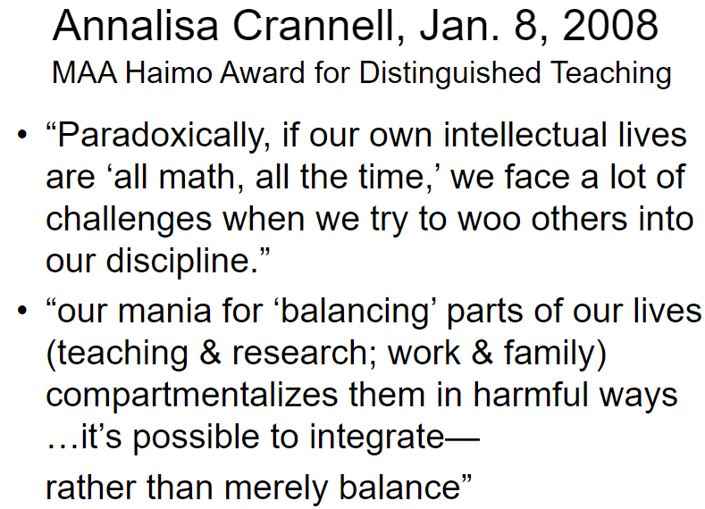

Slide 40
now, my most recent sci-comm adventure:
I launched the opening sci-comm module for the 2022 debut of
UTEP’s UG course “Research and Teaching Integration”
for future STEM researchers
for future STEM teachers

Slide 41


no sharp boundaries between:
science education
science communication
science journalism
scientific literacy
scientific culture
public understanding of science
public awareness of science
etc.

Slide 42
communication vs. education
a difference:
whether audience includes general public
a similarity:
moving to a more interactive/dialogic model
(Baram-Tsabari & Osborne 2015; Burns et al. 2003)

Slide 43
some sci-comm journals
Int’l. J. of Sci. Ed., Part B: Comm. and Public Engagement (Taylor & Francis)
Public Understanding of Sci. (SAGE)
Sci. Comm. (SAGE)
J. of Sci. Comm. (Sissa Medialab, Italy)
(rare) example of comm. paper on teaching statistics

Slide 44
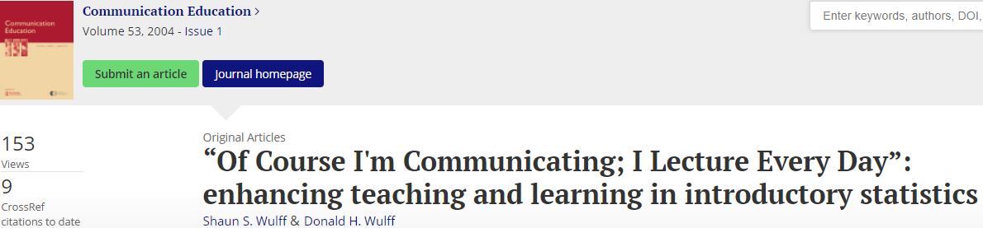

Slide 45
awareness of classroom communication patterns
(Lesser & Kephart, 2011)
from discourse analysis of 3 hours of my teaching, linguist K. Kephart noticed:
varying participation structures
(e.g., small-group and whole-class discussion)
instructor role as facilitator and co-learner
(e.g., inviting students to explain reasoning of peers as well as their own)
Also, see if instructor always speaks after each student

Slide 46
disciplinary Communication Resources
https://www.amstat.org/policy-and-advocacy/statistical-significance-series
https://magazine.amstat.org/blog/2021/09/01/qanda_sept/
https://statsandstories.net/
https://www.worldofstatistics.org/
Regina Nuzzo, ASA’s (inaugural) Senior Advisor
for Statistics Communication and Media Innovation
NCTM: Communications Handbook (1993), Communications Guide (2004)
AMS: https://www.ams.org/publicoutreach/

Slide 47
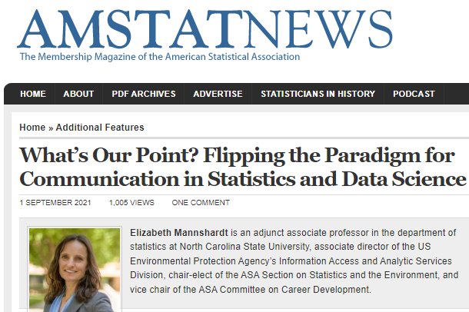

Slide 48
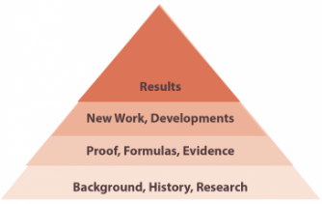
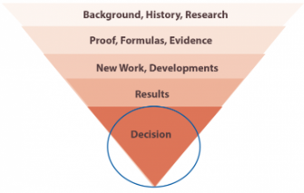
Mannshardt (2021) paradigms
Traditional: go up to your point
Flipped: lead with your point

Slide 49
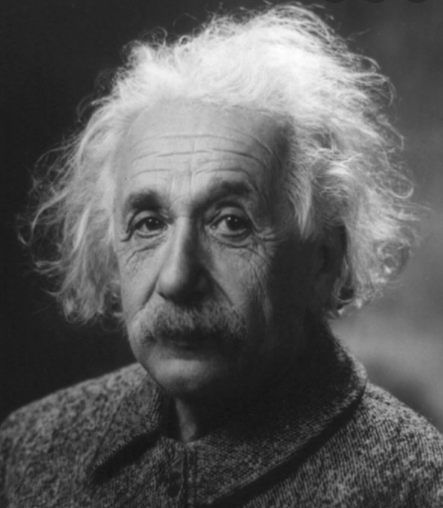
POLL: “If you can't explain it simply, you don't understand it well enough.”
Disagree
Agree

Slide 50
related statement by
American psychologist Jerome Bruner
(p. 33 of his 1960 text, The Process of Education)
“Any subject can be taught effectively in some intellectually honest form to any child
at any stage of development.”

Slide 51
monthly mag WIRED has 23 videos explaining topics at 5 increasing levels of complexity: https://www.wired.com/video/series/5-levels
child
teen
undergrad major
grad student in field
colleague in field

Slide 52
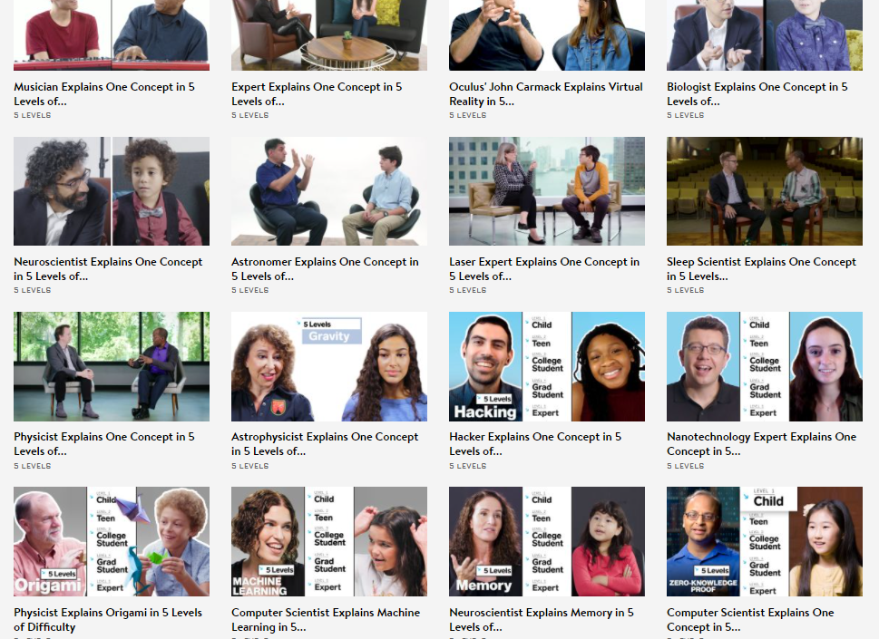

Slide 53
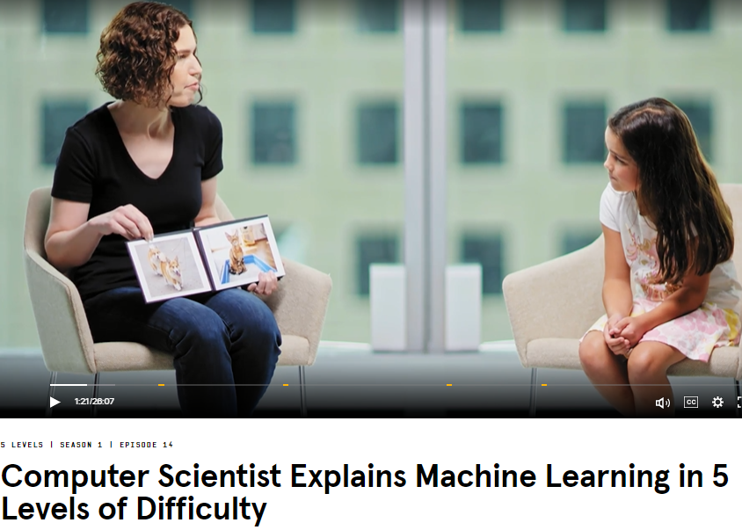
giving machines
many examples
to teach them to
recognize cats or dogs

Slide 54
UTEP students given a 5-levels assignment
“Each student chose a science topic
they were comfortable discussing in 5 levels [3-5 minutes/level].
This exercise created a good base for the rest of the course
as we revisited those topics throughout the
PBL [Project-Based Learning] and
IDR [Interdisciplinary Research] sections.”
-- Amy Wagler, RTI course co-instructor

Slide 55
Related to “simpler level”: briefer communication
“…I have made this letter longer
because I lack the time to make it shorter” – Blaise Pascal (1656)

Slide 56
Related to “simpler level”: briefer communication
20-minute prepared part of JSDSE webinar
3-minute thesis competition
2-minute video abstract
90-second “elevator pitch” competition
75-second radio program script

Slide 57

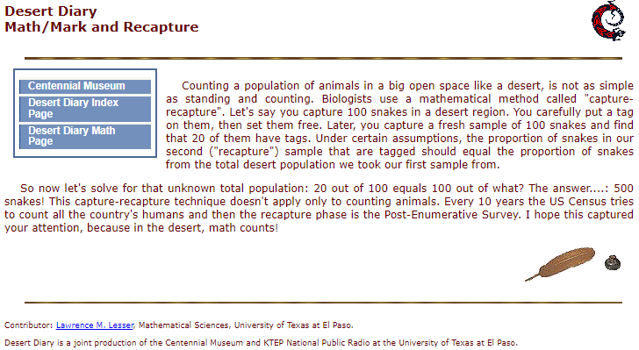
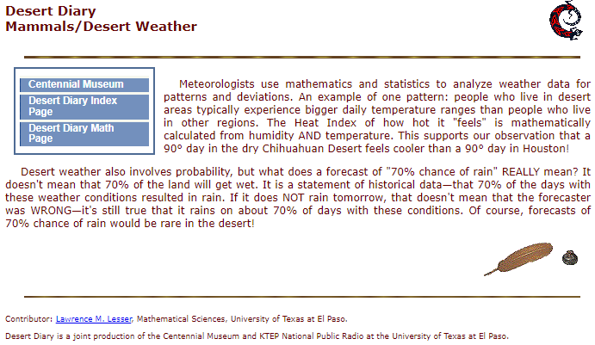
“Desert Diary” on regional cultural/natural history
I launched (and wrote most scripts for) a Statistics/Math category.
Have your students try this: 150 words (no visuals) for general audience

Slide 58
communicating
stat ed research
at multiple levels

Slide 59


how Spanish-speaking emergent bilinguals learn statistics…
(part of my stat ed research on language: https://LarryLesser.com/ell-scholarship/)
for researchers: 28-page paper in Nov. 2009 Stat. Ed. Research Journal
for teachers: brief article in spring 2011 Statistics Teacher Network,
adapted from recommendations in 2009 SERJ paper
for general audience: fall 2016 UTEP magazine (& online extra) for alumni

Slide 60

Share human interest / passion / personal angle
Share stats – Spanish is dominant language of 80% of EBs in the U.S. and is world’s most common non-English language other than Chinese
Share my story (Lesser, 2015) –
Professional (teaching UTEP/El Paso students)
Personal (my own EB experience)
Cultivate empathy – demo

Slide 61
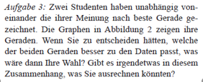
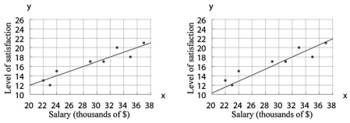
Can you tell what’s asked in this example? from Stochastik in der Schule (Sorto, White & Lesser, 2012), translated from Sorto, White & Lesser (2011)

Slide 62
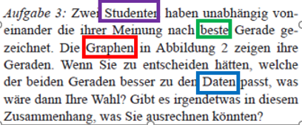
What strategies did you try?

Slide 63
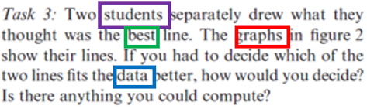
Was that enough to access the problem?

Slide 64
Beyond multiple levels….
try communicating
in new ways/forms

Slide 65
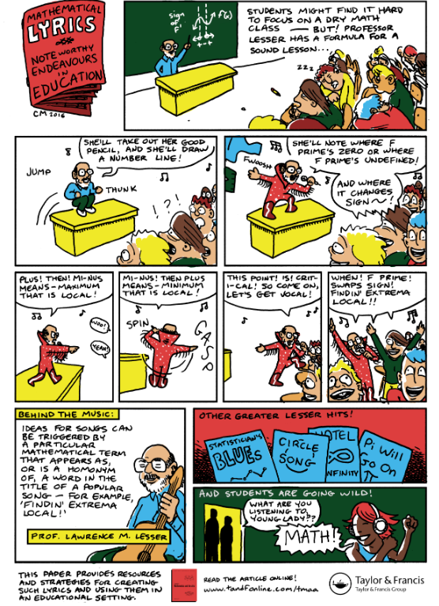
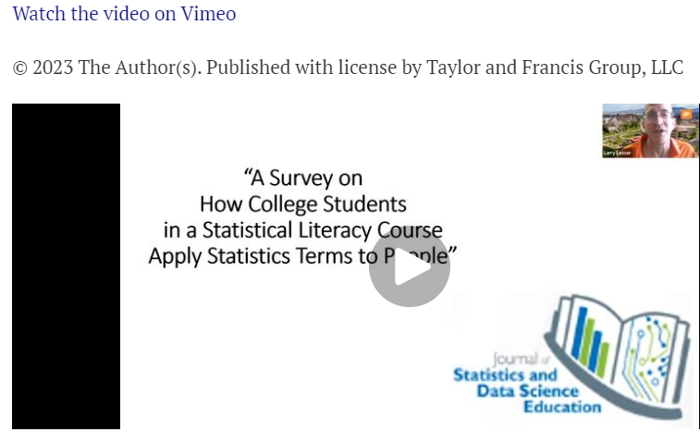
Taylor & Francis posted my video abstract (for JSDSE)
& a cartoon abstract (for JMA)

Slide 66
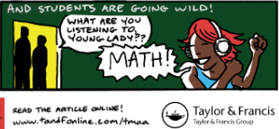
FRAMING
MATTERS
“May I listen to music while learning stats?”
vs.
“May I learn stats while listening to music?”

Slide 67
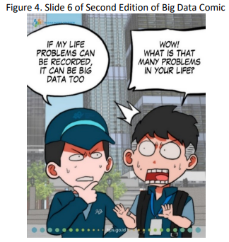
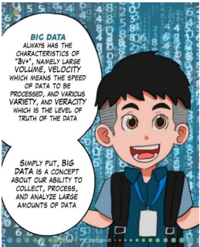
btw, Indonesia Big Data literacy comics reached 17.5K FB and 44.5K Instagram accounts (Faris, 2022)

Slide 68
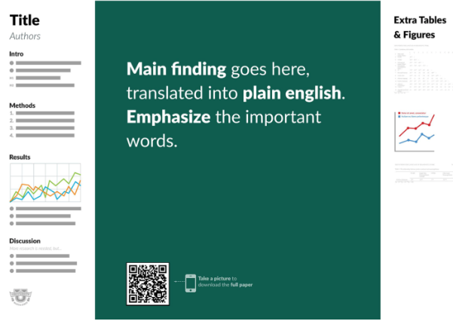
what if more poster presenters used
Mike Morrison’s streamlined #betterposter template?
Avoids assuming all will stop and read “wall of text” for 10 minutes
More punchline-focused, billboard-style so all walking by get the gist
QR code links to full paper and the poster.

Slide 69
ACTION ITEMS we can try!
Analyze communication patterns in one’s class
Assess readability of curriculum materials with 3 free tools demoed in Wagler/Lesser 5-minute eCOTS 2016 videoposter
Try some form of edutainment (CAUSEweb.org/fun)
Try presenting/writing at different “levels” or “genres” (op-ed, etc.)
Be open, be ready!
(More) research needed on framing effects

Slide 70
culmination….
THANKS to Kelly, Allan, Andrew, etc.!
Handout now at: LarryLesser.com/uscots23
After I give a “Pro Tip” for this hotel,
questions are welcome (& later: Lesser@utep.edu)

Slide 71


for safety when inside…..
fully extend deadbolt
into the door frame

Slide 72


Slide 73
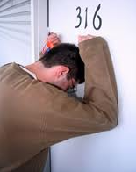
and if you get locked out…
https://www.busybeeslocksmith.com/services/house-lock-out/

Slide 74
…tell the front desk your story,
leading with your main point
in simple language…

Slide 75
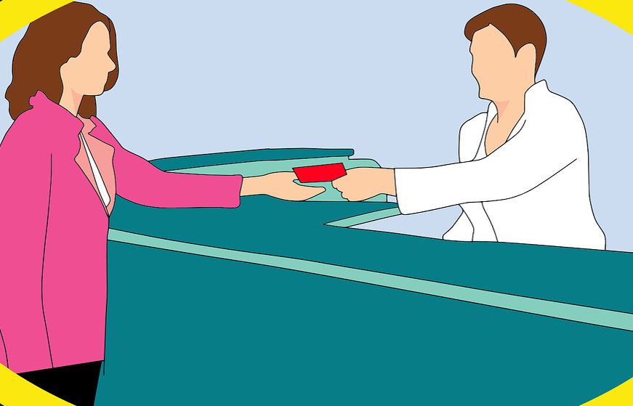
…‘cause communication is KEY!

Slide 76

May our communications inform, inspire, & engage!

