Slide 1
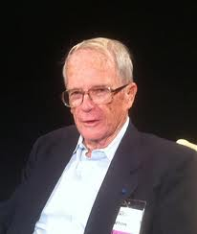
Stu Hunter: Contributions to Statistics in Business & Industry
USCOTS Session in Honor of Stu’s 100th Birthday
State College, PA
Roger Hoerl
Union College
Schenectady, NY

Slide 2
Outline
Stu’s Legacy
Stu the person and Stu the statistician
Meeting Stu
Exponentially Weighted Moving Average (EWMA)
Bayesian Methods
Important Seeds Sown Over the Years
Sampling Paradigms
Sequential Approaches
Subject Matter Knowledge
Role of Variation

Slide 3
Stu’s Legacy – Influence on the Profession
Leader/Advocate
Teacher/Educator
Researcher
Integrator
Builder (of the profession)
Short courses (Chemical Division ASQ)
Technometrics
ASA/ASQ Fall Technical Conference
ASA Quality and Productivity Research Conference
How many people have had a greater influence on the profession?

Slide 4
Meeting Stu Hunter for the First Time
Gordon Research Conference in 1984
Statistics in chemistry and chemical engineering
Stu asked a question.....then the fireworks started
Almost Everyone Remembers the First Time They Met Stu

Slide 5
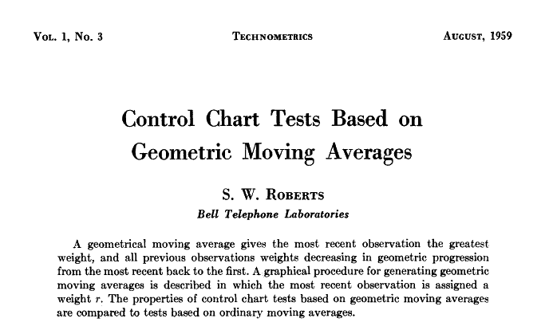
Note: First volume of Technometrics!
The beginning of Stu’s connection with the EWMA

Slide 6
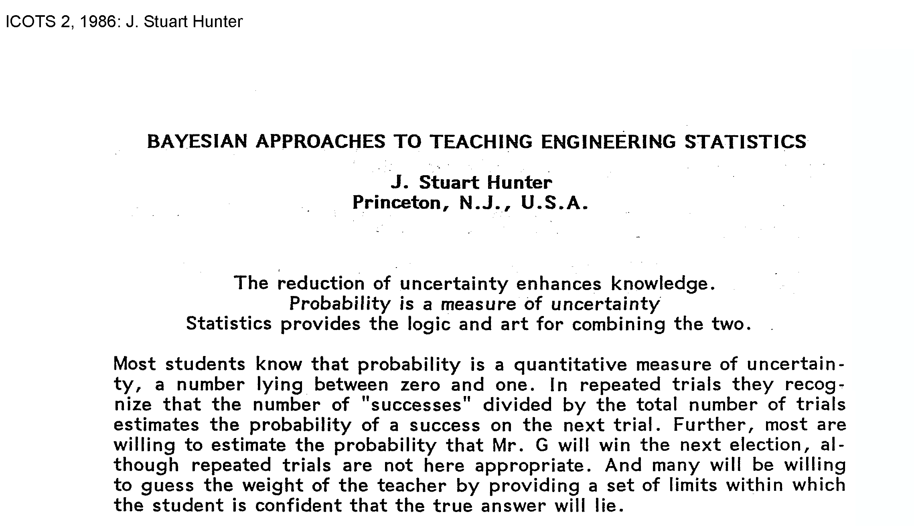
Note the year!
Stu promoted and taught Bayesian methods before they were in vogue

Slide 7
Important Seeds Sown By Stu
In practice, we almost always sample from dynamic processes, not from the static populations so popular in statistics textbooks
EWMA is based not on a static population sampling model, but a dynamic one
This point is emphasized repeated in BH²
Explained in more detail in Stu’s “The Arts of Charts” talk
How well have we incorporated this key point in our journals and textbooks?

Slide 8
Important Seeds Sown By Stu
Real applications of statistics almost always require a sequential approach, integrating more than one technique, to achieve success
“Scientific method” view of experimental design, and statistics in general, in BH²
Evolutionary Operation (EVOP)
Real problems do not “correspond to a recognizable textbook chapter.” (Meng)

Slide 9
Important Seeds Sown By Stu
Subject matter knowledge should guide our data collection, and collected data must always be interpreted within the context of subject matter knowledge
“Data have no meaning in themselves; they only have meaning within the context of a conceptual model of the phenomenon under study.” (BH² 1st ed. 1978)
Would outlawing popsicle sales on Long Island reduce shark attacks?

Slide 10
From Statistical Thinking (3rd ed. Hoerl & Snee 2020)
Business Process
Customer
Data
Data
Plan
Analysis
Plan
Analysis
Subject Matter Knowledge
Process Knowledge Increases

Slide 11
Important Seeds Sown By Stu
Variation, far from being a “nuisance parameter” whose estimation is only needed in order to perform a test on the average, is critical in it’s own right
“The gods love the noise as much as they love the signal.”
Components of variation (nested) designs still included in BH²
Stu’s comments on variation are less well publicized than Deming’s, but equally important

Slide 12
In Summary
I am certainly included in Stu’s legacy of influence
Many of the key points that Ron Snee and I have emphasized over our careers are based on seeds planted by Stu
Statistical Thinking
Dynamic process versus static population paradigm for sampling
Importance of variation
Statistical Engineering
Importance of having a context for data (“data pedigree”)
Integration of subject matter theory
Sequential approach versus “one shot study”
The profession still has much to learn from Stu the person, and his work

Slide 13
