Slide 1
Revising College GAISE Guidelines for Assessment and Instruction in Statistics Education
Patti Frazer Lock Jamie Perrett
St. Lawrence University Brigham Young University
Robin Lock
St. Lawrence University
USCOTS
May 2023
Co-chairs for next College GAISE revision (2025?)
Co-author on original GAISE (2005) and revised GAISE (2016)
Notes:
Dennis

Slide 2
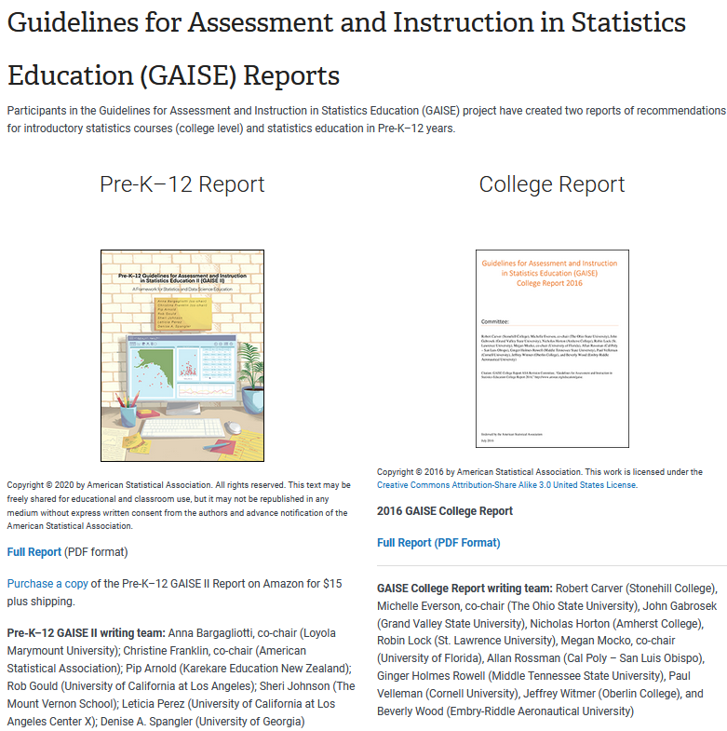

Slide 3
GAISE 2005
Emphasize statistical literacy and develop statistical thinking
Use real data
Stress conceptual understanding, rather than mere knowledge of procedures
Foster active learning in the classroom
Use technology for developing conceptual understanding and analyzing data
Use assessments to improve and evaluate student learning

Slide 4
GAISE 2016
Teach statistical thinking.
Teach statistics as an investigative process of problem-solving and decision making.
Give students experience with multivariable thinking.
2. Focus on conceptual understanding.
3. Integrate real data with a context and purpose.
4. Foster active learning.
5. Use technology to explore concepts and analyze data.
6. Use assessments to improve and evaluate student learning.

Slide 5
GAISE is far more than just these recommendations!
Contents
Committee: .................................................................................................. 1
Executive Summary ..................................................................................... 3
Introduction ................................................................................................. 4
Goals for Students in Introductory Statistics Courses ................................. 8
Recommendations ..................................................................................... 12
Suggestions for Topics that Might be Omitted from Intro Stat……….......... 23
References ................................................................................................. 25
APPENDIX A: Evolution of Introductory Statistics and Emergence of Statistics Education Resources ................................................................... 28
APPENDIX B: Multivariable Thinking .......................................................... 34
APPENDIX C: Activities, Projects, and Datasets ......................................... 43
APPENDIX D: Examples of Using Technology ............................................. 66
APPENDIX E: Examples of Assessment Items .......................................... 104
APPENDIX F: Learning Environments ...................................................... 131

Slide 6
GAISE is far more than just these recommendations!
Contents
Committee: .................................................................................................. 1
Executive Summary ..................................................................................... 3
Introduction ................................................................................................. 4
Goals for Students in Introductory Statistics Courses ................................. 8
Recommendations ..................................................................................... 12
Suggestions for Topics that Might be Omitted from Intro Stat…….......... 23
Formal probability
Constructing plots by hand
Basic statistics (mean, median, …)
Drills with z-, t-, $χ^{2}$, and F-tables
Advanced training on a statistical software package

Slide 7
GAISE is far more than just these recommendations!
Contents
Committee: .................................................................................................. 1
Executive Summary ..................................................................................... 3
Introduction ................................................................................................. 4
Goals for Students in Introductory Statistics Courses ................................. 8
Recommendations ..................................................................................... 12
Suggestions for Topics that Might be Omitted from Intro Stat……….......... 23
References ................................................................................................. 25
APPENDIX A: Evolution of Introductory Statistics and Emergence of Statistics Education Resources ................................................................... 28
APPENDIX B: Multivariable Thinking .......................................................... 34
APPENDIX C: Activities, Projects, and Datasets ......................................... 43
APPENDIX D: Examples of Using Technology ............................................. 66
APPENDIX E: Examples of Assessment Items .......................................... 104
APPENDIX F: Learning Environments ...................................................... 131

Slide 8
Revising College GAISE
Organized by the American Statistical Association and the ASA Section on Statistics and Data Science Education.
Revision process is expected to take about 2 years.
We are just getting started!
Steering Committee:
Patti Frazer Lock, St. Lawrence University (co-chair)
Jamie Perrett, Brigham Young University (co-chair)
Donna Lalonde, ASA Liaison
David Hunter, Penn State University
Lisa Kay, Eastern Kentucky University
Kate Kozak, Coconino Community College
Chris Malone, Winona State University

Slide 9
College GAISE 2025
Initial areas identified for consideration by the ASA Section:
explicit guidance on the foundational aspects of statistics for data science courses;
explicit consideration of curriculum for introductory data science courses;
ensure best practices in pedagogy and curriculum are reflected in a revision;
effectively communicate recommendations and revisions through a JEDIA lens;
include recommended learning outcomes; and
provide more guidance on assessment.

Slide 10
Help us gather data!
We want your insight!
We are going to put you in groups!
BUT FIRST!!

Slide 11
Survey for College GAISE Revision
USCOTS 2023
Name: ________________________ Institution: ____________________
Are you interested in being involved in the College GAISE revision? NO MAYBE YES
If maybe or yes:
email: ____________________________
What introductory statistics courses are offered at your school?
If possible, for each one, give the department in which the course is taught, the intended student audience, and indicate whether you believe the course satisfies the GAISE recommendations.
What introductory data science courses are offered at your school?
If possible, for each one, give the department in which the course is taught, the intended student audience, and what prerequisites (if any) there are for the course.

Slide 12
Discussion
We want to hear your thoughts about the College GAISE revision!
In groups, please record your reactions and ideas.
In 15 minutes or so, we’ll ask you to report out informally.
Then we’ll ask you to create new groups, and repeat the process!

Slide 13
Discussion
Please consider the areas identified by the ASA Section (particularly those in red):
explicit guidance on the foundational aspects of statistics for data science courses;
explicit consideration of curriculum for introductory data science courses;
ensure best practices in pedagogy and curriculum are reflected in a revision;
effectively communicate recommendations and revisions through a JEDIA lens;
include recommended learning outcomes; and
provide more guidance on assessment.
Other thoughts on what the revision might address?
What additional resources would be particularly helpful?
Ideas for effectively sharing the College GAISE report more broadly with a wider audience?

Slide 14
Thank you!!
Steering Committee:
Patti Frazer Lock plock@stlawu.edu
Jamie Perrett perrett@stat.byu.edu
David Hunter dhunter@stat.psu.edu
Lisa Kay lisa.kay@eku.edu
Kate Kozak kate.kozak@coconino.edu
Chris Malone cmalone@winona.edu

