Slide 1

Courses Modeled on the
New College GAISE
Recommendations
Patti Frazer Lock
St. Lawrence University
Lisa Kay
Eastern Kentucky University
Kate Kozak
Coconino Community College
United States Conference on Teaching Statistics
July 2025
Notes:
Dennis

Slide 2
GAISE
Guidelines for Assessment and Instruction in Statistics Education
Originally published in 2005
Revised in 2016
Now being revised again
From the American Statistical Association
Considered the Gold Standard for
Introductory Statistics courses
Notes:
Dennis

Slide 3
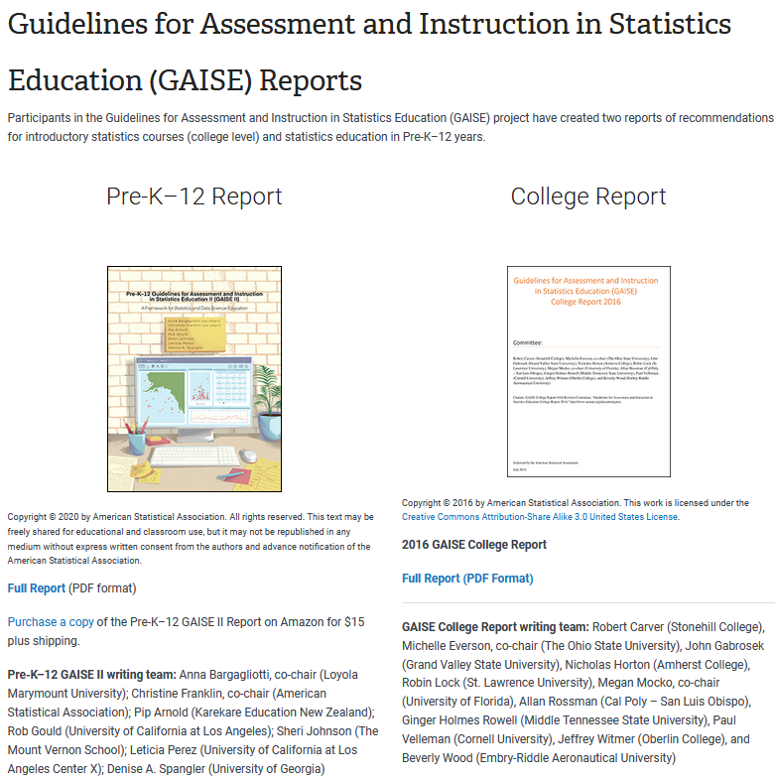
On the ASA site
Google “GAISE”

Slide 4
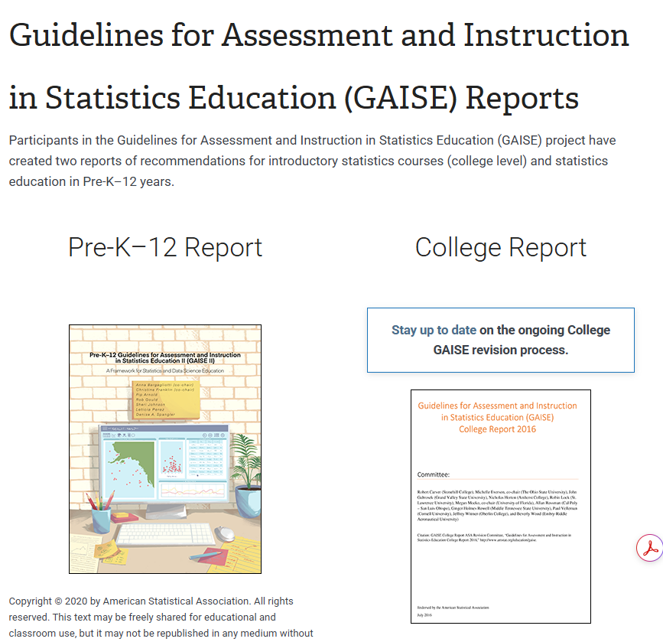
On the ASA site
Google “GAISE”
Temporary Site!

Slide 5
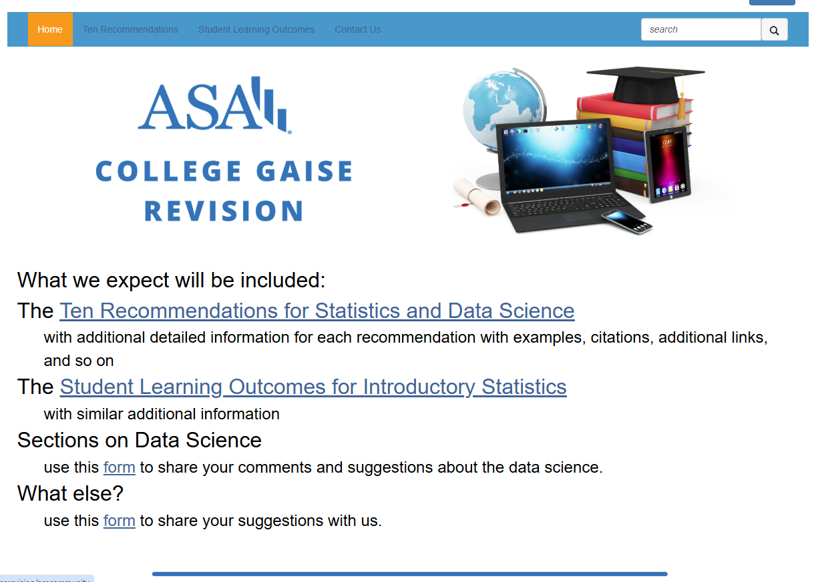

Slide 6
Revising College GAISE
Incorporate Data Science
Incorporate issues of Diversity, Equity, and Inclusion
Make recommendations clearer
Steering Committee:
Patti Frazer Lock, St. Lawrence University (co-chair)
Jamie Perrett, Brigham Young University (co-chair)
David Hunter, Penn State University
Lisa Kay, Eastern Kentucky University
Kate Kozak, Coconino Community College
Chris Malone, Winona State University
Maria Tackett, Duke University
Donna Lalonde, ASA Liaison

Slide 7
Revising College GAISE
Incorporate Data Science
Incorporate issues of Diversity, Equity, and Inclusion
Make recommendations clearer
Steering Committee:
Patti Frazer Lock, St. Lawrence University (co-chair)
Jamie Perrett, Brigham Young University (co-chair)
David Hunter, Penn State University
Lisa Kay, Eastern Kentucky University
Kate Kozak, Coconino Community College
Chris Malone, Winona State University
Maria Tackett, Duke University
Donna Lalonde, ASA Liaison

Slide 8
Ten Recommendations
Recommendations for Statistics and Data Science
Teach statistics and data science as iterative processes of gleaning insights from data to inform evidence-based decisions.
Emphasize effective written and oral communication of results from data, with attention to the scope and limitations of conclusions.
Focus on conceptual understanding rather than algebraic manipulation and formulas.
Integrate real data with a context and purpose throughout the course. Select data that are meaningful and engaging to the students.
Encourage multivariable thinking.
Incorporate software/apps to explore concepts and work with data.
Emphasize responsible and ethical conduct in the collection and use of data and in their analysis.
Employ evidence-based pedagogies that actively engage students in the learning process.
Use a variety of formative and summative assessments to improve teaching and learning.
Implement a course design that uses inclusive strategies to foster a sense of belonging.

Slide 9
The Breakout Session Plan
Pick a recommendation and join a table!
Ask questions, make suggestions, give ideas.
Switch to a new table/recommendation whenever you want.

Slide 10
But Wait! There’s More!
Every recommendation comes with
A short clarifying statement
A longer discussion with resources, examples, assessment items, and more.
Mostly Done
In Process

Slide 11
Recommendation Teams
Name | Rec |  | Name | Rec
Melissa Pittard (chair) | 1 |  | Hunter Glanz (chair) | 6
Rachel Saidi | 1 |  | Michael Sullivan | 6
Anna Bargagliotti | 1 |  | Amelia McNamara | 6
Chris Malone | 1 |  | Patti Frazer Lock | 6
Sara Stoudt (chair) | 2 |  | Judith Canner (chair) | 7
Victor Piercey | 2 |  | Matthew Hayat | 7
Larry Lesser | 2 |  | Jessica Utts | 7
Dave Hunter | 2 |  | Donna Lalonde | 7
Nick Horton (chair) | 3 |  | Beth Chance (chair) | 8
Rebecca Wong | 3 |  | Hollylynne Lee | 8
Laura Ziegler | 3 |  | Amanda Ellis | 8
Joe Roith | 3 |  | Anelise Sabbag | 8
Ulrike Genschel | 3 |  | Jamie Perrett | 8
Lisa Kay | 3 |  | Julie Neisler (chair) | 9
Rob Gould (chair) | 4 |  | Andy Zieffler | 9
Robin Lock | 4 |  | Matt Beckman | 9
Ambika Silva | 4 |  | Jennifer Ward | 9
Jennifer Broatch | 4 |  | Kate Kozak | 9
Jamie Perrett | 4 |  | Jo Hardin (chair) | 10
Kelly McConville (chair) | 5 |  | Allison Theobold | 10
Ben Baumer | 5 |  | Suzy Thornton | 10
Nathan Tintle | 5 |  | Maria Tackett | 10
Mine Dogucu | 5
Patti Frazer Lock | 5
Thank you to all the amazing people who worked on one of the Recommendation Teams!

Slide 12
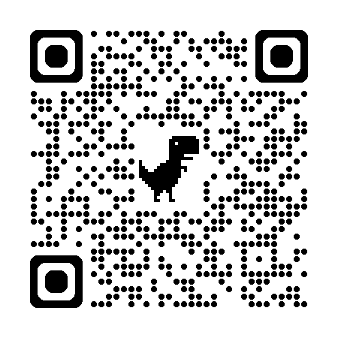

Helpful Links
https://amstat.quarto.pub/college-gaise/
(Temporary Site)
Do YOU have materials to share?
If so, let us know here:
https://forms.gle/keg4jEh5fm86wBJ46

Slide 13
Ten Recommendations
Recommendations for Statistics and Data Science
Teach statistics and data science as iterative processes of gleaning insights from data to inform evidence-based decisions.
Emphasize effective written and oral communication of results from data, with attention to the scope and limitations of conclusions.
Focus on conceptual understanding rather than algebraic manipulation and formulas.
Integrate real data with a context and purpose throughout the course. Select data that are meaningful and engaging to the students.
Encourage multivariable thinking.
Incorporate software/apps to explore concepts and work with data.
Emphasize responsible and ethical conduct in the collection and use of data and in their analysis.
Employ evidence-based pedagogies that actively engage students in the learning process.
Use a variety of formative and summative assessments to improve teaching and learning.
Implement a course design that uses inclusive strategies to foster a sense of belonging.

Slide 14
Ten Recommendations
Recommendations for Statistics and Data Science
Teach statistics and data science as iterative processes of gleaning insights from data to inform evidence-based decisions.
Emphasize effective written and oral communication of results from data, with attention to the scope and limitations of conclusions.
Focus on conceptual understanding rather than algebraic manipulation and formulas.
Integrate real data with a context and purpose throughout the course. Select data that are meaningful and engaging to the students.
Encourage multivariable thinking.
Incorporate software/apps to explore concepts and work with data.
Emphasize responsible and ethical conduct in the collection and use of data and in their analysis.
Employ evidence-based pedagogies that actively engage students in the learning process.
Use a variety of formative and summative assessments to improve teaching and learning.
Implement a course design that uses inclusive strategies to foster a sense of belonging.

