Slide 1
Exhibitor Demo: Wiley
GAISE in Action: Ready-to-use Tools for Teaching Statistics in the Age of AI
Patti Frazer Lock
St. Lawrence University
eCOTS 2026

Slide 2
Sparking Joy and Discovery!
New College GAISE Recommendations
Impact of AI on our pedagogy and assessment
Statistics: UnLocking the Power of Data, Fourth Edition
by Lock, Lock, Lock, Lock, and Lock
Wiley

Slide 3
JDS Article
Wang, S., et al., “Addressing the Challenges of AI-Generated Assignment Submissions in Education: Insights and Strategies”, Journal of Data Science, 2026.
Lock, P.F., Discussion on “Addressing the Challenges of AI-Generated Assignment Submissions in Education: Insights and Strategies”, Journal of Data Science, 2026.
I have a very extensive list of references on the subject.

Slide 4
Current Situation
“Members of the class of 2026 have had access to AI since they were freshmen. Almost half of them are using it to do their work.”
“College Students Have Already Changed Forever,” The Atlantic, August 17, 2025
“Everyone is Cheating Their Way Through College”
“Everyone is Cheating Their Way Through College,” New York Magazine, May 7, 2025
AI is here to stay.
Forbidding its use is not effective or wise or even possible.

Slide 5

The Challenge
Write an outside-class assignment that is AI proof.
Think…
Think…
Think…
Me:
Then Me:
It can’t be done.

Slide 6
Solution Ideas?
Oral exams/assessments
More in-class graded assessments
Increased explicit focus on learning

Slide 7
Oral Exams/Assessments
These can be short and easy!
They are still powerful!

Slide 8
In-Class Graded Assessments
Short off-line quizzes
Group work
Deeper thinking (possible but requires more creativity)
“Please put all phones and laptops away now.”
Mental health
Loneliness
Human interaction
Inside Higher Ed: “more than half of college students feel lonely”

Slide 9
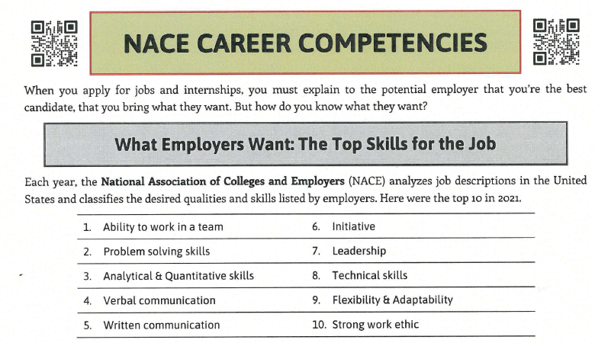
NACE Career Competencies
Each year, the National Association of Colleges and Employers (NACE) analyzes job descriptions in the United States and classifies the desired qualities and skills listed by employers. Here are the top 10:
This semester, we will be actively working on ALL of the first five! And some of the others too!

Slide 10
Explicit Focus on Learning
“You don’t take a forklift to the gym.”
Students: Build Your Brain!
And hopefully build Joy and Discovery along the way!

Slide 11
GAISE
Guidelines for Assessment and Instruction in Statistics Education
Written in 2005
Revised in 2016
Revised in 2026
Robin Lock on the writing team
Robin Lock on the writing team
Patti Frazer Lock on the writing team
From the very beginning, the Locks have worked to create materials that support and reinforce the GAISE recommendations.

Slide 12
College GAISE
Considered the Gold Standard for
Introductory Statistics courses
2026: Statistics and Data Science Education
Steering Committee:
Patti Frazer Lock, St. Lawrence University (co-chair)
Jamie Perrett, Brigham Young University (co-chair)
David Hunter, Penn State University
Lisa Kay, Eastern Kentucky University
Kate Kozak, Coconino Community College
Chris Malone, Winona State University
Maria Tackett, Duke University
Donna Lalonde, ASA Liaison

Slide 13
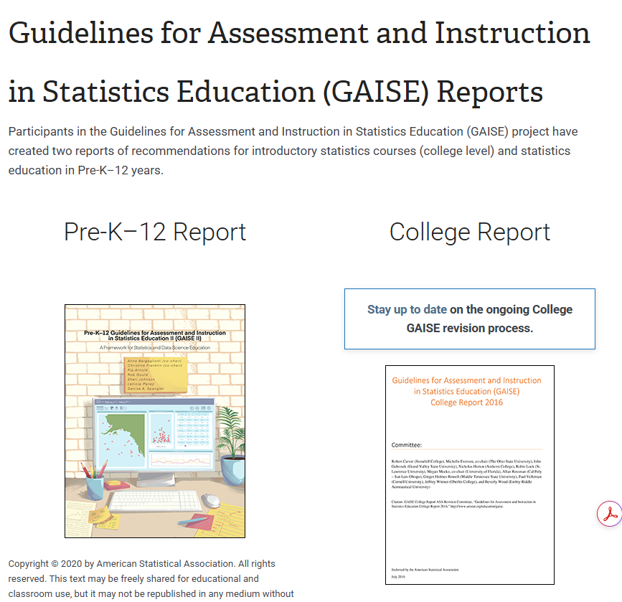
On the ASA site
Google “GAISE”
2026 College GAISE
Ten Recommendations for Statistics and Data Science Education
Student Learning Outcomes for Intro Stat
Syllabi and Current Landscape in Data Science
Assessment items for all

Slide 14
2026 College GAISE Recommendations
Recommendations for Statistics and Data Science
Teach statistics and data science as iterative processes of gleaning insights from data to inform evidence-based decisions.
Emphasize effective written and oral communication of results from data, with attention to the scope and limitations of conclusions.
Focus on conceptual understanding rather than algebraic manipulation and formulas.
Integrate real data with a context and purpose throughout the course. Select data that are meaningful and engaging to the students.
Encourage multivariable thinking.
Incorporate software/apps to explore concepts and work with data.
Emphasize responsible and ethical conduct in the collection and use of data and in their analysis.
Employ evidence-based pedagogies that actively engage students in the learning process.
Use a variety of formative and summative assessments to improve teaching and learning.
Implement a course design that uses inclusive strategies to foster a sense of belonging.

Slide 15
1. Teach statistics and data science as processes of gleaning insights from data to inform evidence-based decisions.
Statistics: Unlocking the Power of Data!!
This the essence of our materials:
Data helps us understand the world better!
Build stronger insights!
Make better decisions!
Across almost ALL fields!
We want the examples we give and the data we use to be so engaging that students WANT to engage and want to learn.

Slide 16
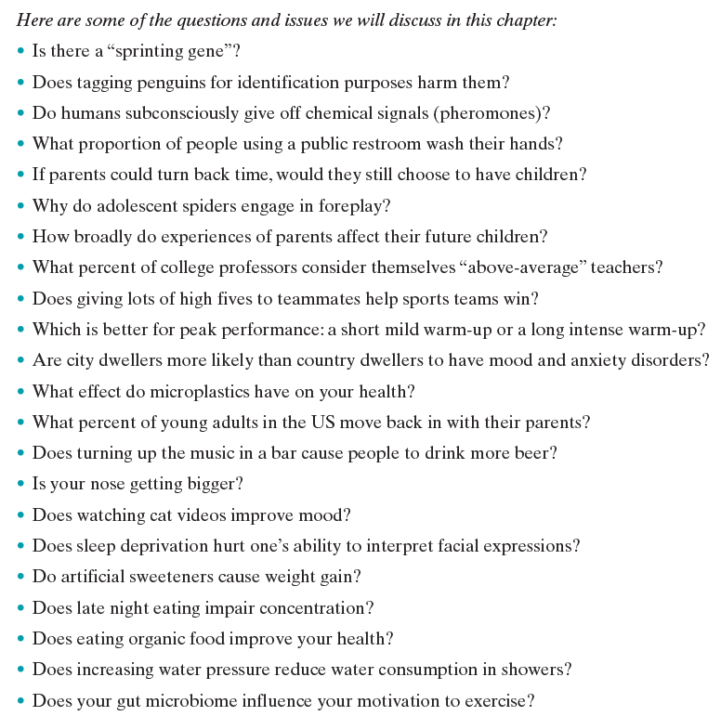
Insights from Data
Every chapter starts with a list of some “questions and issues we will discuss in this chapter.”
The full list would include MANY more but we limit these to one page.
Here is the one for Chapter 1.

Slide 17
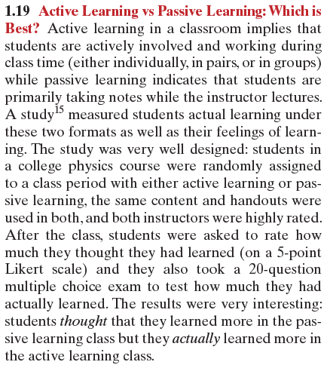
Insights from Data
Students randomly assigned
One group had active learning
One group had passive learning
How much did they think they learned?
How much did they actually learn?
“Students thought they learned more in the passive learning class but they actually learned more in the active learning class.”
Strongly significant in both cases.

Slide 18
2. Emphasize effective written and oral communication of results from data, with attention to the scope and limitations of conclusions.
Interpret! Interpret! Interpret!
What conclusions can we draw from these data?
Interpret the results in context.
These ideas permeate our materials.
“Data Storytelling” can be a key part of every IS and IDS course.

Slide 19
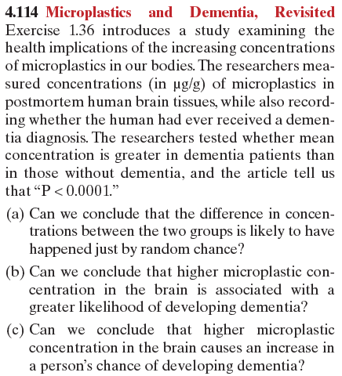
Effective
Communication
One group had dementia.
One group didn’t.
Compared mean concentration of microplastics in
postmortem brain tissue.
Article: “P < 0.0001”
What can we conclude?

Slide 20
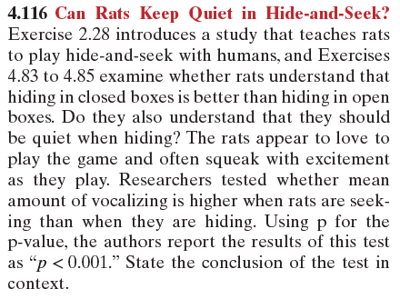
Effective
Communication
Rats love to play hide-and-seek!
They squeak with excitement when playing!
Do they understand the game?
Compared mean amount of vocalizing between when rats are seeking vs when rats are hiding.
Article: “p < 0.001”
What can we conclude?

Slide 21
3. Focus on conceptual understanding rather than algebraic manipulation and formulas.
Simulation-Based Inference!!
Conceptual understanding!
Reduced focus on formulas/algebra!

Slide 22
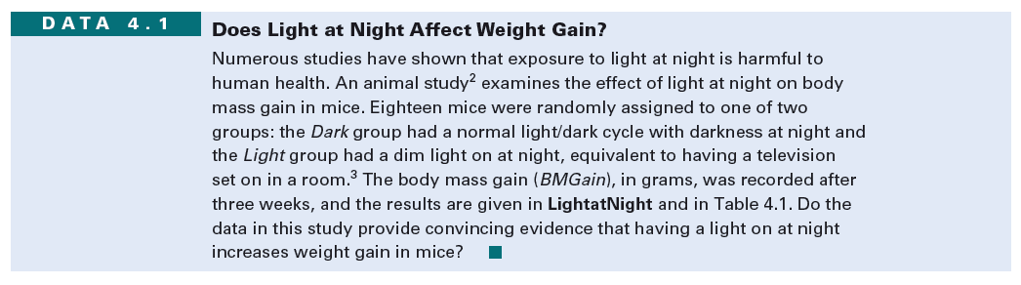
Conceptual Understanding
Does leaving a light on at night have adverse health effects?
(in mice)
Mice randomly assigned to light at night or normal darkness.
Light at Night: Mean weight gain 6.732 g
Dark at Night: Mean weight gain 4.114 g
Difference in means: 2.62 g
Is this difference likely to happen just by random variation?

Slide 23
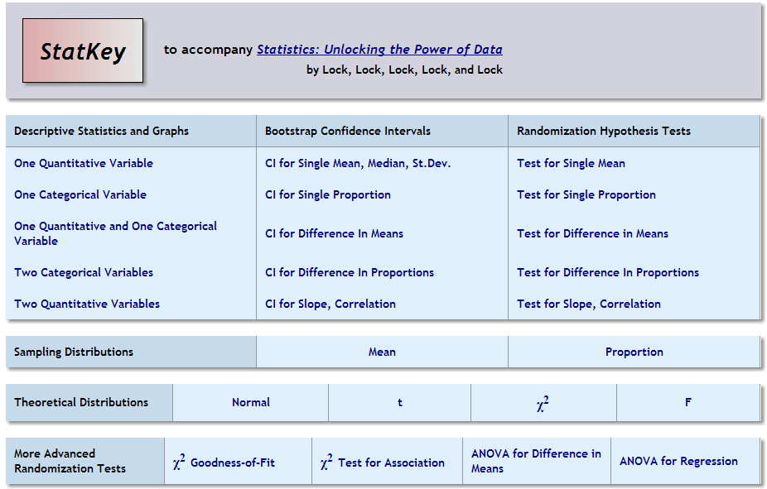
StatKey
www.lock5stat.com/statkey
Notes:
Go live to STatKey after this.

Slide 24
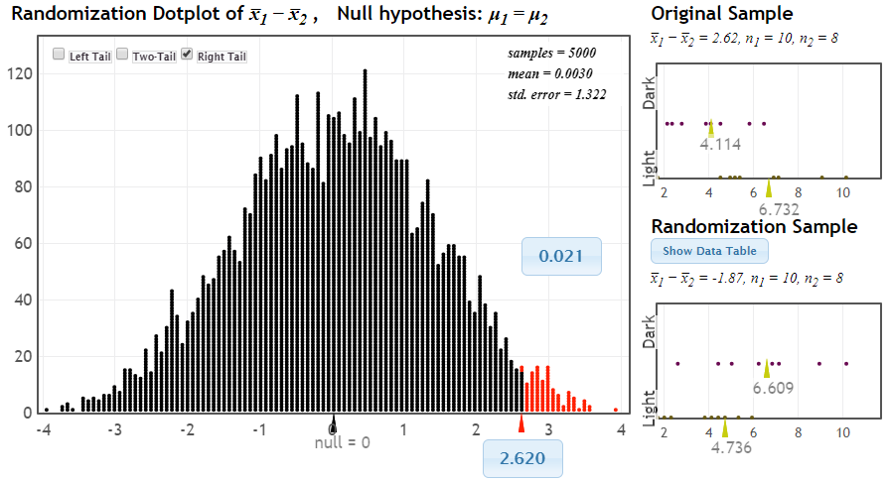
Simulation-Based Inference
Does leaving a light on at night have harmful health effects?
p-value
This is what we might see just by random variation if light has no effect
observed statistic

Slide 25
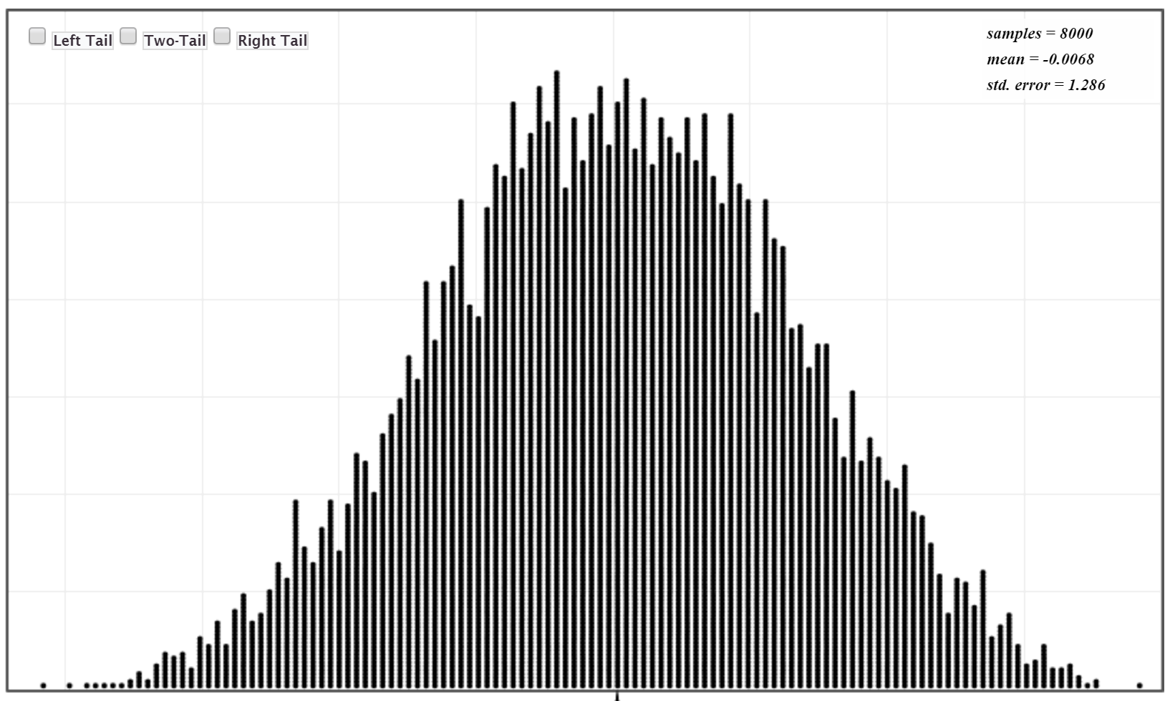
Simulation-Based Hypothesis Test
NO algebra!
But builds and requires deep conceptual understanding of sampling variability and strength of evidence.
Randomization distribution:
Shows what we would likely see just by random chance, if the null hypothesis is true.
Sample statistic here:
Could be just random chance.
Not enough evidence to make a clear conclusion.
(NOT a small p-value)
Sample statistic way out here:
Unlikely to be just random chance!
There is evidence for the effect!
(small p-value)

Slide 26
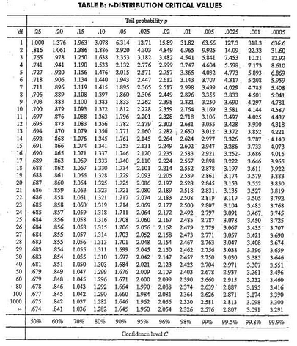



Traditional Hypothesis Test
1. Check conditions
2. Which formula?
5. Which theoretical distribution?
$$t=\frac{{\overline{x}}_{L}−{\overline{x}}_{D}}{\sqrt{\frac{s_{L}^{2}}{n_{L}}+\frac{s_{D}^{2}}{n_{D}}}}$$
6. df?
7. Find p-value
LOTS of algebra!
Process requires algebraic skill but does not build or require conceptual understanding of sampling variability or strength of evidence.
3. Calculate numbers and plug into formula
8. Interpret a decision
$$t=\frac{6.73−4.11}{\sqrt{\frac{{2.97}^{2}}{10}+\frac{{1.56}_{}^{2}}{8}}}$$
4. Chug with calculator
$$t=2.41$$
0.02< p-value < 0.025

Slide 27
4. Integrate real data with a context and purpose throughout the course. Select data that are meaningful and engaging to the students.
We think this is the best part of the Lock5 book!!
So many interesting data sets and data situations, in all the examples and exercises, to engage both students and instructors.
Fourth Edition: More than 140 new exercises (all with real data) and more than 400 updated exercises.
Now more than 2000 exercises in the text, almost all in WileyPLUS and almost all with real data.

Slide 28
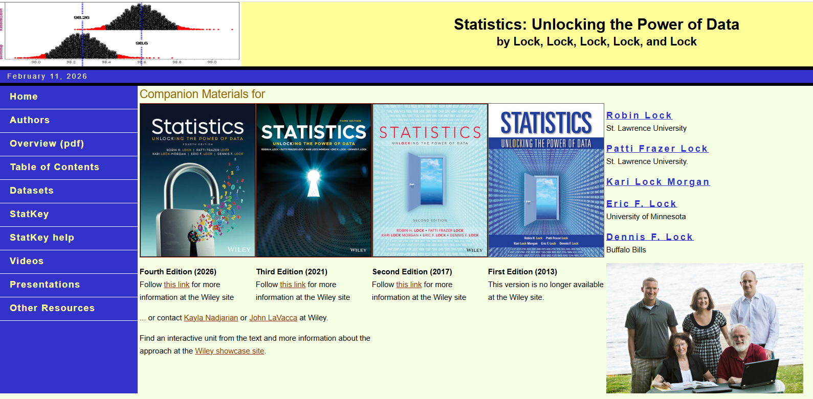
Real Data
www.lock5stat.com
Notes:
Go live to here after this and show datasets.

Slide 29

Real Data: Online Dating
Pew Research large survey
Have you ever used online dating?
30% said yes.
Standard confidence interval for a proportion

Slide 30
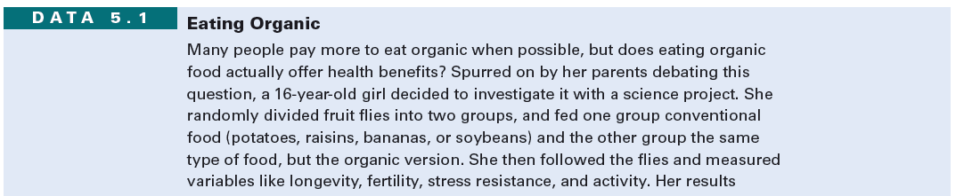

Real Data: Eating Organic
Fruit flies randomly divided.
500 fed organic potatoes; 500 regular potatoes.
After 13 days:
Organic: 318 of 500 still alive
Not-organic: 285 of 500 still alive
Standard difference in proportions hypothesis test

Slide 31
5. Encourage multivariable thinking.
Can introduce multivariable thinking with confounding variables very early.
Can have students discussing/interpreting Data Visualizations with enhanced scatterplots and online apps like www.gapminder.org, also early in a course.
More advanced topics such as a soft introduction to Multiple Regression or creating their own data visualizations may or may not be included.
Notes:
Go live to gapminder after this.

Slide 32
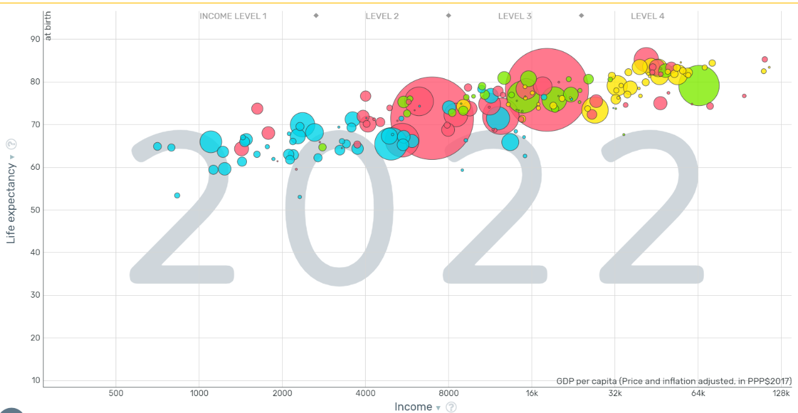
Multivariable Thinking: Gapminder
No Algebra!
But lots of thinking about and understanding data!
www.gapminder.org/tools

Slide 33
6. Incorporate software/apps to explore concepts and work with data.
StatKey!!!
Also, Technology Manuals.
Also, many large datasets
(more added and updated with each new edition)
Also, many exercises asking students to use technology.
Also, many pencil-and-paper exercises that incorporate output.

Slide 34
StatKey
www.lock5stat.com/statkey

Slide 35
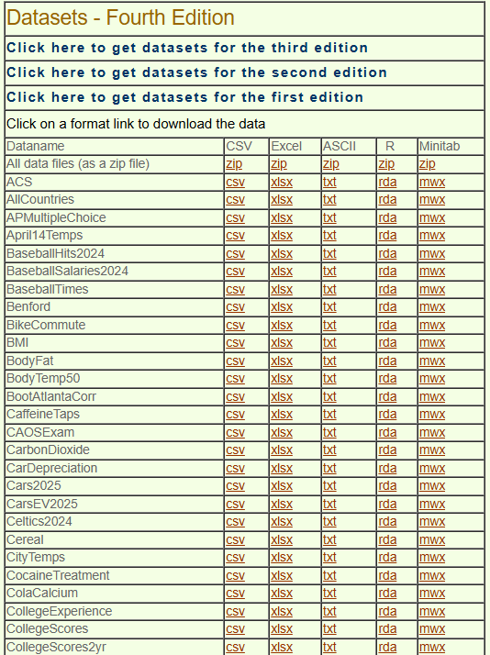
Technology
145 large datasets in many formats

Slide 36
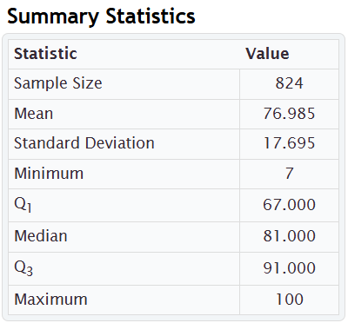
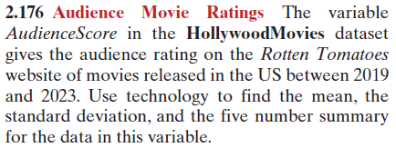
Technology:
Audience Score for Hollywood Movies
For offline assessments:
Give summary statistics or graphs.
Emphasis is on interpreting,
not calculating or creating by hand.
Students can discuss what the summary statistics show,
Or lots of specific questions can be asked.

Slide 37
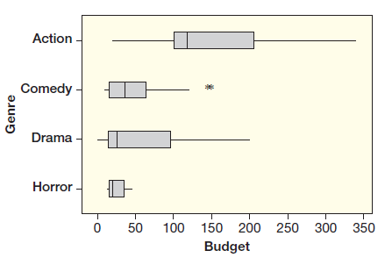
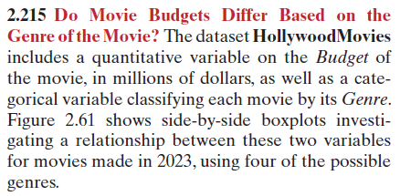
Technology:
Budget for Hollywood Movies, by Genre
For offline assessments:
Give summary statistics or graphs.
Emphasis is on interpreting,
not calculating or creating by hand.
Students can discuss what the graph shows,
Or lots of specific questions can be asked.

Slide 38
7. Emphasize responsible and ethical conduct in the collection and use of data and in their analysis.
Particularly in a World of AI, discussions of ethics become essential.
Particularly in a World of Data, discussions of ethics become essential.
Focus throughout on where data came from, how it is being used, the scope of inference.

Slide 39
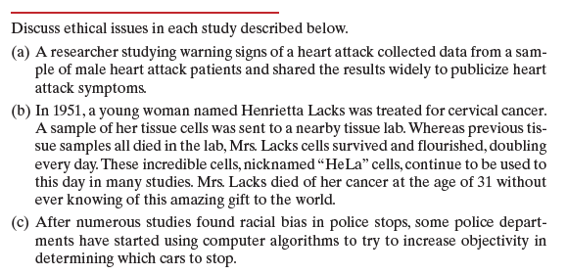
Ethical Conduct
Warning signs of a heart attack:
Sample only included males
HeLa cells from Henrietta Lacks, used without her consent or knowledge.
Racial bias in police stops:
Do computer algorithms help?

Slide 40
8. Employ evidence-based pedagogies that actively engage students in the learning process.
In-class discussions!
In-class group work!
Open-ended questions!
Projects!

Slide 41
9. Use a variety of formative and summative assessments to improve teaching and learning.
Creative assessments are even more important now in the age of AI.
Need a variety of types and levels of assessment!
Short easy questions
Online homework questions that are engaging
Medium questions for quiz/exam
More involved questions for group/class discussions
Projects!

Slide 42
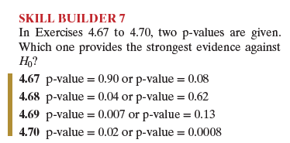
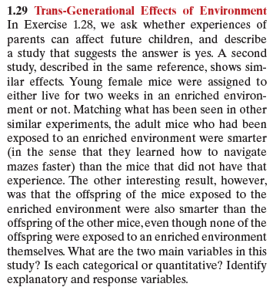
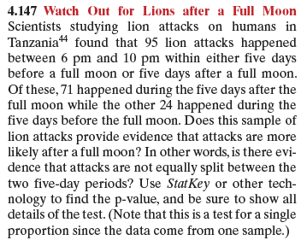
Variety of Assessments
Skill Builders
Short easy questions to build foundational understanding and build confidence.
Trans-Generational Effects of Environment
Trans-Generation Effects of Diet
Are There Human Pheromones?
Do Crows Hold a Grudge?
Do Pigeons Remember a Face?
Are Fast Food Diets and Depression related?
Group work/Full-Class Discussions
Hypothesis Test
Watch Out for Lions after a Full Moon!

Slide 43
10. Implement a course design that uses inclusive strategies to foster a sense of belonging.
Back to AI:
We want students to WANT to learn.
We want them to know we care.
We want them to know that these ideas about data will be relevant in their lives!
We want them ALL to feel welcomed and included.
One suggestion: Student Hours!

Slide 44
Sparking Joy and Discovery!
New College GAISE Recommendations
Impact of AI on our pedagogy and assessment
Statistics: UnLocking the Power of Data, Fourth Edition
by Lock, Lock, Lock, Lock, and Lock
Wiley

Slide 45

Thank you to Wiley!
We are excited about all the new interesting datasets and exercises in the Fourth Edition of Statistics: Unlocking the Power of Data!
We hope you enjoy them!
From all the Locks

