Slide 1
Using R in Statistics
by Faruk Guder and Mary Malliaris Quinlan School of Business, Loyola University Chicago
.
Fact-based decisions

Slide 2
Using R in Statistics
This virtual poster presents our experience in using R in our introductory statistics course.
Purpose of this presentation:
It is not to argue that R is the best tool for data analysis
It is to share our experience with the instructors who are considering to use R in their statistics courses.
After using R in the course, we observed the following:
R is relatively easy and very intuitive.
Students need to know only a small number of R functions to generate the outputs needed in the course.
.
Fact-based decisions
The examples showing the use of these functions in an introductory statistics course are presented on the following slides using the “house” data given on the next page.

Slide 3
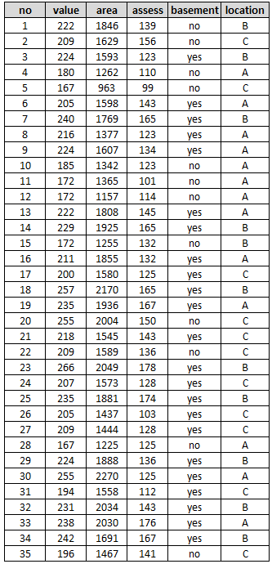
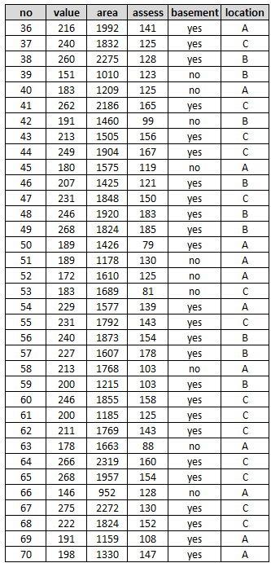
Data: 70 houses, 5 variables file: house.csv
A Random Sample of 70 Houses in a City

Slide 4
R and R Studio
Free and open source. Available for Windows, Mac, and Linux systems. Can be downloaded from https://cran.r-project.org https://www.rstudio.com
Programming Language (might look challenging, relatively simple and very intuitive).
Leading programming language in statistics and data analytics
Professional quality visualization and graphics capability.
There are thousands of contributed packages (over 17,000) for R, written by many different authors. Some of these packages implement specialized statistical methods such as ARIMA time series analysis, others provide techniques for various data analytics tasks such as professional quality graphs, data mining, linear programming, and simulation.

Slide 5
Subjects in Introductory Statistics
Descriptive Statistics
(a) Numerical Measures
(b) Visual Displays
Normal Distribution and Central Limit Theorem
Interval Estimation
Hypothesis Testing
(a) One-sample Tests
(b) Two-Sample Tests
(c) Multi-Sample Tests (ANOVA)
Regression
(a) Correlation
(b) Simple Regression
(c) Multiple Regression
.
Fact-based decisions
R functions used for these subjects are presented on the following slides.

Slide 6
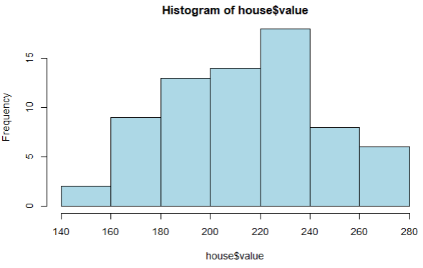
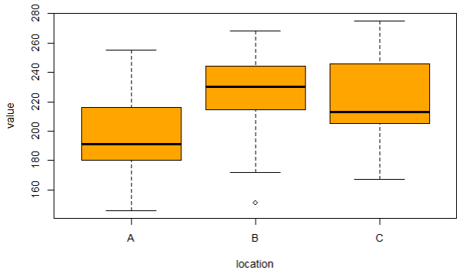
R Functions 1. Descriptive Statistics
Initial Work - Read Data: house <- read.csv("house.csv")
(a) Numerical Measures:
mean(house$value) [1] 215.2 median(house$value) [1] 214.5
sd(house$value) [1] 30.62281
(b) Visual Displays:
hist(house$value)
boxplot(house$value~location, data=house)
Fact-based decisions

Slide 7
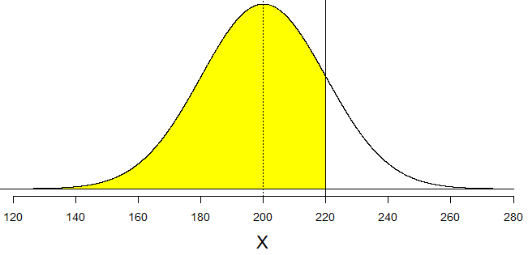
R Functions 2. Normal Distribution and Central Limit Theorem
The house values in a city is known to be normally distributed with a mean (μ) of 200 and a standard deviation (σ) of 20.
(a) What is the probability that a randomly selected house in this city will have value less than 220?
pnorm(220,200,20) [1] 0.8413447
(b) What is the probability that a randomly selected house in this will have a value more than 220?
1-pnorm(220,200,20) [1] 0.1586553
Fact-based decisions
(c) If a random sample of 25 houses is selected in this city, what is the probability the mean value of these houses will be between 196 and 204?
SE = 20/sqrt(25)
pnorm(204,200,SE)-pnorm(196,200,SE) [1] 0.6826895

Slide 8
R Functions 3. Interval Estimation
Based on the observed values in the house.csv file, what is 95% confidence interval for the mean value of all houses?
t.test(house$value, conf.level = 0.95)
One Sample t-test
data: house$value
t = 58.796, df = 69, p-value < 2.2e-16
alternative hypothesis: true mean is not equal to 0
95 percent confidence interval:
207.8982 222.5018
sample estimates:
mean of x
215.2
Fact-based decisions

Slide 9
R Functions 4(a). One-Sample Testing
One-Sample Test: The past data indicated that the mean house value in this city was 205. Does the sample data provide evidence that the mean house value has changed at a significance level of 5%?
t.test(house$value, mu=205, alt="two.sided", conf.level = 0.95)
One Sample t-test
data: house$value
t = 2.7868, df = 69, p-value = 0.00687
alternative hypothesis: true mean is not equal to 205
95 percent confidence interval:
207.8982 222.5018
sample estimates:
mean of x 215.2
Fact-based decisions
Answer: Evidence that the mean house value has changed.

Slide 10
R Functions 4(b). Two-Sample Testing
Two-Sample Test: Does the sample data provide evidence that the mean house value of the houses with finished basement is different from the mean value of the houses with no finished basement at a significance level of 5%?
t.test(value~basement, data=house, conf.level = 0.95)
Welch Two Sample t-test
data: value by basement
t = -6.9071, df = 38.786, p-value = 0.00000002957
alternative hypothesis: true difference in means between group no and group yes is not equal to 0
95 percent confidence interval:
-55.05575 -30.11092
sample estimates:
mean in group no mean in group yes
186.0000 228.5833
Fact-based decisions
Answer: p-value= 0.00000002957 < 0.05. Therefore, the mean values are different.

Slide 11
R Functions 4(c). Multi-Sample Testing (ANOVA)
Multi-Sample Test: Does the sample data provide evidence that the mean value of the houses in each location (A, B, C) is different at a significance level of 5%?
ABC <- aov(value~location, data=house)
summary(ABC)
Df Sum Sq Mean Sq F value Pr(>F) p-value
location 2 10839 5419 6.741 0.00215 **
Residuals 67 53866 804
Answer: The mean house values in all three locations are not the same.
Fact-based decisions
Question: Which locations have different mean house values?
TukeyHSD(ABC)
$location
diff lwr upr p adj
B-A 27.96 7.571322 48.34868 0.0045448
C-A 24.00 4.777370 43.22263 0.0106707
C-B -3.96 -24.348678 16.42868 0.8876148
The mean values are different - between locations B and A - between locations C and A

Slide 12
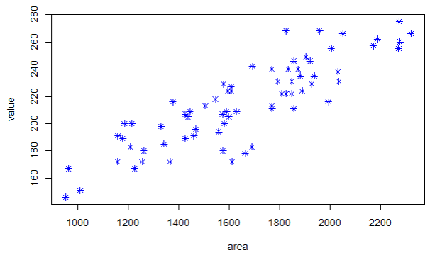
R Functions 5(a). Regression
Correlation coefficient between the house values and the square footage areas?
cor(house$value, house$area) [1] 0.8616099
Scatterplot of house values vs square footage areas.
plot(value~area, data=house)
Fact-based decisions

Slide 13
R Functions 5(b). Linear Regression
Simple Regression to predict house value (Y) using the square footage area (X).
R1 <- lm(value~area, data=house)
summary(R1)
Coefficients:
Estimate Std. Error t value Pr(>|t|)
(Intercept) 83.844469 9.568613 8.762 0.000000000000907 ***
area 0.079467 0.005677 13.998 < 0.0000000000000002 ***
---
Signif. codes: 0 ‘***’ 0.001 ‘**’ 0.01 ‘*’ 0.05 ‘.’ 0.1 ‘ ’ 1
Residual standard error: 15.66 on 68 degrees of freedom
Multiple R-squared: 0.7424, Adjusted R-squared: 0.7386
F-statistic: 195.9 on 1 and 68 DF, p-value: < 0.00000000000000022
Fact-based decisions
Regression equation: Y = 83.844469 + 0.079467area

Slide 14
R Functions 5(c). Multiple Regression
Multiple Regression to predict house values (Y) using the square footage area (X1), basement (X2), and location (X3).
R3 <- lm(value~area+basement+location, data=house)
summary(R3)
Coefficients:
Estimate Std. Error t value Pr(>|t|)
(Intercept) 92.123377 8.046769 11.448 < 0.0000000000000002 ***
area 0.063305 0.005411 11.699 < 0.0000000000000002 ***
basementyes 18.475014 3.831494 4.822 0.00000893 ***
locationB 9.831023 4.033990 2.437 0.0176 *
locationC 8.285070 3.778324 2.193 0.0319 *
---
Residual standard error: 12.88 on 65 degrees of freedom
Multiple R-squared: 0.8333, Adjusted R-squared: 0.823
F-statistic: 81.21 on 4 and 65 DF, p-value: < 0.00000000000000022
Fact-based decisions
Regression equation: Y = 92. 123377 + 0.063305area + 18.475014basementyes
+ 9.831023locationB + 8.285070locationC

Slide 15
R Functions 5(c). Multiple Regression - CIE
What is 95% confidence interval estimate for the mean value of all houses with the following characteristics? area=1653, basement="yes", location="B".
predict(R3, data.frame(area=1653, basement="yes", location="B"), interval="confidence“, conf.level=0.95)
fit lwr upr
1 225.0724 218.954 231.1907
Fact-based decisions
95% Confidence Interval Estimate 218.954 < mean < 231.1907

Slide 16
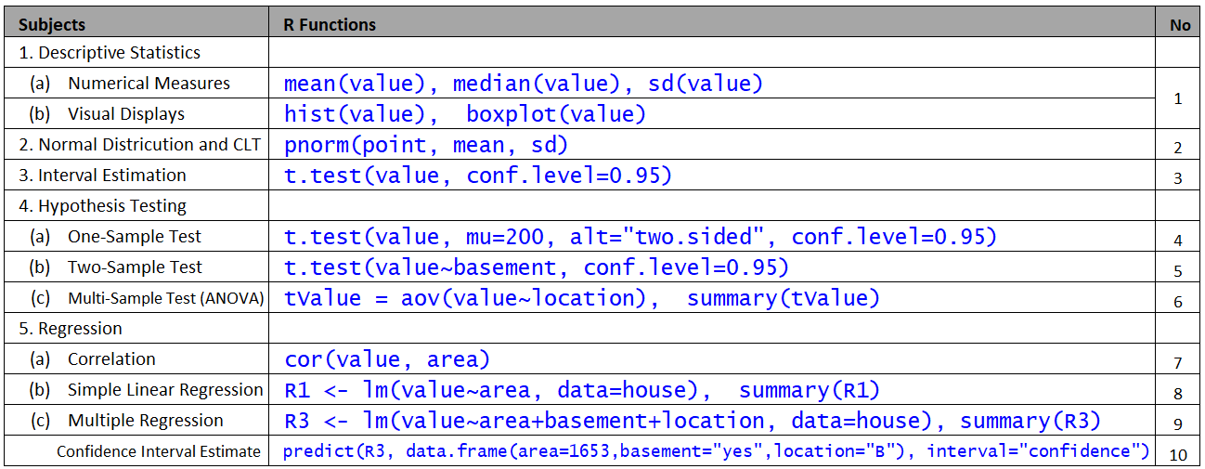
Summary - List of All R Functions

