Slide 1
DO: statistics, data science, data
Jo Hardin, Pomona College, jo.hardin@pomona.edu
June 1, 2023

Slide 2
Don’t
don’t worry about taking the right courses
don’t worry about pursuing the right major
don’t worry about getting the right degree
don’t worry about the perfect summer experience
don’t worry about the perfect job

Slide 3
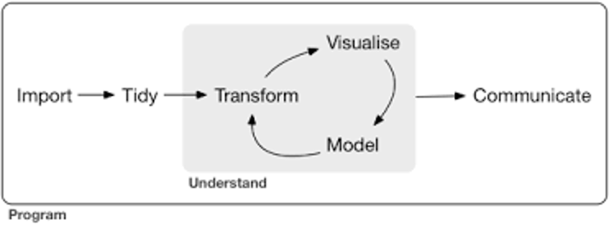
Start with R
for a good start to R in general, https://education.rstudio.com/learn/
interactive tutorials for “R for Data Science” at https://rstudio.cloud/learn/primers

Slide 4
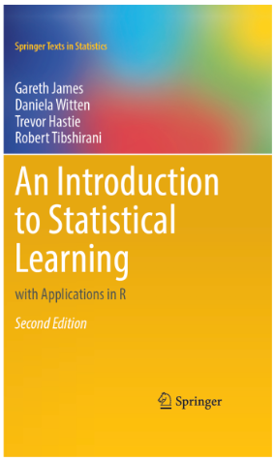
Modeling data
for modeling in R, https://www.tidymodels.org/start/
“An Introduction to Statistical Learning with Applications in R” by James et al.

Slide 5
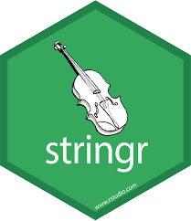
Natural Language Processing
tidytext tutorials
stringr cheat sheet
Blog post(s) by Julia Silge
Julia Silge & David Robinson’s book
Implementation of Google’s BERT framework into R

Slide 6
Practice Doing
Tidy Tuesday: every Tuesday a new dataset is posted
Kaggle.com: online community of data scientists who build models, working together to come up with optimal predictions.
data for social good: https://www.drivendata.org/competitions/ provides real data and structures for working through models and coming up with predictions

Slide 7
Interactive Graphics
register for a (free) shiny account
create a shiny dashboard to highlight the work you are doing!
gallery: https://shiny.rstudio.com/gallery/

Slide 8
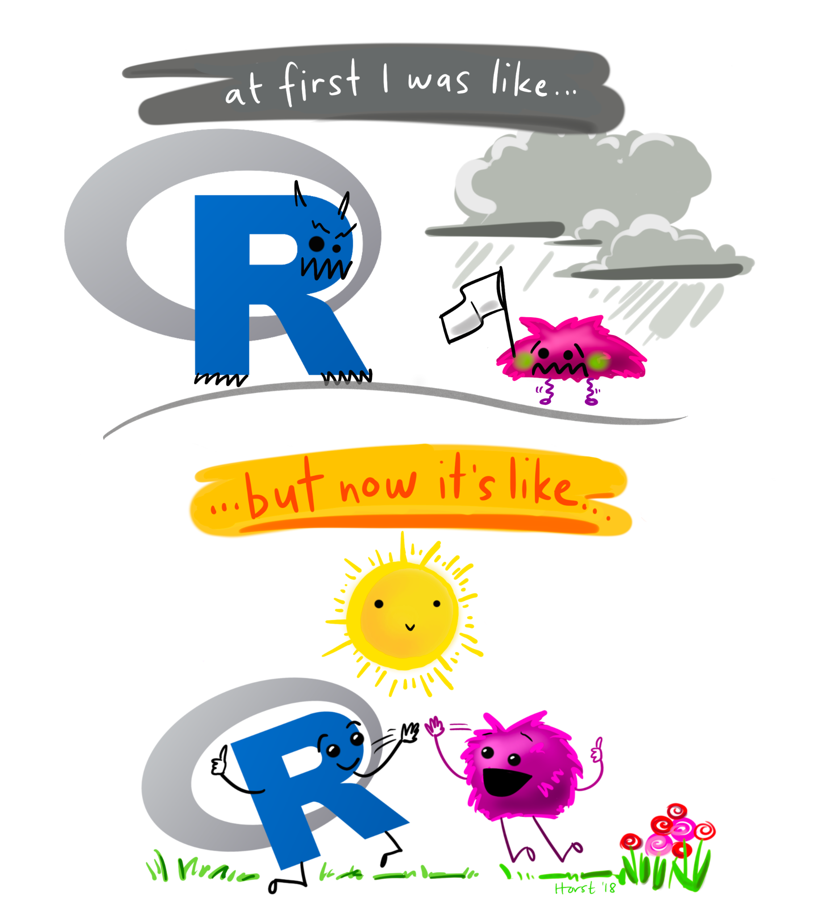
aRt
generative art in R by Danielle Navarro https://blog.djnavarro.net/posts/2021-11-01_unpredictable-paintings/
inspiration by Thomas Lin Pedersen https://www.data-imaginist.com/art
illustrate your learnings like Allison Horst https://allisonhorst.com/
hand drawn data viz by Giorgia Lupi and Stefanie Posavec http://www.dear-data.com/theproject

Slide 9
GitHub
collect and highlight your data projects into a single place
the ultimate resource: https://happygitwithr.com/
set up your own website, try using distill or quarto

Slide 10
Do Statistics
Do Data Science
Do Data

Slide 11
Thank you
https://hardin47.netlify.app/blog/keep-busy-with-data-science/
Jo Hardin / jo.hardin@pomona.edu

