Slide 1
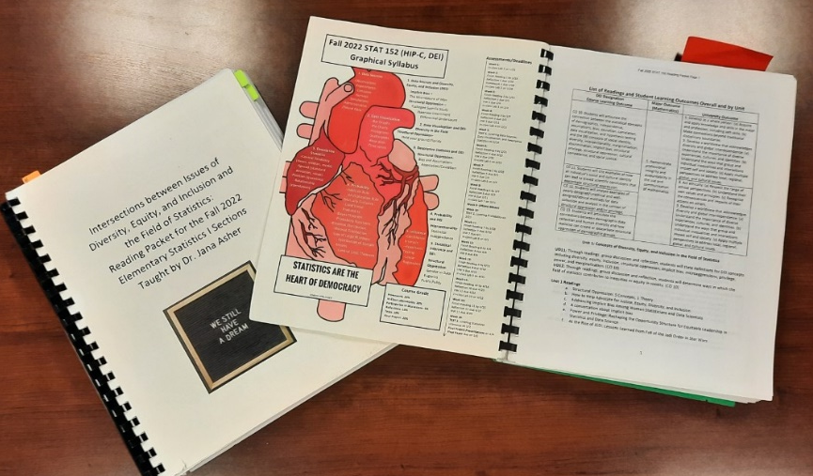
Recreating My Elementary Statistics Course for DEI Designation
Jana Asher (jana.asher@sru.edu)
Department of Mathematics and Statistics
Slippery Rock University
May 22, 2022

Slide 2
Abstract
In January 2022, I was trained to teach my Elementary Statistics course as a Diversity, Equity, and Inclusion (DEI)-designated course at Slippery Rock University. This designation requires that at least four DEI-related student learning outcomes are included in the syllabus and that the entire curriculum is DEI-infused. Modifying the Elementary Statistics course by the strict standards required for DEI designation meant rethinking the content, format, activities, and assessments. In this breakout session, I will spend the first 30 minutes reviewing the new course structure and how I incorporated DEI themes into my lectures and into student activities and assessments. Breakout groups will then meet for 20 minutes to discuss how the course achieves (or fails to achieve) the stated DEI objectives and brainstorm other ways to infuse DEI principles into an Elementary Statistics curriculum. Finally, we will reconvene to discuss the brainstorming sessions and consolidate our ideas.

Slide 3
Outline
Training for DEI Designation (10 minutes)
Course modifications (15 minutes)
Results of first semester (5 minutes)
Brainstorming (20 minutes)
Discussion (20 minutes)

Slide 4
1. Training for DEI Designation
Six (to eight) week asynchronous D2L-based training with two moderators.
Reflections, syllabus revision, discussion boards, storyboard.
Module 1: Conceptual Foundations, including terminology related to diversity, equity and inclusion; exploration through videos and discussion of systems and types of power within society; and readings and written reflection related to structural oppression and cultural humility.
Module 2: Self-Awareness and Identity, including creation of a personal social identity map, readings and videos on racial and ethnic identity models, and written discussion related to social and cultural identity, social position, and teaching.

Slide 5
1. Training for DEI Designation
Module 3: Structure Privilege and Oppression, including readings on white privilege, systemic racism, interpersonal versus structural oppression, and bias in instructional materials. Participants wrote a short reflection on white privilege and how institutions of higher education replicate structural privilege, and then participated in a written discussion on forms of bias that are common in their individual disciplines.
Module 4: Identifying and Incorporating Concepts of Critical Pedagogy, including readings and videos on definitions and applications of critical pedagogy, readings on infusing inclusive practices into coursework, and readings on constructing a learner-centered syllabus. Participants then discussed which aspects of the reading were most applicable to their intended diversity designated course and what revisions they planned to make to their existing syllabus, if applicable.

Slide 6
1. Training for DEI Designation
Module 5: Assessing and Addressing Institutional Systems of Privilege and Oppression, including readings and videos on existing inequities and methods for teaching about those inequities, a written or oral reflection on preparing for difficult conversations in the classroom, and submission of a reviewed syllabus based on the concepts learned in Modules 4 and 5.
Module 6: DEI Course Development Strategies within the Disciplines, including general readings on the development of strong DEI coursework, readings on different approaches to DEI training within different disciplines, and the development of specific course outcomes for the proposed diversity designated course. Within this module, a storyboard was begun that would be developed through the remainder of the course. At the end of this module, only the overall learning outcomes were included on the storyboard.

Slide 7
1. Training for DEI Designation
Module 7: DEI Course Design Part 1. Example storyboards were provided for the purpose of aligning module outcomes with course outcomes and aligning instructional activities and assessments with module outcomes. At the end of this module, module-level objectives, along with their alignment to course-level objectives, were included on the storyboard.
Module 8: DEI Course Design Part 2. Participants completed their storyboard, including placing learning materials, activities, and assessments within each module, as well as indicating the alignment of each element with one or more specific learning objectives for the module. Participants additionally completed a final reflection activity on their experiences during the DEI designation training and how they will apply their new knowledge within the classroom.

Slide 8
2. Course Modifications
Development of four new learning outcomes
  Students will articulate the connection between the statistical concepts of demographics, independence, assumptions, bias, causation, correlation, data visualization, and hypothesis testing and the DEI concepts of social identity, diversity, intersectionality, marginalization, discrimination, implicit bias, structural privilege, structural oppression, cultural competence, and social justice.
  Students will cite examples of how an individual’s social and cultural identity can lead to biased scientific conclusions that exacerbate structural oppression.

Slide 9
2. Course Modifications
Development of four new learning outcomes
  Students will analyze examples of poorly designed/unethical and well-designed/ethical methods for data collection and analysis in the context of structural oppression and/or privilege.
  Students will articulate the connections between demographic data collection and human diversity and how statistics can create or exacerbate structural oppression of demographic groups.
  To support these outcomes, a course packet was created that contained a graphical syllabus, a list of all the modules along with their learning outcomes, discussion questions, and reflection questions, and all readings for the course.

Slide 10
2. Course Modifications
New Assessment Methods
  Mondays: Discussions on Weekly Readings
  Wednesdays: Reflections Due
Module | DEI Learning Outcomes | Statistics Topics
1 | Through readings, group discussion and reflection, students will state definitions for DEI concepts including diversity, equity, inclusion, structural oppression, implicit bias, microaggressions, privilege, power, and marginalization. Through readings, group discussion and reflection, students will determine ways in which the field of statistics contributes to inequities or equity in society. | 1. Data Sources (Observations, Experiments, Censuses, Surveys, Simulations, Administrative, Found Data)

Slide 11
2. Course Modifications
Mod. | DEI Learning Outcomes | Statistics Topics
2 | Through readings, group discussion and reflection, students will explain through specific real-life examples how individual racism and discrimination can lead scientists to make unethical decisions around data that contribute to structural oppression of marginalized groups. Through readings, group discussion and reflection, students will analyze how power that scientists hold in society interacts with societal stereotypes about marginalized groups. | 1. Data Sources (Observations, Experiments, Censuses, Surveys, Simulations, Administrative, Found Data)
3 | Through readings, group discussion and reflection, students will analyze how a statistician’s social identity translates into biased understanding of the history of statistical thought. Through readings, group discussion and reflection, students will critique the dominant narrative about the history of data visualization by comparing and contrasting euro-centric analysis of the history of statistical thought and more diverse understandings of the history of statistical thought. | 2. Data Visualization (Bar Graphs, Pie Charts, Histograms, Scatterplots, Rose plots, Time series)

Slide 12
2. Course Modifications
Mod. | DEI Learning Outcomes | Statistics Topics
4 | Through readings, group discussion and reflection, students will evaluate misleading graphical summaries of data with an equity lens to explore how graphical summaries can exacerbate structural oppression. Through readings, group discussion and reflection, students will identify best practices for promoting equity through appropriate data visualization techniques. | 2. Data Visualization (Bar Graphs, Pie Charts, Histograms, Scatterplots, Rose plots, Time series)
5 | Through readings, group discussion and reflection, students will analyze how unintentional and intentional misinterpretation of descriptive statistics can influence public debate about DEI-related issues. | 3. Descriptive Statistics

Slide 13
2. Course Modifications
Mod. | DEI Learning Outcomes | Statistics Topics
6 | Through readings, group discussion and reflection, students will critique causal arguments related to race in the United States by analyzing the relationship between the author’s social identity and the appropriateness of the use of statistical concepts within the argument. Through readings, group discussion and reflection, students will connect cross-classification and Simpson’s Paradox to concepts of intersectionality. | 4. Probability (Basic rules, Probability Functions, Binomial, Normal, Law of Large Numbers, Distribution of Sample Means, Central Limit Theorem)
7 | Through readings, group discussion and reflection, students will identify, through describing real examples, how statistical knowledge can be a source of power. Through readings, group discussion and reflection, students will examine how current statistical methods are not sufficient to describe the complexities of intersectionality.

Slide 14
2. Course Modifications
Mod. | DEI Learning Outcomes | Statistics Topics
8 | Through readings, group discussion and reflection, students will define different sexual orientations and gender identities and determine which orientations and identities are better represented in current data collection and analysis practice in the United States. Through readings, group discussion and reflection, students will connect how data collection and analysis practice on gender expression and sexual orientation can lead to structural privilege or oppression in United States society. | 4. Probability (Basic rules, Probability Functions, Binomial, Normal, Law of Large Numbers, Distribution of Sample Means, Central Limit Theorem)
9 | Through readings, group discussion and reflection, students will explain how the incorrect use or collection of statistics by governments can lead to structural oppression of marginalized groups. Through readings, group discussion and reflection, students will explain how the incorrect application of hypothesis testing can exacerbate structural inequalities in society. | 5. Inference (Confidence Intervals, Hypothesis Testing, Linear Regression)

Slide 15
2. Course Modifications
Mod. | DEI Learning Outcomes | Statistics Topics
10 | Through readings, group discussion and reflection, students will analyze how the social identities of the originators of modern statistical inference led them to also be proponents of eugenics. Through readings, group discussion and reflection, students will describe how incorrect scientific assumptions led to the inappropriate application of statistical methods to make eugenics arguments. | 5. Inference (Confidence Intervals, Hypothesis Testing, Linear Regression)
11 | Through readings, group discussion and reflection, students will explain how statistics as a field can be a tool for social justice. Through readings, group discussion and reflection, students will list specific approaches to data collection and analysis that promote equity. | 5. Inference (Confidence Intervals, Hypothesis Testing, Linear Regression)

Slide 16
3. (Preliminary) Results from First Semester
Feedback Type: DEI | Count (percent) | Feedback Type: Other | Count (percent)
Positive comment re: DEI | 18 (28%) | Positive comments | 38 (59%)
Negative comment re: DEI | 13 (20%) | Negative/neutral comments | 34 (56%)
Suggested improvements re: DEI | 31 (48%) | Total commenting on non-DEI course characteristics | 54 (84%)
Reduced reading workload | 19 (30%)
More lecture/less discussion | 14 (22%) | Total Responses | 64 (100%)
Total mentioning DEI | 50 (78%)

Slide 17
4. Brainstorming in Small Groups
Which of the 11 modules are most essential to the four DEI learning outcomes? Which could be combined or discarded?
Which of the readings are most essential to the four DEI learning outcomes?
Are there other readings you can recommend?
What are the advantages and disadvantages of reading-discussion-reflection versus reading-discussion board-reflection?
What other activities can you recommend related to DEI?

Slide 18
5. Large Group Discussion
Which of the 11 modules are most essential to the four DEI learning outcomes? Which could be combined or discarded?
Which of the readings are most essential to the four DEI learning outcomes?
Are there other readings you can recommend?
What are the advantages and disadvantages of reading-discussion-reflection versus reading-discussion board-reflection?
What other activities can you recommend related to DEI?

Slide 19
References
Aliaga, M., Cobb, G., Cuff, C., Garfield, J., Gould, R., Lock, R., ... & Witmer, J. (2005). Guidelines for Assessment and Instruction in Statistics Education (GAISE) College Report. Washington, DC, USA: American Statistical Association.
Asher, J. (2022). Infusing DEI Learning into an Elementary Statistics Class. Amstat News (538), pp. 28 29.
Asher, J. (2020). Saving our Community-Engaged Elementary Statistics Course: A Case Study on Preserving High-Impact Practice During the COVID-19 Crisis. In: Hilton, J., & Dimarco, D. (Eds.), Pandemic University, pp. 77-88.
Asher, J., & Goodrick, A. (2021). Case Study: Using COVID-19 Data in a Community-Engaged Elementary Statistics Class. In: Helenius, R. & Falck, E. (Eds.), Statistics Education in the Era of Data Science, Proceedings of the Satellite conference of the International Association for Statistical Education (IASE). The Hague, Netherlands: IASE. iase-web.org/Conference_Proceedings.php.
Carver, R., Everson, M., Gabrosek, J., Horton, N., Lock, R., Mocko, M., ... & Wood, B. (2016). Guidelines for assessment and instruction in statistics education (GAISE) college report 2016. Alexandria, Virginia, USA: American Statistical Association.
Hatcher, J. A., Bringle, R. G., & Hahn, T. W. (Eds.). (2016). Research on student civic outcomes in service learning: Conceptual frameworks and methods, Volume 3. Sterling, Virginia, USA: Stylus Publishing, LLC.
Kuh, G. D. (2008). High-impact educational practices: What they are, who has access to them, and why they matter. Washington, DC, USA: Association of American Colleges and Universities.

