Slide 1
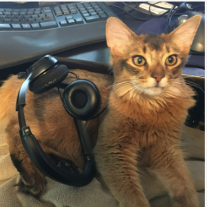
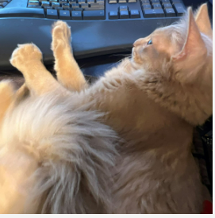
To unlock the information about eCOTS 2024, we need the code word . . .

Slide 2
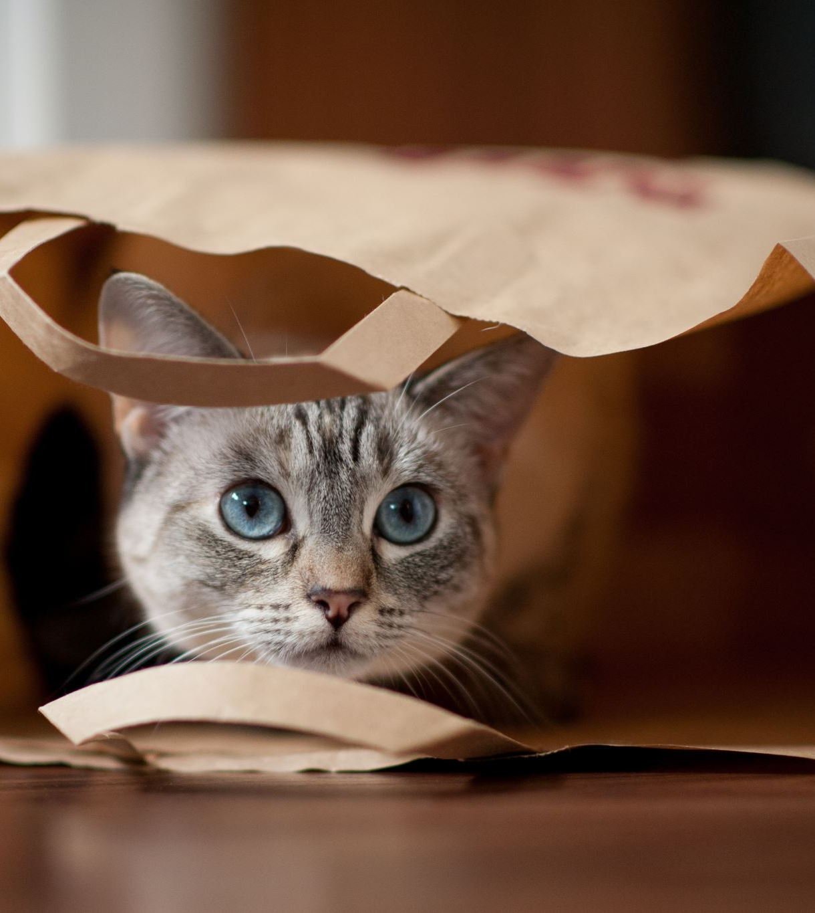
What to know about eCOTS 2024
You have already been to the location. – Its Online!
You can bring your cats or dogs or fish (even).
You can wear your slippers if you want.
It has the same food as your own fridge.
However, with the same great content, great discussions and wonderful colleagues!

Slide 3

Notes:
What topics should we be adding to our courses? Which ones should we be leaving behind?
How do we take everyone with us?
How can we move forward in our teaching sustainability?
How do we prepare teachers of statistics for the new world?
How do we move forward in the face/with AI (i.e., ChatGPT)?
In moving forward, we should reflect on where we have been. With that in mind, how does that inform (or not) where we should go from here?
Can we leave lectures behind us?

