Slide 1
Rate of Decline of the Arctic Sea Ice and Regression Modeling
Presenter: Amanda Walker
Texas State University

Slide 2
Melting Sea Ice
Variables:
Explanatory: Year (measurements begin in 1979)
Response: Arctic Sea Ice Extent (surface area in million square km)
https://climate.nasa.gov/vital-signs/arctic-sea-ice/

Slide 3
Modeling Linear Regression
This presentation uses Rguroo, and internet based statistical software.
I have taught this lesson using fathom, JMP, and once with the TI calculator where I asked students to enter data into calculator before coming to class.

Slide 4
Scatterplot, LSRL, interpret slope
Interpret Scatterplot
Write the LSRL: y = 167.01 – 0.080601x
Correlation coefficient r = -0.89225
Interpret Slope as a rate of change*
- Each year since 1979 the extent of artic sea ice decreases by 80,601 km squared, on average!

Slide 5
Interpret Residual Plot
Interpreting residual plot can be a bit tricky for students at first, especially since R includes the polynomial fit.
There is potential curvature of the residuals around the line y=0, which might indicate a quadratic model is more appropriate.

Slide 6
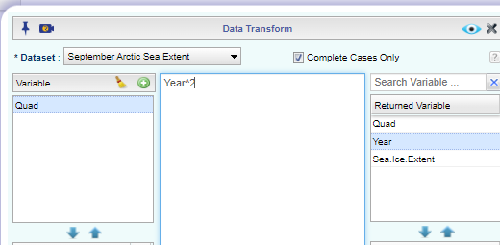
Transform Data for Quadratic Regression
Right click on the data set, select Function, Select Transform
Create Variable: Quad
Returned Variable: Year^2
Save this new Data Set: New Arctic

Slide 7
Multiple Linear Regression Using this new Data Set

Slide 8
Compare Residual Plots & Coefficient of Determination for each model
Quadratic: R-squared 0.805671
Linear: R-squared: 0.79611
While these are close, the quadratic model has less curvature around the line y=0 and higher R-squared value.
*Note: I recently updated this data set using new measurements from NASA and the R-squared values have gotten closer over the last two years.

Slide 9
Resources: This lesson was adapted from the article published in JSE (Witt 2013)
Witt, G. (2013). Using Data from Climate Science to Teach Introductory Statistics. Journal of Statistics Education, 21(1), http://jse.amstat.org/v21n1/witt.pdf
https://climate.nasa.gov/vital-signs/arctic-sea-ice/

