Slide 1
CAUSE Lifetime Achievement Award
2005: George Cobb
2007: Joan Garfield
2009: Roxy Peck
2011: Dick Scheaffer
2013: Chris Franklin
2015: Ann Watkins, Mike Shaughnessy
2017: Danny Kaplan
2019: Rob Gould, Tom Short

Slide 2
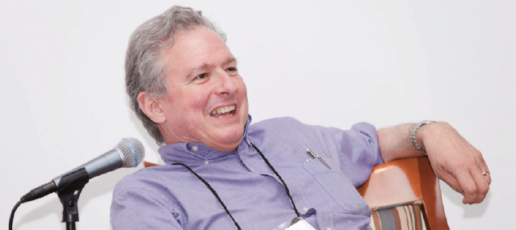
George Cobb Lifetime Achievement Award
George Cobb, 1947 – 2020

Slide 3
George’s wisdom and wit
“Judge a textbook by its exercises, and you cannot go far wrong.”
– George Cobb (JASA, 1987)
“Shorn of all subtlety, and led naked out of the protective fold of educational research literature, there comes a sheepish little fact: lectures don’t work nearly as well as many of us would like to think.”
– George Cobb (Heeding the Call for Change, 1996)

Slide 4
George’s inspiration
“Ptolemy’s cosmology was needlessly complicated, because he put the earth at the center of his system, instead of putting the sun at the center. Our curriculum is needlessly complicated because we put the normal distribution, as an approximate sampling distribution for the mean, at the center of our curriculum, instead of putting the core logic of inference at the center.”
– George Cobb (TISE, 2007)

Slide 5
More about George
Memorial website: georgewcobb.com
Amstat News obituary: https://magazine.amstat.org/blog/2020/07/01/remembering-george-cobb-1947-2020/
JSE interview: www.tandfonline.com/doi/abs/10.1080/10691898.2015.11889729
eCOTS memorial session: www.causeweb.org/cause/ecots/ecots20/program/memorial

Slide 6
George Cobb Lifetime Achievement Award
2021: Jessica Utts
2022: Bob delMas
2023: To be announced by Dennis Pearl, Director of CAUSE

