Slide 1


Teaching Statistics: Intuitive, Visual and Fun with JMP
Ruth Hummel, JMP Academic Ambassador
Consortium for the Advancement of Undergraduate Statistics Education

Slide 2
1. Explore some of the visual and interactive features that make teaching and learning in JMP engaging
2. Identify free and low-cost options to get access to JMP for the classroom

Slide 3
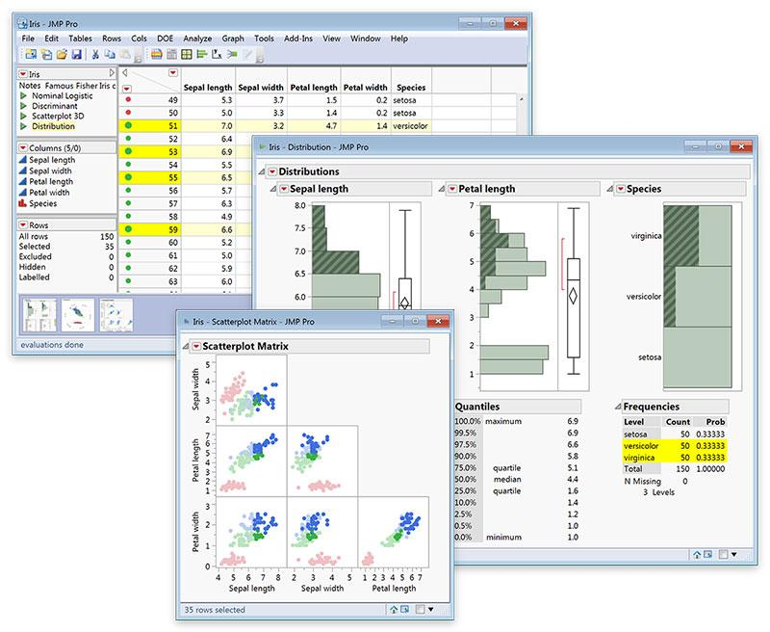
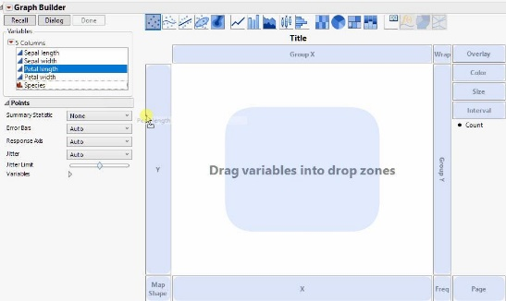
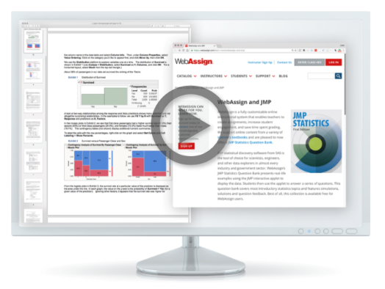
visual and interactive features in JMP
Dynamic Linking of data
Data Filtering
Drag-and-Drop Graph Builder
Profiler
Built-in Concept Applets
Easy transition to data science
  3-clicks to a Validation column
  Visual emphasis for partitioning (CART)
  Profiler to understand model

Slide 4
How to Get JMP
With affordable licensing options to fit every situation, it’s easy to get academic access to JMP.
https://www.jmp.com/en_us/academic/academic-licensing.html
The JMP Academic Suite: site license with access to JMP and JMP Pro for an unlimited number of academic users (including home use and virtualization)– check your University Software webpage for access or email academic@jmp.com
6- or 12-month student licenses of JMP for classroom use: onthehub.com/jmp
JMP Student Edition bundled for free with many Introductory textbooks or available for a 3 year license at jmp.com/getse

Slide 5
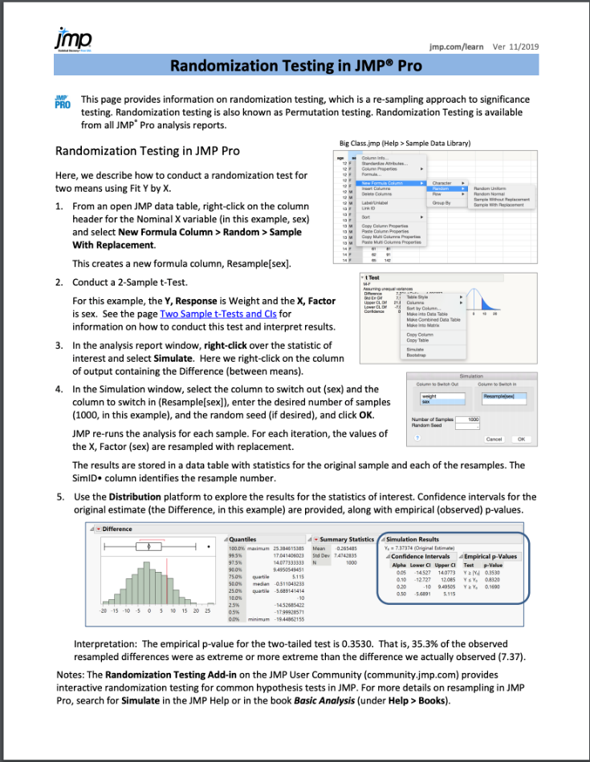
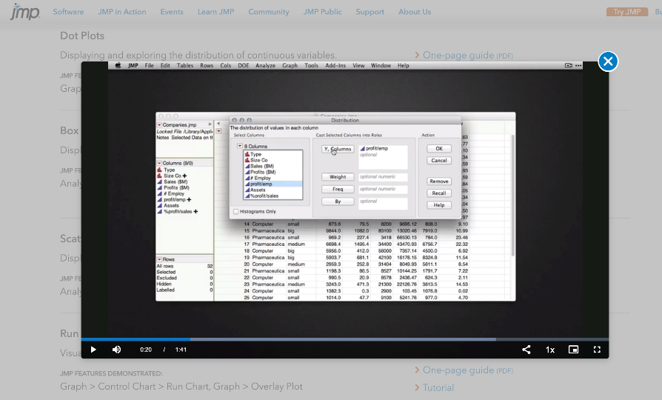
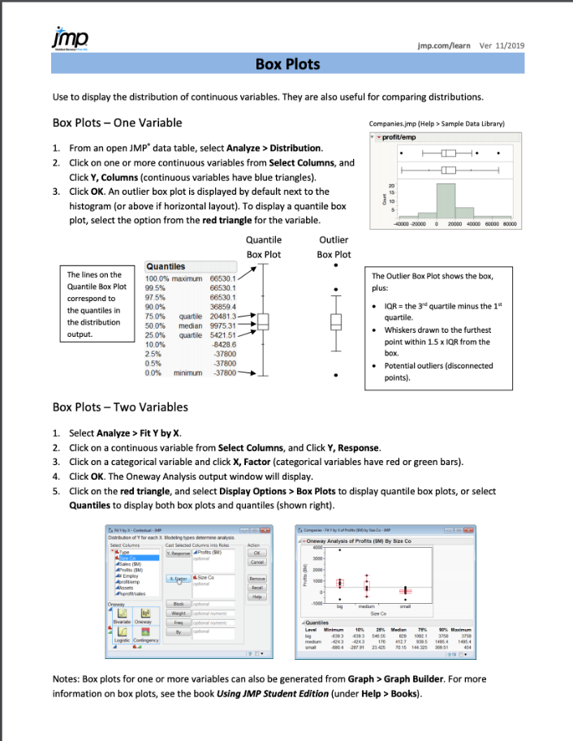
A few resources:
jmp.com/learn

Slide 6
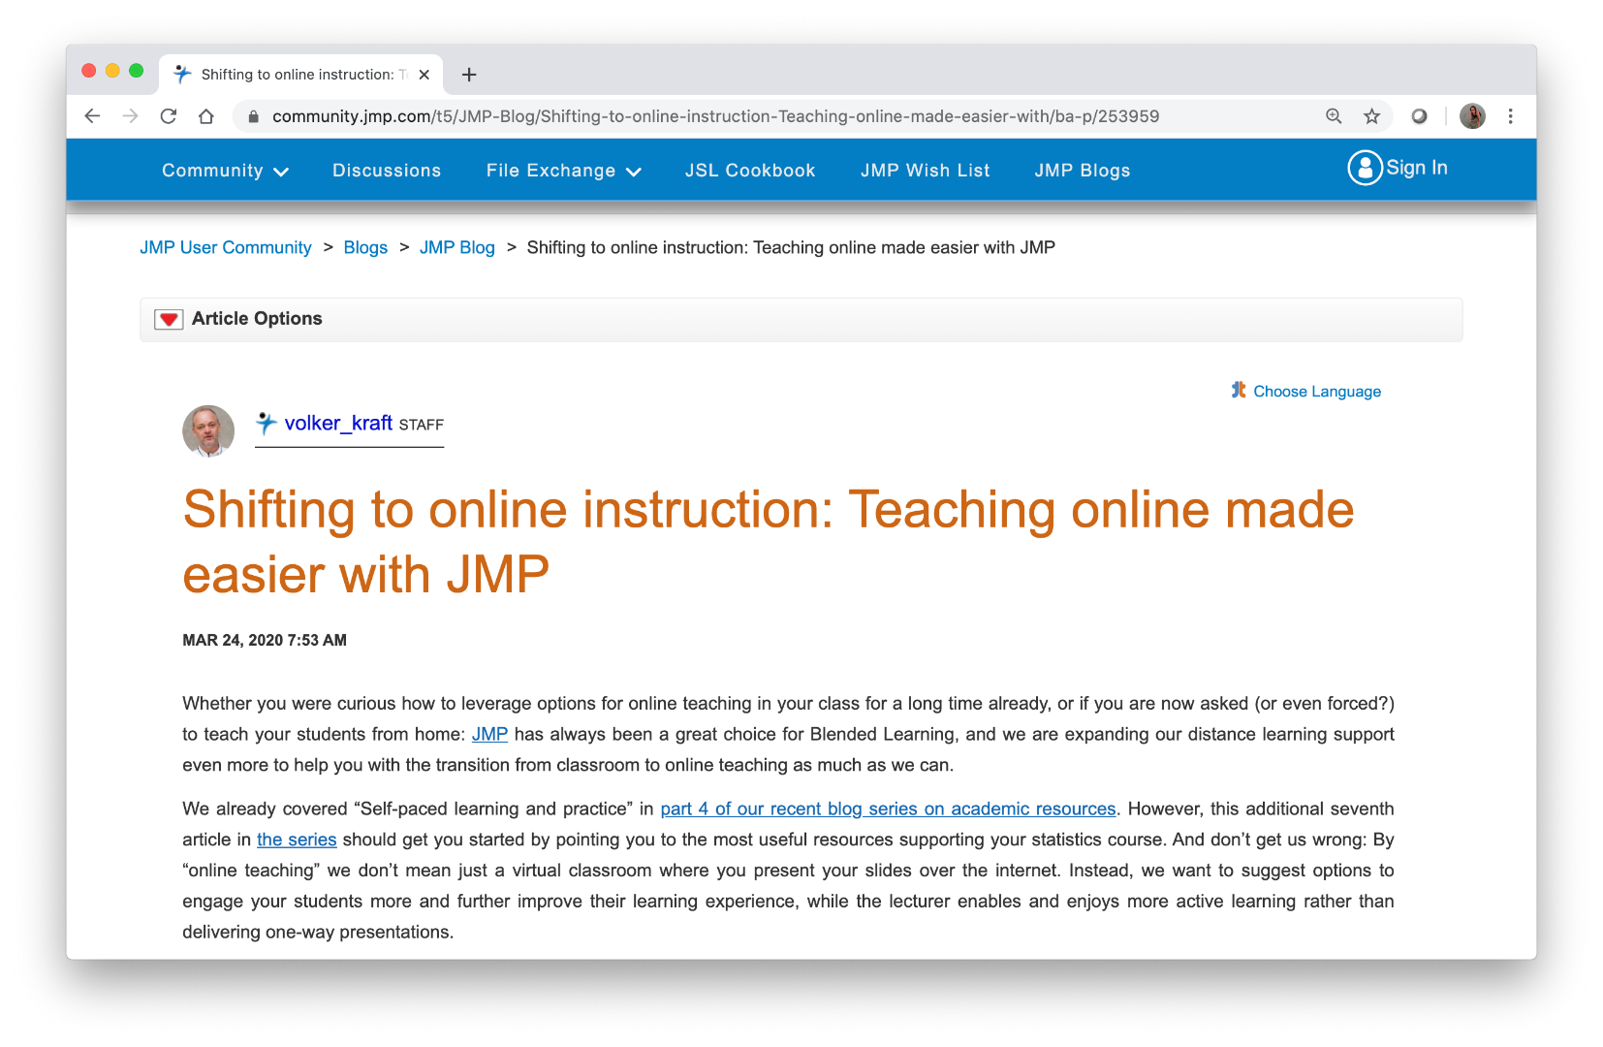
https://community.jmp.com/t5/JMP-Blog/Shifting-to-online-instruction-Teaching-online-made-easier-with/ba-p/253959

Slide 7
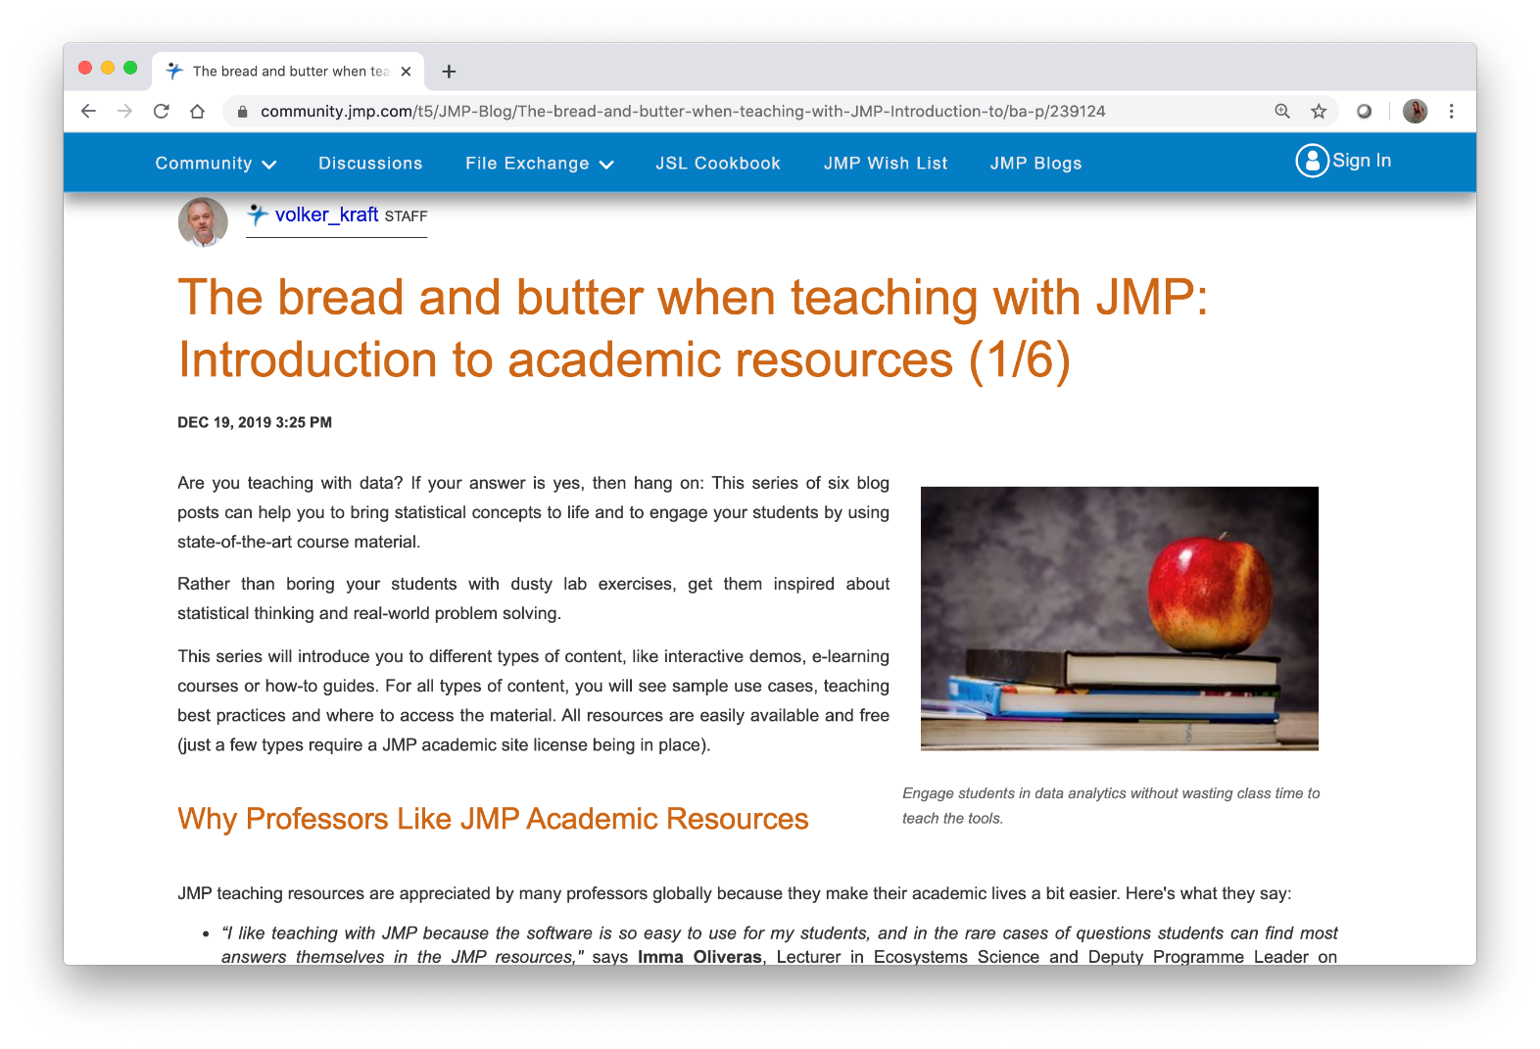
https://community.jmp.com/t5/JMP-Blog/The-bread-and-butter-when-teaching-with-JMP-Introduction-to/ba-p/239124

Slide 8
Questions? academic@jmp.com

